Slide 1
Internet Control Message Protocol (ICMP)
Kundan Shumsher Rana
0218

Slide 2
Introduction
The Internet Control Message Protocol (ICMP) is one of the main protocols of the Internet Protocol Suite.
Used by network devices, like routers, to send error messages indicating that a requested service is not available or that a host or router could not be reached.

Slide 3
Uses
ICMP can also be used to relay query messages. (assigned protocol number 1.)
Used with some diagnostic tools like ping and traceroute.
Generated in response to errors in IP operations

Slide 4
Uses
Used by hosts and routers to communicate network level communication.
-Error reporting : unreachable host, network port, protocol
-Echo request/reply (used by ping)
network-layer above IP:
-ICMP message carried in IP datagrams

Slide 5
For example, every device (such as an intermediate router) forwarding an IP datagram first decrements the time to live (TTL) field in the IP header by one.
If the resulting TTL is 0, the packet is discarded and an ICMP TTL exceeded in transit message is sent to the datagram's source address.

Slide 6
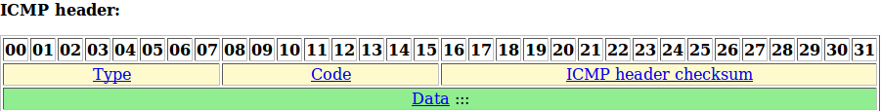

Slide 7
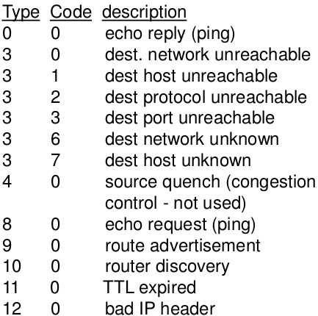
Codes

Slide 8
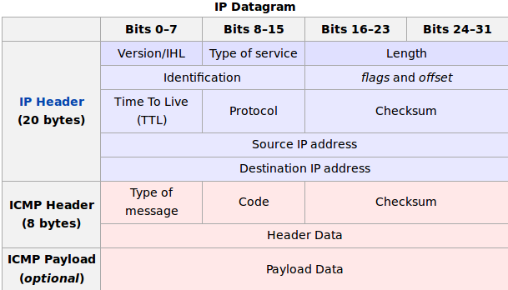

Slide 9
IP Datagram
Generic composition of an ICMP 32-byte packet:
IP Header (in blue):
Protocol set to 1 (ICMP) and Type of Service set to 0.

Slide 11
ICMP Header (in red):
Type of ICMP message (8 bits)
Code (8 bits)
Checksum (16 bits), calculated with the ICMP part of the packet (the IP header is not used). It is the 16-bit one's complement of the one's complement sum of the ICMP message starting with the Type field[7]
Header Data (32 bits) field, which in this case (ICMP echo request and replies), will be composed of identifier (16 bits) and sequence number (16 bits).

Slide 12
ICMP Payload
Payload for the different kind of answers; can be an arbitrary length, left to implementation detail. However, the packet including IP and ICMP headers must be less than the maximum transmission unit of the network or risk being fragmented.

Slide 13
Diagnostic Tool : PING
Ping is a computer network administration software utility used to
-test the reachability of a host on an Internet Protocol (IP) network
-to measure the round-trip time for messages sent from the originating host to a destination computer and back.

Slide 14
Diagnostic Tool : PING
Ping operates by sending Internet Control Message Protocol (ICMP) echo request packets to the target host and waiting for an ICMP echo reply.
It measures the round-trip time from transmission to reception and reports errors and packet loss.
It only computes the final round-trip times from the destination point.

Slide 15
Diagnostic Tool : Traceroute
It is a computer network diagnostic tool for displaying the route (path) and measuring transit delays of packets across an Internet Protocol (IP) network.
The history of the route is recorded as the round-trip times of the packets received from each successive host (remote node) in the route (path).

Slide 16
Diagnostic Tool : Traceroute
The sum of the mean times in each hop indicates the total time spent to establish the connection.
Traceroute proceeds unless all (three) sent packets are lost more than twice, then the connection is lost and the route cannot be evaluated.

Slide 17
THANK YOU

