Slide 1
Circuit Switching Vs Packet Switching
Sunil Shrestha
Batch 2016

Slide 2
Contents
Basic Introduction to circuit switching and packet switching
Diagram of circuit switching and packet switching
Advantage and Disadvantage
Mobile Telephone System

Slide 3
Basic Introduction to Circuit Switching
Two nodes communicating over dedicated path
Need of pre specified route for data transfer(no other data can interfere)
Designed for voice application (Telephone)
Before user making a call, critical path between caller and called is established over network
Application using it will follow three phases
Establish a connection
Transfer the data
Disconnect the circuit

Slide 4
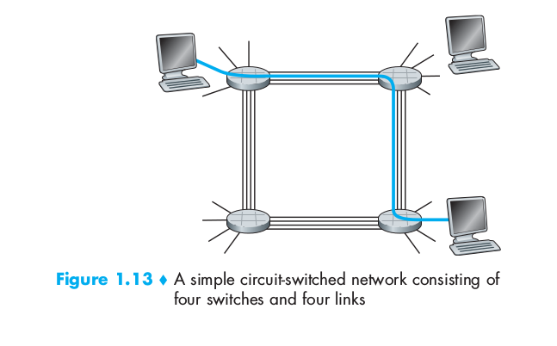
Diagram of Circuit Switching

Slide 5
Basic Introduction to Packet Switching
The entire message is broken down into smaller chunks called packets
Switching information added in header of each packet and transmitted independently
It enhance line efficiency as packets from multiple applications can be multiplexed over a carrier
Packets are stored and forwarded according to priority to provide quality service

Slide 6
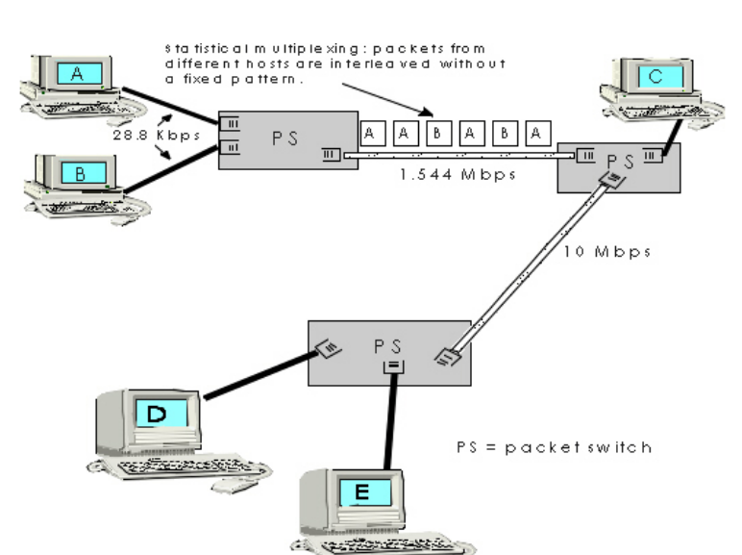
Diagram of Packet Switching

Slide 7
Circuit Switching (Advantage)
Guaranteed service with dedicated lines
Bandwidth reserved (quality assurance)
Only delay is propagation delay (5 ms per 1000km)

Slide 8
Circuit Switching (Disadvantages)
Elapsed time 10 sec or more
Maximum resource unused
Bandwidth is wasted
Charging is based on distance and time

Slide 9
Packet Switching (Advantage)
It places tight upper limit on size of packet which prevent from monopolize over transition line. Hence handle interactive traffic.
No need to setup dedicated path and router used to store-and-forward
It is more fault tolerant
Packets can be routed around dead switches

Slide 10
Packet Switching (Disadvantage)
No bandwidth reserved, packets have to wait long.
Introduces queuing delay and congestion

Slide 11
Mobile Telephone System
Item | Circuit Switching | Packet Switching
Call setup | Required | Not needed
Dedicated physical path | Yes | No
Each packet follow same route | Yes | No
Packets arrive in order | Yes | No
Is Switch crash fatal | Yes | No
Bandwidth Available | Fixed | Dynamic
Time of possible congestion | At setuptime | On every Packets
Potentially wasted bandwidth | Yes | No
Store-and-forward transmission | No | Yes
Charging | per minute | Per packets

Slide 12
Thank You

