Slide 1

Presentation on General Purpose Simulation System(GPSS)
Sagar Giri
Roll No. 205
Notes:
<number>

Slide 2
What is GPSS?
GPSS is one of the earliest discrete simulation languages, it was developed primarily by Geoffrey Gordon at IBM around 1960, and has contributed important concepts to every commercial discrete event Computer Simulation Language developed ever since.
GPSS was designed specially for analysis who were not necessarily computer programmer. It is particularly suited for modelling traffic and queuing systems.
Notes:
<number>

Slide 3
What is GPSS?
A GPSS programmer does not write a program in the same sense as SIMSCRIPT programmer does instead, he construct a block diagram – a network of interconnected blocks, each performing a special simulation oriented function
GPSS provides a set of 48 different blocks to choose from each of which can be used repeatedly. Each block has a name and specific task to perform
Notes:
<number>

Slide 4
GPSS
Moving through the system of block are entities called transaction are customer, messenger, machine parts, vehicle, etc.
Typical blocks are:-
GENERATE, Create transaction
QUEUE, create a queue of transaction and maintain certain queuing statics
TABULATE, tabulates the time in it took the transaction to reach that point from the time it entered the simulation system
Notes:
<number>

Slide 5
GPSS
GPSS is not a programming system like Simscript; one doesn’t “write” program here, but design a network of Blocks through which percolating simulation objects give rise a sense of process.
Notes:
<number>

Slide 6
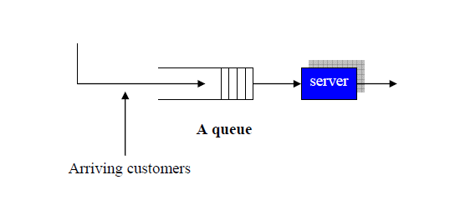
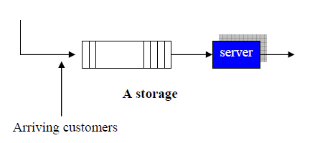
A discrete event simulator that basically sees system dynamics in terms of queues, storage, etc.

Slide 7
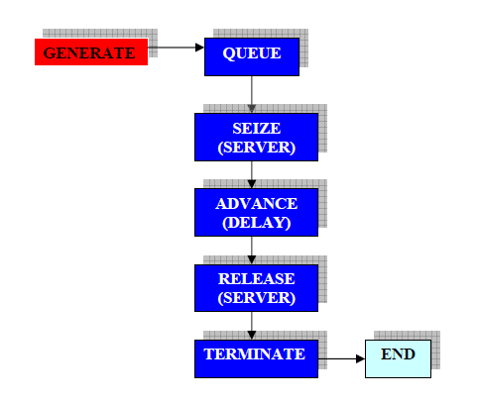
BASIC STRUCTURE

Slide 8
Basic Structure
A transaction is a GPSS object with a number of attributes. A transaction is like a customer entering into the process for service. A single transaction may represent several individual entities.
Each transaction has to be generated either one at a time or in batches. Once they appear into the system, they must be contained exactly in one action Block. However, a Block may contain many transactions.

Slide 9
EXAMPLE

Slide 10
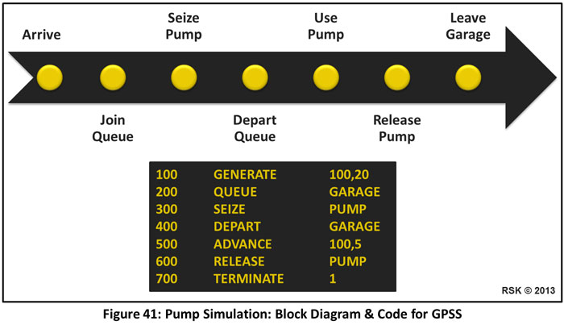
(Petrol Pump Simulation)

Slide 11
EXAMPLE (Petrol Pump Simulation) - Explanation
GENERATE 100,200
The GENERATE block will generate random transactions (cars) according to a uniform distribution. The 100 and 20 on code, specifies that the time between cars arriving will be on average 100 time units plus or minus 20 time units. Thus 20 is the half-width of the distribution.
QUEUE GARRAGE
The QUEUE block instructs GPSS to start gathering statistics on a queue named ‘Garage’.
SEIZE PUMP
The SEIZE block allows the first car to seize a facility named ‘Pump’.

Slide 12
EXAMPLE (Petrol Pump Simulation) - Explanation
DEPART GARRAGE
The DEPART block informs GPSS that a car is leaving the queue named ‘Garage’. Whilst a car is being serviced in the ADVANCE block, any other arriving transaction (car) will remain in the QUEUE block.
ADVANCE 100,5
The ADVANCE block represents the car being filled with petrol. The values 100 and 5 specify that the time taken to fill a car with petrol is on average 100 time units plus or minus 5 time units.
RELEASE PUMP
When a car leaves the ADVANCE block it moves into the RELEASE block which releases the ‘Pump’ and allows the next car at the QUEUE block to SEIZE the ‘Pump.’ The SEIZE and RELEASE blocks also instruct GPSS to gather statistics on a facility named ‘Pump.

Slide 13
EXAMPLE (Petrol Pump Simulation) - Explanation
TERMINATE 1
Finally, the TERMINATE block destroys the transaction as it leaves the RELEASE block and decrements a counter by 1.

Slide 14
This simulation is run by entering the command ‘START 500’. The counter is set to this value, so that when 500 transactions have entered the TERMINATE block, the simulation will stop.
It is then possible to obtain operating statistics about the queue and the petrol pump facility from GPSS.
The statistics obtained from this simulation model along with those from alternative designs will aid the decision-maker in deciding what is the best system to employ for the garage.

Slide 15
SIMULATION IN GPSS WORLD

Slide 16
Thank you!

