Slide 1
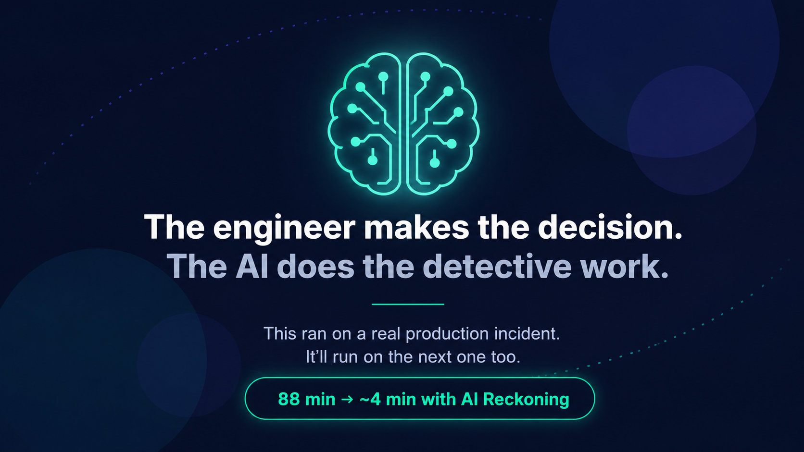
1 / 9
Notes:
Yesterday at 20:34, we deployed fn-connect.
By 20:36, errors were spiking.
By 21:00, error volume had tripled and was still climbing.
One engineer spent 88 minutes figuring out what happened.
Today we're going to show you how to do it in 4.

Slide 2
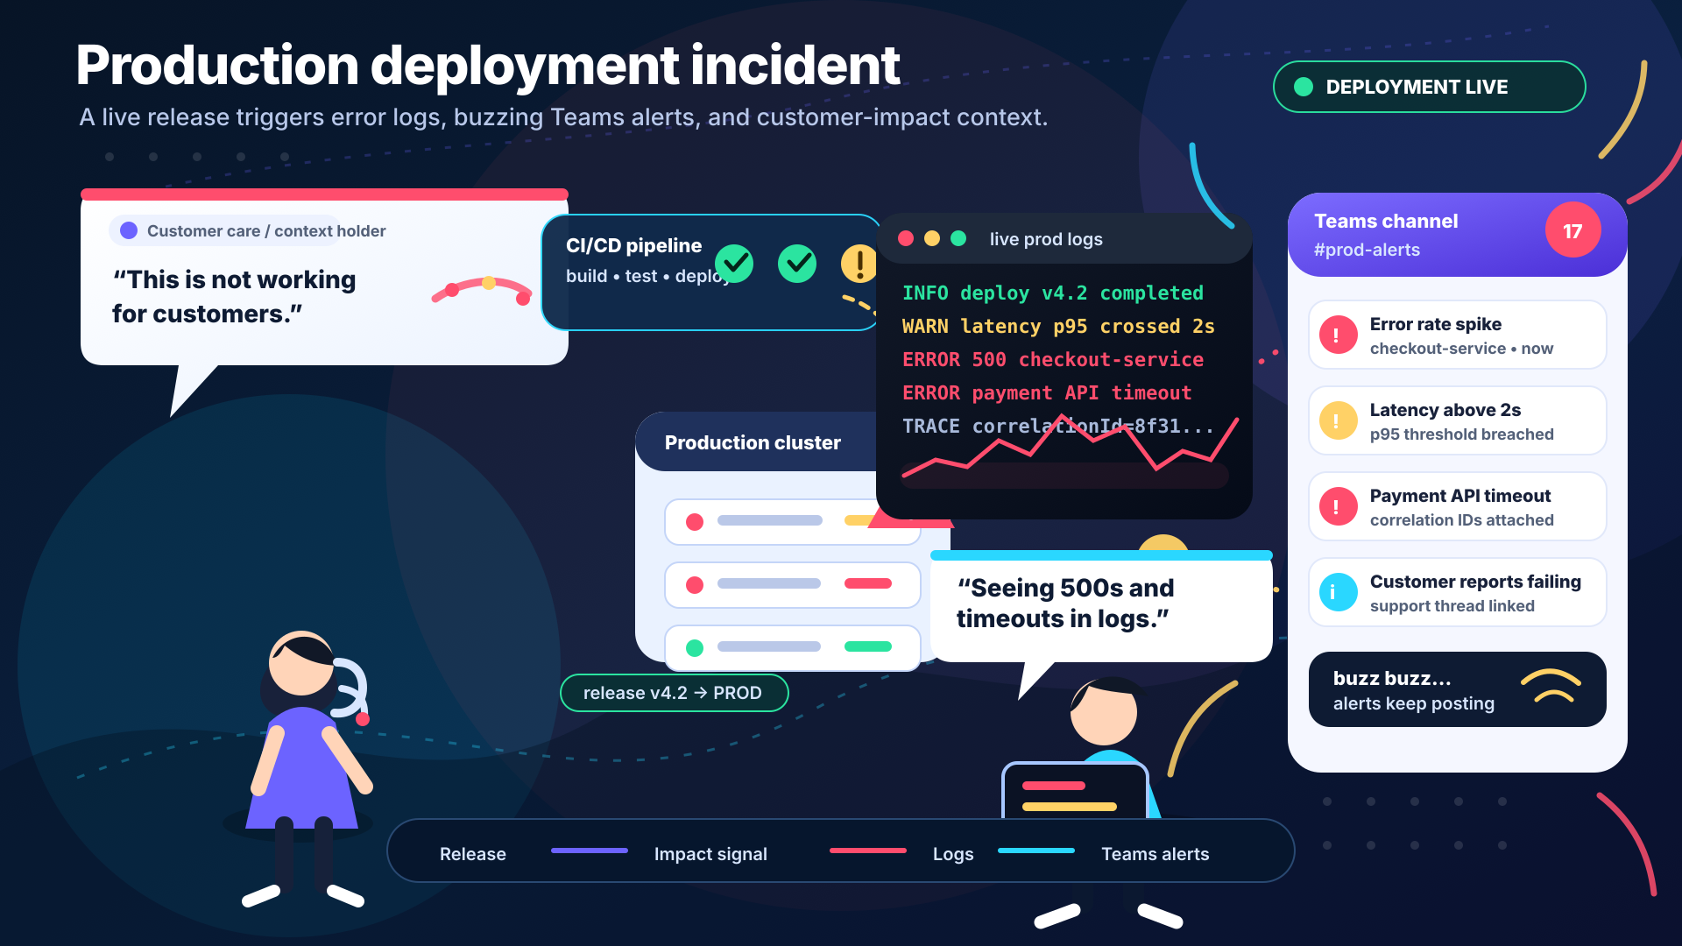
2 / 9
Notes:
This is what an incident looks like from the outside.
A deploy fires. Logs start throwing 500s and timeouts. Teams starts buzzing — error rate spikes, latency up, payment timeouts, customers reporting failures.
Four streams of information. All at once. All in different tools.
An engineer has to open all four, read them, correlate the timestamps by hand, form a hypothesis, confirm it with the team.
That's the 88 minutes at the bottom of this slide.

Slide 3
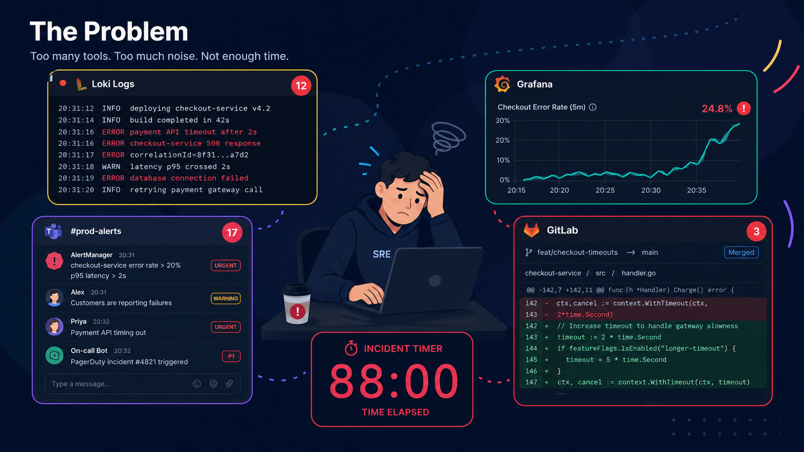
3 / 9
Notes:
Point to each quadrant as you speak.
Top-left: Loki logs — 12 new errors, all red, payment API timeouts, 500s, database failures.
Top-right: Grafana — error rate climbing to 24.8%, clearly correlates with the deploy.
Bottom-left: Teams #prod-alerts — 17 messages, customers reporting failures, P1 declared.
Bottom-right: GitLab diff — the exact commit that just merged. That's four tabs.
Centre: one engineer. 88 minutes on the clock.
This is the problem. The data was always there. The bottleneck is connecting it by hand.

Slide 4
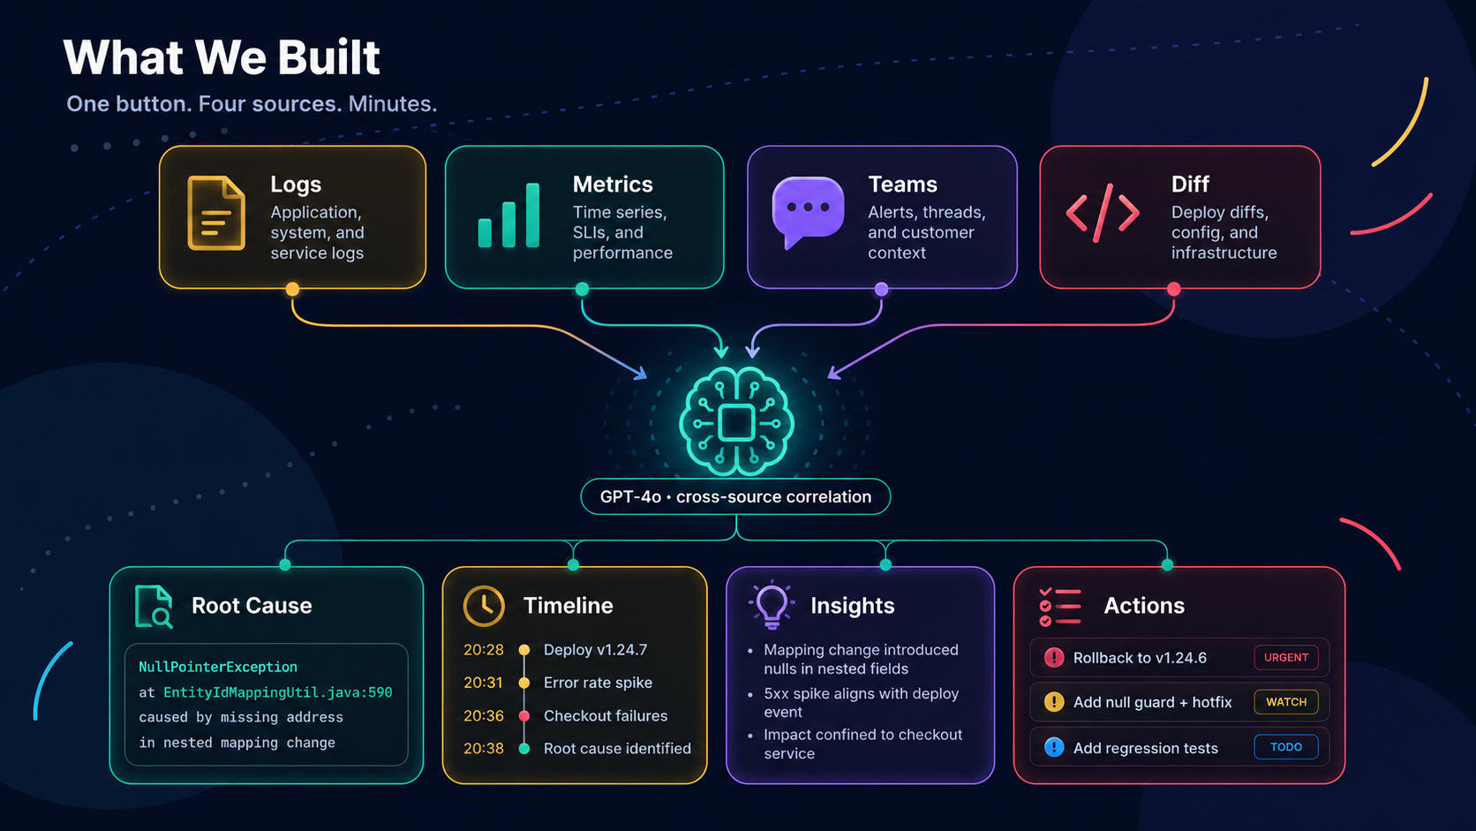
4 / 9
Notes:
Walk through top to bottom.
Top row: four sources — Logs (application, system, service), Metrics (time series, SLIs), Teams (alerts, threads, customer context), Diff (deploy diffs, config, infra).
All four converge into GPT-4o — not searched in isolation, correlated simultaneously.
Bottom row: four outputs — Root Cause with exact file and line, Timeline of every event, Insights into why it happened, Actions with URGENT/WATCH/TODO priority.
Notice the Root Cause card already shows EntityIdMappingUtil.java:590 — that's the real answer from the real incident.

Slide 5
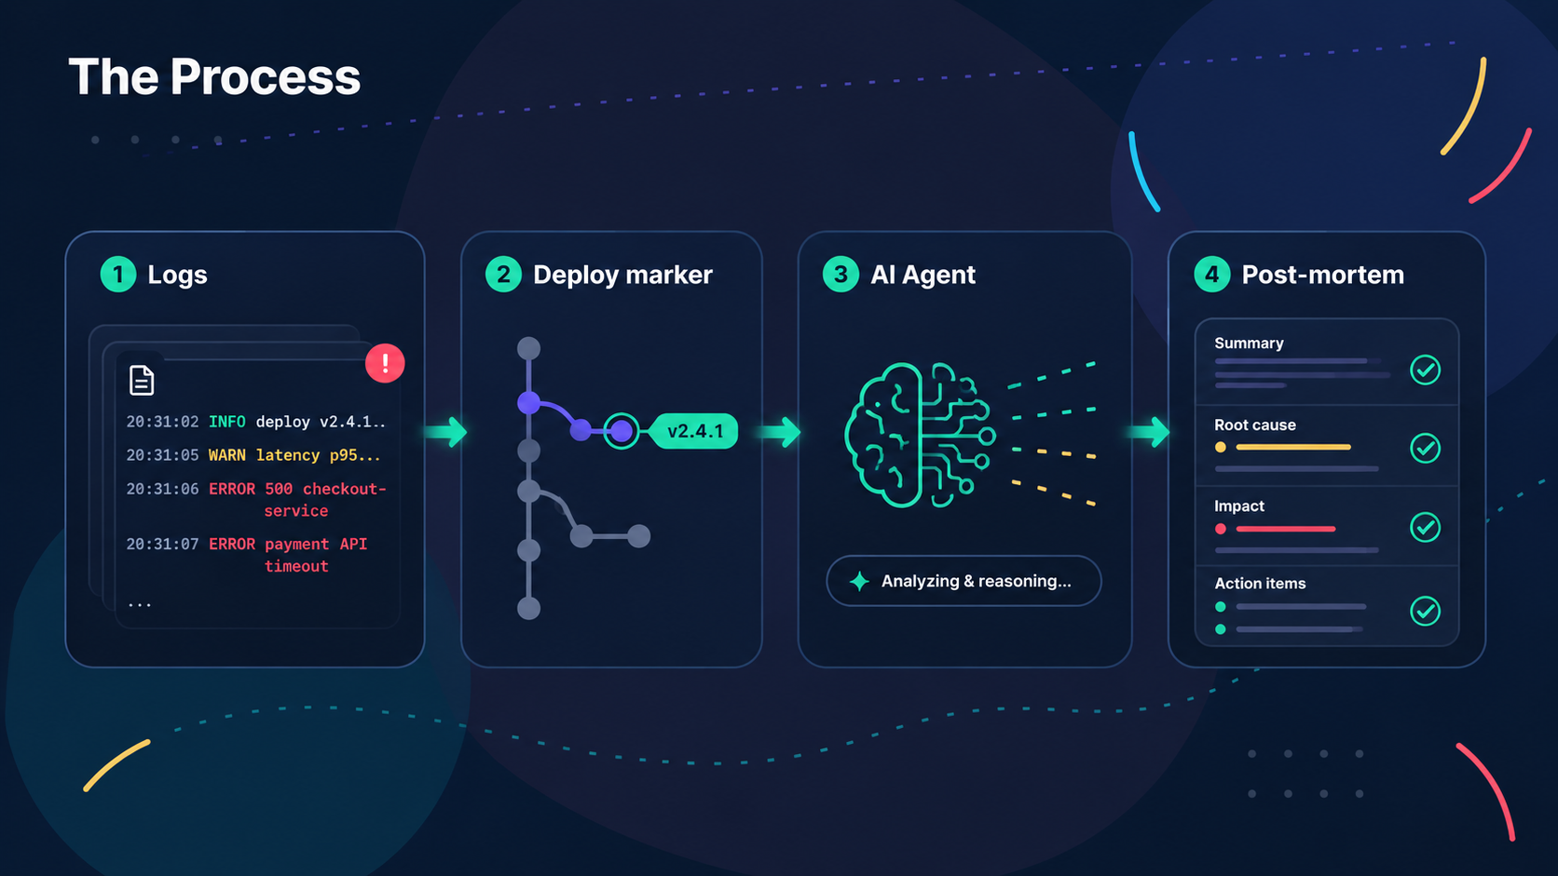
5 / 9
Notes:
Walk through left to right.
Logs come in — raw, noisy, hundreds of lines. Deploy marker pins the version that changed. AI Agent correlates all sources simultaneously, builds a causal chain. Post-mortem comes out structured — root cause, timeline, actions.
The data was always available. The bottleneck was the human connecting it. This removes that bottleneck.

Slide 6
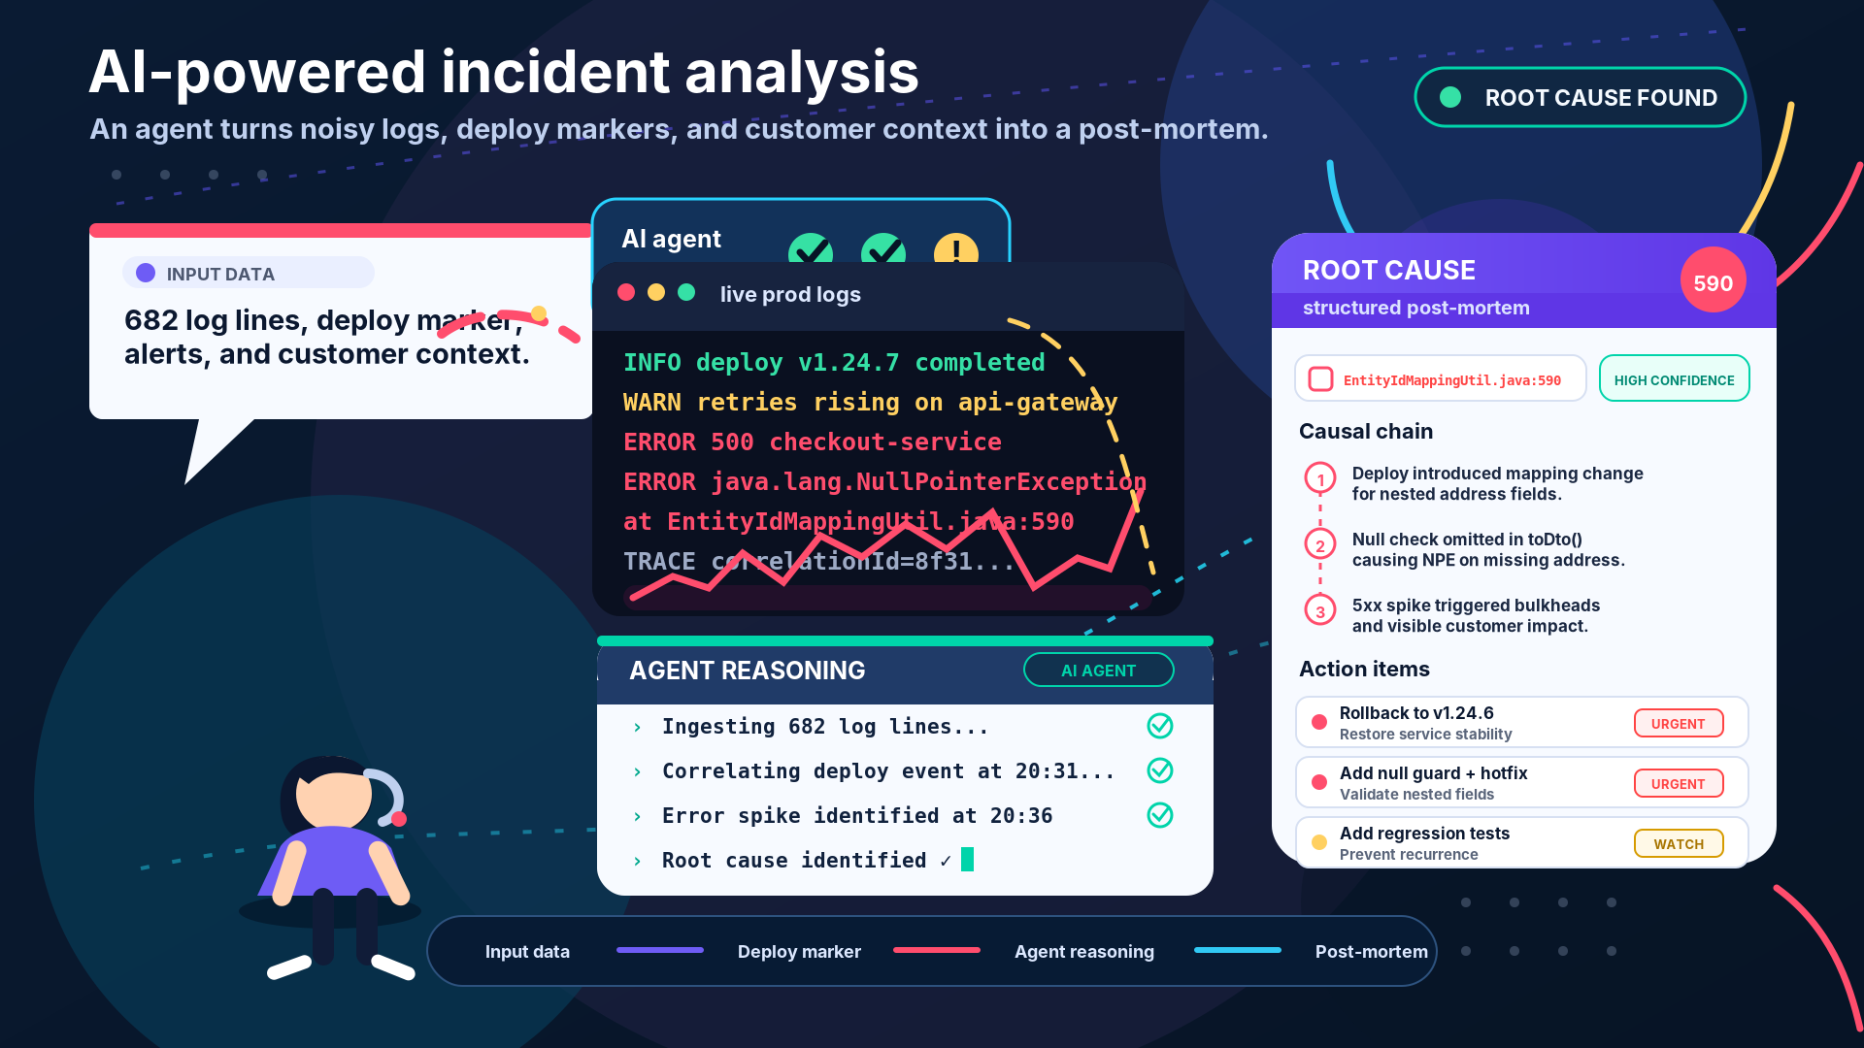
6 / 9
Notes:
This is what the tool looks like when it works.
Left panel — the four data sources loaded and ready.
Middle panel — eight reasoning steps, all checked off. Each one is a real inference step.
Right panel — root cause, HIGH confidence, EntityIdMappingUtil.java:590.
The same answer the engineer found in 88 minutes.
The AI found it in 4.
[Switch to live browser demo now]

Slide 7
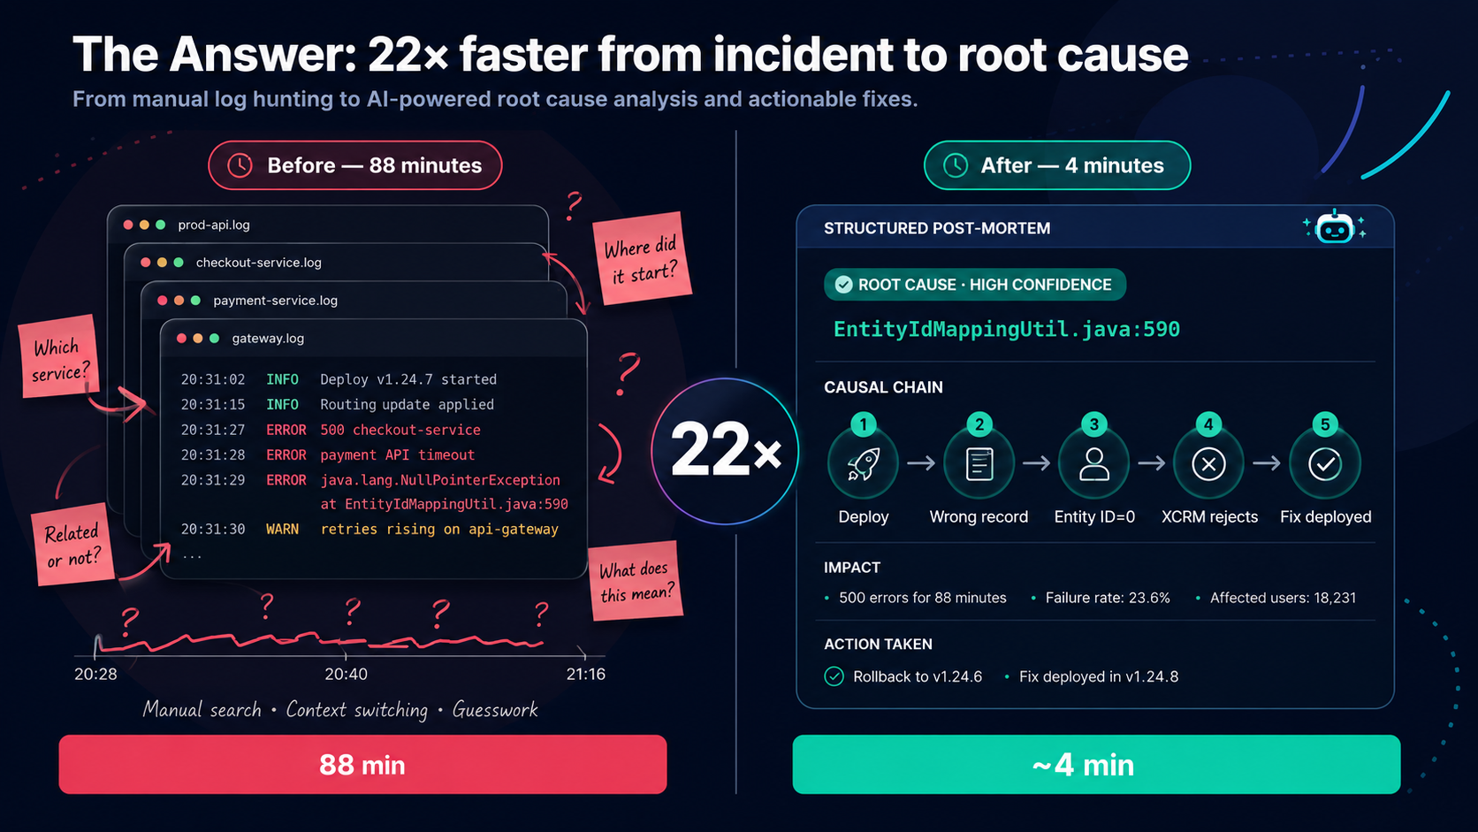
7 / 9
Notes:
This is the answer. 22 times faster.
Left side — Before, 88 minutes: four overlapping log files, question marks everywhere. Which service? Where did it start? What does this mean? Manual search, context switching, guesswork.
Right side — After, 4 minutes: structured post-mortem, ROOT CAUSE HIGH CONFIDENCE, EntityIdMappingUtil.java:590. Causal chain: Deploy → Wrong record → Entity ID=0 → XCRM rejects → Fix deployed. Actions: Rollback to v1.24.6, Fix deployed in v1.24.8.
Same incident. Same root cause. Same fix. The only difference is 84 minutes.
[Pause on the 22× badge in the centre. Let it land.]

Slide 8
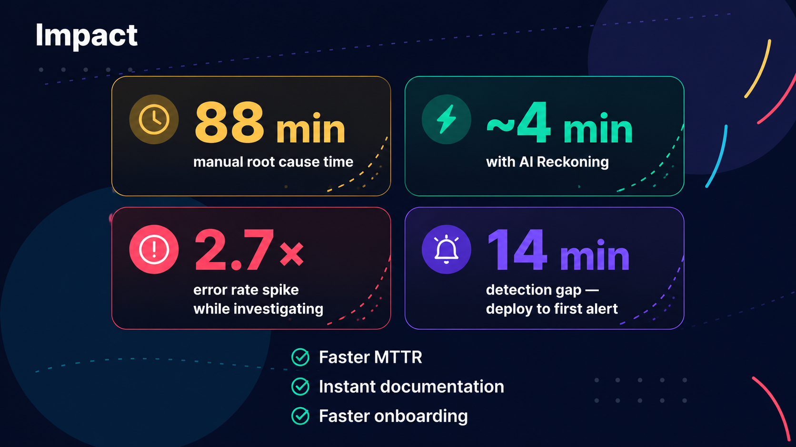
8 / 9
Notes:
Four numbers. Let them land before you speak.
88 minutes — that's the manual root cause time on this real incident.
~4 minutes — that's AI Reckoning on the same incident.
2.7× — the error rate kept climbing the entire time the investigation was running.
14 minutes — the gap between deploy and first alert. Silent failure window.
Then the three bullets below:
Faster MTTR — you spend time fixing, not finding.
Instant documentation — the report exists the moment the root cause is identified.
Faster onboarding — new engineers get AI context the first time they face production.
This is what AI assistance looks like in a real engineering workflow.

Slide 9
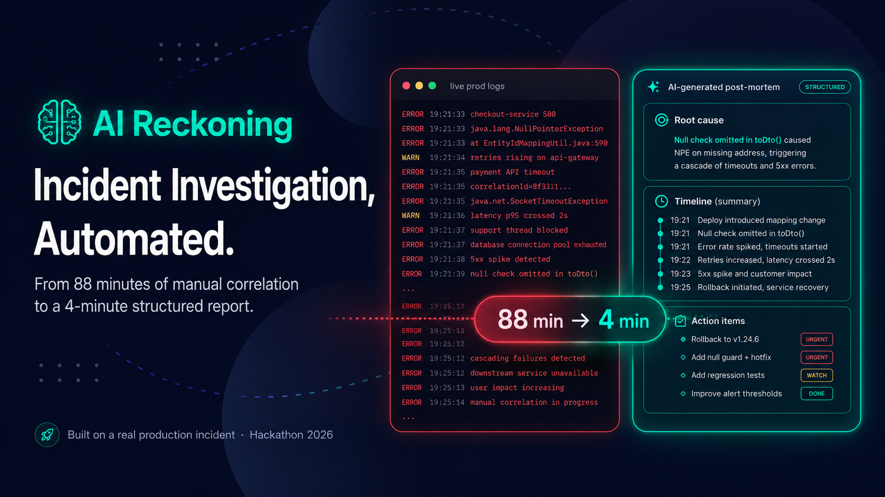
9 / 9
Notes:
Every incident like this costs engineering time, customer trust, and sleep.
The investigation itself doesn't have to.
AI Reckoning turns 88 minutes of manual correlation into a 4-minute report.
The engineer still makes the decision. The AI does the detective work.
This ran on a real production incident. It'll run on the next one too.
[Pause. Let the 88 min → ~4 min badge land. Then open for questions.]

