Slide 1
Pneumonia Diagnosis using X-Rays
Presented by Nuno Delgado
May 6, 2019

Slide 2
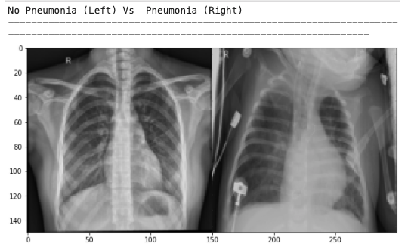
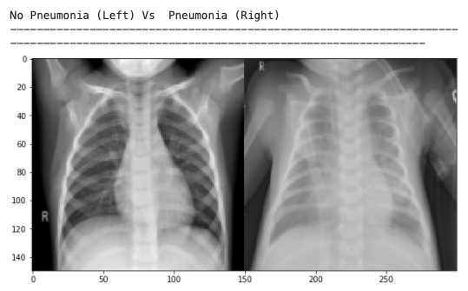
Data understanding

Slide 3
BUSINESS QUESTIONS
What problem does this analysis try to solve?
How accurate is the model in recognizing a pneumonia case?
How much is the cost in case of an error?
Notes:
fsf

Slide 4
What problem does this analysis try to solve?
The risk of pneumonia is immense for many, especially in developing nations
The WHO estimates that over 4 million premature deaths occur annually from household air pollution-related diseases including pneumonia
The problem can be further aggravated due to the lack of medical resources and personnel.
Africa’s 57 nations, a gap of 2.3 million doctors and nurses exists

Slide 5
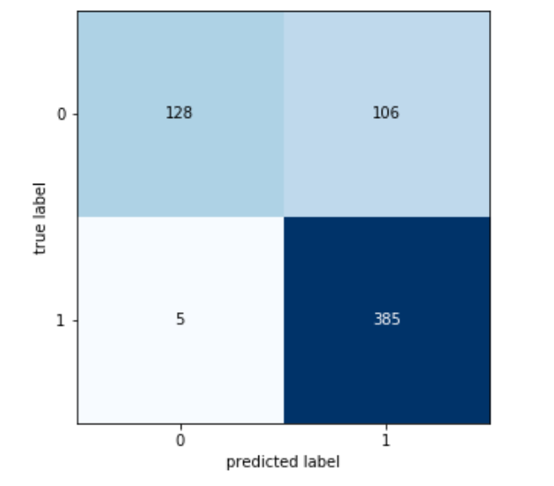
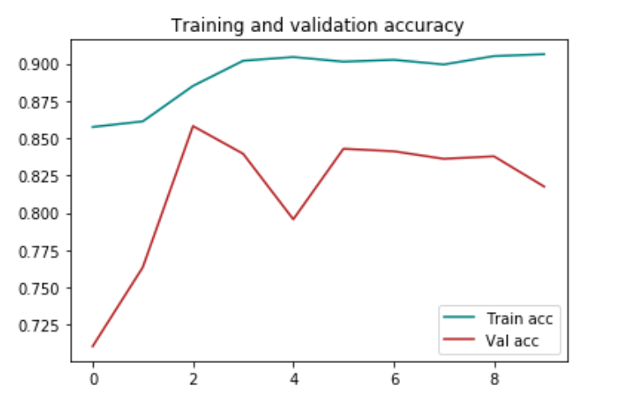
How accurate is the model in recognising a pneumonia case?

Slide 6
How much is the cost in case of an error?
The model predicted a normal case but in the reality the patient was diagnosed with pneumonia, this scenario could have a cost up to 100.000 US dollars
The model predicted a pneumonia case and the patient was normal, in this case the costs would be a considerable lower cost up to 500 US dollars

Slide 7

Thank You for your Attention!!

