Slide 1
Food Ingredients
Recognition
Presented by Nuno Delgado
June 4, 2020

Slide 2
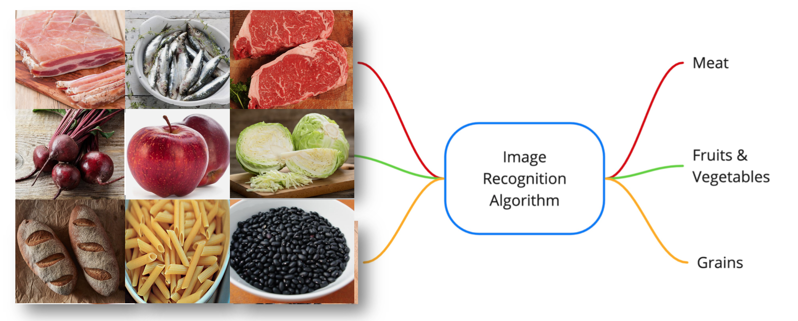
Business Understanding
More and more people is getting into the culinary
I’m looking for help on routine meals with a integrated system(recognition ingredients + recommendation recipes)
So this project will be focus on the first part of it.
Build a high accurate image recognition model, good enough to be used in a model deployment

Slide 3
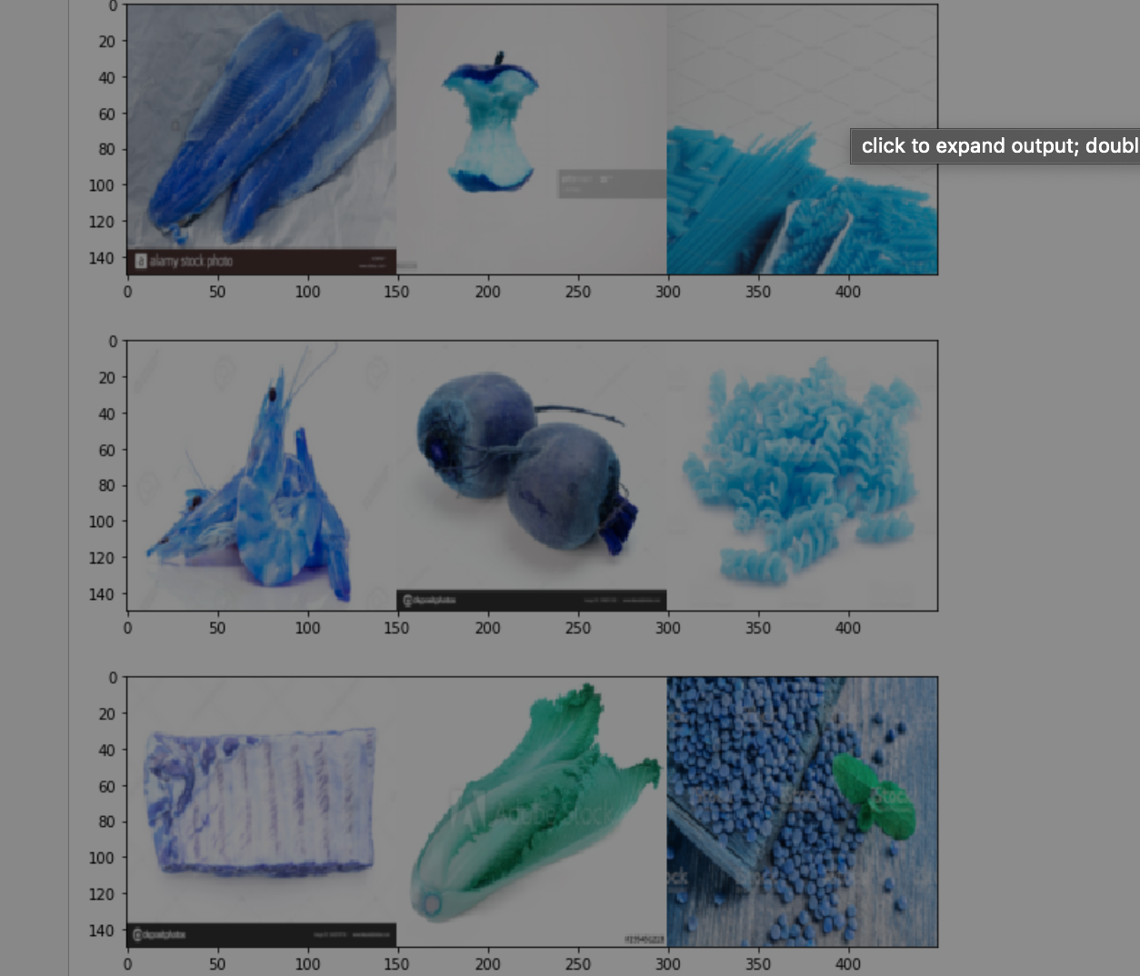
Data Understanding
Dataset has approximately 5,530 images of 63 food ingredients primarily obtained from a combination of sources
The ingredients are divided by 3 main groups Meat, Grains and Fruits/Vegetables.
These three groups represent the main part of the food pyramid and are essential for the most part of the recipes.

Slide 4
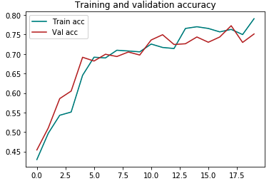
Modeling
I tackle the problem of food ingredients recognition as a multi-class learning problem.
I propose a method for adapting a highly performing state of the art CNN in order to act as a multi-class predictor for learning food ingredients in terms of their nature.
In order to carry out the modelling, I split the final dataset into 3 subsets. Train (3587 images), Validation(471 images) and Test (544 images).
The modeling based on three models, two of them were used to improve the accuracy score of the baseline model

Slide 5
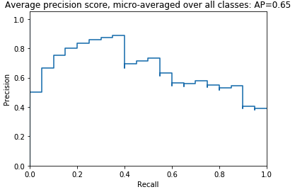
Evaluation
After analysing the three models, the model that shows better performance is the baseline model, more stable, high accuracy and low overfitting.
To evaluate the winning model, I used Average precision because gives the average precision at all such possible thresholds and Precision-Recall metric.
In this project, is an useful measure of success of prediction because the classes are imbalanced and I am not aiming any specific decision threshold.

Slide 6
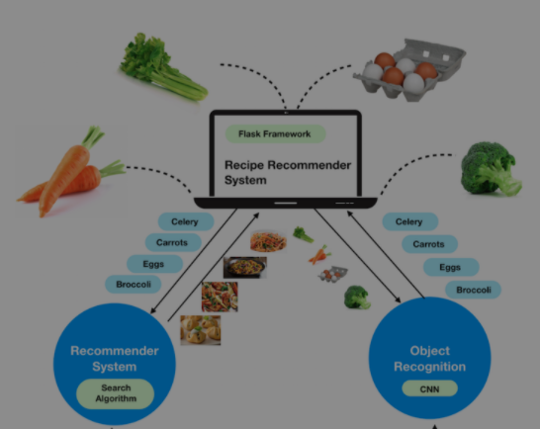
Future Considerations
In future, the baseline model will be expanded upon in order to achieve a greater level of accuracy and the classification model will be focus on classifying each ingredient on its own representation instead of by group.
The model will still have several improvements before the final deployment

Slide 7
Thank You
For Your Attention

