Slide 1
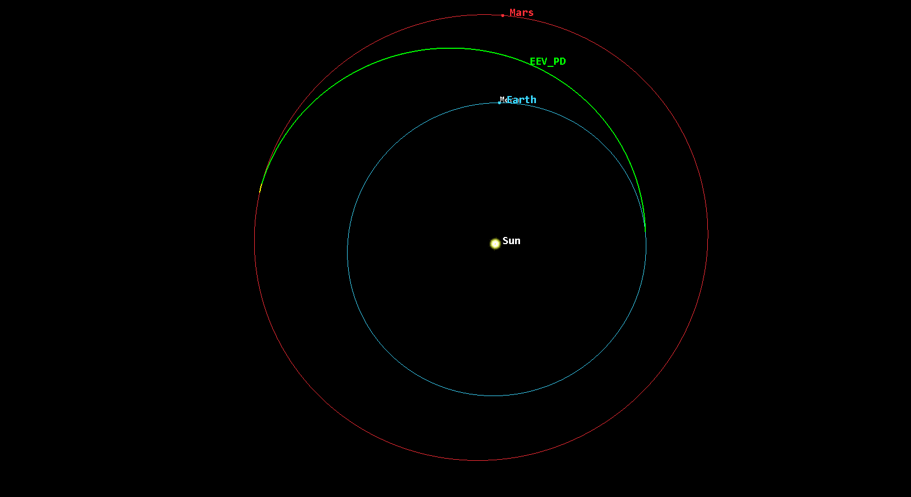
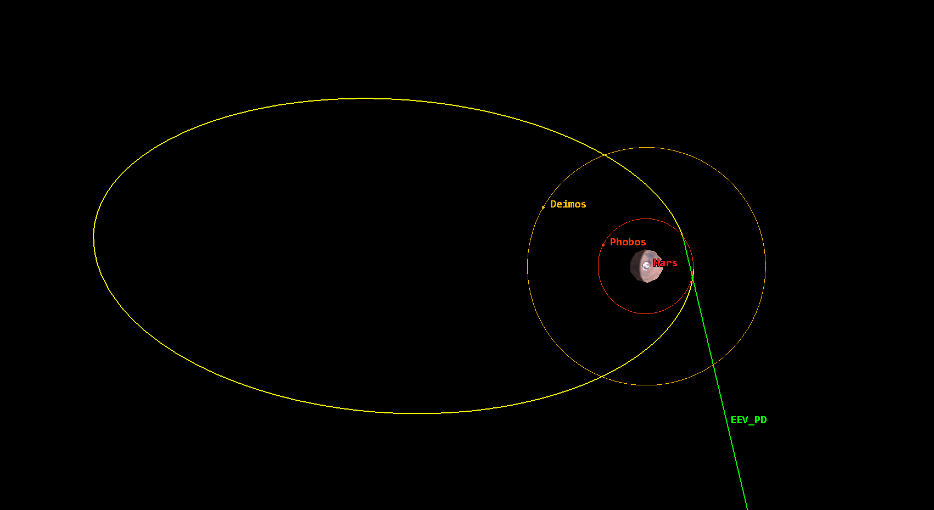
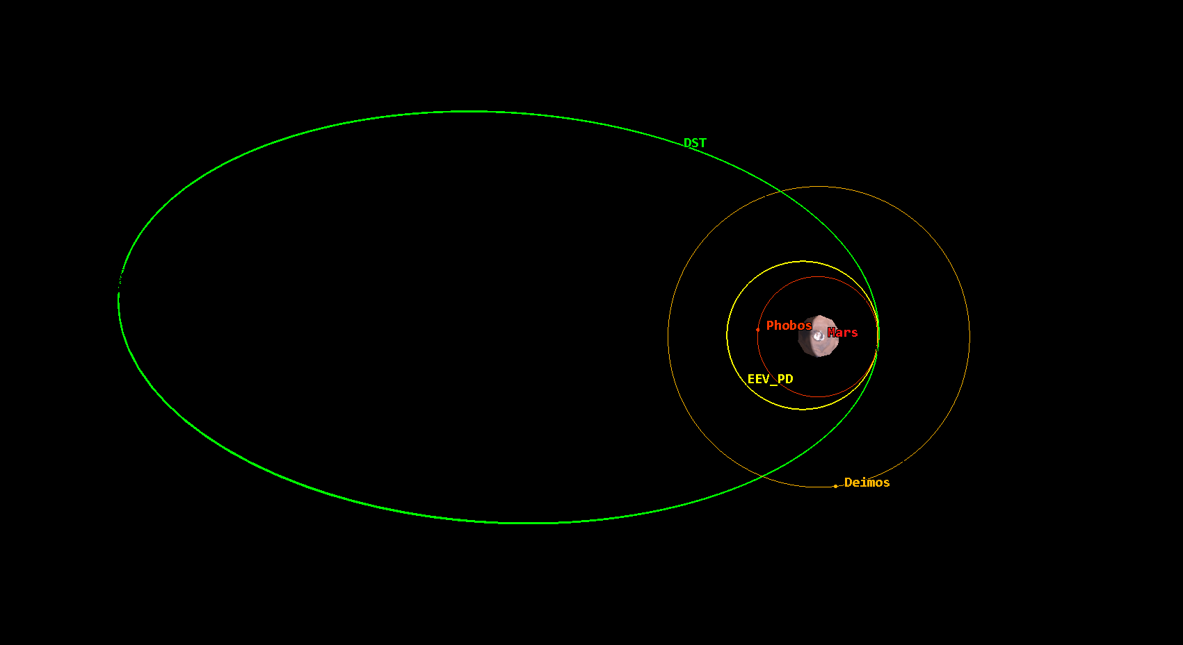
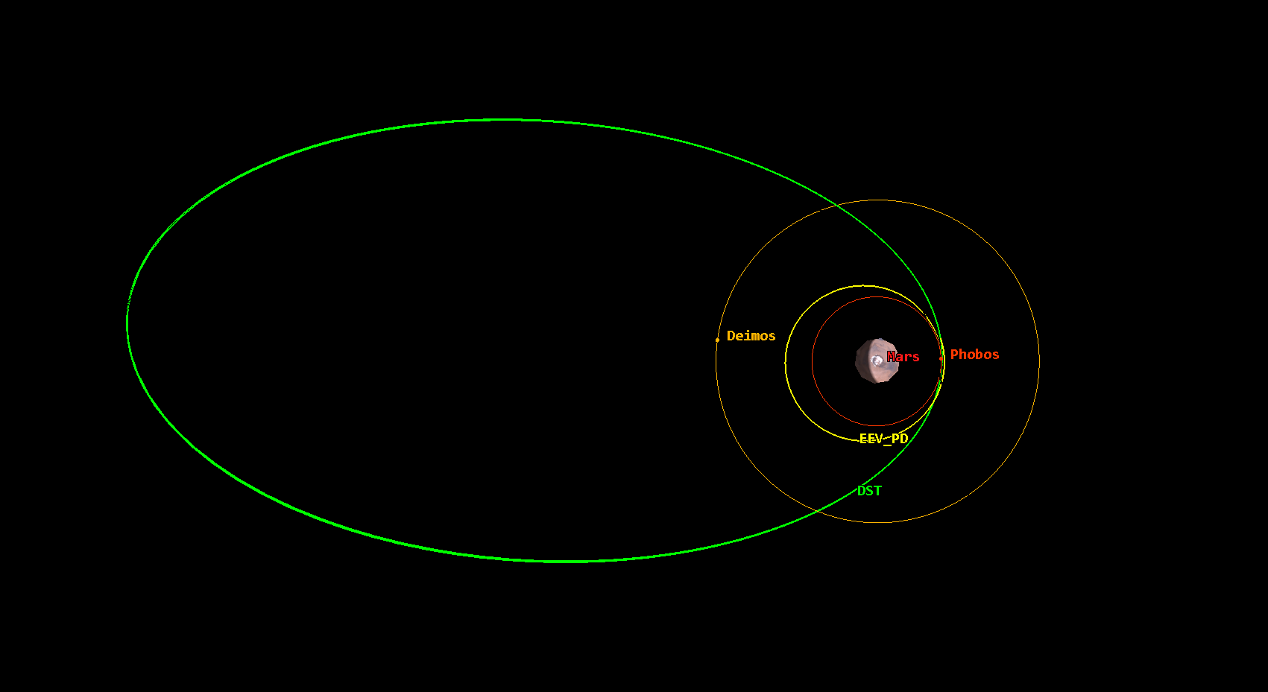
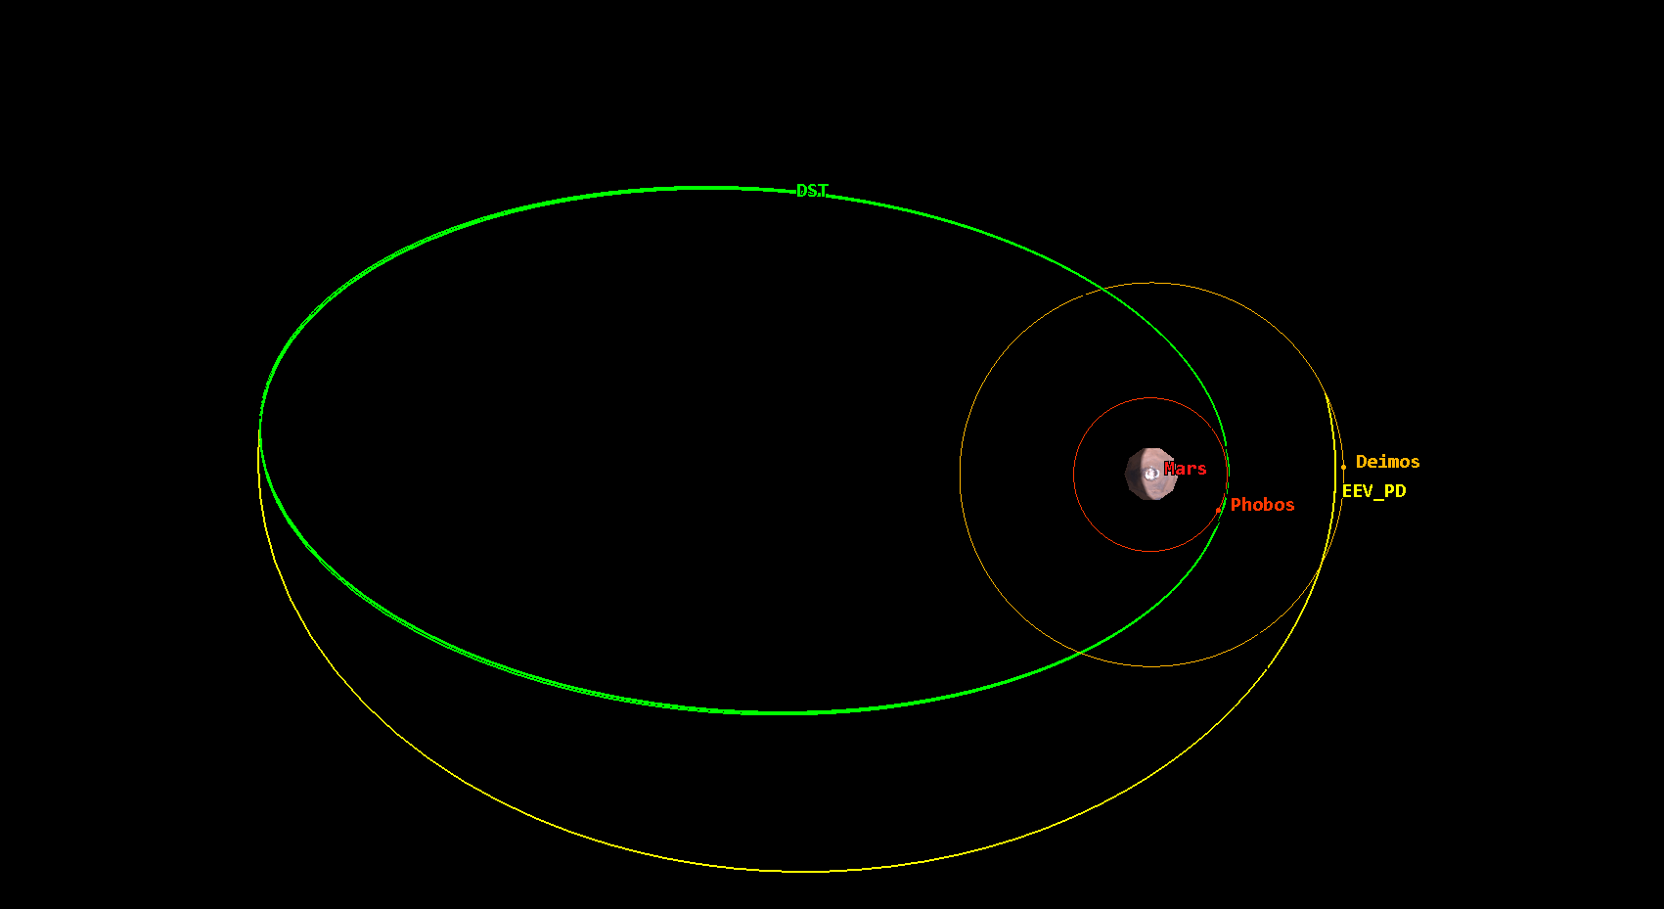
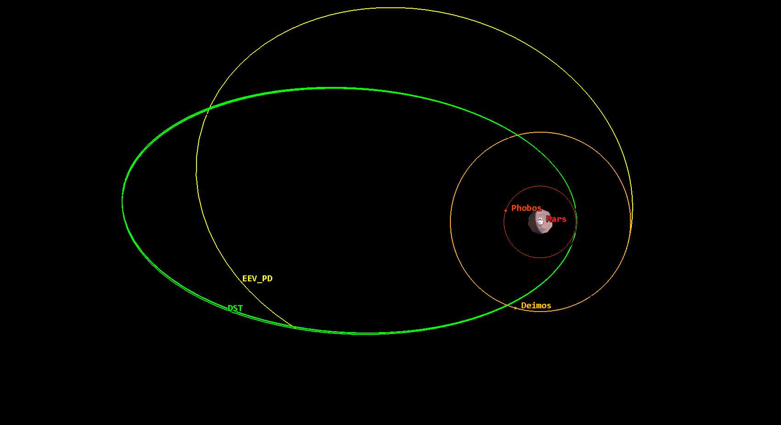
1. EEV Transfer Arc to Mars
Launch Date: Oct 9, 2039
Transfer Time: 256 days
Delta-V: 4.13 km/s
2. Mars Orbital Insertion / Parking Orbit
EEV Arrival Date: Jun 22, 2040
DST Arrival Date: Jun 27, 2040
Delta-V: 0.9 km/s
Parking Orbit Parameters:
Period: 5.0 days
Eccentricity: 0.84
SMA: 59000 km
3. Transfer to Phobos
Transfer Date: Jul 2, 2040
Time on Phobos: 9.2 days
Delta-V: 0.83 km/s
4. Return to DST
Return Date: Jul 12, 2040
Transfer Time: 11 hrs.
Delta-V: 0.90 km/s
5. Transfer to Deimos
Transfer Date: Jul 15, 2040
Time on Deimos: 4.9 days
Delta-V: 0.59 km/s
6. Return to DST
Return Date: Jul 26, 2040
Transfer Time: 4 days
Delta-V: 0.63 km/s

