Slide 1
AUTOMATED INVENTORY CONTROL SYSTEM
presented by:
Onyancha Ndemo Richard
SIT/1008/14

Slide 2
ABSTRACT
A Good automated inventory control system is essential to the successful operation of most business organization. This is basically due to the amount of money inventory represents and the impact that inventories have on the daily operations of a business.
it keeps track of inventory levels, orders, sales and deliveries.
It will assist to avoid product overstock and outage

Slide 3
INTRODUCTION
The purpose of an automated inventory control system is to save a business time and encourage more organized and efficient business processes.
This will be achieved thorough automation of various processes such as calculating total sales automatically every single end day, automatically checking inventory against the reorder point and generating a purchase order, automatically calculating profit of a sold item and projecting profit of the whole stock.

Slide 4
PROBLEM STATEMENT
It takes a lot of time to manually keep track of sales and place correct orders to vendors, wasting useful labor.
A product which would assist in tackling the above mentioned problem would prove to be fruitful as it would help convert the unproductive time to something more useful, by removing unnecessary error prone complication and efforts.

Slide 5
PROBLEM JUSTIFICATION
Basic idea is that at the end of each day, the system analyzes the total sale of stock and deducts the appropriate amount from the resource database.
It then compares the current available resource with the threshold level of each Item.
If it finds that certain Item are below the threshold, it will generate a purchase order for those items and send it to the manager (admin) for approval.

Slide 6
OBJECTIVES
GENERAL OBJECTIVE
Automate the control system
Calculate total sells products at the end of each day and compares with the stock present and generate daily report.
Compares available product stock and generates an updated purchase order and sends to the manager.
SPECIFIC OBJECTIVES.
To analyze the current inventory control systems and the way they operate and find ways of automating such systems to better performance.
To design a system that will automate the control system of inventory management.
To code and test the system designed into an actual form of operation.
To implement the developed system .

Slide 7
TECHNICAL SCOPE
Register products categories, products within the categories and system users while assigning them login details.
Record sales
Control stock by automatically deducting items at the time of selling and showing the remaining stock and generating item purchase order .
Calculate profits after sales of products and also provide the projected profits for the entire available stock.
Generate reports.

Slide 8
FUNCTIONAL REQUIREMENTS
Allow registration of clients to the system.
Allow registration of system users.
Keep record of the stock amount .
Keep record of supplier's details.
Produce warnings in case of threashold level of product are detected.
Keep record of customer payment details.
Produce reports .
NON-FUNCTIONAL REQUIREMENTS
Should perform as optimally as possible.
Be secure.
Be reliable.

Slide 9
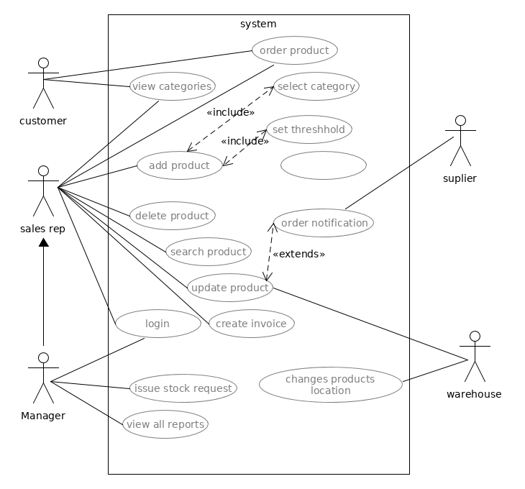
USE CASE DIAGRAM

Slide 10
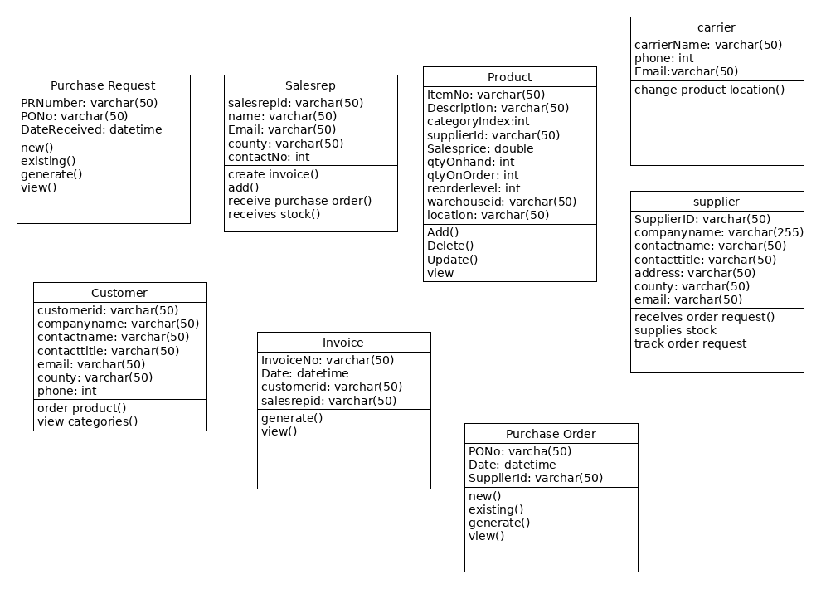
CLASS DIAGRAM

Slide 11
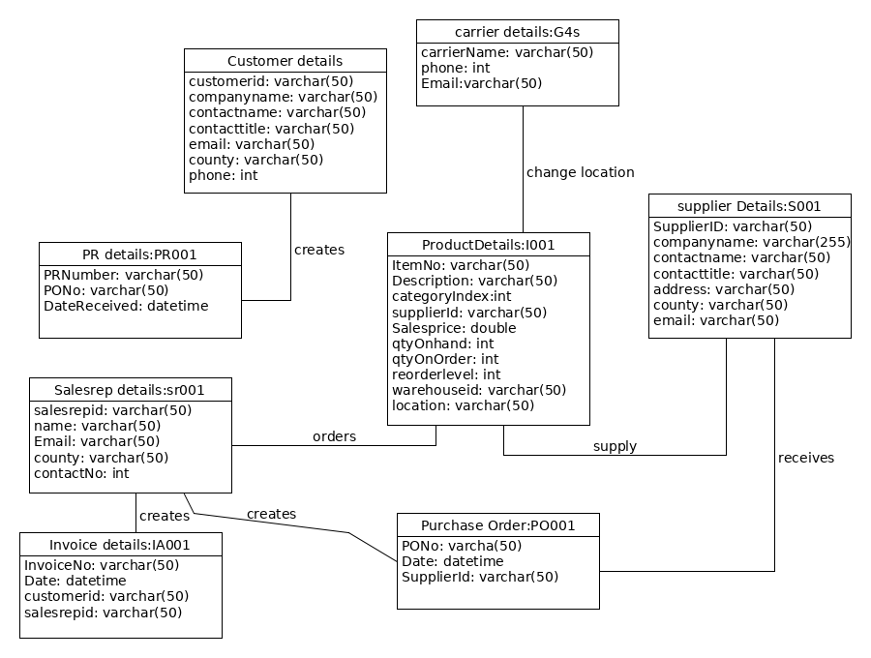
OBJECT DIAGRAM

Slide 12
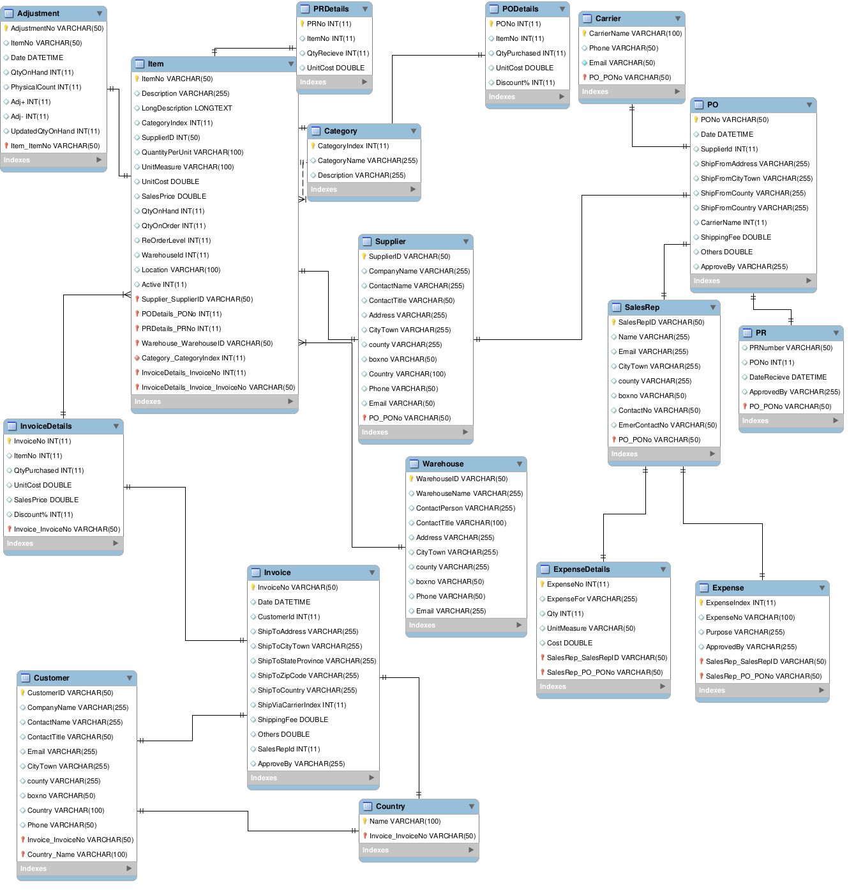
DATABASE SCHEMA

Slide 13
METHODOLOGY
The system will undergo the waterfall model of development which requires that each phase be completed before another phase begins.
In waterfall the outcome of one phase acts as the input for the next phase sequentially.
The application will first be analyzed to get its requirements then it will be designed. Implementation of the design follows after which testing deployment and maintenance will be key.

Slide 14
REQUIREMENTS
HARDWARE REQUIREMENTS
Computer with at least Intel core i3 processor and above.
At least 2gb RAM.
500GB Hard disk.
SOFTWARE REQUIREMENTS
Windows operating system
Java netbeans version 8.0.2 and above
MySQL database application

Slide 15
PROJECT SCHEDULE
Duration in weeks | 1 | 2 | 3 | 4 | 5 | 6 | 7 | 8 | 9 | 10 | 11 | 12 | 13
Feasibility study
Requirement analysis
project proposal
System Design
System coding
System testing
System deployment
System maintenance
System documentation

Slide 16
BUDGET
ITEM | COST(ksh)
Research materials | 2,000
Stationary/printing | 1,000
Miscellaneous | 300
Total | 3,300

Slide 17
THANK YOU

