Slide 1
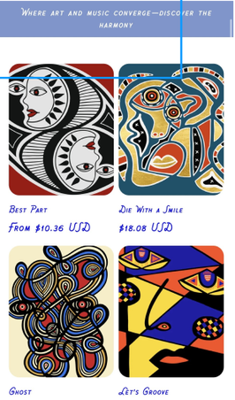
02
Intro
Athletics
Varsity tennis at Bates
Competitive, team-first mindset
Data science, tennis,
and geometric modern art.
Education
Creative Work
Bates College: Math + Econ
UPenn: Data Science + AI
Cubism / Geometric Modern Art
Independent art business
Independent art business
Paints in a Cubism / Geometric Modern Art style, bringing
a visual systems lens to analytical work.

