Slide 1
Executive Summary of Predictive Analytics (DDS 8555) Final Project.
By Samuel Mbah Nde

Slide 2
Project overview
Participation in 3 Kaggle competitions:
Time Series Forecasting: Store Sales for Products of Ecuadorian grocery retailer Corporación Favorita
Regression: Prediction of House Prices based on home attributes.
Classification: Grouping of Crimes committed in San Francisco Crime into various Categories
Workflow: Data exploration → Feature Engineering → Model Selection/Training /Validation → Prediction on Test Set and Submission
GitHub Repository: https://github.com/ndesamuelmbah/DDS-8555/tree/main/AssignmentFiles/Week8

Slide 3
Store Sales Forecasting - Objective & Data
Objective: Forecast sales of 33 product families across 54 stores.
Key Observations:
Sales data shows strong weekly seasonality.
Sales trends show variations across product types and stores.
National holidays impact sales patterns.

Slide 4
Store Sales - Time Series Analysis
Periodogram Analysis:
Major peak at 7 days → Weekly seasonality.
Minor peaks at 14, 21 days suggesting harmonics.
Minor peak at 30 days, suggesting monthly seasonality
Decomposition:
Identified trend and seasonality.
Marked effect of holidays on sales.
ACF/PACF Insights:
Strong autocorrelation at lags 1 and 7 suggesting that each day’s sales are influenced by previous days a weekly season.
Suggests ARIMA(7,1,1) with seasonal order (0,1,1,7).

Slide 5
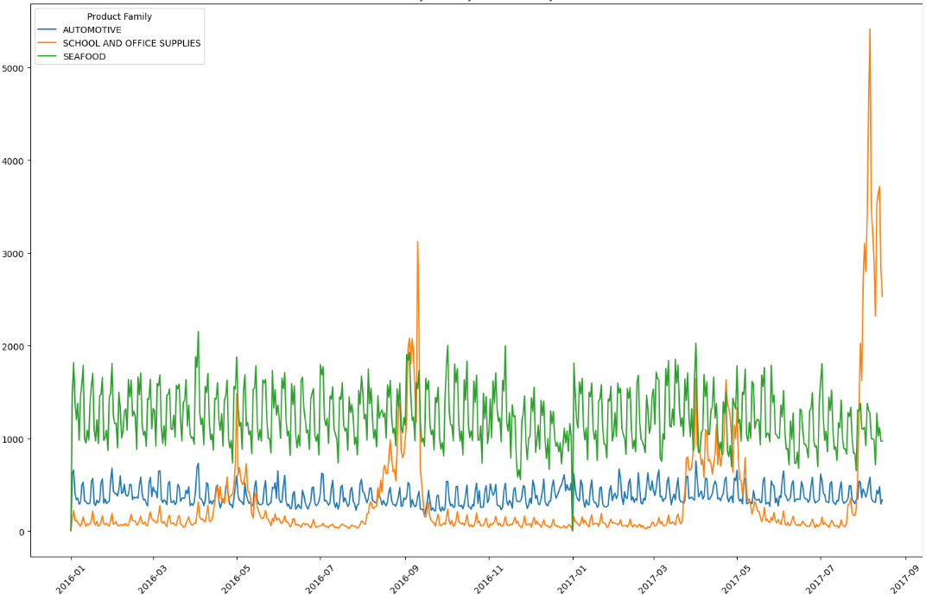
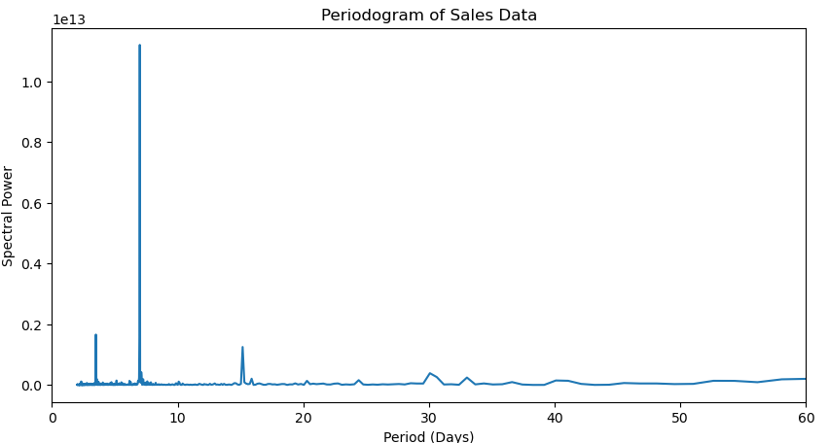
Time series plot for various product families and Periodogram
Time Series Plot by Product Family
Periodogram of Sales Data
Notes:
Left:a The time series of sales of products differ by product types but the weekly seasonality is observed in all products. Right: The clear peak at 7 indicates strong weekly season. The minor peaks at 14 and 21 indicate harmonics. The minor peak at 30 suggests monthly seasonality.

Slide 6
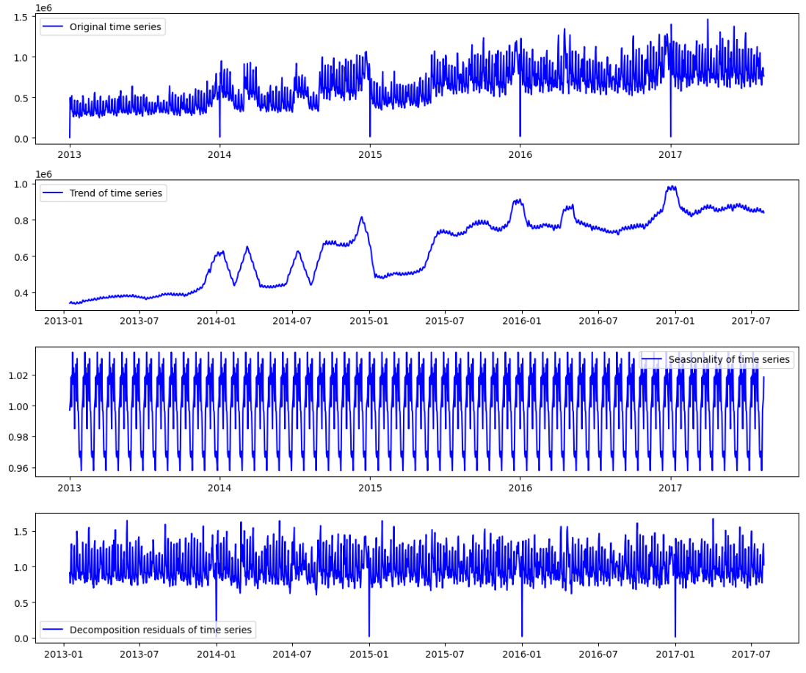
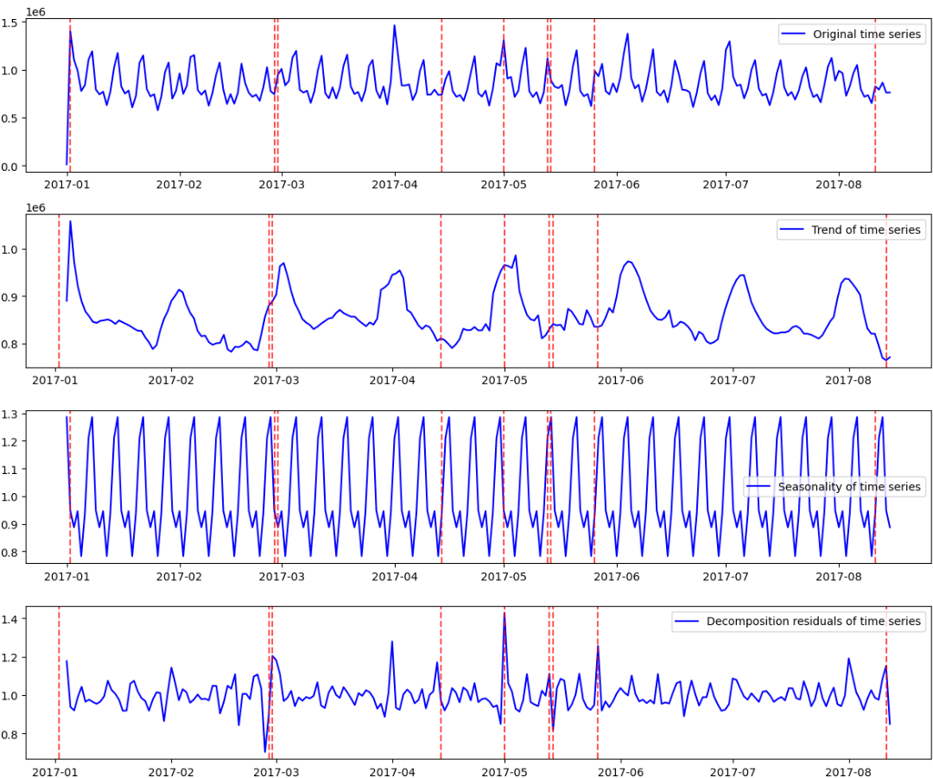
Decomposition Plots of Sales Time Series
Decomposition Plot highlighting trend with 30 days seasonality
Decomposition plot at showing Weekly seasonality
Notes:
Left: Decomposition plot with seasonality of 30 over the entire dataset. This plot makes it clear to see the trend in the data. Right: Decomposition plot with seasonality of 7 for 2017 data annotated with national holidays (red vertical lines). Note that sales on national holidays generally fall. I did not include holidays in left plot because the red lines will be too cluttered together.

Slide 7
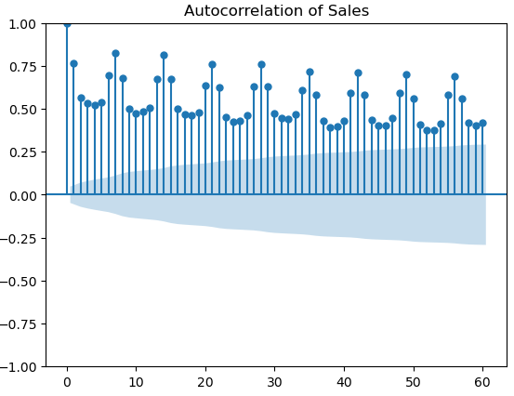
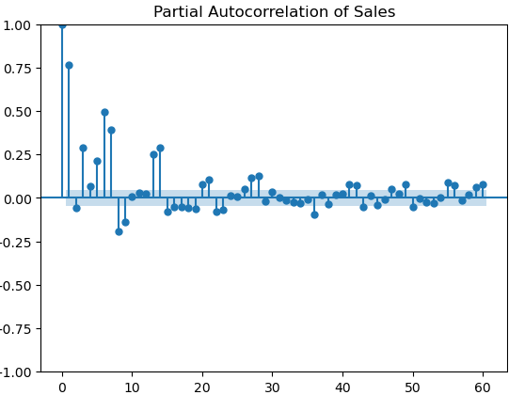
Auto correlation and Partial Auto Correlation plot of total sales.
Notes:
Left: Autocorrelation plot
Strong Positive Autocorrelation at Lag 1: High correlation at lag 1 indicates that sales on one day are highly correlated with sales on the previous day. This suggests that the sales data is highly persistent or exhibits strong temporal dependence.
Seasonal Pattern at Lag 7: Peaks at lag 7, 14, 21, and multiples of 7 indicate a weekly seasonality. This suggests that sales patterns repeat every 7 days, consistent with weekly shopping behavior.
Gradual Decay of Correlation: A gradual decline in autocorrelation indicates that the influence of past observations diminishes over time but still retains some correlation over a 30–40-day period.
Right: Partial Autocorrelation plot
High Partial Autocorrelation at Lag 1: A large spike at lag 1 suggests a strong AR(1) process, meaning that daily sales are strongly influenced by the previous day’s sales.
Significant Correlation at Lag 7: The notable spike at lag 7 indicates that a 7-day lag (weekly lag) has a significant direct impact on sales, supporting the hypothesis of weekly seasonality.
Rapid Decay After Lag 7: After the initial lags (1 and 7), partial autocorrelation quickly drops, suggesting that additional lags beyond these points contribute less to direct correlations.

Slide 8
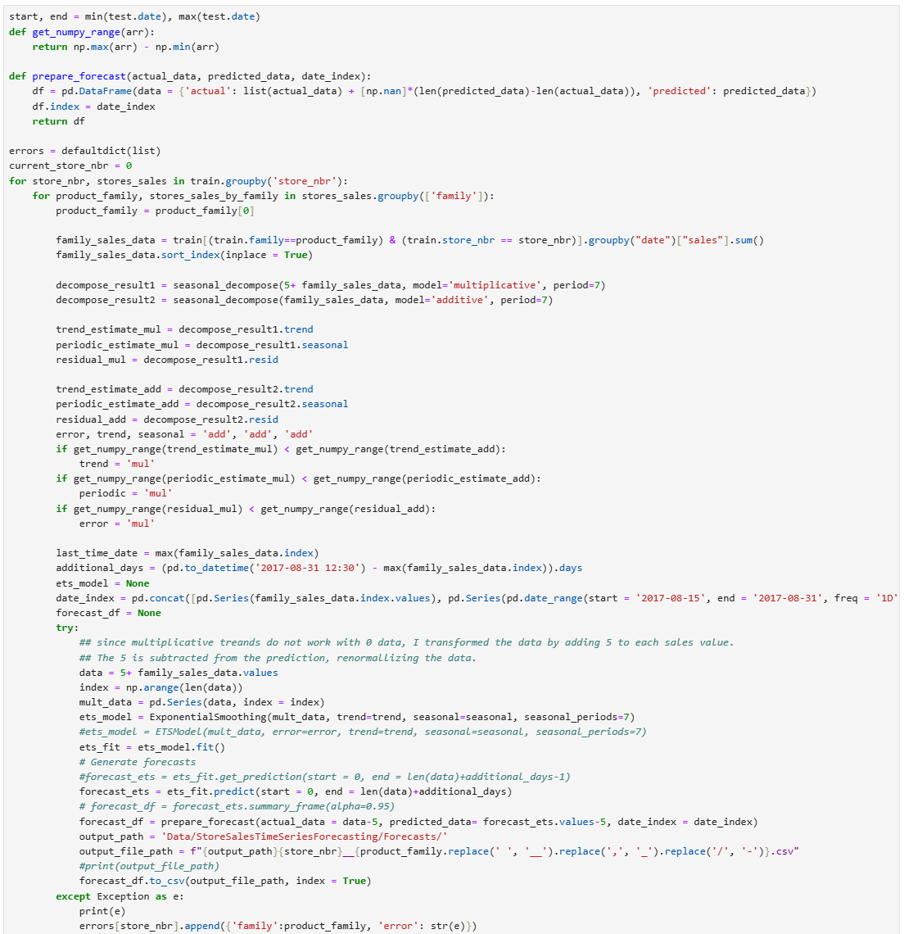

Slide 9
Implementing ETS model.
For each pair of store number and product family, I infer the most appropriate trend, period, and error from the train data. Then use those to fit a model and save the results to a csv file. This approach ensures that a model is fit that captures the specifics of the data.
Notes:
A similar algorithm was used to choose parameters and implement ARIMA model.

Slide 10
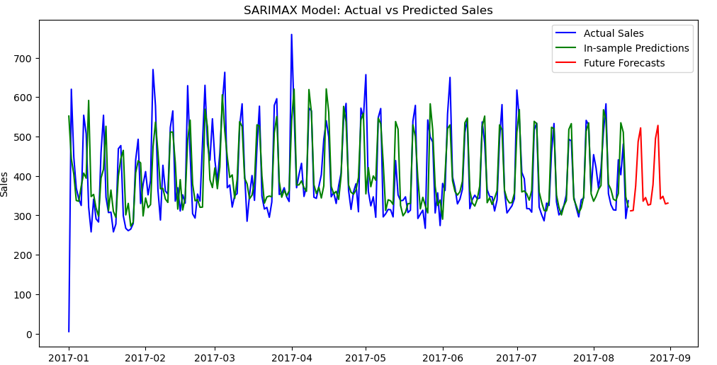
Predictions from ARIMA model
Notes:
The ARIMA model captures the trend much better than the ETS model but both models are conservative, rarely predicting values bigger than the observed ones, suggesting that there might be need to work on damping.

Slide 11
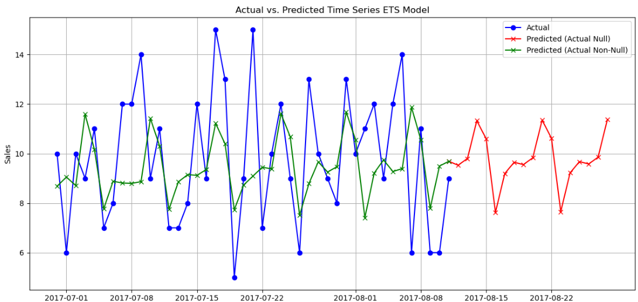
Visuallizing predictions
Notes:
The ARIMA model captures the trend much better than the ETS model but both models are conservative, rarely predicting values bigger than the observed ones, suggesting that there might be need to work on damping.
Forecasts shown here are evaluated for 2017 data
The predictions are for different products which explains the difference in sales but highlights the fact that models do not neatly feat each of the store-product family pairs.

Slide 12
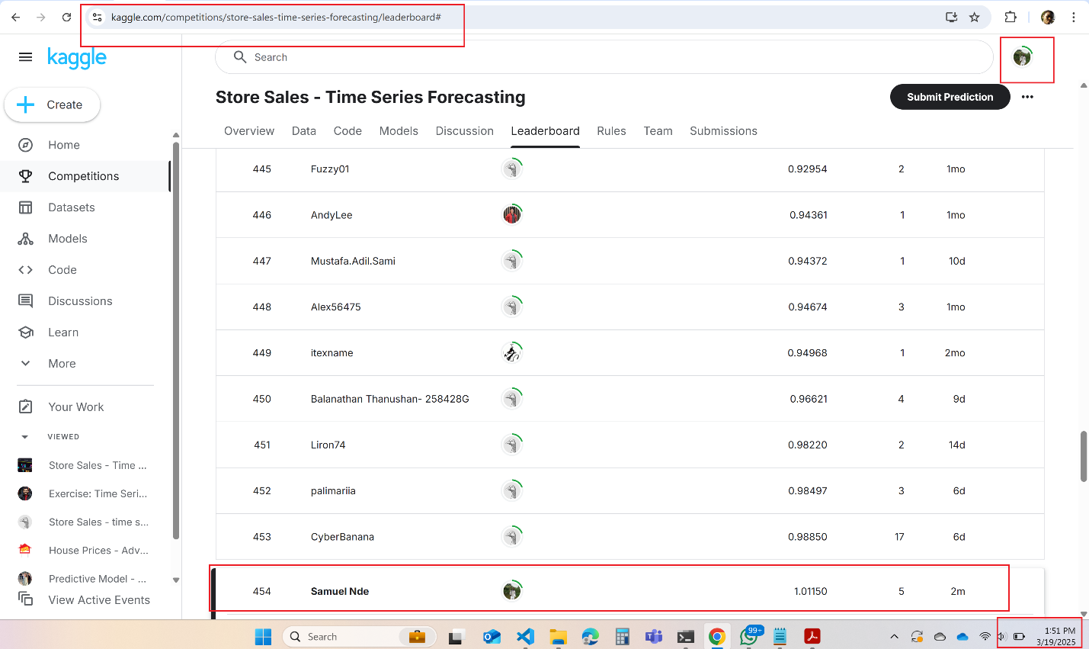
Proof of submission.

Slide 13
House Prices - Objective & Data Preparation
Objective: Predict house prices based on attributes.
Data Issues:
Missing values addressed through a 3-step process (see slide notes).
Imputation strategy guided by domain knowledge.
Feature Engineering:
Created composite features like total bathrooms by summing full baths and a half times half bath.
Encoded categorical variables using ordinal scales guided by ordinal nature of quality ratings.
Notes:
Remove all fields with more than 80% missing values missing because including them in the model will only increase model complexity.
Fill the missing values of each field that is missing because the value does not make sense to be populated with an appropriate default value. For example, when categorical variable fireplace quality is missing because the house does not have a fireplace, I use a default value of `NotA`. Similarly, when a home is missing the Garage Year Built and the total garage area is 0 sqft, I fill the missing year with 1700. Using this approach, I was able to fill 99% of the missing values.
After completing the above approach, I noticed that only one variable had a missing value which was missing electrical circuit breaker value. I filled this with the modal circuit model of the houses in its neighborhood. I did this because homes in each neighborhood tend to have similar configurations.

Slide 14
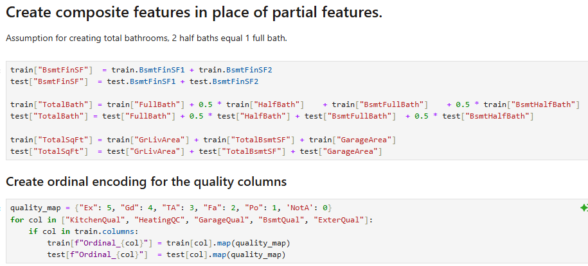
Feature Engineering Code snippet.
Notes:
The feature `BsmtFinSF` representing the finished square footage is a combination of finished square footage of type 1 and 2. Similar logic was used to create features for `TotalBath` (total number of bathrooms in the home) by summing the number of full baths and half bathrooms with an assumption that 2 half bathrooms make a full bathroom. The final cell converts the qualitative variables representing the quality of some fields into ordinal variable.

Slide 15
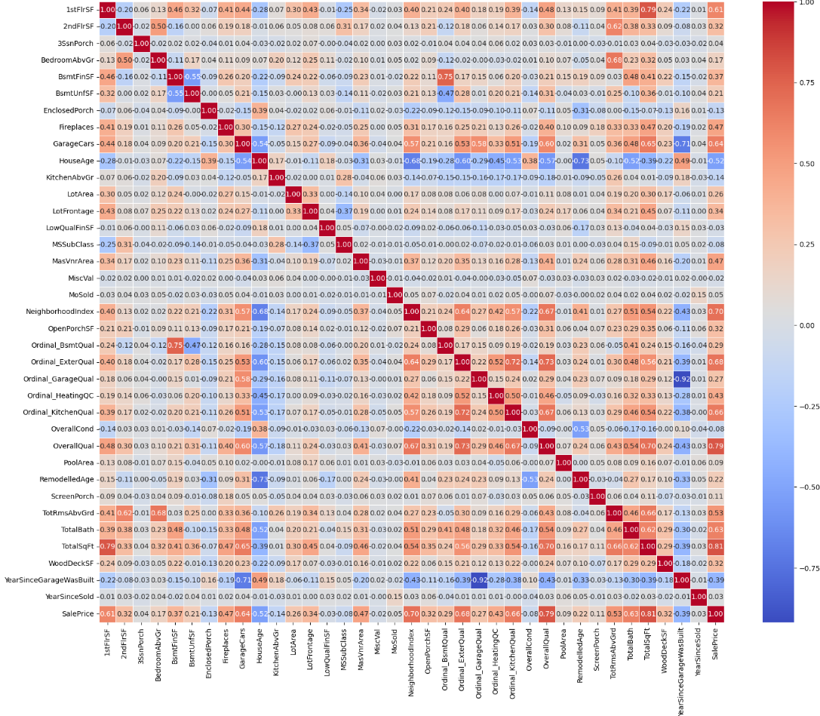
Correlation Matrix of Numerical Features
Notes:
Note the presence of a few highly correlated fields for example `YearSinceGarageWasBuilt` has a -0.92 correlation with `Ordinal_GarageQual` suggesting that older garages (higher `YearSinceGarageWasBuilt`) have a lower quality which is to be expected because of wear from use over time.

Slide 16
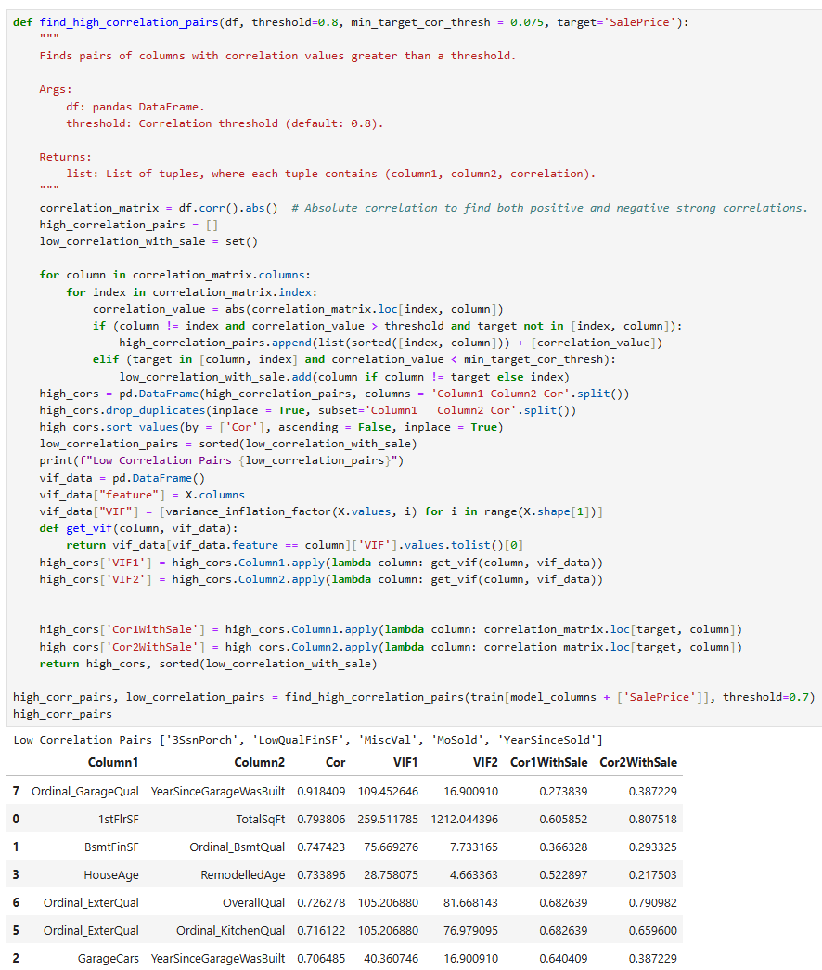
Removing Highly correlated Variables to prevent multi collinearity
I used a combination of Variance inflation factor (VIF) and correlation with sale price to determine which of the highly correlated features to remove from the dataset.
Features we correlations less than a threshold of 0.075 with sale price were also removed
Notes:
Variables with a low correlation threshold of 0.075 (in absolute value) with sale price like ['3SsnPorch', 'LowQualFinSF', 'MiscVal', 'MoSold', 'YearSinceSold'] were dropped. Based on a combination of correlation with sale price and VIF, the features ['YearSinceGarageWasBuilt', 'Ordinal_ExterQual', 'RemodelledAge', 'Ordinal_BsmtQual', '1stFlrSF'] were removed.

Slide 17
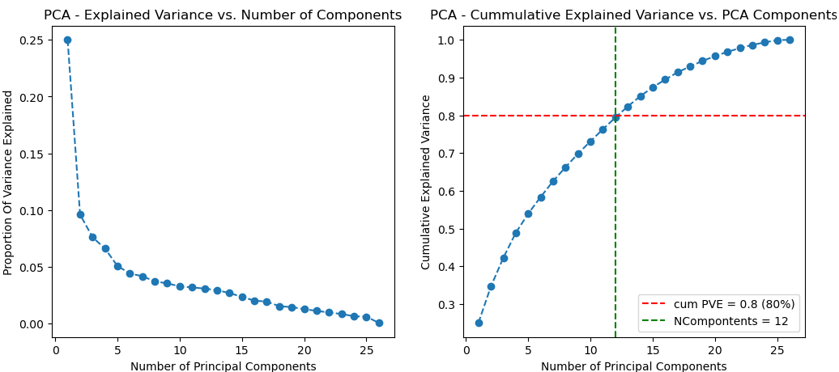
Selecting Features using PCA
Notes:
About 55% of the variation in the dataset is captured by the first 5 principal components. Additional features contribute only a small amount of variation. We need 12 principal components to capture 80% of the variation in the dataset which originally consisted of 26 features.

Slide 18
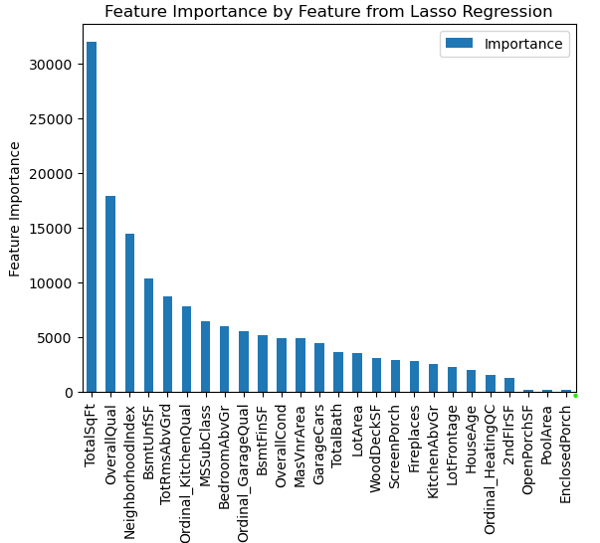
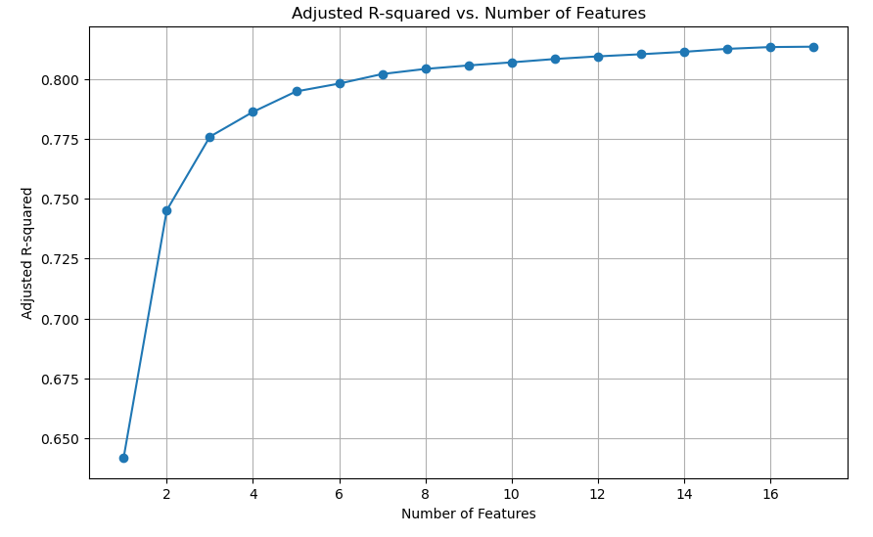
Using Lasso Regression to choose features
Notes:
Using Lasso Regression: Using Lasso Regression, to select important features, and fitting models and measuring adjusted R squared.
This approach provides an interpretable model and provides the bases for choosing features that can be used for Modelling.

Slide 19
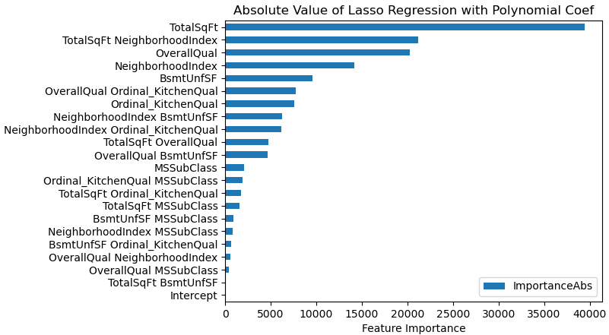
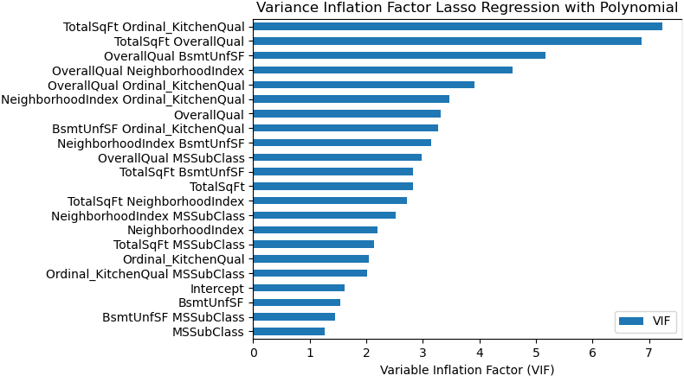
Feature Importance and Variance Inflation Factor from Best Polynomial
Notes:
Left: The most important feature for determining the price of the house is the total square footage. Other important factors are the neighborhood and the overall quality of the house.
Right: All the features in the model have a VIF less than 10 which shows that there is very little multicollinearity between the features.

Slide 20
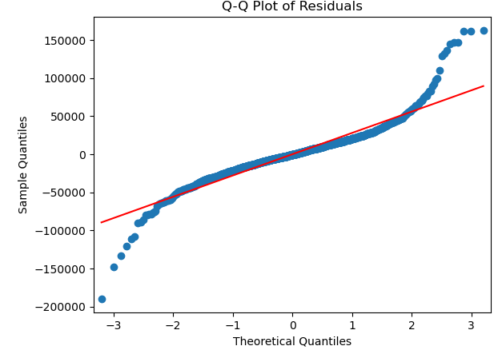
Investigation of Model Assumptions.
Check for multicollinearity: The Variable Inflation factor for the dataset shows a score of less than 10 for all the variables in the dataset. Any VIF more than 10 is generally considered problematic.
Test for Independence: The Durbin-Watson Test for independence produced a test statistic of 1.93 which is very close to 2 - an indication that there is no auto correlation, and the features are independent.
Normality of Residuals: Majority of the residuals lie on the normal QQ Plot with a few outliers which is expected from the distribution of sales data. These outliers represent the expensive homes of the very wealthy in the society.

Slide 21
Bibliography
Alexis Cook, D., & Holbrook, R. (2021). Store Sales - Time Series Forecasting. Retrieved from Kaggle.com: https://www.kaggle.com/competitions/store-sales-time-series-forecasting/overview
Breskuvienė, D., & Dzemyda, G. (2023, 5). Categorical Feature Encoding Techniques for Improved Classifier Performance when Dealing with Imbalanced Data of Fraudulent Transactions. INTERNATIONAL JOURNAL OF COMPUTERS COMMUNICATIONS & CONTROL. doi:10.15837/ijccc.2023.3.5433
Gnat, S. (2021). Impact of Categorical Variables Encoding on Property Mass Valuation. Procedia Computer Science, 192, 3542-3550. doi:10.1016/j.procs.2021.09.127
Josse, J., & Husson, F. (2012). Selecting the number of components in principal component analysis using cross-validation approximations. Computational Statistics & Data Analysis, 56(6), 1869-1879. doi:10.1016/j.csda.2011.11.012
Kan, W. (2015). San Francisco Crime Classification. Retrieved from Kaggle.com: https://kaggle.com/competitions/sf-crime
King, M. (1981). The alternative Durbin-Watson test: An assessment of Durbin and Watson's choice of test statistic. Journal of Econometrics, 14(1), 51-66. doi:10.1016/0304-4076(81)90058-0
Montoya, A., & Canary, D. (2016). House Prices - Advanced Regression Techniques. Retrieved from Kaggle.com: https://www.kaggle.com/competitions/house-prices-advanced-regression-techniques
Nde, S. M. (2025, 03). DDS-8555. Retrieved from Github: https://github.com/ndesamuelmbah/DDS-8555.git

Slide 22
Looking Forward
Address Tail Deviations: The plot shows deviations from normality at both tails. Investigate if transformations of the target or features could improve normality.
Investigate Outliers: The plot highlights potential outliers. Examine these data points to determine if they are errors or genuine data points that need special handling.
We might need to remove the outliers or
Transform the data so that the outliers become less influencing.
Consider Non-Linearity: While the middle portion is good, the tail deviations might indicate uncaptured non-linear relationships. It would be interesting to see what some non-parametric models like Random Forest models can perform on the dataset.
Heteroscedasticity is Present: The residual plot clearly shows heteroscedasticity with the prediction spreading towards the right of the dataset. This may be influenced by the outliers in the dataset. It needs to be investigated and addressed to improve the reliability and accuracy of your model. Some options for addressing this issue include:
Transform the Target Variable: Common transformations like taking the logarithm or square root of the target variable (SalePrice in your case) can often stabilize the variance.
Weighted Least Squares (WLS): WLS is a technique that assigns weights to data points based on their variance. This can give more weight to data points with lower variance and less weight to data points with higher variance.
Feature Engineering: Refine or add features to capture the underlying patterns and reduce residual deviations potentially better. This may also help with the Heteroscedasticity issue.

Slide 23
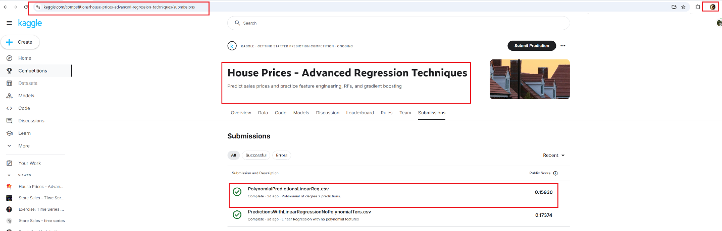
Proof of Participation in Competition.

Slide 24
San Francisco Crime - Objective & Data Analysis
Objective: Classify crimes based on metadata.
Data Overview:
No missing values.
Imbalance in crime categories and district crime rates.
Outliers in geographical coordinates removed.

Slide 25
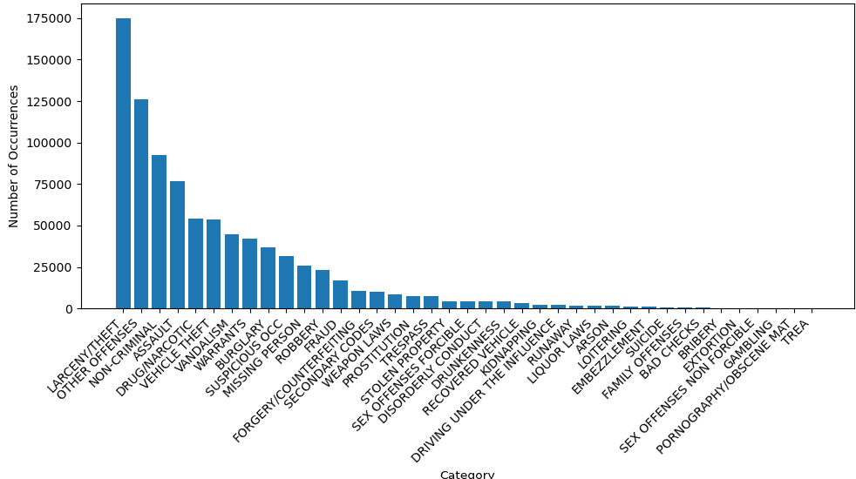
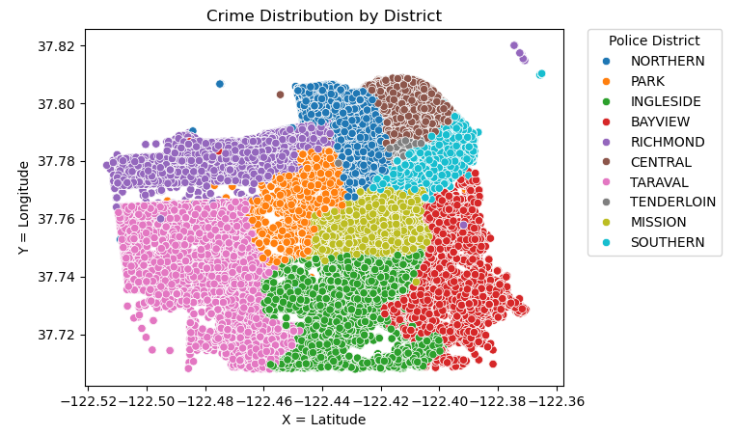
Data imbalance and Distribution of Crime by District
Notes:
Left: Some categories of crime like theft occur more frequently others like Gambling. This presents a data imbalance issue for any algorithem we might build.
Right: There were a few outlier locations in the dataset where the latitude and longitudes were way off the value of San Francisco’s location, I had to remove those because I was confident that there were entered in error.

Slide 26
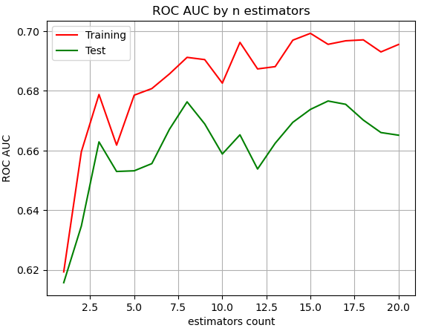
Choosing the optimal number of Trees for Random Forest Classification - ROC AUC for test/training datasets by number of estimators for Random Forest Classifier.
Using More than 8 classifiers does not yield any improvement in either test or training dataset.
The test performance is also consistently below the training performance suggesting that a random forest classifier may not be a good model for this dataset.

Slide 27
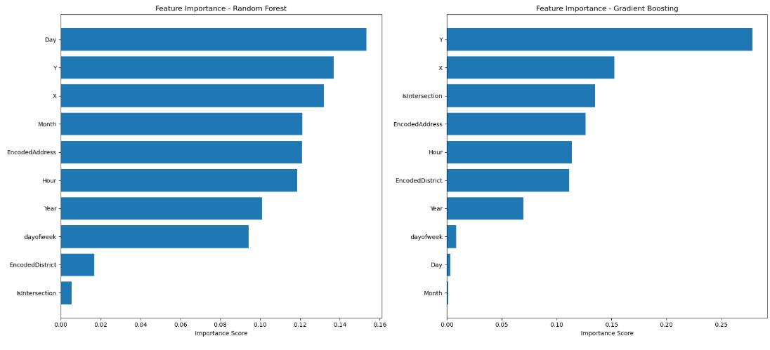
Feature importance of Gradient Boosting vs Random Forest Classifier
Notes:
Left: In the Random Forest model, “Day” and “Month” exhibit the highest importance, suggesting temporal patterns are crucial. Right: Conversely, Gradient Boosting emphasizes spatial features like “Y” and “X” coordinates, along with address-related information (“intersection,” “EncodedAddress,” “EncodedDistrict”). This indicates that while both models leverage similar features, they assign different weights, highlighting the varying ways these algorithms capture underlying data relationships. The discrepancies also suggest potential areas for feature engineering or model refinement, as understanding these differences can lead to improved predictive performance.
SVG Classifier with linear kernel did not work quite as well suggesting that the feature space was not linearly separable. Data was scaled before being used in SVM model because it is a distance sensitive.

Slide 28
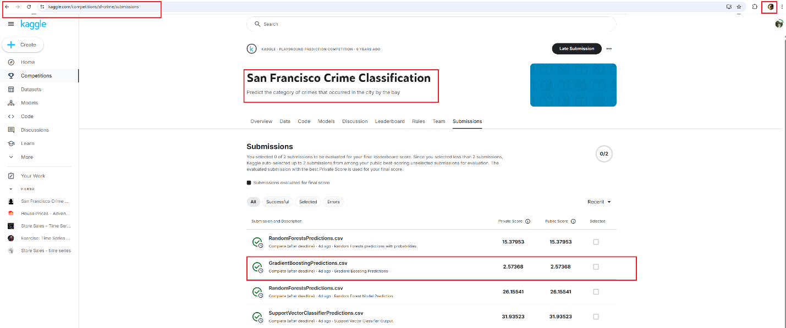
Proof of Participation in competition.

