Slide 1
HP Capstone: Big Data Analytics
Nic Desilets
&
Nathaniel Whitlock

Slide 2
Database Instance
Instance
System Global Area (SGA)
Allocation for shared database memory structures
Instance Program Global Area (PGA)
Allocation for private server process memory structures

Slide 3
SGA - Areas of Interest
SGA
Collection of shared database resources
Memory usage of SGA is governed by:
1. SGA_TARGET
Desired SGA memory usage (exceedable).
2. SGA_MAX_SIZE
Hard limit on SGA memory usage. Cannot be exceeded.
Database Buffer Cache
In-Memory Column Store
Large Pool (?)
Everything Else

Slide 4
Database Buffer Cache
Database Buffer Cache
Block buffer cache
Can also cache entire database objects (ABTC)
Block Caches
2K, 4K, 8K, etc. block caches
Big Table Cache
Table, index, partition object cache
Proportion of Big Table Cache to Database Buffer Cache governed by DB_BIG_TABLE_CACHE_PERCENT_TARGET

Slide 5
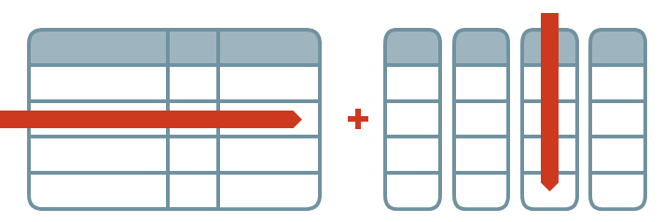
In-Memory Column Store (IMCS)
New feature as of Oracle 12.1
Works along side existing buffer cache for dual architecture format
In-Memory features not available until blocks have been populated
Designed to optimize columnar access to data for analytics
Similar to having a conventional index on every column in the table
Analytic indexes can be dropped
The following objects cannot be placed in IMCS:
Objects owned by sys
Index organized tables
Clustered tables
Buffer Cache
IMCS
Row Storage
Columnar Storage

Slide 6
Architectural Elements of IMCS
Compressed columnar storage
Blocks can be scanned and evaluated in compressed formats
Storage indexes
In-Memory compression units (IMCU) represent several thousand rows
Each IMCU automatically records the min and max values for each columns data, as well as other summary information
Allows for skipping of an IMCU during scan due to WHERE predicate
Optimized joins and reporting
Vector Processing
Allows for scan of billions of blocks per second per core
Bloom filter leveraged for In-Memory hash joins
Scan of outer (dimension) table generates a bit vector filter which can be used to narrow the scan of the inner (fact) table

Slide 7
In-Memory Pools
1MB Pool
IMCU
Used to store actual data populated in columnar format
Subunits knows as In-Memory Compression Units (IMCU)
Column stores composed of 1MB extents
Data can be stored over one or more IMCU
1MB Pool Size = (0.8 * INMEMORY_SIZE)
IMCU
64KB Pool
SMU
SMU
Dynamic Performance Views
Contains IMCU metadata and transactional information
Individual subunits known as Snapshot Metadata Units
64KB Pool Size = (0.2 * INMEMORY_SIZE)
SMU
SMU
v$inmemory_area
v$im_header
v$im_smu_head
V$im_segments
SMU
SMU
IMCU
SMU
SMU
SMU
SMU
SMU
SMU

Slide 8
IMCU
There will be one column CU for each column in the segment (by default) plus one for the rowids that correspond to the column values)
Header
Contains min and max of each column as well as other summary info
Compression unit that stores min and max of single columns data
CU
CU
CU
1MB
1MB
1MB
Memory extents that store raw data in columnar format
1MB
1MB
1MB
Logistics:
1MB
1MB
1MB
Each IMCU maps to a Snapshot Metadata Unit or SMU in the 64KB pool that holds the metadata about the IMCU
Stored column min and max allows IMCU skipping during scans by leveraging WHERE predicate
The higher the compression, the more rows per IMCU

Slide 9
Table | Size(GB) | Rows
Child_Table_V1 | 100 | 5 Billion
Lead_Lag_Test_V1 | 60 | 2.4 Billion
Capstone_Parallel_Test_V1 | 7 | 32 Million
Parent_Table_V1 | 1 | 50 Million

Slide 12
In-Memory Column Store – Vector Processing
Scalar Processing
Vector Processing
Conventional method of processing data.
Considers each element of data one at a time.
Enabled by SIMD instruction sets available on recent processors.
Considers many elements of data all in one go.

Slide 13
In-Memory Column Store – Vector Processing
Scalar Processing
Vector Processing
Data: [1, 3, …, 49]
Filter: >= 45
Step 1: 1 >= 45 -> False
Step 2: 3 >= 45 -> False
Step N - 1: …
Step N: 49 >= 45 -> True
Load each value one by one and compare each time.
Data: [1, 3, …, 49]
Filter: >= 45
Step 1: 1 >= 45 -> False
3 >= 45 -> False
…
49 >= 45 -> True
Load multiple values and then compare all at once.

Slide 14
In-Memory Column Store – Vector Processing
IMCS vector processing can utilize Advanced Vector Extensions (AVX).
New instruction set extension found on recent Intel and AMD processors.
Contains 16 registers to hold sets of data.
Each register holds 8 32-bit floats or 4 64-bit floats
Register
Results
Data 1
Data 2
AVX Instruction
Data …
Data N

Slide 15
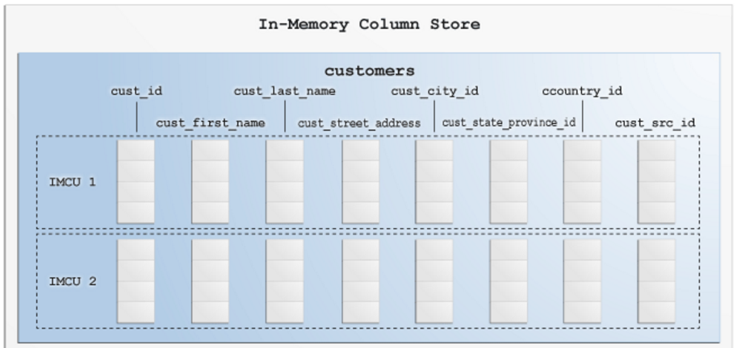
In-Memory Column Store – Vector Processing
Register 1
Data 1
Data 2
Data 3
Data 4
Data 5
Data 6
Data 7
Data 8
Register 2
Data 1
Data 2
Data 3
Data 4
Data 5
Data 6
Data 7
Data 8
Register 3 (Results)
Data 1
Data 2
Data 3
Data 4
Data 5
Data 6
Data 7
Data 8

Slide 16
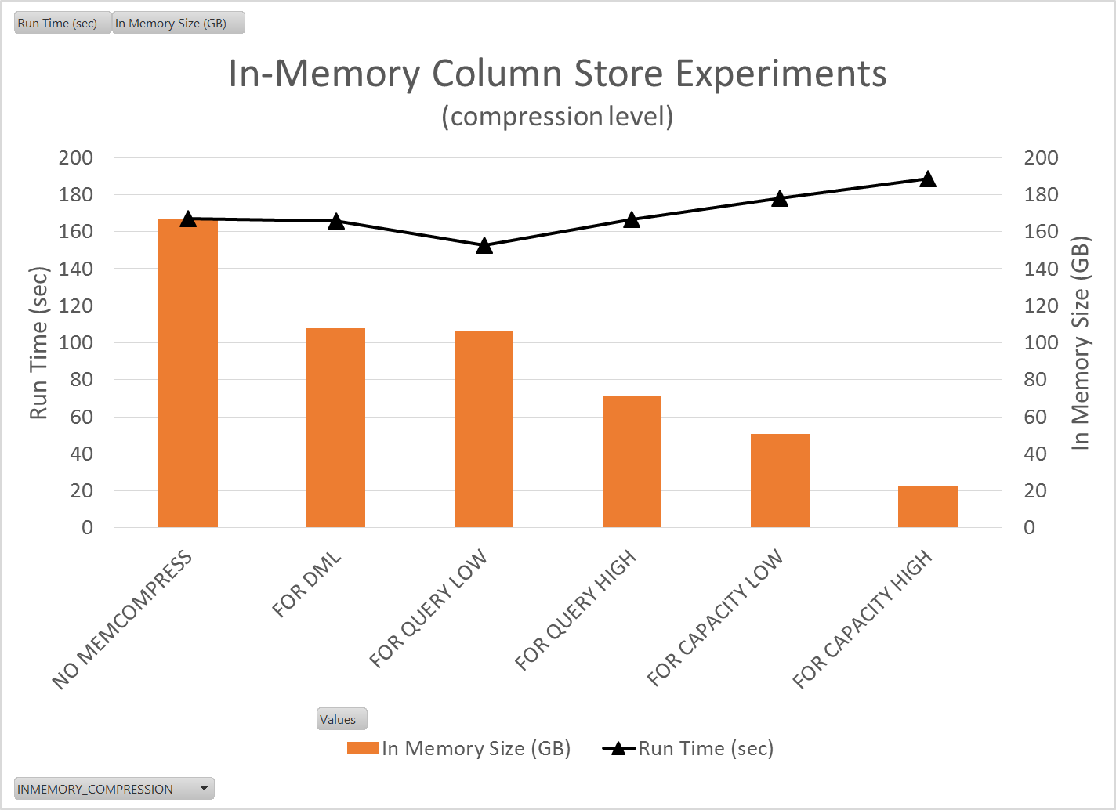

Slide 17
Instance PGA
Instance PGA
Collection of all server process PGAs.
Memory usage of Instance PGA is governed by:
1. PGA_AGGREGATE_TARGET
Desired cumulative PGA memory usage (exceedable).
2. PGA_AGGREGATE_LIMIT
Hard limit on cumulate PGA memory usage. Cannot be exceeded.
PGA
PGA
PGA
PGA
PGA
PGA
PGA
…
Each allocated process PGA comprises the instance PGA.
Note: PGA can allocated to both server or background processes.

Slide 18
Program Global Area (PGA)
Each query server process gets its own PGA.
PGA is comprised of
Session Area
Holds logon variables, etc.
Private SQL Area
Persistent Area
Bind variables and values
Runtime Area
Query execution state
SQL Work Areas
PGAs are stored in the instance PGA (contains all PGAs)

Slide 19
PGA - Areas of Interest
PGA
Private workspace allocated to a server process.
Session Area
Contains logon information, etc.
Private SQL Area
Contains bind variables and work areas for memory intensive operations.

Slide 20
PGA Private SQL Area
Private SQL Area
Contains bind variables and values.
Persistent Area
Runtime Area
Query Execution State
Contains query progress information.
Runtime Area
SQL Work Area
Memory intensive operation work areas.
SQL Work Area

Slide 21
SQL Work Area Sizing
SQL Work Area
SQL Work Area
WORKAREA_SIZE_POLICY = MANUAL
WORKAREA_SIZE_POLICY = AUTO
HASH_AREA_SIZE: max memory used for hash joins
SORT_AREA_SIZE: max memory used for sort operations
BITMAP_MERGE_AREA_SIZE: max memory used for merging bitmap segments
CREATE_BITMAP_AREA_SIZE: max memory used for bitmap index creation
PGA_AGGREGATE_TARGET: desired memory usage of instance PGA
_PGA_MAX_SIZE: cumulative size limit of all work areas for single PGA
_SMM_MAX_SIZE: size limit for a single work area within PGA
Applies to both serial and parallel execution
_SMM_PX_MAX_SIZE: additional size limit for all work areas related to a particular query
Applies only to parallel execution

Slide 22
SQL Work Area Sizing (WORKAREA_SIZE_POLICY = AUTO)
SQL Work Area
SQL Work Area
Serial Execution
Parallel Execution
_PGA_MAX_SIZE:
PAT < 1GB: 200MB
1GB >= PAT <= 2GB: 20% of PAT
PAT > 2GB: min(2GB, 20% of PAT)
_SMM_MAX_SIZE:
PAT < 512MB: 20% of PAT
512MB >= PAT <= 1GB: 100MB
PAT > 1GB: min(1GB, 50% of _PGA_MAX_SIZE)
Work Area = _SMM_MAX_SIZE
_PGA_MAX_SIZE:
PAT < 1GB: 200MB
1GB >= PAT <= 2GB: 20% of PAT
PAT > 2GB: min(2GB, 20% of PAT)
_SMM_MAX_SIZE:
PAT < 512MB: 20% of PAT
512MB >= PAT <= 1GB: 100MB
PAT > 1GB: min(1GB, 50% of _PGA_MAX_SIZE)
_SMM_PX_MAX_SIZE:
Always 50% of PAT
Work Area = min(_SMM_MAX_SIZE, _SMM_PX_MAX_SIZE / DoP)

Slide 23
In order to sort entirely in memory…
Workload per process must be:
For serial operations: less than _SMM_MAX_SIZE
For parallel operations: less than min(_SMM_MAX_SIZE, _SMM_PX_MAX_SIZE / DoP)
Otherwise, temp tablespace (swapping) will be used.
Subsets of workload
Parallel Processes
Coordinator splits up workload N ways
Subset 1
PX 1
Query instructions
QC
QC
Subset 2
PX 2
Workload
Results
Subset …
PX …
Subset N
PX N

Slide 24
PGA - SQL Work Areas
Allocated areas of memory for a memory intensive operation:
Sorting (order by, group by, rollup, window)
Hash join
Bitmap merge
Bitmap create
If Automatic PGA Memory Management is set:

Slide 25
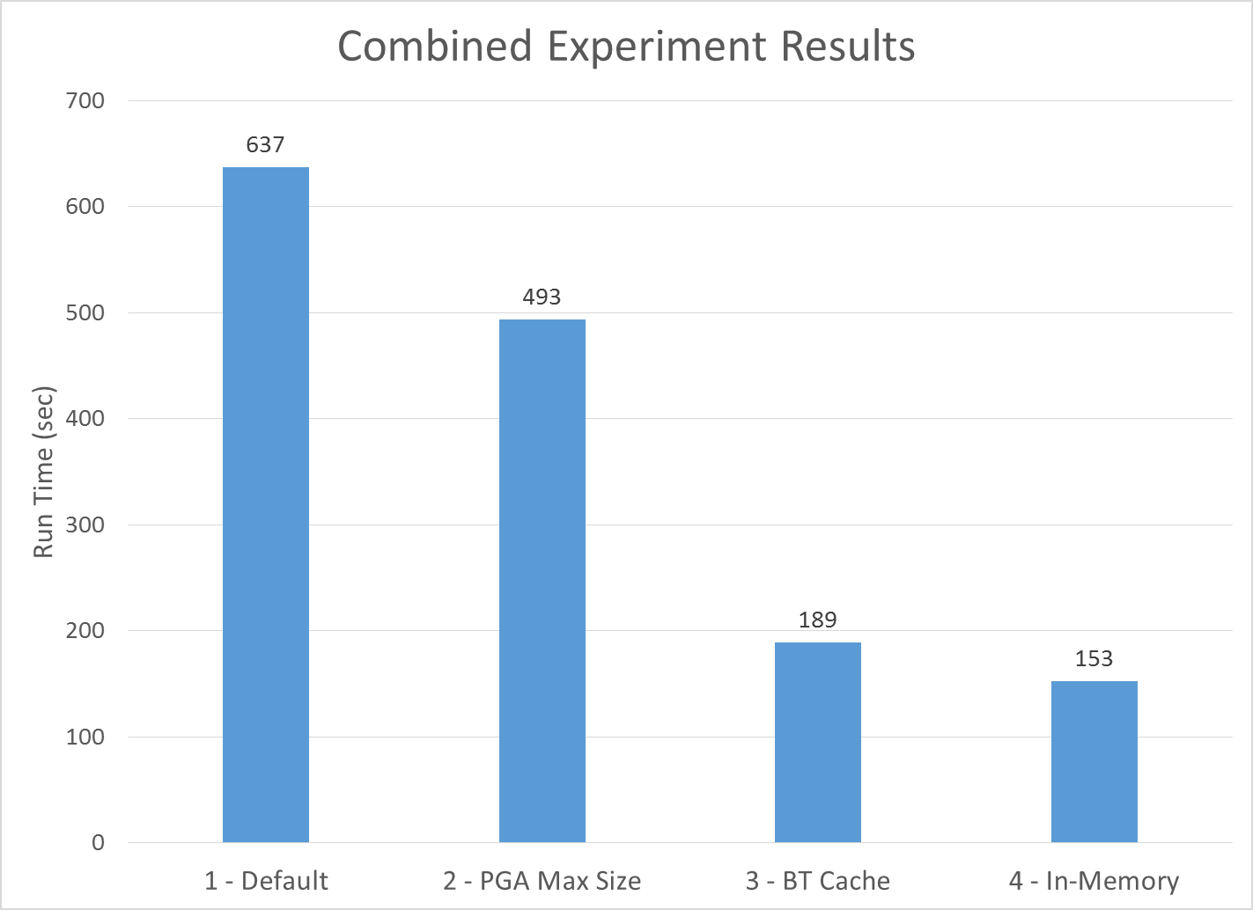
Notes:
Values are from the sum of the minimal value for each of the four tests:
Capstone_Parallel
Parent_Table
Child_Table
Lead_Lag

