Slide 1
Additive Runge Kutta IMEX Methods
Nicole deyerl
Math 6321

Slide 2

IMEX Methods
Used to solve problems of the form
$y^{′}=f_{E}\left(t,y\right)+ f_{I}(t,y)$ $y\left(t_{0}\right)= y_{0}$ $y∈R^{n}$
$f_{E}$ vs $f_{I}$
Implicit part is stiff
Contains large, negative eigenvalues
Explicit part is nonstiff
Contains small eigenvalues relative to implicit part

Slide 3
What does stiffness mean?
Linear stability: how error grows and shrinks
Stiffness is synonymous with multiple timescales
How do we handle stiffness?
Explicitly: take smaller timesteps
Utilize information from both sides of the time interval (the future as well as the past) ->Implicit solvers
Problems with mixed stiffness?
Fast-changing timescale dominated by large eigenvalues
Requires an implicit solve or small timestep
Slow-varying timescale dominated by smaller eigenvalues, determines long-term behavior

Slide 4
Additive Runge Kutta Methods
Explicit RK methods:
Not stable for stiff problems
Don’t require much work to obtain high order of accuracy
Easy to handle nonlinearity in f
Implicit RK methods:
Stable for stiff problems
Need to solve a system of equations at each step to obtain stages
Nonlinearity in f increases cost per timestep
Gist: seek methods suited to handle each part of f
Hard part: combine them in a way that’s high order accurate, and stable

Slide 5
Additive Runge Kutta Methods
Decrease the load on the implicit solver
Guarantee stiff accuracy

Slide 6
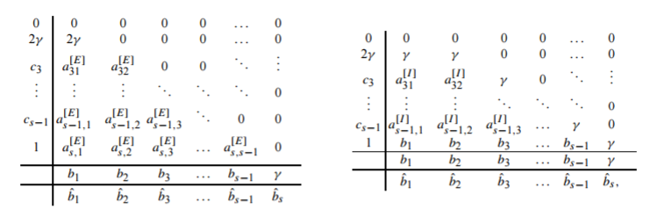
Additive Runge Kutta Methods
Implicit and Explicit Butcher table for 2 methods
Stages: Combine implicit and explicit f’s
Solve a root problem at each stage
Update: Combine implicit and explicit f’s

Slide 7
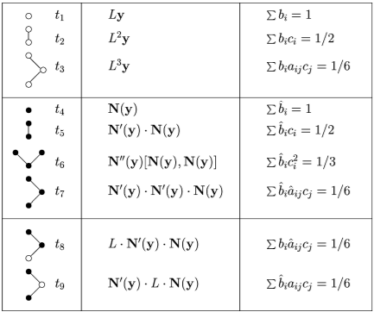
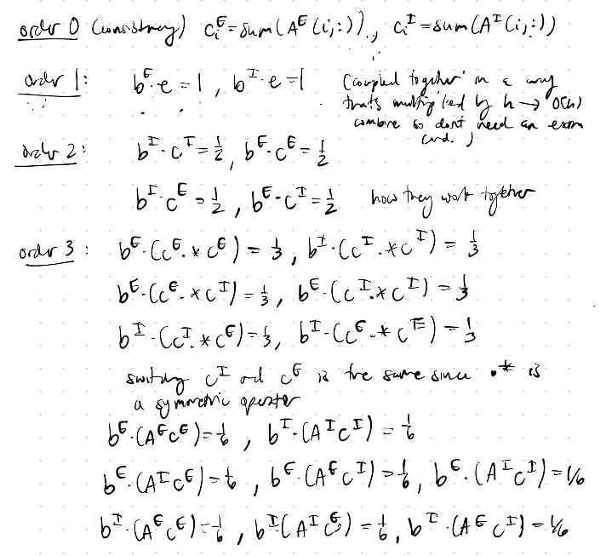
ARK Method Derivation
Order and Consistency: N-trees (Calvo, Frutos, Novo 2001)

Slide 8
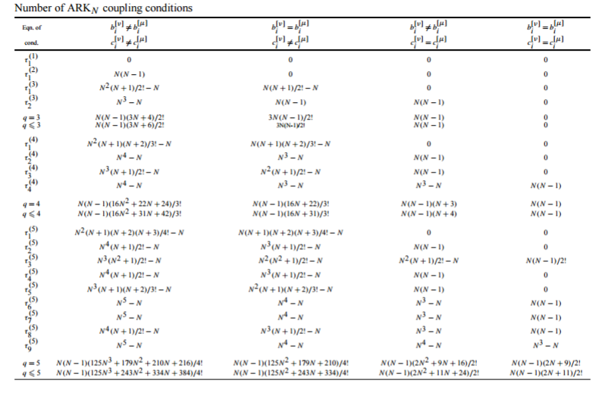
ARK Method Derivation
Coupling order for an order N method (Kennedy, Carpenter 2003)

Slide 9

Methods of Interest
${ARK}_{3}\left(2\right)4L\left[2\right]SA$
${ARK}_{4}\left(3\right)6L\left[2\right]SA$
${ARK}_{5}\left(4\right)8L\left[2\right]SA$
${ARK}_{q}\left(p\right)sS\left[q_{so}\right]X$
q = main order
p = order of embedded method
s = number of stages
S = stability characteristic
$q_{so}$=stage order of implicit method
X = SA -> stiffly accurate

Slide 10

Test Problems
Kaps problem
${y^{′}}_{1}\left(t\right)=−\left(\frac{1}{ε}+2\right)y_{1}\left(t\right)+\frac{1}{ε}{y_{2}}^{2}(t)$ $0≤t≤1$ $y_{1}\left(0\right)=y_{2}\left(0\right)=1$
${y^{′}}_{2}\left(t\right)= y_{1}\left(t\right)−y_{2}\left(t\right)−{y_{2}}^{2}(t)$
$y_{1}\left(t\right)$=${y_{2}}^{2}(t)$ $y_{2}\left(t\right)=e^{−t}$
Stiffness grows as $ε→0^{+}$
$ε=0$ reduces equation to index-1 DAE
Split problem
${{y^{′}}_{1}}^{S}\left(t\right)= −\left(\frac{1}{ε}\right)y_{1}\left(t\right)+(\frac{1}{ε}){y_{2}}^{2}(t)$ ${{y^{′}}_{1}}^{NS}\left(t\right)=−2y_{1}\left(t\right)$
${{y^{′}}_{2}}^{S}\left(t\right)=0$ ${{y^{′}}_{2}}^{NS}\left(t\right)=y_{1}\left(t\right)−y_{2}\left(t\right)−{y_{2}}^{2}(t)$

Slide 11

Test Problems
Prothero and Robinson
$y^{′}=g^{′}\left(t\right)+ \frac{1}{ε}(y−g\left(t\right))$ where $y(t)=g(t)$
Cosine problem (stiffness increases as $ε→0^{−}$)
$y^{′}=−sin⁡(t)+ \frac{1}{ε}(y−cos(t))$ $0≤t≤1$ $y\left(0\right)=1$
$y\left(t\right)=cos⁡(t)$
Split problem
${y′}_{S}=\frac{1}{ε}(y−cos(t))$ ${y′}_{NS}=−sin⁡(t)$

Slide 12

Test Problems
Prothero and Robinson
Exponential problem (stiffness increases as $ε→0^{−}$)
$y^{′}=−e^{−t}+\frac{1}{ε}(y−e^{−t})$ $0≤t≤1$ $y\left(0\right)=1$
$y\left(t\right)= e^{−t}$
Split problem
${y′}_{S}=\frac{1}{ε}(y−e^{−t}$) ${y′}_{NS}=−e^{−t}$

Slide 13

Test Problems
Variable stiffness problem from Homework 3 (stiffness increases as $ε→0^{−}$)
$y^{′}=\frac{1}{ε}y+\frac{1}{1+t^{2}}−\frac{1}{ε}\tan^{−1}(t)$ $0≤t≤1$ $y\left(0\right)=0$
$y\left(t\right)=\tan^{−1}(t)$
Split problem ${y′}_{S}=\frac{1}{ε}(y−\tan^{−1}(t)$) ${y′}_{NS}=\frac{1}{1+t^{2}}$

Slide 14

Test Problems
NAODE Book problem (8.8)
$y^{′}\left(t\right)=\frac{1}{ε}y+\left(1−\frac{1}{ε}\right)\cos\left(t\right)−\left(1+\frac{1}{ε}\right)sin⁡(t)$ $0≤t≤1$ $y\left(0\right)=1$
$y\left(t\right)=\sin\left(t\right)+cos⁡(t)$
Split problem
${y′}_{S}=\frac{1}{ε}(y−\cos\left(t\right)−\sin\left(t\right))$ ${y′}_{NS}=\cos\left(t\right)−sin⁡(t)$

Slide 15
Expected Error Results
h | 0.1 | 0.01 | 0.001 | 0.0001
ARK3-main | 10^-4 | 10^-5 | 10^-6 | 10^-7
ARK4-main | 10^-5 | 10^-6 | 10^-7 | 10^-8
ARK5-main | 10^-6 | 10^-7 | 10^-8 | 10^-9
h | 0.1 | 0.01 | 0.001 | 0.0001
ARK3-stage | 10^-3 | 10^-4 | 10^-5 | 10^-6
ARK4-stage | 10^-3 | 10^-4 | 10^-5 | 10^-6
ARK5-stage | 10^-3 | 10^-4 | 10^-5 | 10^-6

Slide 16
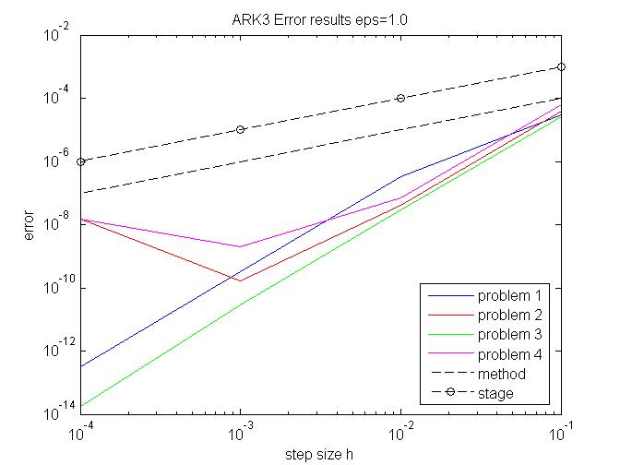
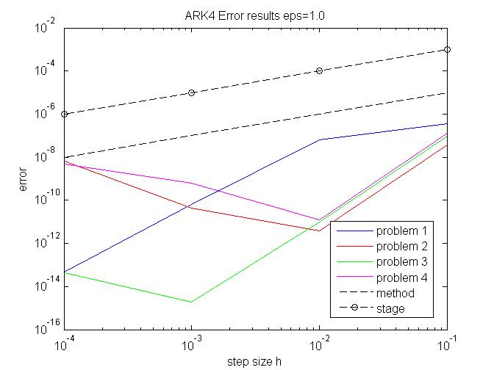
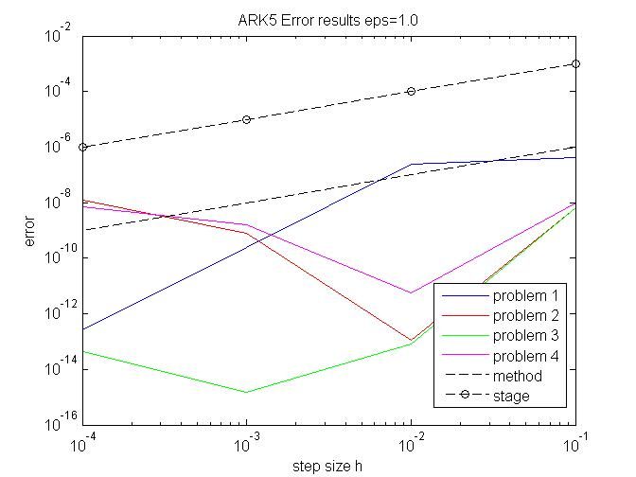

Results $ε=1.0$

Slide 17
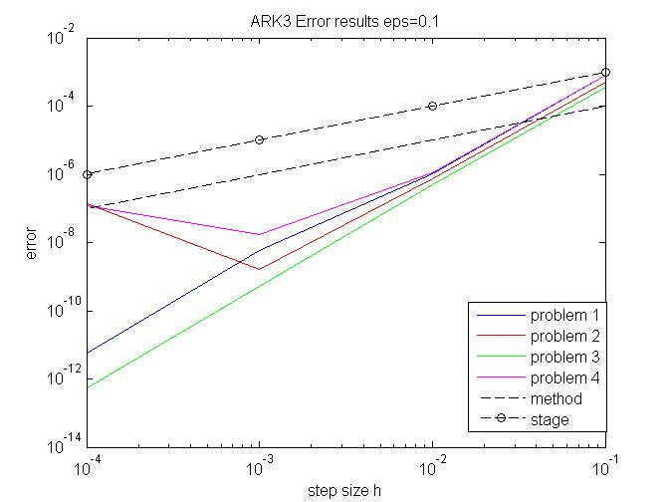
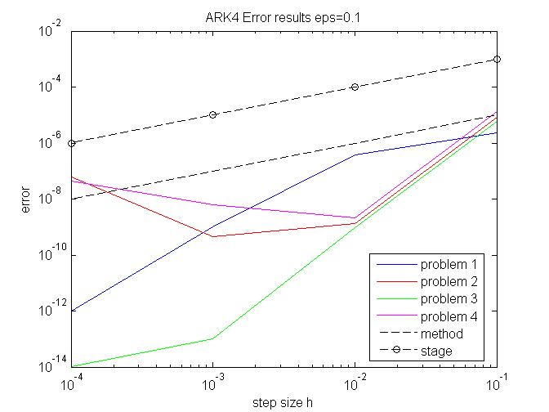
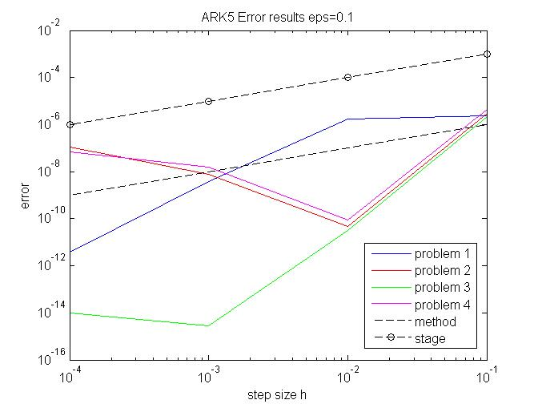

Results $ε=0.1$

Slide 18
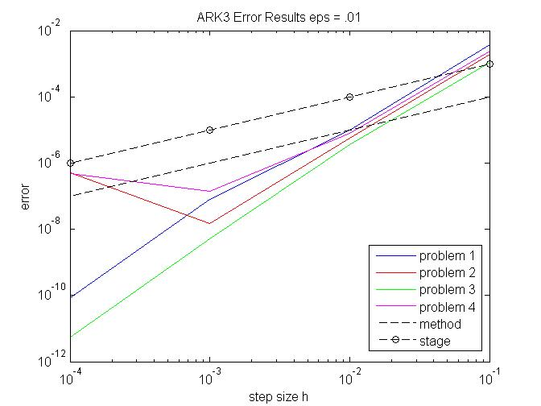
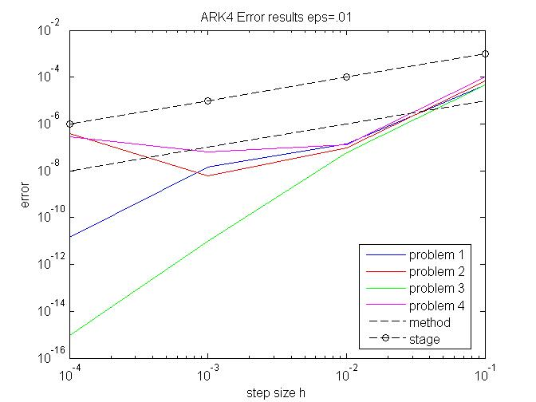
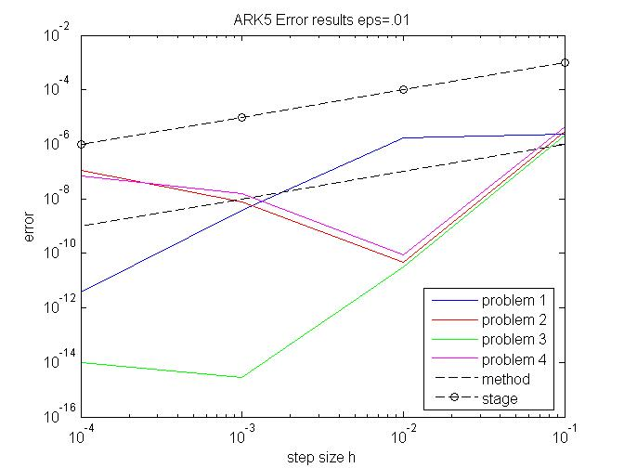

Results $ε=0.01$

Slide 19
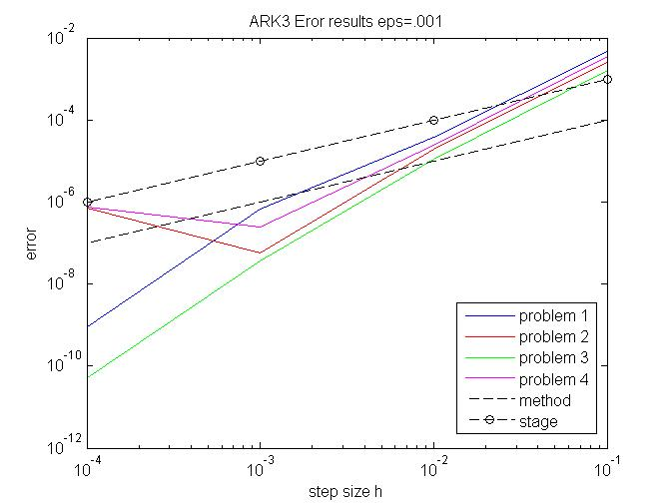
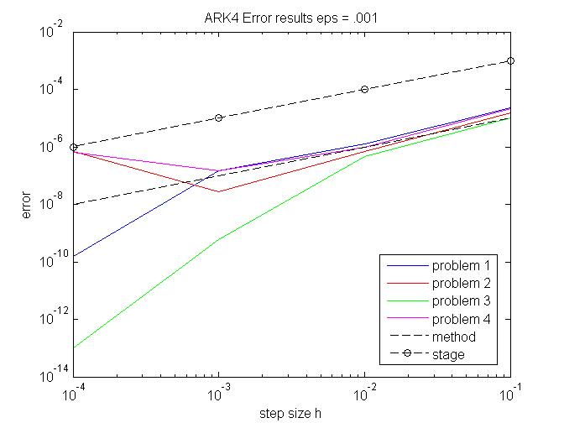
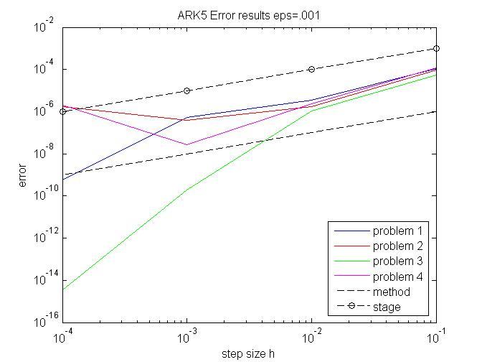

Results $ε=0.001$

Slide 20
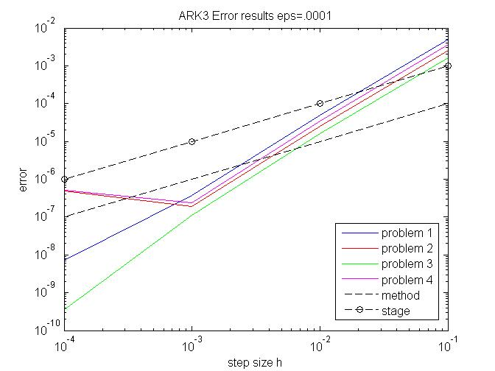
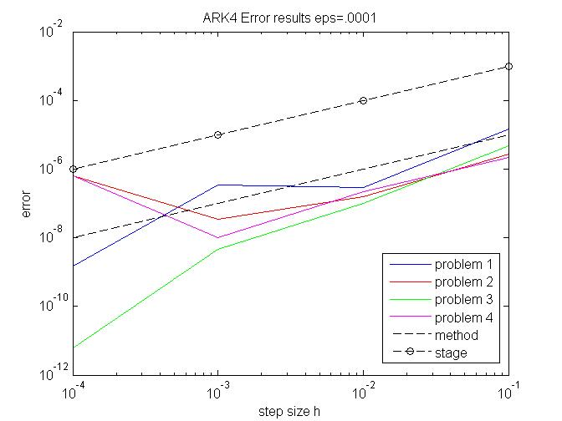
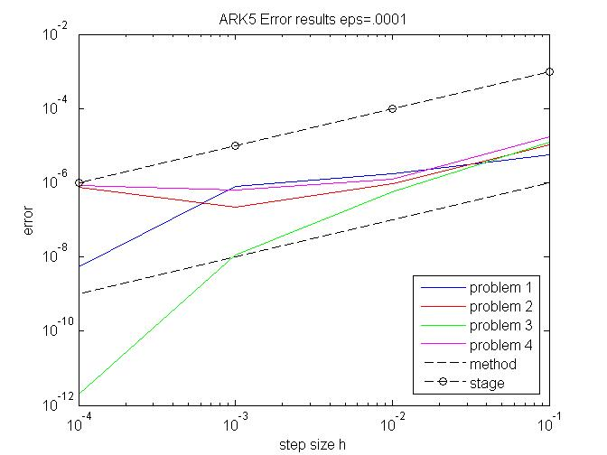

Results $ε=0.0001$

