Slide 1
Movie Genre profitability
Nicholas Gigliotti

Slide 2

The Choice of Genre
Different genres have different production requirements.
Specialized actors
Specialized writers
Specialized designers
Genres vary in popularity and profitability.
Don’t let this decision sneak up on you.

Slide 3
Research Questions
What genres have the strongest correlation with ROI?
How does budget affect these correlations?
Are high or low-budget films more profitable?

Slide 4


Data Sources
Internet Movie Database
Large database
Has genre information
Subsidiary of Amazon
The Numbers
Smaller data collection
Has financial data
Owned by Nash Information Services

Slide 5
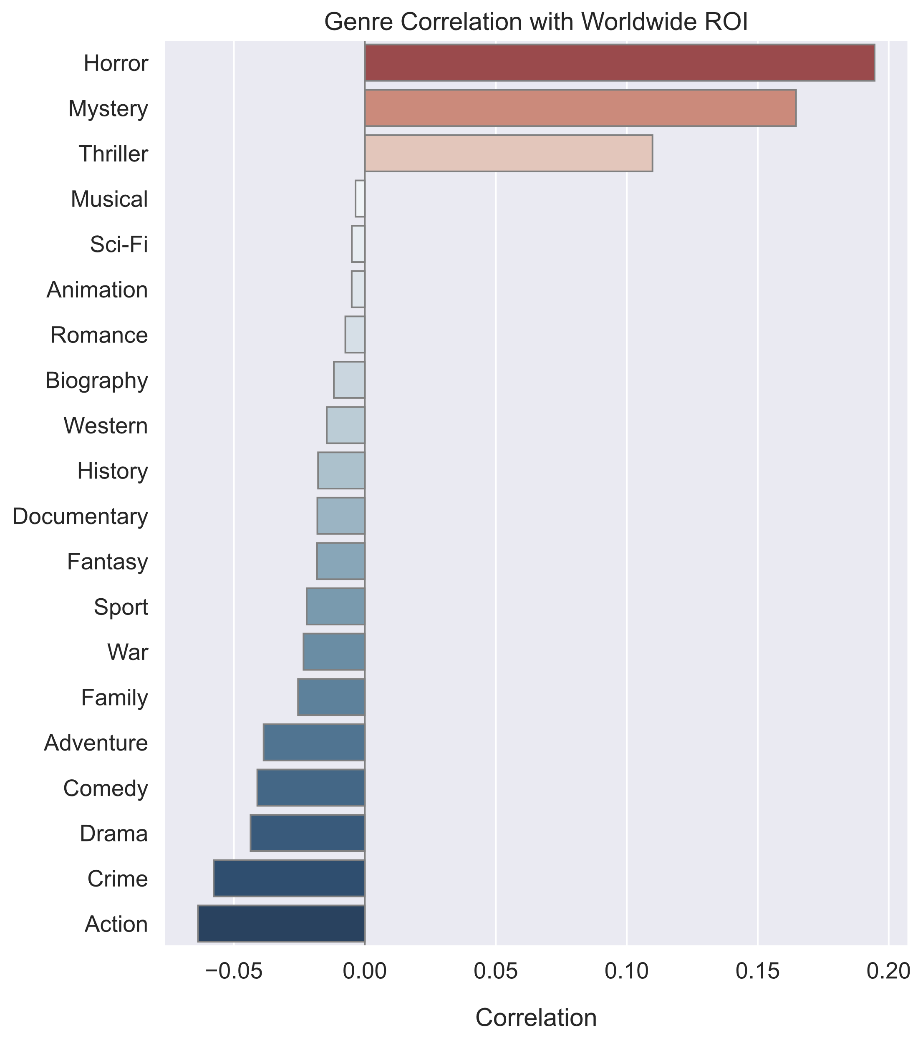
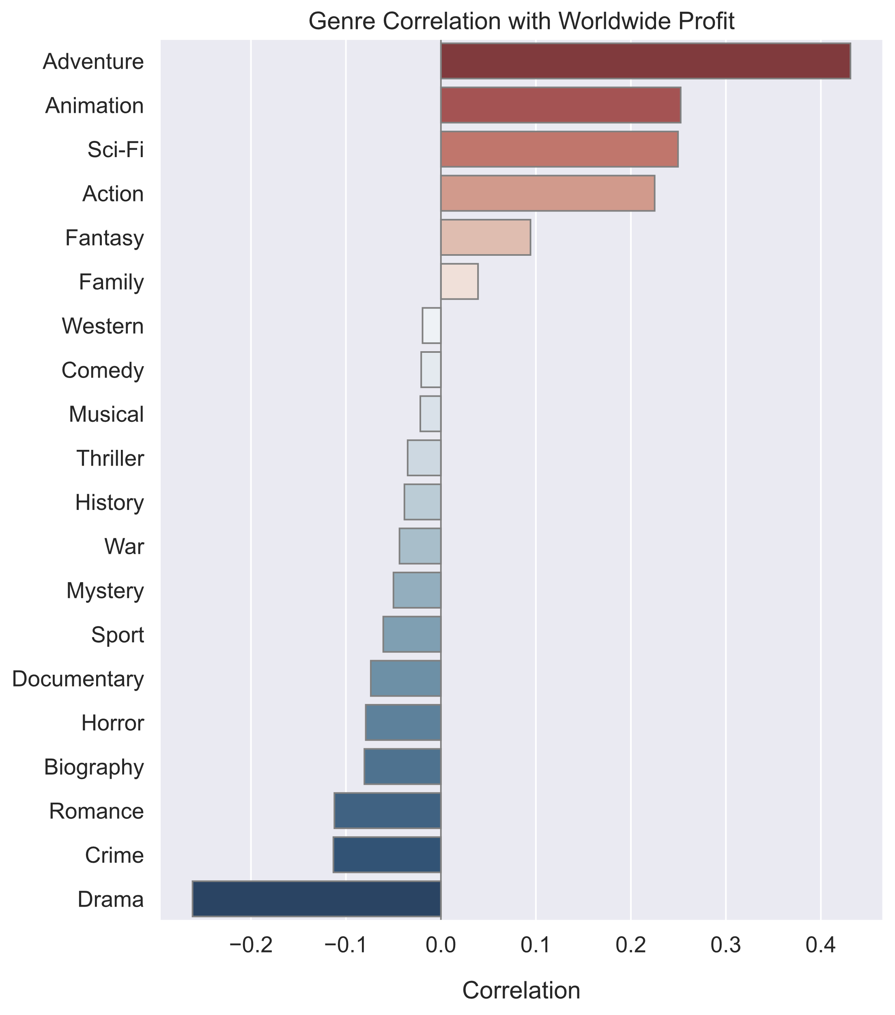

Slide 6
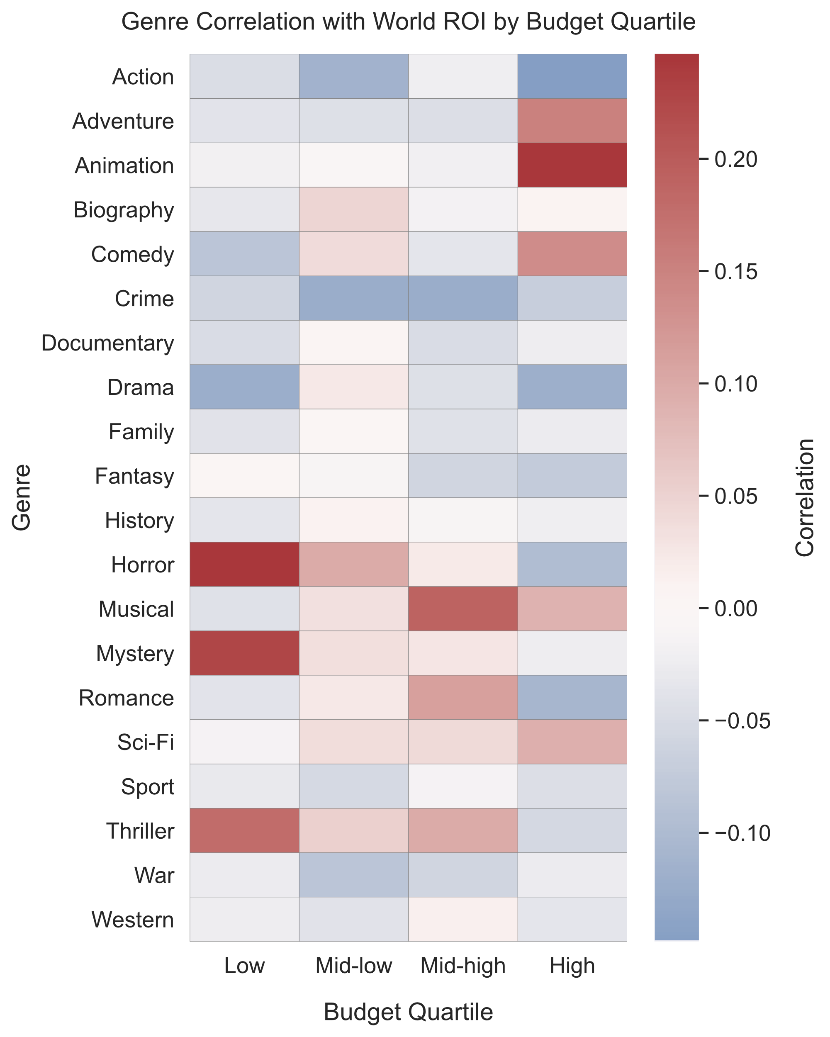
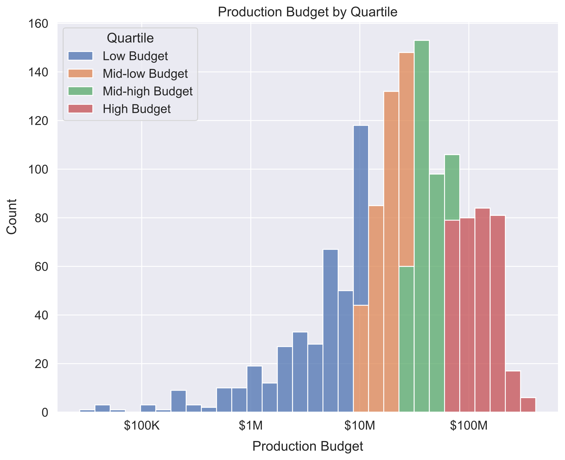

Slide 7
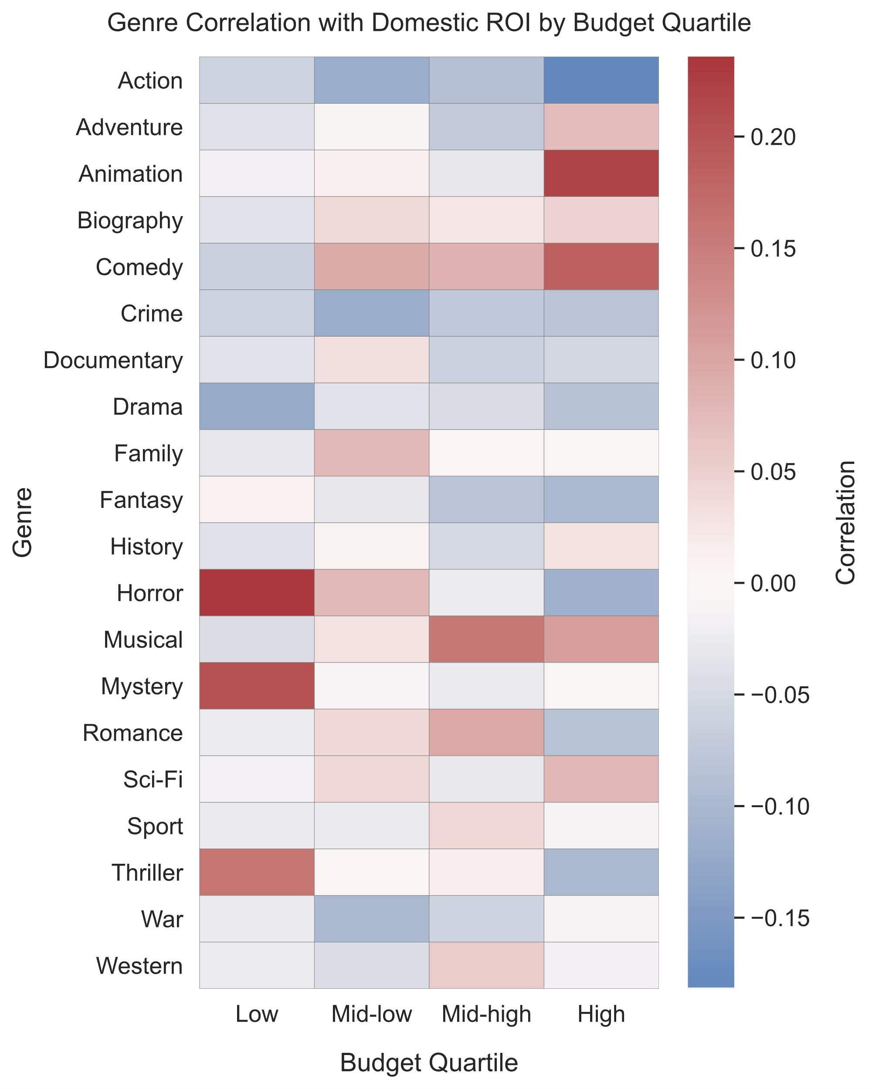

Slide 8
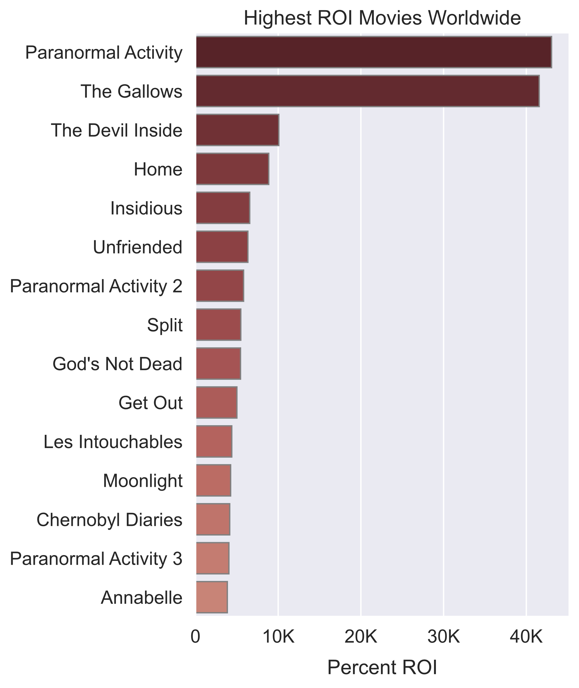
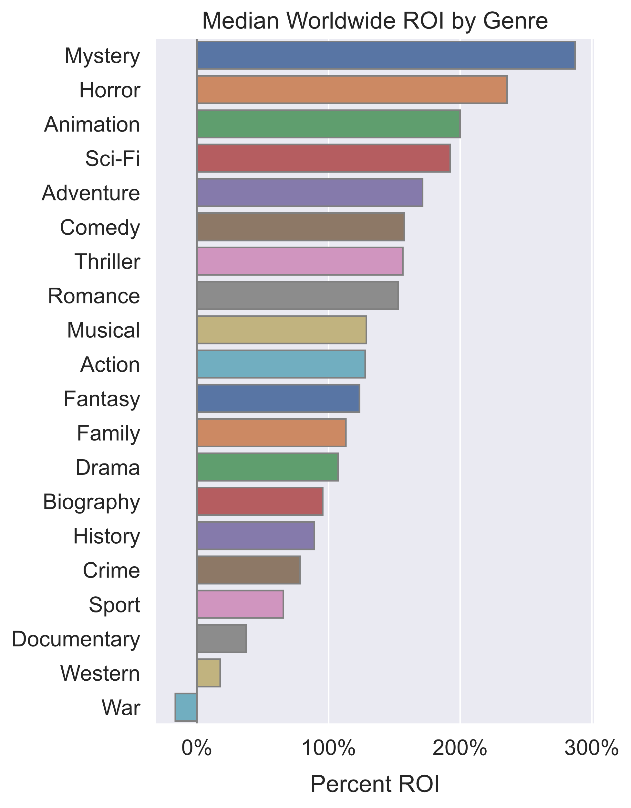

Slide 9
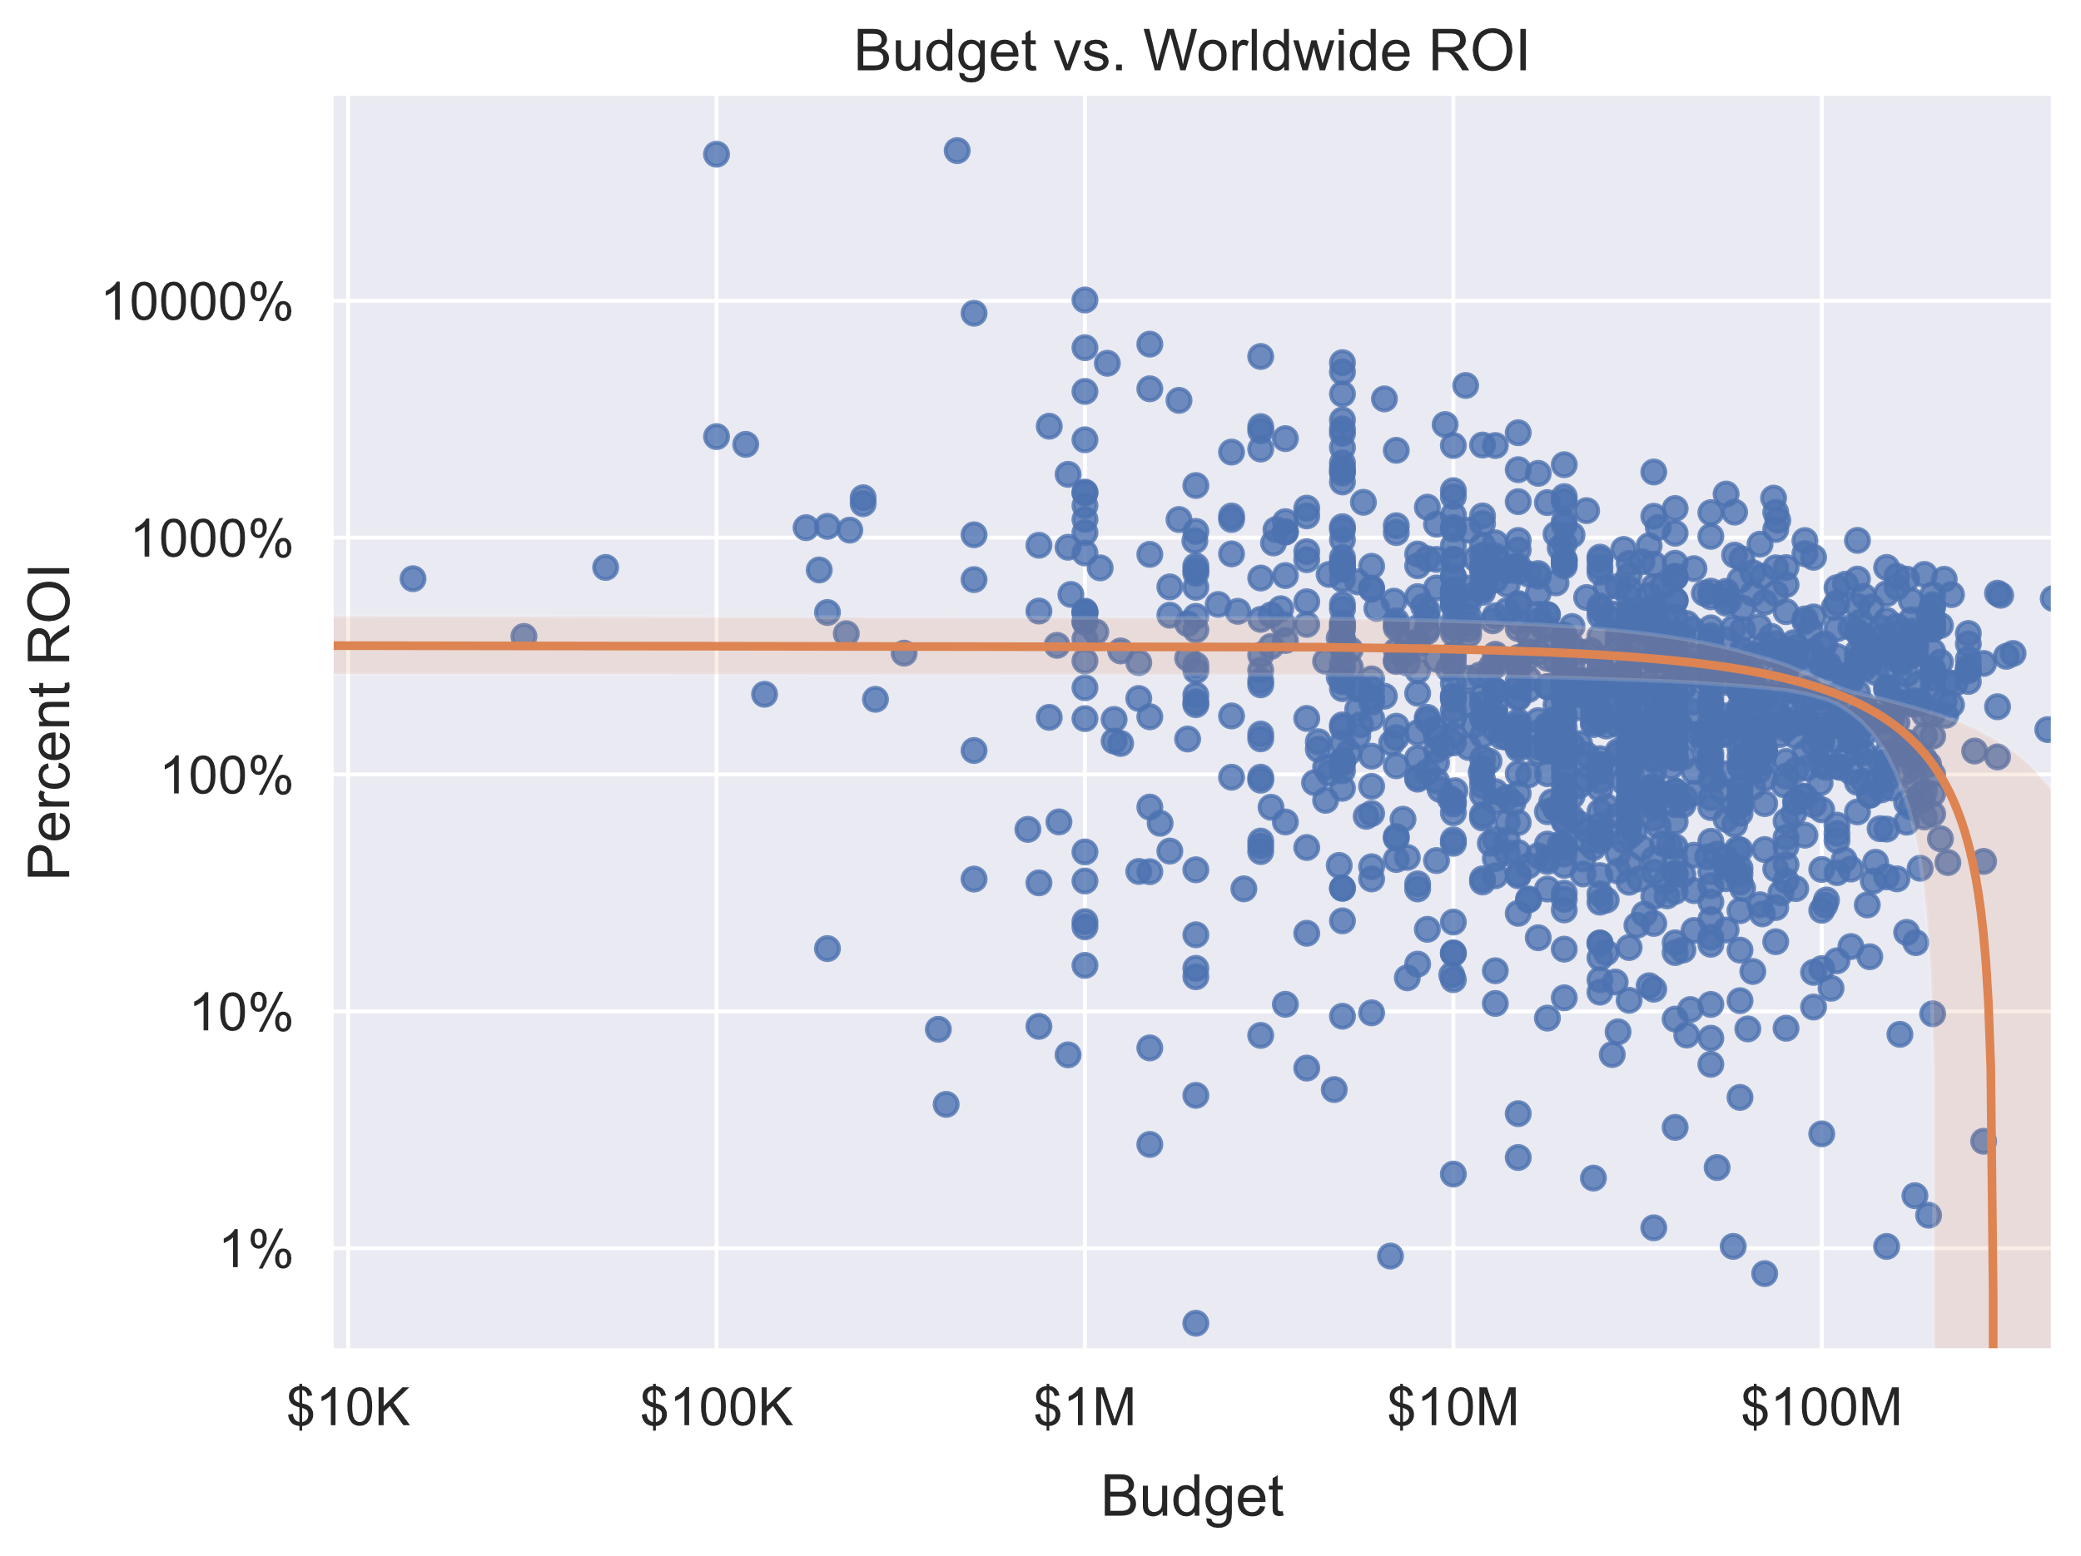

Slide 10
Conclusions
For high-budget productions, go with animation.
For low-budget productions, go with horror.
Stay away from drama, action, and crime.
Keep your movie budgets under $250M.

