Slide 1
Movie Genre profitability
Nicholas Gigliotti

Slide 2
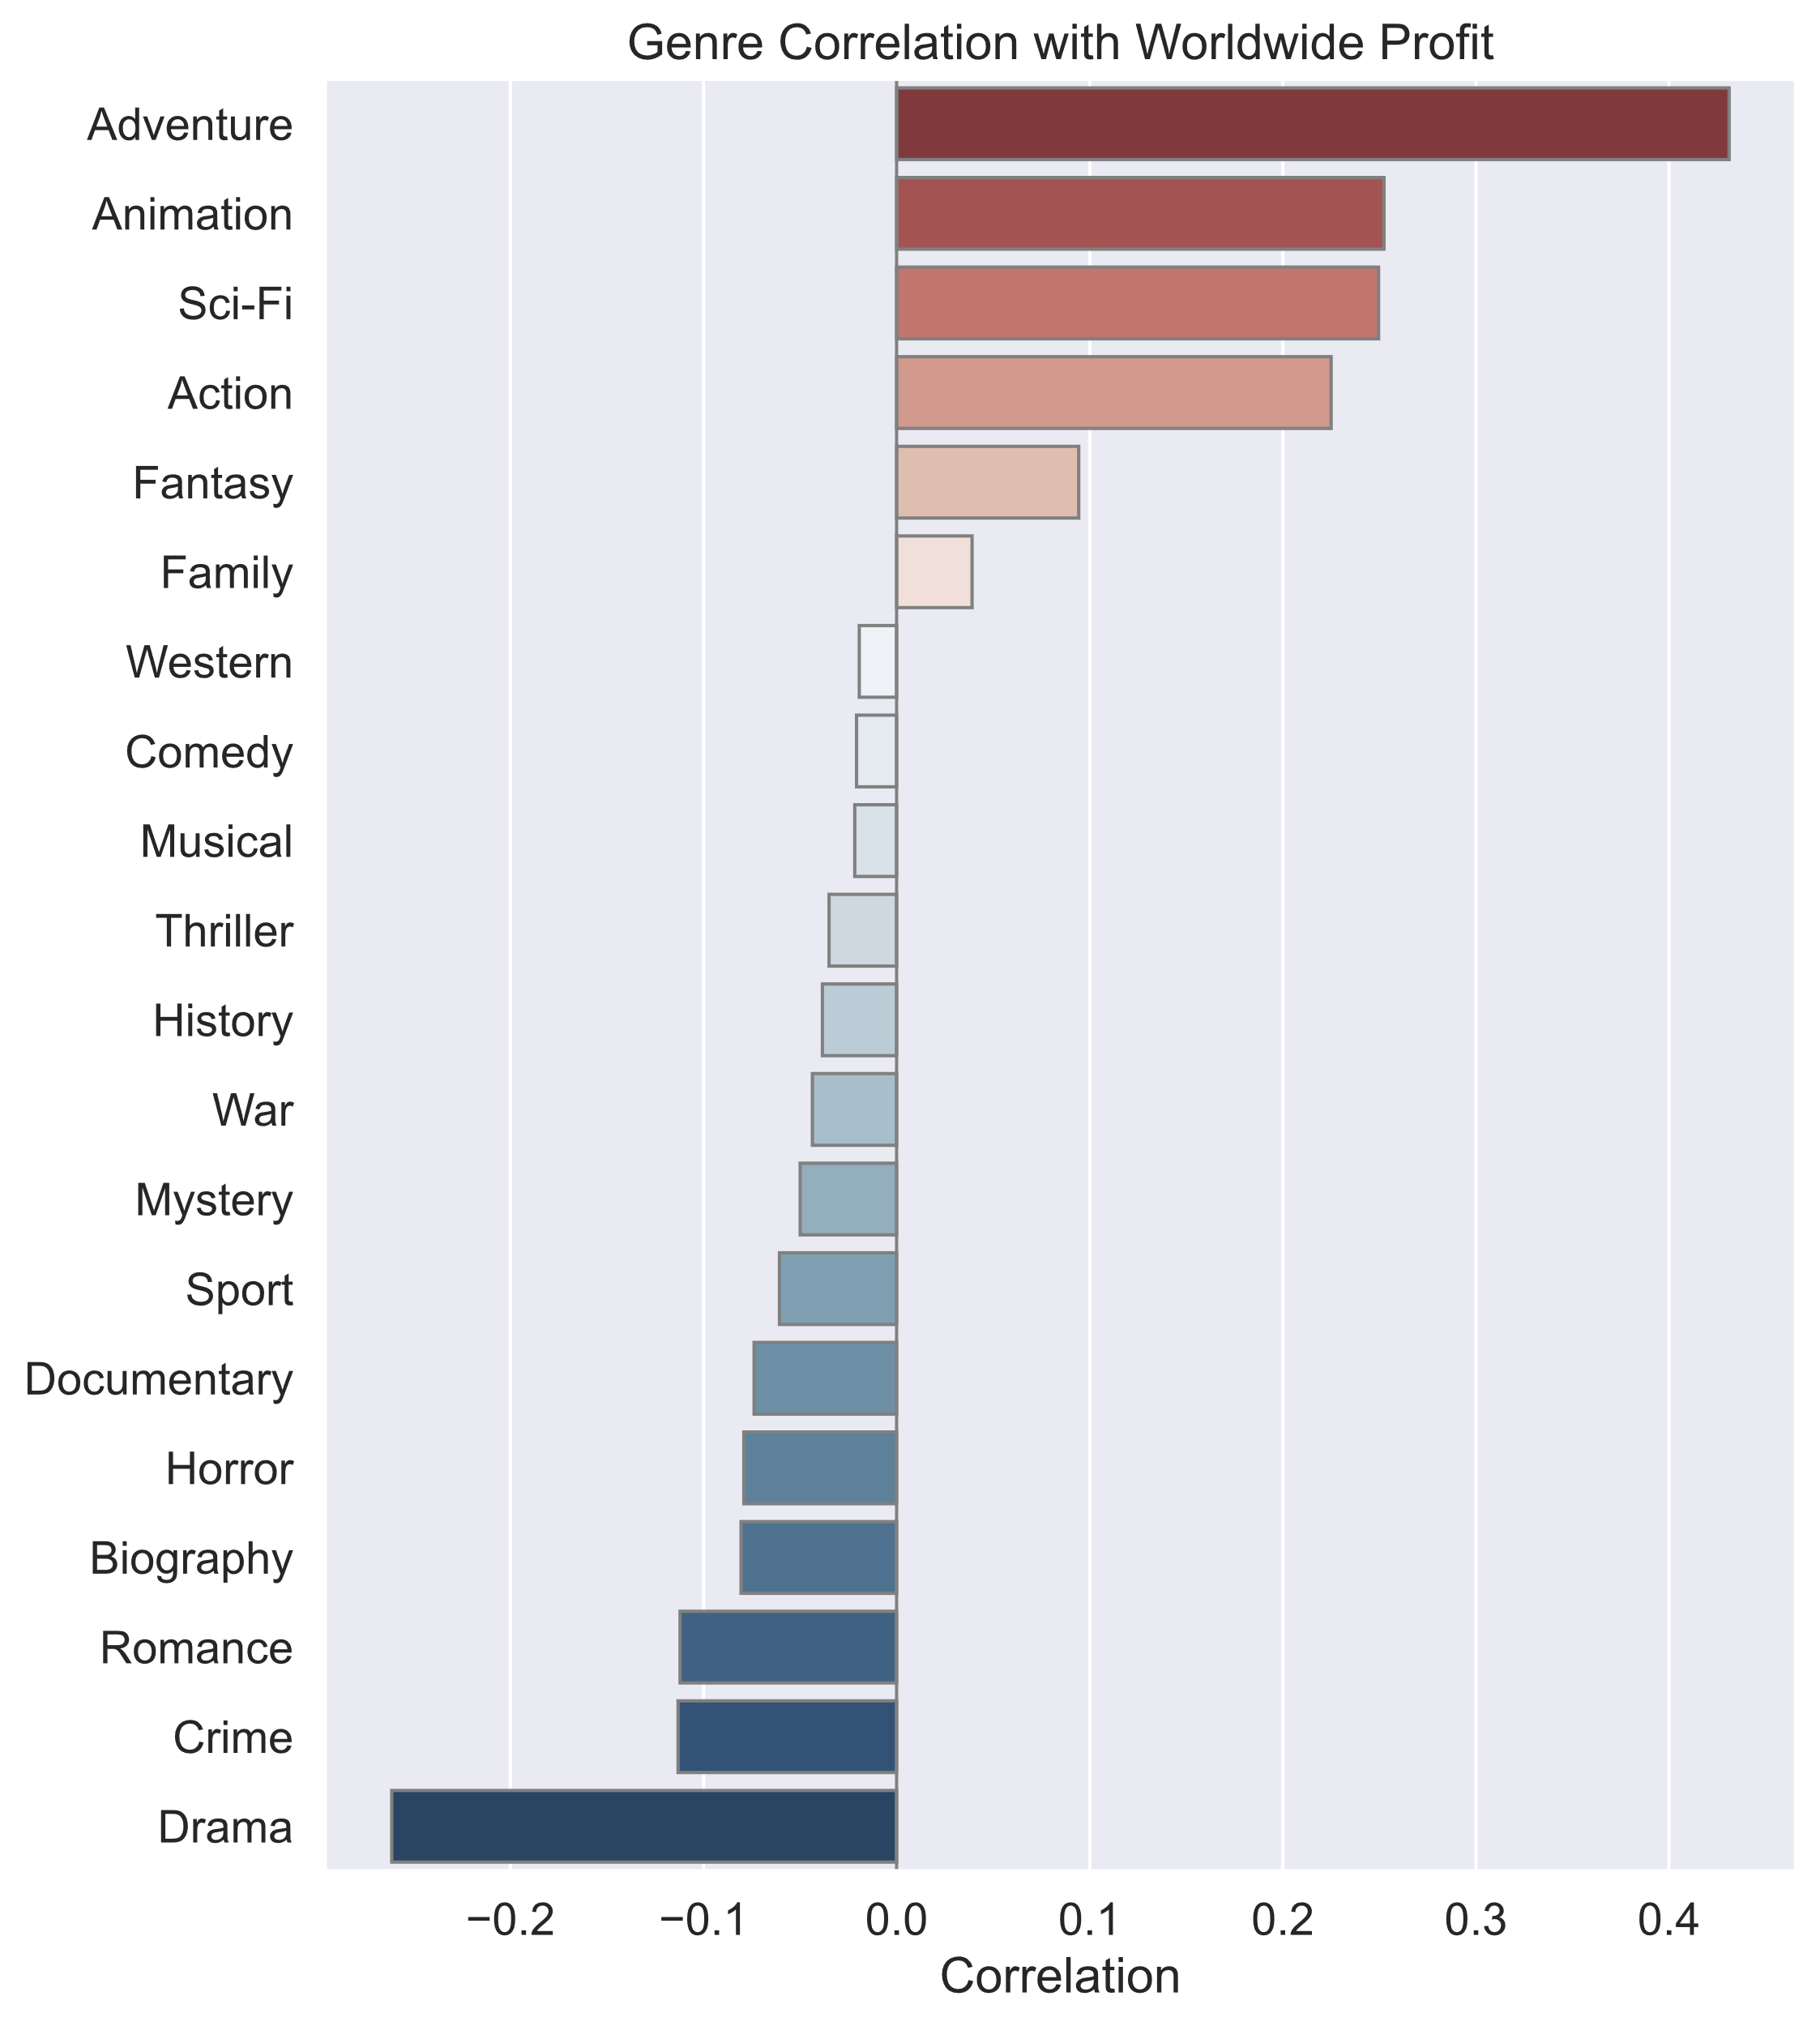
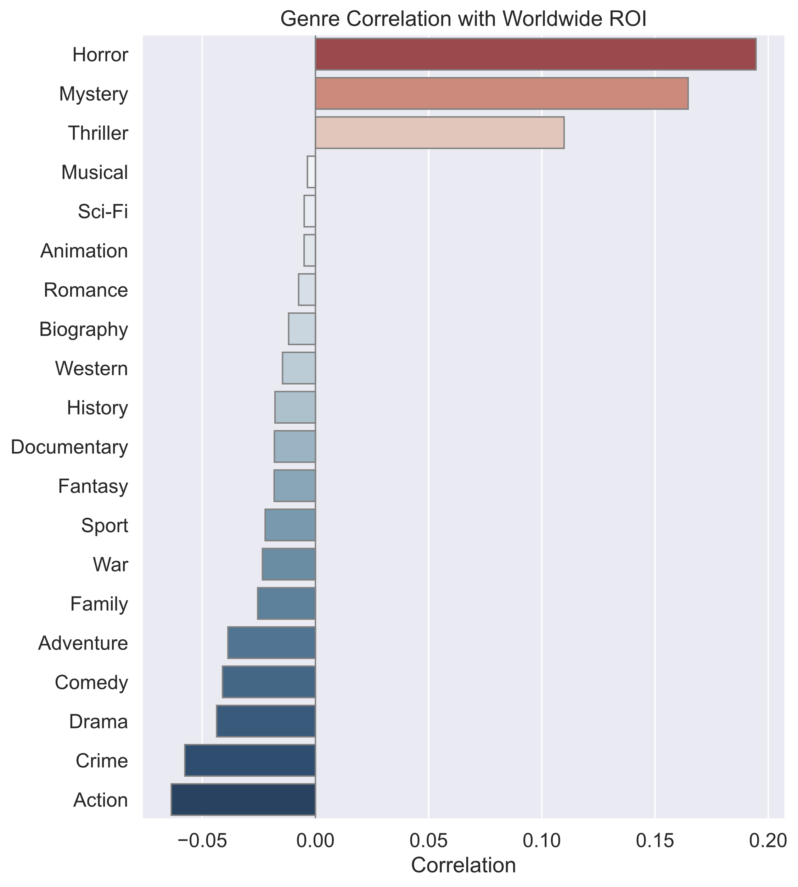

Slide 3
