Slide 1
Movie Genre profitability
Nicholas Gigliotti

Slide 2
Overview
Descriptive analysis of movie genre profitability for Microsoft reveals the most profitable genres by two different measures.
Animation has the best balance of ROI and Revenue
Horror and mystery have the best ROI
Adventure has the best Revenue
Additionally:
ROI was found to drop off for budgets of over $250M.

Slide 3



Data and Methods
Data sources
Internet Movie Database: Genre
The Numbers: Finance
Time period: 2010 – 2019
Pearson Correlation
Used to measure the relationship between genre variables and financial variables
Measures the degree of linearity
Factors in both presence and absence of genre variable
E.g. if non-Crime movies make more profit than Crime movies, Crime will have a negative correlation with profit

Slide 4

The Choice of Genre
Different genres have different production requirements.
Specialized actors
Specialized writers
Specialized designers
Genres vary in popularity and profitability.
Don’t let this decision sneak up on you.

Slide 5
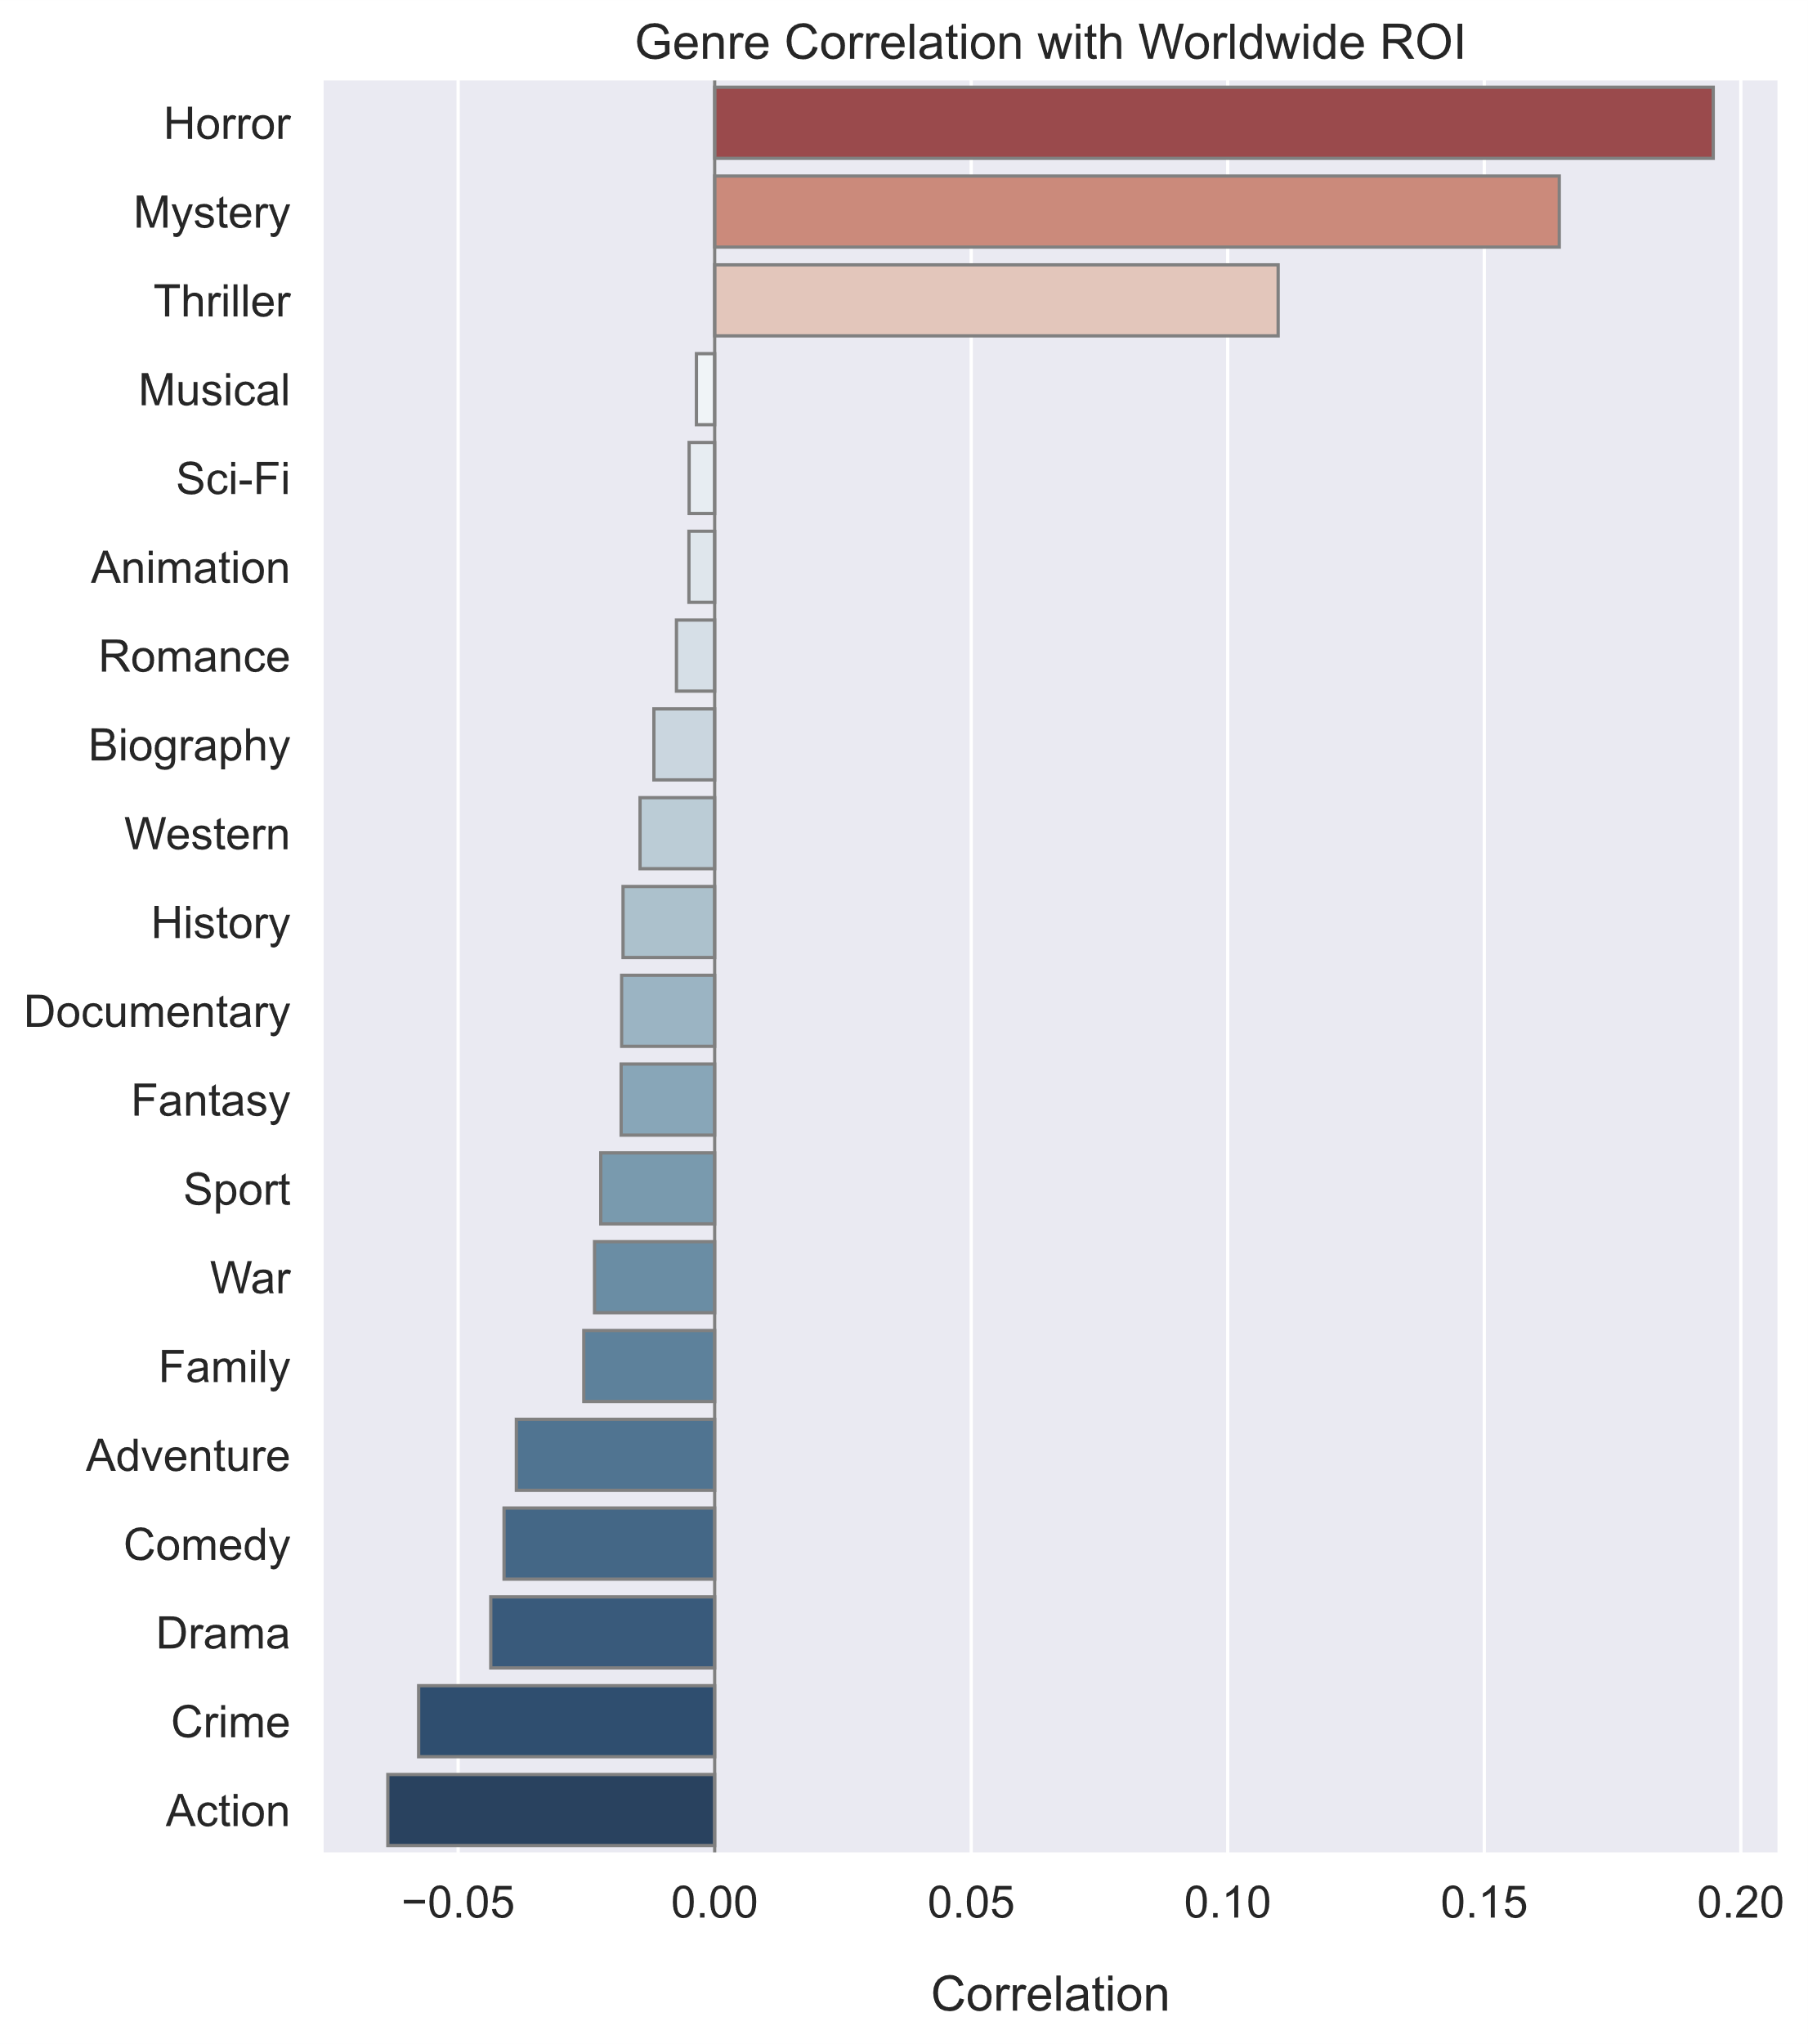
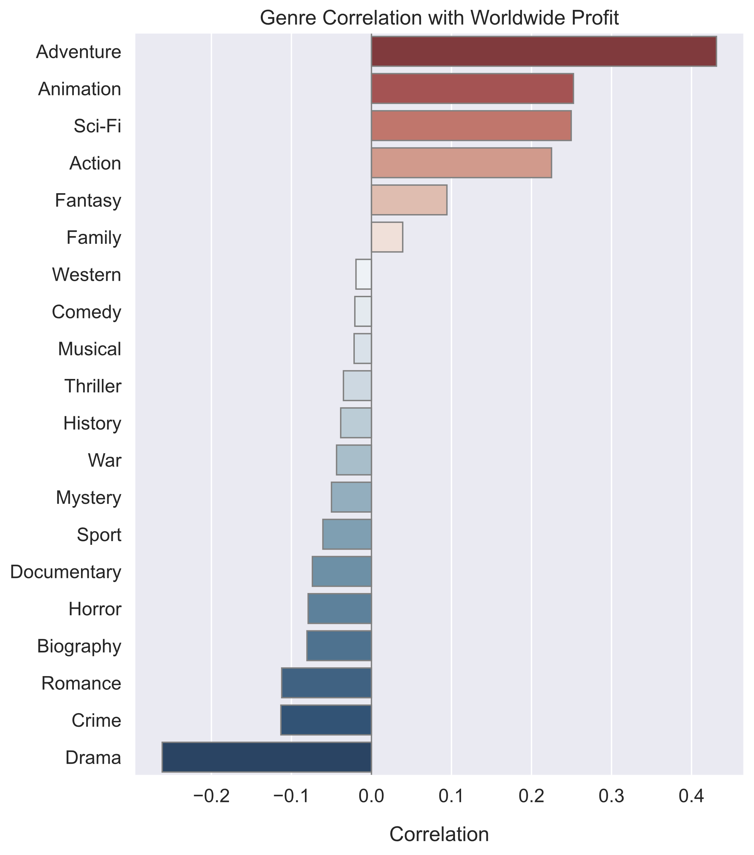
ROI vs. Profit
The difference must be (at least partly) due to budget.

Slide 6
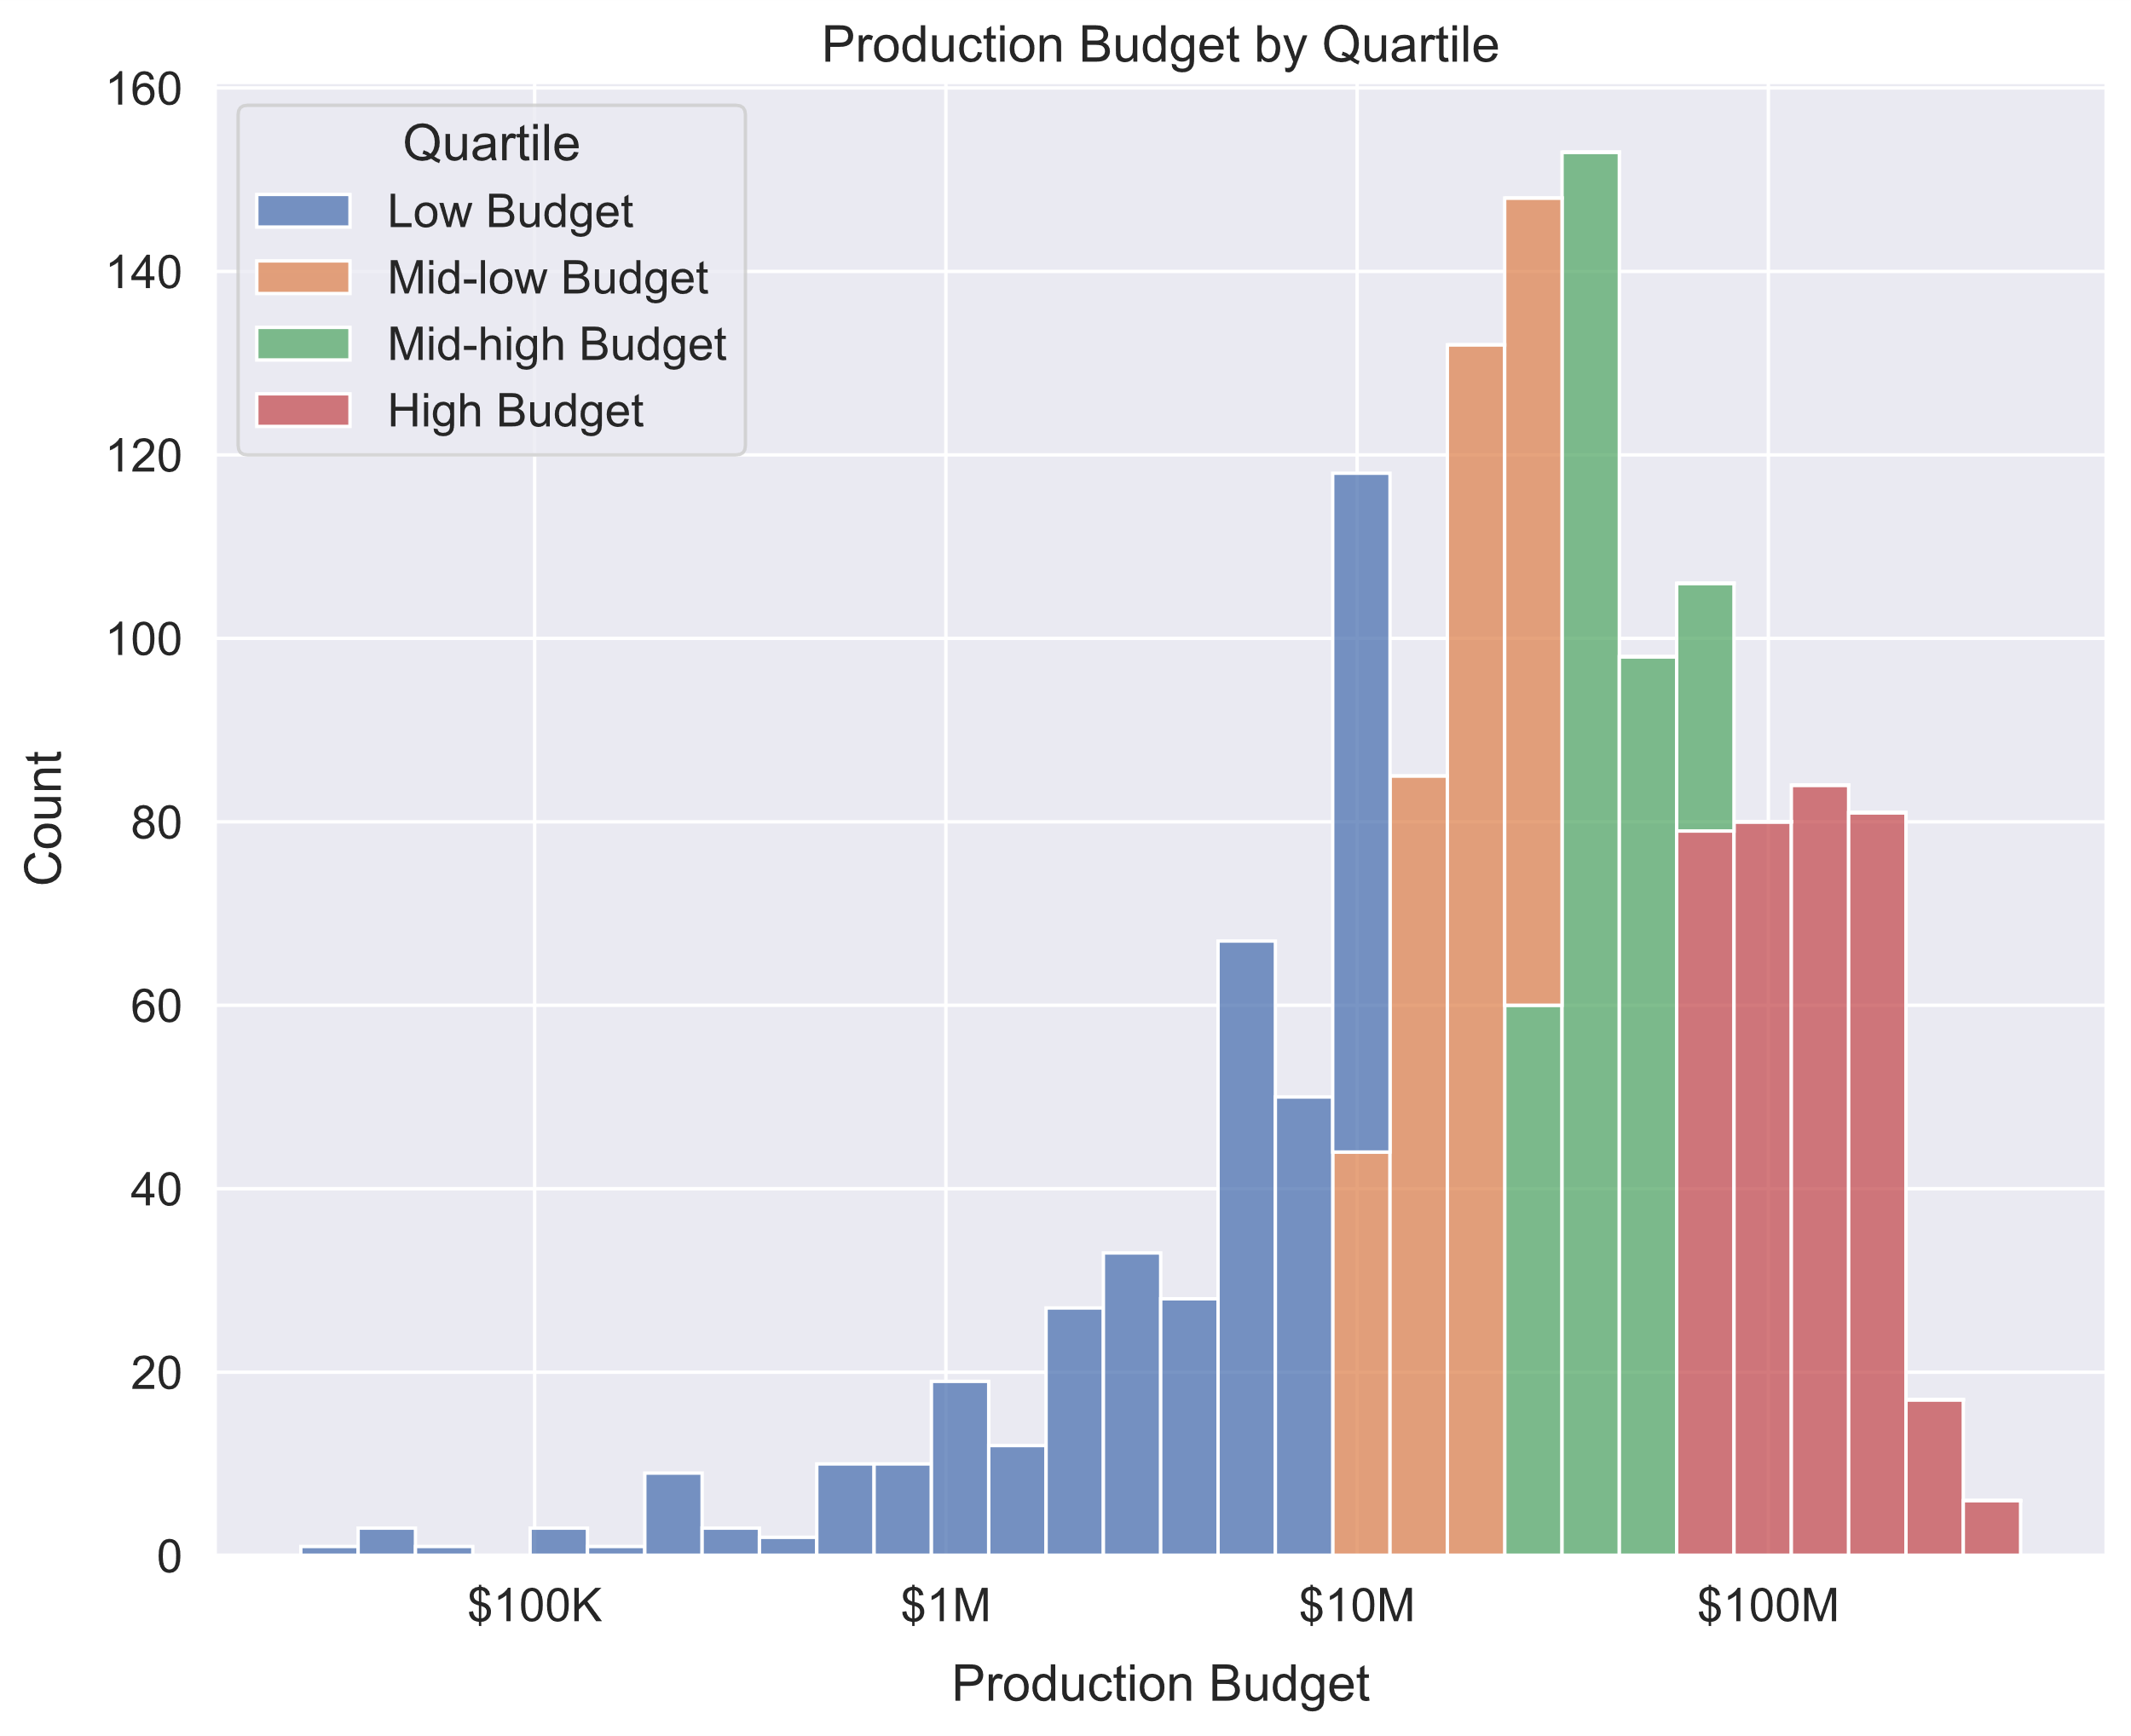
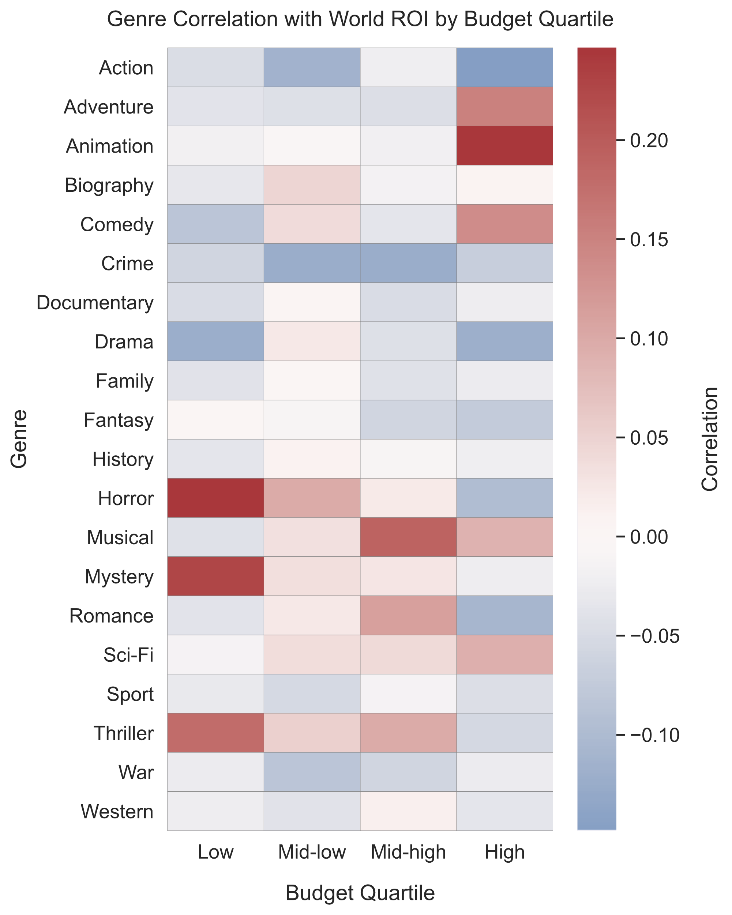
World ROI by Budget
Animation leads High-Budget,
Horror and Mystery lead Low-Budget
The films are evenly divided by budget quartile.

Slide 7
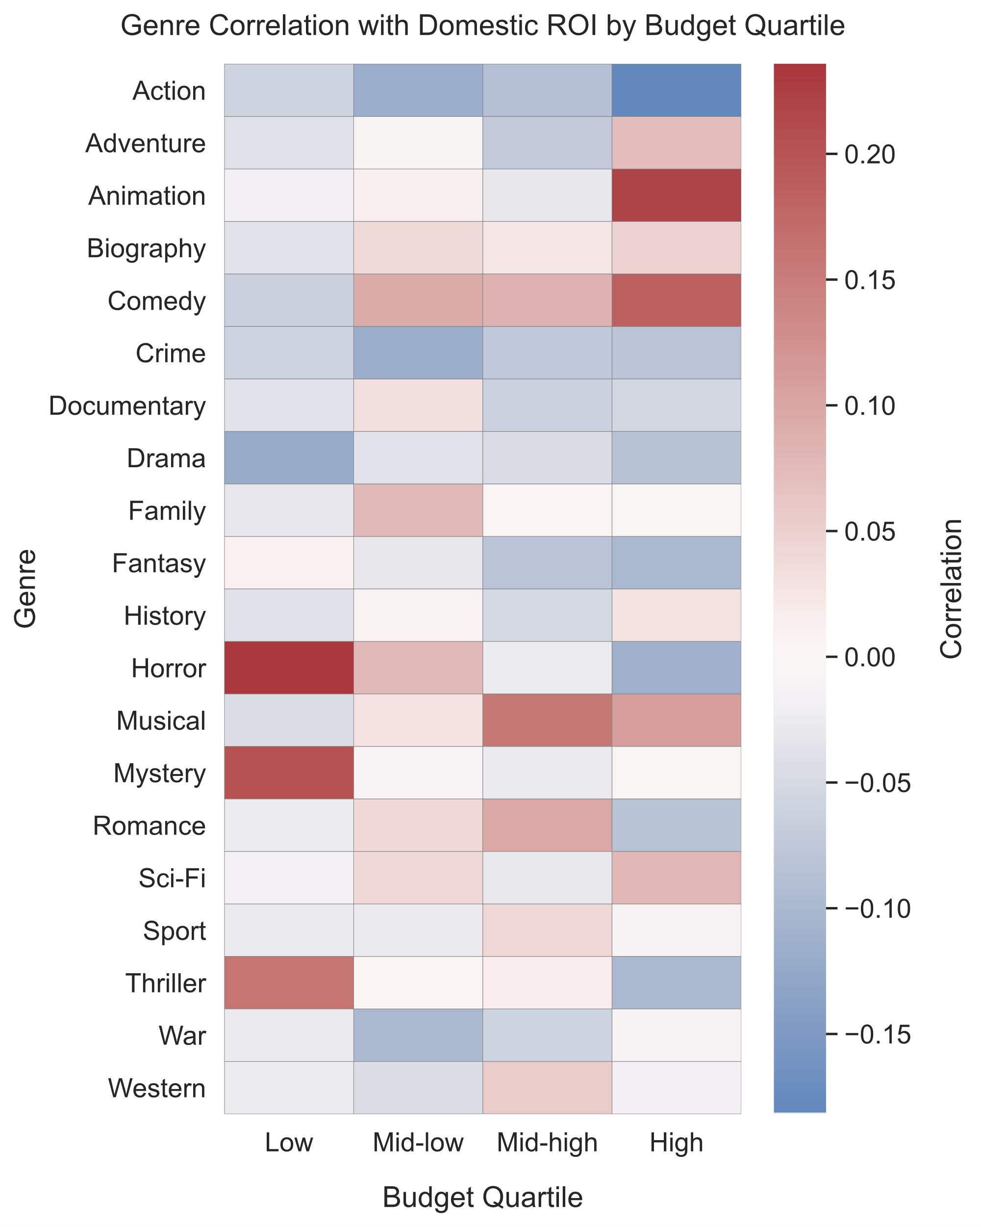
Domestic ROI by Budget
Results are largely the same
Comedy does slightly better
Biography does slightly better
Action, Crime, and Drama are still low

Slide 8
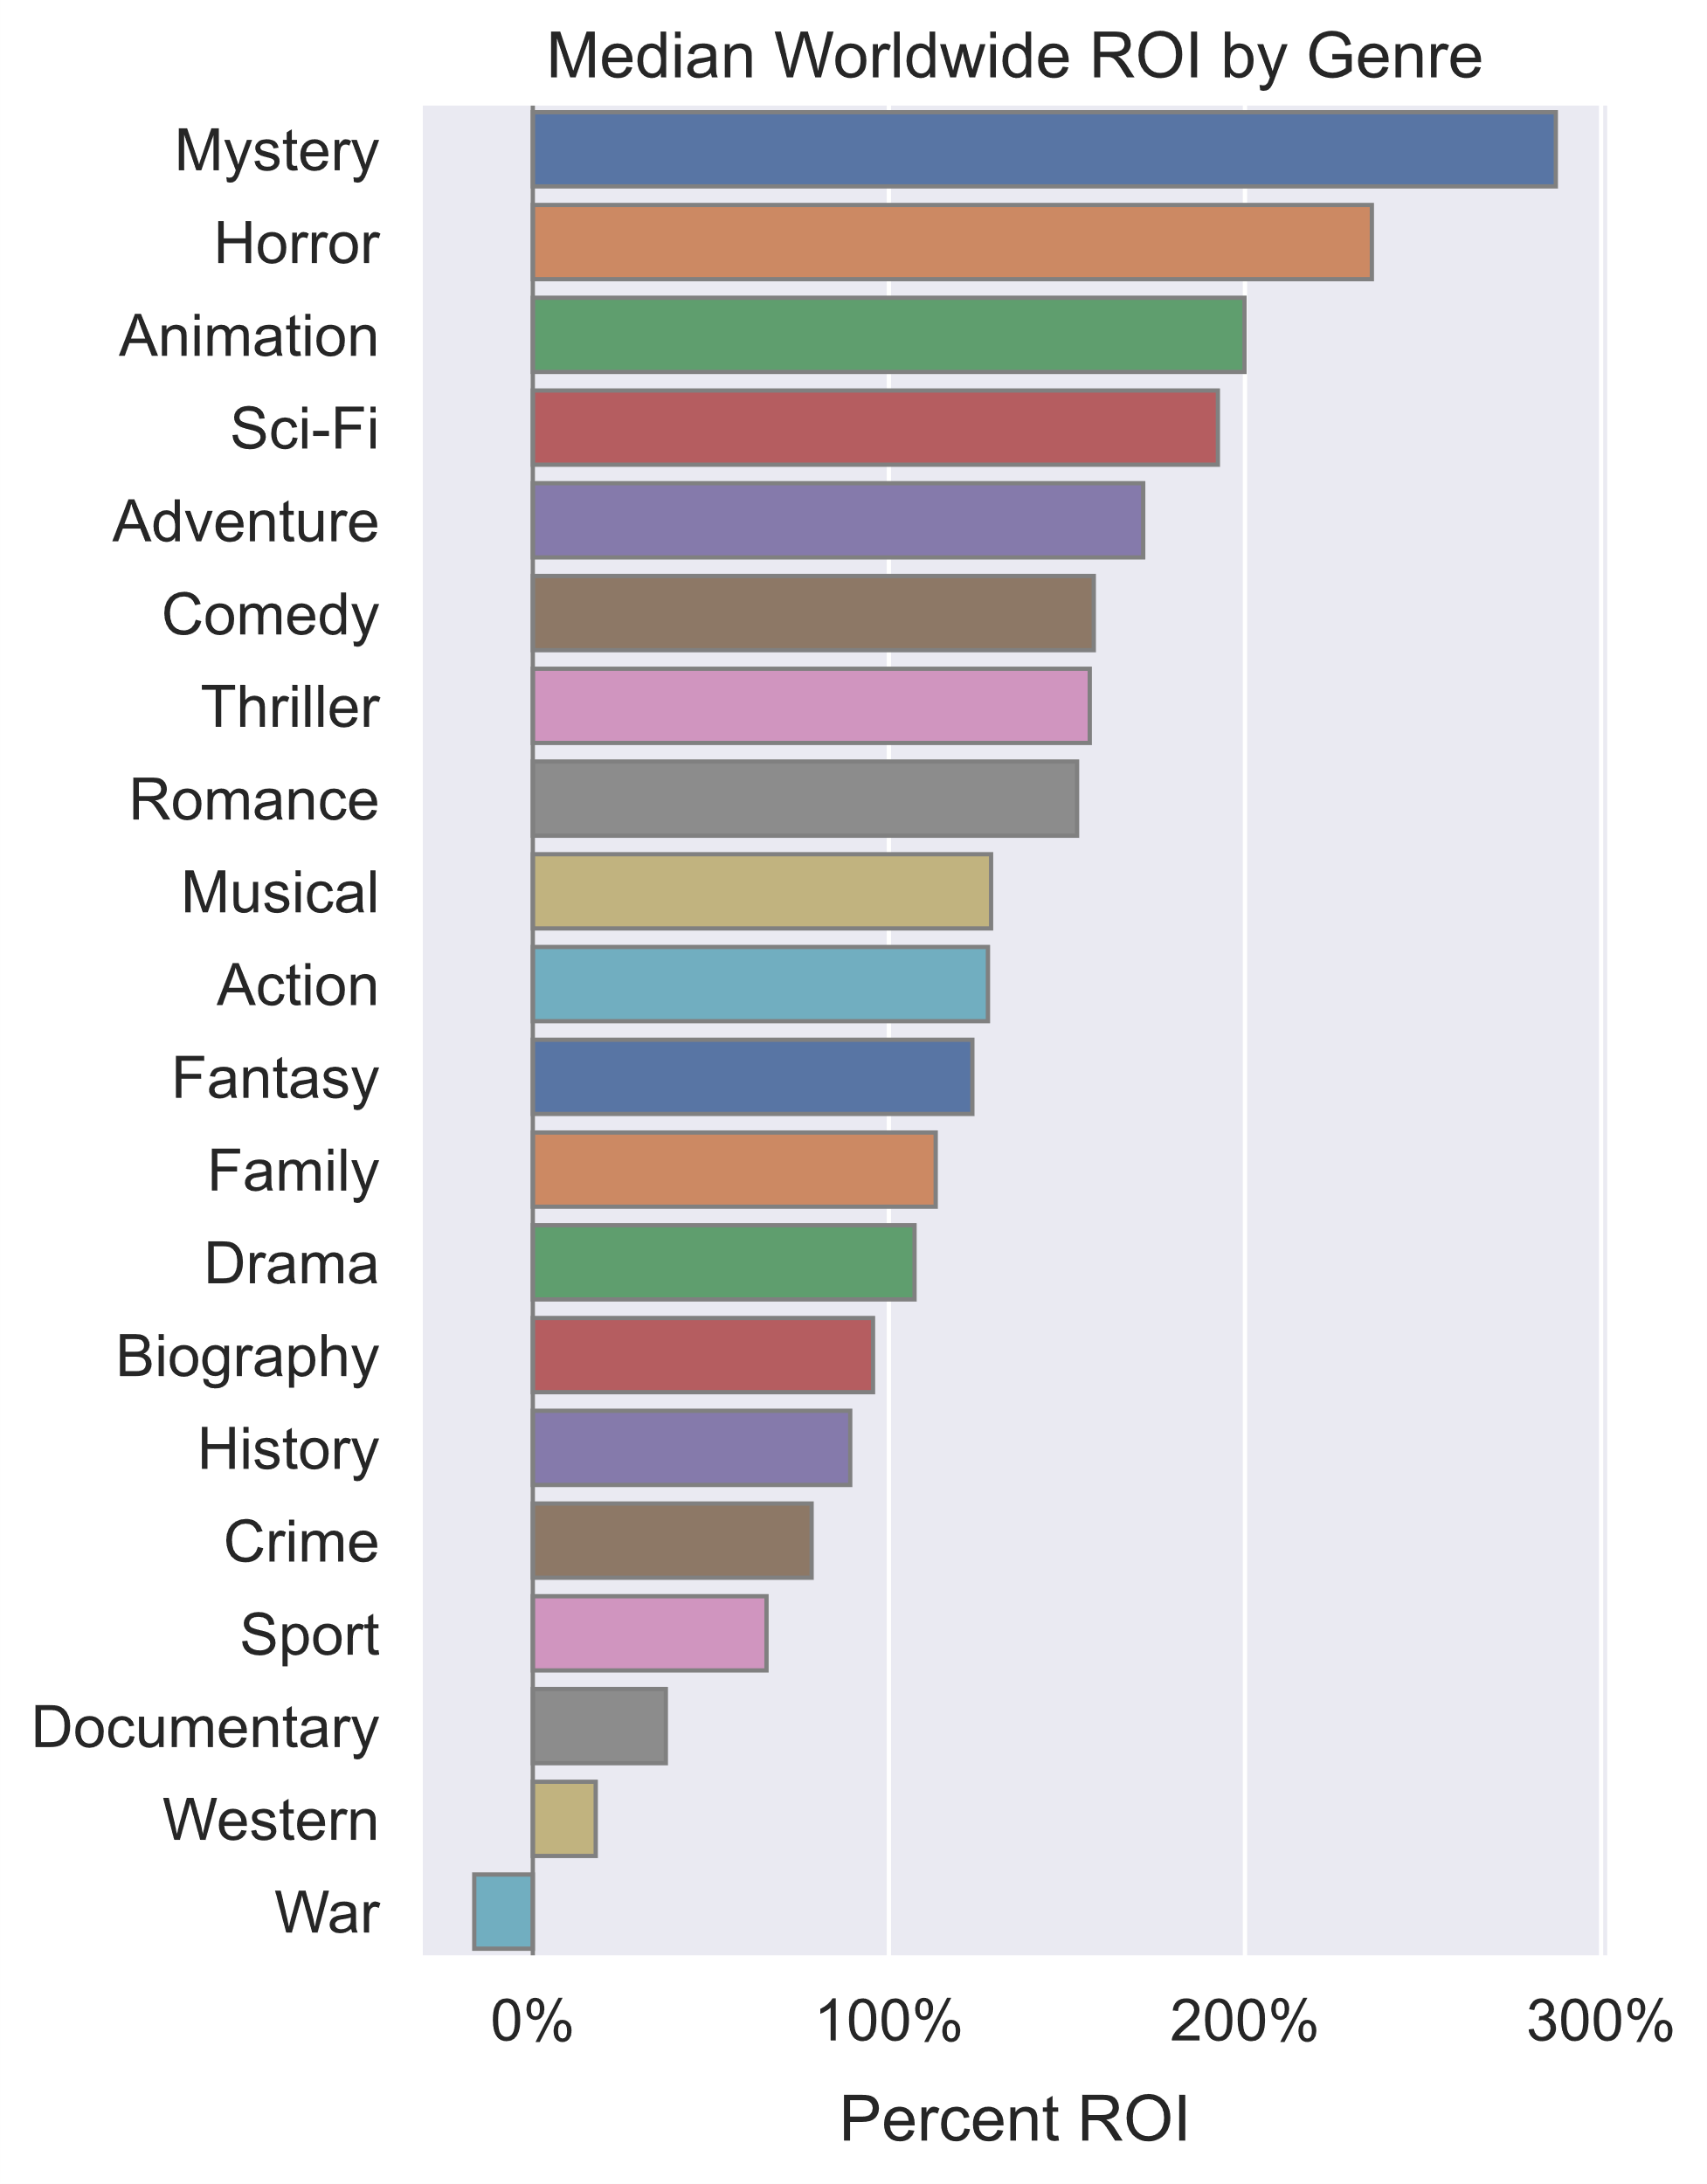
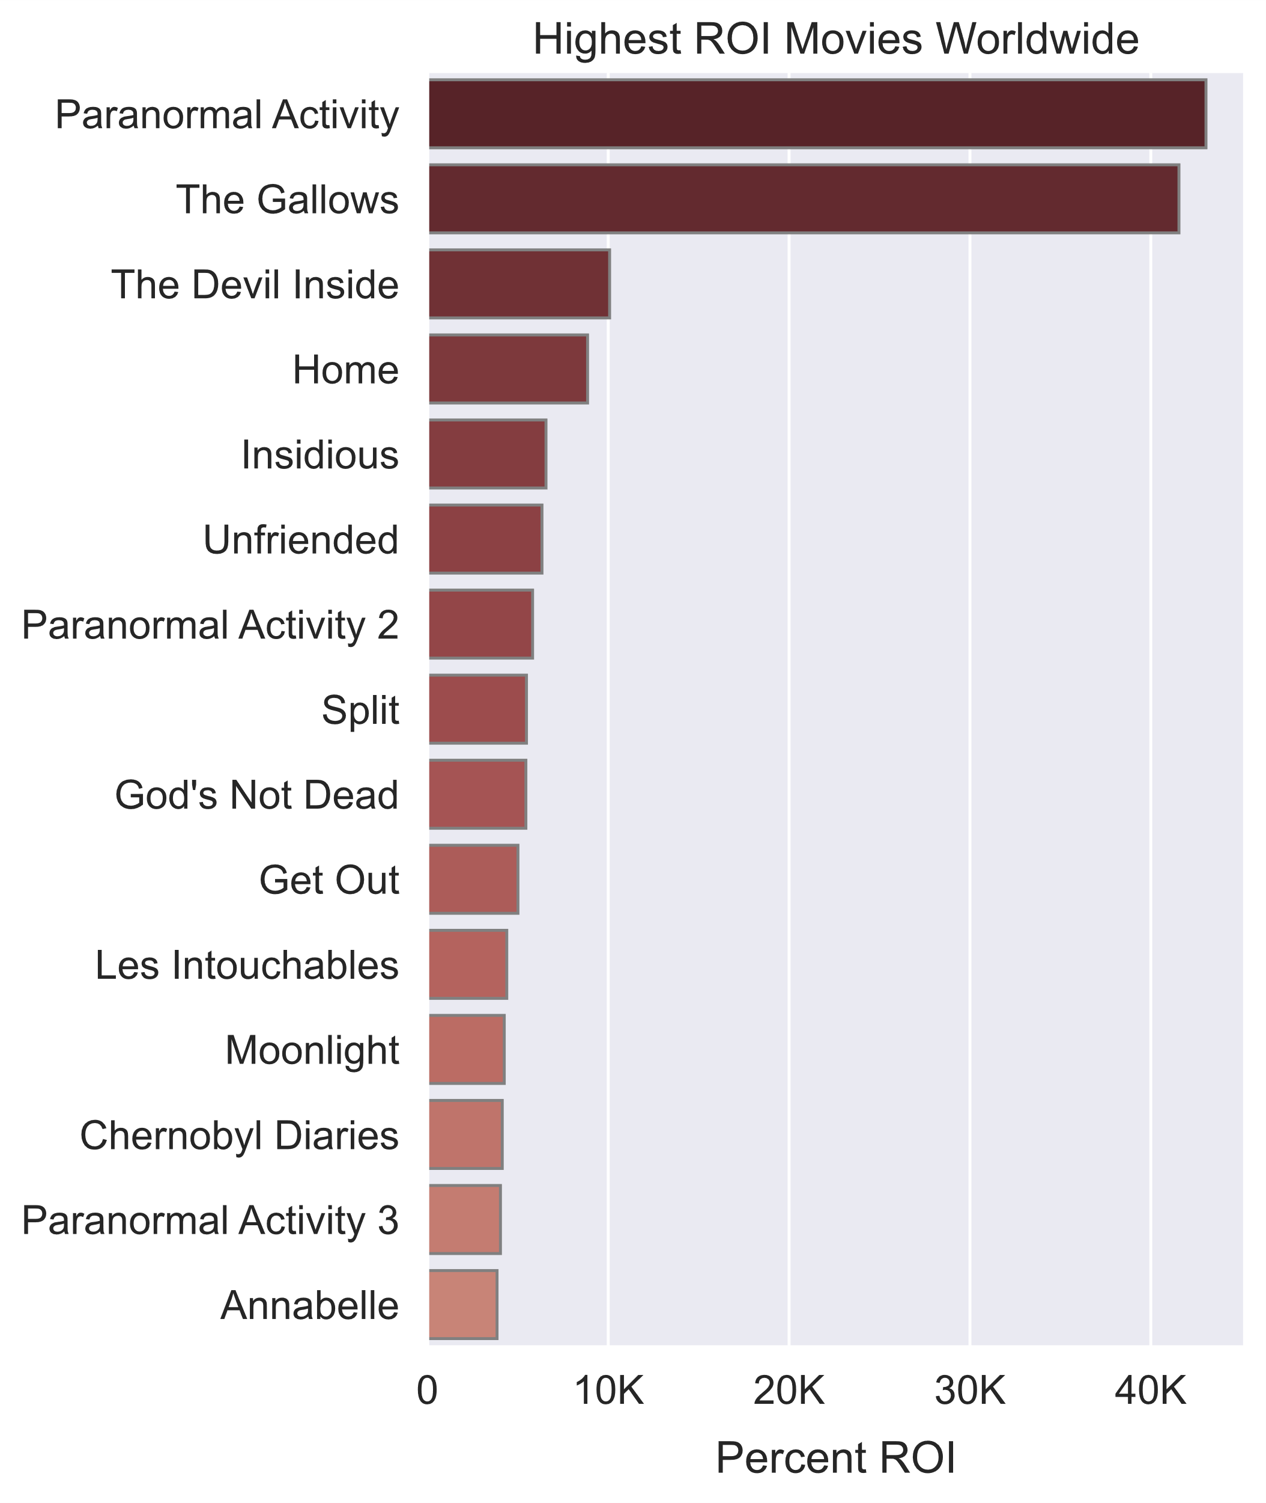
Other Perspectives on World ROI
Horror and Mystery are on top.

Slide 9
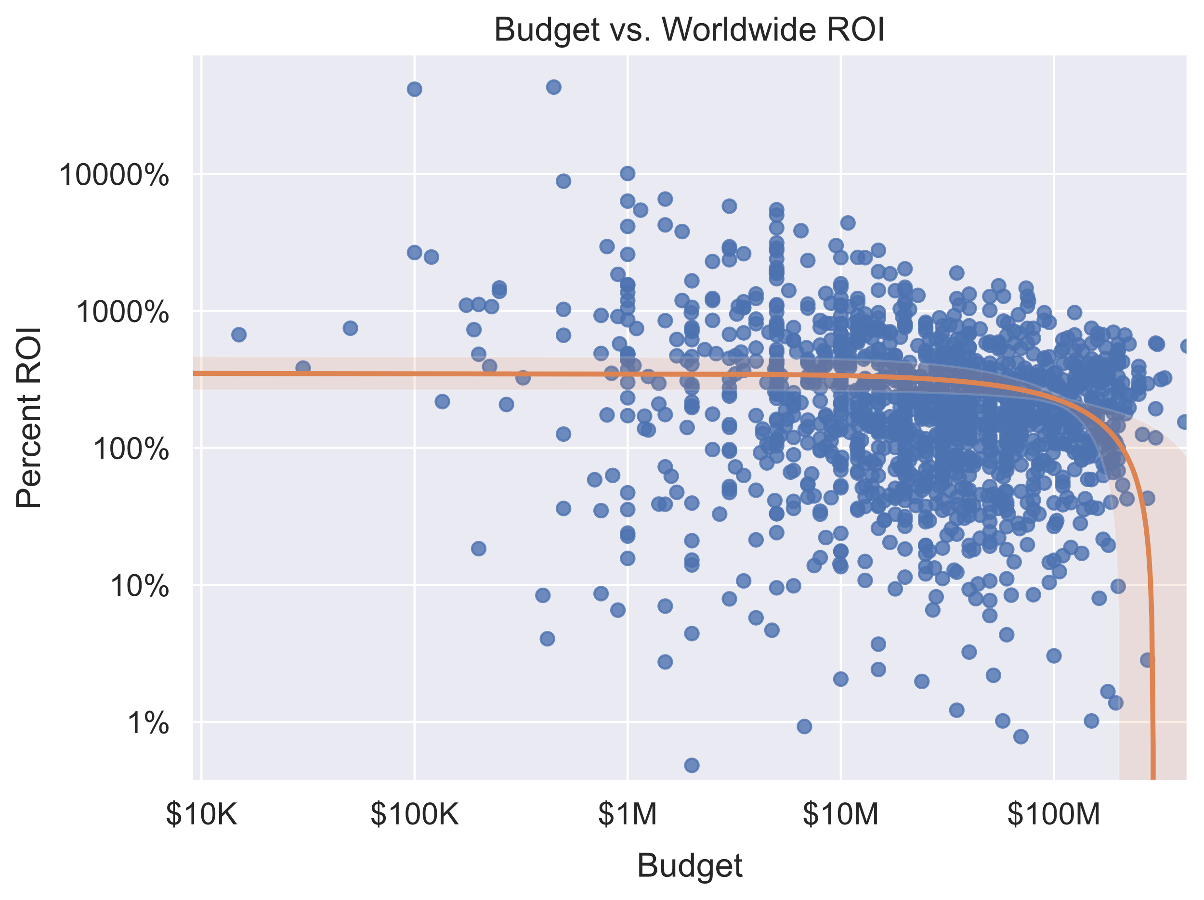
Budget vs World ROI
Regression plot on a log scale
Not much of a correlation, but…
Sharp drop off around $250M
Recommend avoiding extremely high budgets

Slide 10
Conclusions
For high revenue and high ROI, go with Animation.
For maximum ROI, go with Horror and Mystery.
For maximum revenue, go with Adventure.
Stay away from Drama, Action, and Crime.
Keep your movie budgets under $250M.

Slide 11

Next Steps
Reproduce analysis with The Movie Database genre data
Join tables using fuzzy string matching
Consider other factors
Cast and crew
Time of year

Slide 12
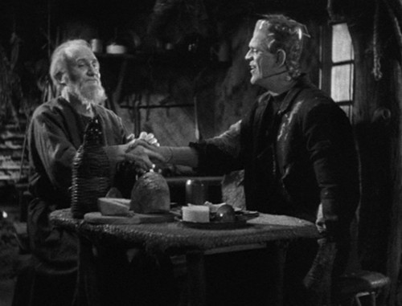
Thank you!
Email: ndgigliotti@gmail.com
GitHub: @ndgigliotti

