Slide 1


Predicting Bank telemarketing Sales
Nick Gigliotti

Slide 2
Business Problem
Banco de Portugal hired me to develop an accurate predictive model to predict which customers are likely to invest in a term deposit as a result of telemarking.
Telemarketing is hard on both salespeople and customers.
Connecting with the wrong customers irritates them and produces no profit.
Connecting with high—potential customers increases profit and customer satisfaction.

Slide 3

Dataset
Bank telemarketing dataset
Collected by an anonymous Portuguese retail bank
Publicly available on the UCI Machine Learning Repository
Compiled in 2014 by:
Sérgio Moro (ISCTE-IUL),
Paulo Cortez (Univ. Minho)
Paulo Rita (ISCTE-IUL)
Collected from May 2008 to November 2010
Date is not provided
Samples are ordered by date (nevertheless)
Originally contains 21 features and 41k samples
Roughly two thirds categorical and one third numeric
Supplemented with economic context indicators
Sourced from Banco de Portugal

Slide 4

Feature Explanations
Client Information
age — years
job — type of job
marital — marital status
education — level of education
housing — has housing loan
loan — has personal loan
Current Campaign
contact_cellular— last contact was on cellular (vs. landline)
contact_month — month of last contact
contact_weekday — weekday of last contact
contact_duration — duration of last contact in seconds
contact_count — total number of contacts during this campaign
invested — invested in a term deposit (target variable)
Previous Campaigns
prev_contact — contacted at least once before current campaign
recent_prev_contact— 7 days or less since contact during previous campaign
prev_success — previous campaign resulted in a sale
prev_failure— previous campaign resulted in no sale
Economic Context
emp_var_rate — employment variation rate (quarterly indicator)
cons_price_idx — consumer price index (monthly indicator)
cons_conf_idx — consumer confidence index (monthly indicator)
euribor_3m — Euribor 3-month rate (daily indicator)
n_employed — thousands of people employed (quarterly indicator)

Slide 5

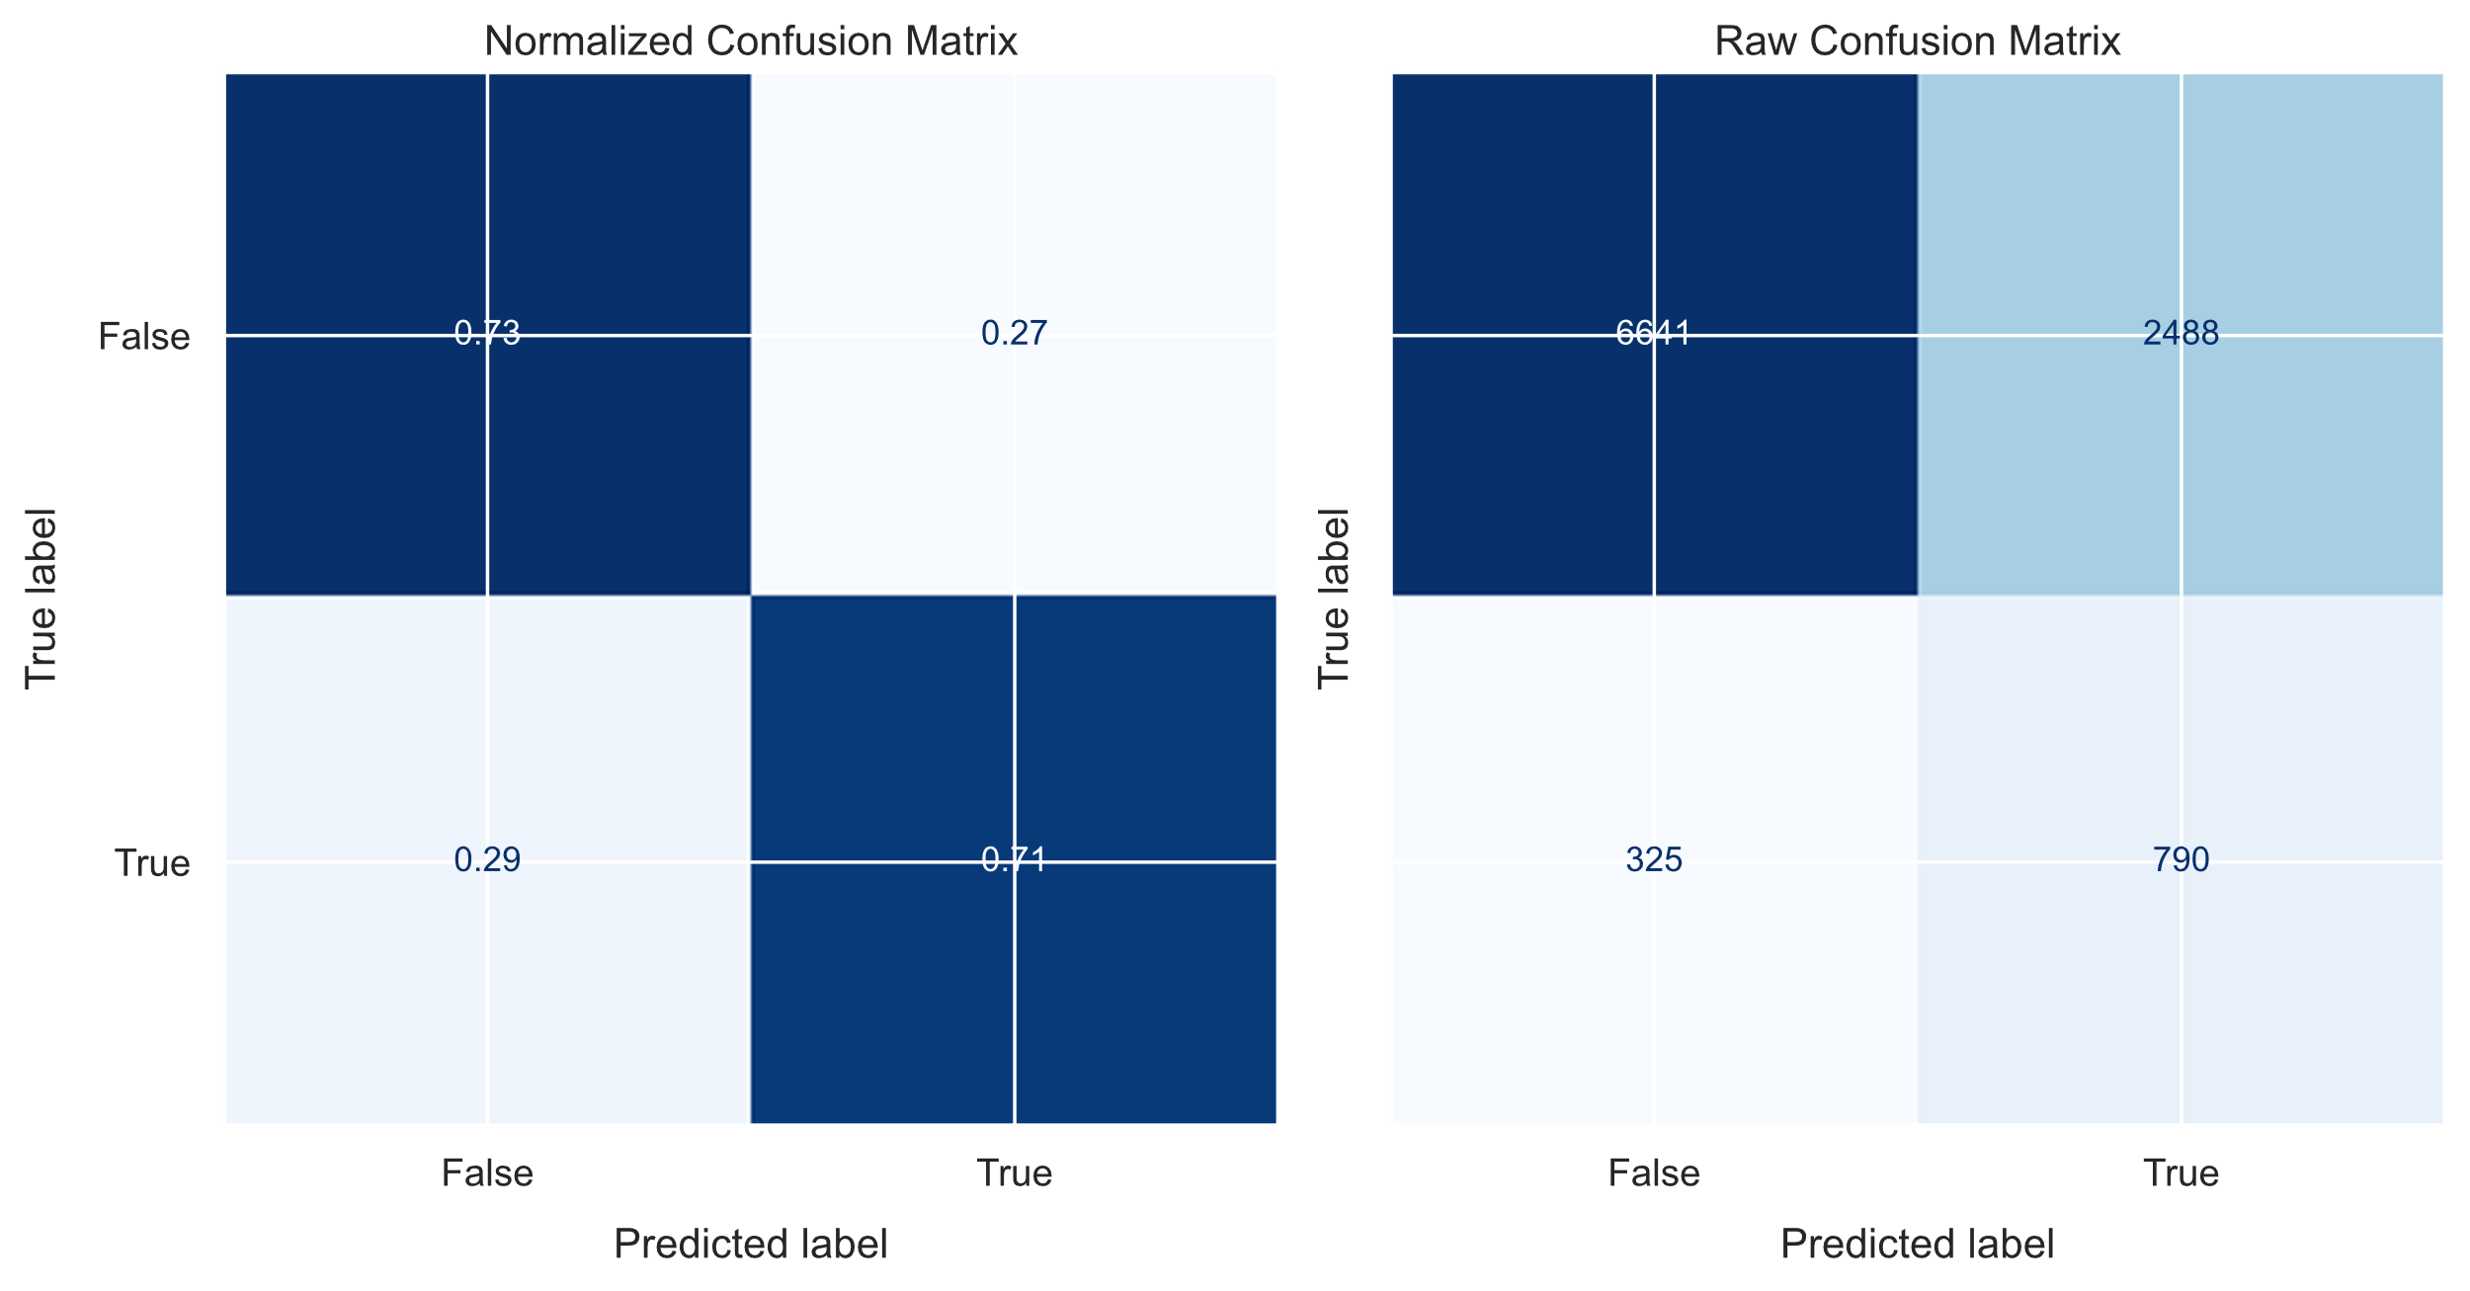
Methods and Model
Iterative Process
Logistic Regression
Relatively simple
Powerful
Widely used
Preprocessing
Fill missing values
Filter out highly correlated sets of features
Reduce the influence of outliers
Scale the data
Final Model Evaluation
Balanced accuracy: 0.72
Average of positive and negative recall
Strong diagonal

Slide 6
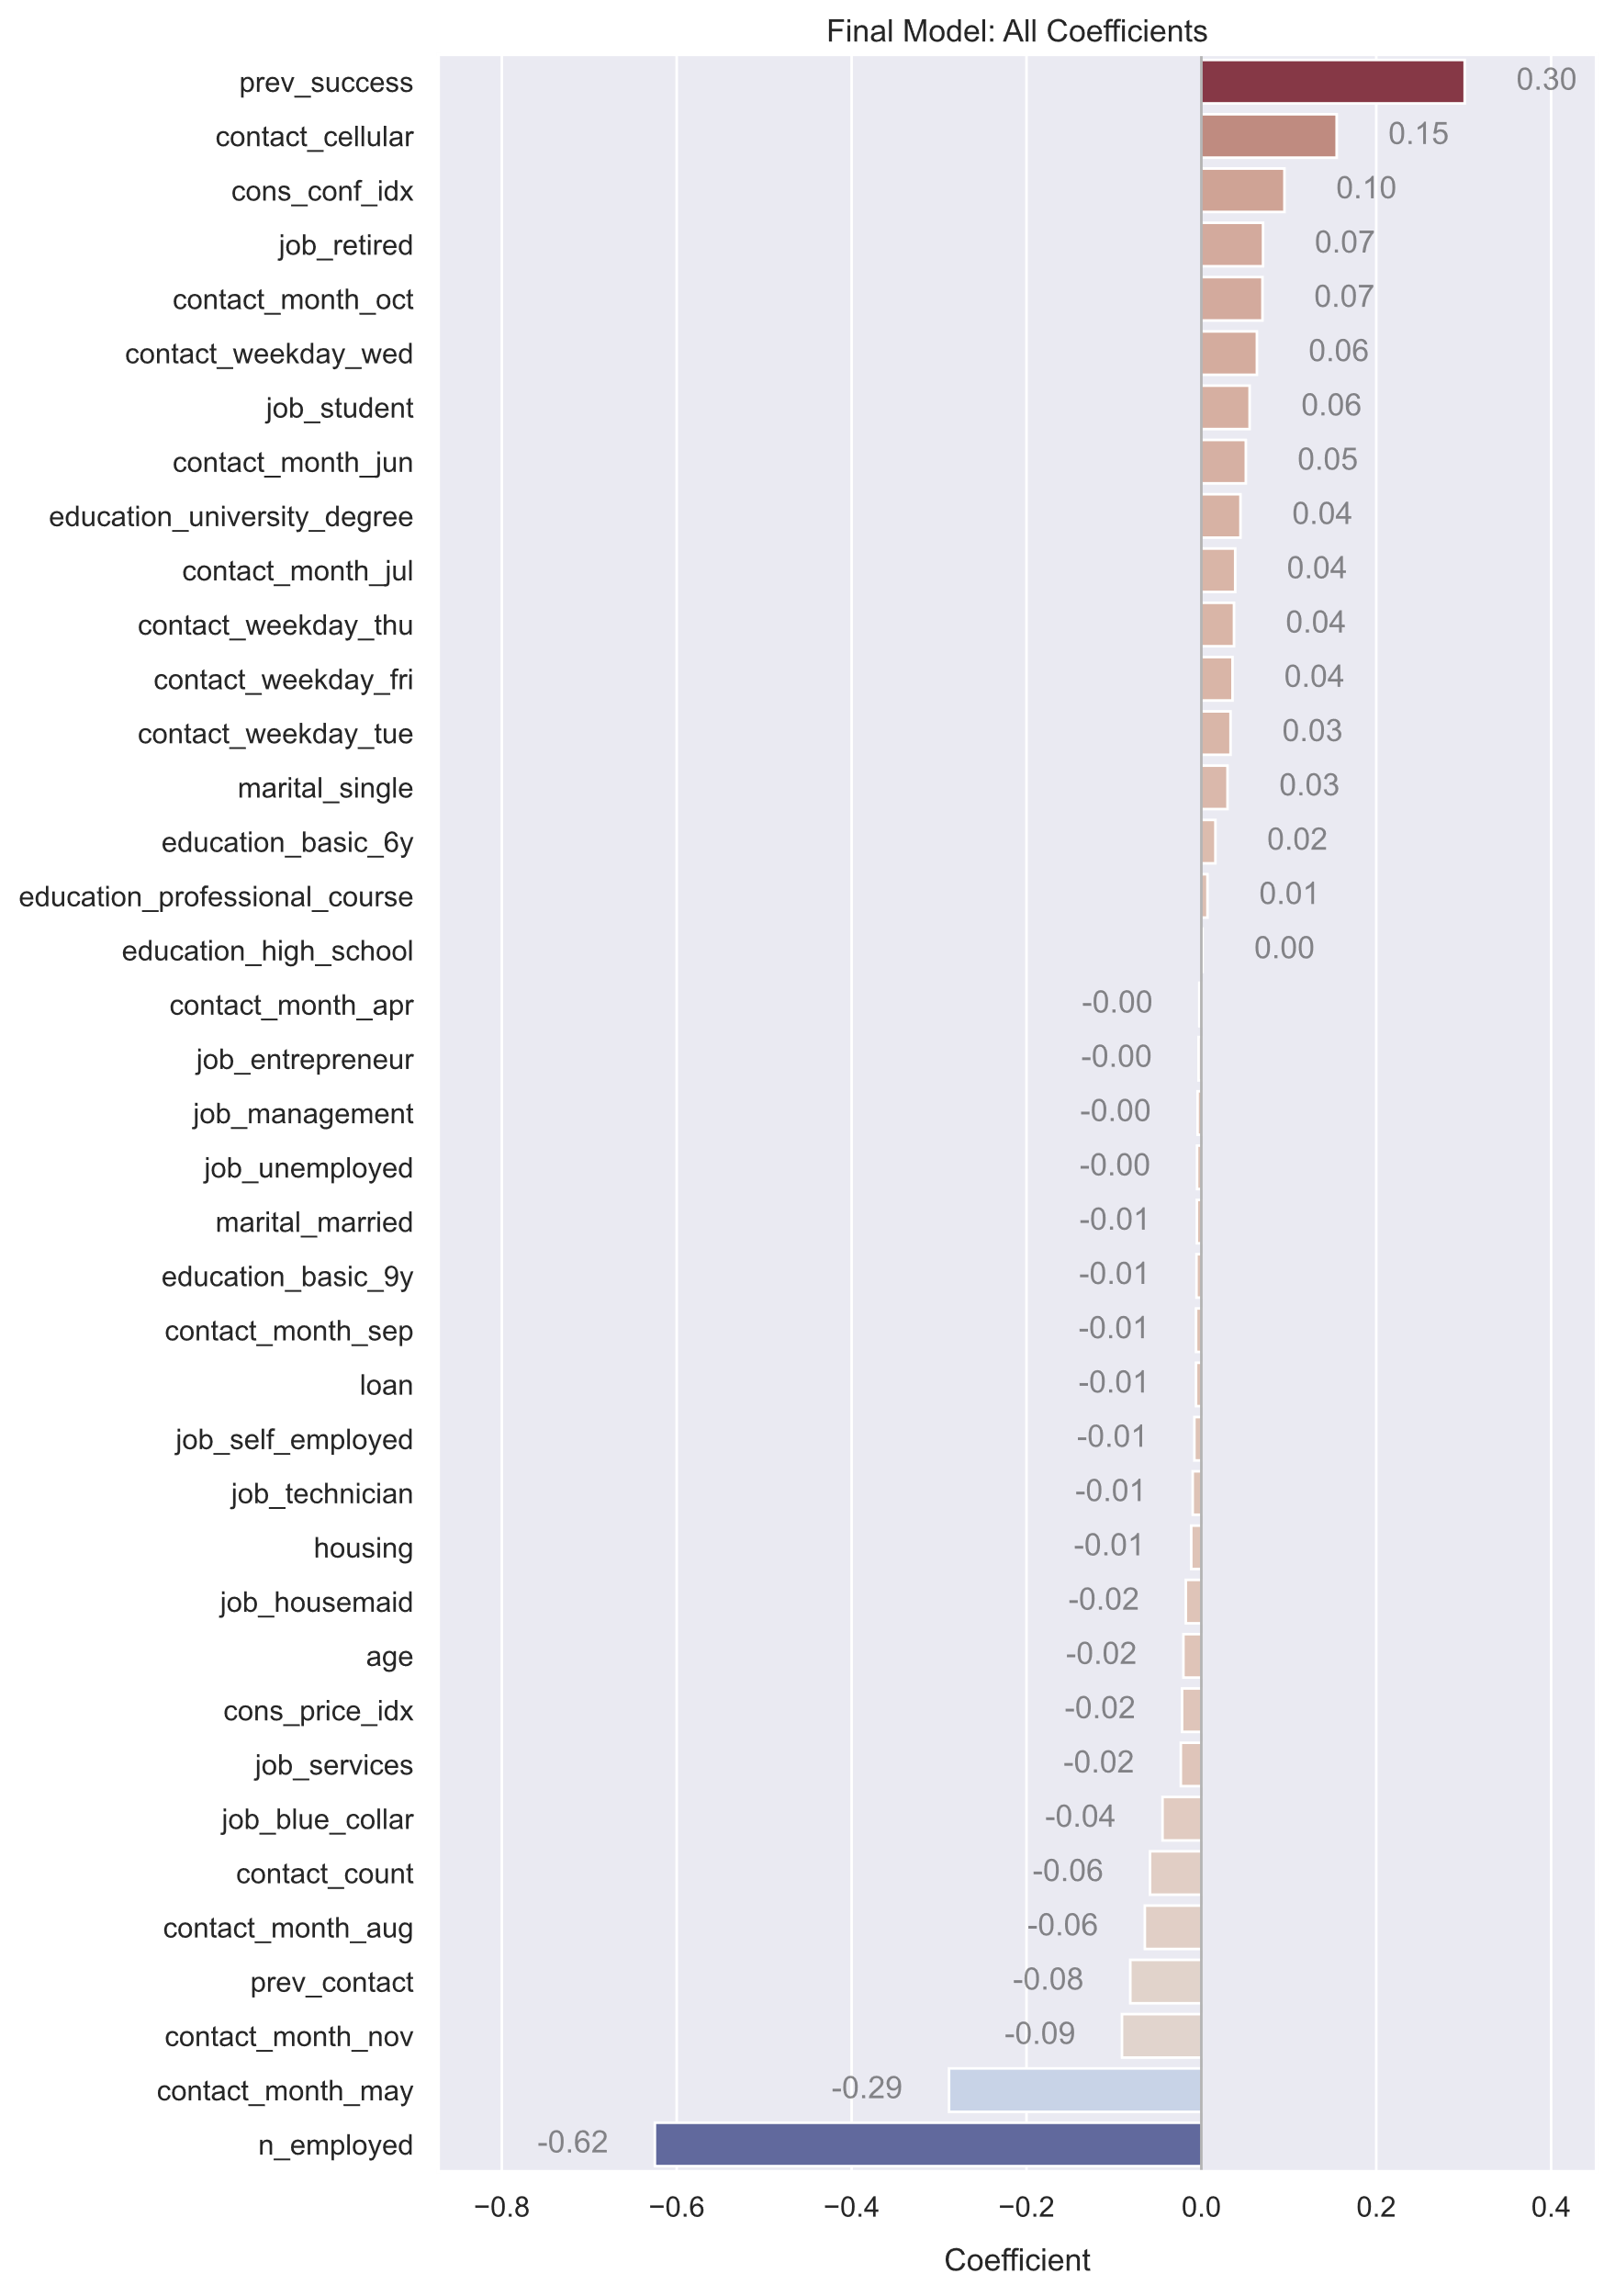
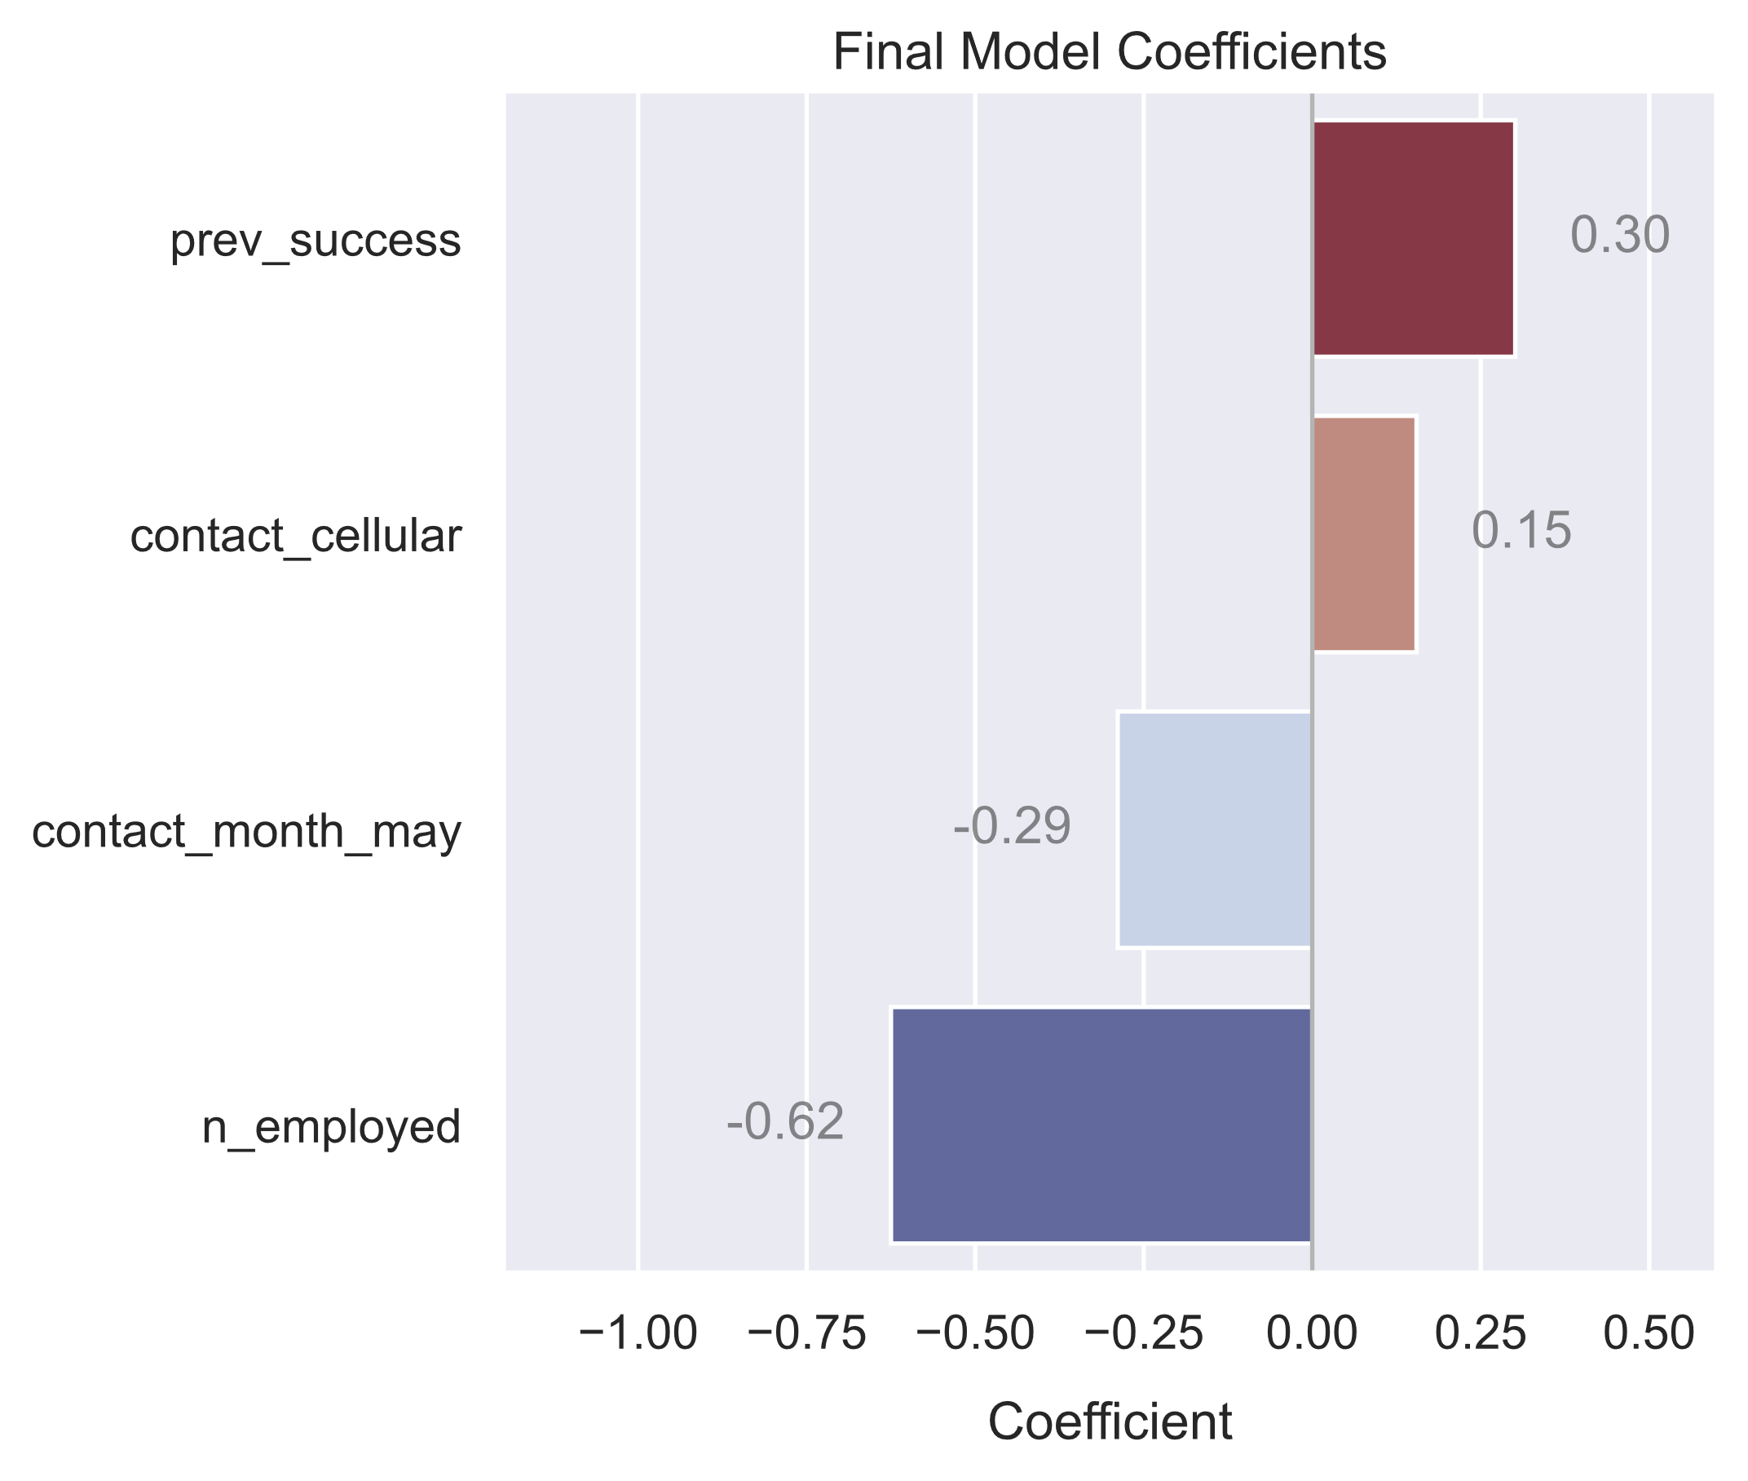
Top Features For Prediction
Ordered by magnitude:
n_employed — Portuguese employment count
prev_success — previous marketing campaign resulted in a sale
contact_month_may — contacted in May
contact_cellular — contacted on a cell phone as opposed to a landline

Slide 7
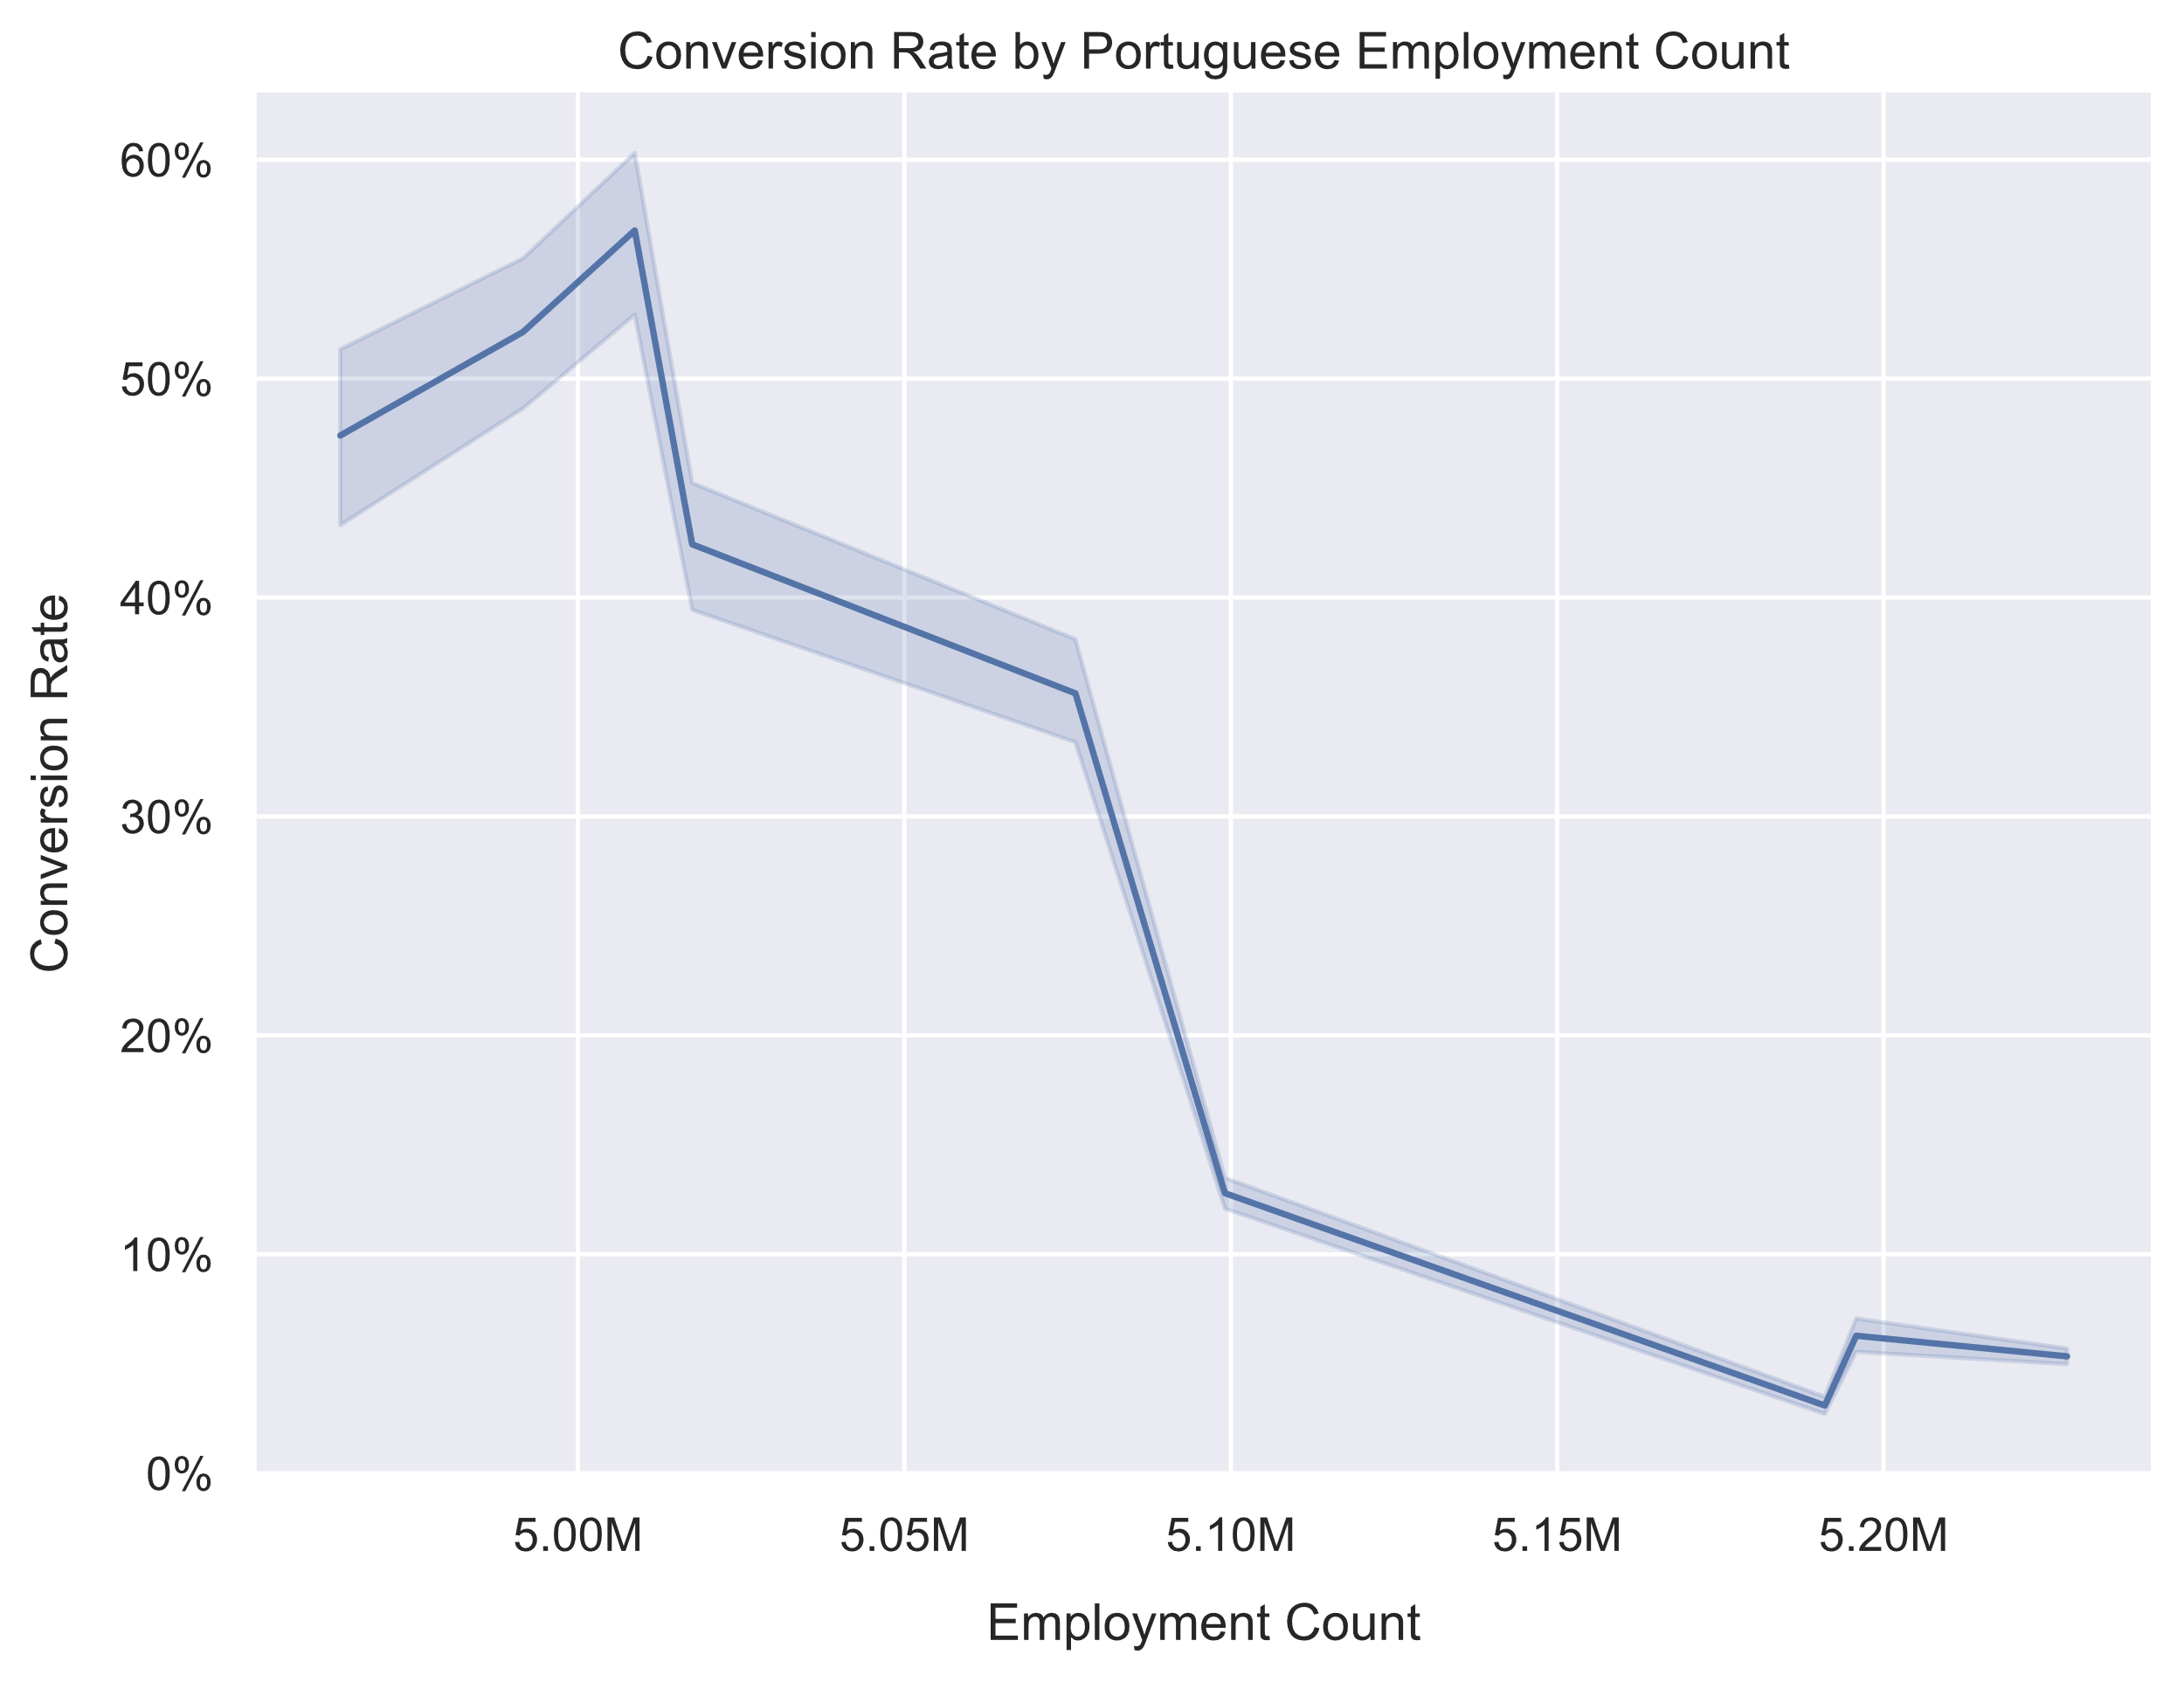
Push Hard When Employment is Low
Undoubtedly, a very strong relationship
The underlying mechanism behind this relationship is unknown to me
A surprising discovery resulting from my model
What is the conversion rate for unemployed people?
Recommendation:
Pump resources into marketing when employment is low.
Relax your efforts when employment is high.

Slide 8
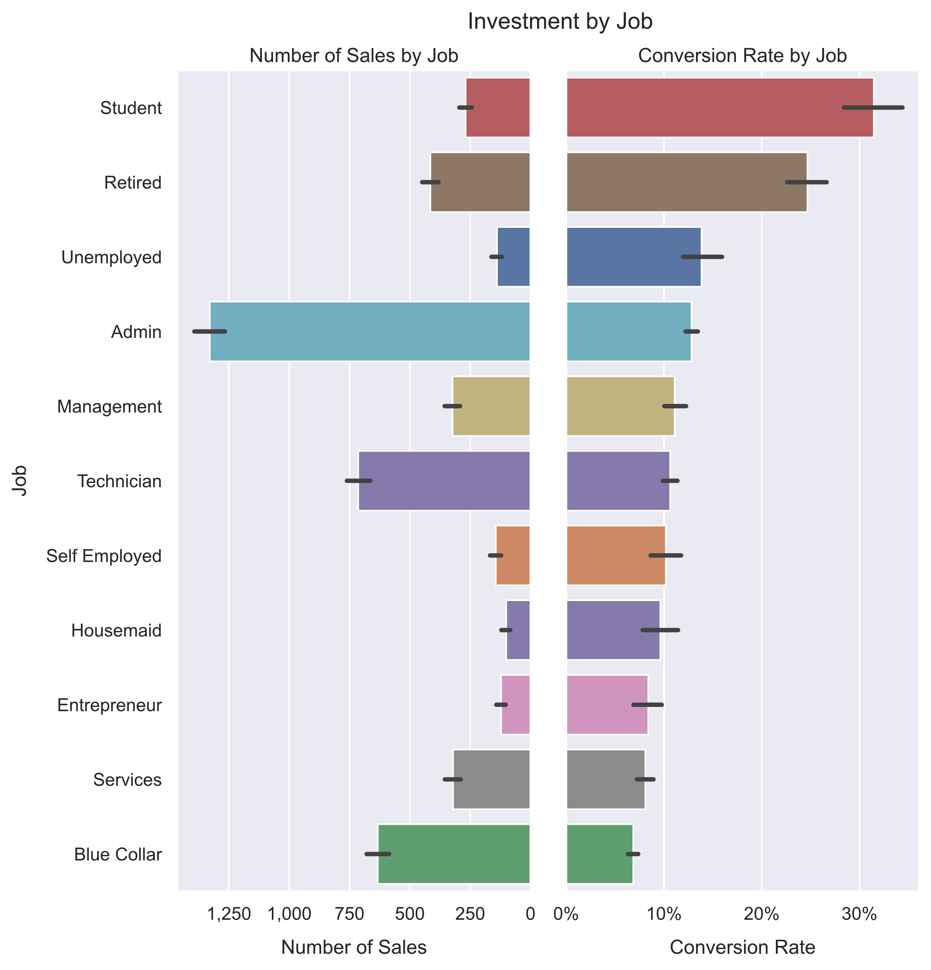
Unemployed People Don’t Invest
The conversion rate for the unemployed is surprisingly high, but not that high
The total sales to unemployed people is predictably low
Students and retirees have the highest average conversion rate
Administrators and technicians have the highest total sales

Slide 9
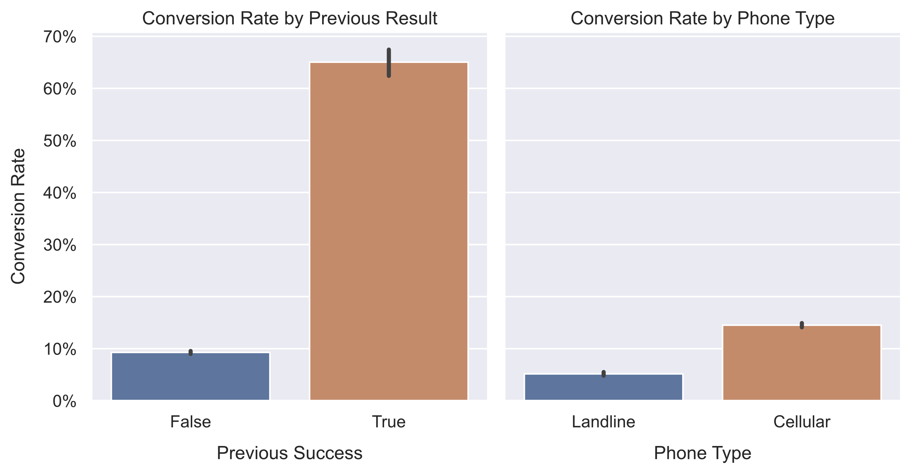
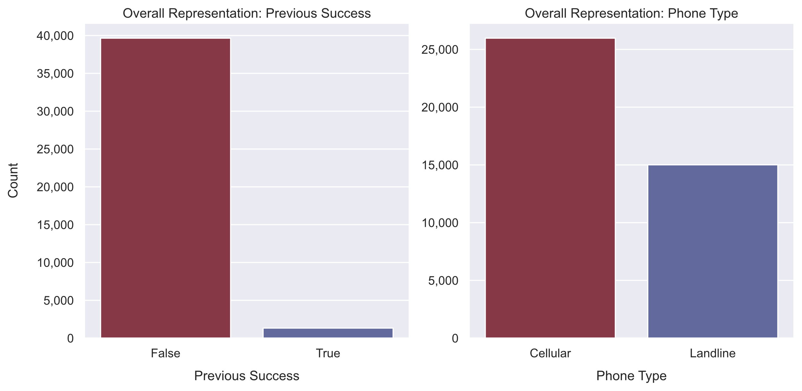
Previous Success is a Major Predictor
Previous success is one of the biggest predictors of future success.
Unfortunately, only about ~14% of the customers were previously contacted, and of those only ~3% made a deal.
Cell phones are more popular than landlines, but other than that its unclear why they have a relationship with conversion.
Recommendations:
Spend your energy and resources returning to previous customers who were receptive to marketing.
Focus on cell-users rather than landline-users.

Slide 10
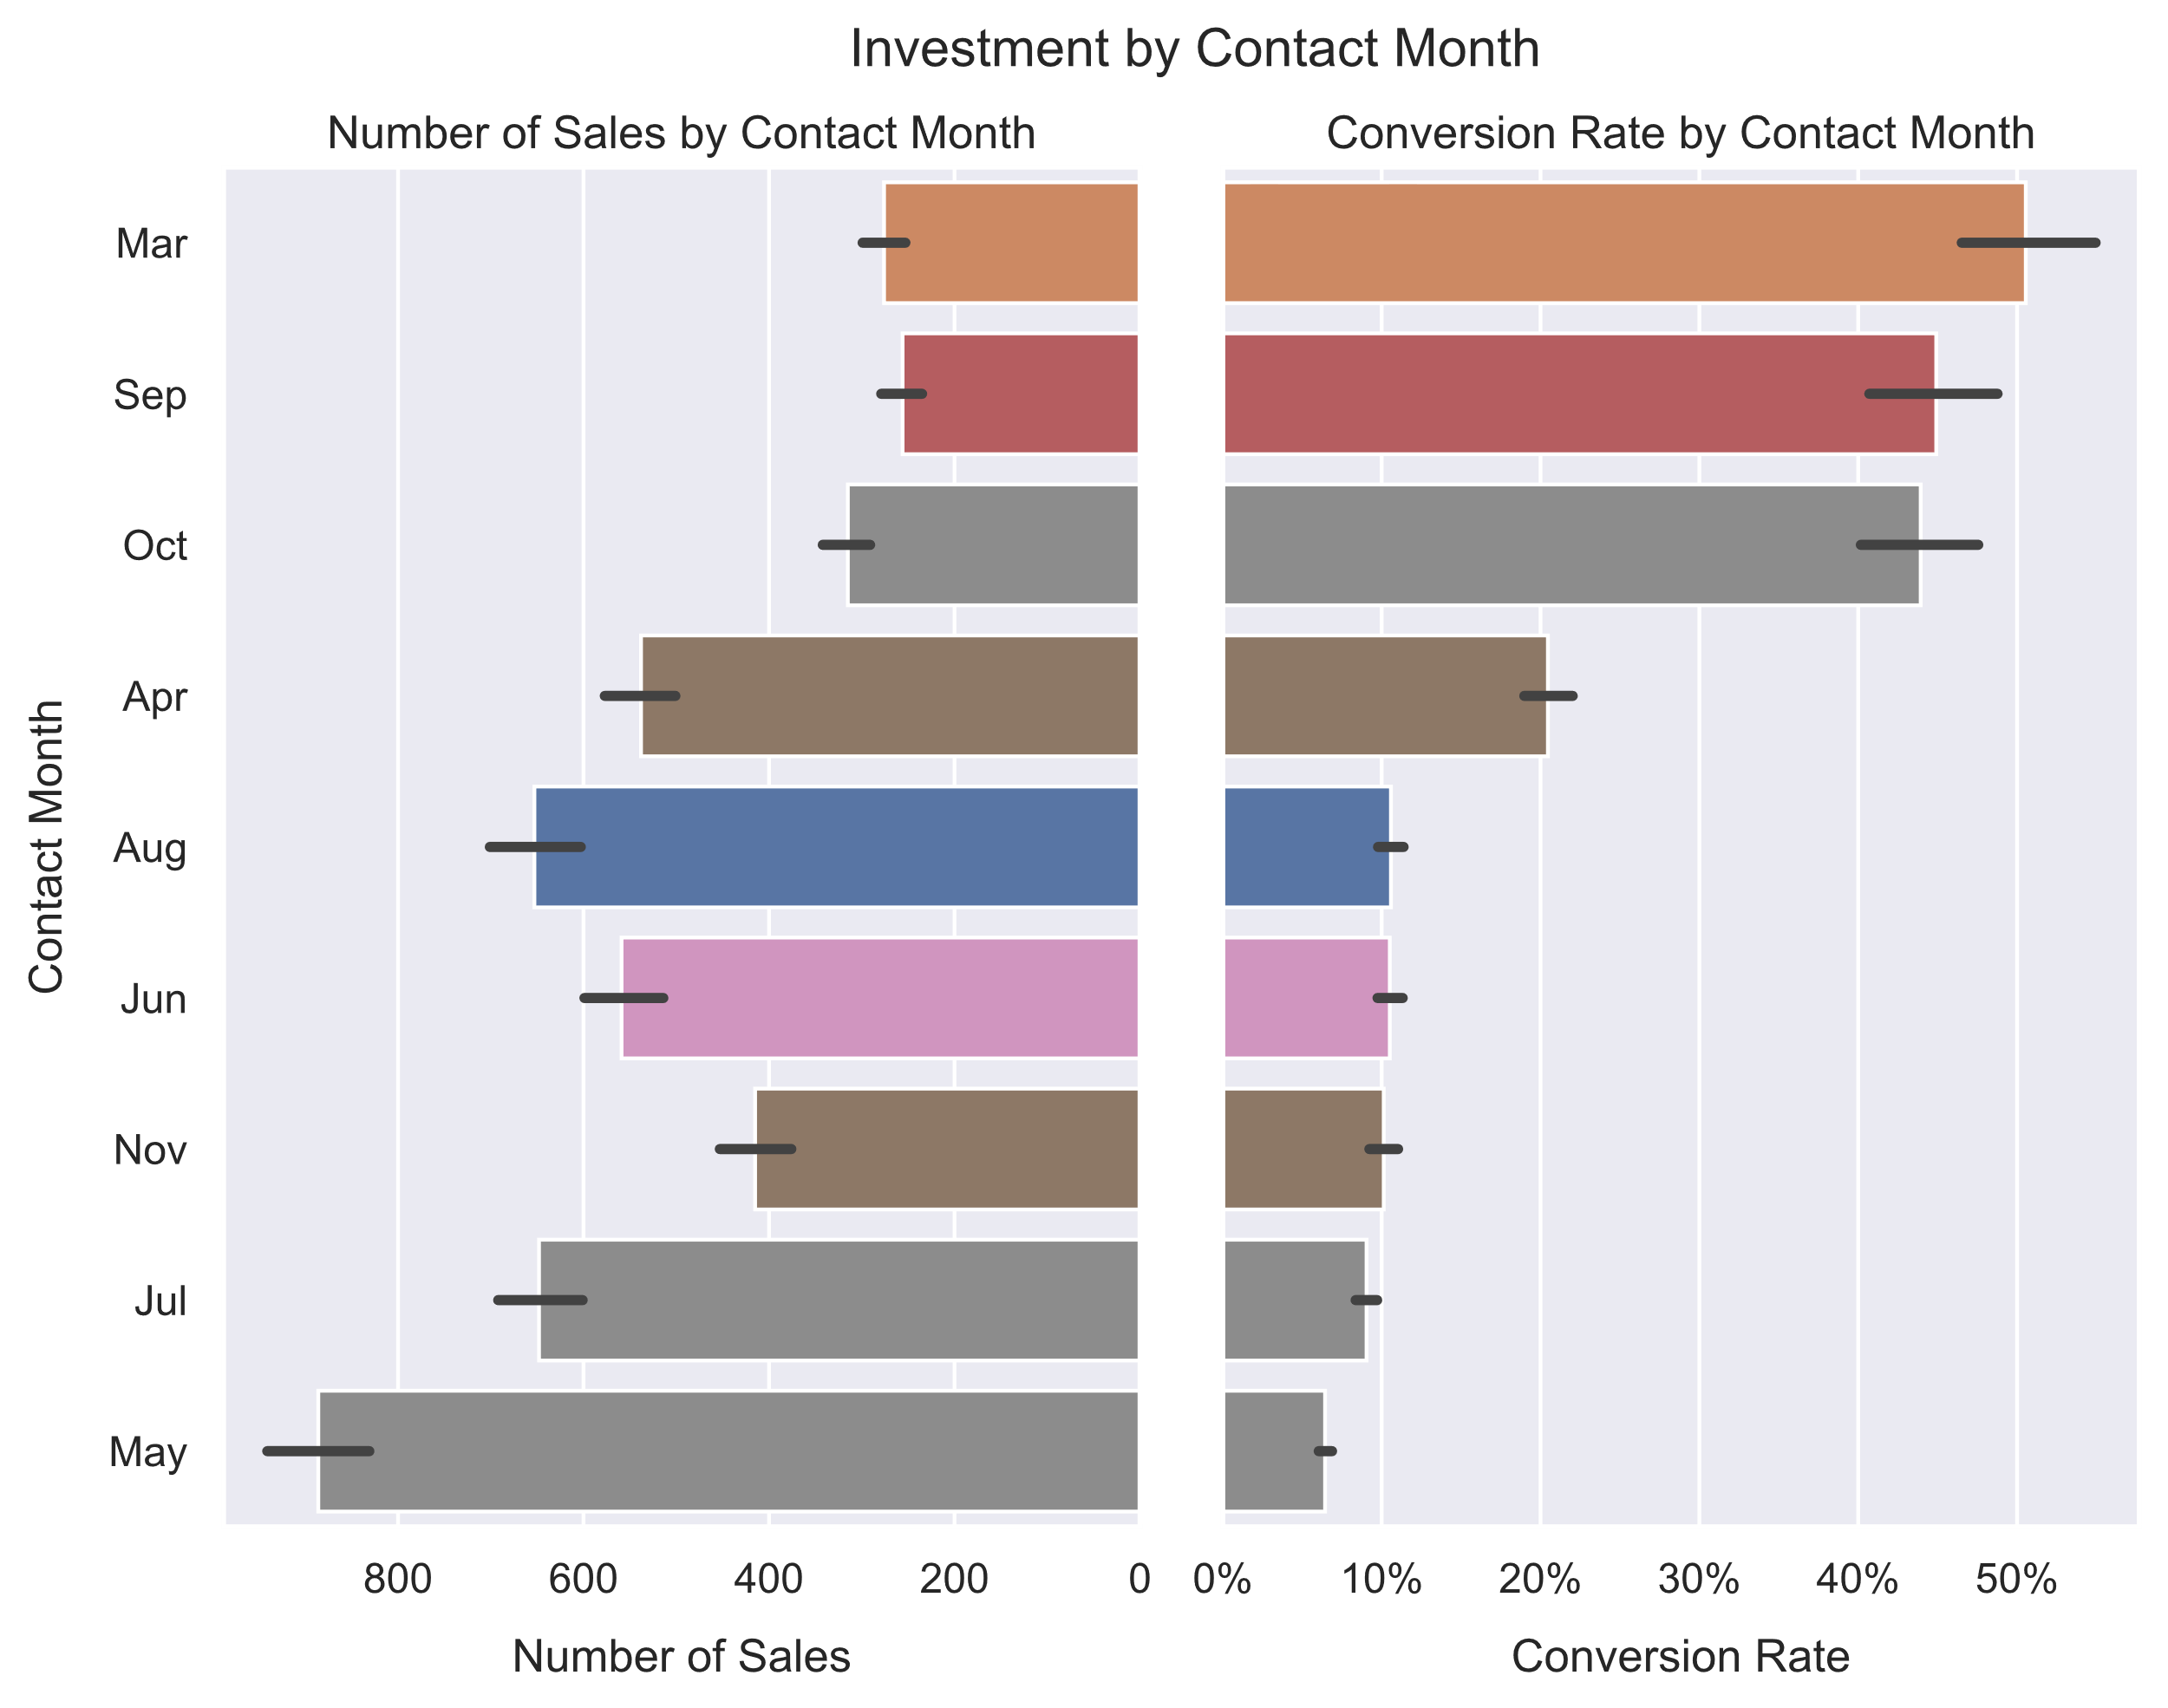
Relax in the Summer
May has the highest total sales by the lowest average conversion rate
It also has by far the most data points of any month, at nearly 14,000
The summer months in general have the highest representation in the dataset
Recommendation:
Put less energy into summer marketing.

Slide 11

Recommendations Recap
Pump resources into marketing when employment is low.
Relax your efforts when employment is high.
Return to previous customers who were receptive to marketing.
Put less energy into summer marketing.
Focus on cell-users rather than landline-users.

Slide 12

Future Work: More Models
Build models of different types
Random Forest Classifier
Linear Support Vector Classification
K Neighbors Classification
Split data by date
Train on early-period
Test on late-period
Join with other datasets
Engineer new features

Slide 13

Thank you!

