Slide 1


Predicting Bank telemarketing Sales
Nick Gigliotti

Slide 2
Business Problem
Banco de Portugal hired me to develop an accurate predictive model to predict which customers are likely to invest in a term deposit as a result of telemarking.
Telemarketing is hard on both salespeople and customers.
Connecting with the wrong customers results in unpleasant conversations and desperate marketing tactics.
Effectively connecting salespeople with high-potential customers reduces stress and increases profit.

Slide 3

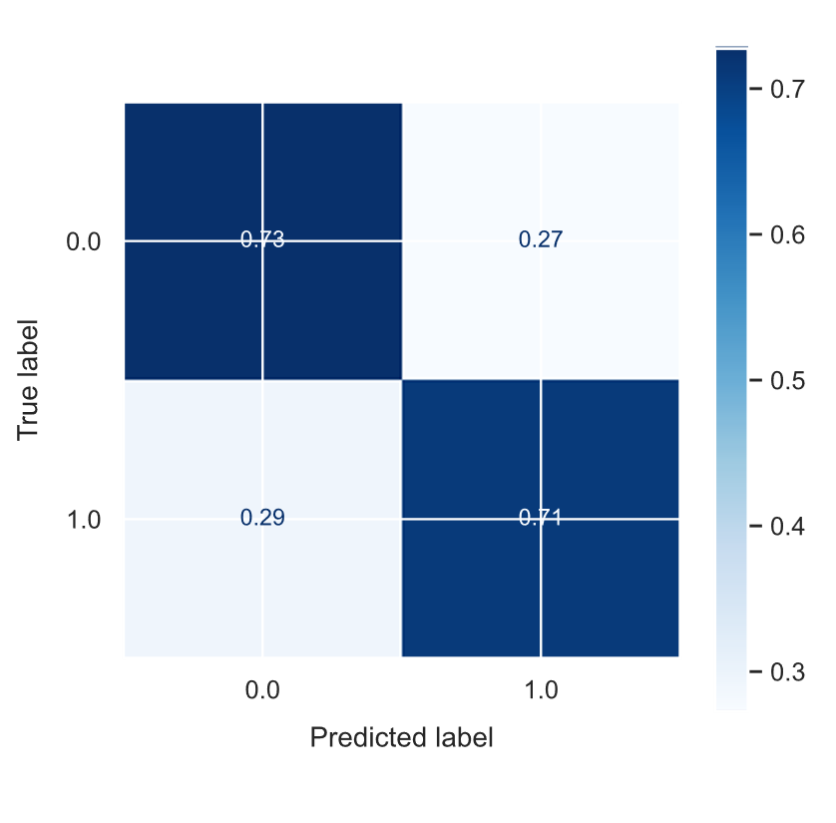
Data and Methods
Banco de Portugal Telemarketing Dataset
Publicly available on the UCI Machine Learning Repository
Collected from May 2008 to November 2010
Originally contains 21 features and 41k samples
Roughly two thirds categorical and one third numeric
Methods
Logistic Regression
Relatively simple
Powerful
Widely used
Iterative Progress
Split the data into a 75% training set and 25% test set
Start with a dummy model and a baseline logistic regression
Make improvements with each successive version of the model
Preprocessing
Set missing categorical values to False
Algorithmically filter out highly correlated sets of features
Keep the feature with the highest variance from each set
Avoids multi-collinearity
Perform slight 95% Winsorization to reduce the influence of outliers
Apply standard scaling, centering on the mean and scaling to standard deviation
Key Parameters
Balanced class weights
L2 regularization to reduce overfitting

Slide 4
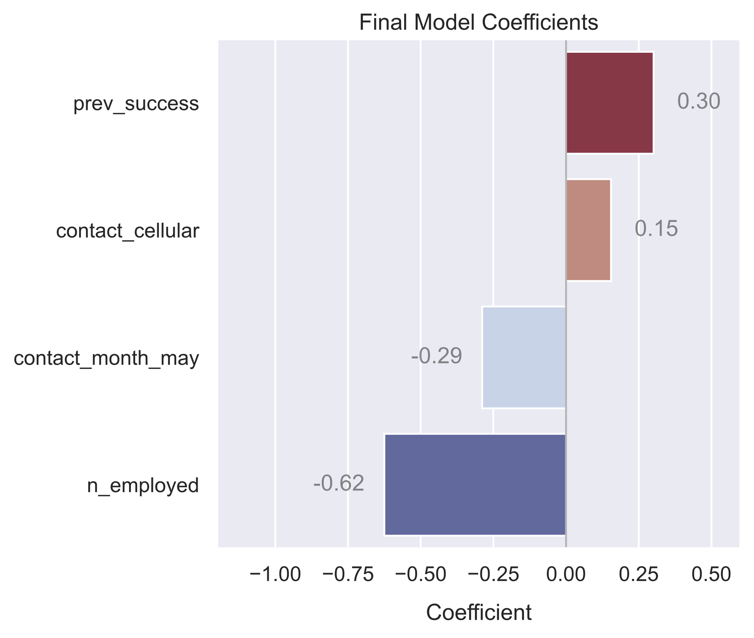
Top 4 Features for Prediction
Ordered by magnitude:
n_employed
Portuguese employment count
prev_success
Customer previously opened an investment account as a result of marketing
contact_month_may
Contacted in May
contact_cellular
Contacted on a cell phone as opposed to a landline

Slide 5
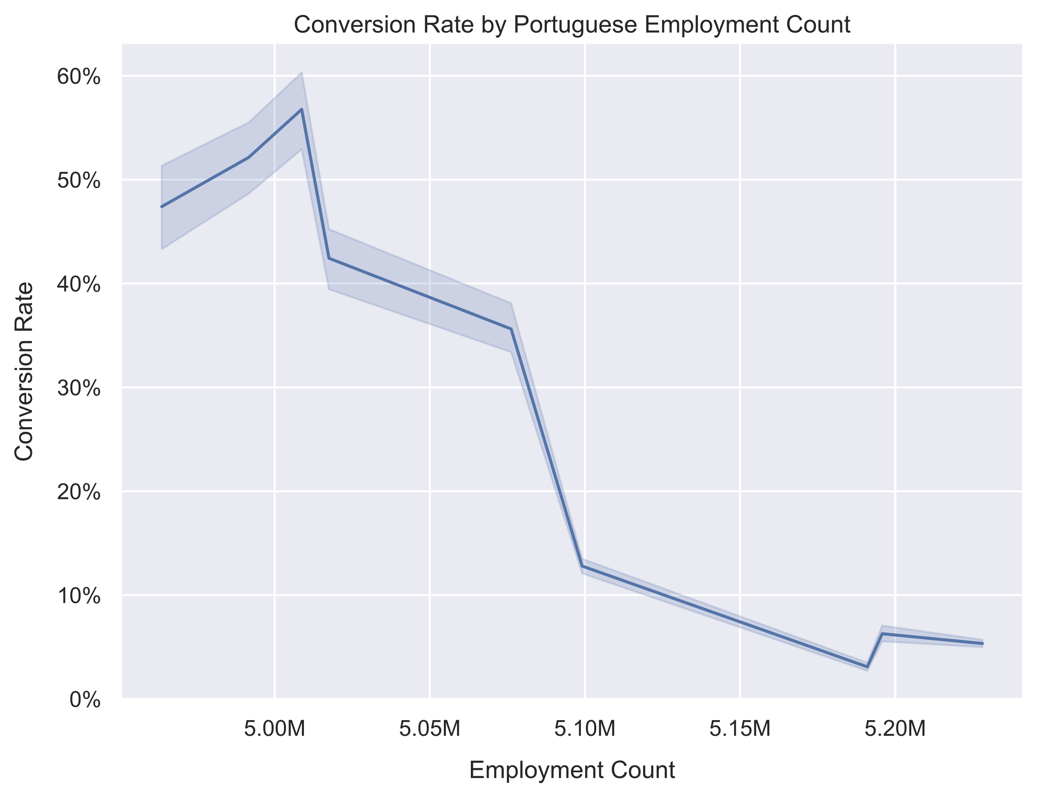
Employment Count
Undoubtedly, a very strong relationship
The underlying mechanism behind this relationship is unknown to me
A surprising discovery resulting from my model
What is the conversion rate for unemployed people?

Slide 6
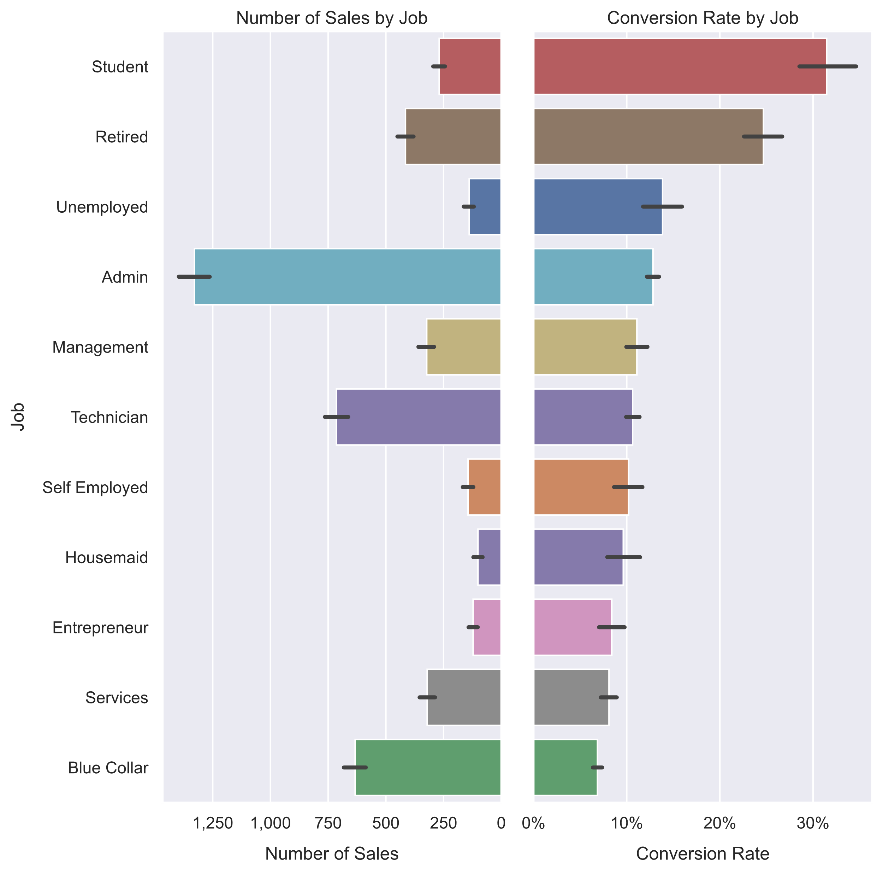
Conversion Rate and Sales by Job
The conversion rate for unemployed people is surprisingly high, but not that high
The total sales to unemployed people is predictably low
Students and retirees have the highest average conversion rate
Administrators and technicians have the highest total sales

