Slide 1


Predicting Bank telemarketing Sales
Nick Gigliotti

Slide 2
Business Problem
Banco de Portugal hired me to develop an accurate predictive model to predict which customers are likely to invest in a term deposit as a result of telemarking.
Telemarketing is hard on both salespeople and customers.
Connecting with the wrong customers irritates them and produces no profit.
Connecting with high-potential customers increases profit and customer satisfaction.

Slide 3

Data
Banco de Portugal Telemarketing Dataset
Publicly available on the UCI Machine Learning Repository
Collected from May 2008 to November 2010
Originally contains 21 features and 41k samples
Roughly two thirds categorical and one third numeric

Slide 4
Feature Explanations
Client Information
'age' - years
'job' - type of job
'marital' - marital status
'education' - level of education
'default' - has defaulted on credit
'housing' - has housing loan
'loan' - has personal loan
Current Campaign
'contact_type' - call type of last contact (cellular or landline)
'contact_month' - month of last contact
'contact_weekday' - weekday of last contact
'contact_duration' - duration of last contact in seconds
'contact_count' - total number of contacts during this campaign
'invested' - invested in a term deposit (target variable)
Previous Campaigns
'days_since_prev' - number of days since last contacted during previous campaign
'prev_contact_count' - total number of contacts before this campaign
'prev_outcome' - sales result of previous campaign
Economic Context
'emp_var_rate' - employment variation rate (quarterly indicator)
'cons_price_idx' - consumer price index (monthly indicator)
'cons_conf_idx' - consumer confidence index (monthly indicator)
'euribor_3m' - euribor 3 month rate (daily indicator)
'n_employed' - thousands of people employed (quarterly indicator)

Slide 5


Methods
Final Model Evaluation
Accuracy: 0.73
$\frac{\text{TP}\text{+}\text{TN}}{\text{TP}\text{ + }\text{TN}\text{ + }\text{FN}\text{ + }\text{FP} }$
Balanced Accuracy: 0.72
Average of Positive and Negative Recall
Positive Recall = $\frac{TP}{TP+FN}$
Negative Recall = $\frac{TN}{TN+FP}$
Logistic Regression
Relatively simple
Powerful
Widely used
Iterative Progress
Split the data into a 75% training set and 25% test set
Start with a dummy model and a baseline logistic regression
Make improvements with each successive version of the model
Preprocessing
Set missing categorical values to False
Filter out highly correlated sets of features
Reduce the influence of outliers
Scale the data

Slide 6
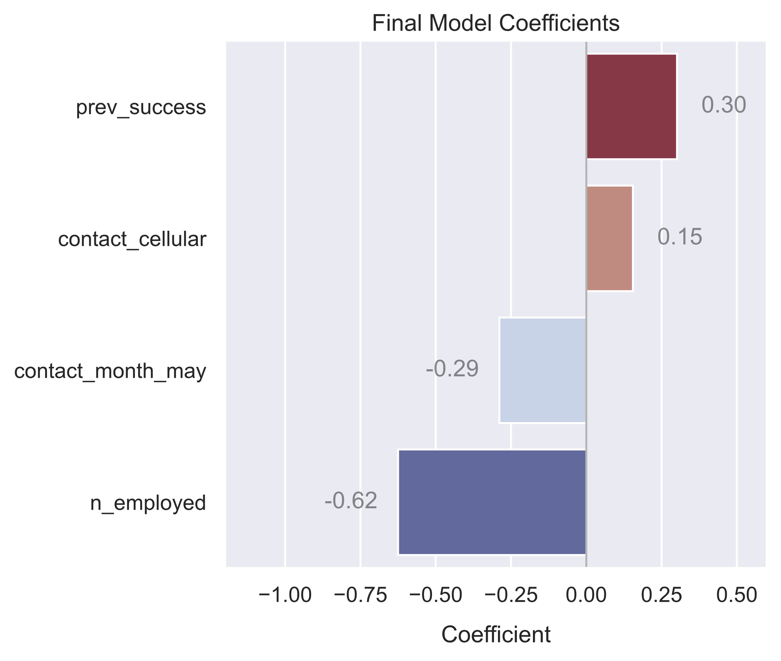
Top 4 Features for Prediction
Ordered by magnitude:
n_employed
Portuguese employment count
prev_success
Customer previously opened an investment account as a result of marketing
contact_month_may
Contacted in May
contact_cellular
Contacted on a cell phone as opposed to a landline

Slide 7
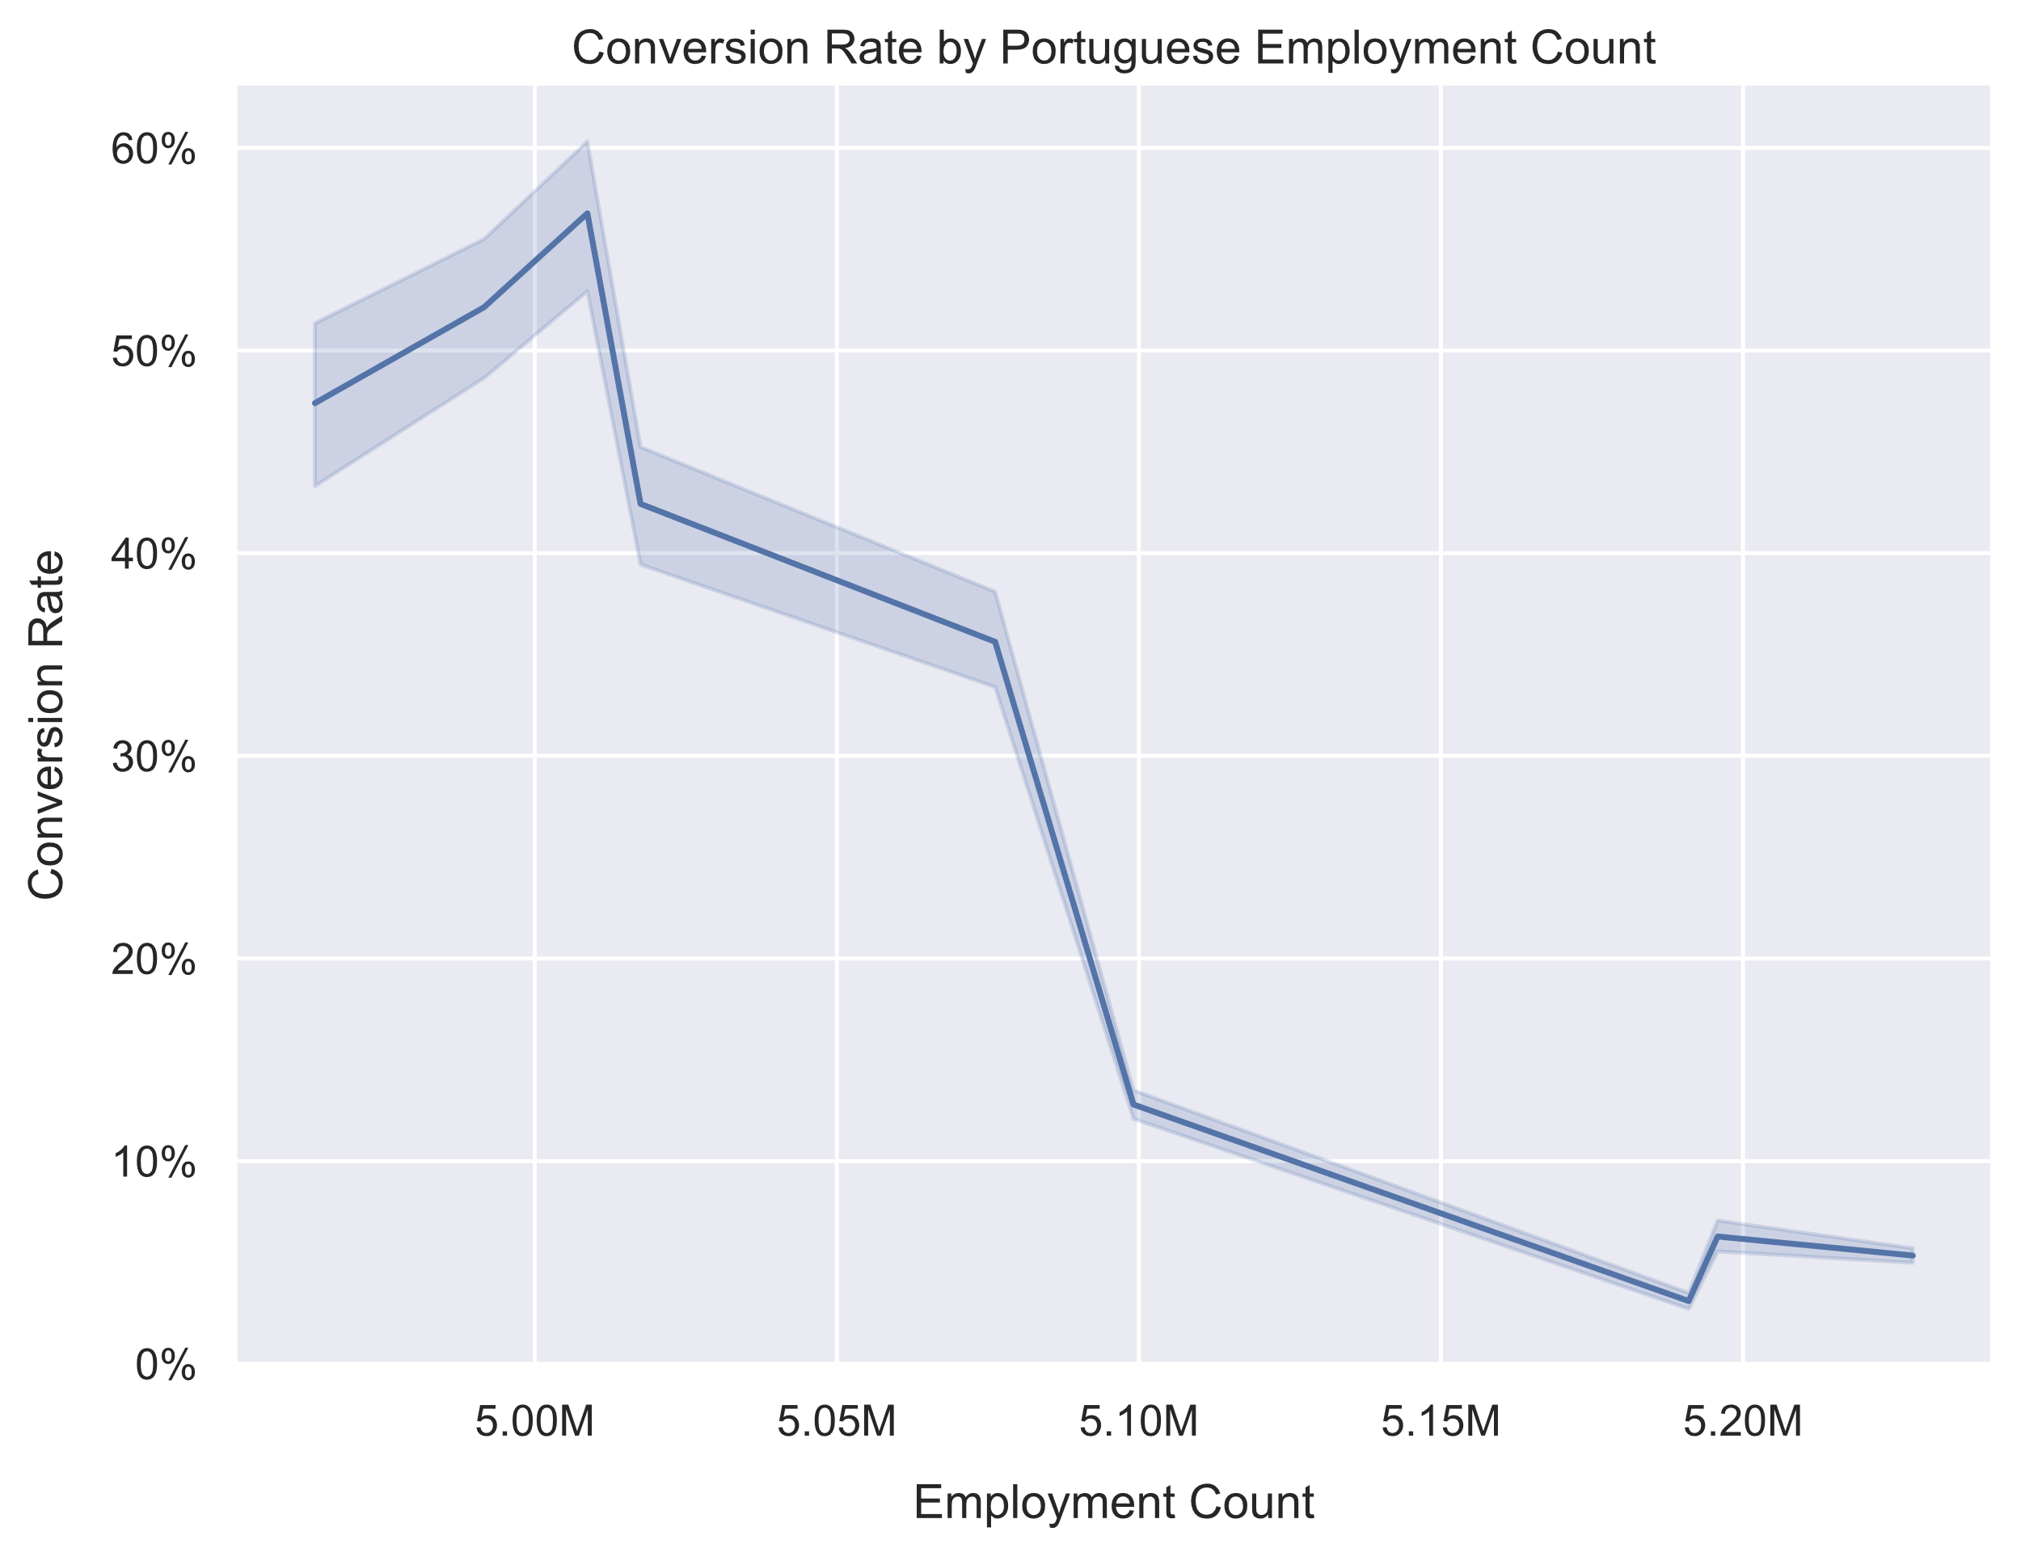
Push Hard When Employment is Low
Undoubtedly, a very strong relationship
The underlying mechanism behind this relationship is unknown to me
A surprising discovery resulting from my model
What is the conversion rate for unemployed people?
Recommendation:
Pump resources into marketing when employment is low.
Relax your efforts when employment is high.

Slide 8
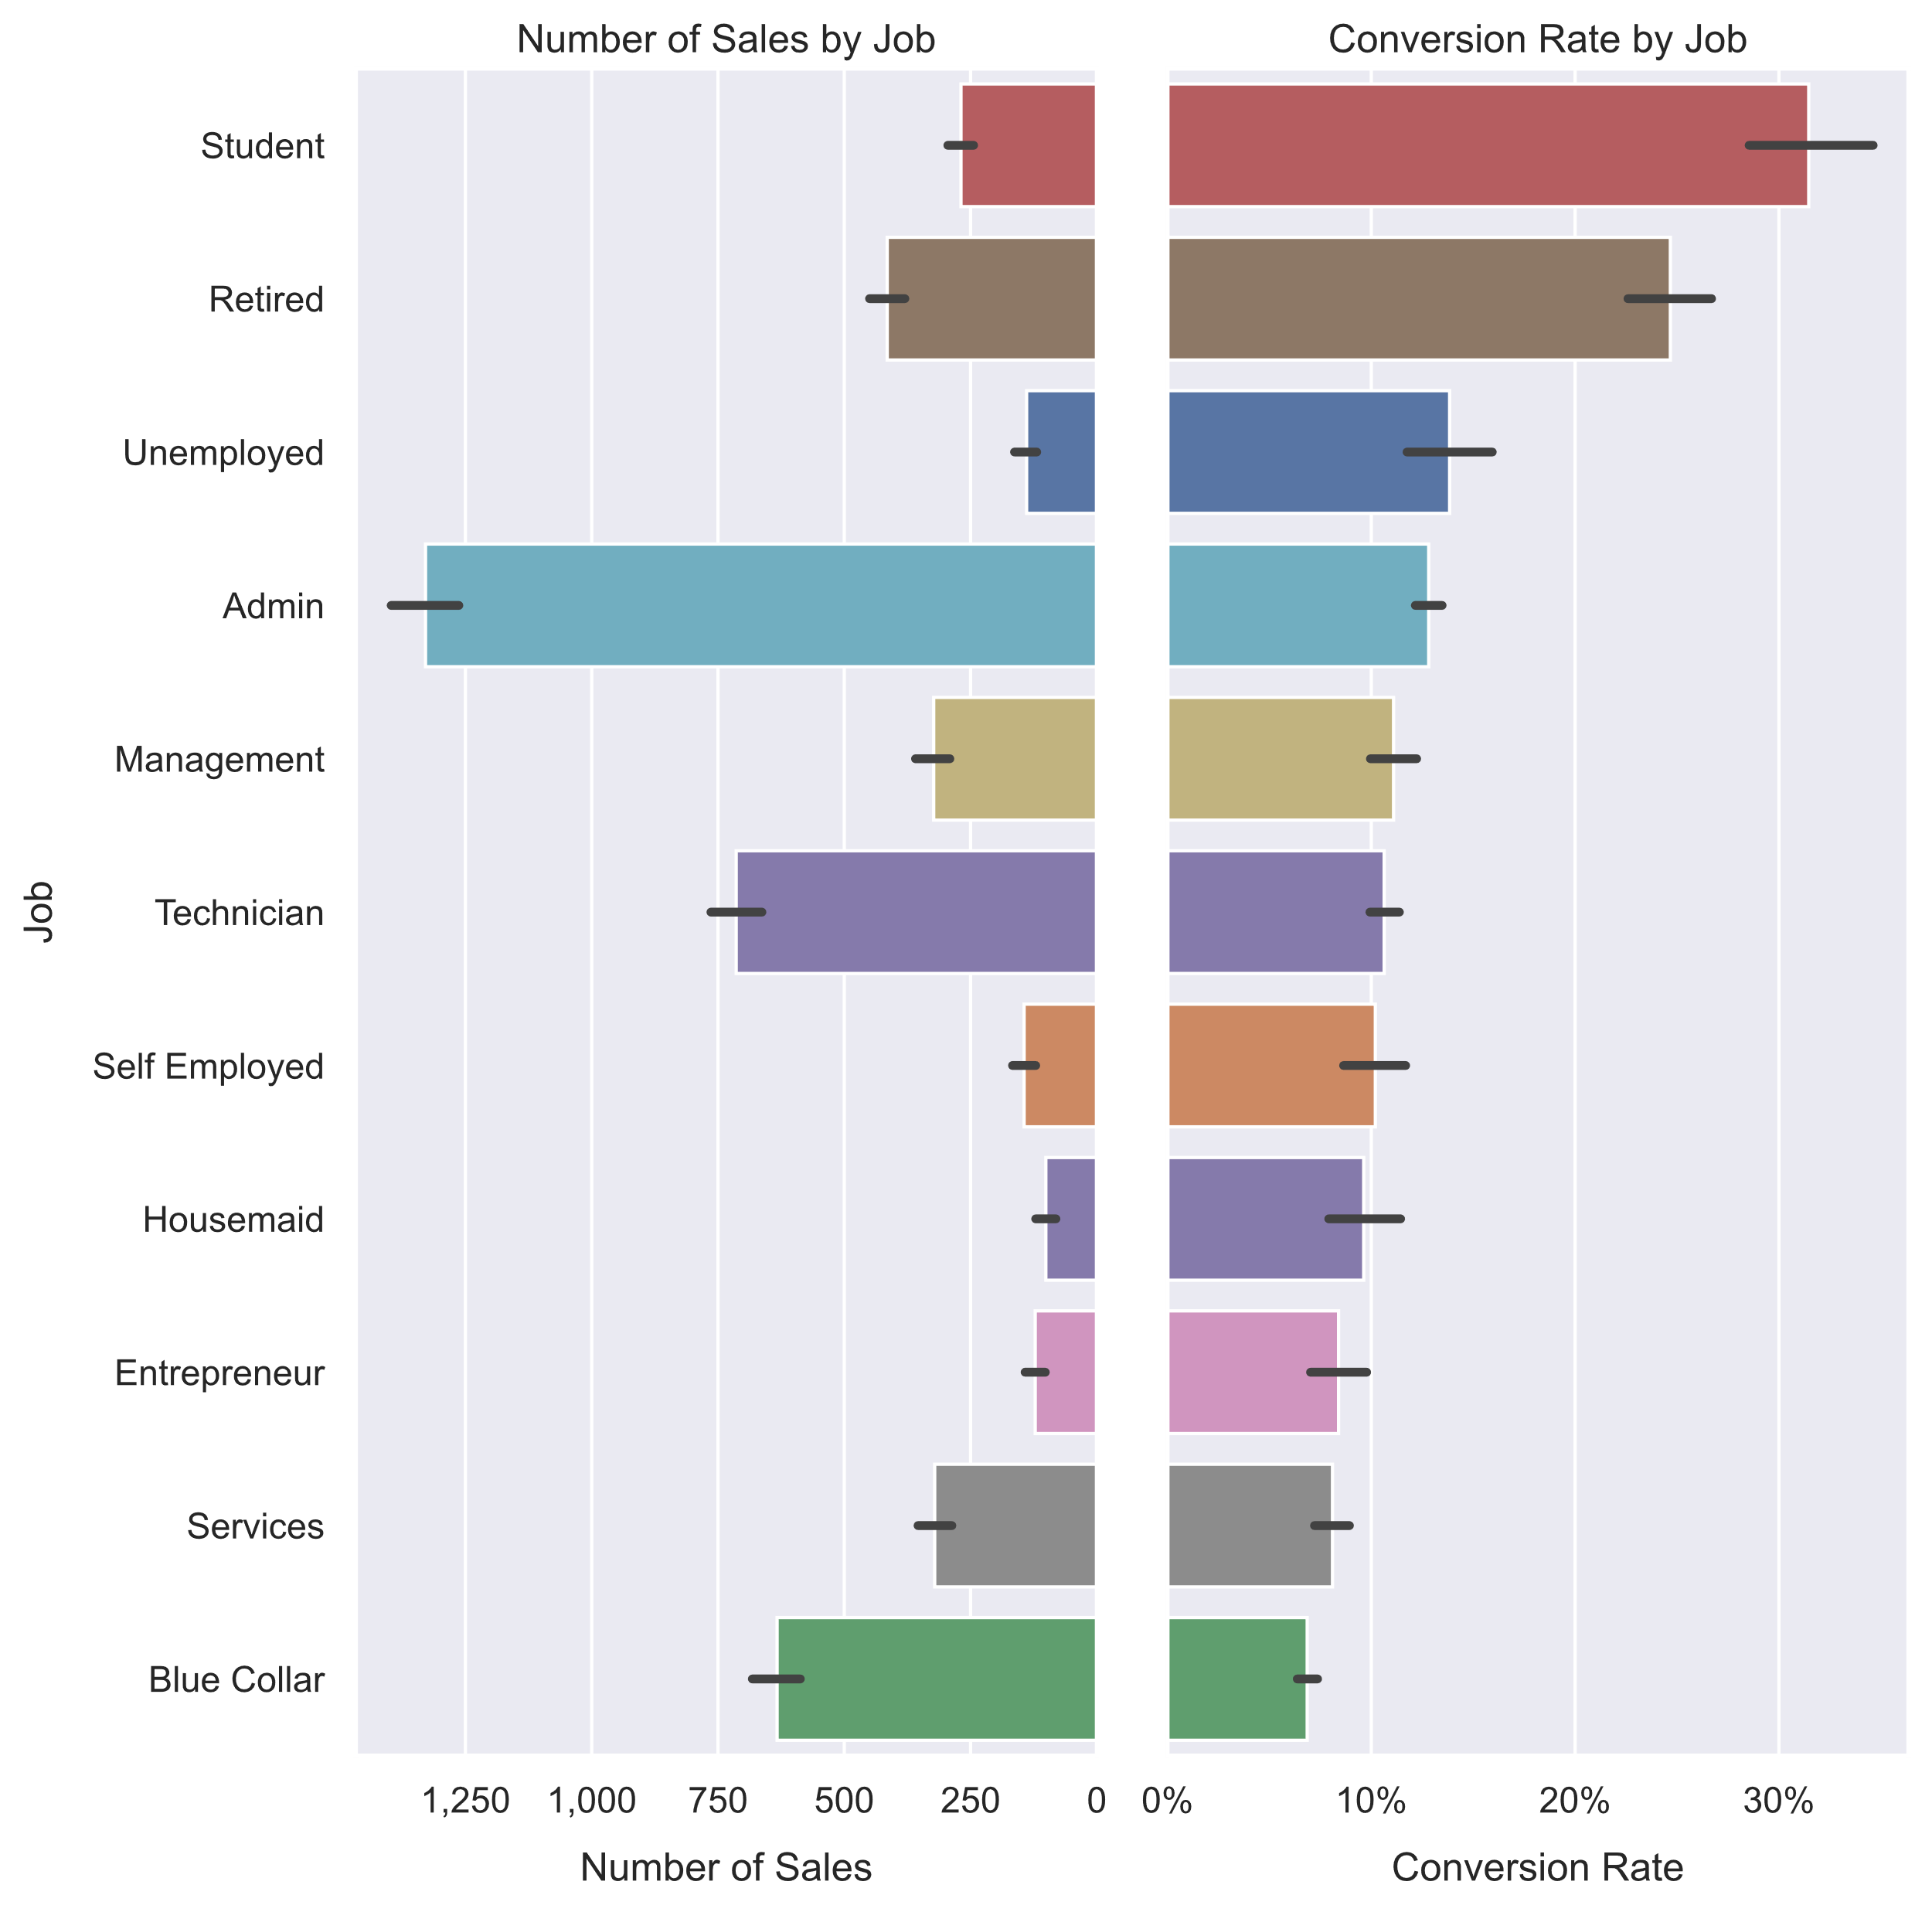
Unemployed People Don’t Invest
The conversion rate for the unemployed is surprisingly high, but not that high
The total sales to unemployed people is predictably low
Students and retirees have the highest average conversion rate
Administrators and technicians have the highest total sales

Slide 9
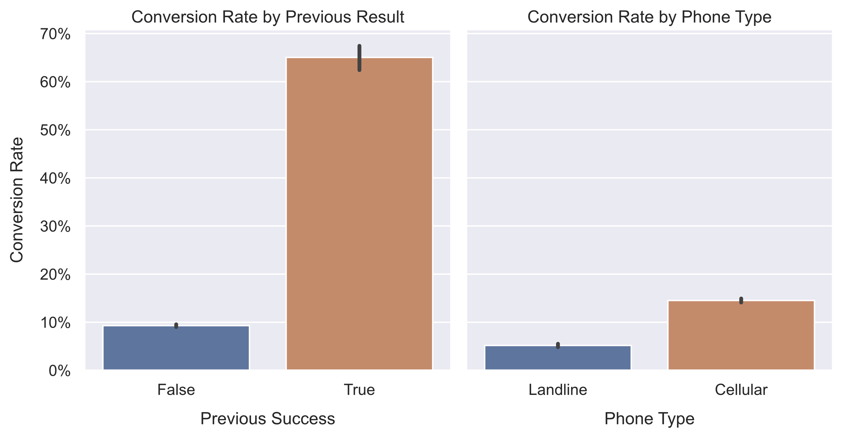
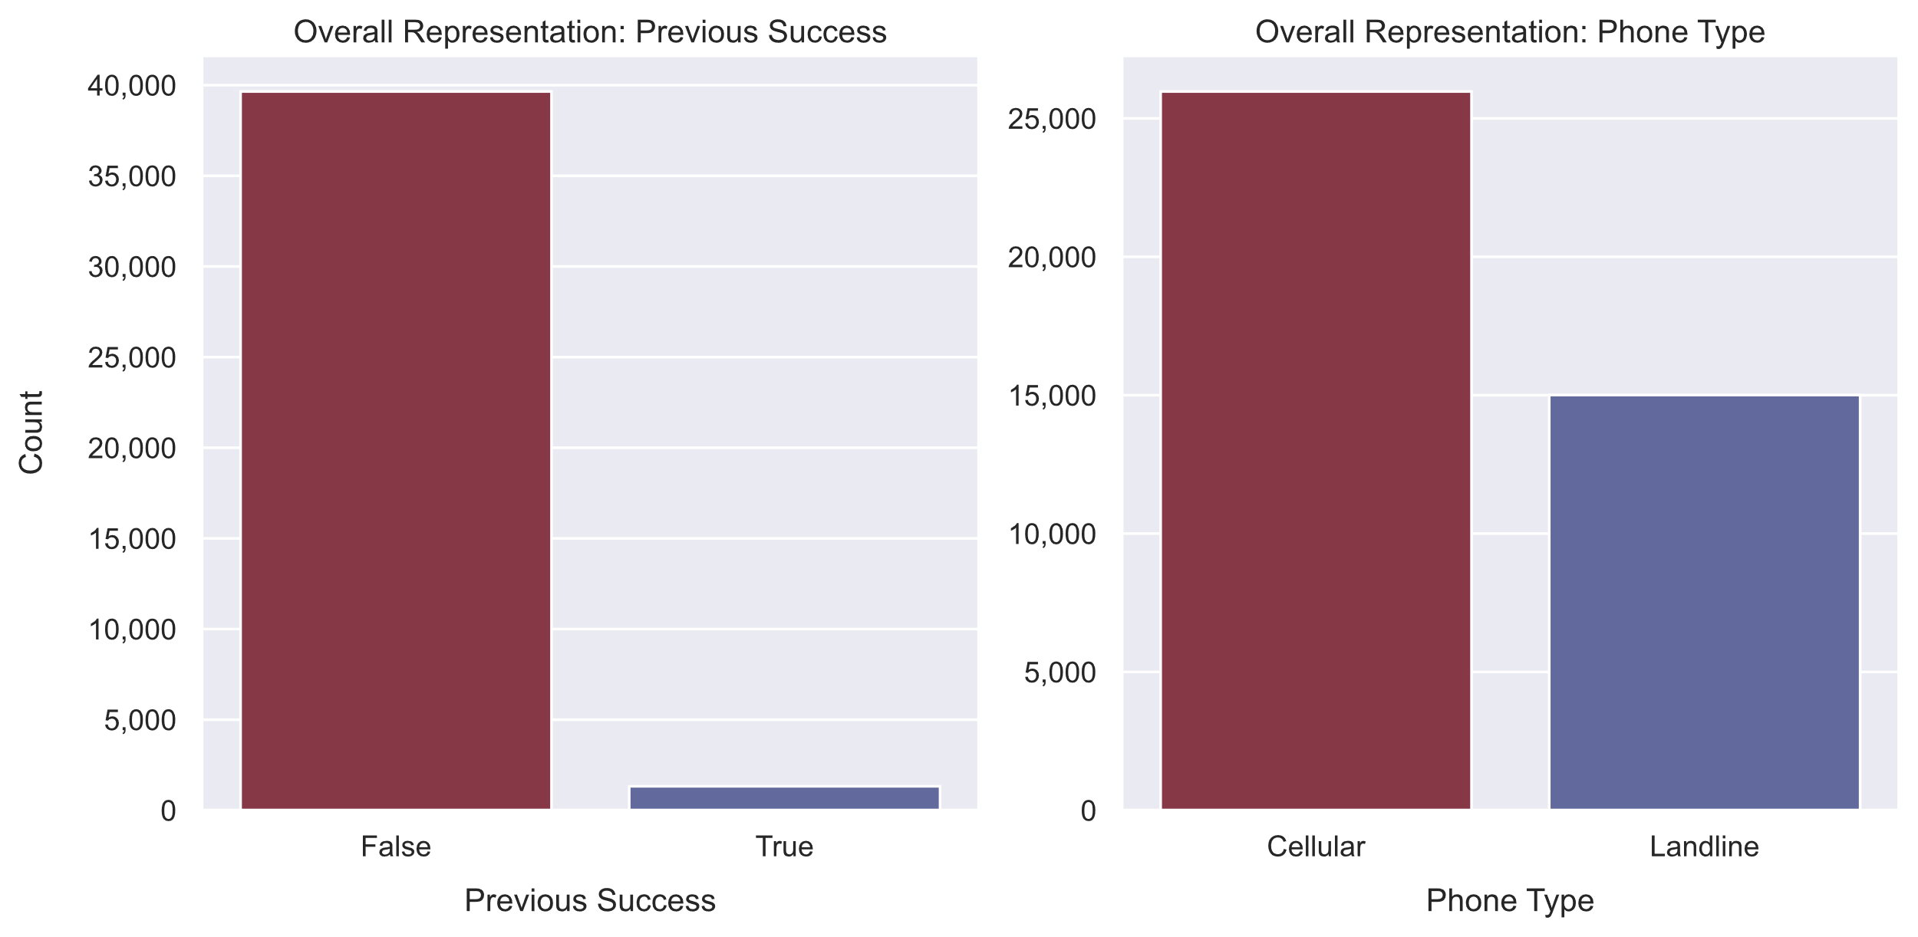
Previous Success is a Major Predictor
Previous success is one of the biggest predictors of future success
Unfortunately, only about ~14% of the customers were previously contacted, and of those only ~3% made a deal
Cell phones are more popular than landlines, but other than that it’s unclear why they have a relationship with conversion
Recommendation:
Spend your energy and resources returning to previous customers who were receptive to marketing.

Slide 10
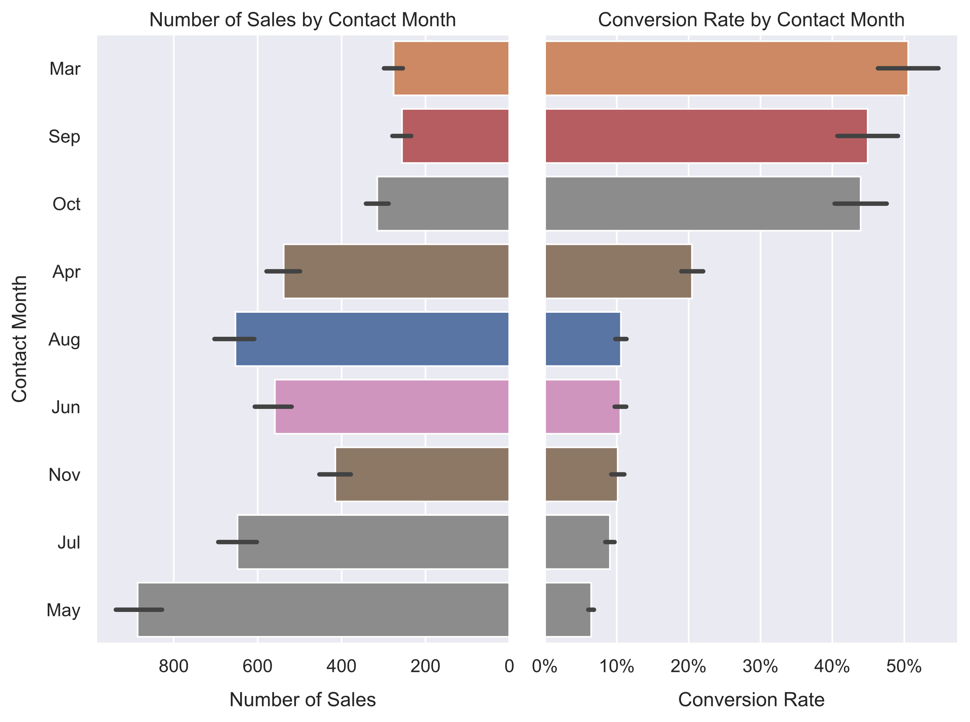
Relax in the Summer
May has the highest total sales by the lowest average conversion rate
It also has by far the most data points of any month, at nearly 14,000
The summer months in general have the highest representation in the dataset
Recommendation: don’t put as much energy into Summer marketing as you’re used to.

Slide 11

Future Work: More Models
Build and optimize models of different types:
Random Forest Classifier
No multi-collinearity issue
Many hyperparameters to tune
Linear Support Vector Classification
Can accommodate datasets of this size, unlike other SVMs
K Neighbors Classification
No multi-collinearity issue
Few hyperparameters to tune, but less sophistication
Experiment with feature engineering and joining with other datasets.
Perhaps other strong positive features like ‘prev_success’ can be engineered
Consider whether new features will be highly correlated with other features, unless using non-linear model

Slide 12

Thank you!

