Slide 2


Slide 3
Click to log in

Slide 4
Gryphons_User_734992

Slide 5



Shut down
Restart

Slide 6
Files







spooky.wav
message.txt
maze.png
code.py
gp.png
black.png
order.png

output.txt

Shut down
Restart

Slide 7

spooky.wav

Shut down
Restart

Slide 8
message.txt
I’m not sure if this challenge will get shortlisted by Gryphons. But I hope it does because I spent WAY too much on making this. :P
I hope you’re having fun with GCTF24, as much as I had fun making it. Good luck! :)

Shut down
Restart

Slide 9
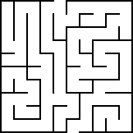
maze.png

Shut down
Restart

Slide 10
code.py
text = "(REMOVED)"
encode = ""
output = open("output.txt", "w", encoding='utf-8')
for i in text:
encode += chr(ord(i) + 12505)
output.write(encode)
output.close()

Shut down
Restart

Slide 11
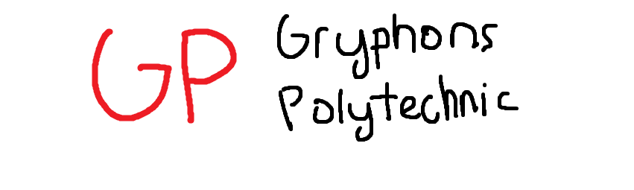
gp.png

Shut down
Restart

Slide 12

black.png

Shut down
Restart

Slide 13
order.png
GCTF24{

ㄞ
(All caps, no spaces!)
}

Shut down
Restart

Slide 14
output.txt
ㄝㄞㄜㄨㄝㄞ

Shut down
Restart

Slide 15
Shutting down…

Slide 18
Restarting…

