Slide 1

Ci/Cd Concepts in the real life
Definition of ci/cd, why we need to use ci/cd

Slide 2
Table of contents
The evolution of industry
What is CI/CD
CI/CD on the business view
Q/A

Slide 3
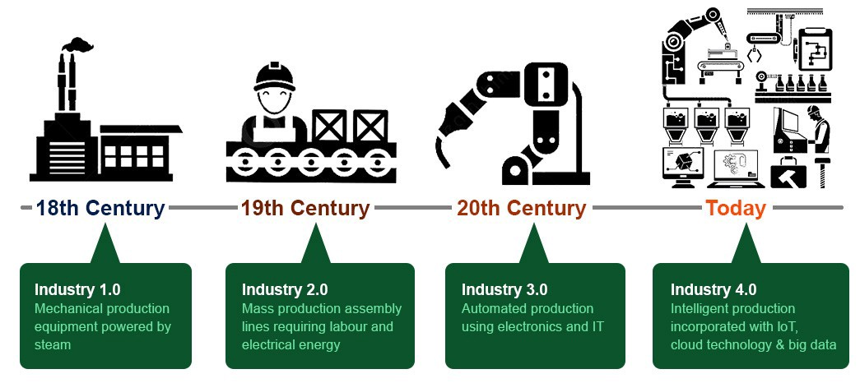
The evolution of industry

Slide 4
Ci/cd is one of key component on the 4.0 industry

Slide 5
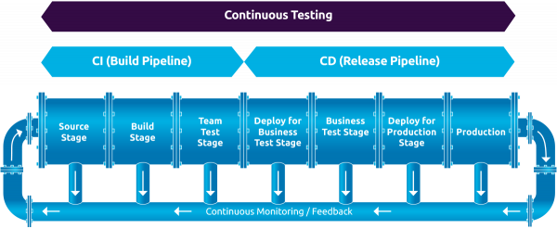
What is ci/cd
The full flow of CI/CD

Slide 6
What is ci/cd
CI/CD is the abbreviation of Continuous Integration / Continuous Deployment. CI/CD is seen as the backbone to enable DevOps.
CI/CD automates much or all of the manual human intervention traditionally needed to get new code from a commit into production, encompassing the build, test (including integration tests, unit tests, and regression tests), and deploy phases, as well as infrastructure provisioning.

Slide 7
What is ci
Continuous integration is the practice of integrating all your code changes into the main branch of a shared source code repository early and often, automatically testing each change when you commit or merge them, and automatically kicking off a build.
With continuous integration, errors and security issues can be identified and fixed more easily, and much earlier in the development process.
Some common CI-related phases might include:
Compile
Unit Test
Static Analysis
Dependency vulnerability testing
Store artifact

Slide 8
What is cd
Continuous delivery is a software development practice that works in conjunction with CI to automate the infrastructure provisioning and application release process.
Some common CD-related phases might include:
Creating infrastructure
Provisioning servers
Copying files
Promoting to production
Smoke Testing (aka Verify)
Rollbacks

Slide 9

CI/CD ON THE BUSINESS

Slide 10
Ci/cd from business view
Reason | Value | Technical side
Less developer time on issues from new developer code | Reduce Cost | Catch Compile Errors After Merge
New value-generating features released more quickly | Increase Revenue | Faster and More Frequent Production Deployments
Less time to market | Increase Revenue | Deploy to Production Without Manual Checks
Reduced downtime from a deploy-related crash or major bug | Protect Revenue | Automated Smoke Tests
Quick undo to return production to working state | Protect Revenue | Automated Rollback Triggered by Job Failure
Less bugs in production and less time in testing | Avoid Cost | Catch Unit Test Failures
Less infrastructure costs from unused resources | Reduce Cost | Automate Infrastructure Cleanup
Less human error, Faster deployments | Avoid Cost | Automate Infrastructure Creation

Slide 11
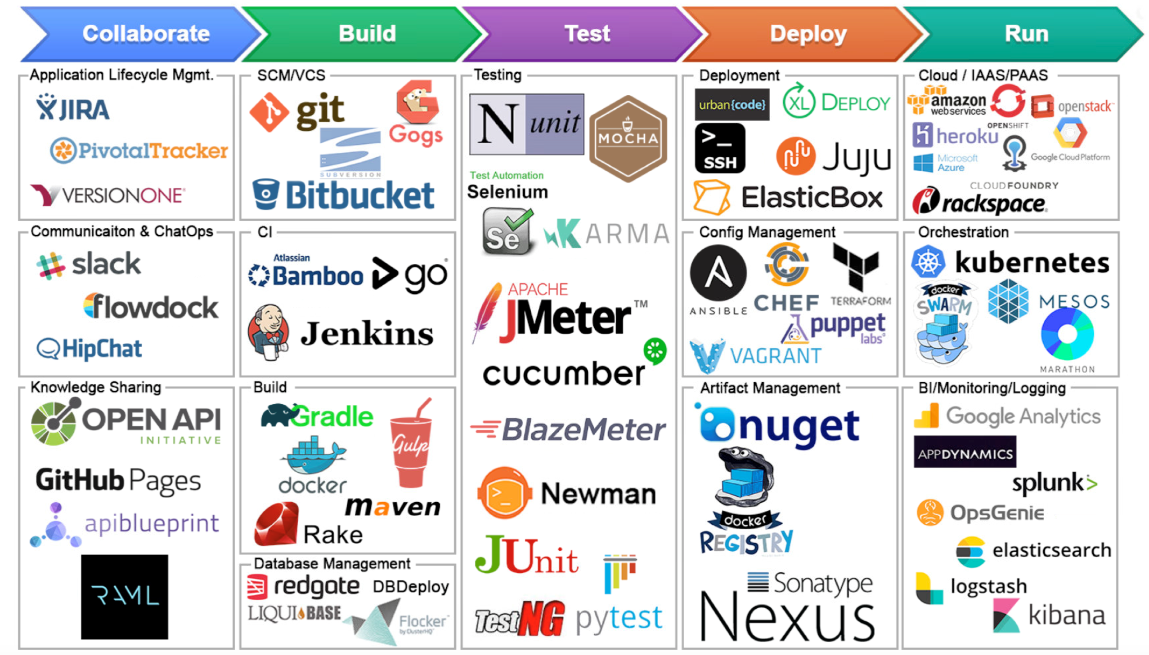
Ci/cd tools

Slide 12


Slide 13


