Slide 1
SSL TUNNEL ANALYSIS
Step 6 — T0 vs Tn
Deformation Analysis
How it works and what the results mean
M3C2 displacement • deformation parameters • per-section warnings
Notes:
Welcome. In this short deck I'll explain Step 6 of the SSL Tunnel Analysis tool: the deformation analysis stage. The idea is simple. We take a baseline scan called T0 and a later monitoring scan called Tn, and we measure exactly how the tunnel surface has moved between them. By the end you'll know how the computation works and how to read every number it produces.

Slide 2
CONTEXT
Where Step 6 fits & what it solves
1 Load
2 Denoise
3 Register T0/Tn
4 Centerline
5 2D Sections
6 Deformation
7 Warnings
Step 6 runs only after T0 + Tn are denoised and registered to a common frame.
Measure surface displacement
Quantify deformation
Compare the Tn cloud against the T0 baseline to see how far each point / section moved (mm).
Crown settlement, lateral convergence, ovality and eccentricity for each cross-section.
Classify risk
(Extension) Trend & forecast
Label every section OK / CAUTION / CRITICAL, tied to its local chainage.
With 3+ epochs: deformation trend over time and time-to-threshold prediction.
2
Notes:
First, where Step 6 sits. The tool is a seven-step pipeline. Steps one to five load, clean, register and slice the point cloud. Step 6 is where we actually measure deformation, and Step 7 raises the warnings. Step 6 only makes sense once T0 and Tn are cleaned and registered to a common frame. It does four things: measure surface displacement, quantify it as engineering parameters, classify risk per section, and, as an extension with more epochs, forecast the trend over time.

Slide 3
CORE CONCEPT
T0, Tn and why registration comes first
T0 — REFERENCE
Tn — MONITORING
Baseline scan, treated as the “clean / undeformed” tunnel. Every displacement is measured RELATIVE to T0.
A later scan (month / quarter). Compared to T0 to get settlement, convergence, ovality and eccentricity at time n.
⚠ Registration must run BEFORE Step 6
The two scans usually sit in different coordinate frames (different setups). Without bringing Tn back into T0’s frame, the difference is setup error — not deformation.
Key: registration aligns on the STABLE majority (trimmed-ICP / fixed targets) and must NOT absorb local deformation.
Verified: register_epochs keeps 32.6 mm of a 60 mm ground-truth local settlement (not flattened to 0).
3
Notes:
Let's define the two scans. T0 is the reference, the baseline we treat as the undeformed tunnel; every displacement is measured relative to it. Tn is a later monitoring scan, perhaps a month or a quarter on. The single most important rule here: registration must happen before Step 6. The two scans usually sit in different coordinate frames, so without alignment the difference you measure is just setup error, not deformation. And crucially, registration aligns on the stable majority; it must not absorb the local deformation we are trying to detect. We verified it keeps thirty-two of a sixty-millimetre ground-truth settlement.

Slide 4
WORKFLOW
The T0 → Tn pipeline inside Step 6
6.1
6.3
5–6
7
Load epochs
→
M3C2 map
→
Parameters
→
Warnings
Load T0 (reference) and Tn (monitoring) point clouds.
Signed surface displacement T0→Tn along normals + level-of-detection (LoD).
Per-section deformation parameters measured against the T0 reference sections.
Classify each section OK / CAUTION / CRITICAL, shared by every view.
For a 2-scan T0/Tn pair this is the full workflow. Multiple epochs (T0…Tn) unlock the 6.2 trend chart and 6.5 forecast.
4
Notes:
Here is the T0-to-Tn pipeline inside Step 6. Step 6.1 loads both epochs. Step 6.3 computes the M3C2 displacement map. Steps five and six extract the per-section parameters against the T0 reference, and Step 7 classifies each section. For a simple two-scan job, that is the whole story. If you have several epochs, you additionally unlock the trend chart and the forecast, which we'll touch on near the end.

Slide 5
6.3 — HOW IT COMPUTES
M3C2: signed displacement + level-of-detection
1
Surface normal
What the numbers mean
At each corepoint, estimate the local surface normal within normal_radius.
distance_mm < 0
surface moved INWARD (settlement / convergence).
|distance| ≤ LoD
within the noise band → no conclusion.
quality_warning
fires if >50% of corepoints have no Tn neighbour (partial scan) → coverage alert.
2
Signed distance
Project the T0→Tn change onto that normal inside cylinder cyl_radius → distance_mm (negative = inward).
3
LoD (detection limit)
lod_mm = uncertainty from roughness / noise. Only |distance| > LoD counts as REAL deformation.
4
significant mask
Flags points above LoD → removes noise, prevents false alarms.
5
Notes:
This is the heart of the measurement: the M3C2 algorithm. At each point we estimate the local surface normal. We then project the change from T0 to Tn onto that normal, giving a signed distance in millimetres; negative means the surface moved inward. The key safeguard is the level of detection, or LoD: the uncertainty from surface roughness and noise. Only displacements larger than the LoD are treated as real, which is what the significant mask captures. And if more than half the points have no neighbour in Tn, a quality warning flags that the scan coverage is incomplete.

Slide 6
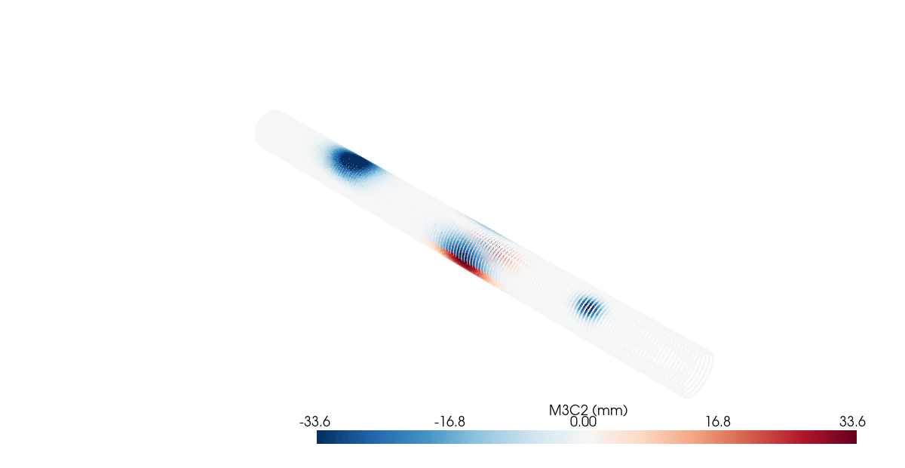
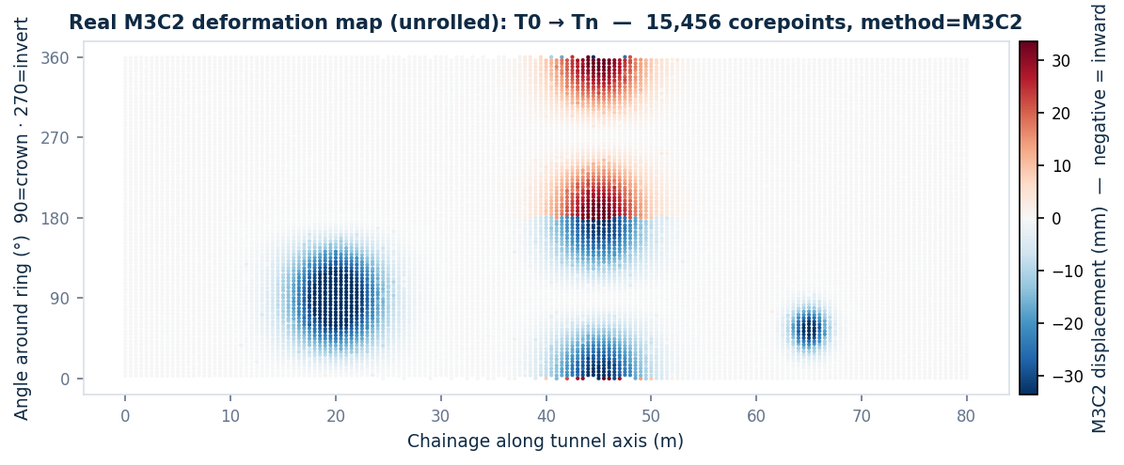
REAL RESULT — TEST DATA
M3C2 deformation map: T0 → Tn
3 local damage zones (match ground truth):
• Crown settlement @ chainage ~20 m (blue, crown)
• Sidewall convergence @ ~45 m
• Local damage @ ~65 m
3D cloud coloured by displacement (PyVista off-screen)
15,456 corepoints · method = M3C2 · real peak displacement −44.5 mm. Not a mock-up — computed from the dataset.
6
Notes:
These are not mock-ups; they are computed live from a real test dataset. On the left is the 3D cloud coloured by displacement, rendered off-screen. On the right is the same data unrolled into a chainage-versus-angle map. You can clearly see three localized damage zones: crown settlement around chainage twenty metres, sidewall convergence near forty-five, and local damage around sixty-five, and those match the dataset's ground truth exactly. Fifteen thousand corepoints, with a real peak displacement of minus forty-four millimetres.

Slide 7
MAIN OUTPUTS
4 deformation parameters & warning thresholds
Crown settlement
Lateral convergence (dW)
Lowering of the tunnel crown vs T0.
Narrowing of the width between sidewalls.
CAUTION > 10 mm
CRITICAL > 25 mm
CAUTION > 10 mm
CRITICAL > 25 mm
Ovality
Eccentricity
Distortion away from the ideal circle.
Shift of the section centre vs the axis.
CAUTION > 0.5 %
CRITICAL > 1.0 %
CAUTION > 10 mm
CRITICAL > 25 mm
7
Notes:
Step 6 condenses the displacement field into four engineering parameters per cross-section. Crown settlement is the lowering of the tunnel top. Lateral convergence is the narrowing between the sidewalls. Ovality measures distortion away from a perfect circle, and eccentricity is the shift of the section's centre from the axis. Each has a caution and a critical threshold: ten and twenty-five millimetres for the linear ones, and half a percent and one percent for ovality. These thresholds drive the colour-coding you see throughout the tool.

Slide 8
RISK CLASSIFICATION
Per-section thresholds (vs T0)
Metric | Meaning | CAUTION | CRITICAL
dW / dH / dR | Width / height / radius change vs T0 | ≥ 10 mm | ≥ 25 mm
dOval | Ovality change vs T0 | ≥ 0.5 % | ≥ 1.0 %
dEcc | Eccentricity change vs T0 | ≥ 10 mm | ≥ 25 mm
clearance | Clearance-envelope intrusion | — | violation = CRITICAL
“Local gate” — stops blanket alarms
dOval, dEcc, single-scan:
flag only when the value exceeds the threshold AND is a local anomaly (v ≥ median + 3·MAD). Suppresses a uniform registration bias painting the whole tunnel red.
dW, dH, dR:
absolute threshold (no local gate) — a real dimension change is real deformation, even across a wide band.
One classifier shared by 2D / ruler / 3D / dashboard → every view stays consistent.
8
Notes:
Warnings are assigned per section, comparing Tn against T0. The table lists the thresholds: dimension changes and eccentricity at ten and twenty-five millimetres, ovality at half and one percent, and any clearance intrusion is automatically critical. The clever part is on the right: the local gate. For ovality, eccentricity and single-scan metrics, we only raise a flag if the value is also a local anomaly, three MADs above the median. This stops a uniform registration bias from painting the whole tunnel red. Direct dimension changes, however, use the absolute threshold, because a real width change is real even over a long stretch. One shared classifier feeds every view, so the 2D, 3D, ruler and dashboard always agree.

Slide 9
READING RESULTS — REAL EXAMPLE
complex_warning dataset (80 sections)
92.0 mm
measured crown_max
GT ≈ 90 mm — matches
100 %
recall over deformation band
17/17 band sections flagged
38
CRITICAL sections
correctly localised to the damage zone
9
Notes:
Here is how a real result reads. On the complex test dataset of eighty sections, the tool flagged thirty-eight critical, nine caution, and thirty-three OK. The measured maximum crown settlement was ninety-two millimetres against a ground truth of about ninety, a close match. And recall over the known deformation band was one hundred percent: every one of the seventeen affected sections was flagged. So the tool both measures the magnitude correctly and localizes the damage.

Slide 10
EXTENSION — MULTIPLE EPOCHS (T0…TN)
Trend chart & threshold forecast
Only with 3+ epochs
6.2 Trend:
track the max_abs PEAK — median ≈ 0 even when the peak is 44.5 mm (local defect hidden by whole-cloud stats).
6.5 Forecast:
fit the trend → rate = +14.94 mm/unit, R² = 1.00, time-to-CAUTION/CRITICAL.
R² < 0.5 → low_confidence: do not trust the extrapolation.
10
Notes:
If you have three or more epochs, two more features open up. The trend chart on the left plots displacement over time. Notice the crucial point: we track the max_abs peak, the red line, because the median stays near zero even when the peak reaches forty-four millimetres, since a local defect is diluted across the whole cloud. The forecast then fits that trend, here about fifteen millimetres per epoch with an R-squared of one, and predicts when it will cross the caution and critical thresholds. But trust the forecast only when R-squared is at least zero point five.

Slide 11
MEANING & CAUTIONS
Read the results correctly
Sign of displacement
LoD is a filter
Coverage warning
Negative = inward (settlement/convergence), positive = outward. Always read with chainage for LOCATION.
Values below LoD sit in the noise — don’t conclude deformation from them.
quality_warning fires when Tn is under-scanned (>50% with no neighbour) — results then unreliable.
Registration preserves it
Local beats global
Forecast needs R²
Alignment locks the stable part; local deformation is NOT cancelled (verified).
Track the max_abs peak and warn per section, not whole-cloud percentiles.
Trust threshold forecasts only with R² ≥ 0.5 and ≥ 3 epochs.
11
Notes:
A few rules for reading results correctly. The sign tells direction; negative is inward, and you must always read it together with chainage to know where. Treat the LoD as a filter; anything below it is just noise. Watch for the coverage warning on partial scans. Remember registration preserves local deformation rather than cancelling it. Always favour the local peak over global averages. And only trust a forecast with a good fit and enough epochs.

Slide 12
SUMMARY
Step 6 in one sentence
Compare Tn against the T0 baseline to measure surface displacement (M3C2 + LoD), quantify per-section deformation, and flag CAUTION / CRITICAL tied to the local chainage.
✓
Denoise + register T0/Tn before running 6.x
✓
6.3 M3C2: trust only points above LoD; check quality_warning
✓
Read displacement with chainage; one classifier across all views
✓
Track the local peak (max_abs), not whole-cloud median / percentile
✓
Multi-epoch only: trend (6.2) + forecast (6.5) need ≥ 3 epochs & R² ≥ 0.5
Notes:
To summarise in one sentence: Step 6 compares Tn against the T0 baseline to measure surface displacement with M3C2 and the level of detection, quantifies deformation per section, and flags caution or critical tied to the local chainage. The checklist on screen is your practical guide: clean and register first, trust only points above the LoD, read displacement with chainage, prefer the local peak, and remember the trend and forecast need at least three epochs. Thank you.

