Slide 1
SSL TUNNEL ANALYSIS
Step 6 — T0 vs Tn
Deformation Analysis
How it works and what the results mean
M3C2 displacement • deformation parameters • per-section warnings
Notes:
Step 6 is the deformation stage. We compare a baseline scan, T0, with a later scan, Tn, and measure how the tunnel surface moved between them.

Slide 2
CONTEXT
Where Step 6 fits & what it solves
1 Load
2 Denoise
3 Register T0/Tn
4 Centerline
5 2D Sections
6 Deformation
7 Warnings
Step 6 runs only after T0 + Tn are denoised and registered to a common frame.
Measure surface displacement
Quantify deformation
Compare the Tn cloud against the T0 baseline to see how far each point / section moved (mm).
Crown settlement, lateral convergence, ovality and eccentricity for each cross-section.
Classify risk
(Extension) Trend & forecast
Label every section OK / CAUTION / CRITICAL, tied to its local chainage.
With 3+ epochs: deformation trend over time and time-to-threshold prediction.
2
Notes:
Step 6 is the sixth of seven steps. It runs after T0 and Tn are cleaned and registered, and does four things: measure displacement, quantify it, classify risk, and optionally forecast.

Slide 3
6.3 — HOW IT COMPUTES
M3C2: signed displacement + level-of-detection
1
Surface normal
What the numbers mean
At each corepoint, estimate the local surface normal within normal_radius.
distance_mm < 0
surface moved INWARD (settlement / convergence).
|distance| ≤ LoD
within the noise band → no conclusion.
quality_warning
fires if >50% of corepoints have no Tn neighbour (partial scan) → coverage alert.
2
Signed distance
Project the T0→Tn change onto that normal inside cylinder cyl_radius → distance_mm (negative = inward).
3
LoD (detection limit)
lod_mm = uncertainty from roughness / noise. Only |distance| > LoD counts as REAL deformation.
4
significant mask
Flags points above LoD → removes noise, prevents false alarms.
5
Notes:
M3C2: at each point we project the T0-to-Tn change onto the surface normal, giving a signed distance. Negative means inward. Only values above the LoD, the noise limit, count as real.

Slide 4
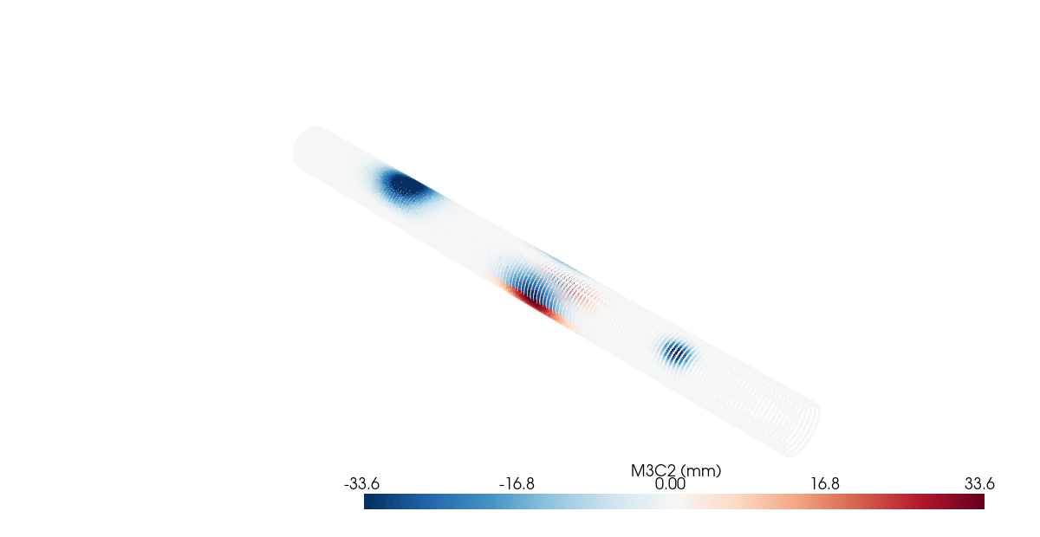
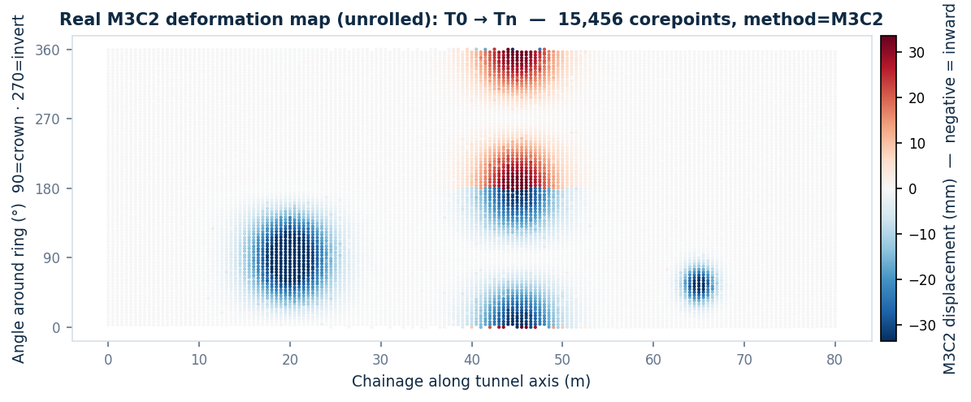
REAL RESULT — TEST DATA
M3C2 deformation map: T0 → Tn
3 local damage zones (match ground truth):
• Crown settlement @ chainage ~20 m (blue, crown)
• Sidewall convergence @ ~45 m
• Local damage @ ~65 m
3D cloud coloured by displacement (PyVista off-screen)
15,456 corepoints · method = M3C2 · real peak displacement −44.5 mm. Not a mock-up — computed from the dataset.
6
Notes:
Real data, not a mock-up. Both views show three damage zones: crown at twenty metres, sidewall at forty-five, local damage at sixty-five, matching ground truth. Peak: minus forty-four millimetres.

Slide 5
MAIN OUTPUTS
4 deformation parameters & warning thresholds
Crown settlement
Lateral convergence (dW)
Lowering of the tunnel crown vs T0.
Narrowing of the width between sidewalls.
CAUTION > 10 mm
CRITICAL > 25 mm
CAUTION > 10 mm
CRITICAL > 25 mm
Ovality
Eccentricity
Distortion away from the ideal circle.
Shift of the section centre vs the axis.
CAUTION > 0.5 %
CRITICAL > 1.0 %
CAUTION > 10 mm
CRITICAL > 25 mm
7
Notes:
Four parameters per section: crown settlement, lateral convergence, ovality and eccentricity. Each has a caution and a critical threshold that drive the colour-coding.

Slide 6
RISK CLASSIFICATION
Per-section thresholds (vs T0)
Metric | Meaning | CAUTION | CRITICAL
dW / dH / dR | Width / height / radius change vs T0 | ≥ 10 mm | ≥ 25 mm
dOval | Ovality change vs T0 | ≥ 0.5 % | ≥ 1.0 %
dEcc | Eccentricity change vs T0 | ≥ 10 mm | ≥ 25 mm
clearance | Clearance-envelope intrusion | — | violation = CRITICAL
“Local gate” — stops blanket alarms
dOval, dEcc, single-scan:
flag only when the value exceeds the threshold AND is a local anomaly (v ≥ median + 3·MAD). Suppresses a uniform registration bias painting the whole tunnel red.
dW, dH, dR:
absolute threshold (no local gate) — a real dimension change is real deformation, even across a wide band.
One classifier shared by 2D / ruler / 3D / dashboard → every view stays consistent.
8
Notes:
Sections are flagged versus T0. The local gate stops a uniform bias painting the whole tunnel; ovality and eccentricity must also be local anomalies. Dimension changes use the absolute threshold. One classifier feeds every view.

