Slide 1
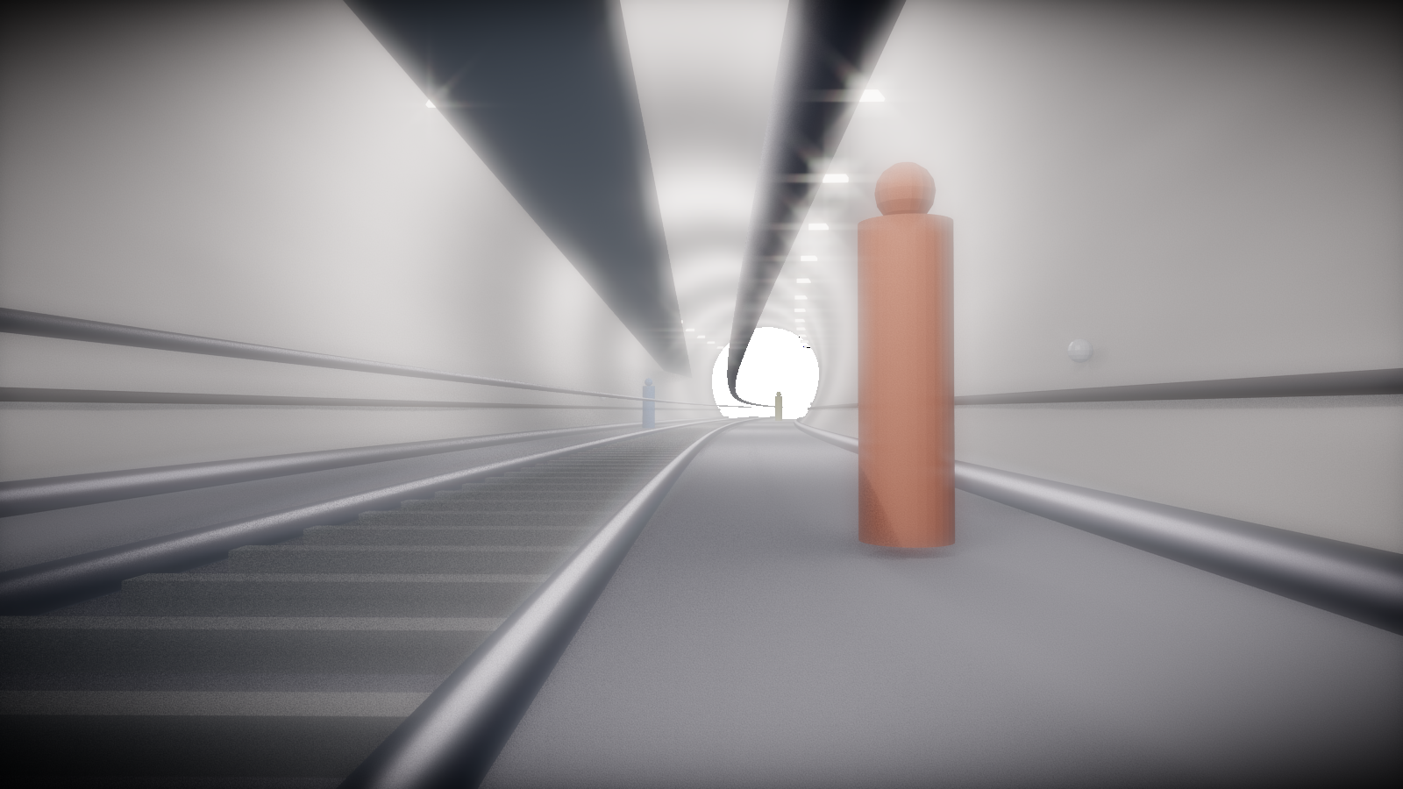
Tunnel Crown Settlement Monitoring Workflow
Blender Ground Truth → Raycast TLS → Step 6 Validation
Dataset
Measured Point
Main Result
curved_real_scale_railway_tunnel_t0t5 T0–T5 railway tunnel settlement
Crown / Đỉnh hầm Location: Ch 52.0m
Regular MAPE 1.15% Raycast MAPE 2.315%
Representative railway tunnel environment
CBNU Smart Structure Lab · Step 6 Crown-First Validation

Slide 2
STEP 6 VALIDATION
Research Goal
Monitor tunnel settlement over time using point-cloud scan epochs.
Measure the same engineering location: Crown / Đỉnh hầm at Ch 52.0m.
Report total settlement, new movement from previous epoch, and status.
Keep the main Step 6 decision metric simple: crown_settlement_mm.
Decision Output
OK / Warning / Danger based on absolute crown settlement.
Warning Threshold
Warning ≥ 10 mm
Danger Threshold
Danger ≥ 25 mm

Slide 3
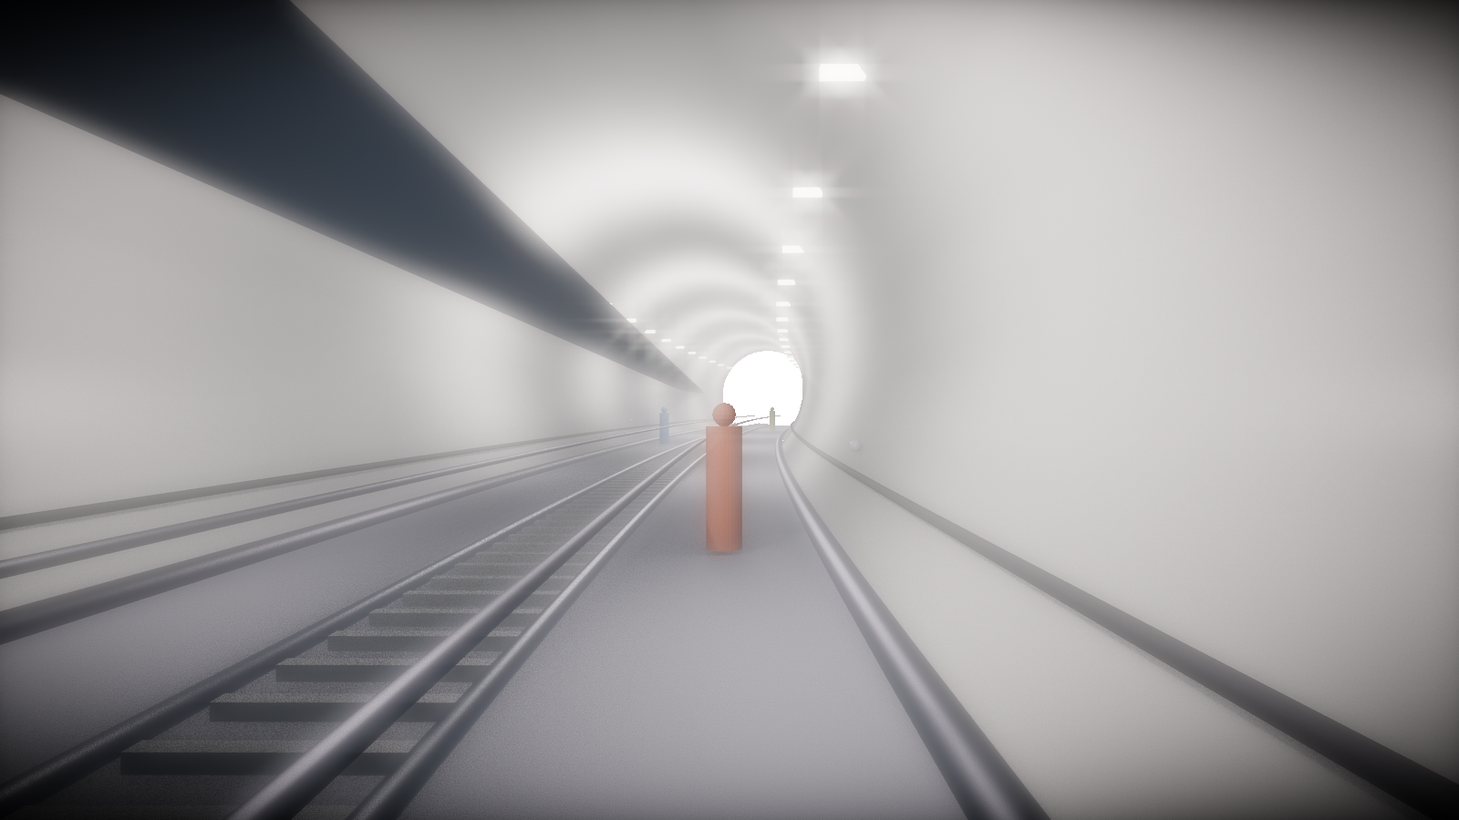
STEP 6 VALIDATION
Overall Workflow
1
2
3
4
5
6
Blender tunnel model
Ground truth T0–T5
Regular clean dataset
Raycast TLS field-like
Step 6 analysis
Accuracy comparison
The same crown location is tracked across all epochs and both data branches.
Workflow targets field-like tunnel scanning conditions

Slide 4
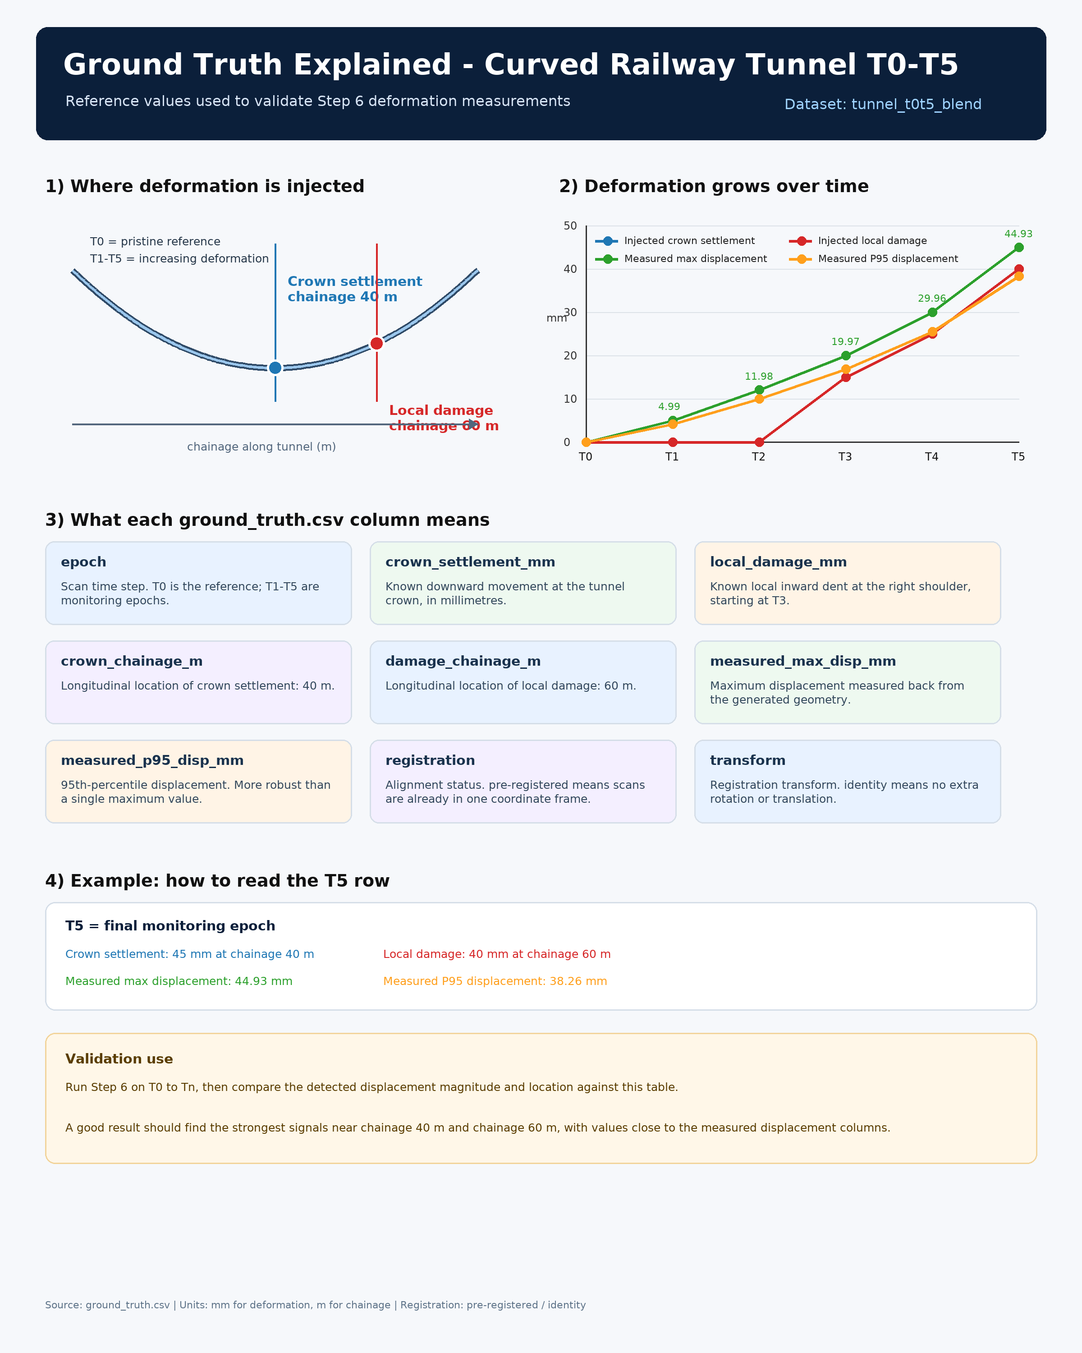
STEP 6 VALIDATION
Blender Ground Truth Setup
Curved railway tunnel generated at real scale.
Known crown settlement is injected by epoch.
Ground truth gives a controlled benchmark for Step 6.
T1 -10.0mm
T2 -22.0mm
Epoch | T0 | T1 | T2 | T3 | T4 | T5
GT mm | 0 | -10 | -22 | -38 | -58 | -80
T3 -38.0mm
T4 -58.0mm
T5 -80.0mm
Known truth for validation
Ground-truth settlement explanation used for validation

Slide 5
STEP 6 VALIDATION
Two Test Data Branches
Regular clean
Raycast field-like TLS
Clean lining surface Low noise and no TLS occlusion Purpose: ideal algorithm check Expected: lowest error
Simulated scanning stations Noise, dropout, and occlusion Purpose: field readiness check Expected: higher but acceptable error
Regular tests the best-case algorithm; raycast tests practical field behavior.

Slide 6
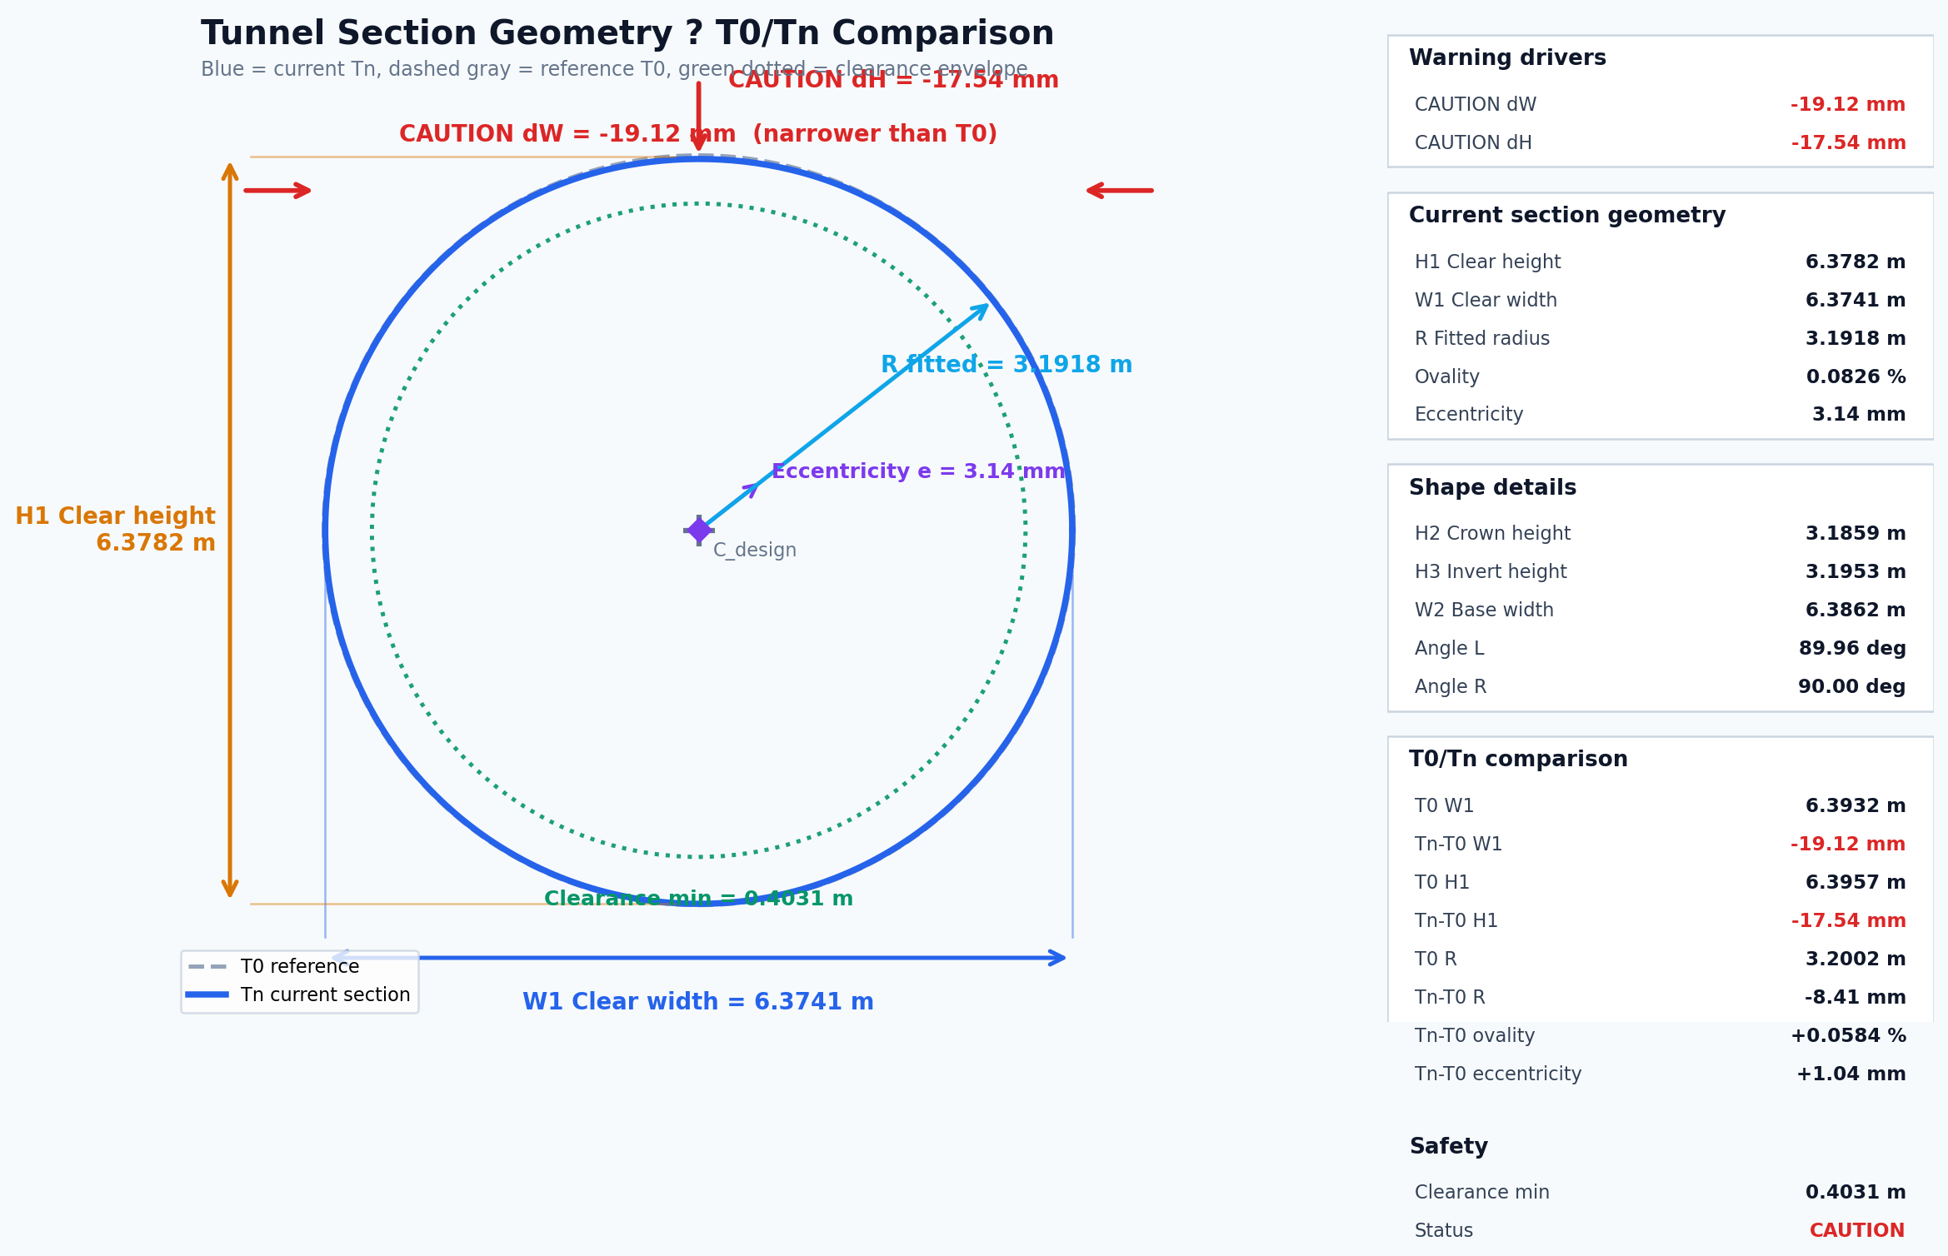
STEP 6 VALIDATION
Step 6 Crown-First Design
Main metric
Measured point
Location
Rule
crown_settlement_mm
Crown / Đỉnh hầm
Ch 52.0m
abs(crown)
M3C2 and p95 remain supplementary context, not the main settlement result.
Warning starts at 10 mm; Danger starts at 25 mm.
Chart, table, 2D marker, CSV, Excel, and PDF should all point to the same metric.
Section parameters are available, but Step 6 conclusion remains crown-first.

Slide 7
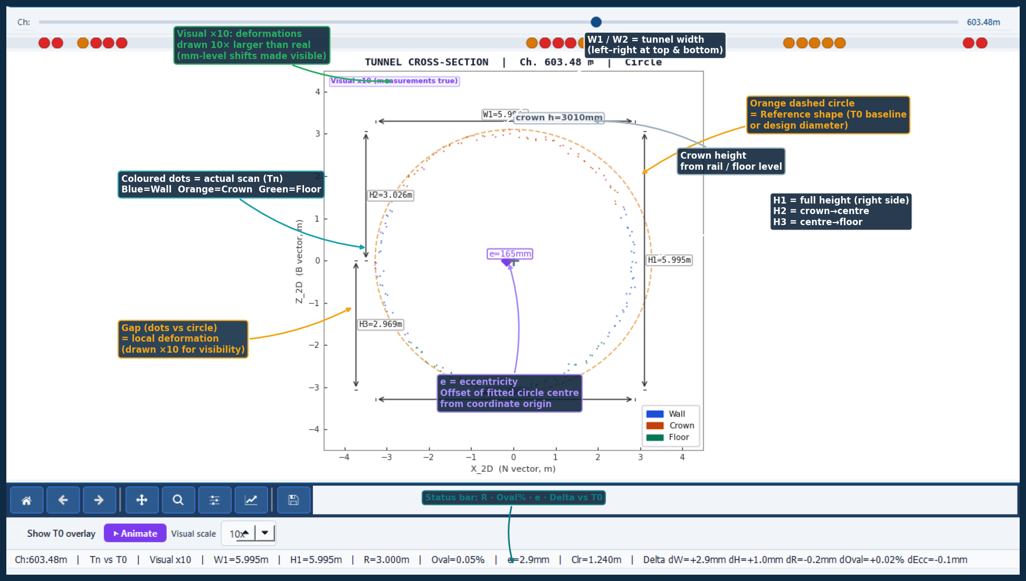
STEP 6 VALIDATION
Step 6 UI Improvements
Time | Location | Measured point | Crown | New move | Result
T5 | Ch 52.0m | Crown / Đỉnh hầm | -79.1 | -21.8 | Danger
User-facing goal
The engineer can answer three questions quickly: 1. Where was it measured? 2. How much did it settle? 3. Is it OK, Warning, or Danger?
Measured point markers for T1–T5 on the 2D section.
Checkboxes hide/show marker per epoch; lines remain visible.
Crown visual x10 magnifies display only; measurements stay true.
2D section view: marker/outline evidence

Slide 8
STEP 6 VALIDATION
Accuracy Result Table
Time | GT | Regular | Raycast | Reg err % | Ray err %
T0 | 0 | 0 | 0 | 0.00 | 0.00
T1 | -10 | -9.9 | -10.243 | 1.00 | 2.43
T2 | -22 | -21.7 | -21.632 | 1.36 | 1.67
T3 | -38 | -37.6 | -37.07 | 1.05 | 2.45
T4 | -58 | -57.3 | -56.607 | 1.21 | 2.40
T5 | -80 | -79.1 | -77.9 | 1.12 | 2.62
Regular MAPE
1.15%
Raycast MAPE
2.315%
Raycast is harder because it includes field-like noise and occlusion, but error remains around 2–3%.

Slide 9
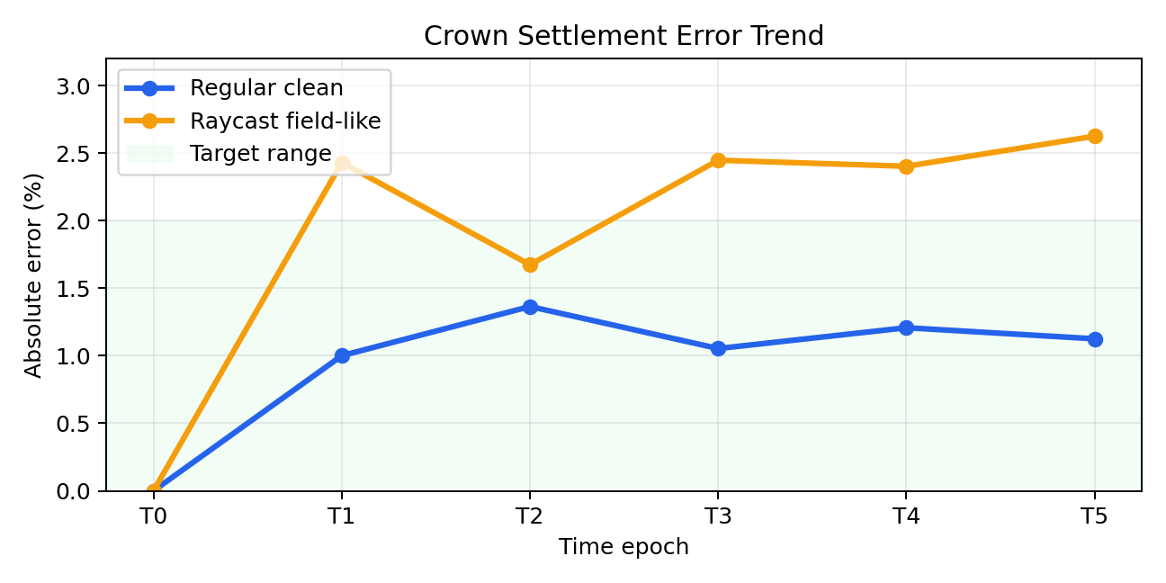
STEP 6 VALIDATION
Error Trend Visualization
Interpretation
Regular clean stays close to ~1% error.
Field-like result
Raycast error is higher but stable and acceptable.
Trend
Settlement magnitude follows T0→T5 correctly.

Slide 10
STEP 6 VALIDATION
2D Section Visual Evidence
QA rule
Marker must sit on the matching T line. Checkboxes hide markers only, not the section lines.
T1: -9.9mm
T2: -21.7mm
T3: -37.6mm
T4: -57.3mm
T5: -79.1mm
Actual 2D section evidence: measured marker should sit on the displayed outline.
Measured points are visual markers on the displayed outline; measurements remain true.

Slide 11
STEP 6 VALIDATION
Field Readiness
Curved tunnel centerline supports non-straight railway tunnel geometry.
Raycast branch simulates multiple TLS stations and field occlusion.
Robust 2D outline reduces visual spikes from rails, pipes, and cables.
Simple Step 6 table is readable for field engineers.
Practical limitation
For raw field scans, denoise and lining extraction should be performed before official Step 6 evaluation.
What is validated?
Crown settlement trend and magnitude are recovered accurately in both clean and raycast conditions.
Field readiness target: railway tunnel TLS workflow

Slide 12
STEP 6 VALIDATION
Conclusion
Regular MAPE
Raycast MAPE
Measured at
1.15%
2.315%
Ch 52.0m
The tool measures crown settlement close to known Blender ground truth.
Step 6 now uses one main metric consistently: crown_settlement_mm.
The workflow is ready for additional real TLS scan validation.
Next work: test real field scans and calibrate preprocessing for different tunnel types.

Slide 13
VALIDATION LOGIC
Validation logic: compare three versions of the same tunnel
Purpose: prove how much the Step 6 tool deviates from known Blender ground truth.
Ground truth
Regular clean
3D Blender model
Known crown settlement: 0, -10, -22, -38, -58, -80 mm.
Direct clean lining export. Tests the ideal algorithm condition.
Step 6 tool
Error
Curved railway tunnel with lining, rail, pipes, cables, lights and equipment.
Measure crown settlement for T0-T5 using the same crown point.
mm %
Same location
Raycast TLS
Crown / Dinh ham at Ch 52.0m for every epoch.
Simulated scanner with noise, occlusion and dropout. Tests field-like condition.
Error mm = Tool result - Ground truth
Error % = |Error mm| / |Ground truth| x 100
T0 is excluded from MAPE because the ground-truth settlement is 0 mm.

Slide 14
ACCURACY RESULT
Three-way comparison result: ground truth vs regular vs raycast
Time | Ground truth | Regular tool | Raycast tool | Regular error | Raycast error
T0 | 0.0 | 0 | 0 | - | -
T1 | -10.0 | -9.9 | -10.243 | 1.00% | 2.43%
T2 | -22.0 | -21.7 | -21.632 | 1.36% | 1.67%
T3 | -38.0 | -37.6 | -37.07 | 1.05% | 2.45%
T4 | -58.0 | -57.3 | -56.607 | 1.21% | 2.40%
T5 | -80.0 | -79.1 | -77.9 | 1.13% | 2.63%
Regular MAPE
Raycast MAPE
1.15%
2.315%
Interpretation
Regular clean has lower error because it is a clean surface export. Raycast is harder because it simulates field TLS effects such as noise, occlusion and missing points.
Main conclusion: both branches follow the same settlement trend from T0 to T5, so Step 6 can quantify crown settlement reliably.
Main metric only: Crown settlement / Lun dinh ham at Ch 52.0m. M3C2/p95 are supplementary, not the final conclusion.

