Slide 1
Easy Workflow to Validate Tunnel Settlement Tool
From Blender 3D model to ground truth, raycast data, regular data, and tool error comparison
Main point
Location
Regular MAPE
Raycast MAPE
Crown
Ch 52.0m
1.15%
2.315%
Goal: prove how much Step 6 differs from known ground truth.

Slide 2
STEP 1
Step 1 — Create the 3D tunnel model in Blender
Input model
Why this matters
A curved railway tunnel is built at real scale. It includes lining, rail, walkway, pipes, cables, lights and equipment.
The Blender model is controlled by us. That means we know exactly what deformation is applied later.
Simple meaning: Blender is the source model used to generate all test data.

Slide 3
STEP 2
Step 2 — Create ground truth settlement
Use the same tunnel for T0, T1, T2, T3, T4, T5.
Apply known settlement at the crown.
This known value becomes the answer key.
Ground truth at Crown / Ch 52.0m
T0 = 0 mm T1 = -10 mm T2 = -22 mm T3 = -38 mm T4 = -58 mm T5 = -80 mm
Simple meaning: we already know the correct settlement, so we can check the tool.

Slide 4
STEP 3
Step 3 — Create regular clean data without raycasting
Regular clean
Purpose
Export the clean tunnel lining surface directly from Blender. This data has very little noise and no scanner occlusion.
Check the measurement algorithm in ideal conditions. If this branch is wrong, the tool logic may be wrong.
Simple meaning: regular clean tests whether the tool can measure correctly on clean data.

Slide 5
STEP 4
Step 4 — Create raycast TLS data like field scanning
Raycast field-like TLS
Field-like effects
Simulate laser scanning from multiple stations along the curved tunnel. Rays hit the model and create a point cloud.
This data can include noise, missing points, occlusion and objects inside the tunnel. It is closer to real TLS data.
Simple meaning: raycast tests whether the tool still works when data looks more realistic.

Slide 6
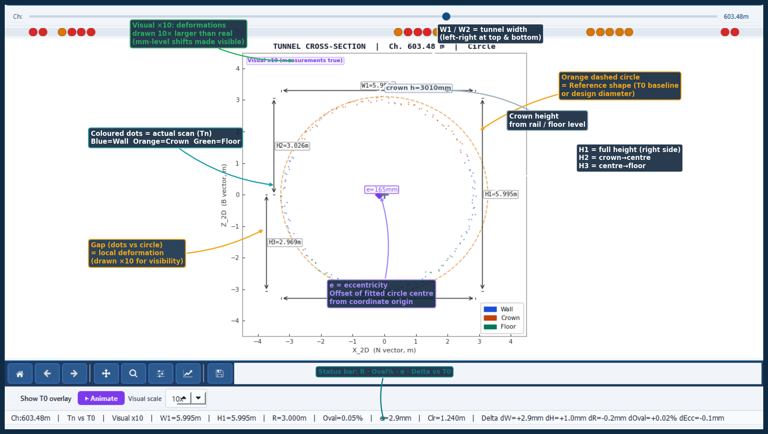
STEP 5
Step 5 — Run Step 6 on both datasets
Metric
Location
Epochs
Output
Crown
Ch 52.0m
T0–T5
Result
Crown settlement = total settlement compared with T0.
New crown move = movement added from the previous epoch.
Result = OK, Warning or Danger.
M3C2/p95 are supplementary checks, not the main conclusion.

Slide 7
STEP 6
Step 6 — Compare three versions to find tool error
Regular result
Tool result on clean data.
Ground truth
Compare
Final error
Known answer from Blender.
Tool − ground truth.
Error in mm and %.
Raycast result
Tool result on field-like data.
Error mm = Tool result − Ground truth
Error % = |Error mm| / |Ground truth| × 100
T0 is not used in MAPE because its ground truth is 0 mm.

Slide 8
RESULT
Accuracy result and conclusion
Time | Ground truth | Regular tool | Raycast tool | Regular error | Raycast error
T0 | 0.0 | 0 | 0 | - | -
T1 | -10.0 | -9.9 | -10.243 | 1.00% | 2.43%
T2 | -22.0 | -21.7 | -21.632 | 1.36% | 1.67%
T3 | -38.0 | -37.6 | -37.07 | 1.05% | 2.45%
T4 | -58.0 | -57.3 | -56.607 | 1.21% | 2.40%
T5 | -80.0 | -79.1 | -77.9 | 1.13% | 2.63%
Regular MAPE
Pass limit
1.15%
< 2%
Raycast MAPE
Pass limit
2.315%
< 5%
Both branches pass the validation criteria.
Raycast error is higher, but acceptable because it simulates field noise and occlusion.

Slide 9
SUMMARY
Final message for the professor
The tool is validated by comparing Step 6 results against known Blender ground truth.
Clean branch
Raycast branch
Main metric
Algorithm check MAPE = 1.15% PASS
Field-like check MAPE = 2.315% PASS
Crown settlement Crown / Ch 52.0m
Regular clean proves the tool works in ideal conditions.
Raycast TLS proves the tool remains accurate with realistic scanning effects.
Next step: test and calibrate with real tunnel TLS scans.

