Slide 1
Tunnel Crown Settlement Validation Workflow
Blender ground truth → Regular clean → Raycast TLS → Step 6 accuracy check
Regular MAPE
Raycast MAPE
Measured point
1.15%
2.315%
Ch 52.0m
Main metric: Crown settlement / Lún đỉnh hầm
Dataset: curved railway tunnel T0–T5

Slide 2
STEP 6 VALIDATION
Goal: validate the tool using known settlement
Create one controlled tunnel model in Blender.
Apply known crown settlement from T0 to T5.
Run Step 6 on generated point clouds.
Compare tool output with known ground truth.
Ground truth settlement at Crown / Ch 52.0m
T0 = 0 mm T1 = -10 mm T2 = -22 mm T3 = -38 mm T4 = -58 mm T5 = -80 mm
Because the true deformation is known, the measured tool error can be calculated directly.

Slide 3
STEP 6 VALIDATION
Complete workflow: one model, three comparable versions
Ground truth
Regular clean
Known settlement values.
Direct clean lining export.
3D Blender model
Step 6
Error
Curved railway tunnel with real-scale components.
Measure crown settlement.
mm %
Same crown point
Raycast TLS
Crown / Ch 52.0m.
Simulated scanner noise and occlusion.
Error mm = Tool result − Ground truth
Error % = |Error mm| / |Ground truth| × 100

Slide 4
STEP 6 VALIDATION
What each dataset proves
Dataset | What it proves
Ground truth | Known settlement from Blender; reference for error calculation.
Regular clean | Algorithm accuracy under clean, ideal lining data.
Raycast TLS | Field-like robustness with scan noise, occlusion and dropout.
All three versions come from the same Blender model and are measured at the same crown location.
This separates algorithm error from field-like scan effects.

Slide 5
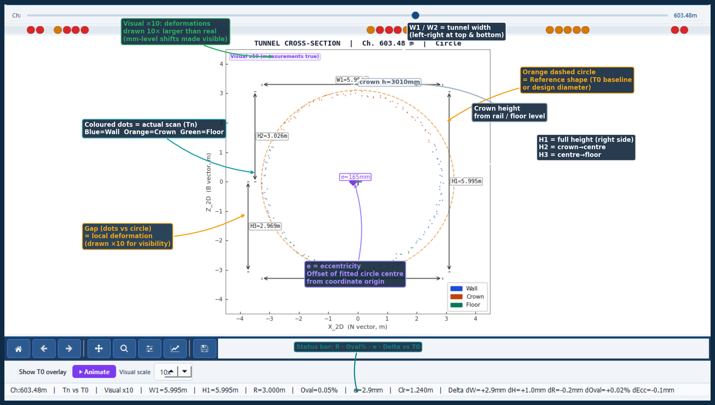
STEP 6 VALIDATION
Measured point: same crown location for every epoch
Point
Location
Epochs
Display
Crown
Ch 52.0m
T0–T5
2D marker
The marker is visual evidence only; the measurement values remain true and are not changed by display scaling.

Slide 6
STEP 6 VALIDATION
Validation criteria: both branches pass
Regular clean criterion
Raycast TLS criterion
Pass if MAPE < 2% Actual result: 1.15% Status: PASS
Pass if MAPE < 5% Actual result: 2.315% Status: PASS
Tool passes controlled validation: clean accuracy is high and field-like robustness is acceptable.
Raycast error is expected to be higher because it includes scanner noise, occlusion and missing points.

Slide 7
STEP 6 VALIDATION
Accuracy result: tool output vs ground truth
Time | GT | Regular | Raycast | Reg err | Ray err
T0 | 0.0 | 0 | 0 | - | -
T1 | -10.0 | -9.9 | -10.243 | 1.00% | 2.43%
T2 | -22.0 | -21.7 | -21.632 | 1.36% | 1.67%
T3 | -38.0 | -37.6 | -37.07 | 1.05% | 2.45%
T4 | -58.0 | -57.3 | -56.607 | 1.21% | 2.40%
T5 | -80.0 | -79.1 | -77.9 | 1.13% | 2.63%
Regular MAPE
Raycast MAPE
1.15%
2.315%
Regular is more accurate because the surface is clean. Raycast error is higher because it includes field-like scan effects.
Both still follow the same T0→T5 settlement trend, so Step 6 quantifies crown settlement reliably.
T0 is not used in MAPE because its ground truth is 0 mm.

Slide 8
STEP 6 VALIDATION
Conclusion
The workflow validates Step 6 against a known Blender ground truth.
Clean data error
Field-like error
Measured at
1.15%
2.315%
Crown / Ch 52m
Regular clean validates the algorithm under ideal conditions.
Raycast TLS validates robustness under field-like scanning conditions.
Next step: test with real TLS scans and calibrate preprocessing.
Key message: Step 6 measures crown settlement accurately enough for controlled validation.

