Slide 1
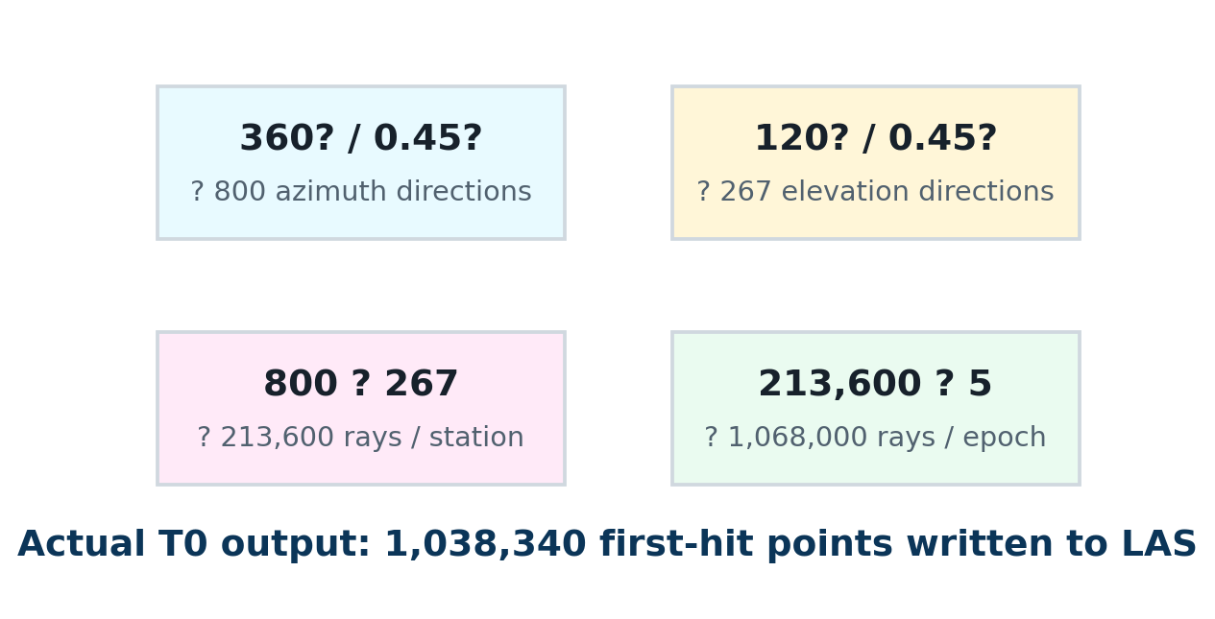
CREATOR NOTES — PARAMETER PROOF
How I know this LAS
was made by raycasting
I check the scanner setup, ray budget, first-hit counts, and known deformation — not just the code claim.
5
0.45°
~1.068M
~1.038M
virtual TLS stations
angular step
rays / epoch
LAS points / epoch
Synthetic TLS raycasting — creator notes | 1

Slide 2
1. SCANNER SETUP
I first fixed the scan geometry, then generated points from it
Station count
5 TLS stations
Builder interpretation
Station chainage
8, 28, 48, 68, 88 m
●
Each station emits rays over azimuth and elevation.
Horizontal scan
360°
●
A point exists only when a ray hits geometry.
Azimuth step
0.45°
●
No hit or dropout means no LAS point.
Vertical scan
-38° to 82° = 120°
●
This is why the output has TLS-like occlusion.
Elevation step
0.45°
Maximum range
44 m
Synthetic TLS raycasting — creator notes | 2

Slide 3
2. RAY BUDGET
The parameters imply over one million rays per epoch
My sanity check
If the data were just random mesh samples, I would not see this clean chain: angular grid → ray count → first-hit count → LAS points.
The count is the easiest way to explain the method without opening the script.
Synthetic TLS raycasting — creator notes | 3

Slide 4
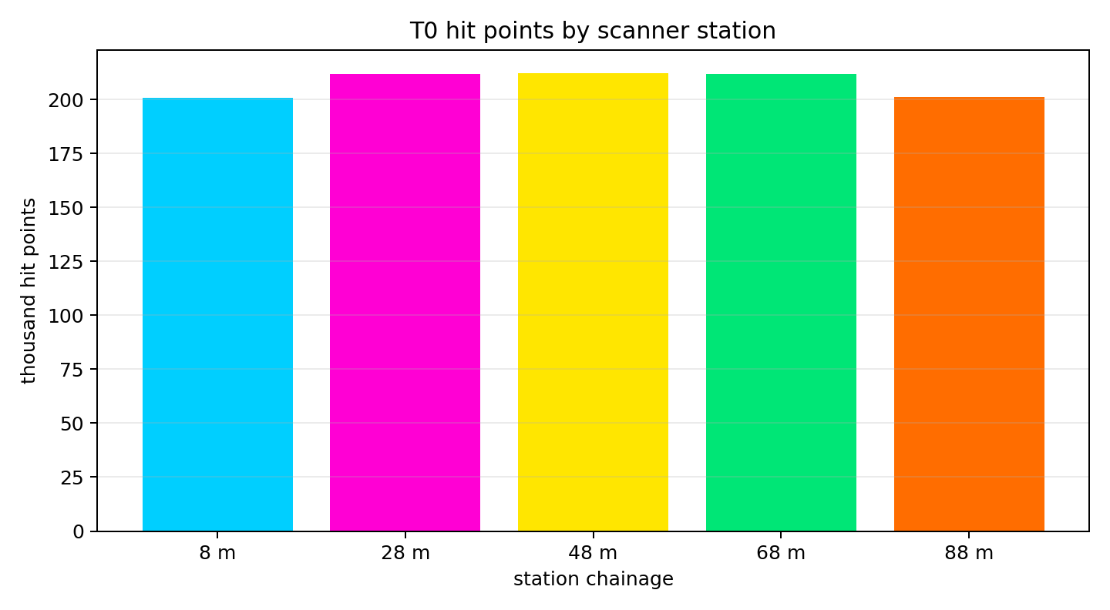
3. STATION-LEVEL EVIDENCE
Each metadata station produced its own hit count
8 m
201,005 hits
28 m
211,884 hits
48 m
212,410 hits
68 m
211,852 hits
88 m
201,189 hits
T0 total = 1,038,340 points
Synthetic TLS raycasting — creator notes | 4

Slide 5
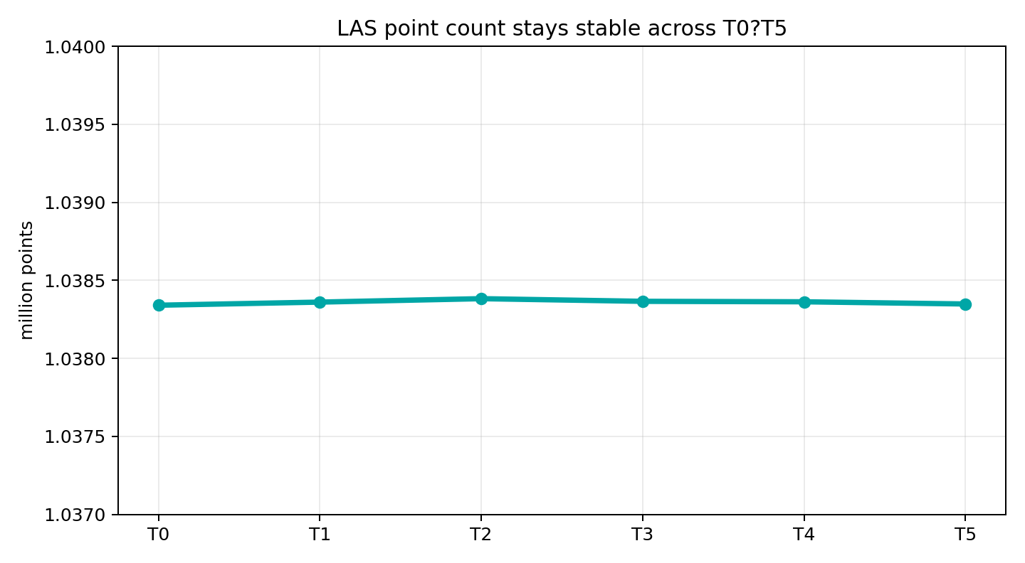
4. LAS OUTPUT
The point count remains stable from T0 to T5
T0
1,038,340 pts
T1
1,038,360 pts
T2
1,038,382 pts
T3
1,038,365 pts
T4
1,038,362 pts
T5
1,038,348 pts
Small differences are expected: dropout, incidence angle, and deformation slightly change which rays survive.
Synthetic TLS raycasting — creator notes | 5

Slide 6
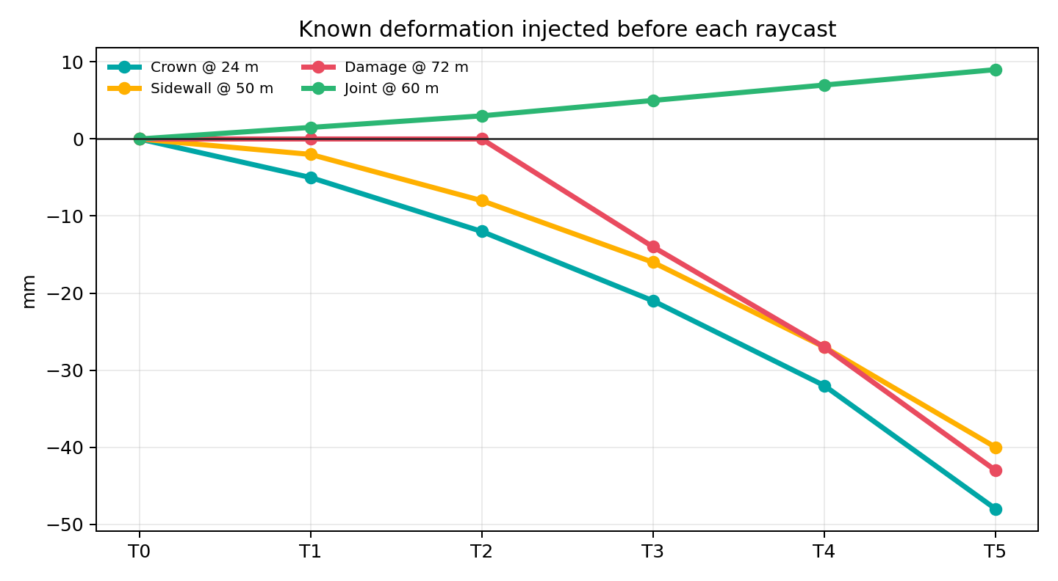
5. KNOWN DEFORMATION
I raycast each epoch after injecting a known mm-level change
T5 stress case
Crown @ 24 m
-48 mm
Sidewall @ 50 m
-40 mm
Damage @ 72 m
-43 mm
Joint @ 60 m
+9 mm
The tool can then measure T0→Tn and compare back to these numbers.
Synthetic TLS raycasting — creator notes | 6

Slide 7
6. MY PROOF CHAIN
This is the explanation I would give in a review
1
Scanner metadata
5 stations, 0.45° grid, 44 m range
2
Ray budget
~1.068M rays per epoch
3
Output count
~1.038M first-hit LAS points
4
Station audit
each station contributes ~201k–212k hits
5
Validation target
T0–T5 include known mm-level deformation
Synthetic TLS raycasting — creator notes | 7

Slide 8
ONE-LINE EXPLANATION
Each LAS file is the first-hit result of more than one million virtual laser rays fired into the tunnel model.
5
~213k
~1.038M
T0–T5
scanner origins
rays / station
first-hit points
known deformation
That makes it synthetic TLS raycasting data, not hand-placed points or random mesh sampling.
Synthetic TLS raycasting — creator notes | 8

