Slide 1
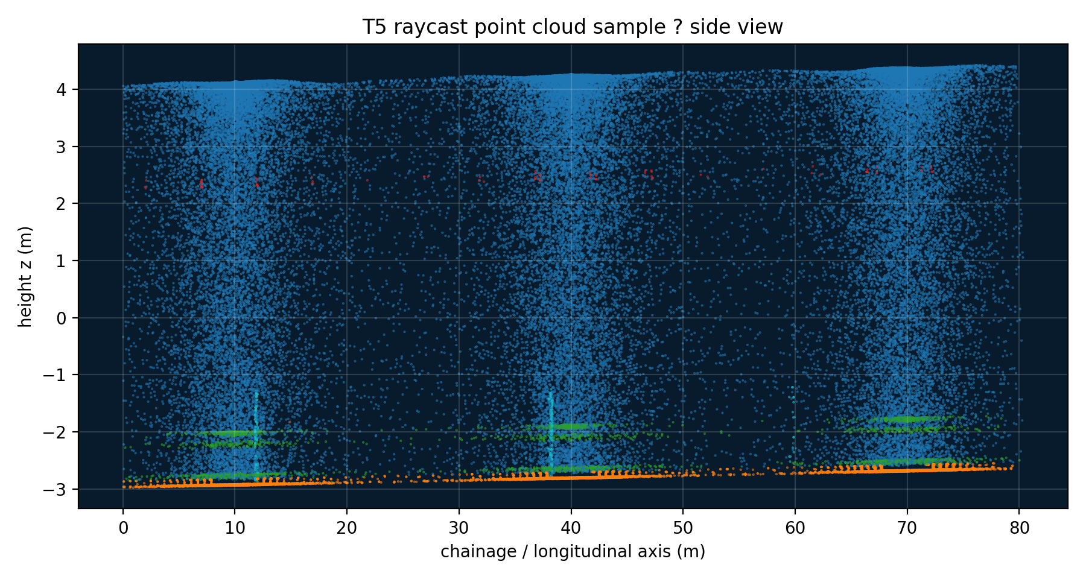
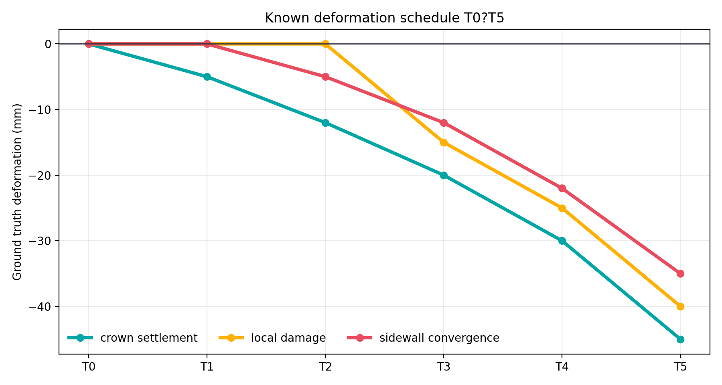
VISUAL-FIRST REPORT
Raycasting LiDAR
for tunnel deformation validation
T0–T5 synthetic TLS scans with known mm-level ground truth
527k
6
3
points / epoch
epochs T0–T5
TLS stations
Raycasting LiDAR validation | 1

Slide 2
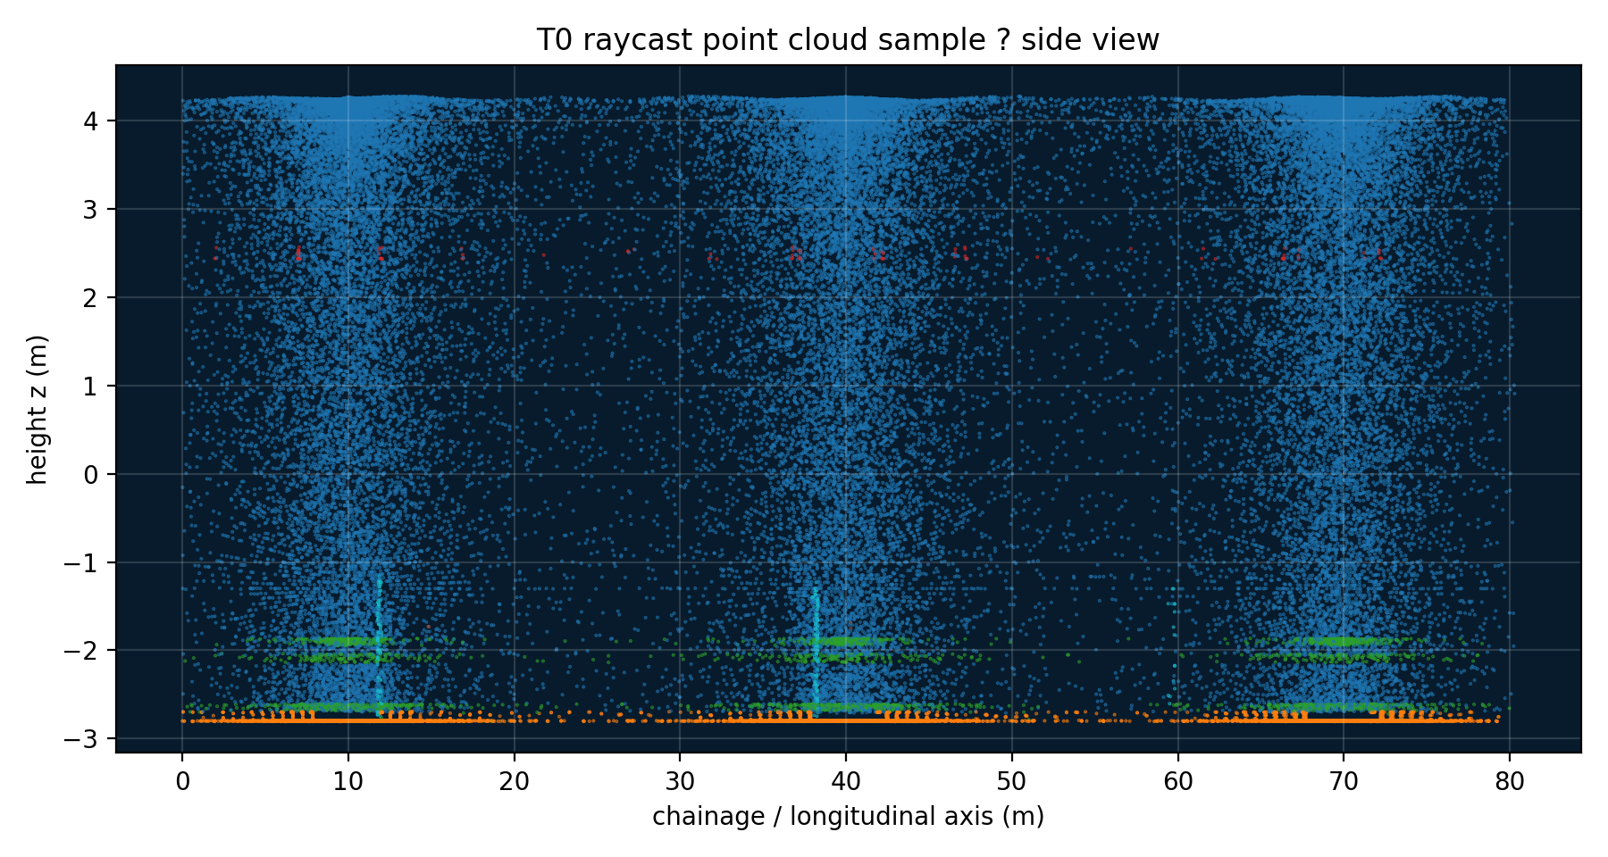
EVIDENCE PACK
Dataset summary: enough numbers to audit the workflow
Epochs
T0 reference + T1–T5 monitoring
Ray engine
Blender scene.ray_cast()
Scanner grid
0.5° horizontal × 0.5° vertical
Stations
Chainage 10 m, 40 m, 70 m
Range / FOV
60 m max; vertical −35° to 90°
Noise
σ = 0.002 + 0.00006 × distance
T0 side-view sample: raycast creates non-uniform visibility and occlusion, not a clean mesh sample.
Raycasting LiDAR validation | 2

Slide 3
METHOD
Pipeline: mesh → virtual scan → validation data
1
2
3
4
5
Blender scene
Virtual TLS
First hit only
Epoch deformation
Export point cloud
Tunnel lining + rails + lights + targets
3 stations, angular ray grid
Occlusion and shadow zones appear naturally
Inject known T1–T5 changes
TXT / LAS-ready labeled scans
One-sentence claim: the point cloud is generated from the same visibility logic as TLS — every point is a ray/object intersection.
Raycasting LiDAR validation | 3

Slide 4
GROUND TRUTH
Known deformation schedule, visible by epoch
Crown settlement
20 m | −45 mm at T5
Sidewall convergence
45 m | −35 mm at T5
Local damage patch
65 m | −40 mm at T5
Raycasting LiDAR validation | 4

Slide 5
VISUAL RESULT
Raycast point clouds show scan-like coverage
T0 reference scan
T5 deformed monitoring scan
Raycasting LiDAR validation | 5

Slide 6
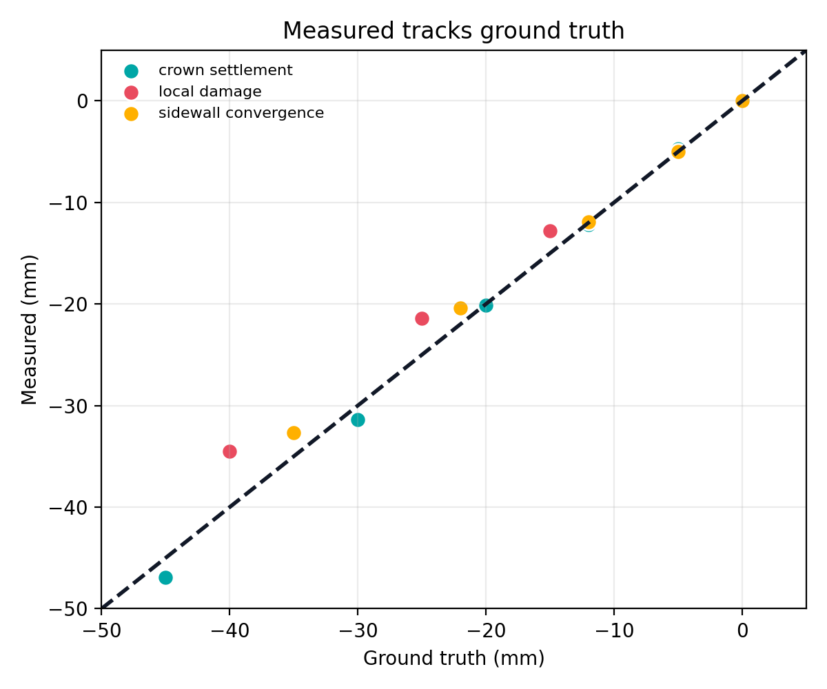
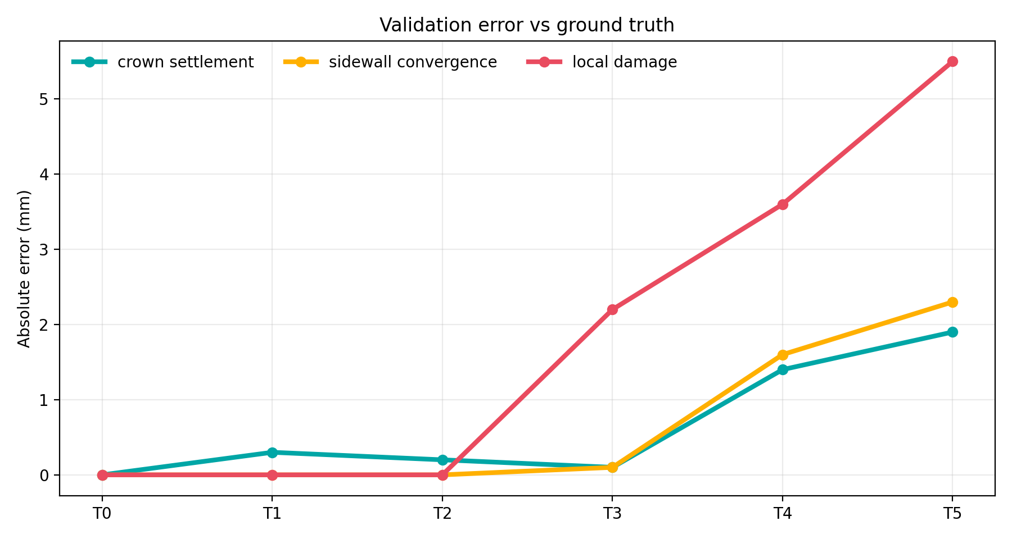
VALIDATION
Measured deformation tracks ground truth
Dashed line = perfect agreement; most deviations stay low, with local damage hardest due to smaller patch and occlusion.
Raycasting LiDAR validation | 6

Slide 7
NUMBERS
Validation table: T5 is the stress test
Metric
GT T5
Measured T5
Error
Crown settlement
−45.0
−46.9
1.9 mm
Sidewall convergence
−35.0
−32.7
2.3 mm
Local damage
−40.0
−34.5
5.5 mm
Interpretation
The global deformation modes are recovered within ~2 mm at T5; the small local patch has larger error because it is more sensitive to sampling density and occlusion.
Raycasting LiDAR validation | 7

Slide 8
WHY IT MATTERS
Raycasting adds the failure modes the tool must survive
Occlusion
First-hit rule hides surfaces behind fixtures
Density gradient
Angular grid creates near/far point imbalance
Intensity
Reflectivity + angle + distance model
Registration bias
Epochs can carry unknown TLS pose
Labels
Structure vs non-structure can be filtered
Bottom line: this is closer to field TLS than direct clean sampling from a mesh.
Raycasting LiDAR validation | 8

Slide 9
DELIVERABLES
Files already available for reproducible reporting
Dataset
data/blender_lidar_t0t5/T0.txt … T5.txt
Metadata
data/blender_lidar_t0t5/manifest.json
Truth
data/blender_lidar_t0t5/ground_truth.csv
Validation
data/blender_lidar_t0t5/series_validation.csv
Protocol
RAYCASTING_GROUNDTRUTH_PROTOCOL.md
Script
tools/raycast_tunnel_epochs.py
Raycasting LiDAR validation | 9

Slide 10
FINAL TAKEAWAY
Raycasting gives us auditable synthetic TLS data with known deformation.
0.5°
527k
−45 mm
~2 mm
ray grid
points / epoch
max crown GT
T5 global error
Use this deck as the report backbone: numbers + visuals first, explanatory text only where needed.
Raycasting LiDAR validation | 10

