Slide 1
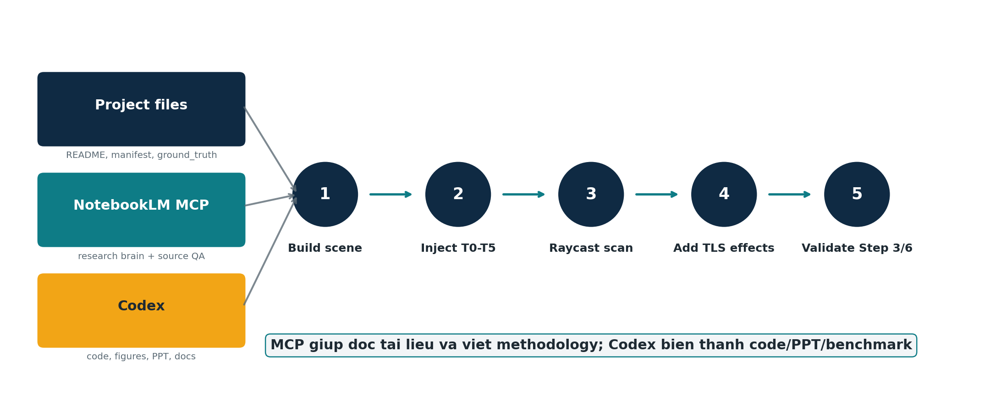
KE HOACH THUC HIEN
Lam theo kieu TLSynth + dung MCP/NotebookLM
Tu tai lieu du an -> workflow raycasting -> PPT/report de ban hieu va bao ve duoc
Y tuong chinh: khong noi la da dung TLSynth add-on. Noi dung hon: custom Blender raycasting follows TLSynth principle.
NotebookLM/MCP = bo nao doc tai lieu. Codex = nguoi lam code, hinh, PPT va benchmark.
TLSynth + MCP workflow - 01

Slide 2
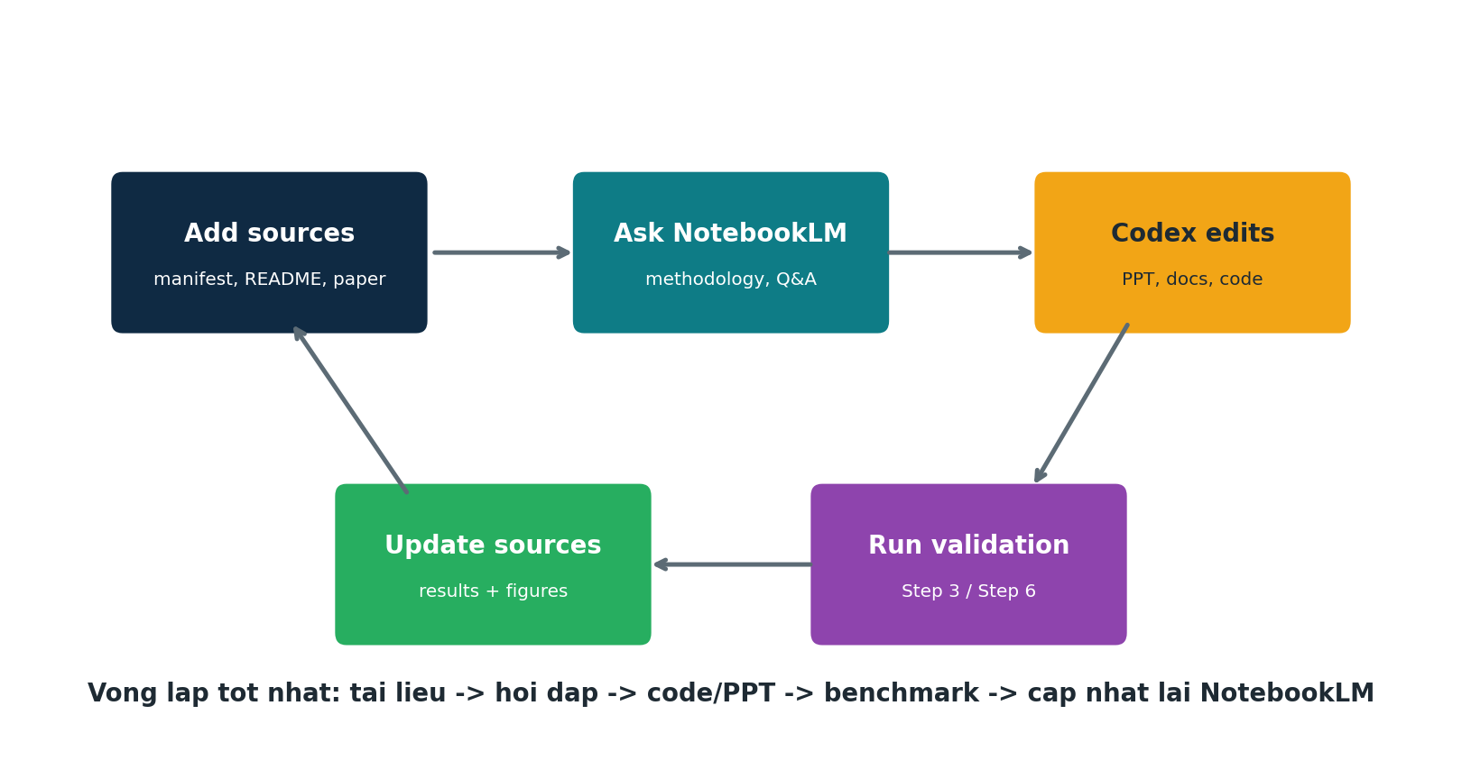
VAI TRO MCP
MCP giup quy trinh bot cam tinh va co nguon
- NotebookLM da co source pack ve manifest, README va cheat sheet raycasting.
- Toi hoi NotebookLM de lay workflow va wording dung voi tai lieu.
- Sau do toi dung Codex de tao slide, hinh minh hoa, script va benchmark.
- Ket qua benchmark se duoc nap nguoc lai vao NotebookLM de viet report tot hon.
TLSynth + MCP workflow - 02

Slide 3
BUC TRANH TONG THE
Pipeline toi se lam trong du an
Day la workflow thuc dung: du lieu co san + NotebookLM de giai thich + Codex de hien thuc hoa.
TLSynth + MCP workflow - 03

Slide 4
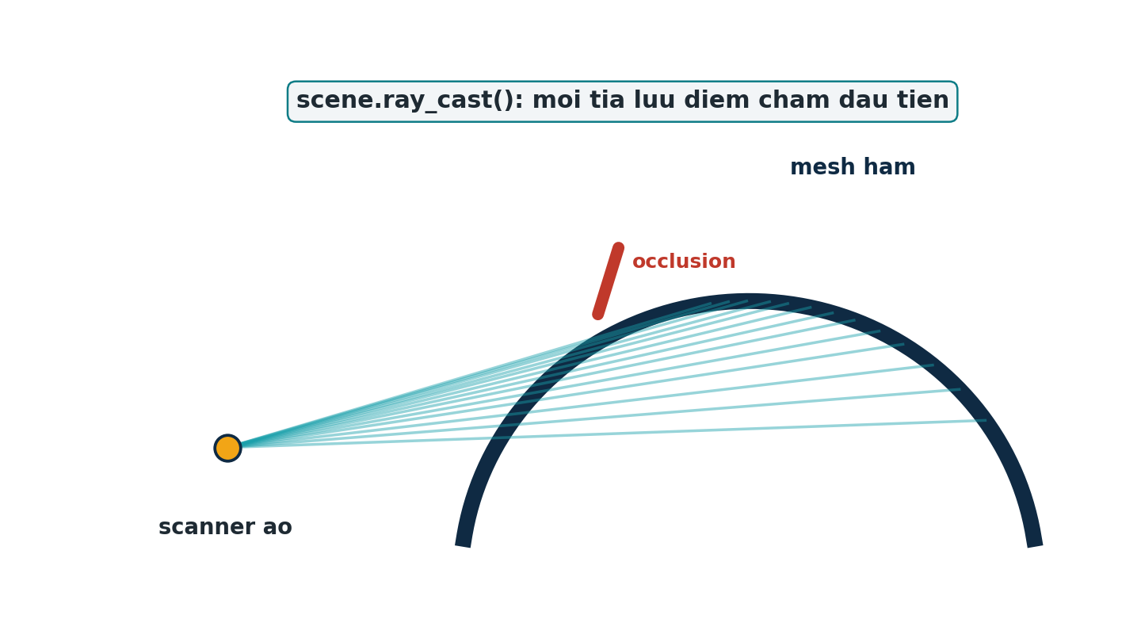
BUOC 1
Chuan bi scene ham trong Blender
- Dung scene ham dai 80.0 m, duong kinh 8.5 m.
- Giu cac object gay occlusion: cable, light, rail, target sphere, person.
- Muc tieu: point cloud sinh ra phai co van de giong scan that, khong qua sach.
Neu scene thay doi, point cloud raycast cung thay doi theo.
TLSynth + MCP workflow - 04

Slide 5
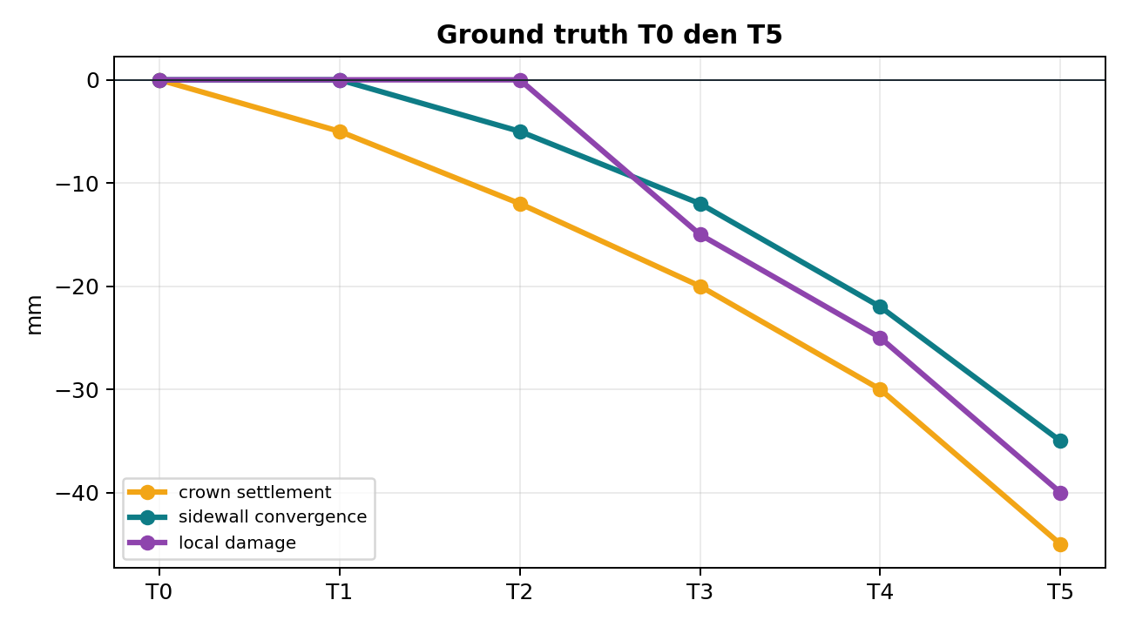
BUOC 2
Chen bien dang T0 den T5 co ground truth
- T0 la reference baseline.
- T1-T5 co bien dang tang dan: crown settlement, sidewall convergence, local damage.
- ground_truth.csv la dap an dung de kiem tra Step 6.
- Day la diem quan trong nhat de chung minh tool do dung mm-level.
TLSynth + MCP workflow - 05

Slide 6
BUOC 3
Dat scanner ao va raycast nhu TLS
- 3 tram scanner tai chainage 10 m, 40 m, 70 m.
- Moi tram ban tia theo luoi goc 0.5 deg.
- Dung scene.ray_cast() de lay diem cham dau tien.
- Diem cham vao cable/light truoc thi mat ham phia sau bi che, tao occlusion that.
TLSynth + MCP workflow - 06

Slide 7
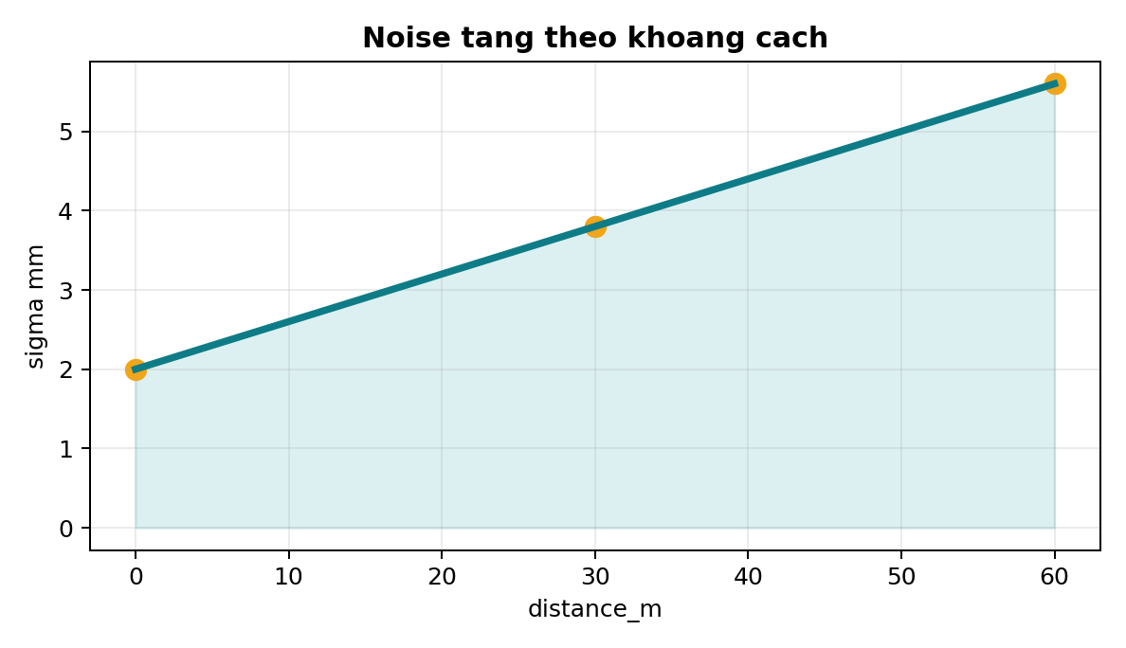
BUOC 4
Them hieu ung LiDAR-like: noise, intensity, label
- Noise model: sigma = 0.002 + 0.00006 * distance_m.
- Intensity phu thuoc reflectivity, goc cham tia va distance falloff.
- Label giup tach tunnel lining, floor, metal, LED, target sphere, person.
- Day la phan lam du lieu synthetic giong TLS hon.
TLSynth + MCP workflow - 07

Slide 8
BUOC 5
Xuat du lieu va kiem chung trong tool
- Xuat T0.txt den T5.txt, manifest.json, ground_truth.csv va registration transforms.
- Chay Step 3 de kiem tra auto-align/registration.
- Chay Step 6 de kiem tra deformation trend T0 -> Tn.
- So sanh ket qua tool voi ground truth de co bang chung.
Output can co: RMSE alignment + sai so deformation theo tung epoch.
TLSynth + MCP workflow - 08

Slide 9
TOI SE DUNG MCP NHU THE NAO
NotebookLM khong thay code; no giup ly luan va viet
- Hoi NotebookLM: methodology nen viet the nao de khong overclaim
- Hoi NotebookLM: vi sao raycasting tot hon random noise
- Hoi NotebookLM: reviewer se hoi gi ve synthetic dataset
- Lay cau tra loi ve, toi chinh lai va dua vao PPT/report.
- Sau khi co benchmark moi, toi nap lai ket qua vao NotebookLM.
TLSynth + MCP workflow - 09

Slide 10
CACH GIAI THICH VOI THAY/CO
Cau noi an toan ve mat hoc thuat
- Nen noi: This work follows the TLSynth principle for synthetic TLS generation.
- Nen noi: A custom Blender raycasting pipeline was implemented for tunnel deformation validation.
- Khong nen noi: We use TLSynth add-on, neu chua tich hop add-on that.
- Diem moi cua minh: T0-T5 tunnel deformation ground truth + Step 3/Step 6 validation.
One-sentence method
Virtual scanner rays are cast from simulated TLS stations into a Blender tunnel mesh; first hit points are stored as point clouds, then noise and intensity are added to validate deformation analysis against known T0-T5 ground truth.
TLSynth + MCP workflow - 10

Slide 11
SAN PHAM TOI DE XUAT LAM TIEP
Mot goi hoan chinh de ban hoc va bao cao
1
Methodology doc
Viet file Methodology_TLSynth_Principle.md bang tieng Anh.
2
Generation script
Dong goi script tao/kiem tra T0-T5 va metadata.
3
Benchmark table
Chay Step 3/Step 6 va lap bang sai so.
4
PPT chinh thuc
Dung hinh tu benchmark that, khong chi hinh minh hoa.
5
NotebookLM update
Nap paper TLSynth PDF + ket qua benchmark vao NotebookLM.
TLSynth + MCP workflow - 11

Slide 12
KET LUAN
Cach tot nhat cho y muon cua ban
Dung TLSynth lam phuong phap tham chieu, MCP lam bo nao doc tai lieu, Codex lam san pham cu the.
1
Khong can tich hop TLSynth add-on ngay.
2
Tap trung chung minh pipeline raycasting hien co bang benchmark.
3
Dung NotebookLM de viet methodology, reviewer Q&A va speaker notes.
Next: them TLSynth paper PDF vao NotebookLM, roi viet Methodology section.
TLSynth + MCP workflow - 12

