Slide 1
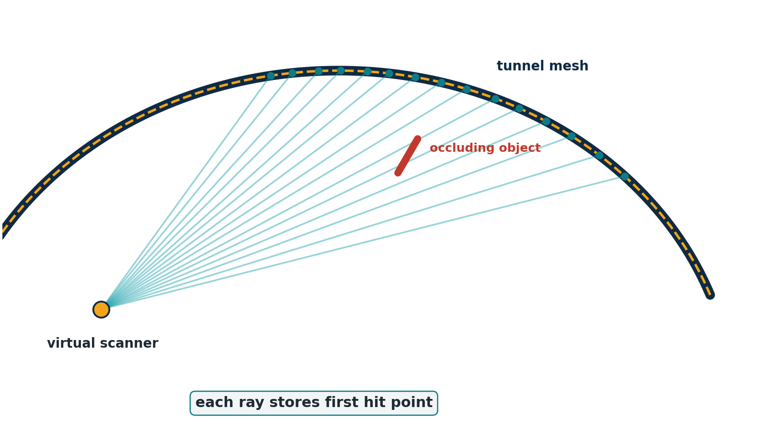
TUNNEL LIDAR PROJECT
Apply TLSynth-principle to synthetic raycasting
Implementation plan + step-by-step explanation
Goal: create tunnel scan data with ground truth to validate Step 3 registration and Step 6 deformation.
Approach: use TLSynth as methodology reference, not as a direct add-on dependency yet.
TLSynth-principle raycasting plan - 01

Slide 2
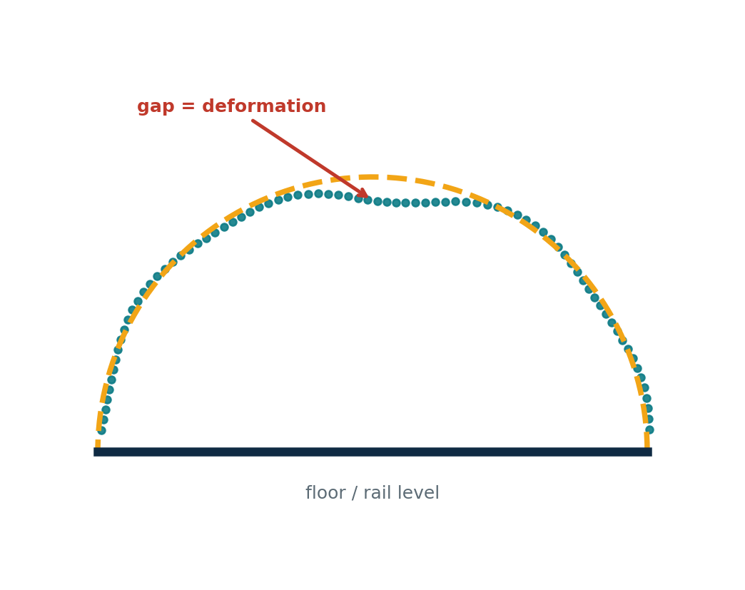
PROBLEM
Real scans do not provide exact mm-level ground truth
- Real LiDAR has noise, occlusion and uneven point density, but true deformation is unknown.
- To prove the tool measures correctly, we need synthetic T0 to T5 data with known deformation.
- Raycasting simulates how TLS sees the scene instead of placing clean random points on a mesh.
TLSynth-principle raycasting plan - 02

Slide 3
PRINCIPLE
TLSynth-principle: virtual scanner casts rays into mesh
- Place a virtual scanner in the Blender scene.
- Generate ray directions using horizontal and vertical angular grids.
- Use ray casting to find the first surface intersection.
- Add noise and intensity to approximate real TLS behavior.
TLSynth-principle raycasting plan - 03

Slide 4
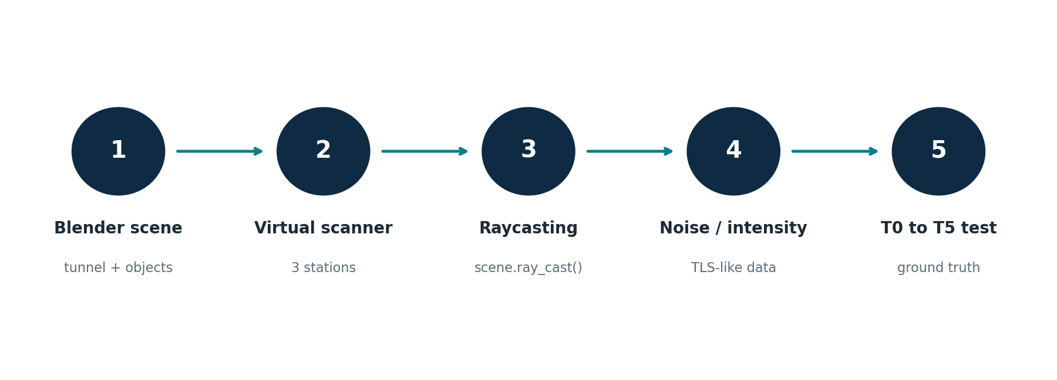
OVERALL PLAN
Five implementation steps in the current project
Final output: T0-T5 dataset + metadata + clear report language: follow TLSynth principle.
TLSynth-principle raycasting plan - 04

Slide 5
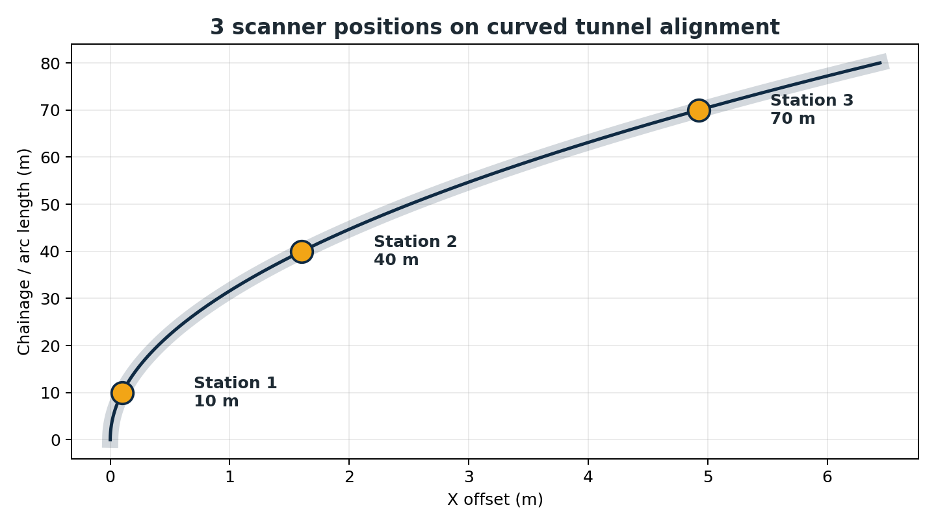
STEP 1
Build the synthetic tunnel scene
- TBM arch tunnel, length 80.0 m, diameter 8.5 m.
- Include rails, sleepers, cable trays, LEDs, handrails, target spheres and scale-reference people.
- Use T0 as baseline; deform T1 to T5 using known ground truth.
A field-like scene makes Step 6 validation more realistic.
TLSynth-principle raycasting plan - 05

Slide 6
STEP 2
Place virtual scanners and define scan settings
- Three scanner stations: chainage 10 m, 40 m and 70 m.
- Angular resolution: 0.5 deg x 0.5 deg.
- Vertical FOV: -35 deg to 90 deg; max range 60.0 m.
- Scanners follow the curved alignment, not a simple straight Y-axis.
TLSynth-principle raycasting plan - 06

Slide 7
STEP 3
Raycasting creates realistic occlusion and point density
- Each ray keeps only the first hit point, so foreground objects hide the wall behind them.
- Points are denser near the scanner and sparser farther away.
- This is stronger than using a clean mesh plus random noise.
Dataset method: scene.ray_cast() from three scanner positions.
TLSynth-principle raycasting plan - 07

Slide 8
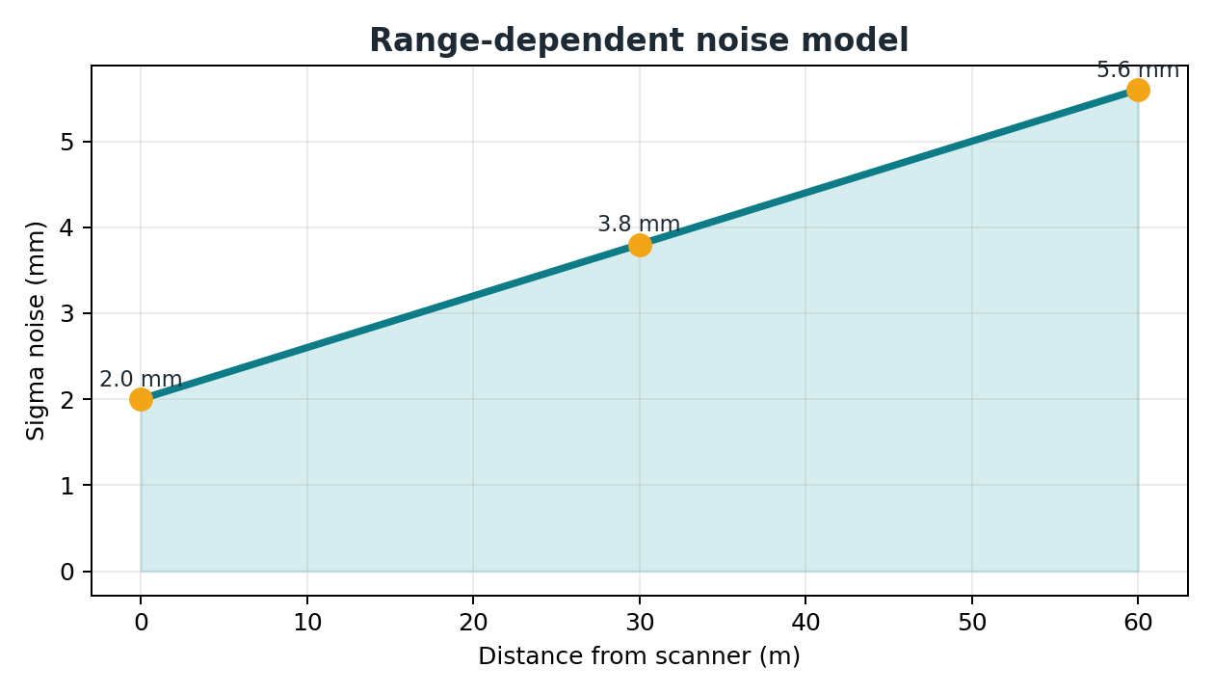
STEP 4
Add noise, intensity and labels
- Current noise model: sigma = 0.002 + 0.00006 x distance_m.
- Intensity uses label reflectivity, Lambert cosine and distance falloff.
- Labels separate lining, floor, metal, LED, target spheres and people.
This is LiDAR-like degradation, not perfect synthetic geometry.
TLSynth-principle raycasting plan - 08

Slide 9
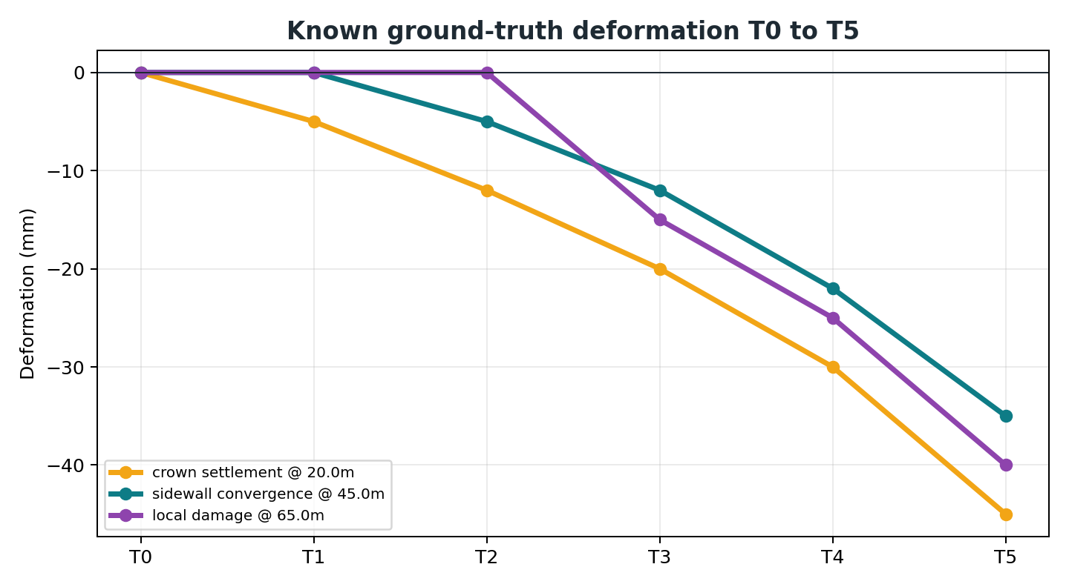
STEP 5
Validate Step 3 and Step 6 against ground truth
- Step 3: use target spheres and registration transforms to test auto-align.
- Step 6: compare T0 with Tn for crown settlement, convergence and local damage.
- Expected result: alignment error approaches noise floor and deformation trend follows ground truth.
TLSynth-principle raycasting plan - 09

Slide 10
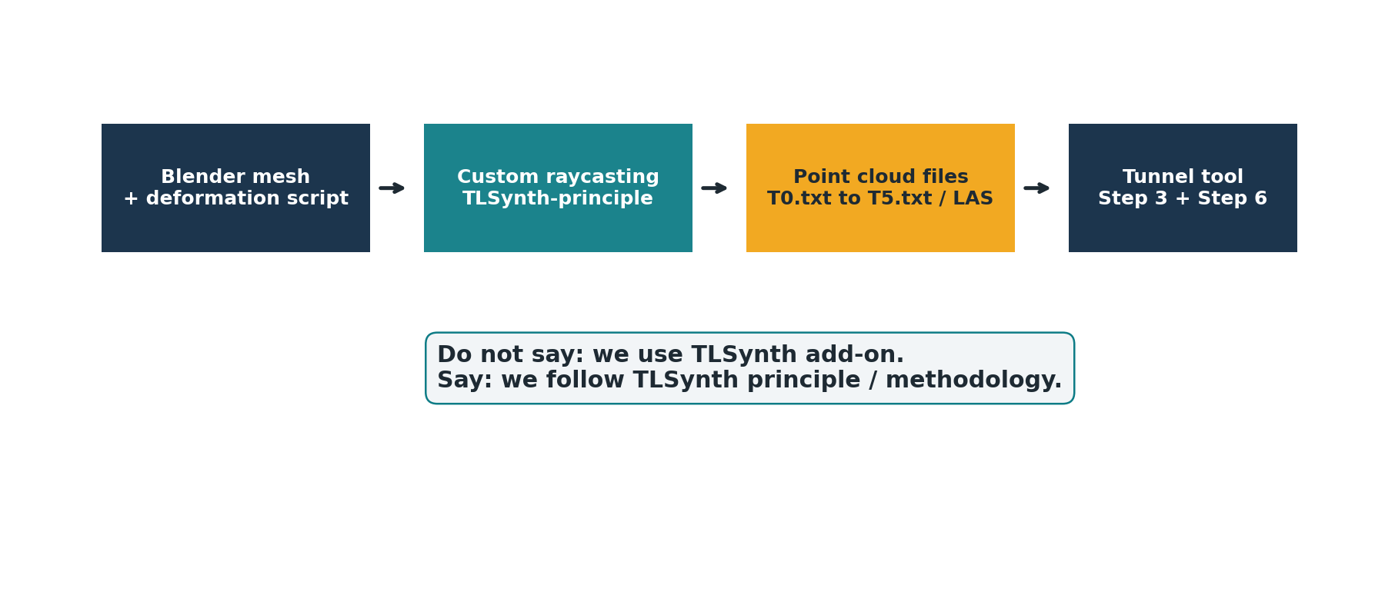
ACADEMIC WORDING
Use TLSynth as a reference method without overclaiming
- Say: following or inspired by TLSynth principle.
- Do not say: we use TLSynth add-on, unless it is truly integrated.
- Project contribution: tunnel-specific T0 to T5 deformation validation with ground truth.
- Future upgrade: integrate the TLSynth add-on if stricter simulator standardization is needed.
TLSynth-principle raycasting plan - 10

Slide 11
EXECUTION ROADMAP
Recommended next actions in the repo
1
Documentation
Update README: custom Blender raycasting follows TLSynth principle.
2
Generation script
Create one command to generate T0-T5, manifest and ground_truth.
3
Benchmark
Run Step 3 and Step 6; save RMSE and deformation error.
4
Report assets
Use raycasting diagram, noise curve and deformation trend in paper/slides.
5
Real TLSynth add-on
Integrate later only if direct tool comparison is required.
TLSynth-principle raycasting plan - 11

Slide 12
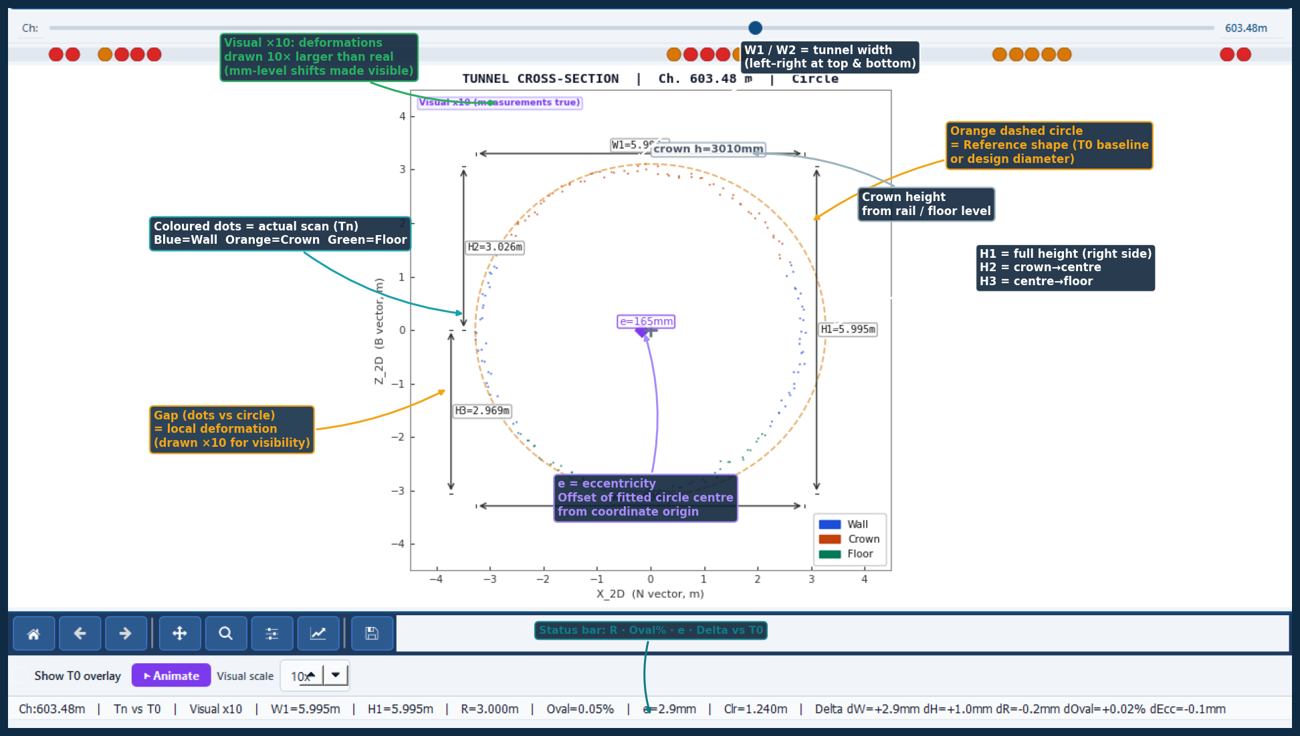
PROJECT VISUAL
Annotated section: how users read T0/Tn output
- Reference circle = T0 or design baseline.
- Scan dots = Tn data after scan/raycasting.
- Gap = deformation measured by the tool.
- Visual x10 makes mm-level deformation visible.
- Status bar summarizes R, ovality, eccentricity and delta.
This connects the synthetic scan method to the final Step 6 explanation.
TLSynth-principle raycasting plan - 12

