Slide 1
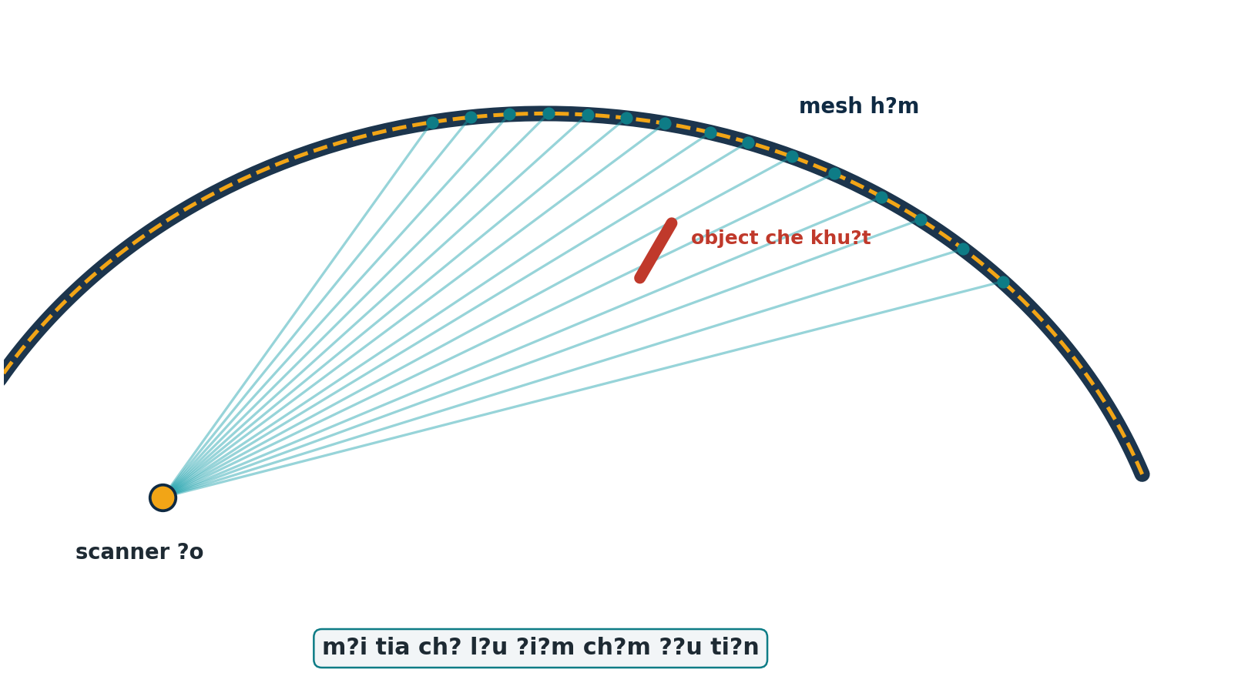
D? ?N TUNNEL LIDAR
?ng d?ng TLSynth-principle v?o raycasting synthetic
K? ho?ch tri?n khai + gi?i th?ch t?ng b??c cho pipeline T0?T5
M?c ti?u: t?o d? li?u qu?t h?m c? ground truth ?? ki?m ch?ng Step 3 registration v? Step 6 deformation.
Kh?ng t?ch h?p TLSynth add-on ngay; d?ng TLSynth nh? c? s? ph??ng ph?p lu?n.
TLSynth-principle raycasting plan ? 01

Slide 2
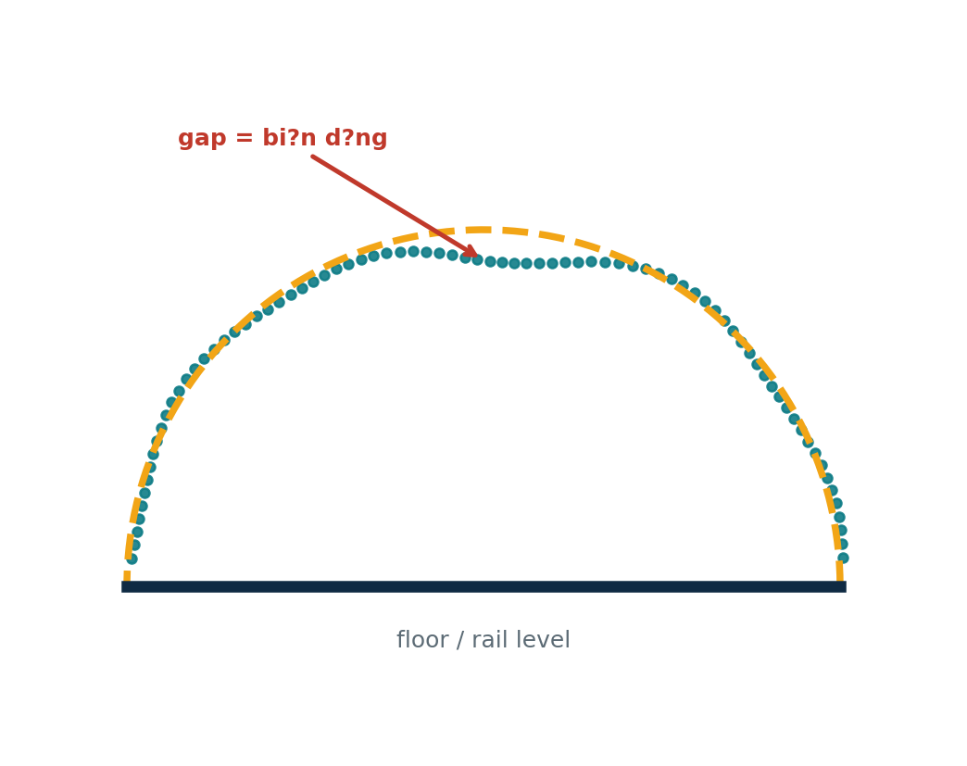
V?N ?? C?N GI?I QUY?T
Scan th?t kh?ng c? ???p ?n ??ng? ?? ki?m ch?ng mm-level
D? li?u LiDAR th?c t? c? noise, occlusion, m?t ?? ?i?m kh?ng ??u nh?ng kh?ng bi?t bi?n d?ng th?t l? bao nhi?u mm.
Mu?n ch?ng minh tool ?o ??ng, c?n m?t h?m synthetic bi?t tr??c bi?n d?ng T0?T5.
Raycasting gi?p t?o point cloud gi?ng c?ch TLS nh?n th?y scene, kh?ng ch? r?i ?i?m s?ch l?n mesh.
TLSynth-principle raycasting plan ? 02

Slide 3
NGUY?N L?
TLSynth-principle: scanner ?o b?n tia v?o mesh
??t scanner ?o trong Blender scene.
T?o h??ng tia theo l??i g?c ngang/d?c.
D?ng ray casting ?? l?y giao ?i?m ??u ti?n.
Th?m noise/intensity ?? g?n TLS th?c t? h?n.
TLSynth-principle raycasting plan ? 03

Slide 4
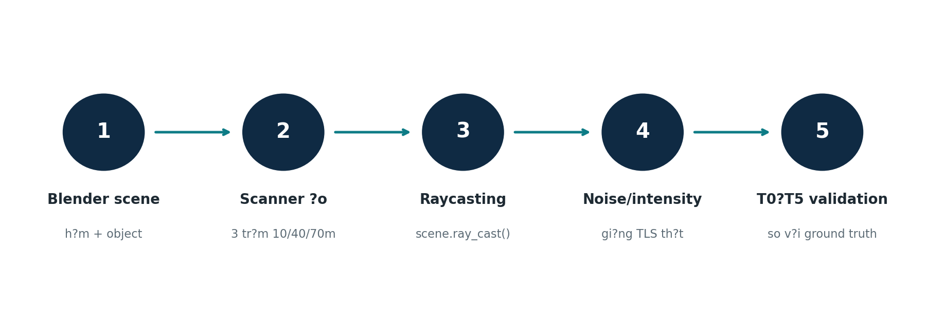
K? HO?CH T?NG TH?
5 b??c tri?n khai trong d? ?n hi?n t?i
Output cu?i: b? d? li?u T0?T5 + metadata + slide/report gi?i th?ch r? ?follow TLSynth principle?.
TLSynth-principle raycasting plan ? 04

Slide 5
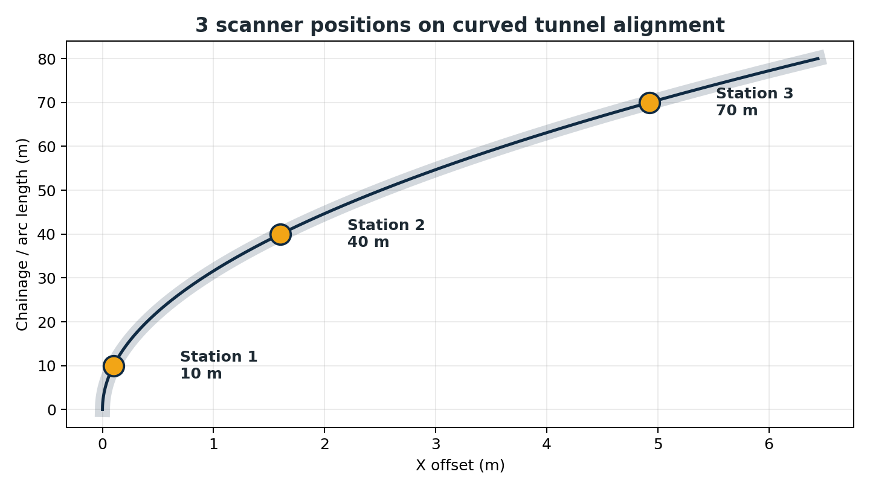
B??C 1
D?ng scene h?m synthetic ??ng ng? c?nh d? ?n
H?m TBM d?ng arch, d?i 80.0 m, ???ng k?nh 8.5 m.
C? rail, sleepers, cable tray, LED, handrail, target sphere v? ng??i l?m scale reference.
T?o T0 l?m baseline; T1?T5 bi?n d?ng t?ng d?n theo ground truth.
Scene c?ng gi?ng field scan th? Step 6 c?ng ???c ki?m th? th?t h?n.
TLSynth-principle raycasting plan ? 05

Slide 6
B??C 2
??t scanner ?o v? c?u h?nh qu?t
3 v? tr? scanner: chainage 10 m, 40 m, 70 m.
?? ph?n gi?i ngang/d?c: 0.5? ? 0.5?.
Vertical FOV: -35? ??n 90?; max range 60.0 m.
Scanner ?i theo alignment cong, kh?ng ph?i m?t ???ng Y th?ng.
TLSynth-principle raycasting plan ? 06

Slide 7
B??C 3
Raycasting t?o occlusion v? m?t ?? ?i?m gi?ng th?c t?
M?i tia ch? gi? hit point ??u ti?n n?n object ph?a tr??c s? che m?t h?m ph?a sau.
?i?m g?n scanner d?y h?n, xa scanner th?a h?n theo h?nh h?c qu?t.
??y l? l? do raycasting t?t h?n ?mesh s?ch + noise ng?u nhi?n?.
Trong code/dataset hi?n t?i: ph??ng ph?p ???c m? t? l? scene.ray_cast() t? 3 scanner positions.
TLSynth-principle raycasting plan ? 07

Slide 8
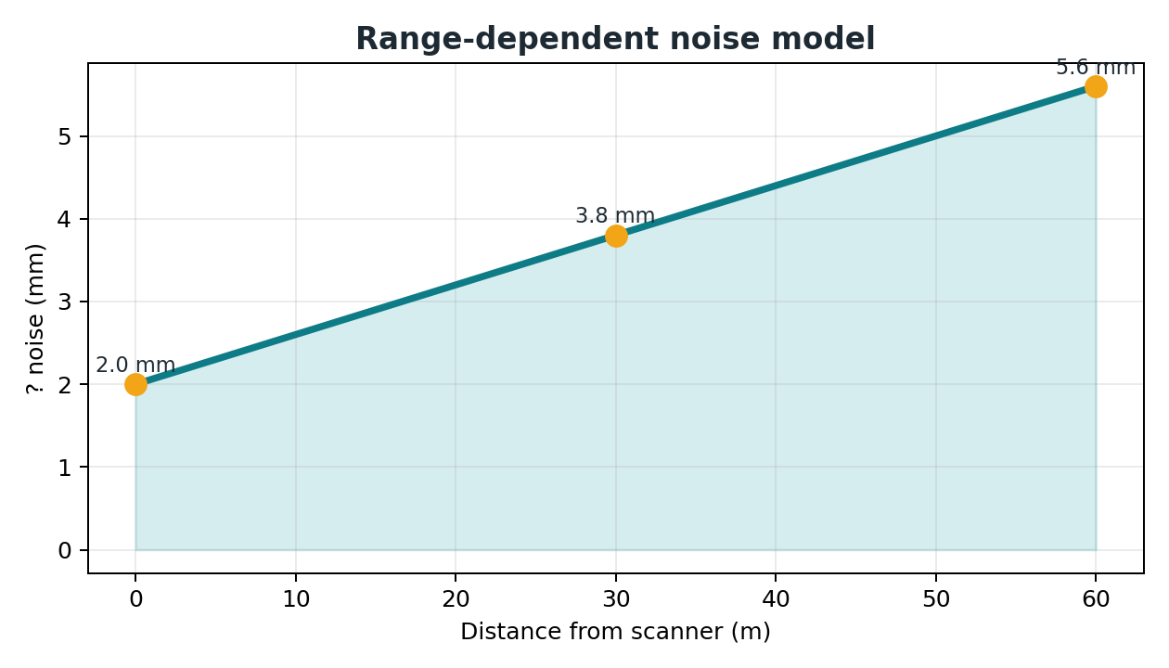
B??C 4
Th?m noise, intensity v? nh?n ?? gi?ng TLS th?t
Noise hi?n t?i trong manifest: ? = 0.002 + 0.00006 ? distance_m.
Intensity d?ng reflectivity theo label + cosine + distance falloff.
Labels ph?n bi?t lining, floor/sleepers, metal, LED, target sphere, person.
?i?m quan tr?ng khi vi?t b?o c?o: ??y l? ?LiDAR-like degradation?, kh?ng ph?i d? li?u ho?n h?o.
TLSynth-principle raycasting plan ? 08

Slide 9
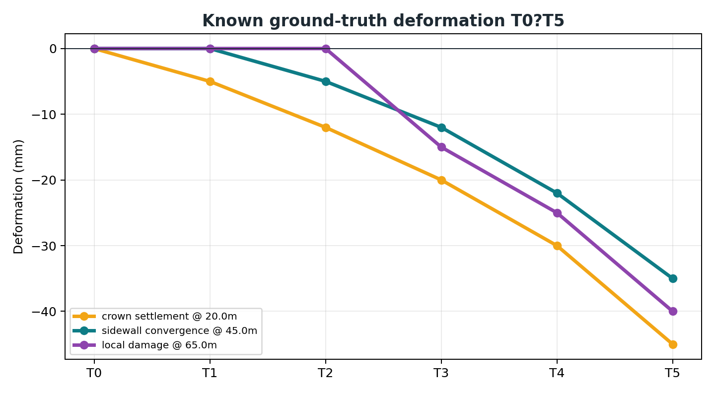
B??C 5
Ki?m ch?ng Step 3 v? Step 6 b?ng ground truth
Step 3: d?ng target sphere/registration transforms ?? ki?m tra auto-align.
Step 6: so s?nh T0 v?i Tn ?? xem tool c? b?t ??ng crown settlement, convergence, local damage.
K?t qu? k? v?ng: sau alignment RMSE v? m?c noise floor; deformation trend b?m ground truth.
TLSynth-principle raycasting plan ? 09

Slide 10
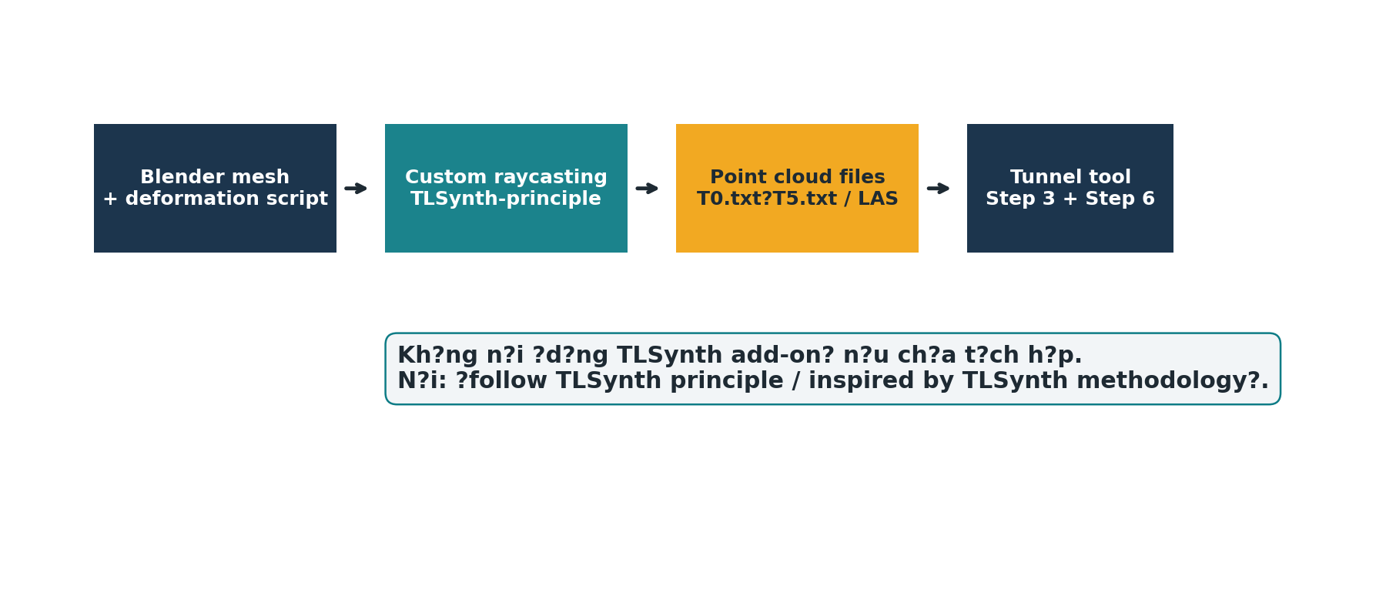
C?CH N?I H?C THU?T
D?ng TLSynth l?m reference method, kh?ng claim qu? m?c
N?n n?i: ?following / inspired by TLSynth principle?.
Kh?ng n?n n?i: ?we use TLSynth add-on? n?u ch?a t?ch h?p th?t.
?i?m m?i c?a d? ?n: tunnel-specific T0?T5 deformation validation v?i ground truth.
N?u c?n n?ng c?p sau: t?ch h?p TLSynth add-on th?t ?? chu?n h?a scan simulator.
TLSynth-principle raycasting plan ? 10

Slide 11
ROADMAP TH?C THI
Vi?c n?n l?m ti?p theo trong repo
1
Chu?n h?a t?i li?u
README: ghi r? custom Blender raycasting follows TLSynth principle.
2
??ng g?i script
M?t command generate T0?T5 + manifest + ground_truth.
3
Benchmark
Ch?y Step 3/Step 6, l?u RMSE v? sai s? deformation.
4
Slide/report
??a h?nh raycasting, noise curve, deformation trend v?o paper/presentation.
5
T?ch h?p th?t n?u c?n
Ch? t?ch h?p TLSynth add-on khi c?n so s?nh/chu?n h?a th?m.
TLSynth-principle raycasting plan ? 11

Slide 12
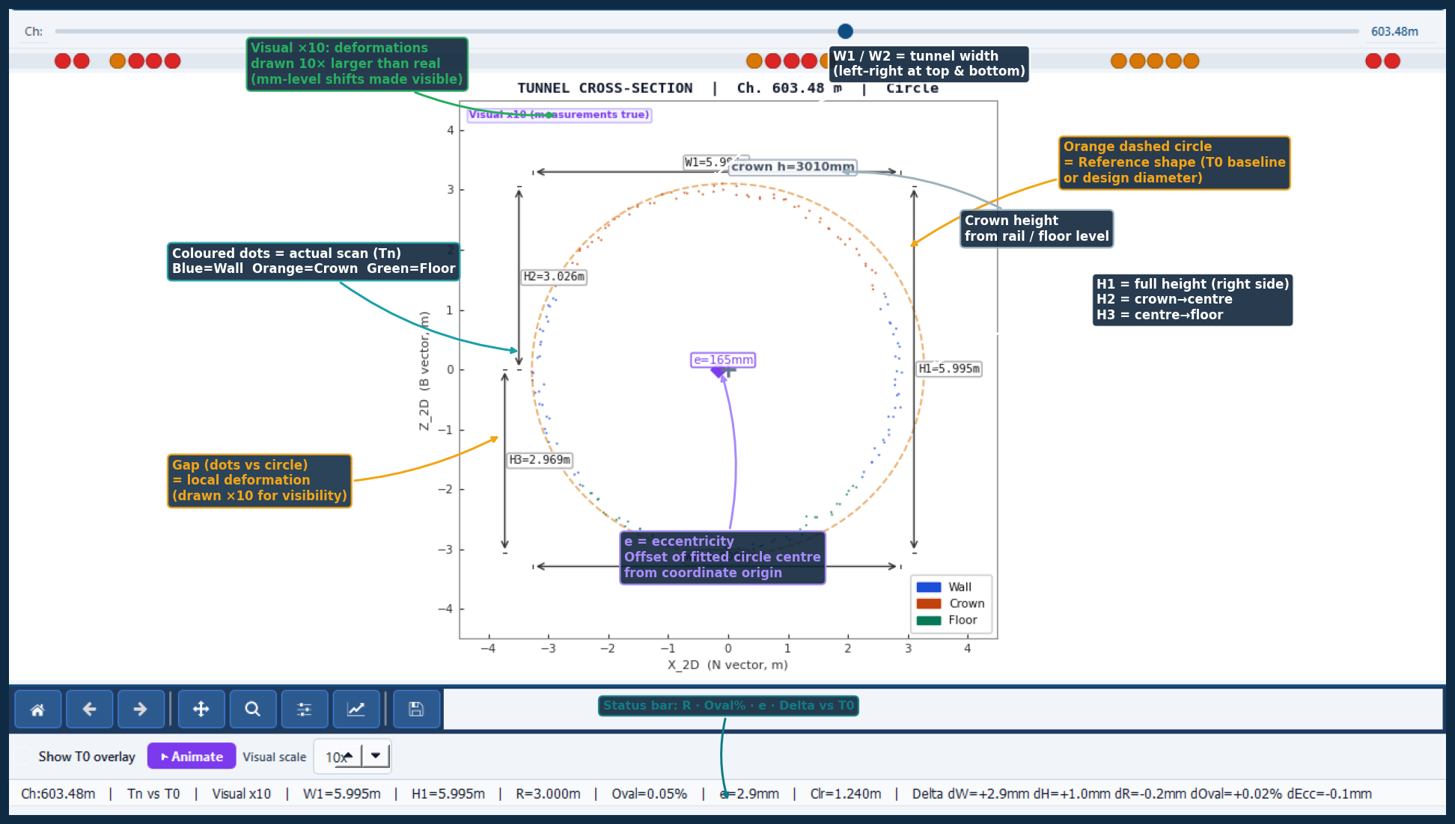
MINH H?A T? D? ?N
?nh section annotated: c?ch ng??i xem ??c k?t qu? T0/Tn
V?ng tr?n/reference = T0 ho?c design baseline
Ch?m scan = d? li?u Tn sau raycasting/scan
Kho?ng l?ch = deformation c?n ?o
Visual ?10 gi?p bi?n d?ng mm-level d? nh?n
Status bar gom metric R, oval%, e, delta
Slide n?y d?ng ?nh th?t ?? c? trong repo ?? n?i ph?n m? ph?ng v?i giao di?n gi?i th?ch k?t qu?.
TLSynth-principle raycasting plan ? 12

