Slide 1
Admission Demographics Final Project Group : 7
1) We will not be using Tabular format for KPI’s, this is an initial sketch.
For most of the KPI’s we will use appropriate visuals.
The layout might change as we progress building dashboards.
As for Font Kent state National font
Color palette Kent State preferred colors
Only thing which will change is the dashboard layout but not the order of information.
Group Members:
Ananth Kumar
Ankith Dasu
Ryan Spake
Nemin Dholakia

Slide 2
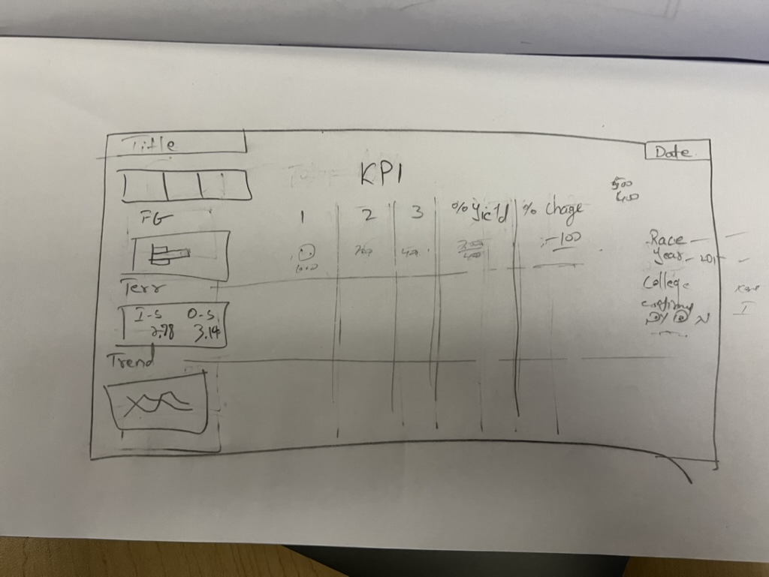

Slide 3
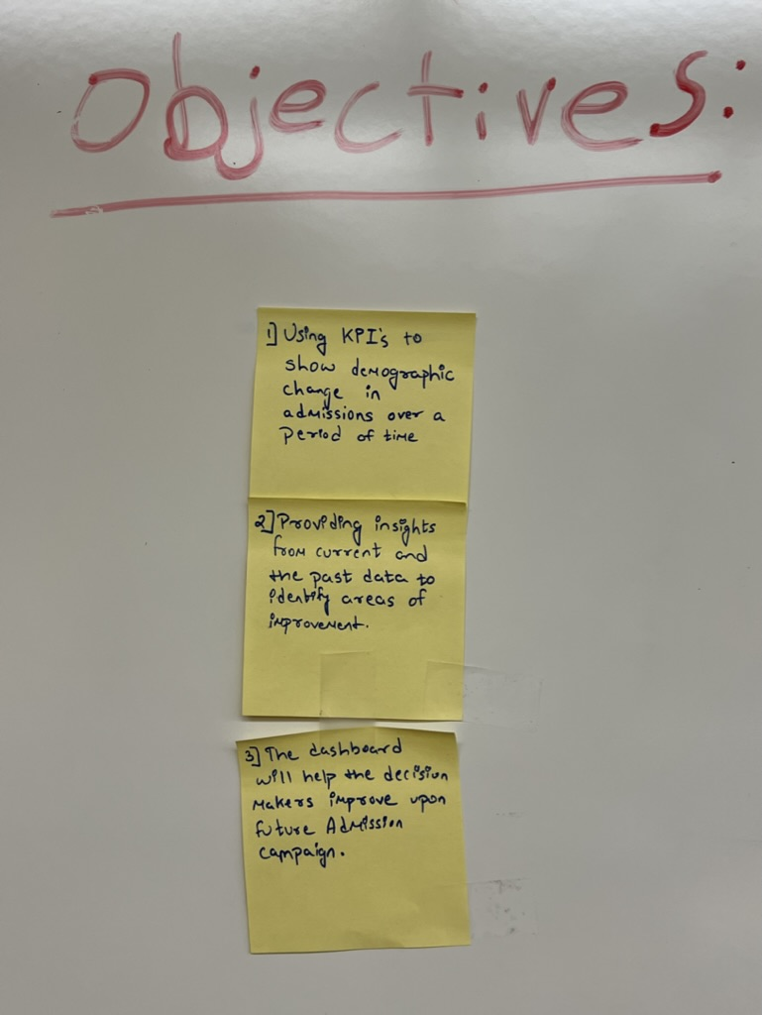
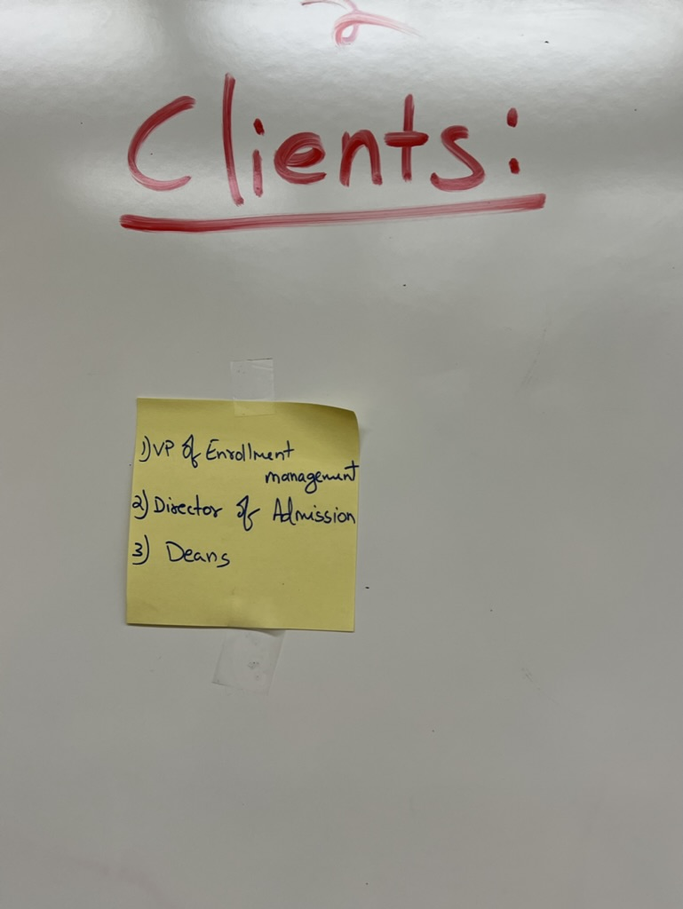
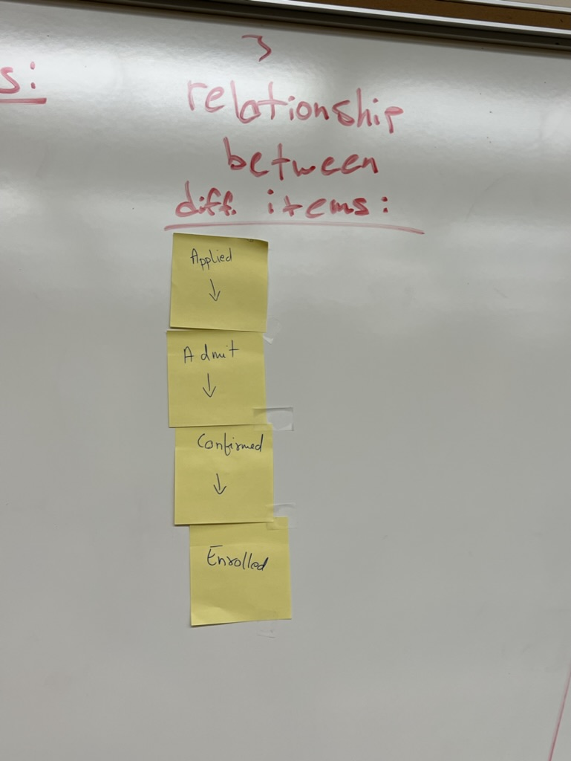
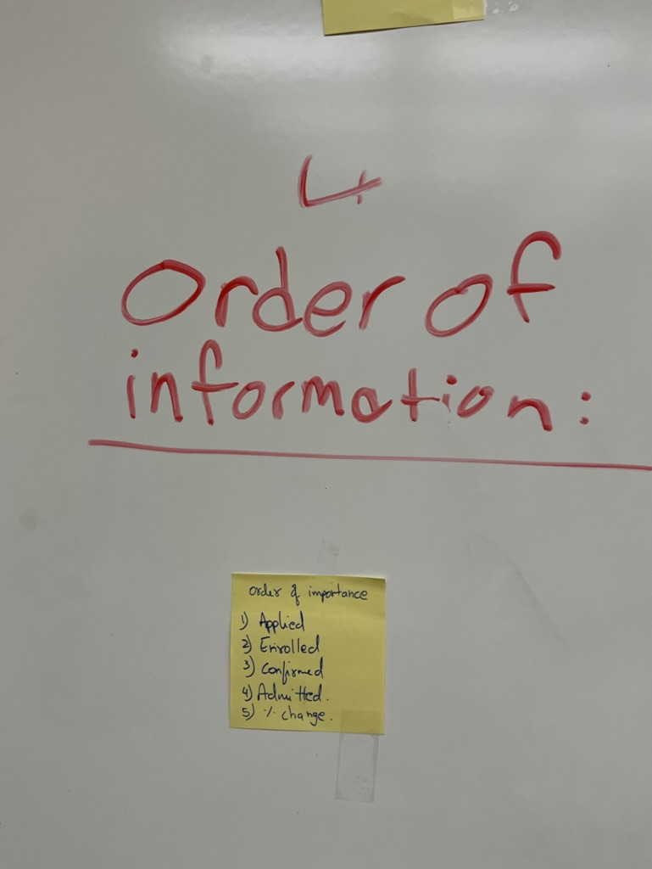
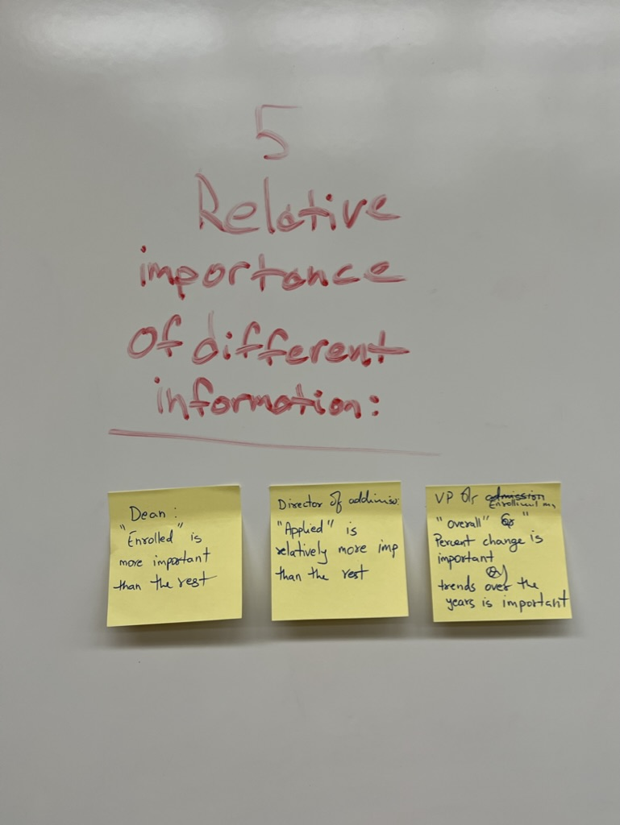
Flow of Project

Slide 4
