Slide 1
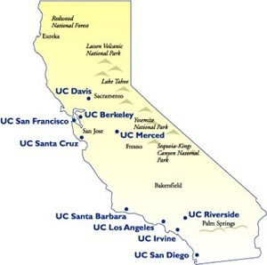

Predicting the student yield for the University of California
Iteration 2
Michal, Nick, Nelson

Slide 2

Outline
Updates
More Data Cleaning
More Exploration / Visualization
Plans for Completion
Challenges

Slide 3

Update
Our main goal - predicting student yield rate for UC schools.
Fixed pre-processing data file.
Generated more statistical analyses
Examined the yield rate under different categories (2D histogram, more line plots, probability distribution plots etc.)
Processing on new datasets: SAT, AP and ACT per California High Schools
Google Maps scraping: distance between high schools and colleges

Slide 4

More Data Cleaning
Verifying the data cleanup process from our previous iteration
Fixing possible artifacts
Finding new data
Cleaning up and verifying the new data
Merging the new data with our main dataset

Slide 5
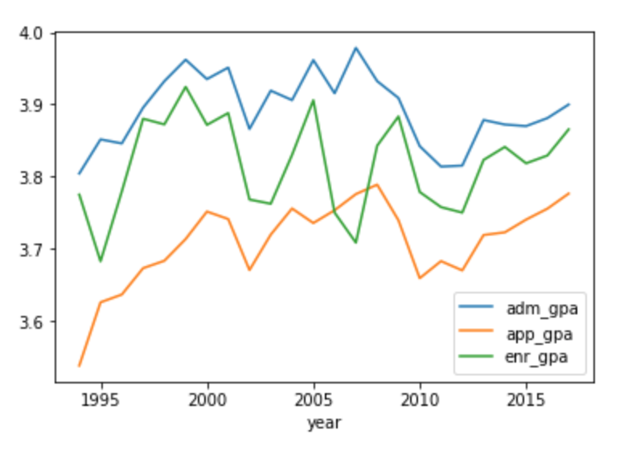
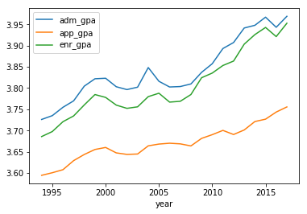
Artifacts Fixes
GPA Inflation Plots
Before
After

Slide 6
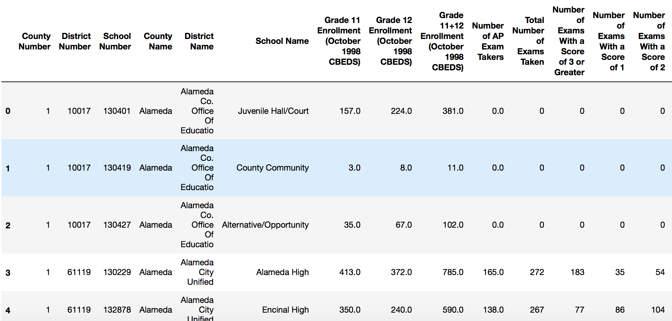
SAT / AP Scores Overview

Slide 7
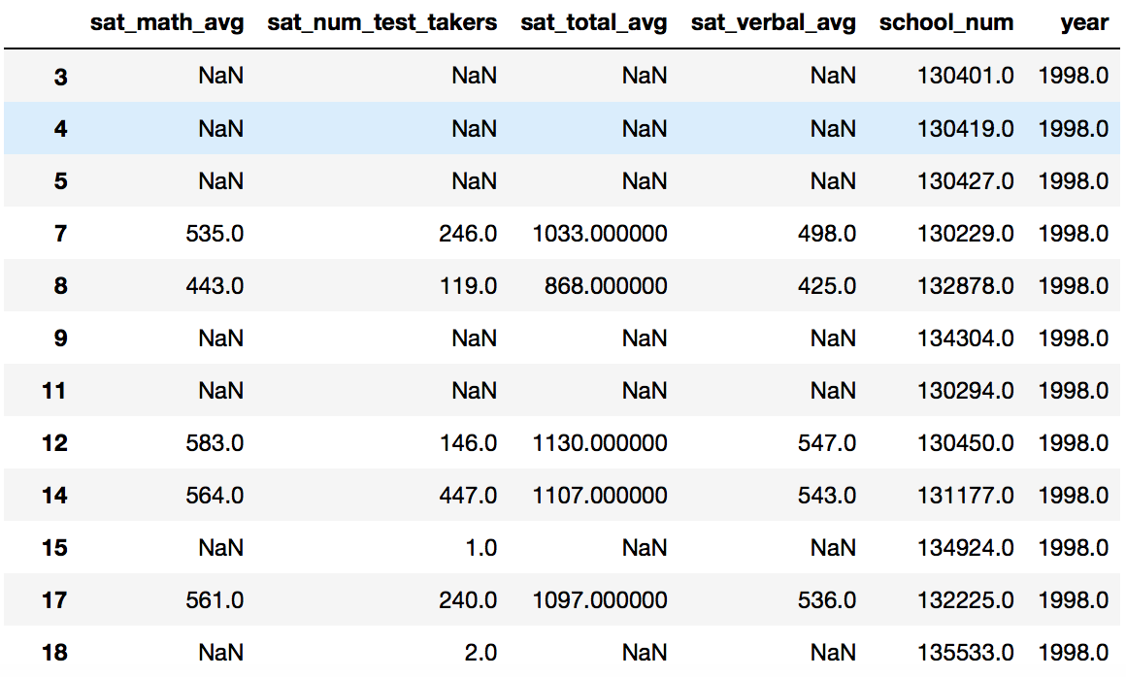
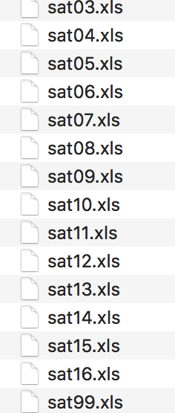
SAT

Slide 8
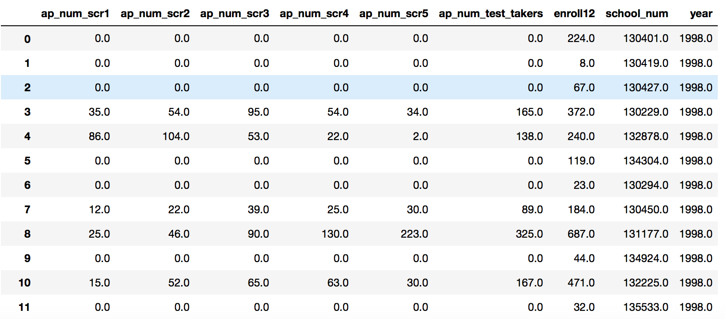
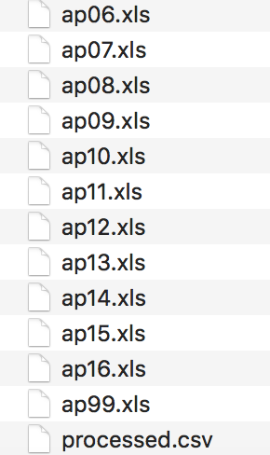
AP

Slide 9

Distance
Distance between the high school and the UC campus
Used the Google Maps API to locate the high schools from our dataset
Computed high schools’ distances to each UC campus

Slide 10
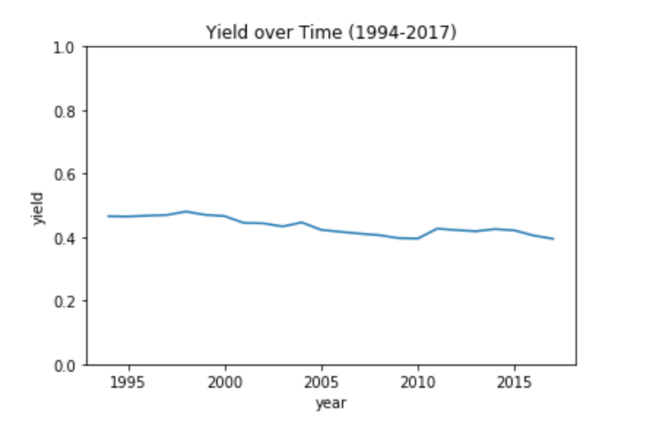
Exploration / Visualization

Slide 11

Plans for Completion
Finish getting distance data from high schools to campuses
Finish test scores integration
Use distance, test score, gpa, and year to predict the yield for a school
Find a multivariate linear regression model

Slide 12

Challenges
Insufficient data in breadth and depth
Poor correlation between existing variables
Integration / Merging of new datasets
API limit of Google Maps
Multiple high schools with the same name

