Slide 1
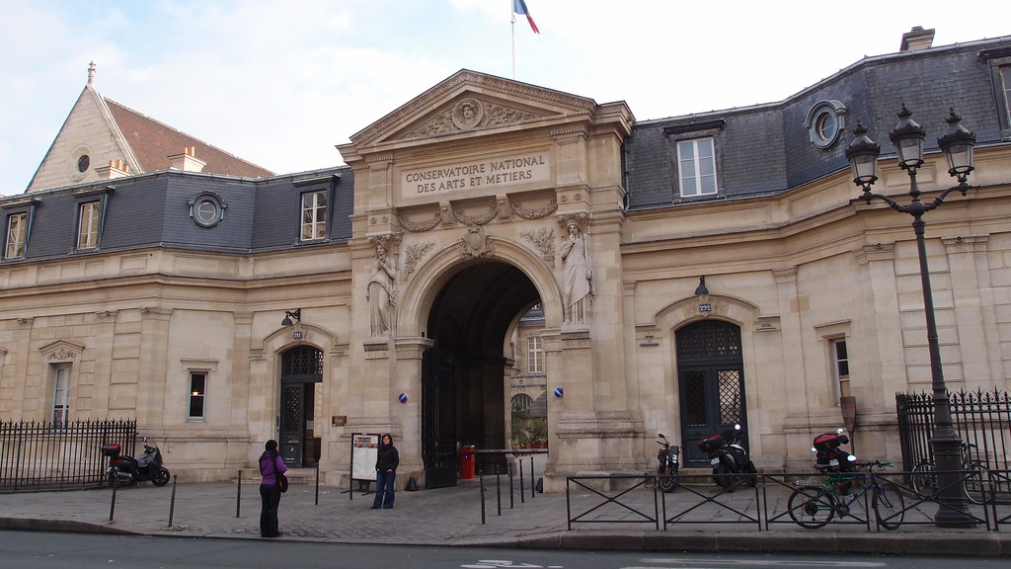
Project in partnership with the Conservatoire National des Arts et Métiers
BI Sainan
YILMAZ Aksel
NOUADJE FOTSO Enge
LOU Shangzhi
Boudin Capucine

Slide 2
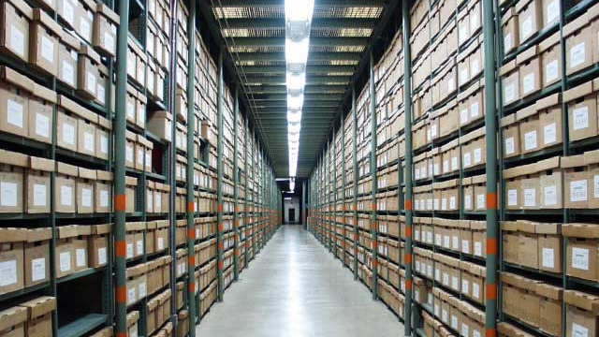
Presentation and analysis of the subject
Scope of the Subject :
-Prosopographic database
-Analyze social networks, power dynamics, individual and collective influences
Aim of the project :
-Digitalize texts from historical archives
-Propose a factoid extraction model that is able to make correlations
-Propose a learning model for the fusion of factoids
Cette photo par Auteur inconnu est soumise à la licence CC BY-ND

Slide 3

Challenges
Data Acquisition & Processing:
-Large volume of diverse format data from National Library archives.
AI Model Training:
-Developing a model to recognize names, facts, and correlations.
Handling Data Uncertainty & Bias.
Fact Fusion & Validation:
-Merging facts from different sources and ensuring accuracy.
Legal & Privacy Concerns:
-Compliance with data protection laws and permissions.

Slide 4

Accomplished Work
Spacy (french and english models)
Web Scraping script
BERT and other variants

Slide 5

Next Steps and Outlook
Test our dataset with BERT and its variants
Automatization of Web scraping

