Slide 1
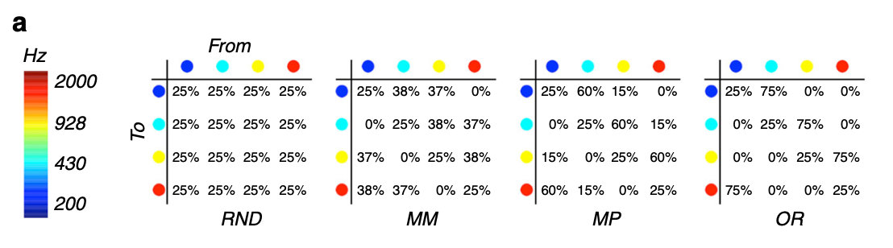
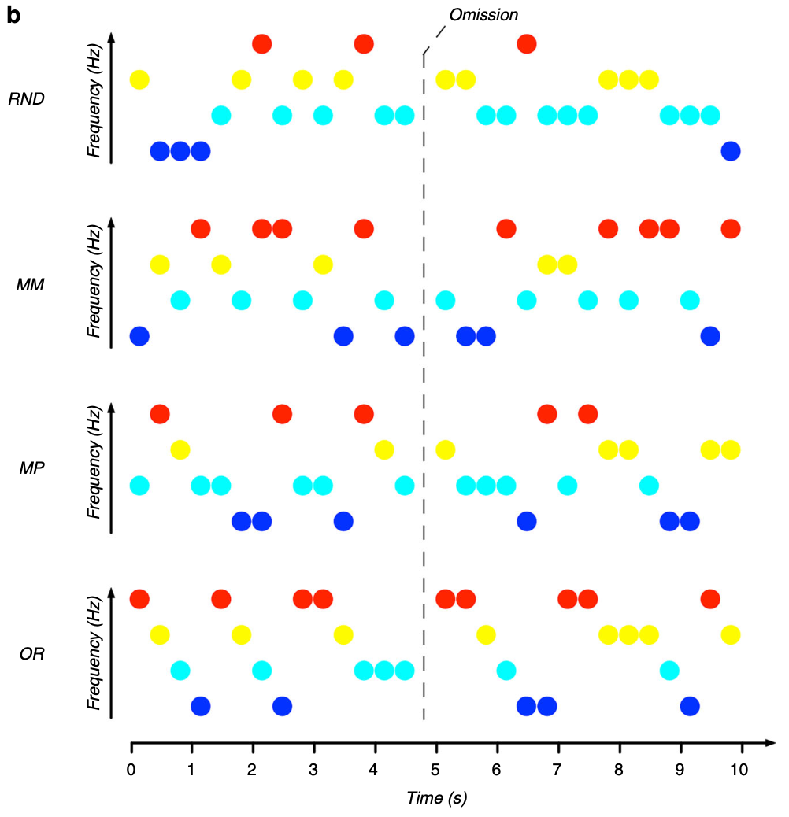
Final Experiment: Automatic and feature-specific prediction-related neural activity in the human auditory system (Demarchi et al. (2019))
equal transition probability from one sound to another
Intermediate conditions:
Probability across diagonal approx. 25%
presentation of one sound was followed with high probability by another sound
-> Within the block, 10% of the stimuli were omitted

