Slide 1

Team 20 : Extron
Team Members:
Chris Allen Natalie Kerby
Jean de Klerk Corey Melton
Sponsor:
Mike Izquierdo

Slide 2
Outline
Sponsor Background
Project Outline
Challenges
Design Plan
Next Steps

Slide 3
Sponsor Background

Slide 4

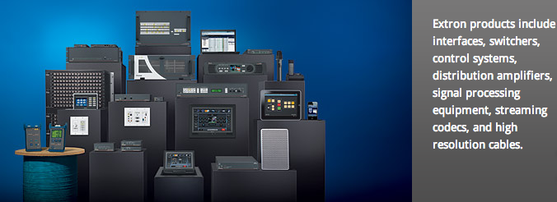

Slide 5



MPEG-DASH
Dynamic
Adaptive
Streaming
HTTP
International Standard
November 2011
Notes:
Uses of Adaptive Streaming Technologies:
Netflix
Hulu/Hulu Plus
Youtube
Quickly Explain adaptive streaming
D-A-S-H
MPD (Media Presentation Description) to get file names/locations
HTTP GET for files (changes quality/bit rate by requesting different files)

Slide 6
Project Summary

Slide 7
Project Mission
Research Oriented Project
Better Understand Interactions
Setup Testbed
Conduct Experiments

Slide 8
Project Goals
Create the Testbed
Project Documentation
To replicate projects in future:
Data Collection
Create demo to display functionality

Slide 9
Testing/Data Collection
Daily Tests for Routing Tables
Collect Data
Wireshark
Excel
Notes:
Daily Tests
Batch files for traceroutes
make sure hitting all computers
Collect Data
Bandwidth
current video source (size)
dropped packets
See possible reactions between DASH and TCP (put TCP gen into excel data as well)

Slide 10
Challenges

Slide 11
Challenges
Virtual/Physical
Changing Requirements
Multiple Subnets
Data Collection
Traffic Generation

Slide 12
Design PLan

Slide 13
Resources
Hardware
Software
4 Desktop Computers
1 5-port switch
5 Ethernet Cables
Ubuntu 12.10
Apache Server
MasterShaper
Nmap
VLC
WireShark
TightVNC

Slide 14
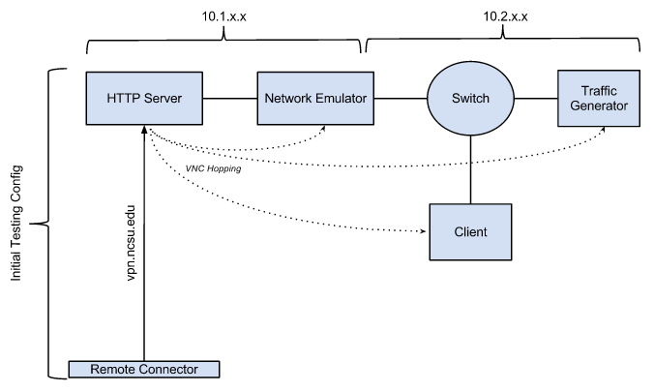
Current Progress

Slide 15



Slide 16

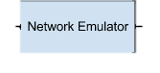

Slide 17


Slide 18



Slide 19


Slide 20



Slide 21


Current Progress

Slide 22
Next Steps

Slide 23
Next Steps
Setup Routing Tables
Test VPN/VNC
Test simple DASH stream
Scripts/Batch Files

Slide 24
Thank You!

