Slide 1
Team 20 Oral Progress Report 2
Chris Allen
Jean de Klerk
Natalie Kerby
Corey Melton

Slide 2
Preview
Recap
Progress
Challenges
Next Steps

Slide 3
Recap
Sponsor: Extron
Project: Research Adaptive Streaming over HTTP
Phase 1: Test Bed Setup
Phase 2: Encoding and Decoding Setup
Phase 3: Research and Testing

Slide 4
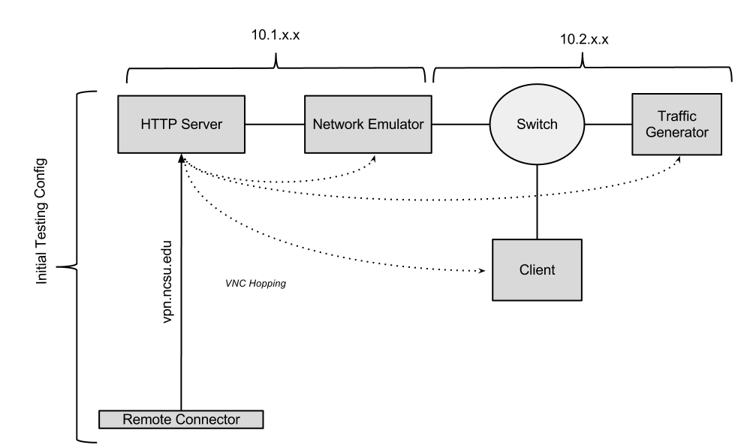

Slide 5
Progress
Server setup
Chose to ignore encoding
Created scripts for mass download
Tested various decoders, chose VLC
Implemented WANEM to emulate network
Could NOT get streaming to work – only up to 500kbits/sec

Slide 6
Progress
Approached problem from different angles:
Different segment sizes
Altering the MPD
Messing with our bandwidth
Trying different videos
Emailing ITEC directly
Talking with sponsor
Finally, noticed something odd..

Slide 7
EUREKA
Tiny max-resolution setting in VLC
Fixed, changed buffer size to 10s from 30s
Full streaming capability, from 240p-1080p (50kbits/sec – 8000kbits/sec)
Let’s see an example

Slide 8
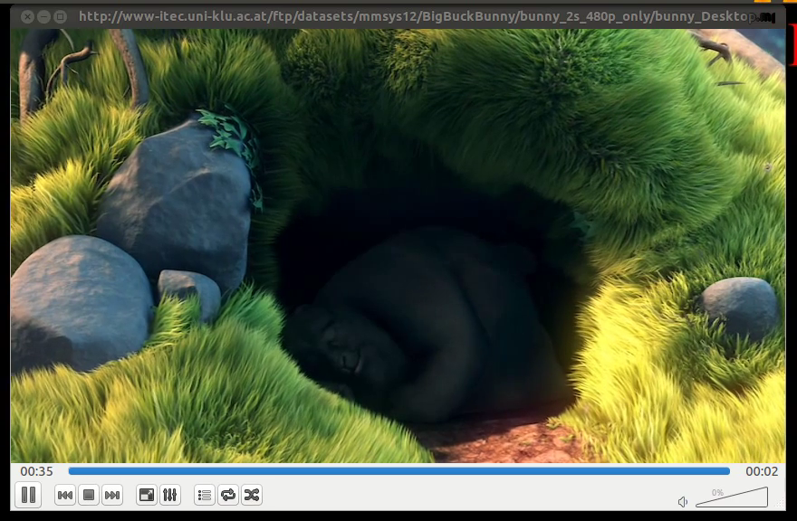
VIDEO

Slide 9
Challenges
Faulty encoder
Hard choice to make: fix encoder or use pre-defined test cases and focus on decoder
Decoder setup
Many tiny configurations to make decoder work
Had to choose between Open-Source decoders (VLC) and Closed-Source decoders (Amazon, Apple, Microsoft). Chose Open-Source
Network Emulator setup
Chose WANEM

Slide 10
Future Steps
Identify specific areas of research interest
Create a plan of investigation
Begin setup of testing software – iftop, wireshark, VLC plugins, WANEM, packet generator
Begin testing
Continue and finalize project documentation

Slide 11
Thanks

