Slide 1
Team 20: Extron OPR3
Chris Allen
Jean de Klerk
Natalie Kerby
Corey Melton

Slide 2
Outline
Project Recap
Current Progress
Challenges
Action Steps

Slide 3
Project Recap

Slide 4
Problem Statement
Sponsor
Extron
Problem Statement
To create a streaming media testbed using open source software to study the interactions of adaptive streaming over HTTP.

Slide 5



Adaptive Streaming
Varying Bandwidths
Video Quality

Slide 6

High Bandwidth = High Resolution

Slide 7

Low Bandwidth = Low Resolution

Slide 8
Background Research
Dynamic Adaptive Streaming over HTTP Dataset
Alpen-Adria Universität
Initial research on Adaptive Streaming
Using:
Testbed Setup
Software Setup

Slide 9
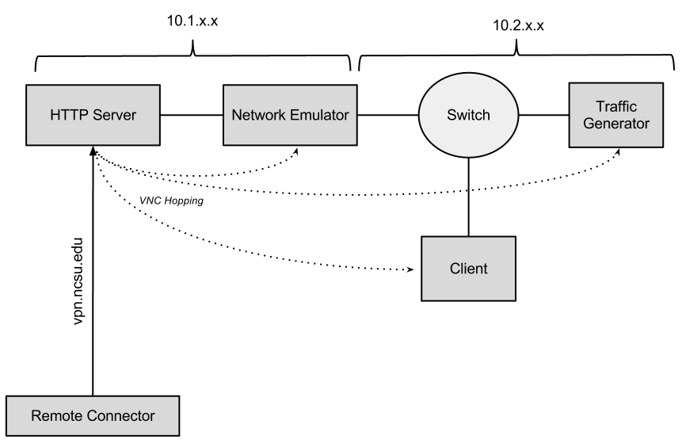
Testbed Setup

Slide 10
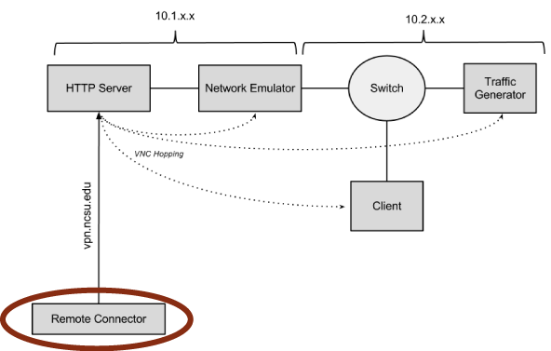
Testbed Setup

Slide 11
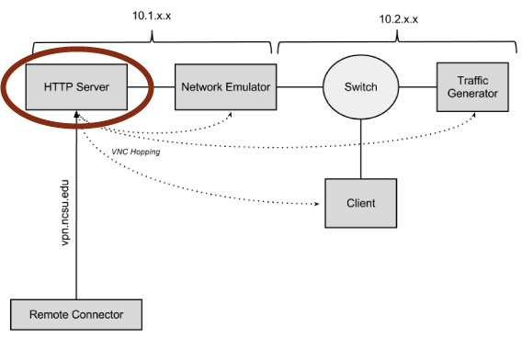
Testbed Setup

Slide 12
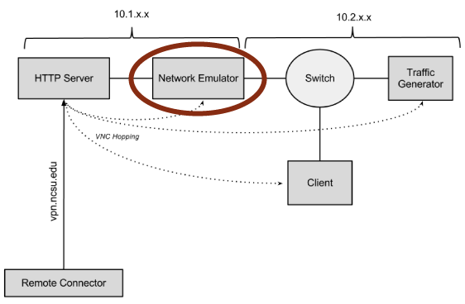
Testbed Setup

Slide 13
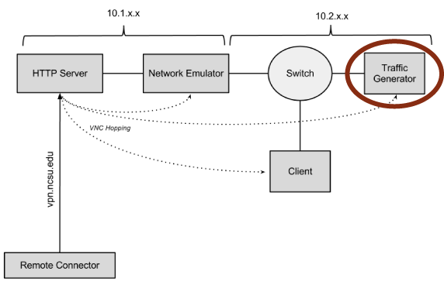
Testbed Setup

Slide 14
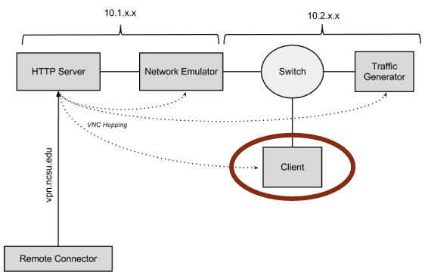
Testbed Setup

Slide 15
Testbed Setup

Slide 16
Project Phases
Three Phase
Phase 1: Complete
January – Feb
Phase 2: Complete
Feb – March
Phase 3: In Progress
March - April

Slide 17
Phase 1 - Complete
Physical versus Virtual
Gathered all hardware
Setup subnets and IP tables

Slide 18
Phase 2 - Complete
Installed all software
VLC
Wireshark

Slide 19
Phase 3 – In Progress
Data Collection
Automation
Data Analysis

Slide 20
Current Progress

Slide 21
Data Collection
What Data
How to collect

Slide 22
Test Plan
Confirmation Test
3 Experiments

Slide 23
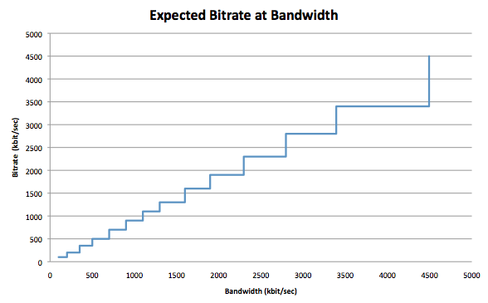
Confirmation Test

Slide 24
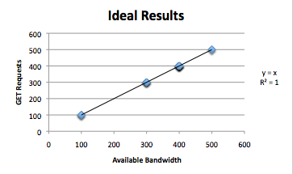
Taking it One Step Further
Measuring available bandwidth versus the GET requests from VLC

Slide 25
Experiment 1
To see how changing the buffer size affects the time it takes for the GET requests to adjust to the bandwidth.
Independent Variable:
Buffer Size
Dependent Variable:
GET Requests
Time

Slide 26
Experiment 2
To see how the client reacts when artificially adding congestion to the network.
Independent Variable:
Packet Flooding
Dependent Variable:
GET Requests

Slide 27
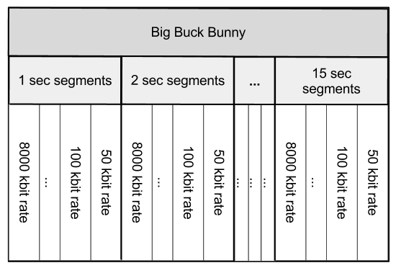
Experiment 3
To see what happens when different combinations of buffer sizes and segment sizes are used in adaptive streaming.
Independent Variable:
Buffer Size
Segment Size
Dependent Variable:
GET Requests

Slide 28
Automated Testing
Synchronize Programs
Time Management
Reduce Human Error

Slide 29
Challenges

Slide 30
Adaptive Streaming Client
VLC DASH plugin is not stable
Bandwidth changes result inconsistent bitrate
Does not exit properly

Slide 31
Automated Scripting
Wireshark
Doesn’t quit
CSV output challenge
Capturing exact amount of packets
WanEm CLI does not exist
VLC process does not quit
Parsing output files

Slide 32
Action Steps

Slide 33
Data Analysis
Goal:
Input and Analyze data in R
Backup programs are:
Excel
MatLab

Slide 34
Coming Up for Next Month
Experiment Scripting
April 1st
Data Collection
April 8th
Data Analyzing
April 15th
Final Report & Posters and Pies
April 26th

Slide 35
Thank You

