Slide 1
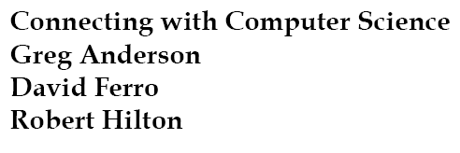
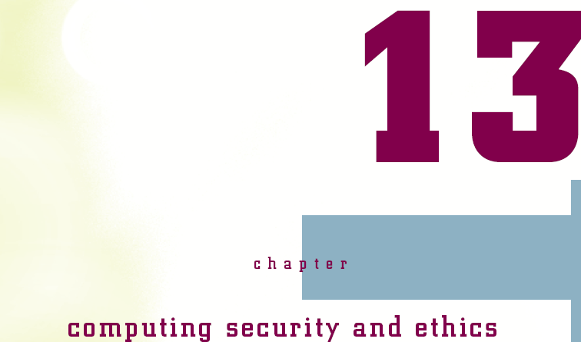


Slide 2
Objectives
Learn why today almost everyone is a computer operator
Learn about the predecessors of modern computer hardware and software
Trace the development of computer hardware and software through several generations
Connecting with Computer Science

Slide 3
Objectives (continued)
Learn that sometimes good ideas flop and bad ones survive
Meet some interesting figures—some famous, some infamous, some wealthy, and some obscure
See some issues facing modern computing
Connecting with Computer Science
Notes:
Obscure: mờ nhạt

Slide 4
Why You Need to Know About the History of Computing
Computers are everywhere
  Communication device
  Tool for artists, architects, and designers
  Information archive
  Entertainment device
  Trains, planes, automobiles
What caused the revolution?
What lies ahead?
Connecting with Computer Science

Slide 5
Ancient History
Ａｎｃｉｅｎｔ Ａｓｓｙｒｉａ
Ｍｅｃｈａｎｉｃａｌ
Ｅｌｅｃｔｒｏｍｅｃｈａｎｉｃａｌ
Vacuum tubes worked as memory
Data(MD,MT,PaperT,Cardｓ）
1950s
First Generation
Late 1950s
Software innovations(H.L.Lang.)
Hardware development(Tr. & RAM)
Second Generation
Second half of 1960s
Operation System
Hadware development(IC, Chip)
Third Generation
Early 1970s
LSI,VLSI
Mini-. Micro computer
Forth Generation
1990
Parallel computing
SIMD, MIMD
Fifth Generation
Now
What will be happened?
What will need?
In the future
Connecting with Computer Science
Notes:
LSI (Large Scale Integrated);
VLSI (Very Large Scale Integrated)

Slide 6
Ancient History
Ａｎｃｉｅｎｔ Ａｓｓｙｒｉａ
Ｍｅｃｈａｎｉｃａｌ
Ｅｌｅｃｔｒｏｍｅｃｈａｎｉｃａｌ
Vacuum tubes worked as memory
Data(MD,MT,PaperT,Cardｓ）
1950s
First Generation
Late 1950s
Software innovations(H.L.Lang.)
Hardware development(Tr. & RAM)
Second Generation
Second half of 1960s
Operation System
Hadware development(IC, Chip)
Third Generation
Early 1970s
LSI,VLSI
Mini-. Micro computer
Forth Generation
1990
Parallel computing
SIMD, MIMD
Fifth Generation
What will be happened?
What will need?
In the future
Connecting with Computer Science

Slide 7
Ancient History
Origins of computer in ancient Assyria
  Tablets with arithmetic/trigonometric solutions
  Math solves societal and personal problems
Drivers of mathematical development
  Property ownership and the need to measure
  Vertical construction and the pyramids
  Navigation and the need to control time
Computers do math
Connecting with Computer Science

Slide 8
Pascal and Leibniz
Start the Wheel Rolling
Paper, wood, stone, papyrus tables, abacuses as “computers”
1622: invention of slide rule
1642: invention of mechanical calculator by Blaise Pascal
1694: Leibniz Wheel expands arithmetic operations
Connecting with Computer Science
Notes:
Blaise Pascal designed a mechanical calculator with gears and levers that performed addition and subtraction
Gottfried Leibniz built on Pascal’s work in 1694 by creating the Leibniz Wheel, which added multiplication and division to the mechanical calculator’s capabilities
Devices such as Pascal’s and Leibniz’s allowed a user to “key in” a problem’s parameters and get a solution.
Unfortunately, cost and complexity kept these devices from becoming widespread

Slide 9
Joseph Jacquard
Invents programmable loom in 1801
  Jacquard loom weaves patterns in fabric
  Allows input and storage of parameters
  Selection pins oriented with punch cards
  Similarities with player piano
Concept of the stored program
Connecting with Computer Science
Notes:
- In 1801, a major invention allowed not only keying in the parameters of a problem, but also storing parameters and using them whenever needed

Slide 10
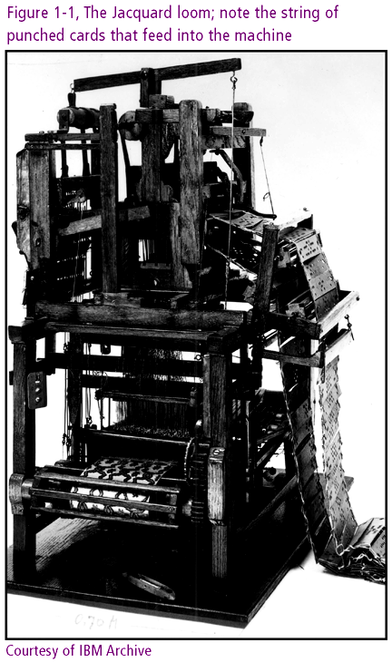
Connecting with Computer Science

Slide 11
Charles Babbage
Invents Difference Engine in 1823
  Mechanical device adds, subtracts, multiplies, divides
Designs Analytical Engine
  Components of modern computer
    Input and output devices, memory and CPU
  Not built due to lack of funds
Collaborates with Ada Lovelace Byron
  Attribution of program loop concept
  Ada programming language namesake
Connecting with Computer Science

Slide 12
Herman Hollerith
Invents electromechanical counter in 1880s
  Serves tabulation role in 1890 US census
  Machine uses punch cards as input
  Single-purpose machine
Created a company created around this technology, then becomes IBM
  IBM rolls out multi-purpose Mark I in 1944
  Mark I rapidly made obsolete by vacuum tubes
Connecting with Computer Science
Notes:
American Herman Hollerith:
- Is the person who did find adequate funding to develop a “computing” machine
-

Slide 13
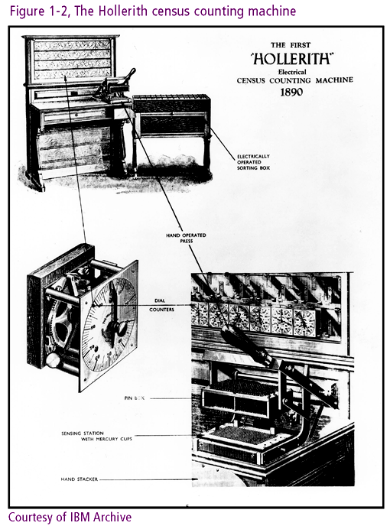
Connecting with Computer Science

Slide 14
Progression of
Computer Electronics
Charles Sanders Peirce extends work of Boole
  Electric switches emulate the true/false conditions of Boolean algebra
  Benjamin Burack implements concepts in 1936 logic machine
John Atanasoff and Clifford Berry build computer using vacuum tubes
World War II as developmental turning point
Connecting with Computer Science

Slide 15
Wartime Research Drives
Technological Innovation
Military need: trajectory tables for weapons testing
  U.S. Navy Board of Ordinance helps fund Mark I
  U.S. Army funds ENIAC (Electronic Numerical Integrator and Computer)
ENIAC runs 1000 times faster than Mark I
ENIAC and Mark I too late to assist in war effort
Connecting with Computer Science
Notes:
Navy Board of Ordinance: Ban quân dụng Hải quân tài trợ cho dự án Mark I tại Harvard
The U.S. Navy Board of Ordnance became involved in the Mark I project at Harvard
In 1943, the U.S. Army sponsored a different group at the Moore School of Engineering at the University of Pennsylvania

Slide 16
ENIAC and EDVAC
ENIAC’s overhead
  Loud and large at 30 tons: fills a huge basement
  18,000 vacuum tubes need constant attention
  6,000 switches need for arithmetic operations
ENIAC’s strengths
  Performs arithmetic and logic operations
  Made multi-purpose with symbolic variables
ENIAC’S other weaknesses
  Could not modify program contents
  Had to be programmed externally
Connecting with Computer Science

Slide 17
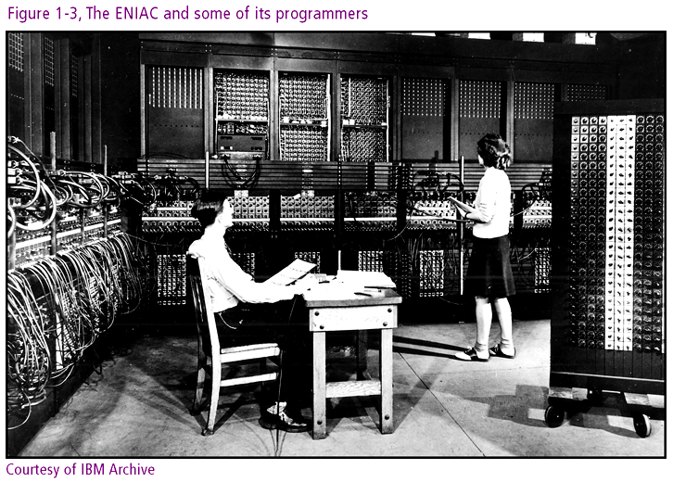
Connecting with Computer Science

Slide 18
ENIAC AND EDVAC (continued)
EDVAC (Electronic Discrete Variable Automatic Computer) created in 1944
  Recognized as the Von Neumann machine
  Superior model for descendant computers
  Operation governed by program in memory
  Programs could be modified
  Stored program concept: programs reusable
The British response: Colossus
  Colossus helps crack German U-boat Enigma code
  All machines destroyed by 1960s
Connecting with Computer Science
Notes:
Descendant: con cháu

Slide 19
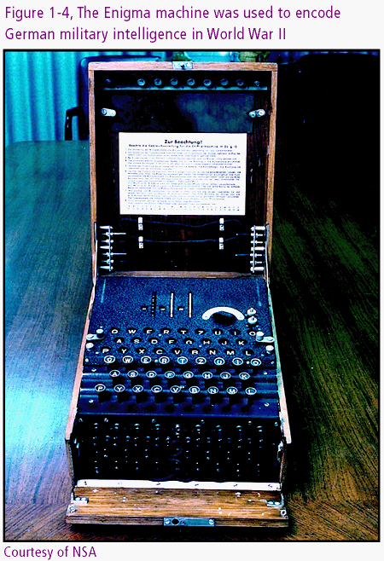
Connecting with Computer Science

Slide 20
Ancient History
Ａｎｃｉｅｎｔ Ａｓｓｙｒｉａ
Ｍｅｃｈａｎｉｃａｌ
Ｅｌｅｃｔｒｏｍｅｃｈａｎｉｃａｌ
Vacuum tubes worked as memory
Data(MD,MT,PaperT,Cardｓ）
1950s
First Generation
Late 1950s
Software innovations(H.L.Lang.)
Hardware development(Tr. & RAM)
Second Generation
Second half of 1960s
Operation System
Hadware development(IC, Chip)
Third Generation
Early 1970s
LSI,VLSI
Mini-. Micro computer
Forth Generation
1990
Parallel computing
SIMD, MIMD
Fifth Generation
What will be happened?
What will need?
In the future
Connecting with Computer Science

Slide 21
The Computer Era Begins:
The First Generation
1950s: First Generation for hardware and software
  Vacuum tubes worked as memory for the machine
  Data written to magnetic drums and magnetic tapes
  Paper tape and data cards handled input
  The line printer made its appearance
Software separates from hardware and evolves
  Instructions written in binary or machine code
  Assembly language: first layer of abstraction
  Programmers split into system and application engineers
Connecting with Computer Science

Slide 22
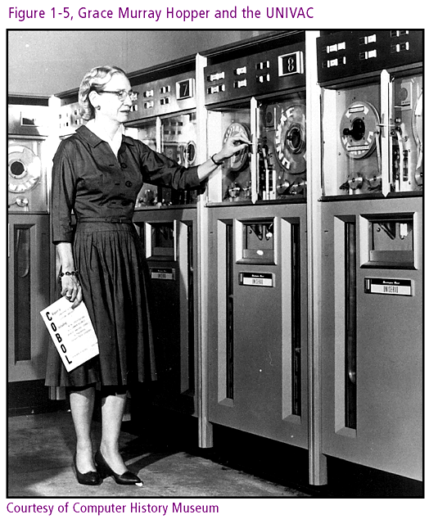
Connecting with Computer Science

Slide 23
UNIVAC
UNIVAC: first commercially viable computer
  US Census Bureau is first customer
  Faces skepticism from Howard Aiken, Mark I builder
UNIVAC and the 1952 Presidential election
  Successfully predicts outcome during CBS broadcast
  Quickly adopted by all major news network
Connecting with Computer Science

Slide 24
IBM (Big Blue)
IBM dominates mainframe market by the 1960s
  Strong sales culture
  Controlled 70 percent of the market
IBM vision
  Sharp focus on a few products
  Leverage existing business relationships
  Introduce scalable (and hence flexible) systems
  Lease systems with 10 to 15 year life spans
Connecting with Computer Science

Slide 25
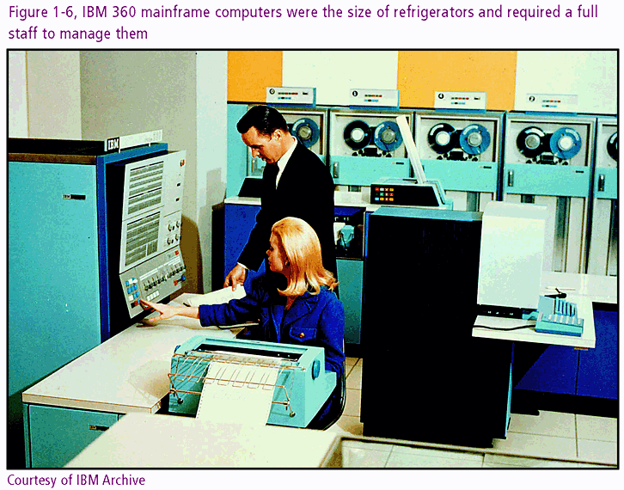
Connecting with Computer Science

Slide 26
Ancient History
Ａｎｃｉｅｎｔ Ａｓｓｙｒｉａ
Ｍｅｃｈａｎｉｃａｌ
Ｅｌｅｃｔｒｏｍｅｃｈａｎｉｃａｌ
Vacuum tubes worked as memory
Data(MD,MT,PaperT,Cardｓ）
1950s
First Generation
Late 1950s
Software innovations(H.L.Lang.)
Hardware development(Tr. & RAM)
Second Generation
Second half of 1960s
Operation System
Hadware development(IC, Chip)
Third Generation
Early 1970s
LSI,VLSI
Mini-. Micro computer
Forth Generation
1990
Parallel computing
SIMD, MIMD
Fifth Generation
What will be happened?
What will need?
In the future
Connecting with Computer Science

Slide 27
Transistors in the
Second Generation
Software Innovations
  Assembly language limitations
  Appearance of high-level languages: FORTRAN, COBOL, LISP
Hardware Development
  Transistor replaces vacuum tube
  RAM becomes available with magnetic cores
  Magnetic disks support secondary storage
Connecting with Computer Science

Slide 28
Ancient History
Ａｎｃｉｅｎｔ Ａｓｓｙｒｉａ
Ｍｅｃｈａｎｉｃａｌ
Ｅｌｅｃｔｒｏｍｅｃｈａｎｉｃａｌ
Vacuum tubes worked as memory
Data(MD,MT,PaperT,Cardｓ）
1950s
First Generation
Late 1950s
Software innovations(H.L.Lang.)
Hardware development(Tr. & RAM)
Second Generation
Second half of 1960s
Operation System
Hadware development(IC, Chip)
Third Generation
Early 1970s
LSI,VLSI
Mini-. Micro computer
Forth Generation
1990
Parallel computing
SIMD, MIMD
Fifth Generation
What will be happened?
What will need?
In the future
Connecting with Computer Science

Slide 29
Circuit Boards in the Third Generation
Integrated Circuits(IC) or Chips
  Miniaturized circuit components on board
  Semiconductor properties
  Reduce cost and size
  Improve reliability and speed
Operating Systems (OS)
  Program to manage jobs
  Utilize system resources
  Allow multiple users
Connecting with Computer Science

Slide 30
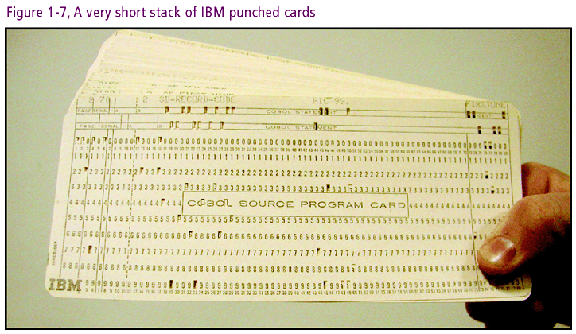
Connecting with Computer Science

Slide 31
Time-Sharing
Allocates system resources to multiple users
  Input with long paper rolls instead of punch cards
  Productivity gains offset by increased response time
General purpose machines broaden appeal
Programmers gear software toward end user
  Distinctions between application level and OS level
  Statistical and accounting programs hide implementation details
Connecting with Computer Science
Notes:
the computer was beginning to be used by a broader population as a general-purpose machine

Slide 32
Living in the ‘70s with the Fourth Generation
The era of miniaturization
  LSI chips contain up to 15,000 circuits
  VLSI contain 100,000 to 1 million circuits
Moore’s Law
  Circuit density doubles every 1.5 years
  Memory capacity and speed rise while costs drop
Minicomputer industry grows
Microcomputer makes appearance
Connecting with Computer Science
Notes:
Iconoclastic: lề thói

Slide 33
The Personal
Computer Revolution
Causes
  Hardware vision of engineers
  Iconoclastic software developers seeking challenges
  Electronic hobbyists realizing a dream
The role of will
  Components previously developed
  Social and economic support
Connecting with Computer Science

Slide 34
Intel
The Intel 4004 chip
  4004 transistors aboard
  Accrues greater functionality
  Precursor to central processing unit (CPU)
Gary Kildall writes OS for Intel microprocessor
Software and hardware become separate commodities
Connecting with Computer Science
Notes:
Precursor : tiền thân

Slide 35
The Altair 8800
Development spurred by Popular Electronics
Ed Roberts reports on the Altair 8800
  Kit based on Intel 8080
  Generates 4000 orders within three months
Altair 8800 features
  I/O similar to ENIAC’s
  Open architecture provides adaptability
  Portable
Connecting with Computer Science
Notes:
Spur: Thúc đẩy

Slide 36
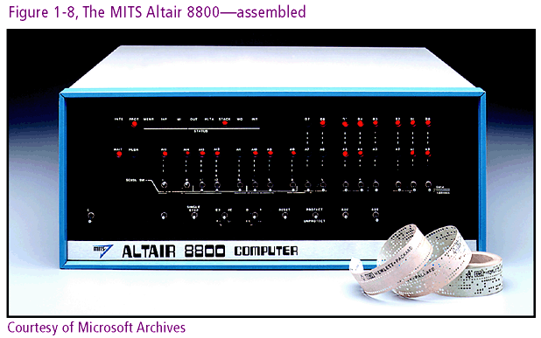
Connecting with Computer Science

Slide 37
Enter Bill Gates,
Paul Allen, and Microsoft
Gates and Allen develop a BASIC interpreter
  High level language for microcomputer programmers
Briefly associate with MITS
Form Micro-Soft company in 1975
Connecting with Computer Science

Slide 38
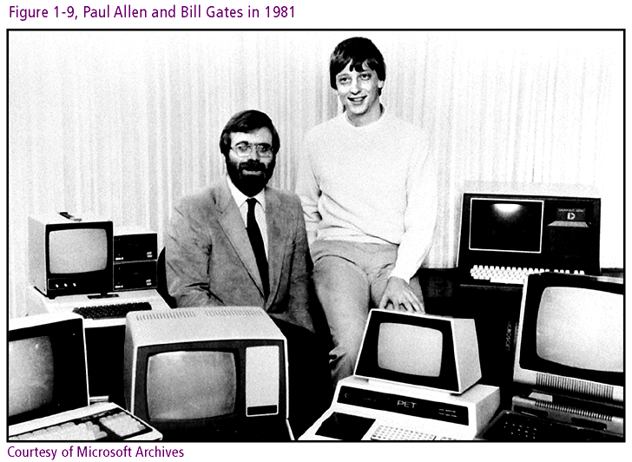
Connecting with Computer Science

Slide 39
The Microcomputer
Begins to Evolve
Microcomputer’s profitability lures more players
  Enter Radio Shack, IMSAI, Sphere and others
Altair’s bus becomes S100 industry standard
MITS stumbles
  Links prices of faulty hardware to BASIC
  Develops new model incompatible with 8080
1977
  MITS sold off
  Hardware companies introduce competing models
Connecting with Computer Science
Notes:
Stumbles: Trượt chân

Slide 40
An Apple a day…
1976: Steve Jobs and Steve Wozniak offer Apple I
1977: Apple II developed and released
  Based on Motorola 6502 processor
  Gains respect in industry as well as among hobbyists
  Promotes application development
VisiCalc spreadsheet program
  Drives Apple II sales
  Earns new title: killer app
  Draws attention of wider business community
Connecting with Computer Science

Slide 41
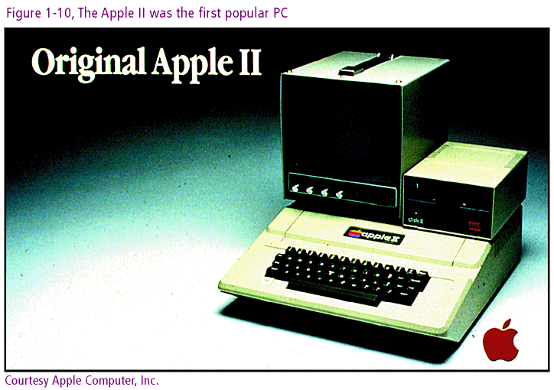
Connecting with Computer Science

Slide 42
Ancient History
Ａｎｃｉｅｎｔ Ａｓｓｙｒｉａ
Ｍｅｃｈａｎｉｃａｌ
Ｅｌｅｃｔｒｏｍｅｃｈａｎｉｃａｌ
Vacuum tubes worked as memory
Data(MD,MT,PaperT,Cardｓ）
1950s
First Generation
Late 1950s
Software innovations(H.L.Lang.)
Hardware development(Tr. & RAM)
Second Generation
Second half of 1960s
Operation System
Hadware development(IC, Chip)
Third Generation
Early 1970s
LSI,VLSI
Mini-. Micro computer
Forth Generation
1990
Parallel computing
SIMD, MIMD
Fifth Generation
What will be happened?
What will need?
In the future
Connecting with Computer Science

Slide 43
IBM Offers the PC
IBMS builds a microcomputer with new ways
  Adopts the Intel 8088 off the shelf
  Uses a non-proprietary CPU
  Create approachable documentation
  Offer open architecture
New product name: personal computer (PC)
PC sold through retail outlets
Connecting with Computer Science

Slide 44
MS-DOS
IBM chooses Microsoft to develop OS
Microsoft introduces MS-DOS
  Based on Kildall’s 8 bit CP/M
  Runs on 16 bit CPU (Intel 8088)
  Prevails over competition
IBM calls operating system PC-DOS
Connecting with Computer Science
Notes:
Prevail: chiếm ưu thế

Slide 45
The Apple Macintosh
Raises the Bar
Steve Jobs visits Xerox PARC
  Alto machine: graphics, menus, icons, windows, mouse
  Observes functioning Ethernet network
  Learns about hypertext
Jobs succeeds with Xerox ideas
  Picks up where Xerox, focused on copiers, leaves off
  Incorporates many Palo Alto components in Macintosh
1984: Macintosh unveiled
  Graphical user interface (GUI)
  Mouse: point-and-click and ease-of-use
Connecting with Computer Science
Notes:
Unveiled: công bố

Slide 46
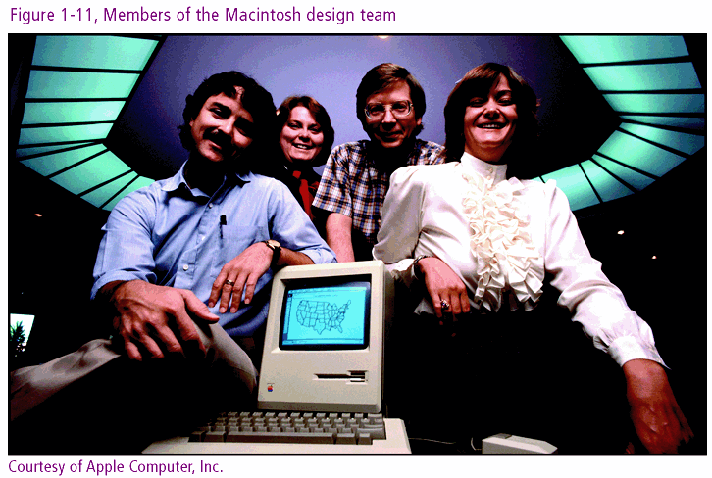
Connecting with Computer Science

Slide 47
Other PCs (and One Serious OS
Competitor) Begin to Emerge
Microsoft two-fold argument to IBM
  Adapt open architecture concept to OS
  Allow Microsoft freedom to license its OS
Microsoft answers Apple
  Windows 3.1 incorporates Mac’s GUI features
  Competing PC clones appear with Microsoft’s OS
Microsoft leverages position
  OS presence drive application software sales
  Sales synergies and licensing give 90 % of PC pie
Connecting with Computer Science

Slide 48
Ancient History
Ａｎｃｉｅｎｔ Ａｓｓｙｒｉａ
Ｍｅｃｈａｎｉｃａｌ
Ｅｌｅｃｔｒｏｍｅｃｈａｎｉｃａｌ
Vacuum tubes worked as memory
Data(MD,MT,PaperT,Cardｓ）
1950s
First Generation
Late 1950s
Software innovations(H.L.Lang.)
Hardware development(Tr. & RAM)
Second Generation
Second half of 1960s
Operation System
Hadware development(IC, Chip)
Third Generation
Early 1970s
LSI,VLSI
Mini-. Micro computer
Forth Generation
1990
Parallel computing
SIMD, MIMD
Fifth Generation
What will be happened?
What will need?
Now
In the future
Connecting with Computer Science

Slide 49
The Latest Generation (Fifth)
Parallel computing
  Aka parallel architecture
  CPUs joined for simultaneous task execution
Three approaches
  SIMD (single instruction, multiple data) stream
  MIMD (multiple instruction, multiple data) stream
  Internetworking
Uses
  Control web pages, databases, networks
  Mathematical modeling and scientific research (Cray)
Connecting with Computer Science
Notes:
Aka: also known as

Slide 50
The Internet
ARPA origins of new communication system
  Resource sharing
  Common protocols
  Fault tolerance
1969: ARPANET born
  Consisted of (4) computers at (4) locations
  Different systems linked with Interface Message Processor (IMP)
ARPANET grows rapidly
  Protocols allow easy entry into network
  Electronic mail comprises 2/3 of network traffic
Connecting with Computer Science
Notes:
ARPA: dvanced Research Projects Agency of the U.S. Department of Defense

Slide 51
LANs and WANs and other ANs
The Internet as network of networks
  Wide Area Network (WAN)
  Local Area Network (LAN)
  Wireless Local Area Network (WLAN)
  Metropolitan Area Network (MAN)
  Urban Area Network (UAN)
Network technologies
  Ethernet
  Fiberoptics
  Wireless technologies
Connecting with Computer Science

Slide 52
Super Software and the Web
Object-oriented programming (OOP)
Computer Aided Software Engineering (CASE)
Origin of the World Wide Web (WWW)
  1990: Tim Berners-Lee develops hypertext
  Prototype browser created on NeXT computer
  Marc Andreesen and Mosaic
  Microsoft and Internet Explorer
Web components
  Web pages
  Browser
  Network technology
Connecting with Computer Science
Notes:
NeXT is company of Steve Job started after he left Apple.
Mosaic browser was written by Marc Andreessen and released free of charge in 1993.

Slide 53
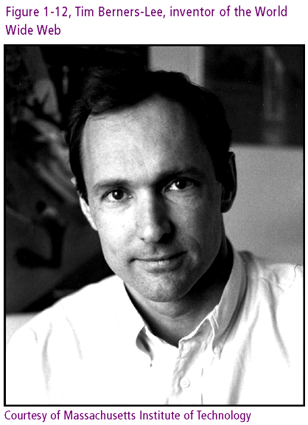
Connecting with Computer Science

Slide 54
The Microsoft Era and More
The “browser wars”
  Microsoft integrates IE browser into Windows
  Netscape opposes Microsoft: goes open source
The wars continue in court
  US government file antitrust suit against Microsoft
  By 2001 most of antitrust suit dropped or lessened
Linux OS threatens Windows
  Low cost, open source, reliability
Microsoft in perspective
  Accounts for 10 percent of world’s software
  Microsoft a small software player outside of PC
Connecting with Computer Science

Slide 55
Ancient History
Ａｎｃｉｅｎｔ Ａｓｓｙｒｉａ
Ｍｅｃｈａｎｉｃａｌ
Ｅｌｅｃｔｒｏｍｅｃｈａｎｉｃａｌ
Vacuum tubes worked as memory
Data(MD,MT,PaperT,Cardｓ）
1950s
First Generation
Late 1950s
Software innovations(H.L.Lang.)
Hardware development(Tr. & RAM)
Second Generation
Second half of 1960s
Operation System
Hadware development(IC, Chip)
Third Generation
Early 1970s
LSI,VLSI
Mini-. Micro computer
Forth Generation
1990
Parallel computing
SIMD, MIMD
Fifth Generation
What will be happened?
What will need?
In the future
Connecting with Computer Science

Slide 56
What About the Future?
Parallel Computing
  Massive amplification of computing power
  Can be hosted by local networks as well as Internet
Wireless networking
  Bluetooth
  Embedded or ubiquitous computing
Digitization of Economy
Privacy and security
Open source movement
Connecting with Computer Science

Slide 57
One Last Thought
Development as a product of needs and wants
The mixture of forces driving innovation
  Commercial and physical requirements (IC)
  The need to solve a problem (Analytical Engine)
  The desire to create something new (Apple I)
  The goal of winning a war (World War II)
  The need to succeed (Bill Gates)
The evolutionary view
The purpose of historical study
  Avoid mistakes and emulate triumphs
Connecting with Computer Science

Slide 58
Summary
The evolution of computers is tied to the evolution of mathematics and driven by the need to master time and space
From stone tablets to electronic machines, the computer’s chief purpose has been to manipulate mathematical and linguistic symbols
Many civilizations from the times of the ancients to the present have contributed to the development of computers and their science
Connecting with Computer Science

Slide 59
Summary (continued)
Mechanical calculators were invented in the 17th century by Pascal and Leibniz
The Jacquard Loom of 1801 introduced the punch card and the concept of a stored program
Charles Babbage designed a prototype of the modern computer: The Analytical Engine
Herman Hollerith incorporated punch cards in his mechanical tabulating machines
Connecting with Computer Science

Slide 60
Summary (continued)
World War II drove computer innovation in the mid-twentieth century: ENIAC, Mark I, Colossus
The EDVAC’s Von Neumann architecture has become a basic model for all later development
Progress from vacuum tubes to integrated circuits has exponentially increased the computer speed and simultaneously reduced the size and cost
The microcomputer and Internet, latter 20th century developments, have made computers ubiquitous
Connecting with Computer Science

