Slide 1

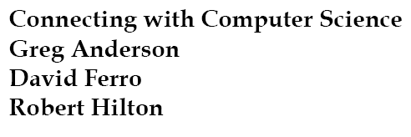


Slide 2
Objectives
Learn what an operating system is
Become familiar with the different types of operating systems
Identify the major functions of an operating system
Understand how operating systems manage processes
Connecting with Computer Science

Slide 3
Objectives (continued)
Understand how operating systems manage resources
Understand how operating systems provide security
Learn how to perform basic operating system file management functions in Windows, UNIX, and DOS
Connecting with Computer Science

Slide 4
Why You Need to Know About...
Operating Systems
Operating System(OS): mediates all activity within computer
System knowledge improves efficiency
Practical skills easily acquired
  Demonstrate basic folder and file functions
Connecting with Computer Science

Slide 5
What Is an Operating System?
OS: software control center
  Resident in main memory (RAM)
  Interfaces user, applications, hardware with CPU
    Supervises and facilitates program execution
    Connects hardware to CPU with device drivers
Common brands: Microsoft Windows, UNIX, Linux, Mac OS
Connecting with Computer Science

Slide 6
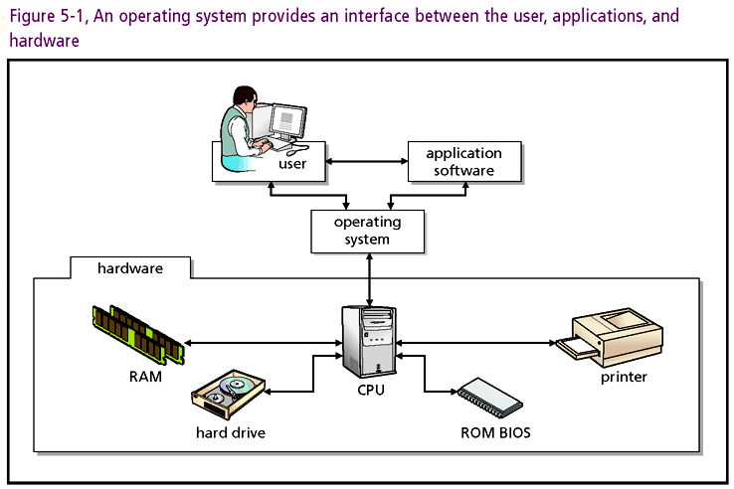
Connecting with Computer Science

Slide 7
What Is an Operating System?
(continued)
OS has (2) main program regions
  Kernel: system core loaded at boot time by BIOS
  Modules: components provide user/device interface
Platform: OS fitted to a particular CPU
Cross-Platform application: runs on multiple platforms
Connecting with Computer Science

Slide 8
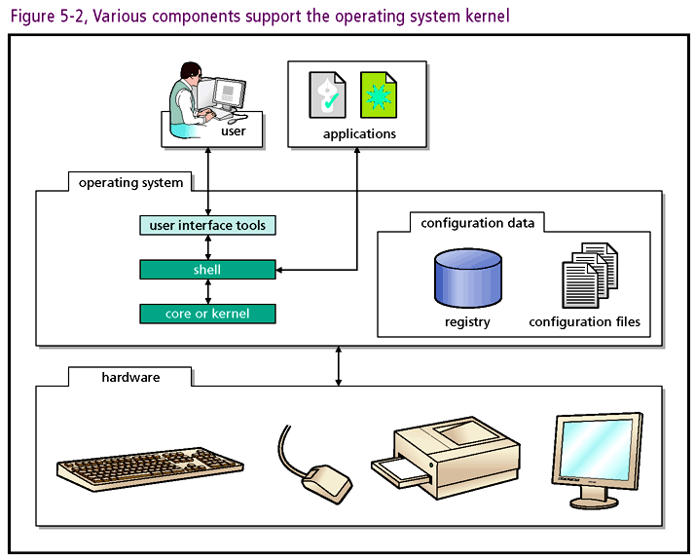
Connecting with Computer Science

Slide 9
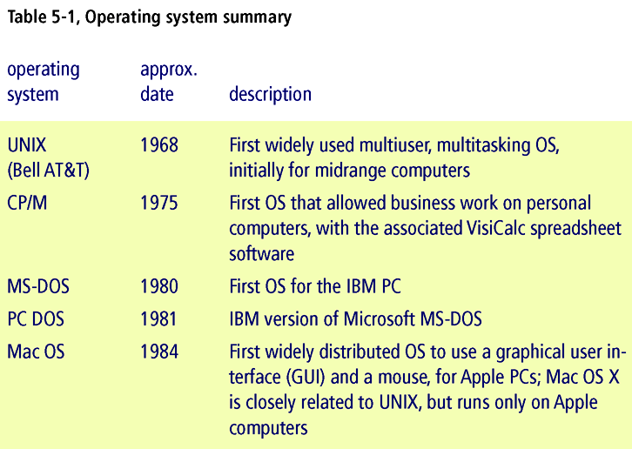
What Is an Operating System?
(continued)
Table 5-1: OS development in historical context
Connecting with Computer Science
Notes:
1) CP/M, originally standing for Control Program/Monitor and later Control Program for Microcomputers, is a mass-market OS created for Intel 8080/85-based microcomputers by Gary Kildall of Digital Research
2) MS-DOS acronym for Microsoft Disk Operating System) is a discontinued OS for X86-based PCs mostly developed by Mícrosoft.

Slide 10
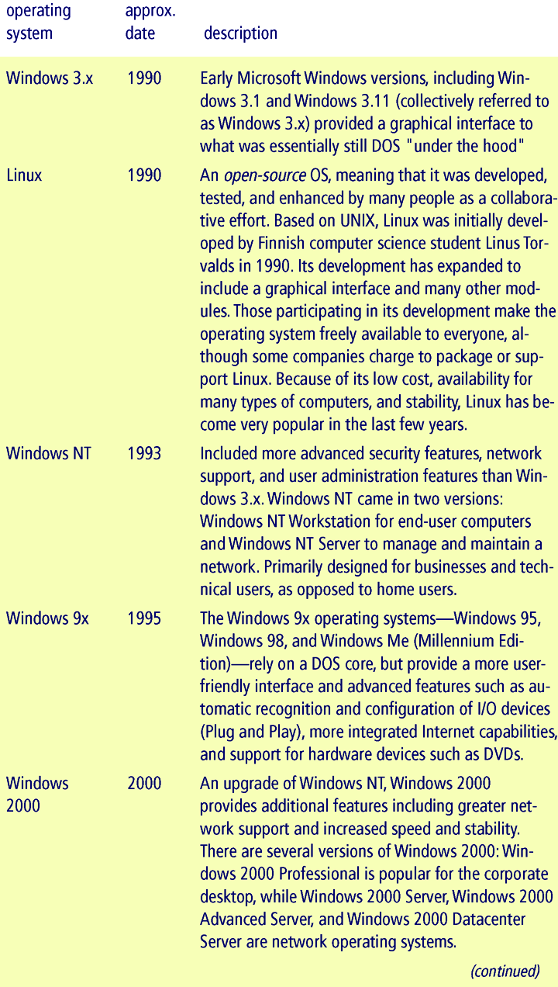
Connecting with Computer Science

Slide 11
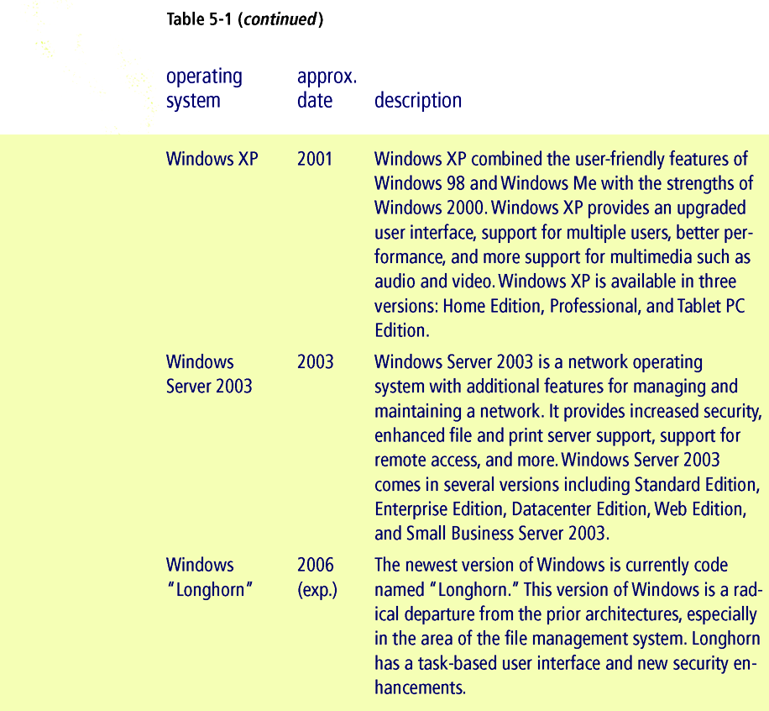
Connecting with Computer Science

Slide 12
Types of Operating Systems
OS classification schemes based on features and use
  Single-tasking; e.g., DOS and Windows 3.x
  Multi-tasking; e.g., Windows, Mac OS, UNIX
  Network Operating Systems NOS; e.g., NetWare, UNIX, Windows 2000 Server, and Windows Server 2003
Connecting with Computer Science

Slide 13
Types of Operating Systems (continued)
OS design parameters tailored to customer base
  Microsoft Windows and Mac OS appeal to home and small business users
    User-friendly interfaces and multimedia capabilities
  UNIX often the OS of choice in the server environment
    Stability, multitasking, security, multiprocessing
Every multipurpose device with CPU must have an OS
  Desktops, clients, servers, PDAs, cell phones, appliances
Connecting with Computer Science

Slide 14
Functions of an
Operating System
All operating systems perform four basic functions:
  Provide a user interface
  Manage processes
  Manage resources
  Provide security
Connecting with Computer Science

Slide 15
Provide A User Interface
User interface: program provides system access
Two interface types:
  Command line interface (console operating system)
    Text input entered at command prompt
    Output displayed as characters and numbers
  Graphical User Interface (GUI)
    Input devices: keyboard, mouse, touch screen, audio
    Command OS via menu selections in open window
Connecting with Computer Science

Slide 16
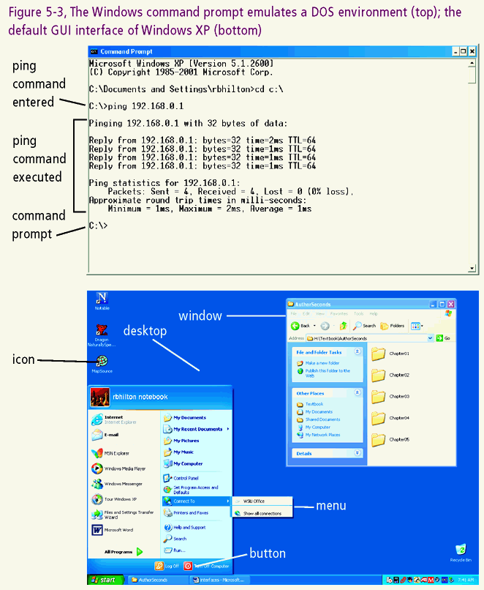
Connecting with Computer Science

Slide 17
Provide A User Interface (continued)
Example interfaces
  GUI: Microsoft Windows and Mac OS
  Command-line (console window)
    Standard UNIX (can be fitted with GUI)
    DOS (disk operating system): MS console OS
      Windows backwardly compatible with DOS
Connecting with Computer Science

Slide 18
Manage Processes
The OS loads, starts, supervises, stops processes
  Process is a running program
  Processes may start (spawn) other processes to support them
In Windows, Task Manager shows running processes
  Accessed by pressing Ctrl+Alt+Del keys
  Not available for single-tasking DOS
Connecting with Computer Science

Slide 19
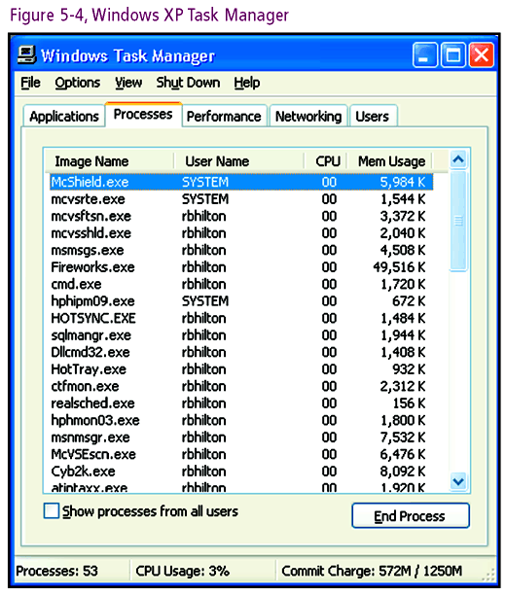
Connecting with Computer Science

Slide 20
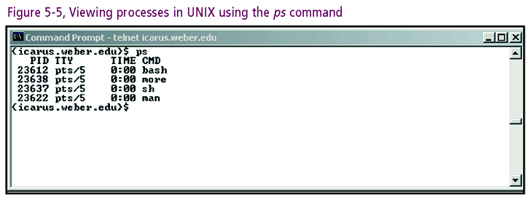
Connecting with Computer Science

Slide 21
Manage Processes (continued)
In UNIX/Linux, running process information also available
  type ps-aux at console prompt for running processes
CPUs only run one process at a time
  Von Neumann machine supports serial execution
  Only one instruction from one single program per clock cycle
Connecting with Computer Science

Slide 22
Manage Processes (continued)
Time slicing: OS time management method
  Allocate multiple processes to a single CPU
  Illusion of simultaneous execution
  Attributable to the different speeds of devices
  CPU executes billions of instructions per second
  Memory, keyboard, monitor, and network adapter slower by many orders of magnitude
  CPU multitasks while waiting
Connecting with Computer Science

Slide 23
Manage Processes (continued)
Efficiencies generated with cost of system complexity
  OS needs to distinguish between ready/waiting process
  OS needs to service asynchronous I/O device request
  Interrupt handling: routine re-allocates processes to CPU
Connecting with Computer Science

Slide 24
Manage Resources
OS is a resource manager
  Configure I/O devices within environment
    Plug and Play (PnP) automates process (from 1995)
    Relieve applications of direct I/O interface
  Recognize and eliminate deadlock
    Circular wait for resources freezes system
    OS must remedy or system will need rebooting
Connecting with Computer Science

Slide 25
Manage Memory
The OS is a resource manager
  Monitor free space in memory
  Load programs and data into memory location
  Keep track of instruction trace
  Reallocate memory as processes come and go
Connecting with Computer Science

Slide 26
Provide Security
The OS protects memory and other resources
Unintended violation
  Application writes into address space of another process
  OS prevention: place boundaries around processes
Intended violation (security issue)
  Unauthorized access of programs or devices undesirable
  OS prevention
    System administrators set up password protected accounts
    Group policies automatically assigns rights/privileges
Connecting with Computer Science

Slide 27
Using An Operating System
OS concepts enable adaptation to individual design
Practical knowledge also essential
  Starting and running programs
  Managing system resources
Skills focus: basic file management in various operating systems
Connecting with Computer Science

Slide 28
Managing Disk Files
Basic OS file management features
  Dynamic file naming
  Folder or directory creation and modification
  Formal folder structure needed
    System is treelike
    Single root level and one or more branches
    Files viewed as leaves, or nodes on the tree structure
Windows Explorer: manage files through graphical interface
Connecting with Computer Science

Slide 29
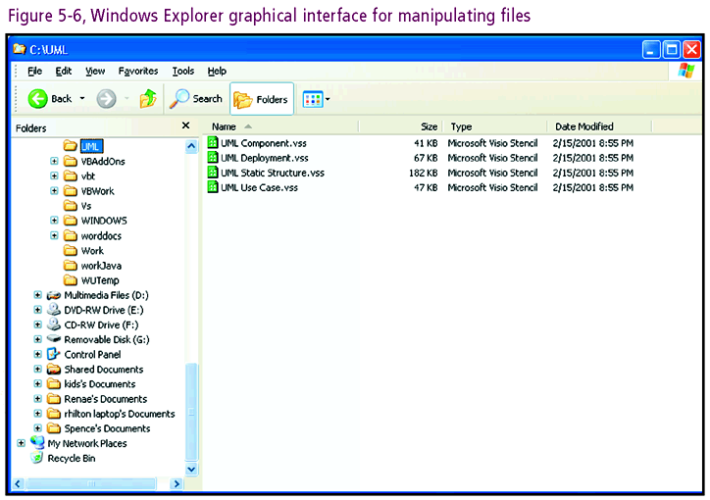
Connecting with Computer Science

Slide 30
Managing Disk Files (continued)
UNIX/DOS command prompt: access directory through the console window
UNIX/DOS: command-line switches (parameters/flags)
  Example DOS command: DIR C:\*.* /P
    Causes OS to list all files located at the root of the C drive
    /P switch modifies DIR command with screen pause
  In DOS enter HELP <command> to get more details
  In UNIX or Linux, enter man <command> for manual
Connecting with Computer Science

Slide 31
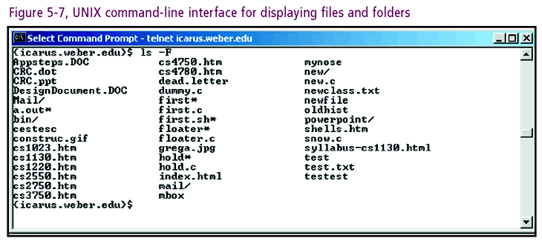
Connecting with Computer Science

Slide 32
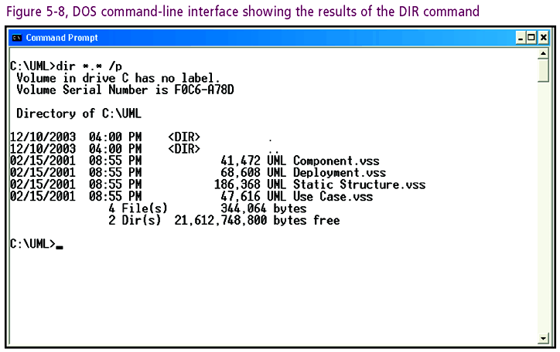
Connecting with Computer Science

Slide 33
Managing Disk Files (continued)
Present (8) file and folder operations in XP, DOS, UNIX
Partitioning disks: dividing surface into specific areas
  Windows/DOS: use FDISK to partition drives
  UNIX: use fdisk
Formatting disks
  Arrange disk surface into addressable areas
  Set up basic directory tree structure
  Copy OS onto back-up boot disk
Connecting with Computer Science

Slide 34
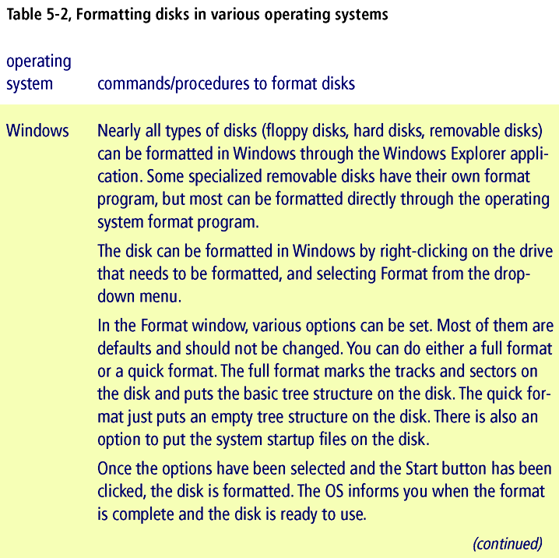
Connecting with Computer Science

Slide 35
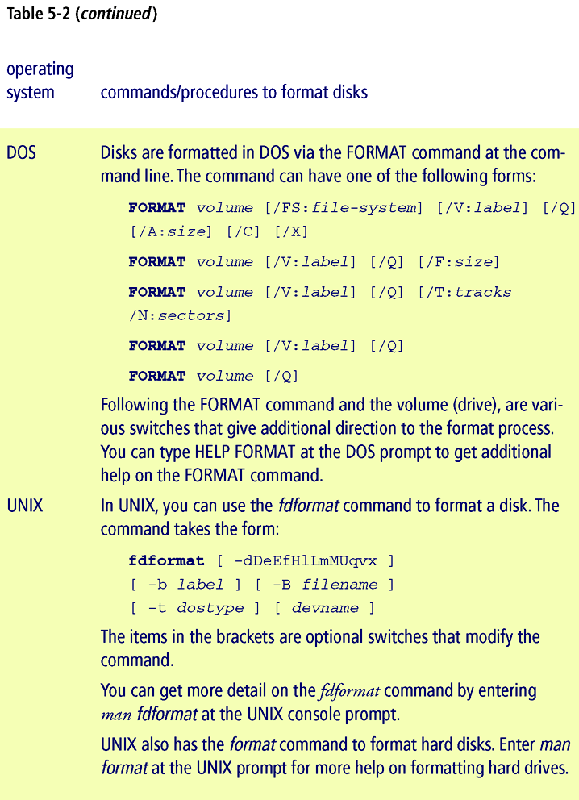
Connecting with Computer Science

Slide 36
Managing Disk Files (continued)
Creating folders (subdirectories)
  Treelike file structure available after partitioning and formatting
  Main level called the root
    Create one or more folders at root
    Each folder lies within root folder, or within another folder level
Connecting with Computer Science

Slide 37
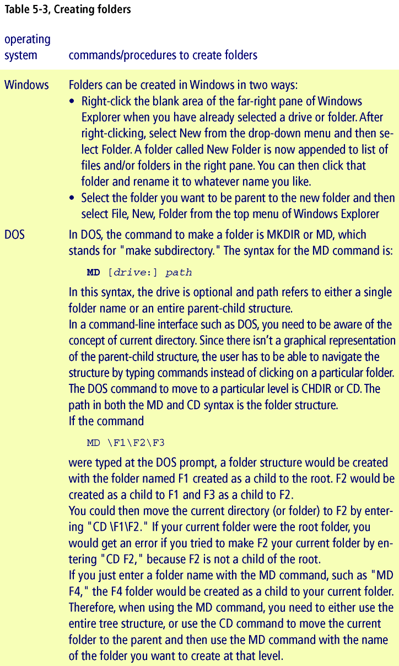
Connecting with Computer Science

Slide 38
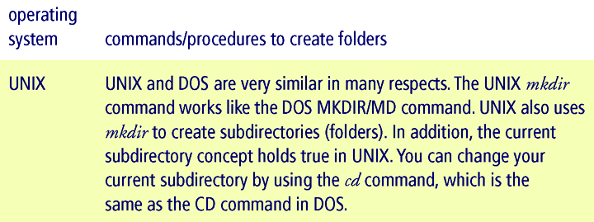
Connecting with Computer Science

Slide 39
Managing Disk Files (continued)
  Folders in another folder are child folders or subdirectories
  Container folders are parents
  Structure has unlimited depth (5–10 recommended)
  Each OS enables user to create directories (folders)
    Folders named according to specific rules
    UNIX is case sensitive, DOS and Windows are not
Connecting with Computer Science

Slide 40
Managing Disk Files (continued)
Listing the Contents of Drives and Folders
  XP lists drive/folder contents via GUI (Windows Explorer)
  DOS/UNIX pass same information with text-based commands
Connecting with Computer Science

Slide 41
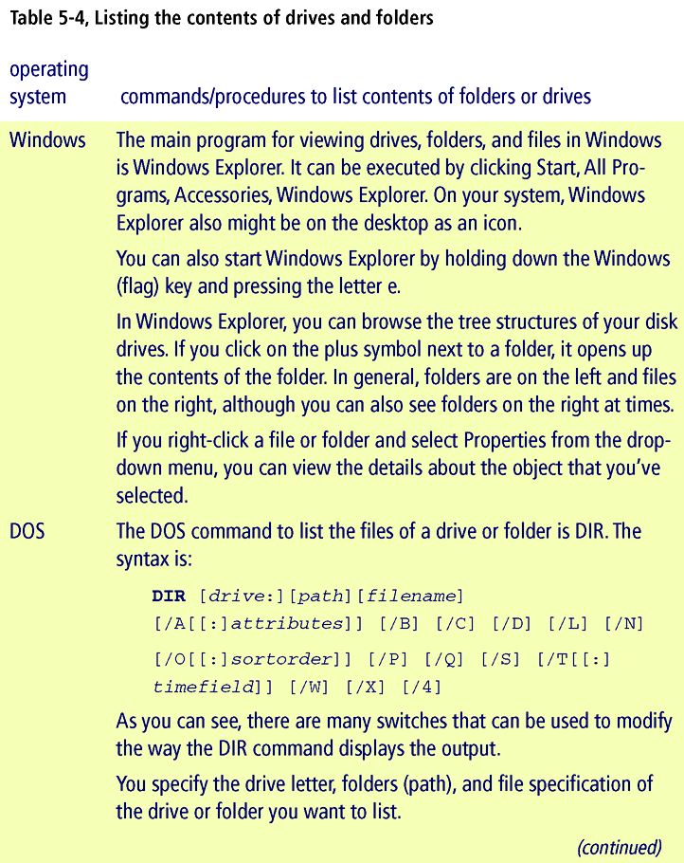
Connecting with Computer Science

Slide 42
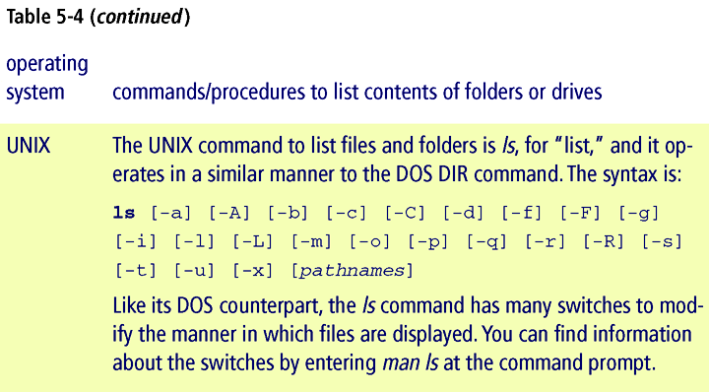
Connecting with Computer Science

Slide 43
Managing Disk Files (continued)
Renaming Folders and Files
  Every OS provides procedures for renaming
Connecting with Computer Science

Slide 44
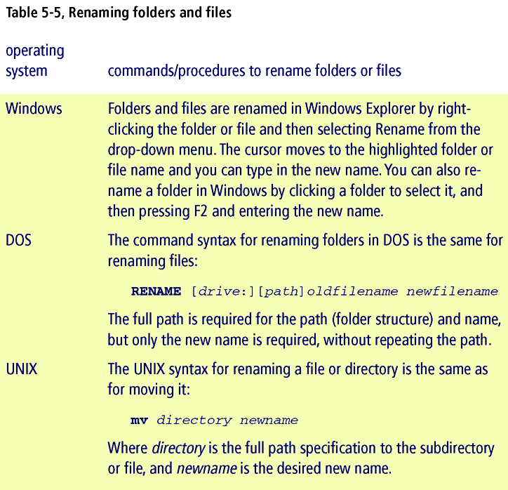
Connecting with Computer Science

Slide 45
Managing Disk Files (continued)
Deleting Folders and Files
  Every OS allows for files to be deleted
  XP also allows recovery (Recycle Bin)
  Wildcard: symbol used to select directories
    Asterisk (*) and question mark (?) are wildcards
    Example: *.exe signifies all .exe files
Connecting with Computer Science

Slide 46
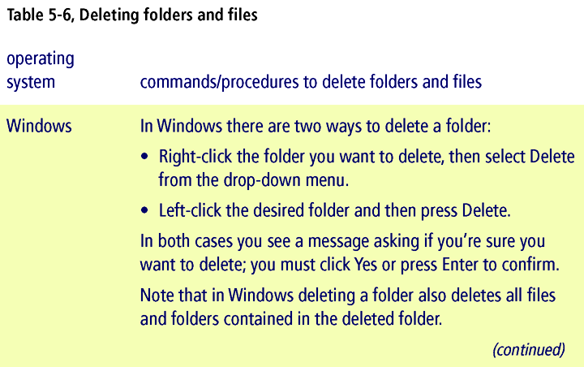
Connecting with Computer Science

Slide 47
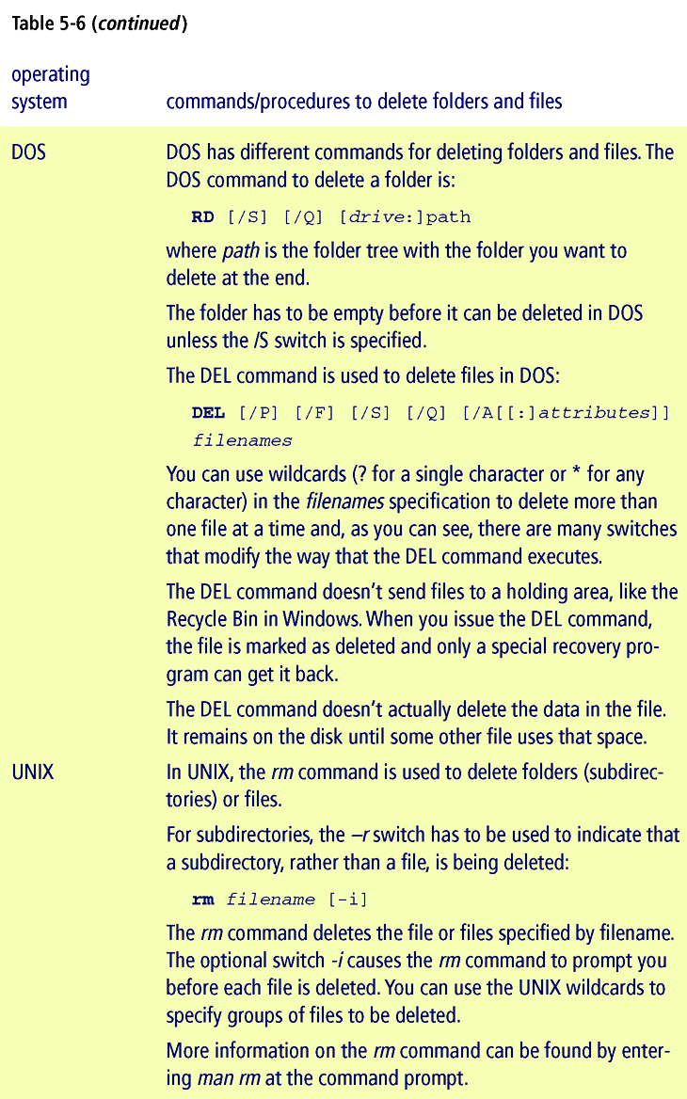
Connecting with Computer Science

Slide 48
Managing Disk Files (continued)
Copying Files and Folders
  Files can be copied into folders or stored at root
  Possible after partitioning,formatting, file creation
Connecting with Computer Science

Slide 49
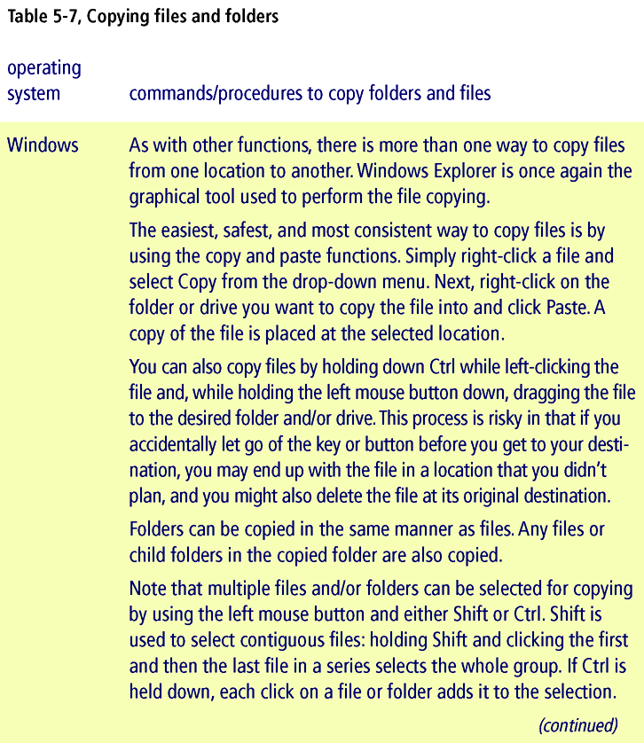
Connecting with Computer Science

Slide 50
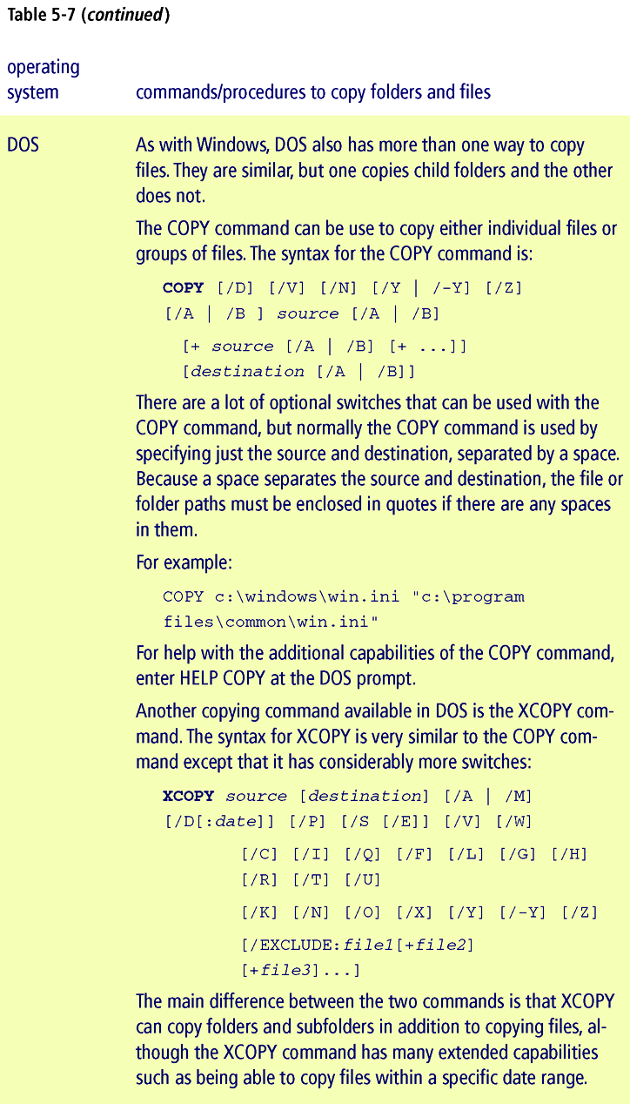
Connecting with Computer Science

Slide 51
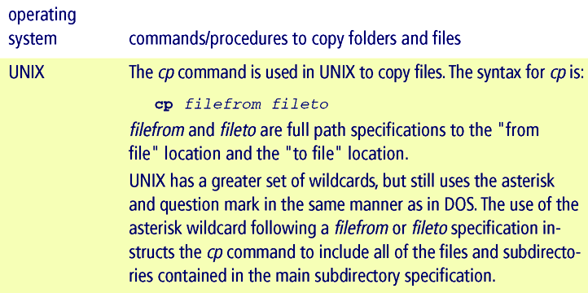
Connecting with Computer Science

Slide 52
Managing Disk Files
(continued)
Moving Files and Folders
  Similar to copying files
  Copy command followed by delete command
Connecting with Computer Science

Slide 53
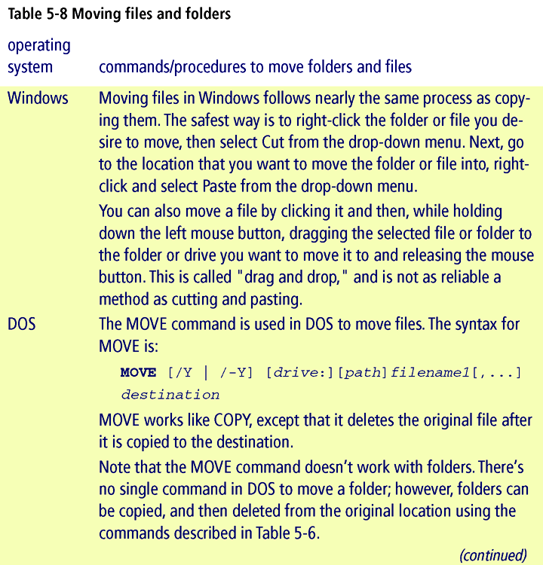
Connecting with Computer Science

Slide 54
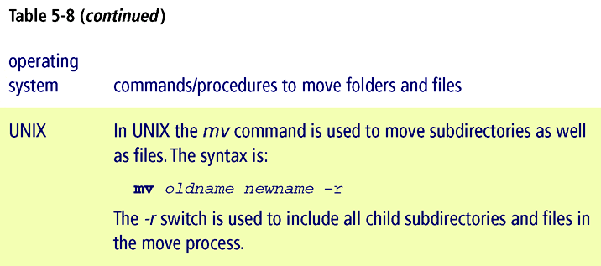
Connecting with Computer Science

Slide 55
One Last Thought
OS knowledge essential for computer scientists
OS concepts taught alongside practical skills
Expand OS toolkit beyond basic file management
Advanced study recommended
Connecting with Computer Science

Slide 56
Summary
OS is the software control center of the computer
OS consists of a kernel and other system programs
OS loaded into RAM by program in BIOS chip
OS may be single tasking or multitasking
Time slicing: OS method for multitasking
Connecting with Computer Science

Slide 57
Summary (continued)
Basic OS tasks: provide user interface, manage processes, manage resources, provide security
Two OS interfaces: GUI and console window
OS supervises program in execution (process)
OS interfaces hardware elements through drivers
OS protects system from intended/unintended violations
Connecting with Computer Science

Slide 58
Summary (continued)
OS file management:
  Partitioning/Formatting disks
  Creating folders (subdirectories)
  Listing/Renaming folders and files
  Deleting/Copying/Moving folders and files
Connecting with Computer Science

