Slide 1

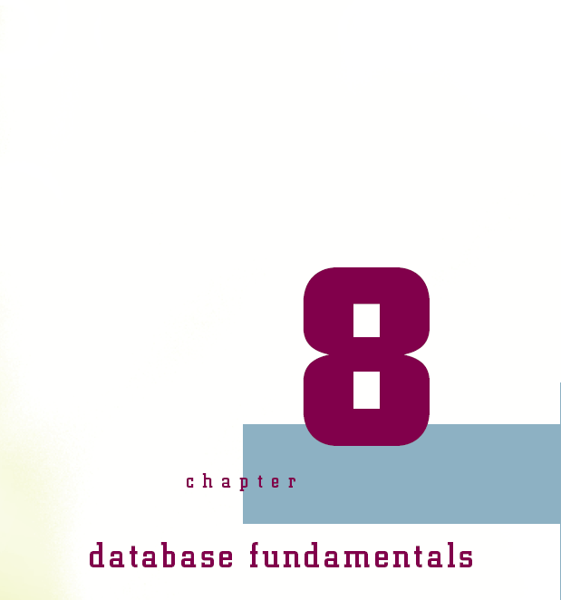

Slide 2
Objectives
Consider the widespread use of databases
Take a brief tour of database development history
Learn basic database concepts
Be introduced to popular database management software
See how normalization makes your data more organized
Connecting with Computer Science

Slide 3
Objectives (continued)
Explore the database design process
Understand data relationships
Gain an understanding of Structured Query Language (SQL)
Learn some common SQL commands
Connecting with Computer Science

Slide 4
Why You Need to Know About...
Databases
Data must be organized for consumption
Effective computer scientists know database design
Normalization: multi-step database design process
Structured Query Language (SQL): interface for storing, modifying, retrieving data
Connecting with Computer Science

Slide 5
Database Applications
Database
  Data structure built out of logical relations
  Affords data manipulations through queries
Database applications are pervasive
  Range: from human genome to space shuttle missions
Databases important for both living daily life and doing computer science
Connecting with Computer Science

Slide 6
Brief History of Database Management Systems
1970 – 1975
  Work of IBM employees E.F. Codd and C.J. Date
    Create theoretical model for database structures
    Model has become foundation for database design
  Software for organizing and sorting data
    System R by IBM and Ingres by UC-Berkeley
    Deploy Structured Query Language (SQL)
    SQL has become database standard
    Database management system (DBMS) for PCs
Connecting with Computer Science

Slide 7
Brief History of Database Management Systems (continued)
1970 – 1975 (continued)
  Wayne Ratliff of Martin-Marietta develops database program called Vulcan
1980 – present
  Vulcan renamed dBASE II (there is no dBase I)
  Popularity of dBASE II inspires other companies
    Paradox, Microsoft Access, or FoxPro
  Databases become essential for business
    Corporate decision making
    Systems: inventory management to customer support
Connecting with Computer Science
Notes:
Viking spacecraft ground support system

Slide 8
Database Management
System Fundamentals
Six main functions of a DBMS:
  Manage database security
  Manage access of multiple users to the database
  Manage database backup and recovery
  Ensure data integrity
  Provide an end-user interface with the database
  Provide or interface with a query language to extract information from the database
Connecting with Computer Science

Slide 9
Database Concepts
Basic elements of a database
  Database: collection of one or more tables (entities)
  Table: divided into rows and columns (spreadsheet)
  Row (record or tuple): collection of columns
  Column (field or attribute)
    Represents specific information
    Set of possible column values is called domain
  Index (order): facilitates information access
Connecting with Computer Science

Slide 10
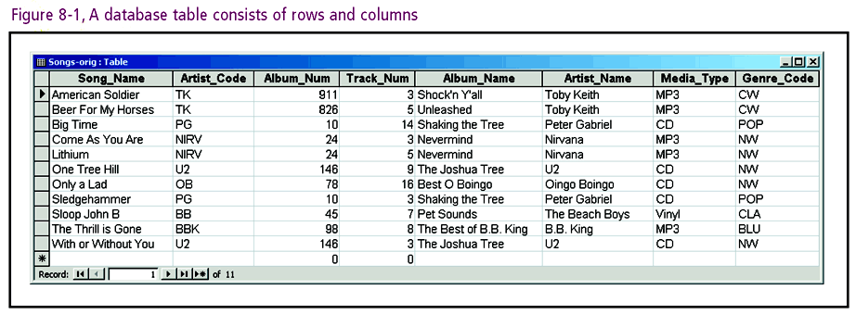
Connecting with Computer Science

Slide 11
Indexes
Index: data structure (specific file) that organizes records according to specific column(s)
Examples: music database and telephone book
Chief advantages
  Flexibility: many different columns to sort against
  Searching and retrieval are sped up
Chief disadvantages
  Extra storage space
  Updating takes longer
Connecting with Computer Science

Slide 12
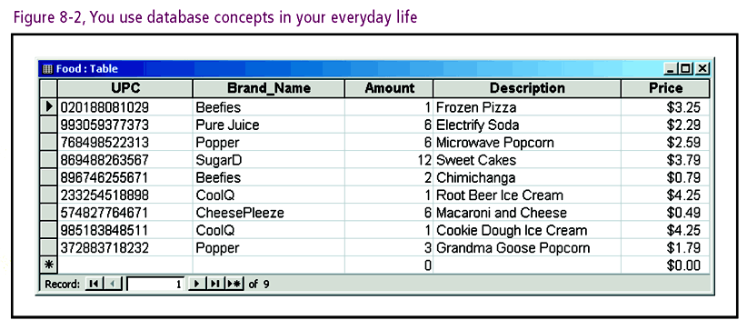
Indexes (continued)
An example of indexing: grocery store shopping
Connecting with Computer Science

Slide 13
Indexes (continued)
Information in a database kept in sequential order
Key: column(s) used to determine sort order
  Sort grocery items by UPC column as key
  Sort grocery items by Brand_Name and Description
Media used to manipulate or view data
  Reports, forms, labels, low-level file I/O, source code
Connecting with Computer Science

Slide 14
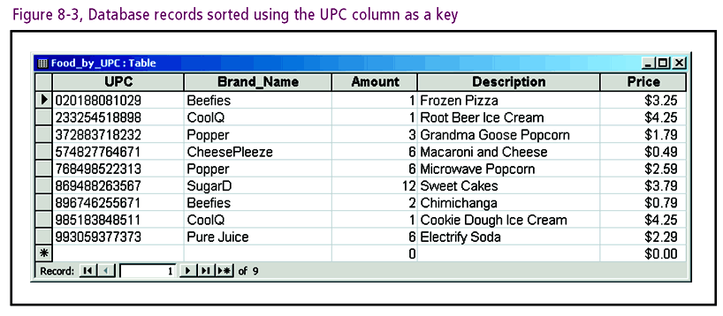
Connecting with Computer Science

Slide 15
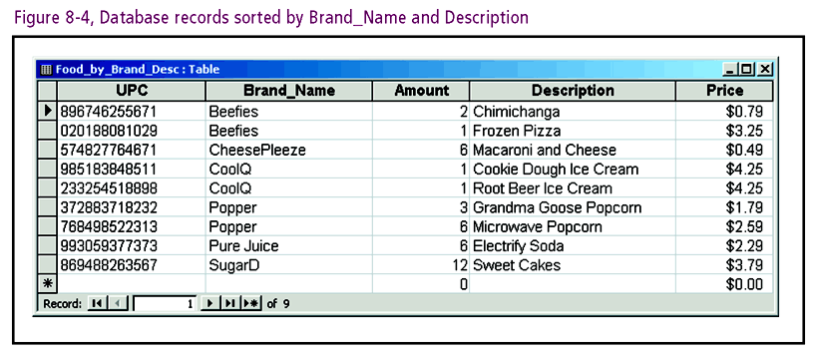
Connecting with Computer Science

Slide 16
Normalization
Normalization
  Standard set of rules for database design
  Process: sequence of stages called normal forms
    There are five normal forms
    Third normal form provides sufficient structure
Three database design problems solved
  Representation of certain real-world items
  Redundancies (repetitions) in data
  Excluded and inconsistent information
Connecting with Computer Science

Slide 17
Preparing For Normalization: Gathering Columns
Make a list of all pertinent fields (columns or attributes)
  Source of fields: end user reports; e.g., Song inventory
Write fields on your column list
Review the input forms that the user has specified
Each field from report converted to column in table
Connecting with Computer Science
Notes:
Pertinent: Thích hợp

Slide 18
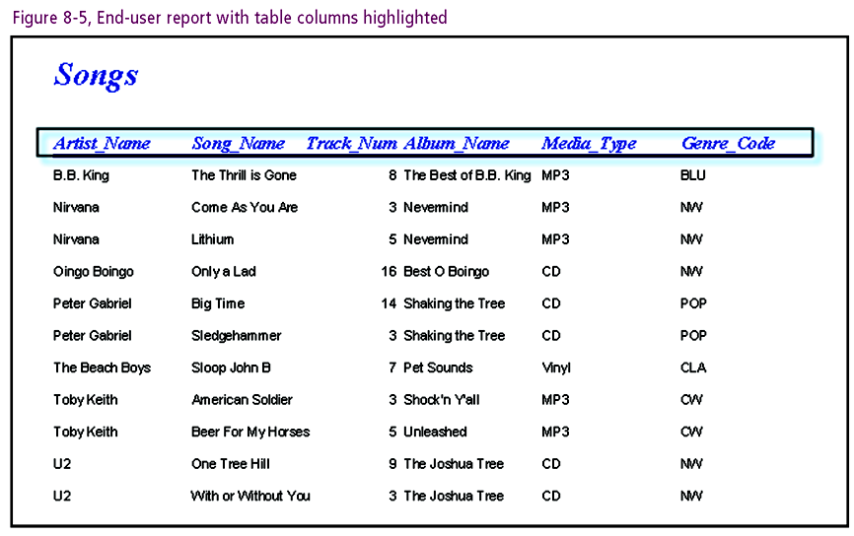
Connecting with Computer Science

Slide 19
Preparing For Normalization: Gathering Columns (continued)
Reconcile fields in report to column list
Create tables of columns
  Combine associated fields
  Logically group related information
  Example: Information on artist and song files
Gather data to create physical music database
Connecting with Computer Science

Slide 20
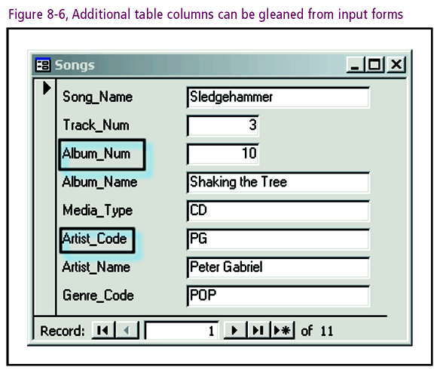
Connecting with Computer Science

Slide 21
First Normal Form
Unnormalized table: row-column intersection with two or more values
First normal form (1NF): all columns contain only single values,
  Create a new record for the duplicated column
  Fill in blanks so all columns in record have a value
  Columns with duplications: the Album_Num, Album_Name, Artist_Code, Artist_Name, Media_Type, and Genre_Code
Remaining redundancies addressed later
Connecting with Computer Science

Slide 22
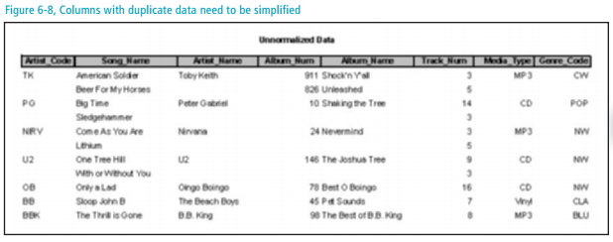
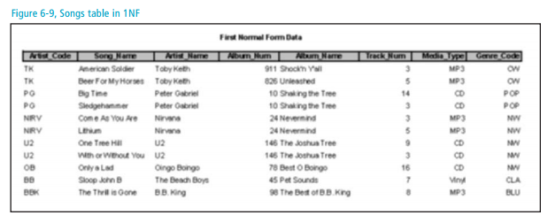
Connecting with Computer Science
Notes:
Artist_Code, Song_Name, and Album_Num is the PK

Slide 23
Second Normal Form
Next steps
  Assign a primary key to the table
  Identify functional dependencies within the table
Primary key (PK): a column or combination of columns (composite) that uniquely identifies a row within a table
  Examples: Student ID or Artist_Code
Connecting with Computer Science

Slide 24
Second Normal Form (continued)
Determinant: column(s) used to determine value assigned to another column(s) in the same row
  Example: Artist_Code determinant for Artist_Name
Functional dependency
  Determinant and columns that it determines
  Each value of first column matched to single value in second
  Example: Artist_Name functionally dependent on Artist_Code
Connecting with Computer Science

Slide 25
Second Normal Form (continued)
Second normal form (2NF)
  First normal form and
  Every columns (isn’t part of PK) is fully dependent on PK. In that case, PK composes of Artist_Code, Song_Name, and Album_Num
Creating 2NF
  Determine which columns aren’t dependent on the entire PK.
  Remove such columns and place in new table
  Default 2NF: Table without composite PK
Chief 2NF benefit: save disk space
Connecting with Computer Science

Slide 26
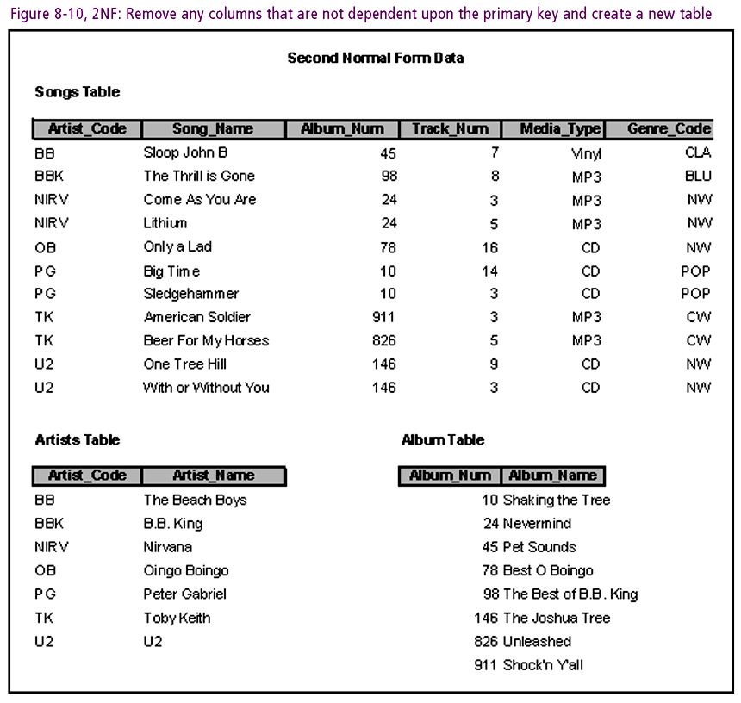
Connecting with Computer Science
Notes:
Primary Key: Artist_Code, Song_Name, and Album_Num

Slide 27
Third Normal Form
Third normal form (3NF)
  Eliminate transitive dependencies
    Transitive dependency: column dependent upon another column not part of PK
    Example: Genre_Desc depends on Genre_ Code
Connecting with Computer Science

Slide 28
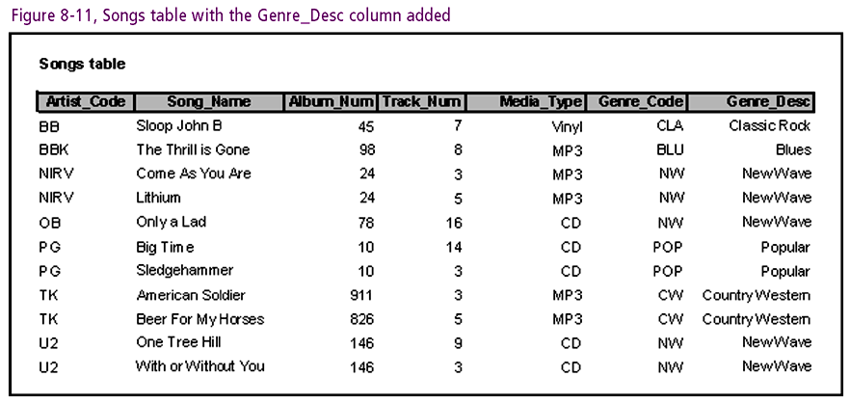
Connecting with Computer Science

Slide 29
Third Normal Form (continued)
Creating 3NF
  Remove transitive dependencies
  Place removed columns in new table
Chief 3NF benefit: save disk space
By 3NF level, following new tables created
  Genre, Artists, Album
Connecting with Computer Science

Slide 30
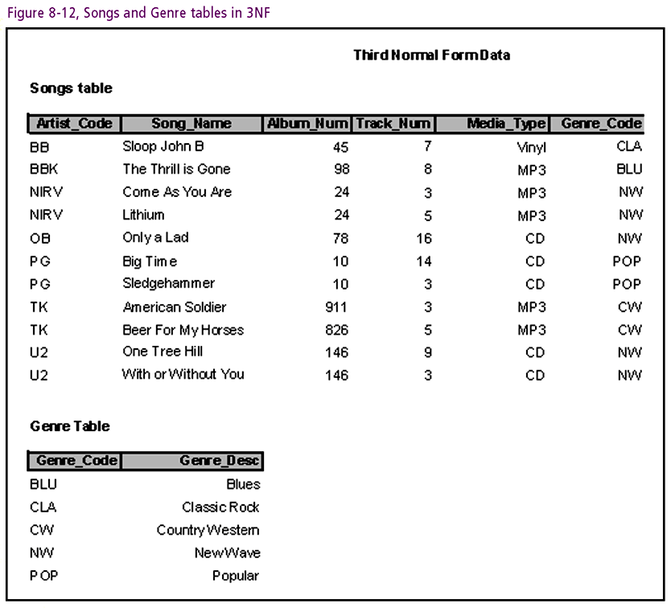
Connecting with Computer Science

Slide 31
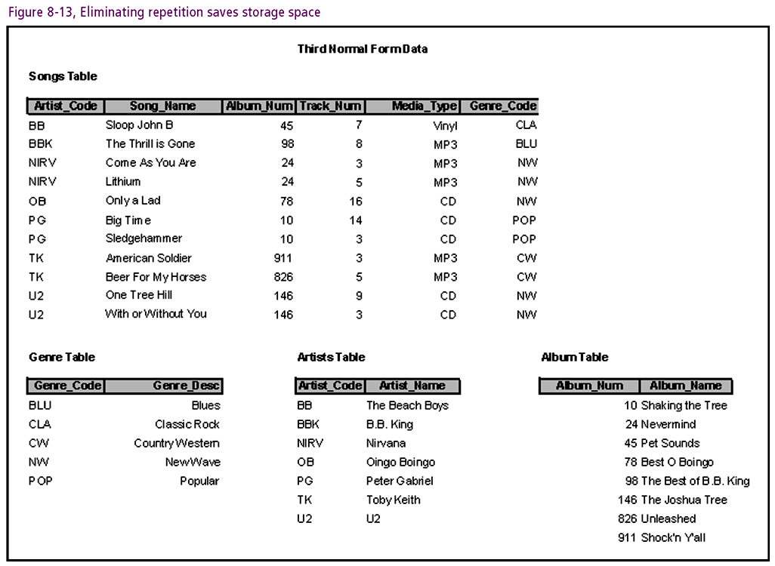
Connecting with Computer Science

Slide 32
The Database Design Process
Six steps to designing normalized database
Example: Creation of student grading system
Connecting with Computer Science

Slide 33
Step 1— Investigate And Define
Investigate and research info to be modeled
Define purposes and uses of the database
Use any documents end user works with to complete tasks
Involve the end user in design process
Student grading system based on a course syllabus
Connecting with Computer Science

Slide 34
Step 2 — Make a Master Column List
Create a list of fields for information
Field properties might include such items as:
  Field Name
  Data type (char, varchar, number, date, etc.)
  Length
  Number of decimal places (if any)
Review users documents for fields
  Forms and reports good source for fields
  Example fields: Student ID, First Name, Last Name
Connecting with Computer Science

Slide 35
Step 3 — Create the Tables
Logically group defined columns into tables
  Heart of the design process
  Relies heavily upon the normalization rules
Main rules in database design: 1NF – 3NF
A table in 3NF is well defined
Normalizing databases is like cleaning a closet
Connecting with Computer Science

Slide 36
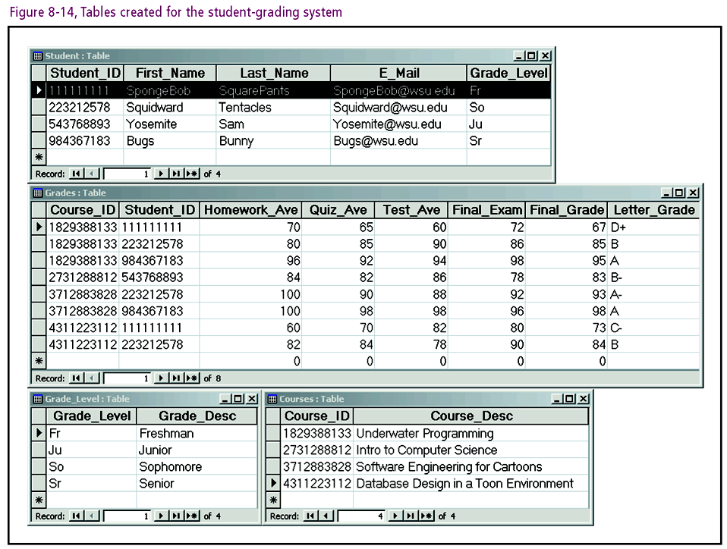
Connecting with Computer Science

Slide 37
Step 4 - Work On Relationships
Relationship: defines table relations
Two types of relationships discussed in this chapter
  One-to-many (1:M)
  One-to-one (1:1)
Primary and foreign keys defined in each of the tables
  Primary key (PK): determinant discussed earlier
  Foreign key (FK): column in one table is PK in another
  Following sections describe how PK and FK function
Connecting with Computer Science

Slide 38
Step 4 - Work On Relationships (continued)
One-To-Many (1:M)
  Most common relationship
  States that each record in Table A relates to multiple records in Table B
  Requires that FK column(s) in “many” table refers back to PK in “one” table
  Example: Grades Table to Student Table
Connecting with Computer Science

Slide 39
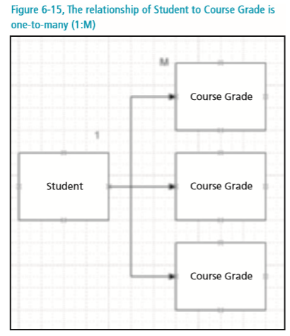
Connecting with Computer Science

Slide 40
Step 4 - Work On Relationships (continued)
One-to-one (1:1)
  Dictates that for every record in Table A there can be one and only one matching record in Table B
  Consider combining tables in 1:1 relationship
  1: 1 sometimes appropriate: each student has one grade level (Student Table to Grade Level Table)
  FK column(s) in “one” table PK column(s) in the other “one” table
Connecting with Computer Science

Slide 41
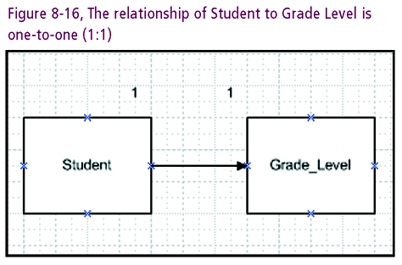
Connecting with Computer Science

Slide 42
Step 5 - Analyze The Design
Analyze the work completed
  Search for design errors, refine the tables as needed
  Follow the normalization forms (ideally to 3NF)
  Correct any violations
ER models
  Visual diagram comprised of entities and relationships
  Entities represent the database tables
  Relationships show how tables relate to each other
  Cardinality: shows numeric relations between entities
Connecting with Computer Science

Slide 43
Step 5 - Analyze The Design (continued)
Types of cardinality (and their notation) include:
  0..1, 0:1 (zero to one)
  0..M, 0:N, 0..*, 0..n (zero to many)
  1..1, 1:1 (one to one)
  1..M, 1:M, 1:N, 1..*, 1..n (one to many)
  M..1, M:1, N:1, *..1, n..1 (many to one)
  M..M, M:M, N:N, *..*, n..n (many to many)
Example: an ER model for the student-grading system
Connecting with Computer Science

Slide 44
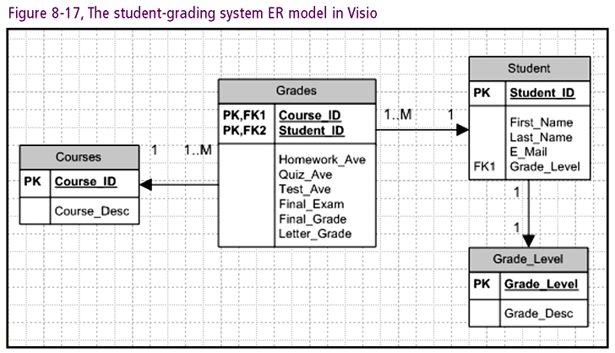
Connecting with Computer Science

Slide 45
Step 6 - Reevaluate
Reevaluate database performance
  Ensure database meets all reporting and form needs
  Include the end user
  Explain each of the tables and fields being used
  Make sure fields are defined to user’s requirements
Manipulate data structure with SQL commands
Connecting with Computer Science

Slide 46
Structured Query Language (SQL)
Structured Query Language (SQL) functions
  Manipulate data
  Define data
  Administer data
Many different “dialects” of SQL
SQL commands can be uppercase (conventional) or lowercase
Connecting with Computer Science

Slide 47
Structured Query Language (SQL) (continued)
SQL provides the following advantages:
  Reduces training time (syntax based in English)
  Makes applications portable (SQL is standardized)
  Reduces the amount of data being transferred
  Increases application speed
Following sections show basic SQL commands
  Creating tables
  Adding (inserting) rows of data
  Querying table to select certain information
Connecting with Computer Science

Slide 48
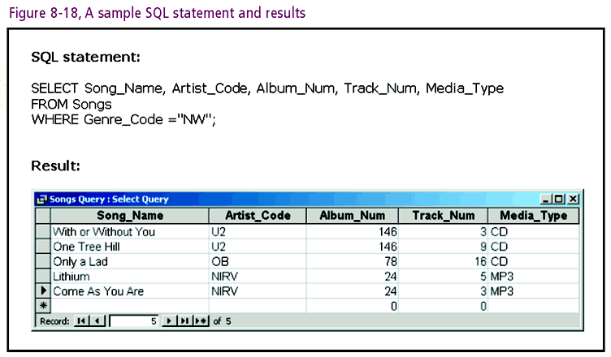
Connecting with Computer Science

Slide 49
CREATE TABLE Statement
CREATE TABLE statement: make new table
Syntax:
  CREATE TABLE table_name
  ( column_name datatype [NULL | NOT NULL]
  [, column_name datatype [NULL | NOT NULL] . . . );
NULL/NOT NULL
  Optional property indicates whether data required
Connecting with Computer Science

Slide 50
CREATE TABLE Statement (continued)
Following SQL statement creates table called Songs:
  CREATE TABLE Songs
  (Song_Name char (50) NOT NULL,
  Album_Num number NOT NULL,
  Artist_Code char (5) NOT NULL,
  Track_Num number NULL,
  Media_Type char (5) NULL,
  Genre_Code char (5) NOT NULL,
  );
Connecting with Computer Science

Slide 51
INSERT Statement
INSERT statement: add new rows of data
Syntax:
INSERT INTO table_name [(column1, column2, . . . )]
  VALUES (constant1, constant2, . . . )
INSERT statement requires a table name
Square brackets ([..]) specify optional columns
Columns on separate lines for readability
Connecting with Computer Science

Slide 52
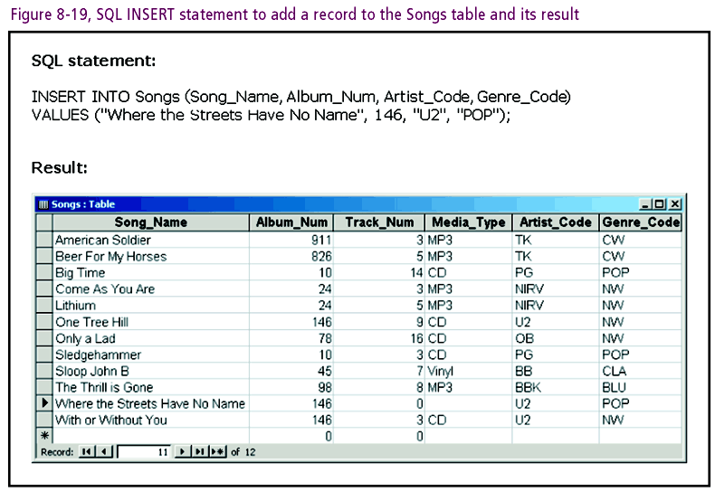
Connecting with Computer Science

Slide 53
SELECT Statement
SELECT statement: retrieves data from one or more tables
Syntax:
  SELECT [DISTINCT] column_list
  FROM table_reference
  [WHERE search_condition]
  [ORDER BY order_list]
Specified order determines order of retrieval/ display
Connecting with Computer Science

Slide 54
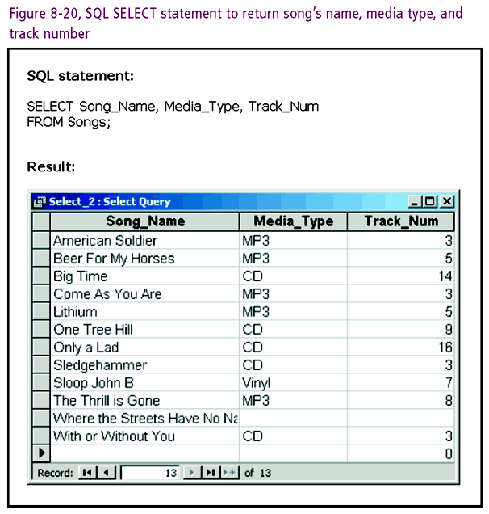
Connecting with Computer Science

Slide 55
WHERE Clause
WHERE clause
  Specifies additional criteria for retrieving data
  Fields should be included in fields selected
AND and OR keywords
  Allow specification of multiple search criteria
  AND indicates that all criteria must be met
  OR indicates only one criterion needs to be met
Connecting with Computer Science

Slide 56
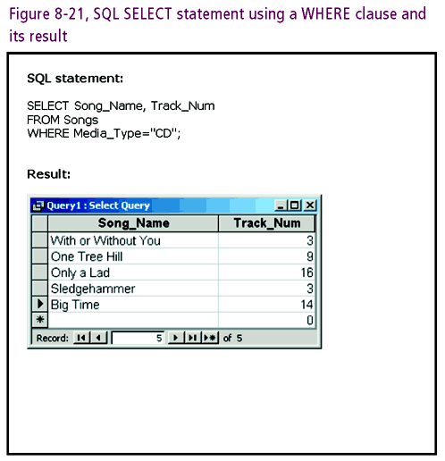
Connecting with Computer Science

Slide 57
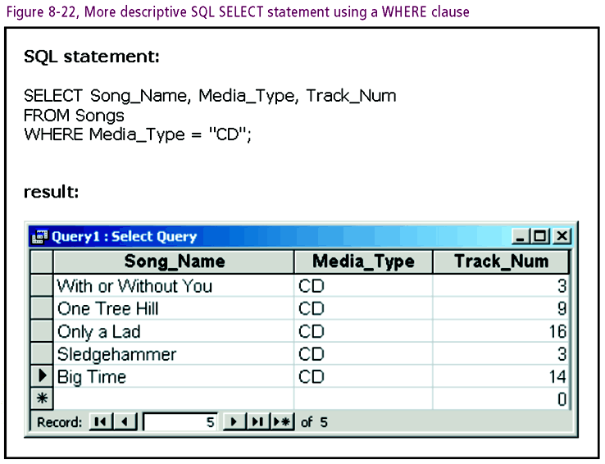
Connecting with Computer Science

Slide 58
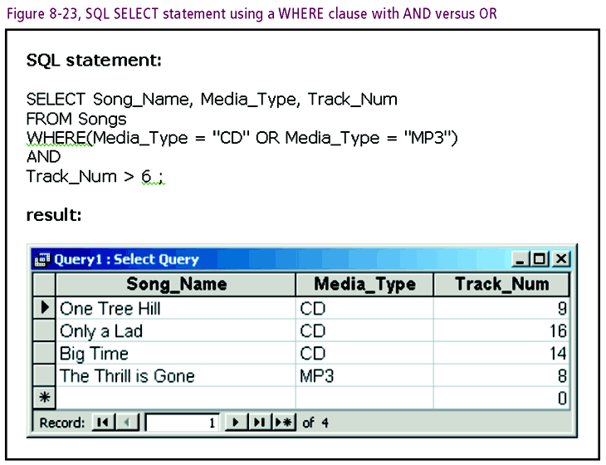
Connecting with Computer Science

Slide 59
ORDER BY Clause
ORDER BY clause
  Permits you to change how the data is returned
  Makes for more meaningful presentation
By default, the data is returned in sequential order
You can specify the ORDER BY column name(s)
ORDER BY also returns data in ascending (default) or descending order
Connecting with Computer Science

Slide 60
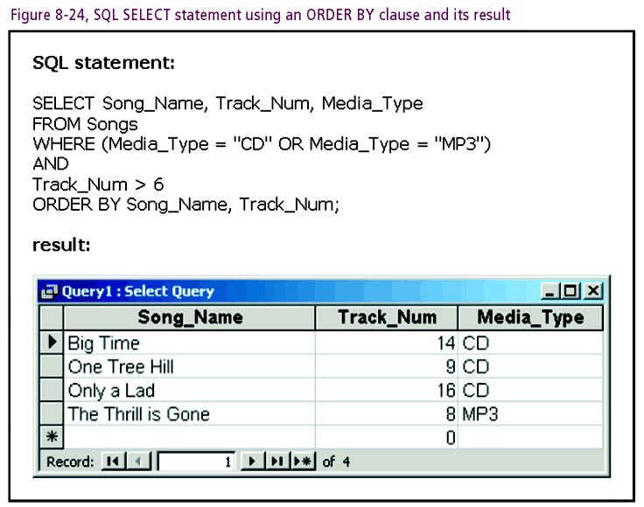
Connecting with Computer Science

Slide 61
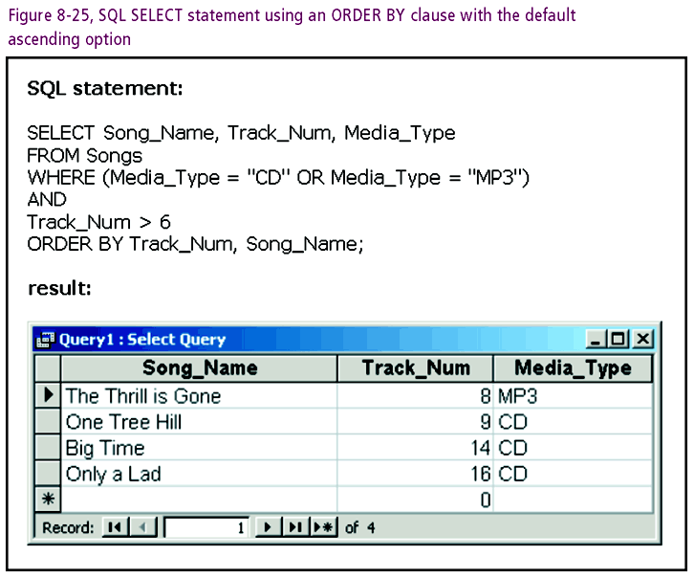
Connecting with Computer Science

Slide 62
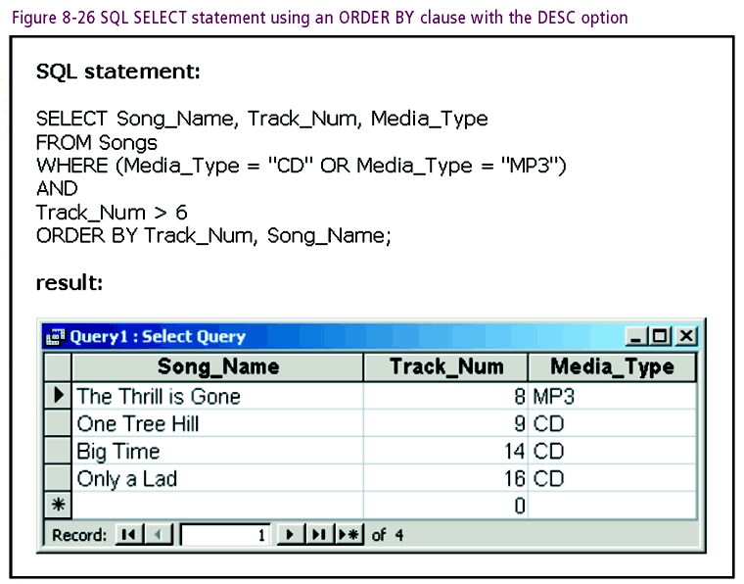
Connecting with Computer Science

Slide 63
ORDER BY Clause
(continued)
Many more options can be specified on SELECT statement
Many more SQL commands used to maintain, define, administer data found within a database
Connecting with Computer Science

Slide 64
Summary
Database: collection of logically related records
DBMS: software used to design, manage, interface with databases
Indexes: files that revise default sequential order of data
Normalization: process of removing data redundancies
Connecting with Computer Science

Slide 65
Summary (continued)
Data normalized with five normal forms
First three normal forms most important
Primary key: uniquely identify table entries
Foreign key: refer to a primary key in another table
Entity relationship model: visual diagram of tables and relationships
Connecting with Computer Science

Slide 66
Summary (continued)
1:M and 1:1 notations indicate cardinality
Six-step database design process
Structured Query Language (SQL): manipulates, defines, and administers data
Basic SQL statements: CREATE TABLE, INSERT, SELECT
Connecting with Computer Science

