Slide 1



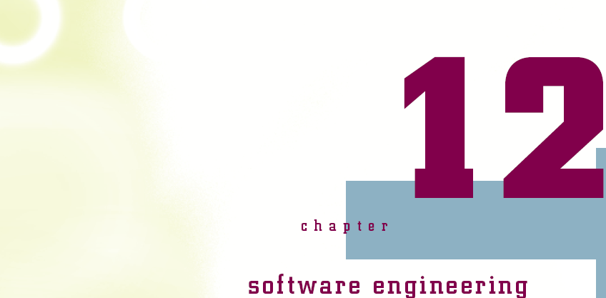

Slide 2
Objectives
Learn how software engineering is used to create applications
Learn some of the different software engineering process models
Understand what a design document is and how it should be used during software development
Be introduced to the proper steps in formulating a design document used in creating an application
Connecting with Computer Science

Slide 3
Objectives (continued)
Learn how Unified Modeling Language (UML) diagrams can be used as a blueprint in creating an application
See some of the pitfalls in developing software, and learn how to avoid them
Gain an understanding of how teams are used in application development
Connecting with Computer Science

Slide 4
What is Software Engineering?
The process of producing software applications
  Source code and data
  UML diagrams and screen prototypes
  Requirements and reports
  Future development issues
The end user is the driving force behind software development
  Determines the required functionality of the program
Connecting with Computer Science

Slide 5
Software Development
Life Cycle
Describes the life of the application including the development, testing, installation, and maintenance of the program
Elements of the SDLC
  Project feasibility
  Software specification
  Software design and implementation
  Software validation
  Software evolution
Connecting with Computer Science

Slide 6
Software Development
Life Cycle (continued)
Models of the software development process
  Waterfall
    The output from each development phase is used as the input to the next phase
  Build and fix
    The developer writes a program and continues to modify it until the system is functional
  Rapid prototyping
    Tools allow end users to work with user interface prototypes before building the final product
Connecting with Computer Science

Slide 7
Software Development Life Cycle (continued)
  Incremental
    Development with a series of software releases
  Spiral
    Cycles through the waterfall approach until all functionality has been completed
  Extreme programming (XP)
    Places emphasis on teamwork and feedback
  Agile Software Development
    Focuses on customer satisfaction through continual delivery and modifications of software products
Connecting with Computer Science

Slide 8
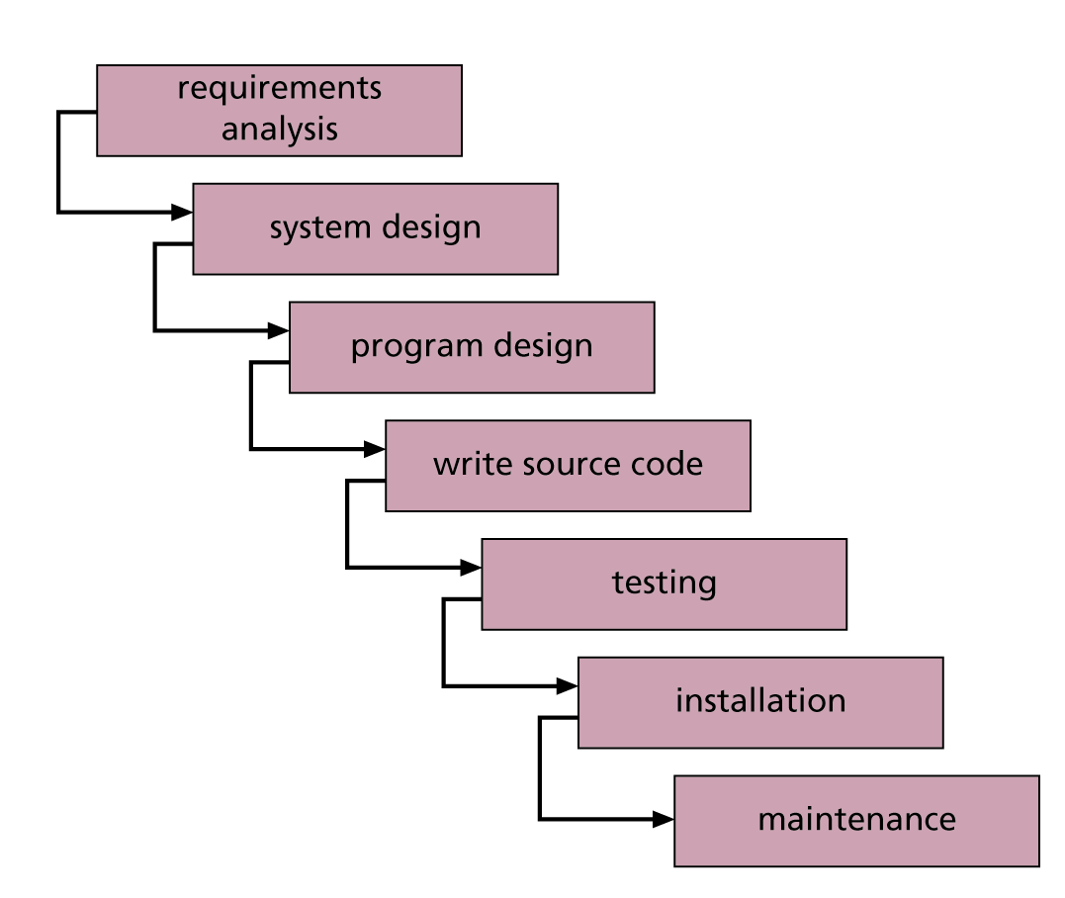
Figure 12-1
The “waterfall” model of software development
Connecting with Computer Science

Slide 9
Creating the Design Document
A design document details all of the design issues for an application
  Issues include screen layouts, colors, reports, security, paths for files, online help, user documentation, future plans, and more
Acts like a blueprint for the system
Based upon good communication with the end user in determining requirements
Connecting with Computer Science

Slide 10
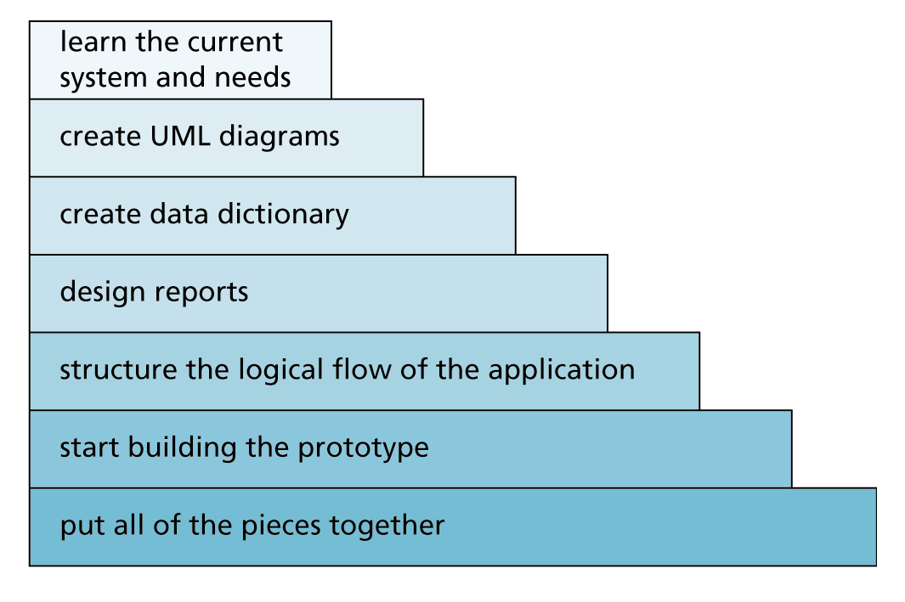
Figure 12-2
Process of creating a design document
Connecting with Computer Science

Slide 11
Step 1: Learn the Current System and Needs
Case Study: a media inventory for a music store
Initial task is to establish the end user’s (owner of the music store) needs and goals
  Ask client to give you samples of desired reports
Document information client gives you
  Dig for more information if necessary
Write the project objectives or introduction, specifications, and requirements
Connecting with Computer Science

Slide 12
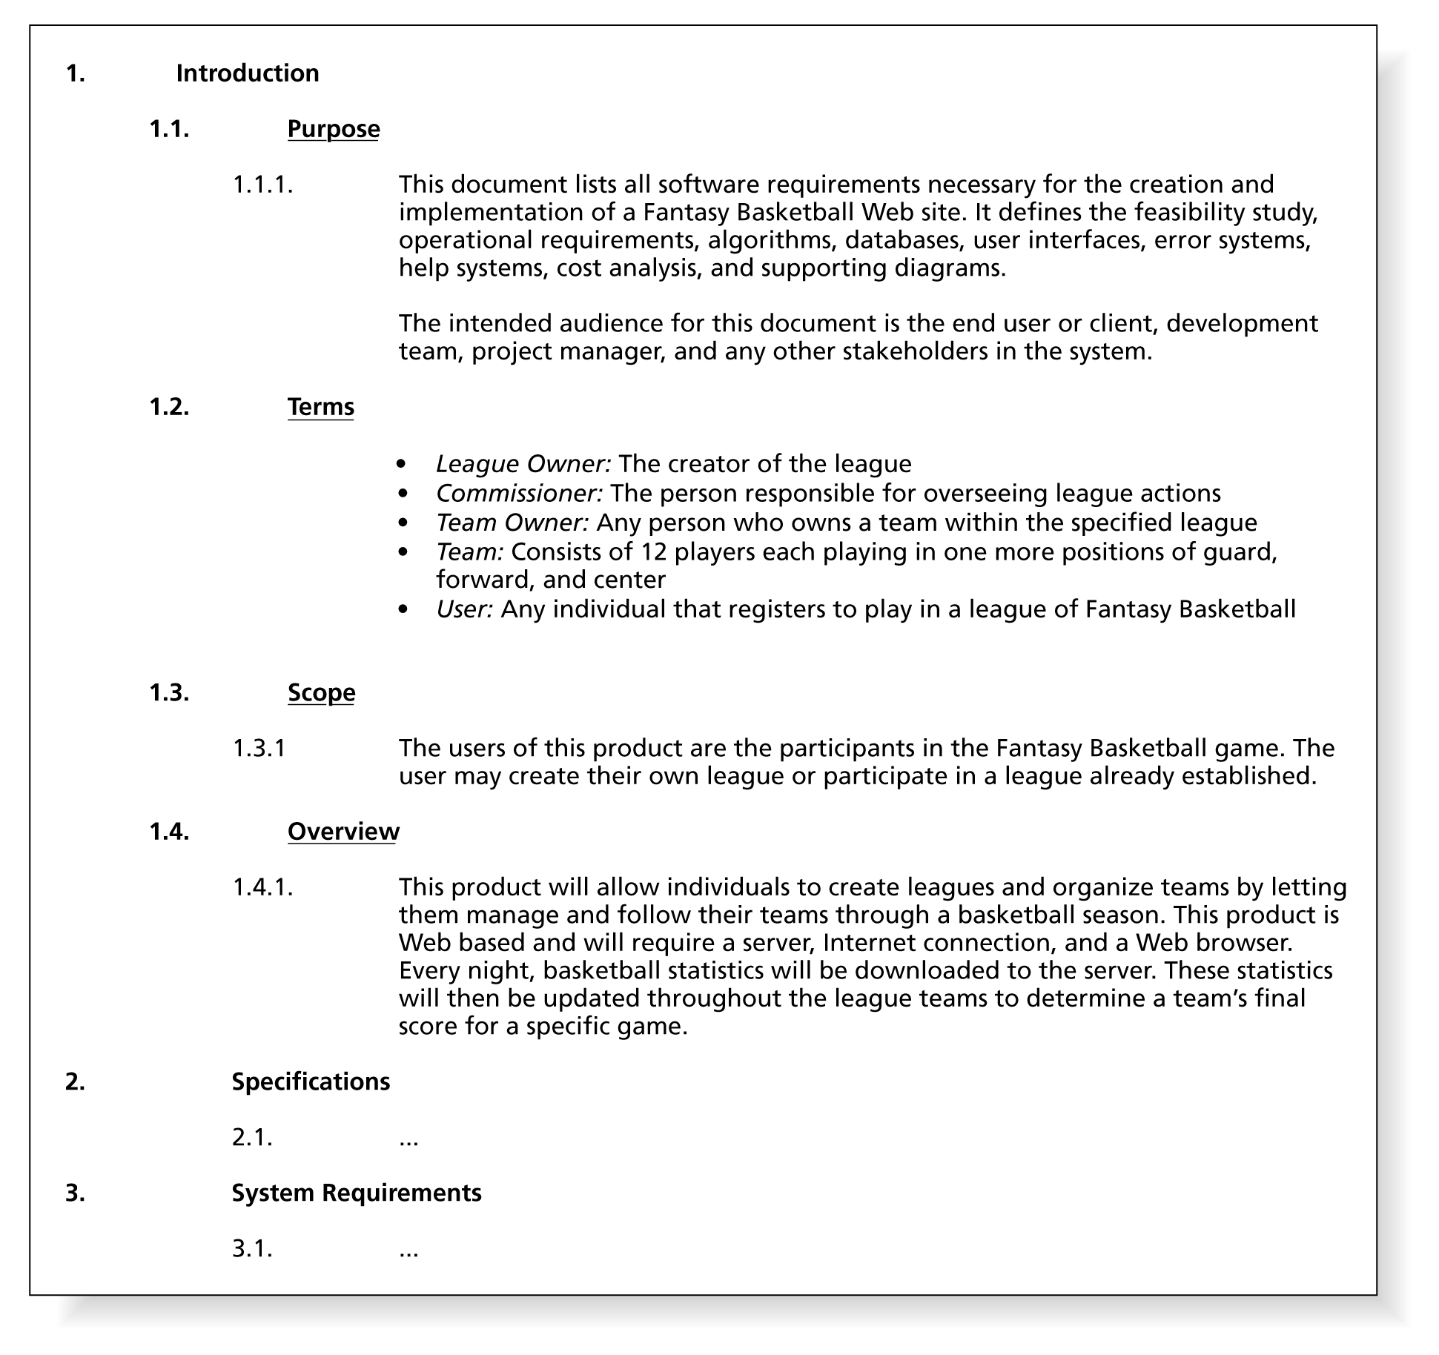
Figure 12-3
A design document includes the project
introduction, specifications, and requirements
Connecting with Computer Science

Slide 13
Step 2: Create UML Diagrams
Unified Modeling Process (UML) enables developers to create a visual blueprint of the functionality of the system
  Provides a way for the client and developer to communicate
  Visual diagrams are created before any lines of source code are written
Tools such as Microsoft Visio can be used to create UML diagrams
Connecting with Computer Science

Slide 14
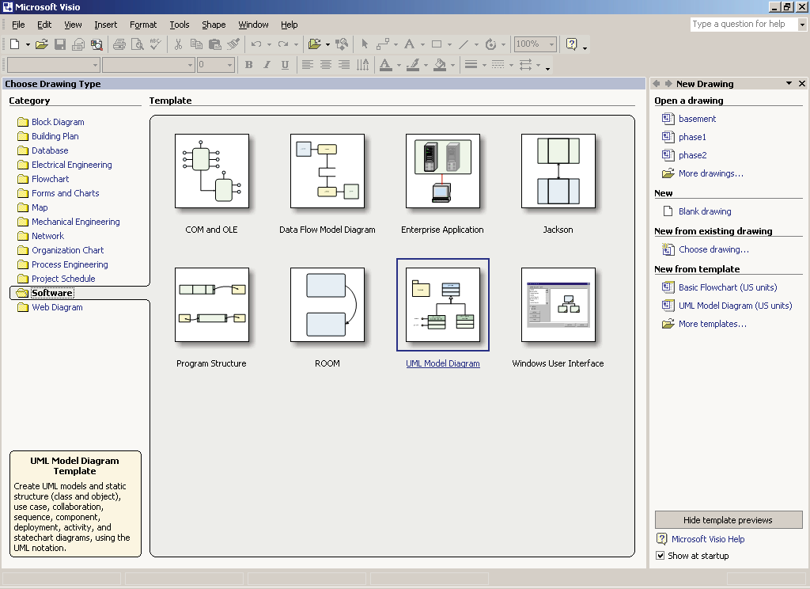
Figure 12-4
Creating UML diagrams in Microsoft Visio
Connecting with Computer Science

Slide 15
Some Types of UML Diagrams
Class
  Shows how different object classes relate to each other
Object
  Gives details of an object created from a class
Use case
  Describes a system’s behavior from a user’s standpoint
Connecting with Computer Science

Slide 16
Types of UML Diagrams (continued)
State
  Shows an object’s particular state at any given time
Sequence
  Shows how one class communicates with another class by sending messages back and forth
Activity
  Shows activities that occur within a use case or within an object’s behavior
Connecting with Computer Science

Slide 17
Types of UML Diagrams (continued)
Collaboration
  Shows how system elements work together to accomplish the system’s objectives
Component
  Shows how system components relate to each other
Deployment
  Shows physical architecture of a computer-based system
Connecting with Computer Science

Slide 18
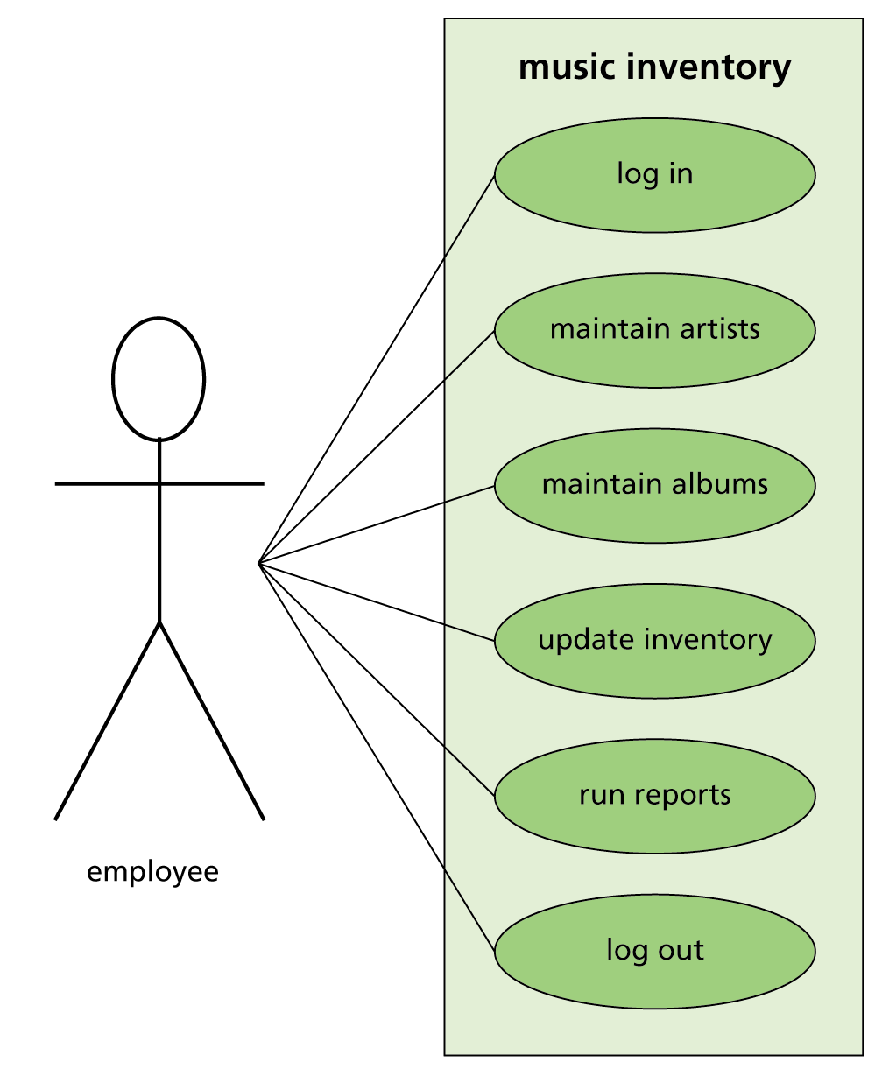
Figure 12-5
Use case diagram for music inventory application
Connecting with Computer Science

Slide 19
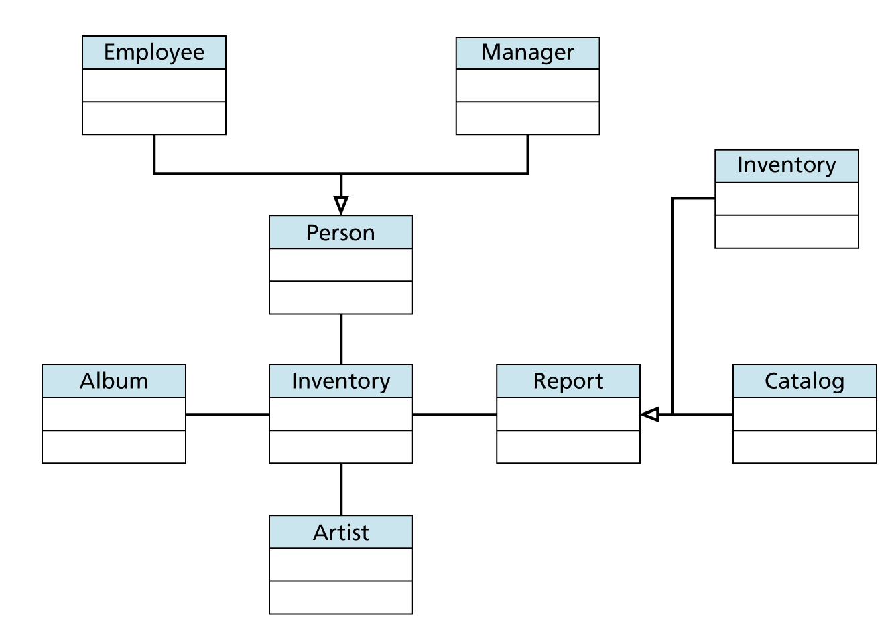
Figure 12-6
Class diagram for music inventory application
Connecting with Computer Science

Slide 20
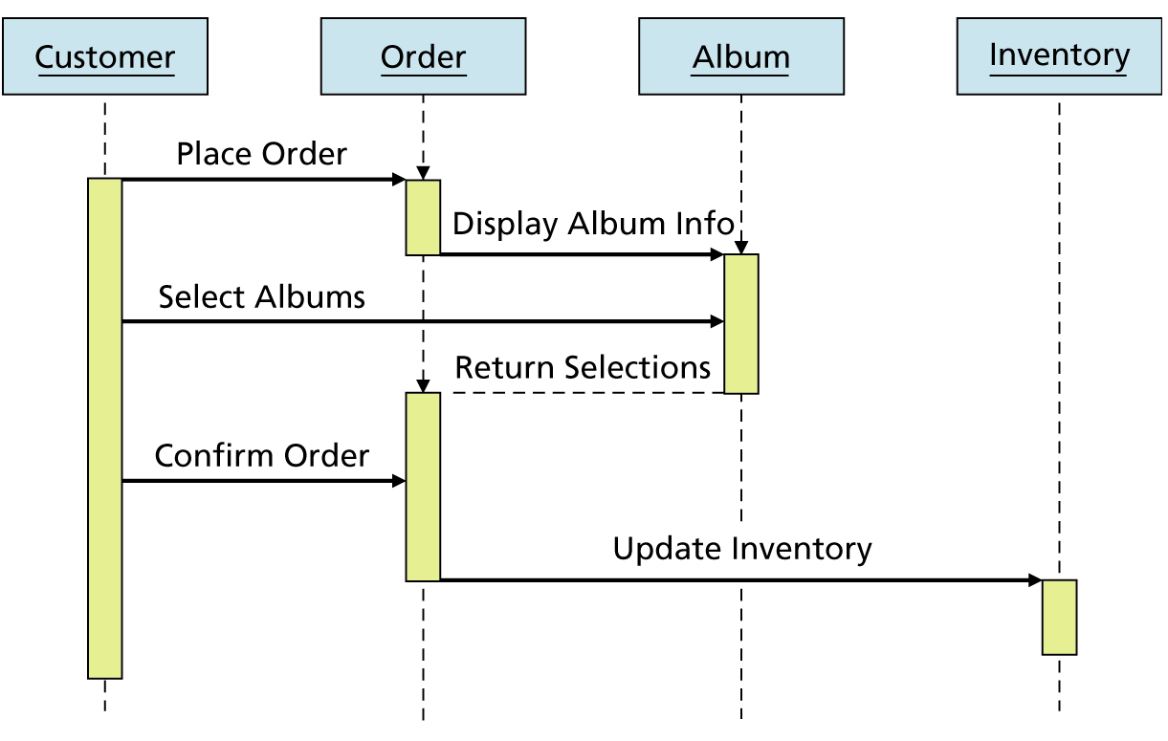
Figure 12-7
Sequence diagram for music inventory application
Connecting with Computer Science

Slide 21
Step 3: Create the Data Dictionary
If a database is needed, create a data dictionary
  Document describing the type of data being utilized within the program
    Shows table definitions, indexes, and other data relationships
Use information from end users to summarize the current system and organize a brief plan for the new application
Review end-user reports to find tables and elements
Connecting with Computer Science

Slide 22
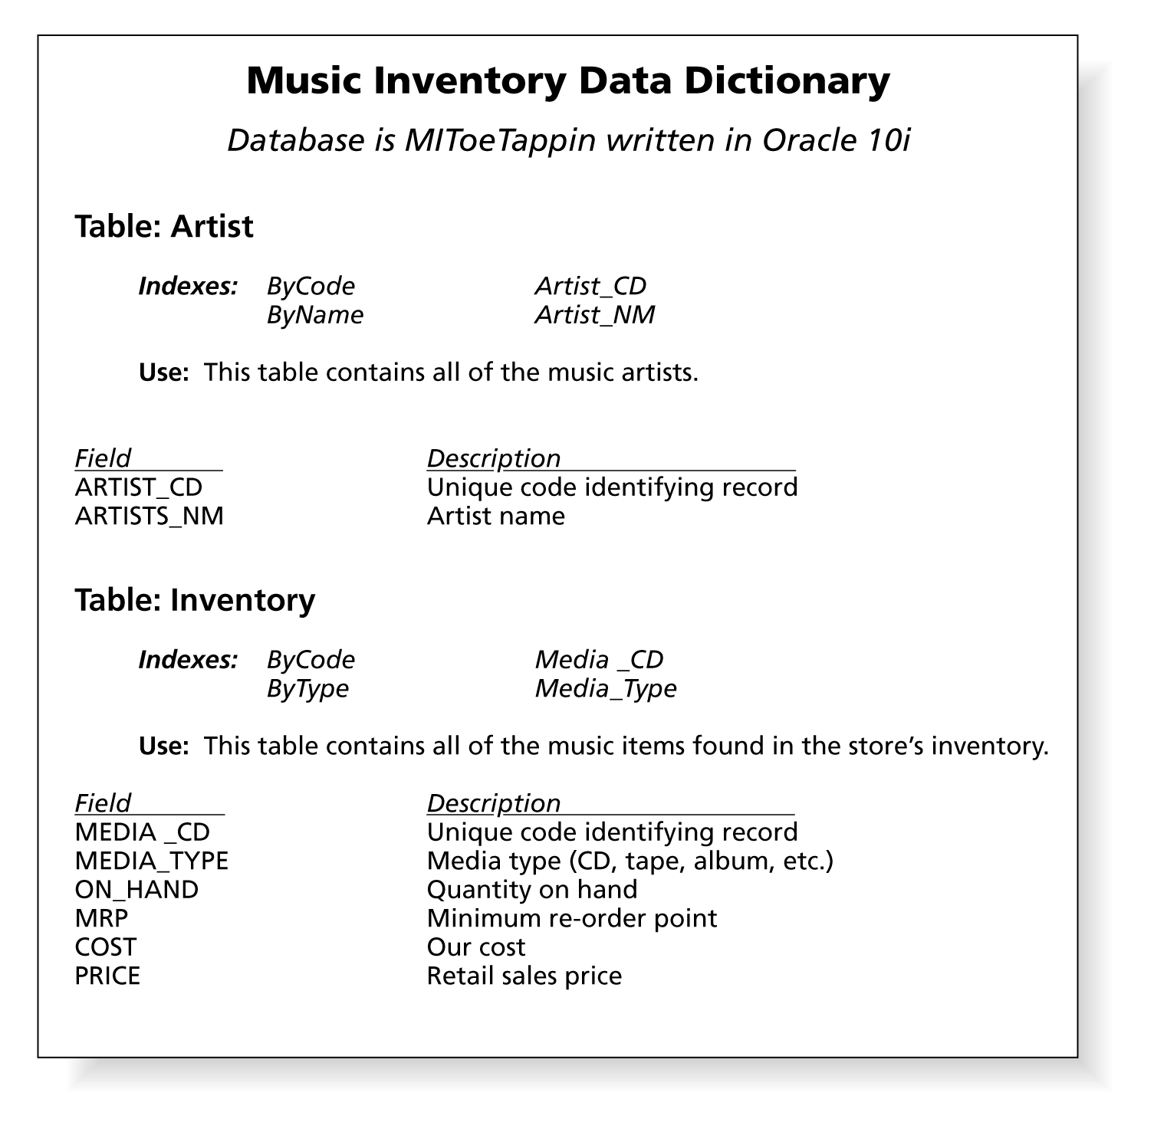
Figure 12-8
Creating a data dictionary
Connecting with Computer Science

Slide 23
Step 4: Design Reports
Meet with users and let them help you design the reports
  Review data dictionary
  Use an Integrated Development Environment (IDE)
    Use the reporting tools in the IDE to interactively create report prototypes with the users
Connecting with Computer Science

Slide 24
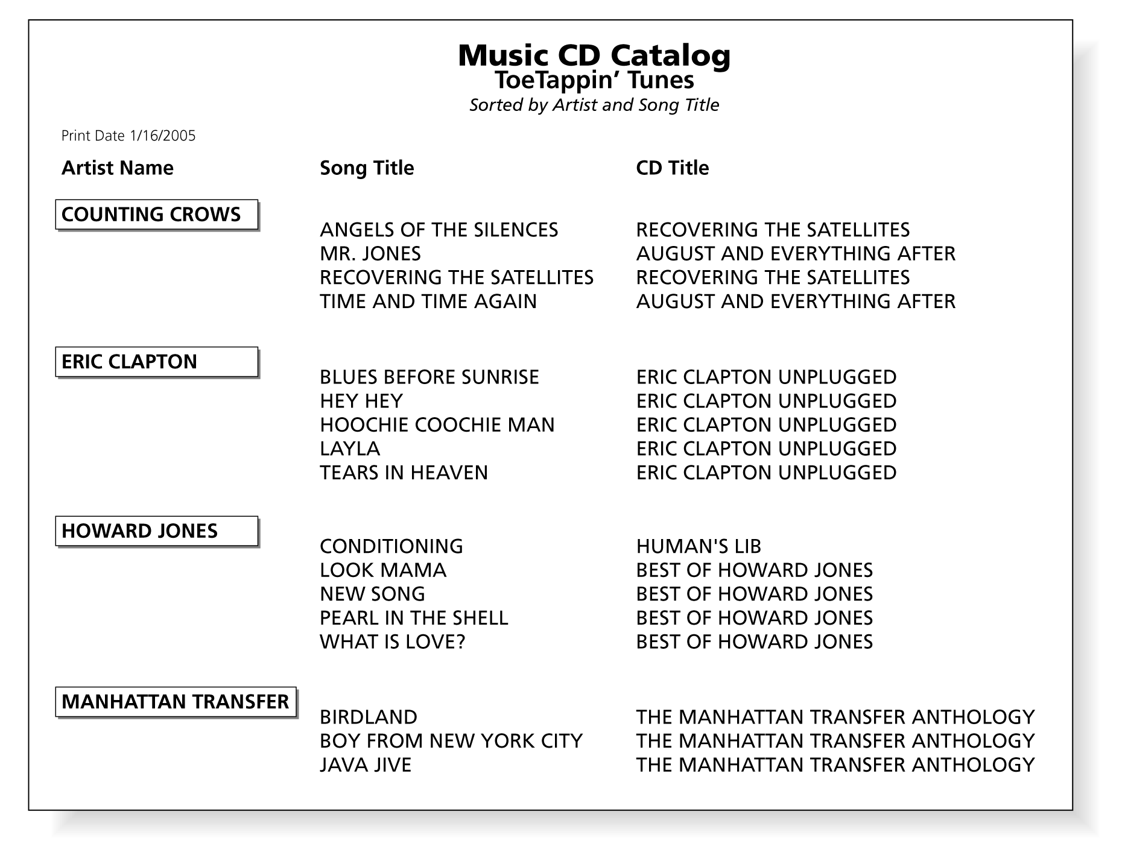
Figure 12-9
Example of report created with report generator
Connecting with Computer Science

Slide 25
Step 5: Structuring the Logical Flow of the Application
Create logical flow of application before you begin writing source code with
  Flowcharts
    Combination of symbols and text that provide a visual description of a process
  Pseudocode
Detail the main functionality of the system and the relationship of the different tasks to be completed
Connecting with Computer Science

Slide 26
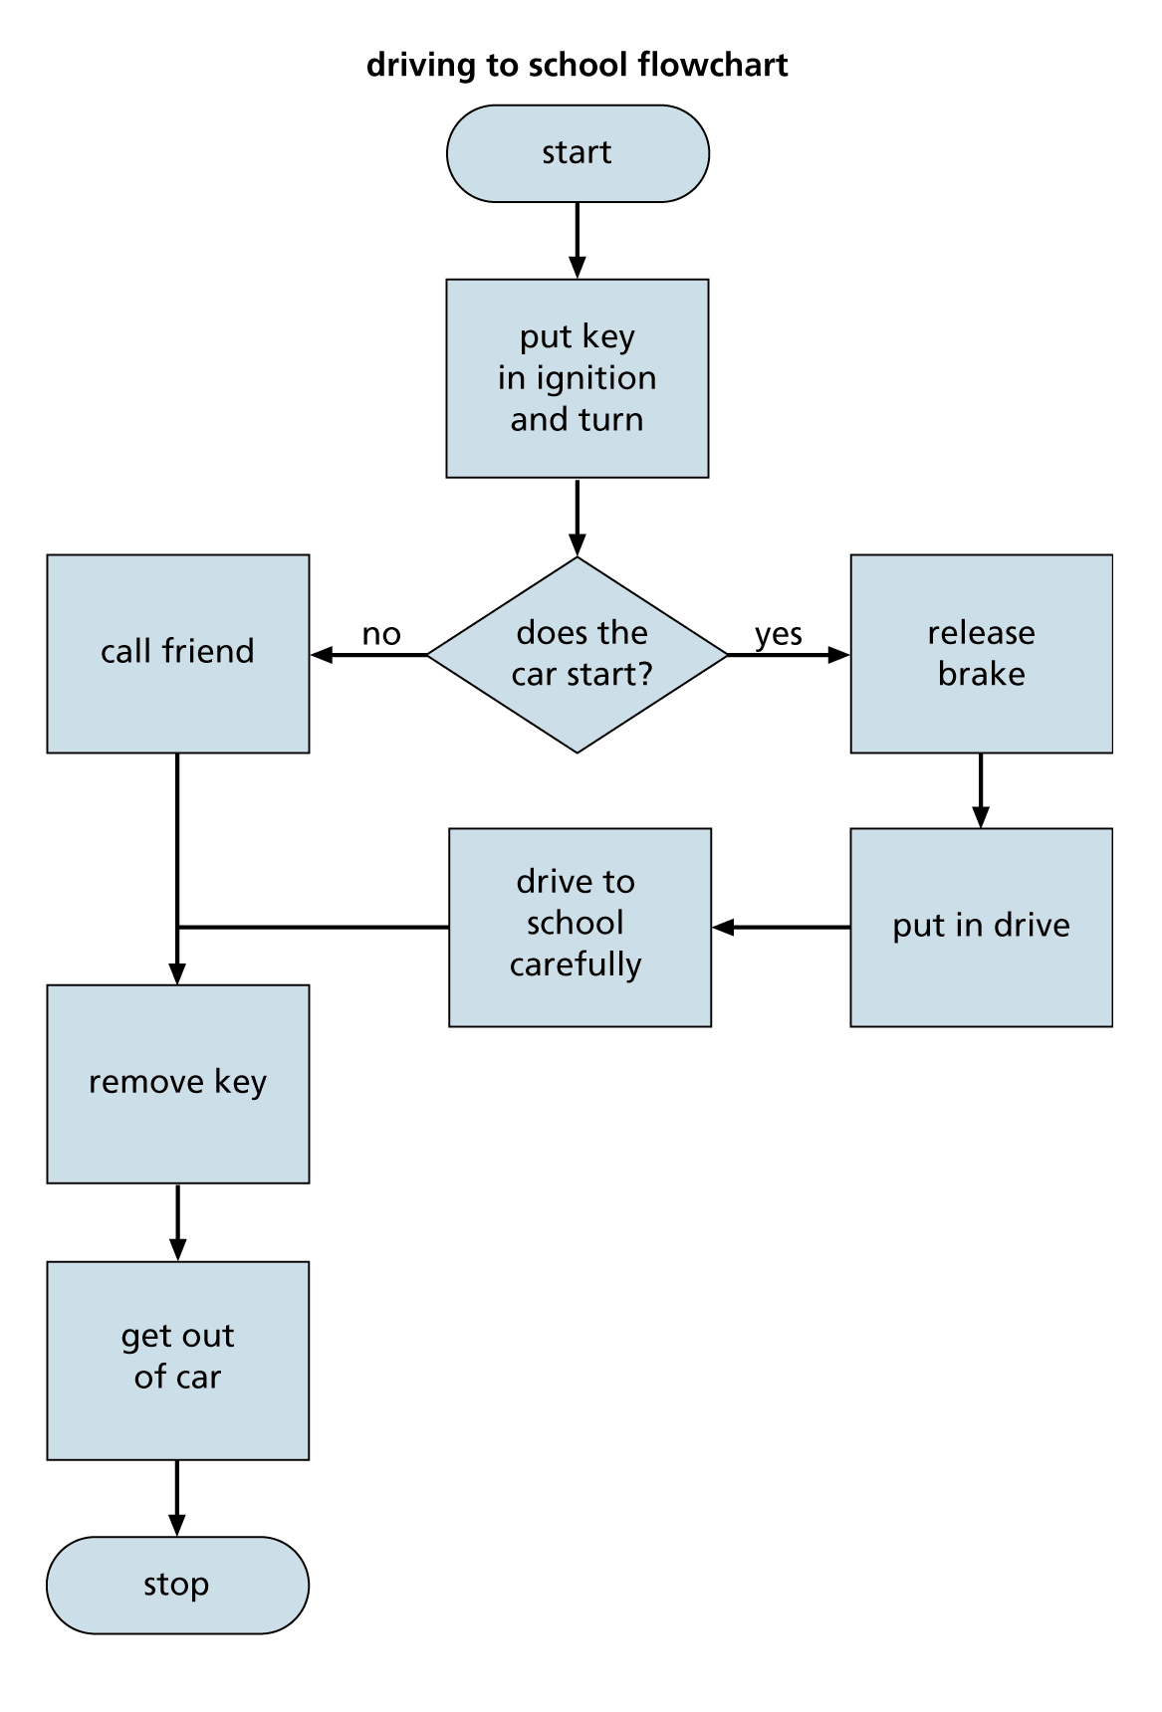
Figure 12-10
Flowchart
Connecting with Computer Science

Slide 27
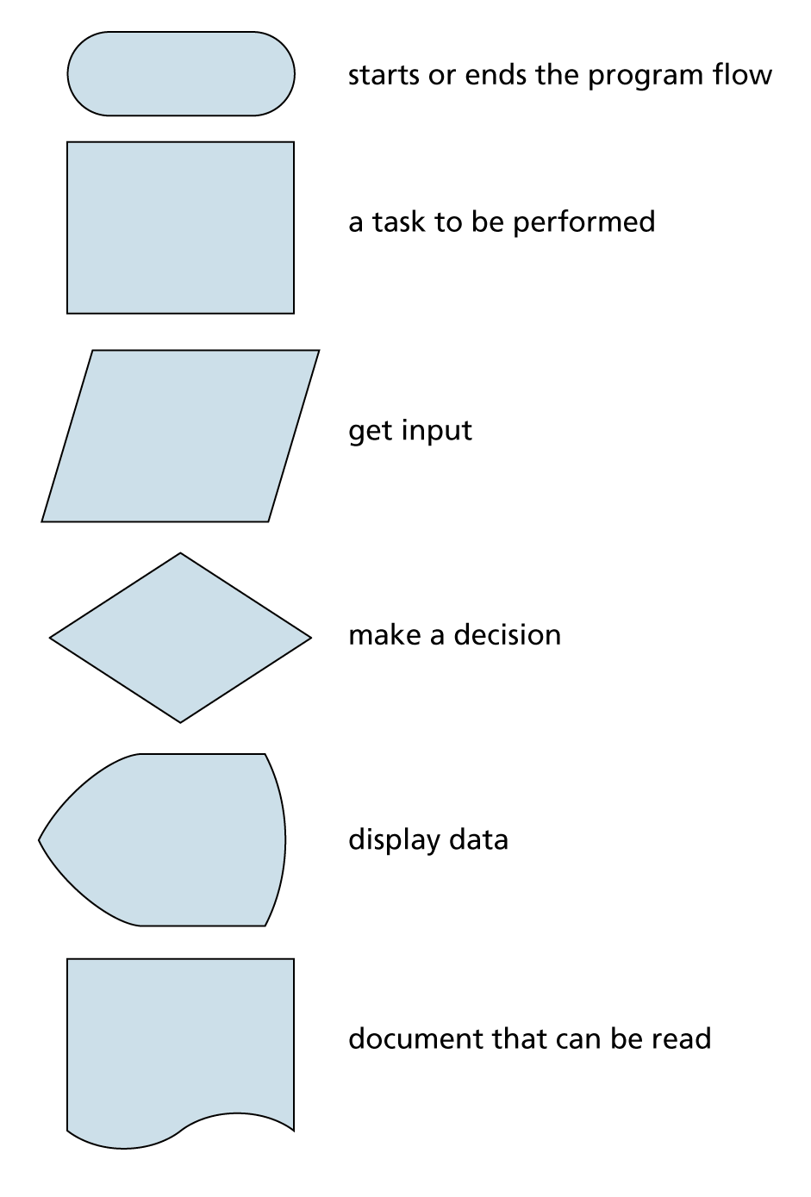
Figure 12-11
Flowchart symbols
Connecting with Computer Science

Slide 28
Step 6: Start Building the Prototype
Prototype: typical example that gives end users a good idea of what they will see when their application is completed
  Ask end users as many questions as possible to understand main functionality of the program
  Do not write source code until project specifications are approved!
  Let the user help you design the screens
    Opening screen should reflect the purpose of the client and main function of the program
Connecting with Computer Science

Slide 29
Step 7: Putting All of the
Pieces Together
Take all of the gathered information and create the design document
  Be realistic in defining project completion dates, time lines, and price estimates
  Make user sign the design document, thus agreeing to the deadline defined by the scope of the project
  Create addendums when modifications to the document are needed
Connecting with Computer Science

Slide 30
Step 7: Putting All of the Pieces Together (continued)
Include the following items in the design document
  Header page, objective, definition of terms
  Project feasibility study, specifications, requirements, and cost analysis
  Data dictionary and all visual diagrams
  Copies of screens, and reports
  Testing and user feedback plans
  Notes from meetings
Connecting with Computer Science

Slide 31
Avoiding the Pitfalls
User-phobia
  Fears that including end user in design process will result in failure
  Solution: Keep communication open
Too much work
  The “heap on the work” syndrome
  Solution: Be assertive and honest with the manager
Scope creep
  Making continual changes and extensions
  Solution: Use a phased approach to development
Connecting with Computer Science
Notes:
Phobia: ám ảnh
Syndrome: hội chứng
Heap: chất đầy
Assertive: xác nhận
Creep: trượt

Slide 32
The Project
Development Team
Project manager
  Responsible for choosing the right players for the right positions
  Determines risk involved with project, cost, and the scheduling of tasks
  Pulls together the design document
Creator of the database (database administrator)
  Creates and maintains database structure
Connecting with Computer Science

Slide 33
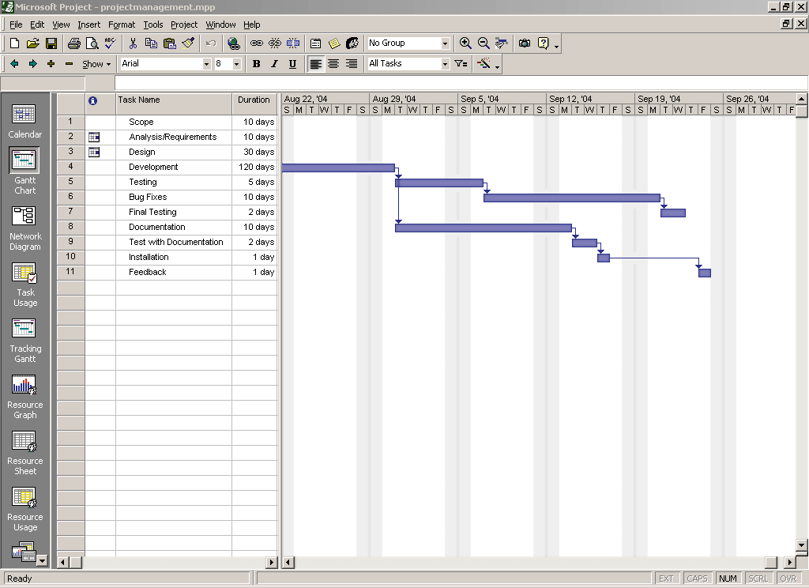
Figure 12-12
A project management tool helps a manager
keep track of the status of the project
Connecting with Computer Science

Slide 34
The Project Development Team (continued)
Developers (programmers)
  Responsible for writing source code to meet functional requirements of the end user
Client (end user)
  Driving force behind project
Tester
  Responsible for making sure the program functions correctly and meets all functional requirements in the design document
    Test all possible situations and keep a log of errors
Connecting with Computer Science

Slide 35
The Project Development Team (continued)
Customer relations representative
  Interface between the testers, developers, and end users during product creation and early release cycles
Generator of the application CD
  Interface with developers to ensure that all of the necessary files are included on the disks
Installer of the application disks
  Installs disk on the end user’s machine and gives the user a guided tour of the application
Connecting with Computer Science

Slide 36
One Last Thought
Good design results in good programs
  Skipping steps will result in poor performance, unmet client needs, or a project that runs over budget and over schedule
The project manager’s primary responsibilities are to build a team that can work well together, and to keep the project on schedule and within budget
Include a thorough testing cycle
Connecting with Computer Science

Slide 37
Summary
Software engineering involves many different steps that can be followed in order to create an application that meets an end user’s needs
The process of building the application is accomplished by implementing a software development life cycle (SDLC) process
Each SDLC provides a different way of detailing the steps used in creating a software product
Connecting with Computer Science

Slide 38
Summary (continued)
A design document acts as a blueprint for software development
Several steps when creating a design document
  Researching the needs of the end user, communication, logical design of screens, reports, and data structures, etc.
UML enables developers and end users to visually design the functionality of the system
Connecting with Computer Science

Slide 39
Summary (continued)
Several types of UML diagrams, each for a particular purpose or a part of a system
Using the reports and the data dictionary can help a developer assess any design “holes”
Software development is often a team effort
  Team members include a project manager, database administrator, developer/programmer, client/end users, a tester, and sometimes customer relations
Connecting with Computer Science

Slide 40
Summary (continued)
Once the application has been developed, installation disks need to be generated
After the system is installed on the client’s system, spend some time training initial end users, who can in turn train other end users
Connecting with Computer Science

