Slide 1
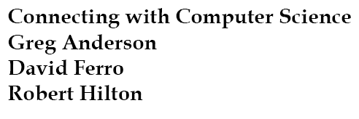



Slide 2
Objectives
Understand the performance limitations of Von Neumann architecture
Learn why computer speed enables new innovation
Gain an understanding of current and future computing paradigms
Learn how light and biologic computers can speed processing
Connecting with Computer Science

Slide 3
Objectives (continued)
Learn what the Turing Test is and how it applies to computing
Learn about the changing shape of computers
Learn how computers are merging with other devices
Learn about innovations in memory and data storage
Connecting with Computer Science

Slide 4
Objectives (continued)
Learn how the Internet will affect future computing
Gain an understanding of artificial intelligence (AI)
Learn about developments in AI
Connecting with Computer Science

Slide 5
Hardware Limitations
The main limitations of hardware continue to be related to three factors
  Speed
  Physical size
  Power requirements
Connecting with Computer Science

Slide 6
Limitations of Von Neumann Architecture
Most computers today are limited by the number of instructions that can be processed each second
However, increasing the CPU seldom results a proportional overall speed increase in the computer
  Von Neumann architecture has to fetch instructions from RAM over the system bus
    Bus speeds are limited to less than 200 MHz
    Input and output devices limit overall speed
Connecting with Computer Science

Slide 7
Why Speed Is Important
Many tasks currently cannot be accomplished because of the speed limitations
  Visual recognition
  Speech recognition
  Character recognition
  Accurate weather predictions
  Computer robotic systems
Connecting with Computer Science

Slide 8
A New Paradigm
A paradigm is a theoretical framework, or a way of doing things
To achieve a giant leap in speed requires a paradigm shift in the design of computer hardware (the Von Neumann architecture)
  Semiconductors and transistors have speed limitations
Connecting with Computer Science
Notes:
Leap: Nhảy vọt

Slide 9
Light Computers
Shifting from semiconductor switches and electrical buses to optical switches and fiber optic buses promises a large increase in the speed of computing
  “Light ” buses are not limited to the speeds of electronic buses
  Light beams can cross without interfering with each other
  Light computers require much less power
Connecting with Computer Science

Slide 10
Quantum Computers
A computer built using the principles of quantum mechanics
  The study of matter and radiation at an atomic level
  The fundamental unit of information is a qubit
    A qubit can represent four values (the bit in Von Neumann architecture can represent two values)
Scientists predict that the quantum computers of the future will have speeds millions of times faster than current computers
Connecting with Computer Science
Notes:
Radiation: sự bức xạ

Slide 11
Biological Computers
Prototype biological computers use enzymes and DNA
  Speeds comparable to the speed of the Pentium 2.4 GHz CPU
Billions of biological computers could fit in the same space as a current semiconductor CPU
Researchers are trying to design biological computers that can be used inside the body to watch for and treat problems
Connecting with Computer Science

Slide 12
Passing the Turing Test
The Turing Test was conceived by Alan Turing in 1950
  Reveals whether a machine has the equivalent of human intelligence
  Based on an imitation game where both a computer and person answer questions
    If a person cannot tell the difference between the answers, the computer is considered to be as intelligent as the computer
Connecting with Computer Science

Slide 13
The Computer’s
Changing Shape
The original Eniac computer occupied over 5000 square feet of space
PDAs today have much more computing power than the Eniac…and yet fit in the palm of your hand
Notebook and PDA computers provide portability and computing power that greatly exceeds that of the supercomputers of just a few years ago
Connecting with Computer Science

Slide 14
Wearable Computers
Making computers out of clothing (or vice versa)
  Allows you to have an intelligent assistant with you at all times
  Used as a language translator (visual or spoken)
  Allows people to perform tasks without prior training using voice commands
Only thing holding this technology back is speed and size of present computers
Connecting with Computer Science

Slide 15
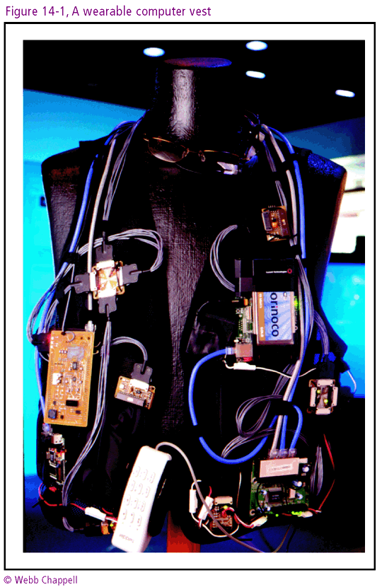
Connecting with Computer Science

Slide 16
Merging Technologies
The lines between computer, television, and radio technology have become increasingly fuzzy
The recording of television shows is an example of merging technologies
  A DVR is a specialized computer that records and plays back video content from cable and satellite sources
  A TiVo service interfaces with the DirectTV program guide and gives the user power and flexibility in which programs to record
Connecting with Computer Science

Slide 17
Project Oxygen
An alliance of educators, students, and researchers formed to create a new paradigm of computing that would make computers and communication between computers as natural as the air we breathe
  People will be able to communicate with computers by just talking with them
  Brings computers to the human level and to serve people
Connecting with Computer Science

Slide 18
Innovations in Storage
Early computers could only store data in volatile electronic memory
Punched cards and paper tape stored programs and data, but they were slow and bulky
Magnetic tapes and disk drives became the standard method of semi permanent storage
  Research is trying to achieve even higher densities
Connecting with Computer Science

Slide 19
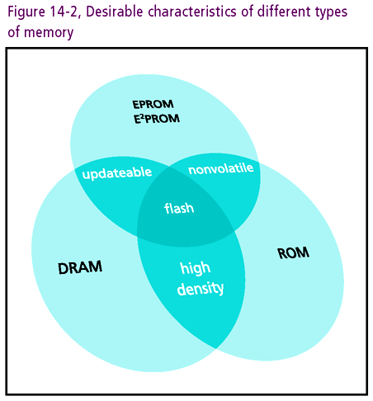
Connecting with Computer Science

Slide 20
Optical Storage
Optical disks (CDs and DVDs) can store approximately 700 MB of storage
  More stable than magnetic storage
  Lends itself to removable storage
Holographic storage is currently being researched
  Method of splitting a laser beam and using a device called a spatial light modulator to store full pages of information in layers on a crystal material
  May store 1 terabyte (1,000 gigabytes) of data
Connecting with Computer Science

Slide 21
New Storage Technologies
Magnetic and optical storage both use spinning disks
  Moving parts require higher energy and are prone to mechanical failure
  Inertia and other physical laws slow down data transfer
Solution: develop storage devices with no moving parts
  Flash memory
Connecting with Computer Science

Slide 22
Flash Memory
Nonvolatile memory that allows the user to electrically program and erase information
  Functions as erasable, rewritable ROM memory
  A standard alternative for removable drives
  Plugged into external connectors on electronic devices
  Store up to 2 GB
Connecting with Computer Science

Slide 23
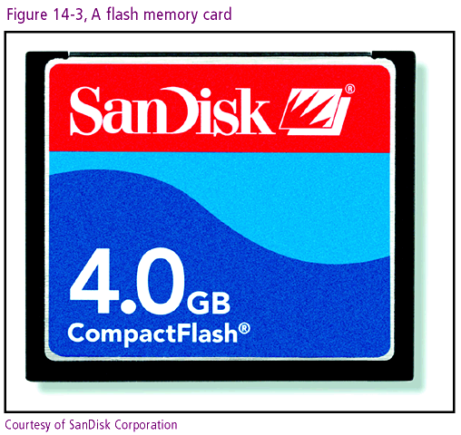
Connecting with Computer Science

Slide 24
USB Drives
Flash memory in a small, durable portable case that can be plugged into a USB port of a computer
  Used as a disk drive
  Portable
  Used for carrying files and even desktop configurations
Can be made secure by combining them with fingerprint sensors
Connecting with Computer Science

Slide 25
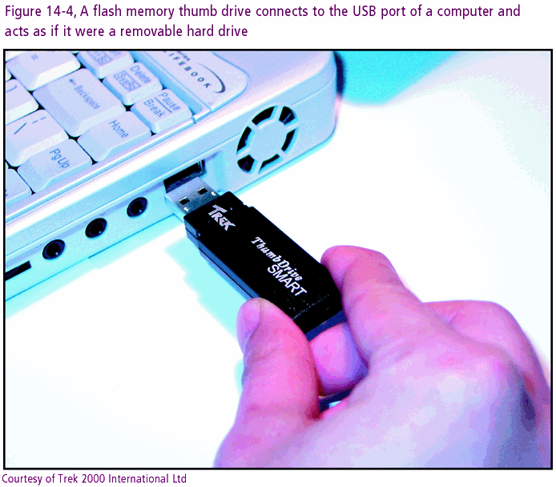
Connecting with Computer Science

Slide 26
Magnetic RAM
Uses the polarization of microscopic magnetic layers to store ones and zeros that remain after the power source is removed
  Very low power requirements for reading and writing data
  Main purpose is to replace the DRAM as computer main memory, but has several other uses as well
Connecting with Computer Science

Slide 27
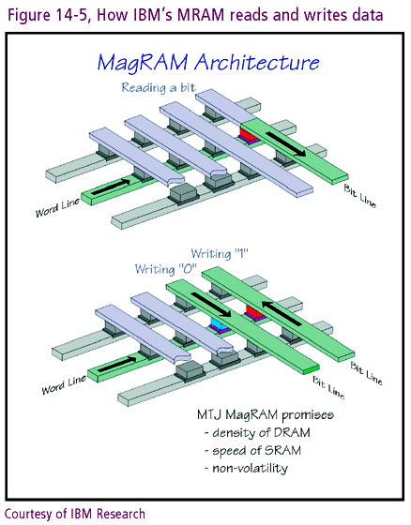
Connecting with Computer Science

Slide 28
Polymer Memory
Nonvolatile memory that uses artificial polymers to store ones and zeros
  Polymers are chains of complex molecules
Types of polymer technology
  Uses nanotechnology to burn microscopic pits in a thin polymer coating inside the memory chip
    Can be written thousands of times
  Uses electrical currents to burn though microscopic segments in the polymer
    Can only be written once
Connecting with Computer Science

Slide 29
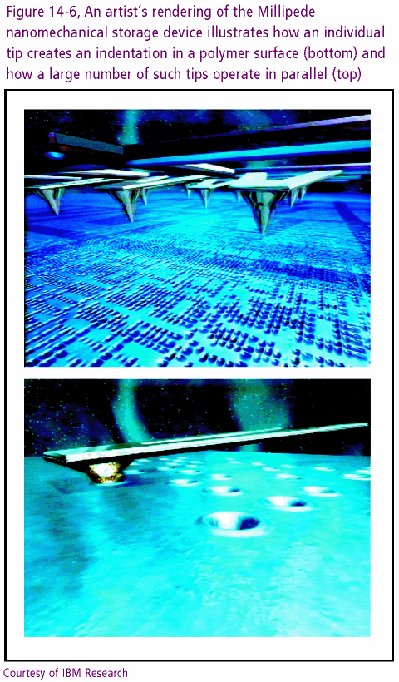
Connecting with Computer Science

Slide 30
The End of the Mechanical Storage Device
New types of storage devices will make mechanical storage obsolete
  Much lower power requirements
  Much smaller
Miniature storage increases security risks
  Sensitive information can be removed easier
    Many organizations ban devices such as USB drives in the workplace to avoid this problem
Connecting with Computer Science

Slide 31
The Internet and Future Computing
In the future, the Internet will become an extension of your computer bus
  All types of devices connected to the Internet will be able to communicate with each other
  Audio and video
    The Internet will be the standard way to transmit music, television, and movies
  Wireless technology
    Connectivity to any place at any time
Connecting with Computer Science

Slide 32
Artificial Intelligence
The science and engineering of making intelligent machines, especially intelligent computer programs
  Gives computer the ability to make decisions
  Requires a computer program that can adjust to the situation
Connecting with Computer Science

Slide 33
Fuzzy Logic
A superset of conventional (Boolean) logic that has been extended to handle the concept of partial truth
  Deals with truth values between “completely true” and “completely false”
The core of fuzzy logic is to consider all of the possibilities and then take the course that seems to have the least amount of problems attached to it
Connecting with Computer Science

Slide 34
Neural Networks
A parallel interconnection of simple processing units based on the architecture of human and animal brains
  An alternative computing paradigm to Von Neumann architecture
  Can process many pieces of data at the same time
    Any problem that can be solved more quickly in parallel will benefit from neural networks
  Well suited to visual and speech recognition applications
Connecting with Computer Science

Slide 35
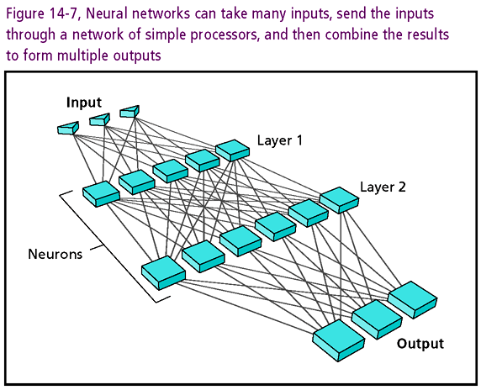
Connecting with Computer Science

Slide 36
Speech Recognition
It is difficult for a computer to understand different accents, dialects, or speech problems
For a human to be able to communicate more easily with computers, the computers must be able to understand the nuances of human speech
  Faster CPUs have made speech recognition more accurate
  Used in online banking, online surveys, and voicemail
Connecting with Computer Science

Slide 37
Visual Pattern Recognition
Computers using Von Neumann architecture are not fast enough to perform all of the calculations and comparisons to allow for real-time visual discrimination
  Problem is more solvable as computers get faster
  Research is also being done to use neural networks
Visual pattern recognition is a vital aspect of artificial intelligence
  Ability to act on recognition of shapes and motion
Connecting with Computer Science

Slide 38
Machine Learning
(Expert Systems)
Fuzzy logic is effective because it gives a human (or computer) the ability to learn, especially from mistakes
An expert system is a computer program that simulates the judgment and behavior of a human or an organization that has expert knowledge and experience in a particular field
Applications for expert systems
  Medical and technical support, telephone hotlines
Connecting with Computer Science

Slide 39
Natural Language Processing
Computer applications that can recognize and interact with natural language text
  Eliminates the need to specify every single step of a set of instructions
  Infers many actions based on receiving a simple command
We are still far away from having natural language processing that approximates human capabilities
Connecting with Computer Science

Slide 40
Robotics
The development, study, and use of robots
In most cases, robotics also involves work with artificial intelligence
Used today to assemble cars, perform medical operations, defuse bombs, vacuum clean, mow the lawn
Primarily concerned with the mechanics and electronics that carry out the results of other areas of artificial intelligence
Connecting with Computer Science

Slide 41
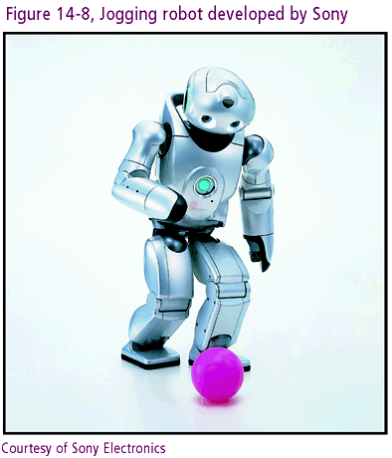
Connecting with Computer Science

Slide 42
One Last Thought
Computers are becoming part of every aspect of life
Technology is currently changing so rapidly that even a chapter like this one can quickly become outdated
The key to a successful career in computer science is your ability to stay current with technology
Connecting with Computer Science

Slide 43
Summary
Understanding past technologies helps you evaluate new innovations
Current hardware devices have limitations of speed, size, and power requirements
Speed limitations are inherent in Von Neumann architecture
Limitations on computer speed have made some applications impossible or impractical at this time
Connecting with Computer Science

Slide 44
Summary (continued)
Computing paradigms constantly change
Light computers may provide tremendous computer speed increases
Mathematician Alan Turing proposed a test to determine the intelligence of a computer
Computers will not be constrained to a desktop in the future
Connecting with Computer Science

Slide 45
Summary (continued)
Computers will become part of nearly all devices and appliances
Computers and other technologies are merging
Research is ongoing to allow people to interact more naturally with computers
Storage devices with moving parts will be replaced with optical and magnetic innovations
Polymer memory may become the standard in future storage products
Connecting with Computer Science

Slide 46
Summary (continued)
The Internet will be a prominent part of the future of computing
Scientists have been working to give computers artificial intelligence capability
Branches of AI include fuzzy logic, neural networks, speech recognition, visual pattern recognition, machine learning, natural language processing, and robotics
Connecting with Computer Science

