Slide 1



Connecting with Computer Science

Slide 2
Objectives
Learn what tasks you need to be prepared to accomplish within the computer industry and which tools can help you succeed in completing the tasks
Learn how even computer scientists have to use word processors to create documents
Learn what tools can be used to create a presentation
Learn about the different types of graphics and what tools allow you to create and modify them

Slide 3
Objectives (continued)
Refresh your understanding of e-mail and how it benefits the computer industry
Learn what tools are used to compress files
Understand how files can be shared through the use of FTP
Learn about creating spreadsheets to manage projects and which spreadsheet tools are best to use

Slide 4
Objectives (continued)
Realize that there are many different programming languages to choose from and that using a particular programming environment may make it easier to create an application
Learn that Web development is an essential task to add to your skills
Learn about database design and maintenance tools
Learn that project management is essential to the success of a project

Slide 5
Why You Need to Know About…Software Tools
Specific tools designed for specific tasks
  Scissors cut fabric, paper, threads, etc.
  Hammers drive nails into a board
Software products are also customized tools
  Word processors are used to create documents
  Desktop publishers are used to create brochures
Benefit of picking the right tool from the “box”
  Enhance progress toward task completion

Slide 6
Different Tools for Different Rules
Learning about a task precedes tool selection
Tasks are grouped into (3) main categories:
  Office tasks
  Programming tasks
  Internet or Web Tasks
Meeting the challenge of matching tool to task
  A critical factor in achieving goals
  The chief objective of Chapter 2

Slide 7
Office Tools
Office tools support overall professional development
Office tools help generate the following:
  Documents
  Presentations
  Spreadsheets
  Budgets
  Work schedules

Slide 8
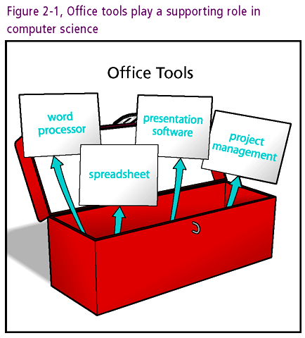

Slide 9
Document Tools
Document-creation tools improve experiences of career, education, and personal life
List of specific document tools:
  Word processors
  Text Editors
  Desktop publishing software

Slide 10
Word Processors
Word Processor: multipurpose document creation tool
A partial list of items generated by word processor:
  Letters, resumes, design documents, project proposals, faxes, memos, assignments, resumes
Broad range of capabilities
  Formatting options (such as font selection)
  Graphics
  Spell and grammar check
Microsoft Word: the word processor of choice for both Windows and Mac operating systems

Slide 11
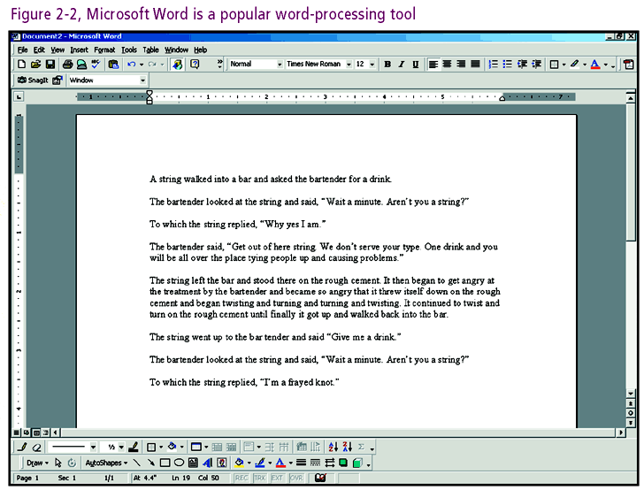

Slide 12
Word Processors (continued)
StarOffice Writer: popular word processor in UNIX and Linux operating system environments

Slide 13
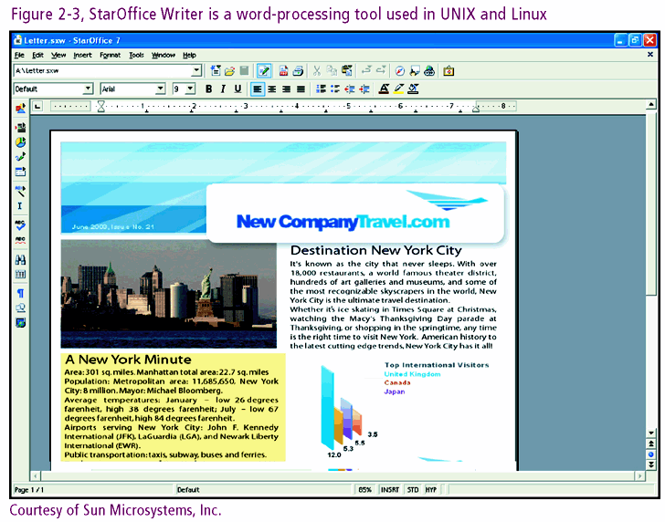

Slide 14
Text Editors
Text editor: generic tool with basic editing capabilities
Used for entry of straight text such as program commands
Text editors built into most operating systems
  Windows: Notepad
  Unix and Linux: vi

Slide 15
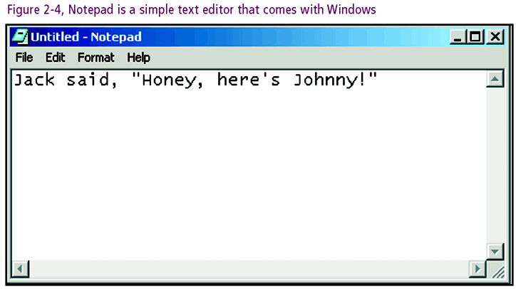
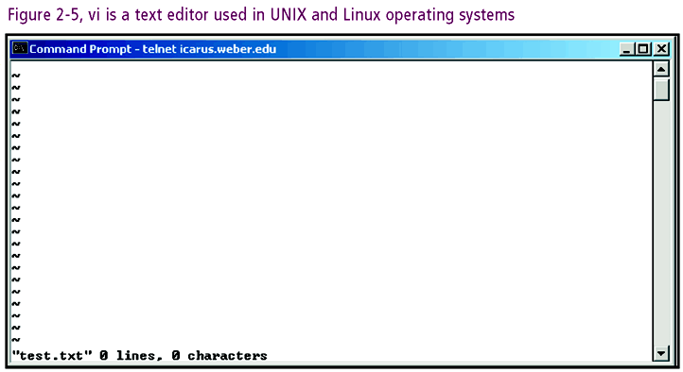

Slide 16
Desktop Publishers
Desktop publisher: tool emphasizing the generation and coordination of graphical content
Provide page-layout for brochures, magazines, newspapers, and books
Relationship to word processors
  Embed document input into templates, figures, photos
  May share most features, including a text editor

Slide 17
Presentation Tools
Presentation software: supports oral presentation with visual and acoustic effects
Example: Microsoft PowerPoint + data projector
  “A picture is worth a thousand words”
  Add sensory dimension to spoken word
Some special PowerPoint Techniques
  Slide transitions
  Custom animation

Slide 18
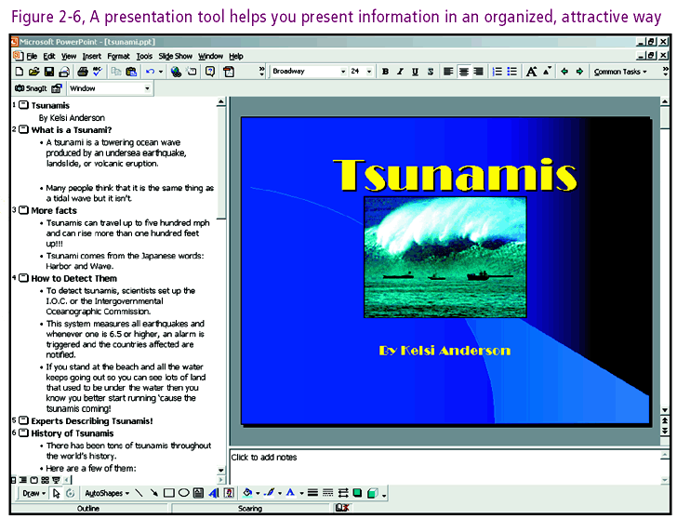

Slide 19
Spreadsheet Tools
Spreadsheet: document that organizes information in rows and columns
  Tool of choice for budgets
  Utilized by project leaders and managers
Powerful tool: Microsoft Excel
  Allows category definitions
  Accommodates math operations, functions, and graphs

Slide 20
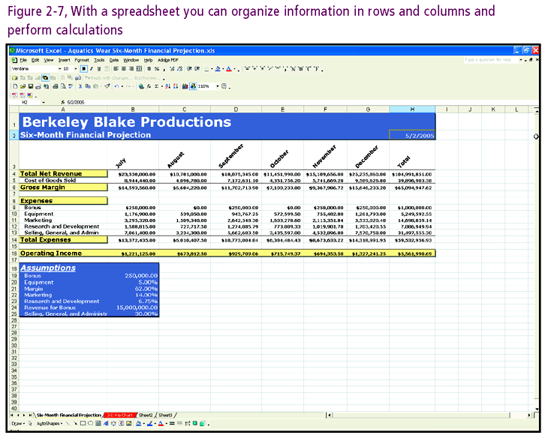

Slide 21
Project Scheduling and Management Tools
Project Schedulers/Managers: tools track status of project development
Ingredients for successful project
  Define and organize major tasks
  Map course of project
  Mark milestones on the path toward completion
  Adhere to budget constraints
  Seek ways of improving efficiency
Popular Tool: Microsoft Project
  Charts project progress
  Outputs info in various report formats

Slide 22
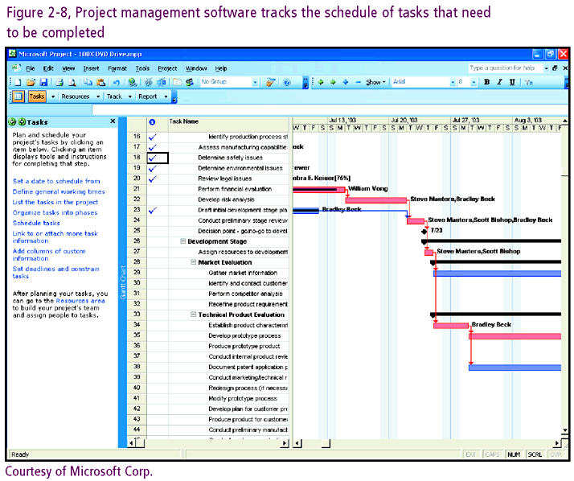

Slide 23
Programming Tools
Programs consist of many components
  Various components call for various tools
Partial list of tasks supported by toolkit
  Graphics
  Diagram and flowchart construction
  Database management
  Technical support

Slide 24
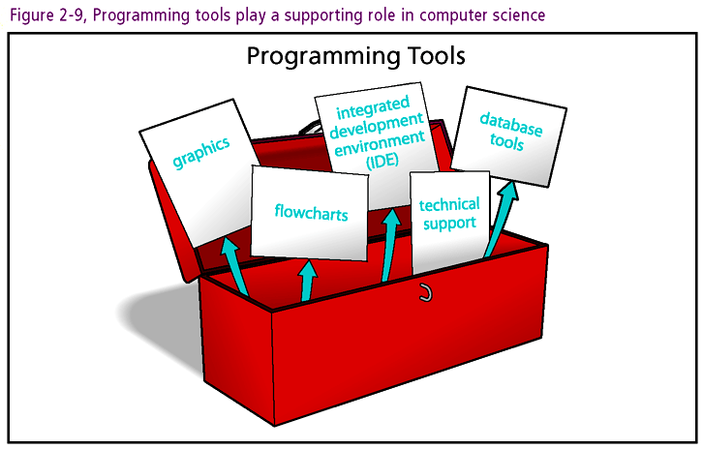

Slide 25
Creating Graphics
Graphic content takes a number of forms
  Picture
  Photo
  Logo
  Animation
  Map
Resources
  Internet downloads (with permission)
  Graphics tools

Slide 26
Graphic Formats
Variety of graphic formats
  .BMP (bitmap): 16.7 million colors, no animation
  .GIF (Graphics Interchange Format): allows 256 colors and includes transparency feature
  .JPG (Joint Photographic Experts Group): most efficient storage method and Internet friendly
  .TIF (Tag Image File Format): format of choice for professional photographers
Right image should match right task

Slide 27
Graphic Compression
Graphic compression: reduces file size
Two compression techniques
  Lossless compression: removes redundant areas
  Lossy compression: removes redundant areas and information not perceptible by the human eye
Choose compression technique based on need
  Lossy compression trades quality for efficiency
  Most video compression (MPEG) and JPEG formats use Lossy compression

Slide 28
Working with Graphics
Selection of graphics tool based on features
(4) ways to modify graphics (not inclusive)
  Scaling: resizing image
  Rotating: repositioning image based on 360º circle
  Cropping: Trimming portions of images
  Format conversion: Converting image from one file format to another
Tradeoff between image control and quality

Slide 29
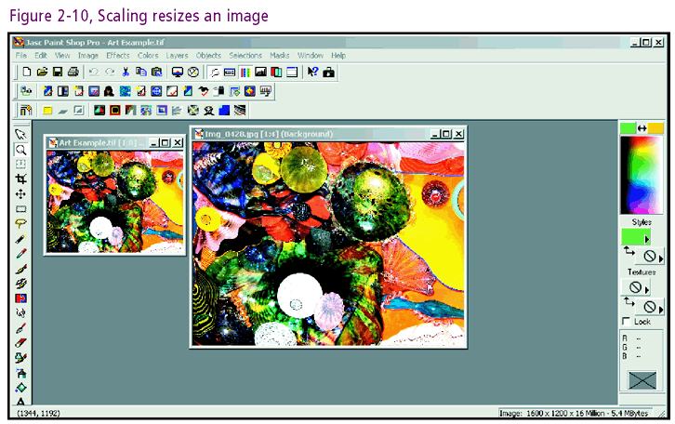

Slide 30
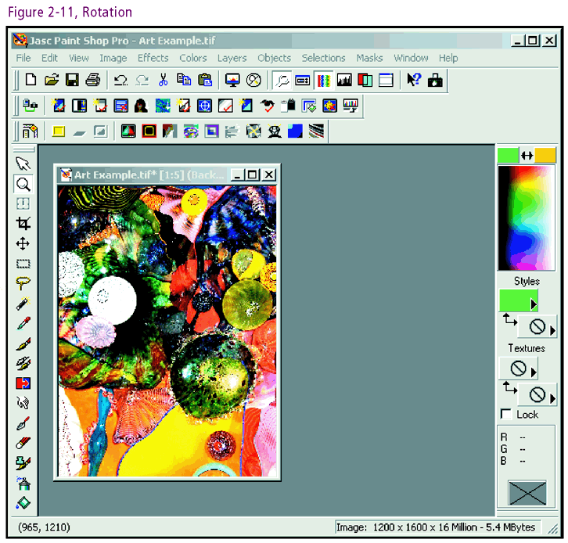

Slide 31
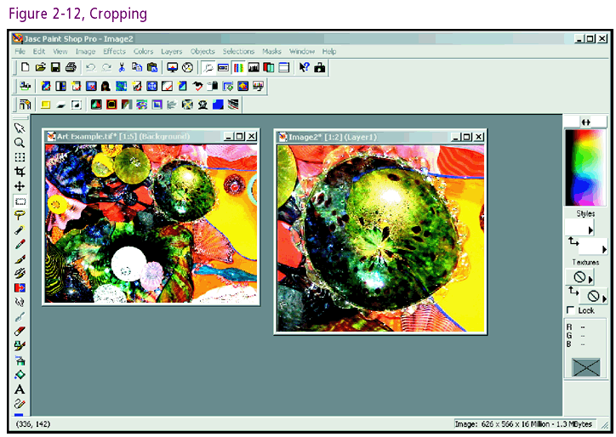

Slide 32
Working with Graphics (continued)
Economic classes of graphics tools
  Proprietary: for sale
  Freeware: absolutely free
  Shareware: initial free trial use followed up with fee
Popular graphics tools
  Macromedia Fireworks
  JASC Paint Shop Pro
  Adobe Photoshop

Slide 33
Diagramming Tools
Diagramming software: tool that creates diagrams analogous to builder’s blueprint
Flowcharts
  Geometric symbols that model program flow
  Roadmap for system development
UML (Universal Modeling Language) diagrams
  Represent object-oriented systems and designs
Comprehensive tool: Microsoft Visio
  Produces flowcharts plus a number of other diagrams such as organizational hierarchies, graphs, and maps

Slide 34
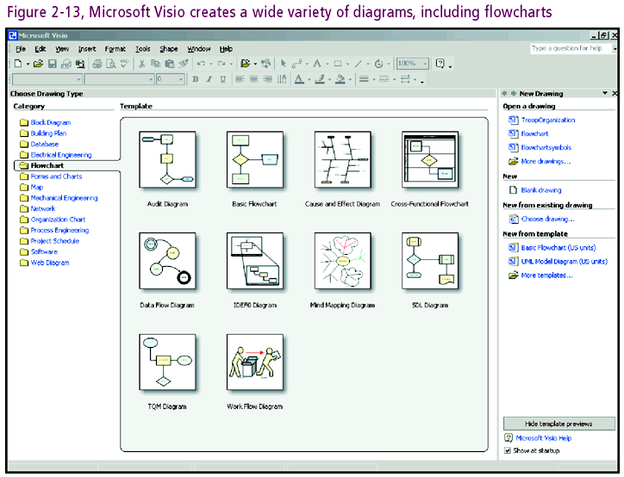

Slide 35
Integrated Development Environments
Integrated Development Environment (IDE): single user interface incorporating programming tools such as
  text editor
  compiler
  debugger
Product choice dependent on features needed, developer language used, and cost

Slide 36
Database Tools
Definition of terms
  Database: data warehouse comprised of tables
  Table: data organized by rows and columns
  Row: represents a record of information
  Column: represents a field within a record
Database purpose: facilitate information collection and sharing
Chief tool: database management system (DBMS)
  Stores, extracts, organizes, and maintains data

Slide 37
Database Tools
Variety of database formats
  Oracle (with or without Toad support)
  SQL server
  Microsoft Access
  MySQL
Criteria for product selection
  Purchasing entity: corporation? small business? individual?
  Cost
  Features

Slide 38
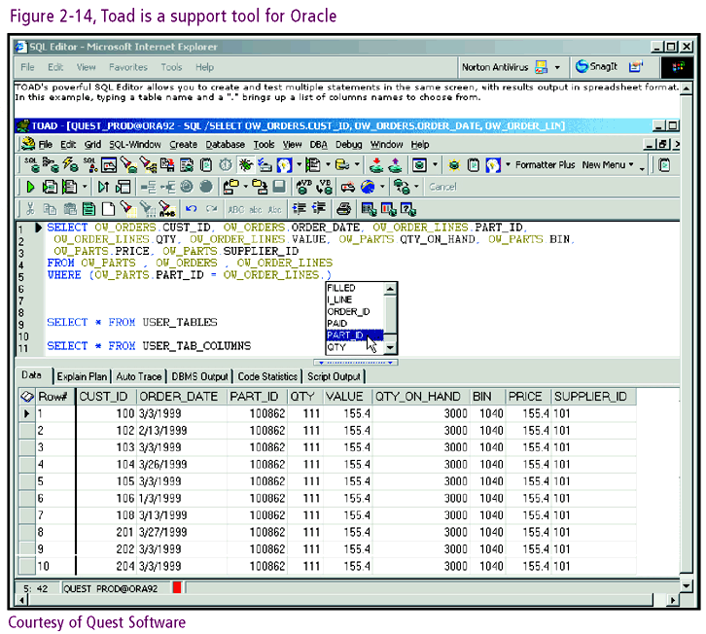

Slide 39
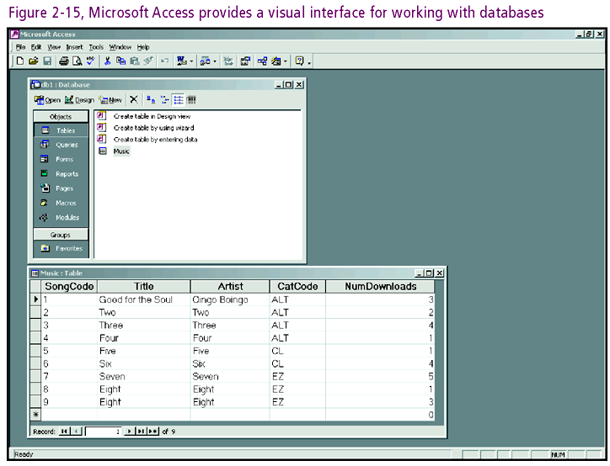

Slide 40
Technical Support Tools
Example tool: pcAnywhere
  Affords control of PC at remote location via Internet
  Activities on remote PC simulcast on controlling PC
  Requires software installation at both sites
Technicians greatly empowered with tools such as pcAnywhere

Slide 41
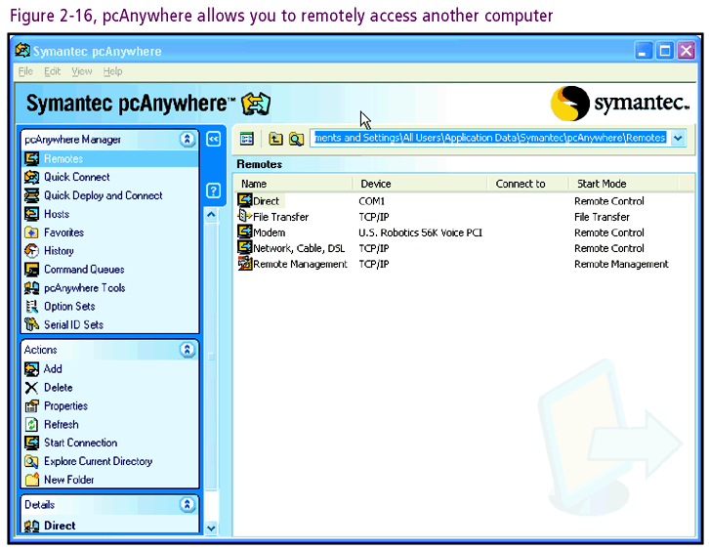

Slide 42
Internet Tools
Areas impacted by the Internet (aka the Net)
  Research
  Communication
  Commerce
Internet tools
  Browsers
  E-mail software
  File transfer software
  Remote access software

Slide 43
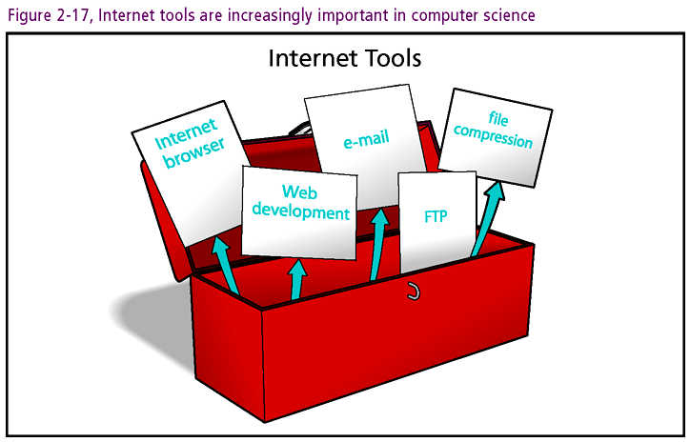

Slide 44
Web Browsers
Browser: Internet interface program
  Retrieves and displays Web pages and other files
  Provides user with visual friendly environment
Popular browsers
  Microsoft Internet Explorer
  Netscape Navigator
  Mozilla
  Mosaic
  Lynx
  Opera

Slide 45
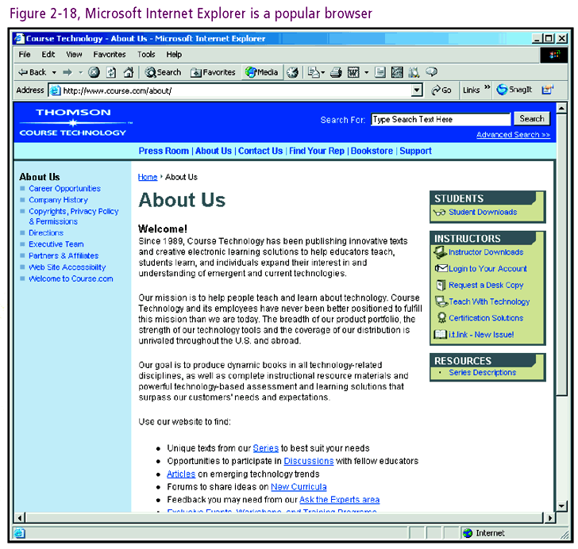

Slide 46
E-mail Tools
E-mail: communication format that leverages the Internet for delivery of electronic post
E-mail benefits
  Global reach at the “touch of a button”
  Speedy and low cost transmission
Common tools
  Microsoft Outlook or Outlook Express
  Netscape Navigator
  Novell GroupWise
  ELM
  Pine

Slide 47
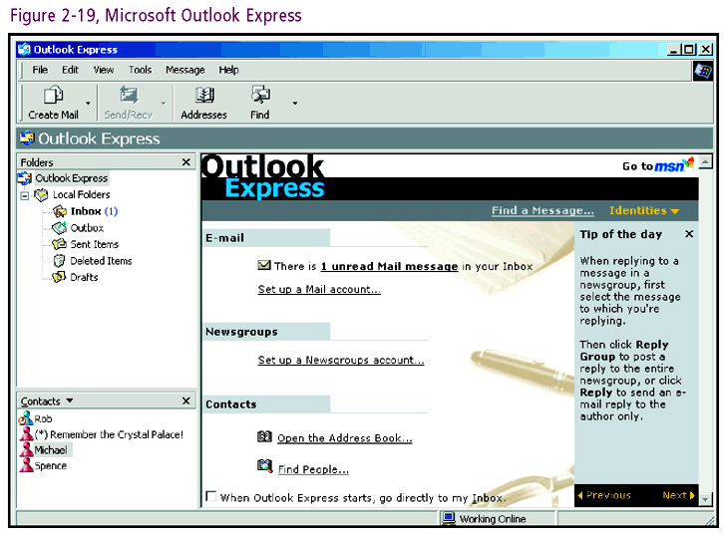

Slide 48
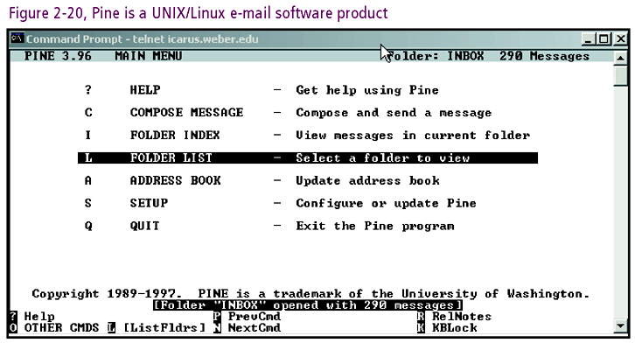

Slide 49
Compressing Files
Data compression: technique used to reduce size and transmission speed of a file
Decompression: restores compressed file to original format
Compression formats
  Have deep mathematical foundations
  Come in wide variety such as .zip, .tar, .lzh
Popular compression tool: WinZip

Slide 50
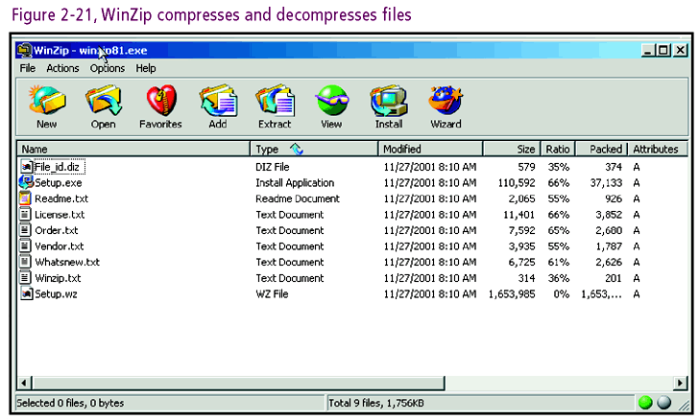

Slide 51
File Transfer Tools
File Transfer Protocol (FTP): system used to transmit files across the Internet
  Provides common location called (FTP) site for storage and retrieval
  FTP site defined and accessed by FTP address
  FTP sites possess electronic security gates
Purpose: provide more complex and secure communication structure than e-mail
Many tools available such as WS_FTP Pro

Slide 52
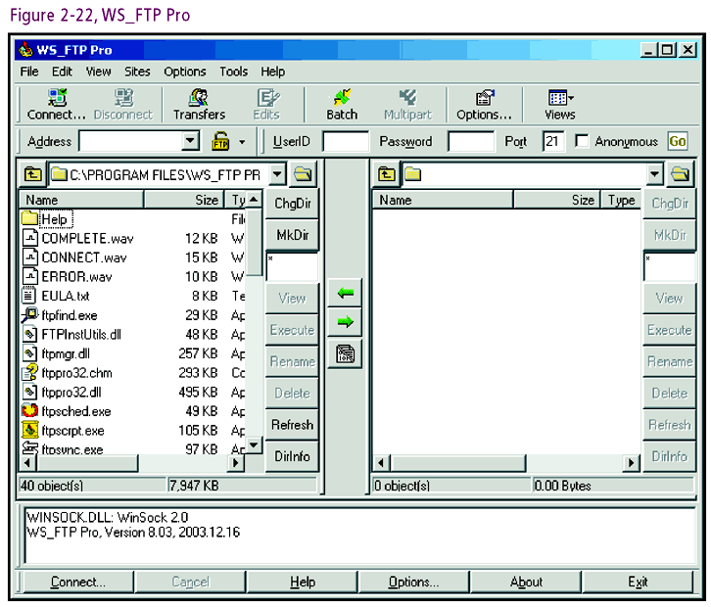

Slide 53
Web Development Tools
Definition: help create and maintain Web sites
Various products
  Adobe GoLive
  Macromedia Dreamweaver MX
  Microsoft FrontPage
Selection criteria
  Cost
  Ease of use
  Level of expertise
  Professional need

Slide 54
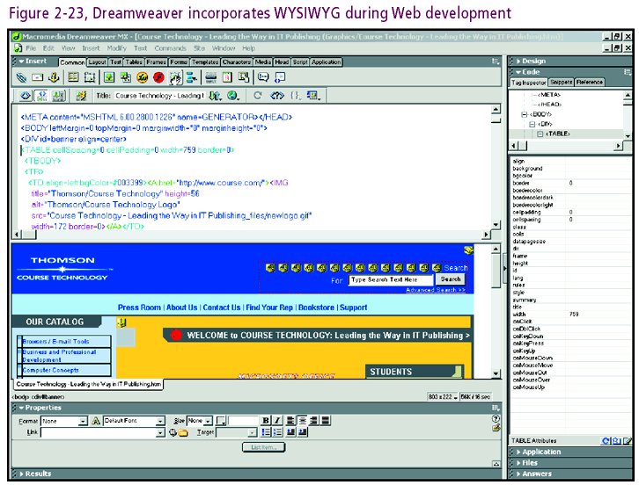

Slide 55
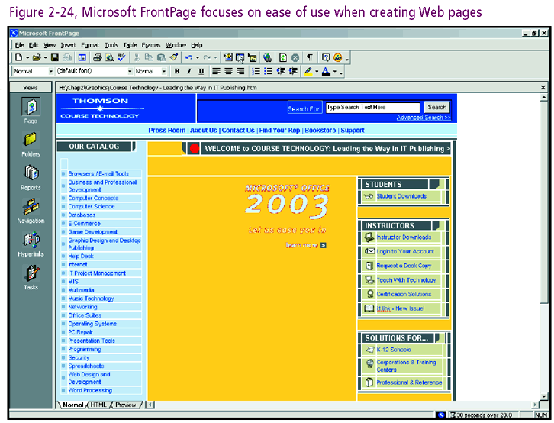

Slide 56
Extra Web Tools
Extra Web tools: enhance Web site appearance
Popular product: Macromedia Flash MX
  Provides animation and interactivity
  Helps distinguish a site from the commonplace
Web developer goals
  Drive traffic to site
  Induce visitors to return

Slide 57
One Last Thought
Using is believing
  Experiment with the various tools available
  Discover pros and cons for yourself
Construct an inventory matching tool to task
Sustain marketability with dynamic toolkit

Slide 58
Summary
Computer scientists interested in career development need a well stocked software toolbox
Specific tools are fitted to specific tasks
There are three broad task categories
  Office
  Programming
  Web or Internet

Slide 59
Summary (continued)
A variety of tools exist for each task
Generic tool selection criteria
  Need
  Cost
  Level of expertise
  Ease of use
  Testimonials
The development of tool and task knowledge is an ongoing process

