Slide 1
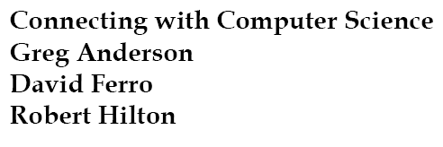
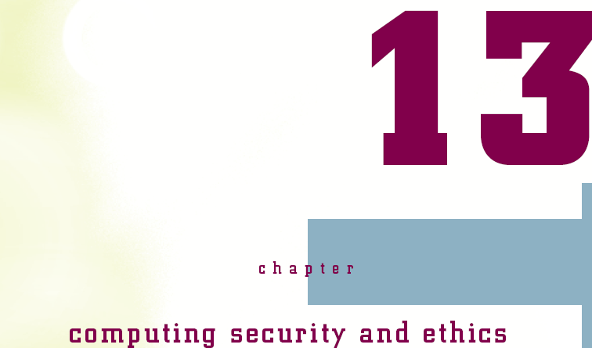

Slide 2
Objectives
Learn about the origins about computer hacking
Learn about some of the motivations for hackers and crackers
Learn about technologies that system intruders use
Learn about malicious code
Learn what social engineering is and how it works
Connecting with Computer Science
Notes:
Hacker: a person who uses computers to gain unauthorized access to data.
Cracker: người ăn trộm

Slide 3
Objectives (continued)
Learn how security experts categorize types of system attacks
Learn about physical and technical safeguards
Learn how to select a good password
Learn about antivirus software
Learn about encryption
Connecting with Computer Science

Slide 4
Objectives (continued)
Learn about preventive system setup, including firewalls and routers
Learn about laws to protect intellectual property and prosecute cracking
Learn about ethical behavior in computing
Learn about privacy in computing and ways to assure it
Connecting with Computer Science
Notes:
Prosecute: Khởi tố

Slide 5
The Intruder
A hacker is a technically proficient individual who breaks into a computer system
  Originally connoted good intent, but usage today is similar to cracker
  A cracker is an unwelcome system intruder with malicious intent
  A script kiddie is an amateur hacker that simply uses the hacking tools developed by others
Connecting with Computer Science
Notes:
Connoted: có nghĩa
A script kiddie : kịch bản nhỏ

Slide 6
The Intruder (continued)
Two types of intentional intruders
  An undirected hacker is motivated by the challenge of breaking into a system
  A directed hacker is motivated by greed and/or politics
Hacktivism is cracking into a system as a political act
  The Hacker’s Manifesto is an anonymous document that justifies cracking into systems as an ethical exercise
Connecting with Computer Science
Notes:
Hackers: tin tặc
Cracker: kẻ ăn trộm

Slide 7
How Do They Get In?
Holes in the system
  System configuration, programming, security
Malicious software programs (viruses)
Social engineering
  Taking advantage of the innocent human tendency to be helpful
  One of the most effective tools for hackers
Connecting with Computer Science

Slide 8
Holes in the System
Open nature of the Internet and networks
  Remote access, mounting drives on other machines
Backdoors
  Shortcuts into programs created by system designers
Sloppy programming
  Leaving sensitive information in a URL string
Buffer overflow
  Placing more information into a memory location than that location can handle
Connecting with Computer Science
Notes:
Mounting: gắn
Sloppy programming: Lập trình cẩu thả

Slide 9
Viruses, Worms, and
Other Nasty Things
Malicious code is designed to breach system security and threaten digital information
Viruses are uninvited guest programs on your computer with the potential to damage files and the operating system
  A virus may be silent for awhile
  Users who share files can transmit a virus
  E-mail attachments can host a virus when the attachment is opened
Connecting with Computer Science

Slide 10
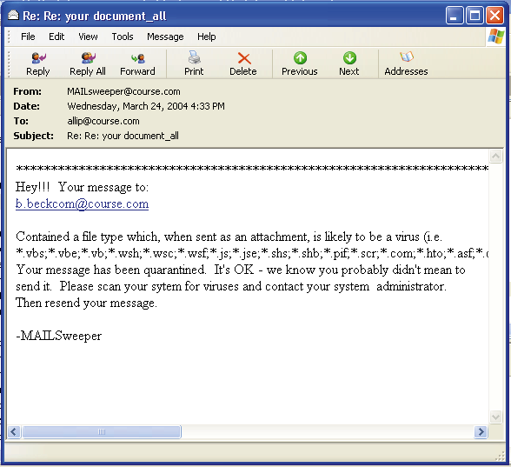
Figure 13-1
A typical virus e-mail warning
Connecting with Computer Science

Slide 11
Viruses, Worms, and Other Nasty Things (continued)
A worm is a bot that actively reproduces itself across a network
  A bot is a program that can roam the Internet anonymously
    Bots can be quite useful
A Trojan horse is a program that poses as an innocent program
  Some action or the passage of time triggers the program to do its dirty work
Connecting with Computer Science

Slide 12
The Human Factor-Social Engineering
Preys on human gullibility, sympathy, or fear to take advantage of the target - basically, a con
  Posing as an insider at a company
  Dumpster diving
  Browsing a company Web site for intranet information
  Using cracker techniques
  Sending spam
Connecting with Computer Science
Notes:
Gullibility: khờ dại
Sympathy: Cảm thông, trắc ẩn
Con: điều khiển
Dumpster: bãi rác

Slide 13
Types of Attacks
Access attacks include snooping, eavesdropping, and interception
  Snooping may involve browsing a person’s files
  Eavesdropping may use a sniffer program to allow the user to listen in on the traffic of a network
  Intercepting determines whether the information continues on to its intended receiver
Modification attacks modify information illicitly
Connecting with Computer Science
Notes:
Snooping: Lấy trộm
Eavesdropping: Nghe trộm
Intercept: Ngăn chặn

Slide 14
Types of Attacks (continued)
Denial-of-service attacks deny legitimate users from using the system or access to information
  Usually pure vandalism
Repudiation attacks injure the reliability of the information by creating a false impression about an event
  Sending an e-mail to someone as if it it was from someone else
Connecting with Computer Science

Slide 15
Managing Security:
The Threat Matrix
Risk is the relationship between vulnerability and threat
  Managed risk is the basis of security
Vulnerability is the sensitivity of the information and the skill level needed by the attacker to threaten that information
  i.e., open ports, Internet connections
A threat is characterized by targets, agents, and events
Connecting with Computer Science

Slide 16
Threats: Targets and Events
Confidentiality ensures that only those authorized to access information can do so
  Encryption is often used with a high level of confidentiality
    Transforms original text into coded or encrypted data
Integrity assures that information is correct
  Digital certificates, encryption
Connecting with Computer Science

Slide 17
Threats: Targets and Events (continued)
Availability involves making information and services accessible on a normal basis
  Backup copies, disaster recovery plans
Accountability makes sure that a system is as secure as feasible, and that there is a record of activities for reconstructing a break
  Identification is knowing who someone is
  Authentication is verifying that someone is who they claim to be
Connecting with Computer Science

Slide 18
Measuring Total Risk
Risk can be measured in terms of cost
Risk is difficult to calculate until the event occurs in many cases
  Time the event might take to fix if a key system is down
  Physical resources that need to be brought to bear
  Damage to the organization’s reputation
  Opportunity cost of lost business during the crisis
Connecting with Computer Science

Slide 19
Managing Security: Countermeasures
Have a security policy
Have physical safeguards
  For computers, trash, visitors, etc.
Use passwords to protect everything
  Startup, e-mail, router, phone, PDA, screen saver
Destroy old copies of sensitive material
  Shredder, overwriting, software degausser
Back up everything of value
  Generations of backups for important files
Connecting with Computer Science
Notes:
Shredder: máy hủy tài liệu

Slide 20
Managing Security: Countermeasures (continued)
Protect against system failure
  Surge protector, uninterruptible power supply
Create an Acceptable Use Policy (AUP) for your company
  Defines who can use company computers and networks, when, and how
  Options: callbacks, virtual private networks
Protect against viruses
  Antivirus, antispam, and anticookie software
Connecting with Computer Science
Notes:
Surge:

Slide 21
Managing Security: Countermeasures (continued)
Have a disaster recovery plan (DRP)
  Written plan for responding to natural or other disasters
  Intended to minimize downtime and damage to systems and data
  May require off-site storage, alternative communication technologies, and end-user communication parameters
Connecting with Computer Science

Slide 22
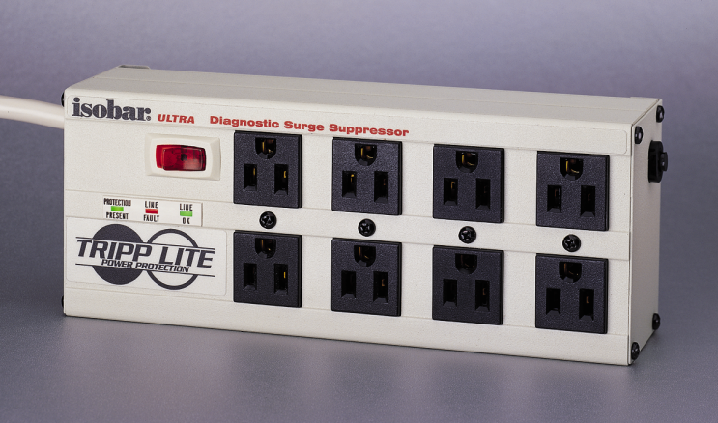
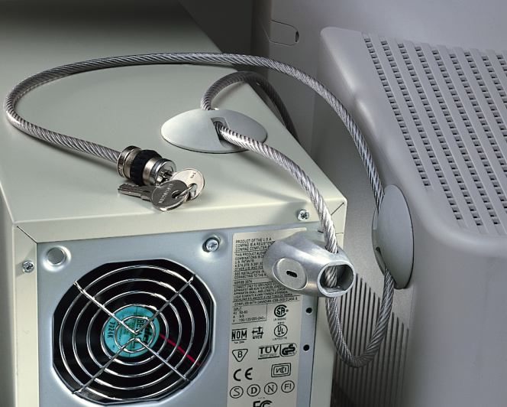
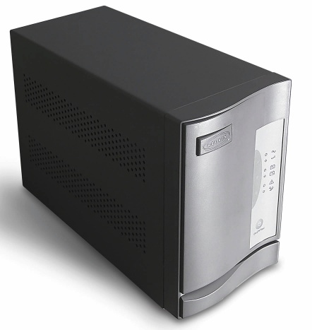
Figure 13-2
Three technologies that help back up your system. From left to right: surge suppressor, UPS, and physical locks
Connecting with Computer Science
Notes:
surge suppressor: Bộ giảm áp
UPS: uninterruptible power supply

Slide 23
Passwords
Good passwords should
  Be at least eight characters
  Have no real words
  Include as many different characters as possible
Because of problems with secure passwords, many companies use a combination of
  something you know (like a password)
  something you have (like an ID)
  Something you are (using biometrics)
Connecting with Computer Science

Slide 24
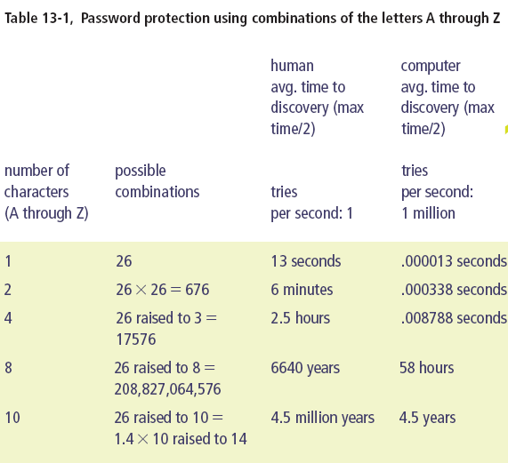
Connecting with Computer Science

Slide 25
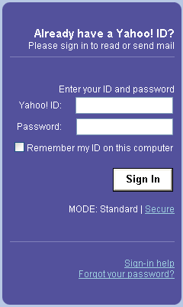
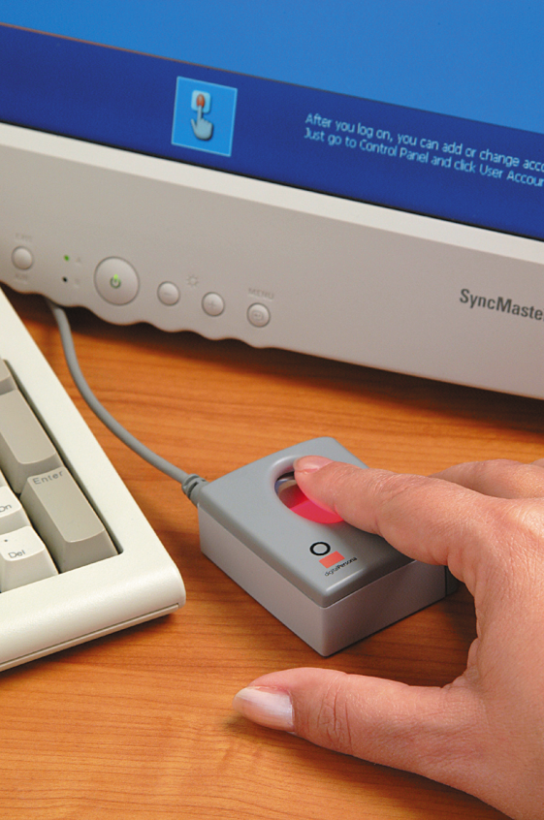
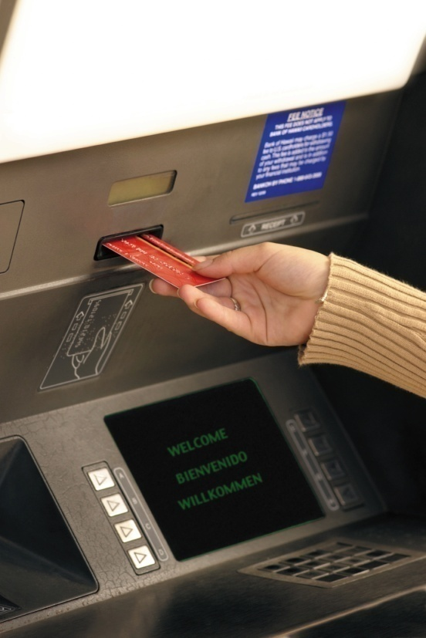
Figure 13-3
Three potentially combined authentication methods. From left to right: what you know, what you have, what you are
Connecting with Computer Science

Slide 26
Antivirus Software
Program designed to detect, block, and deal with computer viruses
  Virus signature: bits of code that uniquely identify a particular virus
  Honeypot: a trap laid by a system administrator to catch and track numbers
  Heuristics: a set of rules that predict how a virus might act
  Checksum: mathematical means to check the content of a file or value
Connecting with Computer Science
Notes:
Honeypot:hũ mật ong

Slide 27
Using Encryption to Secure Transmissions and Data
Encryption uses an encryption key to scramble a transmission so only the receiver with the appropriate decoding key can read it
  The longer the key, the more secure the encryption (128-bit encryption used for online banking)
Web pages use S-HTTP, SET, or SSL to send secure transactions
  S-HTTP and SSL use digital certificates
    A certifying authority encrypts and verifies user information
Connecting with Computer Science
Notes:
scramble a transmission : Tráo đổi sự truyền

Slide 28
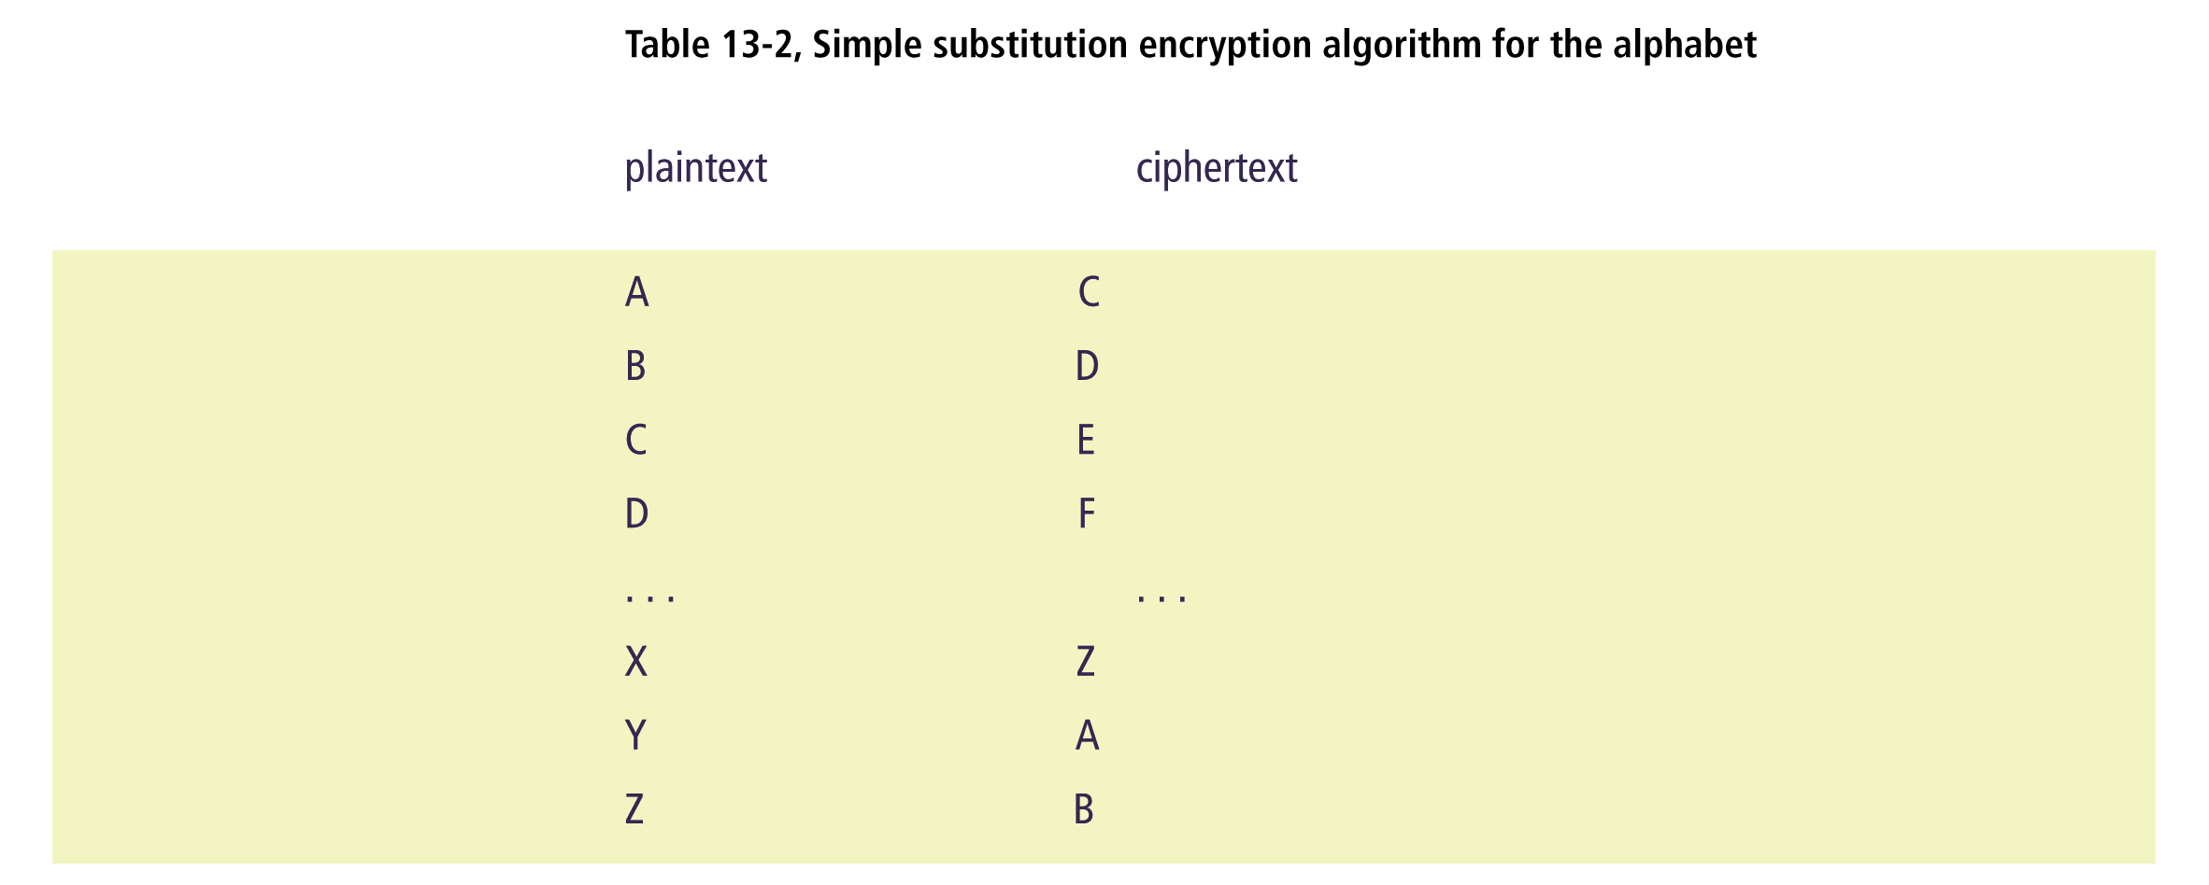
Connecting with Computer Science
Notes:
Substitution: Thay thế

Slide 29
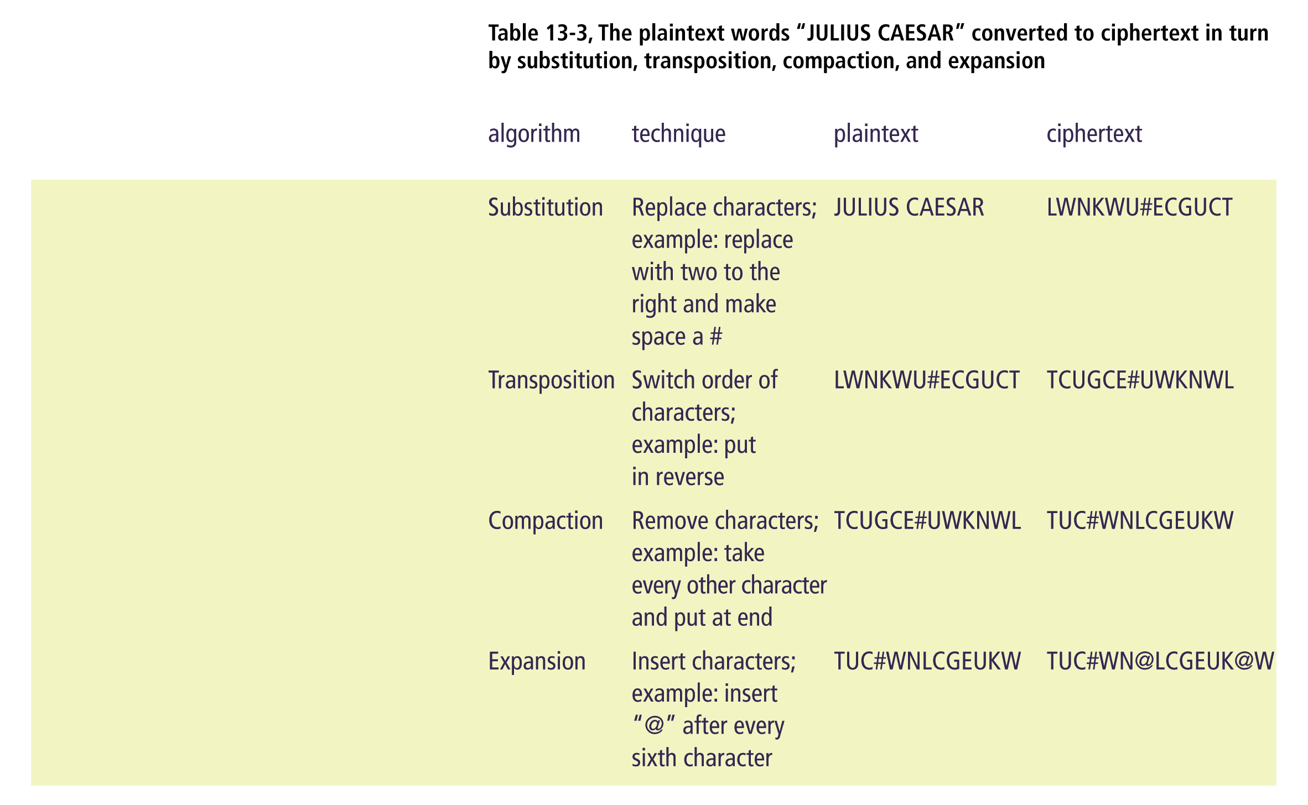
Connecting with Computer Science

Slide 30
More About Encryption
Encryption standards used today are key-based standards
Symmetric encryption uses a private key to both encrypt and decrypt
Asymmetric encryption uses both a public key and a private key
  Often used to avoid the difficulty with keeping both private keys secret
Connecting with Computer Science

Slide 31
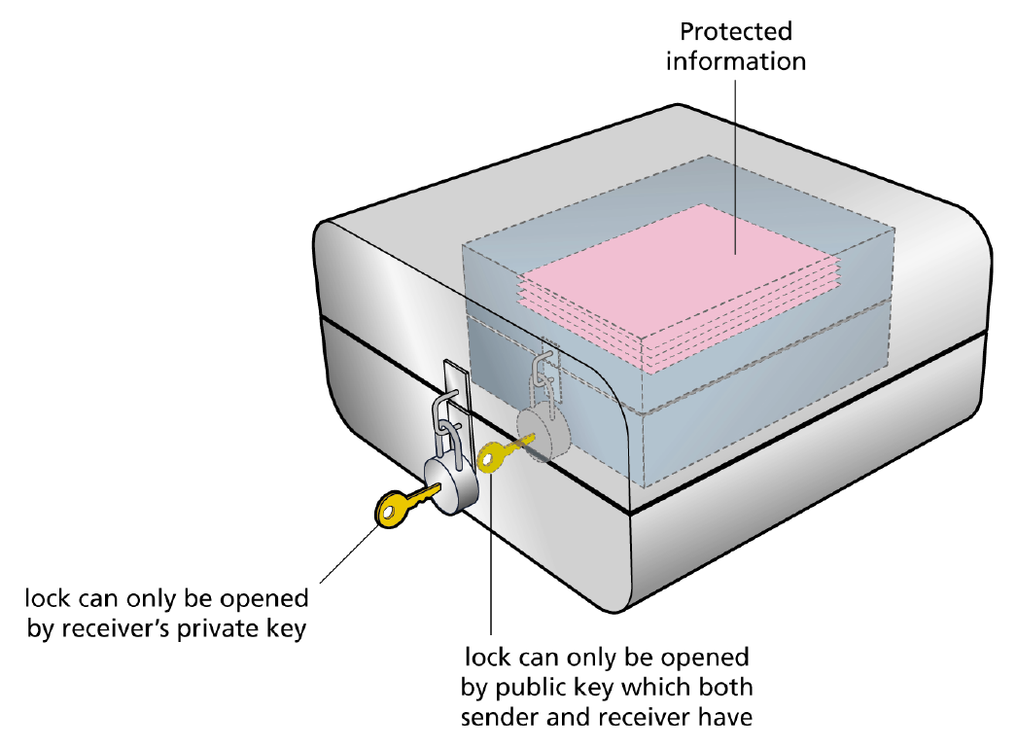
Figure 13-4
Using a public and private key (asymmetric encryption)
Connecting with Computer Science

Slide 32
Securing Systems with Firewalls
A firewall is software or hardware that acts as a protective filter between an internal computer system and an external network such as the Internet
  Only allows authorized entrants
  A proxy firewall establishes a new link between each packet of information and its destination
  A packet-filtering firewall inspects each packet and moves it along an established link
    Faster but less secure than a proxy firewall
Connecting with Computer Science

Slide 33
Protecting a System with Routers
Filtering software in a router can be a front line of defense against certain service requests
  Closes ports that are not allowed
  Determines where servers are to be located on the network
  Determines what services are offered outside a firewall
    Internal and external DNS servers
Connecting with Computer Science

Slide 34
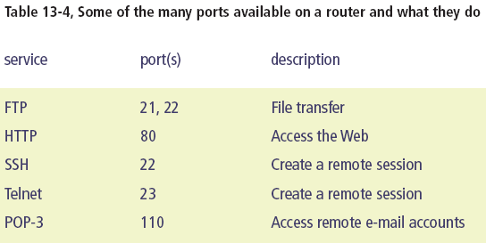
Connecting with Computer Science

Slide 35
The DMZ
A location outside the firewalls (or between firewalls) that is more vulnerable to attack from outside
  Separates services offered internally from those offered externally
Is protected by
  Filters on the router
  Only allowing each server a particular service
  Another firewall on the other side of the firewall
Connecting with Computer Science

Slide 36
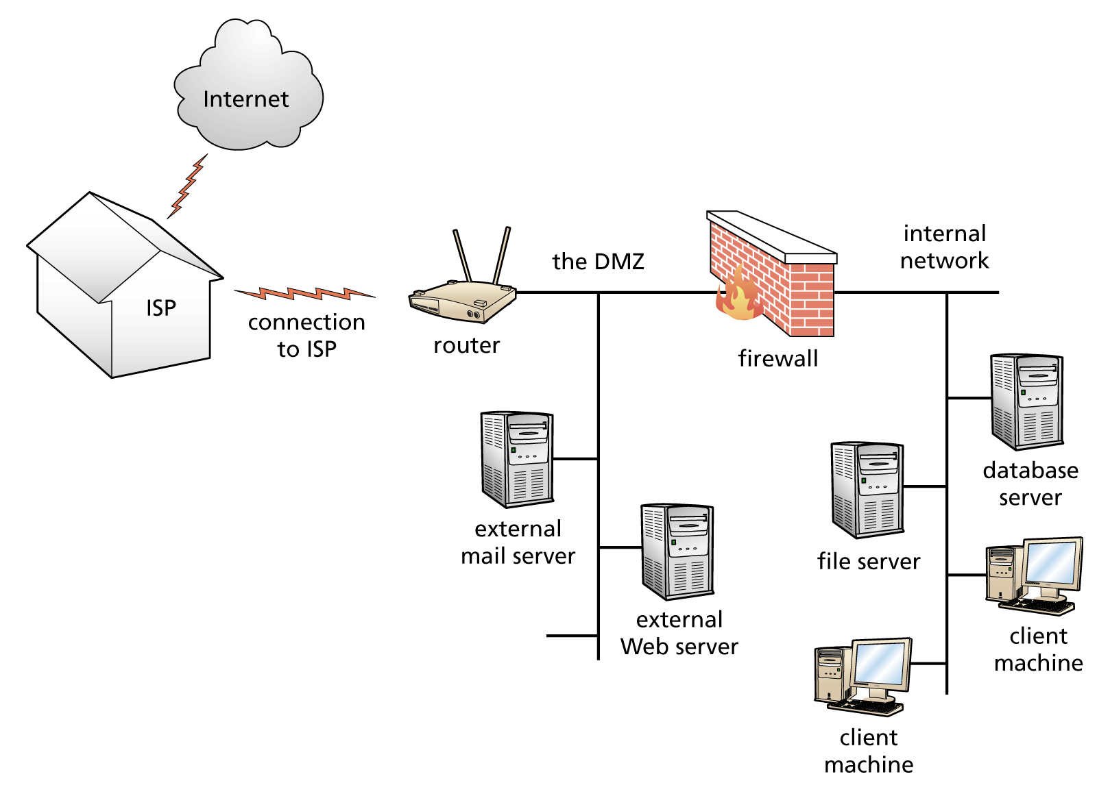
Figure 13-5
System configuration of a network that
includes a firewall, a DMZ, and a router
Connecting with Computer Science
Notes:
DMZ: demilitarized zone Vùng phi quân sự

Slide 37
Protecting Systems with
Machine Addressing
Organizations usually have more machines than they have IP addresses
  Handled by dynamically allocating IP addresses
Organizations also use private class addressing
  Nodes on the internal network have a different address than what is seen on the outside
  Network Address Translation (NAT): conversion of internal to external IP addresses (and vice versa)
    Usually provided by the firewall
Connecting with Computer Science

Slide 38
Putting It All Together
A comprehensive security plan includes
  Firewalls and antivirus software
  Restricting physical access to buildings and hardware
  Reminders and training about security dangers
  Security policy
  Continual updates and patches
  Appropriate access controls
Connecting with Computer Science

Slide 39
Computer Crime
Intellectual property protections
  Copyright
    Protects the expression of the idea - not the idea itself
  Patent
    Government grant giving the sole right to make, use, and sell an invention for a specified period of time
  Trade secrets
    Methods, formulas, or devices that give companies competitive advantage and are kept secret
Connecting with Computer Science
Notes:
Sole: duy nhất
Trade secrets: Bí mật thương mại

Slide 40
Prosecuting Computer Crime
The United State has a number of laws designed to protect against computer crime
  Laws differ widely (both in the U.S. and in other countries) and are open to interpretation
Prosecuting a computer crime is complex
  Systems must be replicated entirely or put out of use
  Perpetrators are very difficult to find
Connecting with Computer Science
Notes:
Perpetrator: kẻ phạm tội
Prosecuting: Truy tố

Slide 41
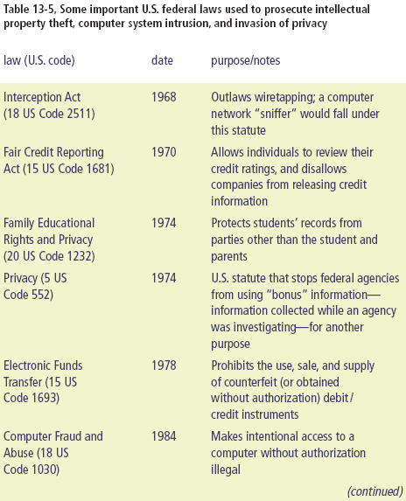
Connecting with Computer Science
Notes:
intellectual property: Sở hữu trí tuệ
Statute: Đạo luật
Wiretapping: Nghe lén
credit reporting: báo cáo tín dụng
Counterfeit: Giả mạo

Slide 42
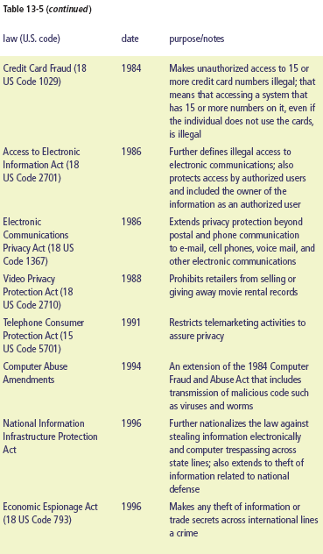
Connecting with Computer Science
Notes:
Fraud: Gian lận
Telemarketing: Tiếp thị qua điện thoại
Trespassing: Xâm phạm
Espionage: Gián điệp

Slide 43
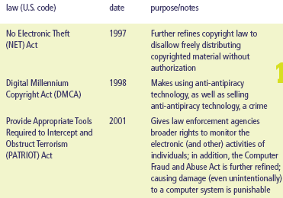
Table 13-5 (continued)
Connecting with Computer Science
Notes:
Obstruct: ngăn trở
Millennium: Ngàn năm

Slide 44
I Fought the Law and the Law Won
Increasing numbers of crackers are being caught and persecuted
Corporations are willing to pursue copyright violations much more aggressively
Legal ways to use software today
  Purchase the right to use a copy with an EULA agreement
  Purchase time on a program and connect to it through a network
Connecting with Computer Science
Notes:
Persecuted: hành hạ
Persue: Truy nã
EULA: End User Legal Agreement

Slide 45
Ethics in Computing
Ethics are principles for judging right and wrong, held by an individual or group
Ethical systems (along with laws) help create a stable platform from which to live life comfortably with other people and benefit all
Organization of computer professionals have outlined ethical standards or codes of ethics (IEEE, ACM, Computer Ethics Institute, etc.)
Connecting with Computer Science

Slide 46
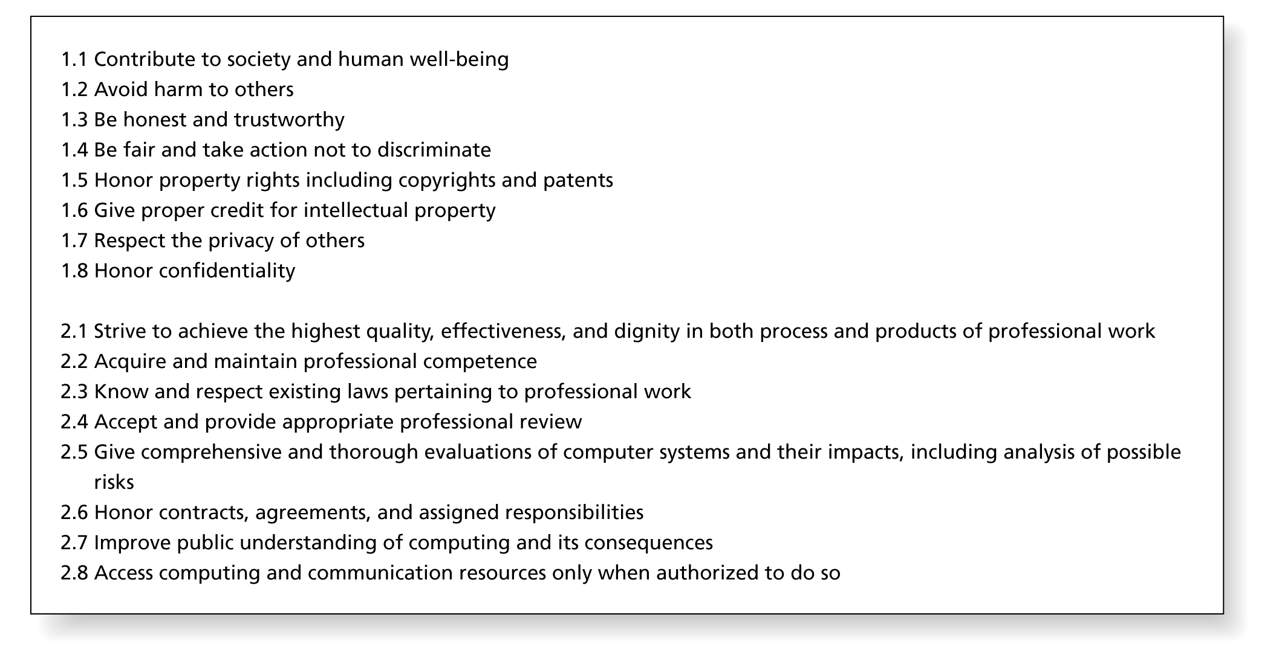
Figure 13-6
An excerpt from the Association for Computing Machinery (ACM) “Code of Ethics and Professional Conduct”
Connecting with Computer Science
Notes:
Dignity: phẩm giá
Strive: Phấn đấu
Trustworthy: Tin cậy

Slide 47
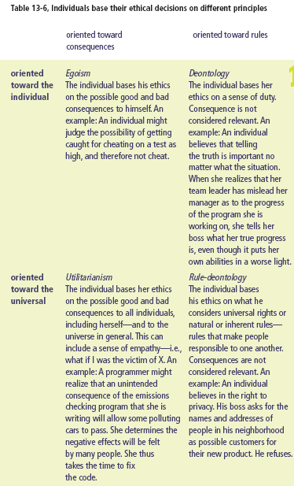
Connecting with Computer Science

Slide 48
Ethical Issues
Software piracy: illegal copying of software
Viruses and virus hoaxes (phony virus warning)
Weak passwords
Plagiarism
Cracking or hacking
Health issues
  Designers should be aware of the ergonomics of how the interface will be used
Connecting with Computer Science
Notes:
Hoax: đánh lừa, a humorous or malicious deception.Lừa gạt
Phony: Giả mạo
Plagiarism: Đạo văn
Ergonomics: usable

Slide 49
Privacy
The Internet and computerized databases have made invasion of privacy much easier
  Spam: unsolicited (and almost always unwanted) e-mail
  Spyware: software that can track, collect, and transmit to a third party or Web site certain information about a user’s computer habits
  Cookies: programs that can gather information about a user and store it on the user’s machine
Connecting with Computer Science
Notes:
Spam: irrelevant or inappropriate messages sent on the Internet to a large number of recipients.
Unsolicited: Không yêu cầu

Slide 50
One Last Thought
Operators of computer systems must realize that they are not just individually vulnerable; they are part of an overall vulnerability
Steps to reduce vulnerability
  Install and update antivirus software, firewalls, and operating system patches
  Guard against communicating information
  Reassess balance between ease of use, customer, time and cost on one hand, and system security on the other
Connecting with Computer Science

Slide 51
Summary
Security is more than the hunt for intruders
“hacking” and “hacker” did not originally have the negative connotation that they do today
Intruders can be classified as directed or undirected
Crackers find holes in systems put there intentionally or unintentionally by system administrators and programmers
Connecting with Computer Science
Notes:
Connotation: ý nghĩa

Slide 52
Summary (continued)
Viruses, worms, and Trojan horses are programs that crackers use to infiltrate system
Social engineering - human (not technological) manipulation - one of the the greatest risks to a company and its computers
Types of attacks on computer systems: access, modification, denial of service, and repudiation
Total risk to an organization is made up of vulnerability, threat, and existing countermeasures
Connecting with Computer Science
Notes:
to infiltrate : Thâm nhập
Repudiation: Chối bỏ, phủ nhận

Slide 53
Summary (continued)
Intruders target the confidentiality, integrity, availability, or accountability of information
Many countermeasures in managing security
Install antivirus software, perform system updates, physically restrict access to your computers, and have a good backup system
Users support cracking by using weak passwords
Authentication and identification are different
Connecting with Computer Science

Slide 54
Summary (continued)
Encrypt information to secure communications
Use firewalls and routers
Difficult to prosecute computer attackers
Some issues in computing that can be viewed from an ethical perspective: software piracy, virus propagation, plagiarism, breaking into computers, and doing harm to people through computers
Connecting with Computer Science
Notes:
Piracy: ăn cướp
Propagation: lan truyền
Prosecute: truy tố

Slide 55
Summary (continued)
Privacy is protected by law, but employees have fewer rights to privacy while on the job
Many things you can do to protect your privacy
  Only give out personal information when you must
Computer and network security is everyone’s responsibility
Connecting with Computer Science

