Slide 1

Penn State University
College of Education
Understanding College of Education Resources

Slide 2
Welcome
We hope you will find this reference guide useful for accessing information or resolving technical challenges that you may experience during your stay in the College of Education. This guide covers information for Windows, Mac and Mobile computers and devices.

Slide 3
The Carrara Education Technology Center
The mission of the Carrara Education Technology Center (CETC) is to provide outstanding technical consultation, support, and training to faculty, staff and graduate students in the College of Education.
We are located in 233 Chambers Building
If you need technical assistance we recommend submitting a ticket at help.educ.psu.edu (this is the best way to reach us)
Our Helpdesk phone is 814-865-0626

Slide 4
What is the Penn State Password?
Penn State provides access to your userID and password via a “Signature Station”. This account goes by various names but all mean the same thing (Access Account, PSU Password, Penn State Account, Fingerprint) If you forget your password, you must visit one of these stations to reset it. You will need PhotoID.
  103 Boucke Building
  204 Wagner Building (ITS Help Desk and Accounts Services Office)
  6 Findlay Commons
  W113 Pattee Library (Recommended)
  201 Pollock Library
  112 Shields Building Lobby area (2 Kiosks)
  107 Waring Commons
  108 Warnock Commons
  2 Willard Building
  168 Physical Plant Building (8:00 a.m. - 4:00 p.m. access, Monday through Friday)

Slide 5
What is the College of Education Password?
Once your Penn State Access Account is set up the College of Education provides an additional password to access College resources.
The College of Education account is used to log on to computer systems and resources in College of Education.
You will be promted to refresh your password every 120 days. If you forget your password, you can call our CETC Helpdesk at 814-865-0626 or come to 233 Chambers building.

Slide 6
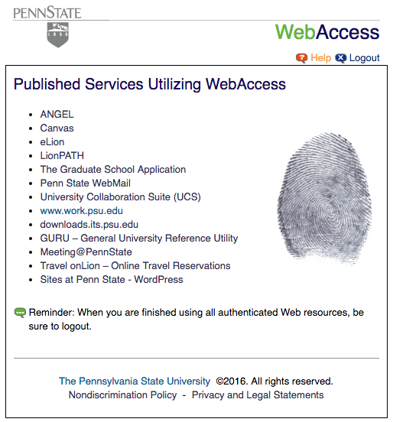
What is the difference between the Penn State Access Password and the College of Education Password?
The PSU password is Penn State’s Full Access Account Password; this password is used for the following (not all instances may apply to all users):
Angel (canvas.psu.edu)
Penn State E-mail Services (WebMail, UCS, POP, IMAP)
Box (box.psu.edu)
Personal web (sites.psu.edu)
Personal Portal (work.psu.edu)
VPN (Cisco AnyConnect)
Penn State (PSU) wireless
Penn State WebAccess (finger print) for Web-based services that require authentication with a Penn State Access Account user ID and password.

Slide 7
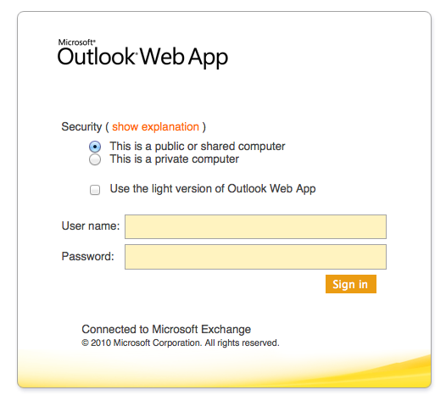
What is the difference between the Penn State Access Password and the College of Education Password?
The College of Education (ED) password is used strictly for systems and resources in the College; this password is used for the following (not all instances may apply to all users):
Logging into any College of Education system, service, computer, or mobile device
Exchange E-mail Service (email.educ.psu.edu)
Nova (educ file share)
Help Desk (help.educ.psu.edu)

Slide 8
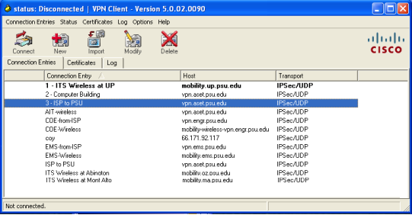
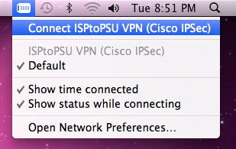
How and When Should I Use VPN?
The purpose for VPN is to establish a secure connection with Penn State from off campus using the "ISPtoPSU" connection. This would be used to connect to Penn State network-restricted resources (such as PASS and BOX) from off campus.
If you want access to your Education file share off campus you will need to connect to VPN, also if you are prompted to update your Education password while you’re off campus you will want to connect to VPN before changing your College of Education (ED) password.
CETC can install the VPN Client on any system and in most cases it is already installed on College owned systems and devices.
For Detailed instructions on how to set up VPN on your personal computer please consult the handout titled How and When should I Use VPN?

Slide 9
How do I access wifi on campus?
The College of Education offers wireless connectivity to the Internet and for access to some other PSU restricted resources (such as email, career services, some library resources). All faculty and staff are required to use the “PSU” SSID (Service Set Identifier)
Other buildings on campus also offer the same wireless connectivity.
See other PSU campus wireless locations at http://wireless.psu.edu/locations.html

Slide 10
How to get connected to Wireless@PennState
Wireless 2.0 Setup (aka 802.1x)
On campus please launch your wireless and choose the psuwirelesssetup connection.
The psuwirelesssetup connection will allow you to access only the information below and no other web sites. The information below can also be found by visiting
http://wireless.psu.edu
What Do I Need?
To get connected to the Penn State Wireless 2.0 service, you'll need:
Your Penn State Access Account
A laptop with an *802.11 compatible wireless network card.
* IEEE 802.1X is an IEEE Standard

Slide 11
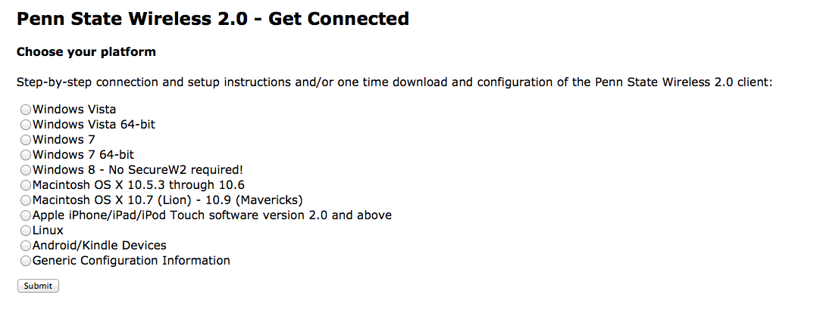
How to get connected to Wireless@PennState
Wireless 2.0 (aka 802.1x)
You must then install the Wireless 2.0 software, it's easy to get connected to Penn State
Wireless. All you have to do is select the type of operating system you are running from the list of options on the configuration page:
Once this is complete, select the psu wireless network from your wireless connection options on your computer. You will then be prompted to enter your Penn State Access Account UserID and Password, once that is complete the connection should be setup.

Slide 12

What is Box?
Box is a collaboration File Service at Penn State. Box offers secure, scalable, and user-friendly content sharing.
Much like Dropbox or Google Drive, but Box is Penn State’s in-house recommended and secured service which allows content to be stored online, so it can be accessed, managed, and shared from anywhere.
Access to Box is also available on mobile devices and can be seamlessly synced to your laptop or desktop computer.
Each user has unlimited file storage space and is secured by Web Access, To Access use your Penn State Access Account to login.
Go to: http://box.psu.edu/

Slide 13

What is IEM and Managed Software Center?
PC Updates IBM Endpoint Manager (BigFix) is a powerful, cross-platform systems management tool for deploying software to our Windows users.
Big Fix is also used for Penn States Sustainability initiative: We use Big Fix to and power management settings to both our Mac and Windows based systems.
The Managed Software Center: Provides our users with the the ability to install packages that are available within Managed Software Center. All College of Education distributed Macs have Managed Software Center available on the Launch bar. Requests for new software can be packaged and added by the CETC if need arises. This service can also be found by clicking on spotlight (Search: Top right menu) and typing “Managed”.

Slide 14

What is Identity Finder?
Why is this important?
This is an ongoing Penn State security initiative that will help to protect the user, the College, and the University, from Personally Identifiable Information (PII) breaches.
Scans will take place every 30 days and you will be required to take action when prompted, by Identity Finder (IDF), if anything is found during the scan.
You will have the option to:
  Scrub - Removes offending data from within documents and leave them otherwise fully intact. Identity Finder’s Scrub feature literally opens a file and replaces the sensitive data contained inside it with X’s.
  Shred - Permanently delete locations containing sensitive information, so thieves and viruses do not find any information that would cause a data breach.

Slide 15
SPIRON to Replace Identity Finder?
Why is this important?
Sometime in November, December 2016 or January 2017 the IDF console will change along with the look a feel of the software our clients use to remediate PII on their systems.
For example, we know our ongoing efforts have already resulted in eliminating PII which, if inappropriately disclosed, could have cost the University nearly $500K so an upgrade is required. We believe this represents just a small fraction of the PII that remains in various locations across campus.
Current security policies, scheduled scans, and requirements, to take action, will continue. Users are responsible for remediating any PII data.

Slide 16
Questions?
CETC Helpdesk (Ticketing System)
help.educ.psu.edu
CETC Helpdesk Phone:
814-865-0626
ITS @PSU
its.psu.edu

