Slide 1

Open-Sourcing Epidemiological Data
Nathan Levinzon
SOC 3673-090 Fall 2023

Slide 2

Philosophy of Open-Source
Freedom and Access:
Free as in Freedom: The term "free" in open source doesn't only refer to free-of-charge but, more importantly, to freedom. Users have the freedom to run, modify, and distribute the software as they see fit. This ethos emphasizes user empowerment and control over their computing environment.
Collaboration and Community:
Community Development
Meritocracy
Transparency:
Open Code
Public Discussions
Iterative Development:
Rapid Prototyping
Agile Practices
Licensing:
Open Source Licenses
Copyleft vs. Permissive
Innovation and Problem Solving:
Innovation through Collaboration
Shared Resources
Community Values:
Ethical Considerations
Social Impact

Slide 3
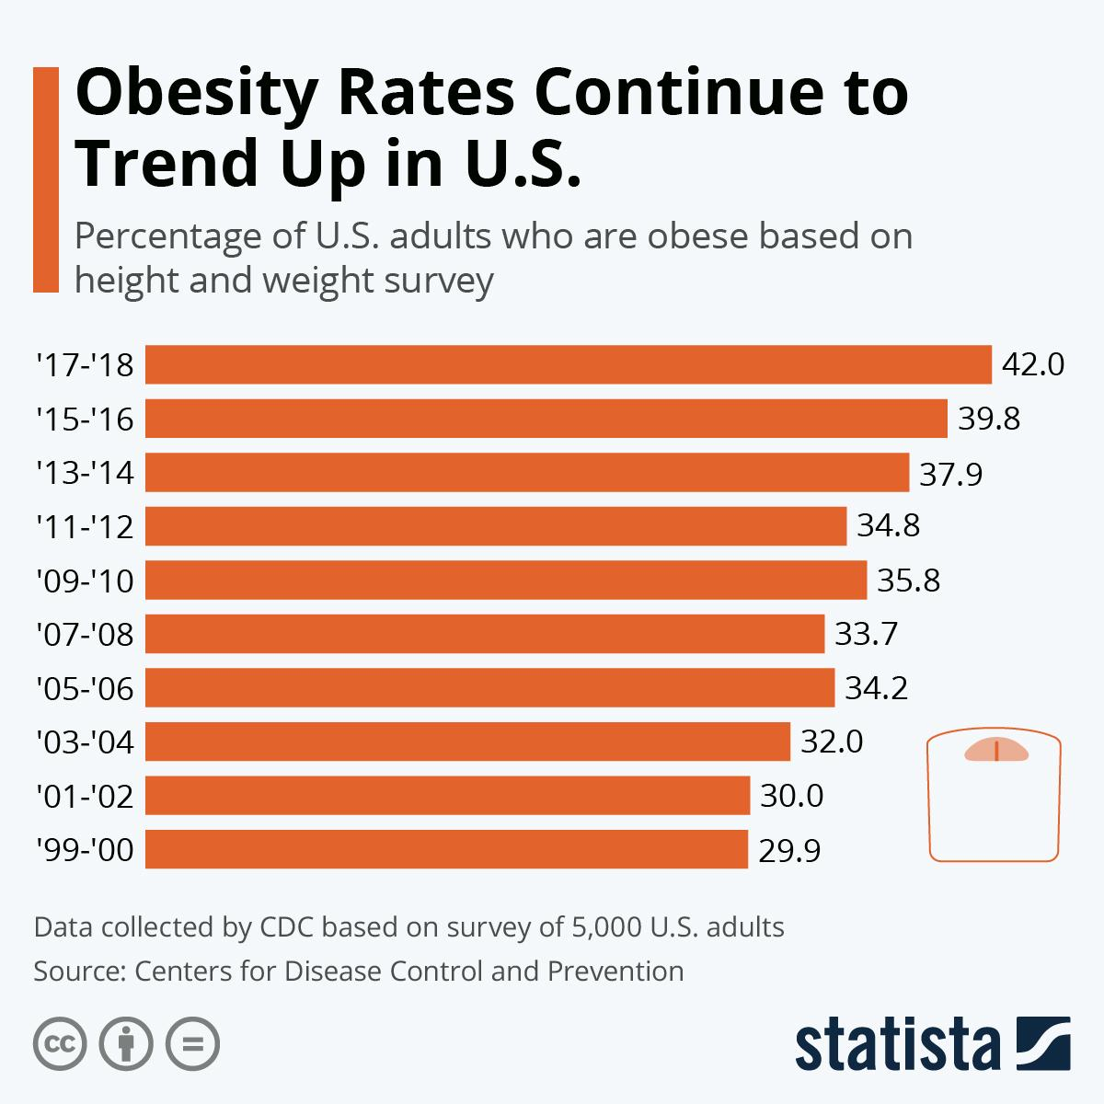
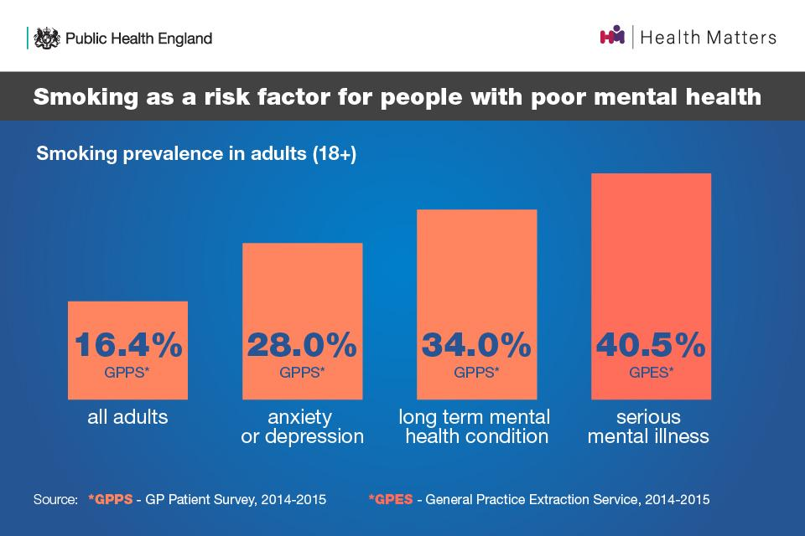
Social Epidemiology of Obesity and Smoking
Socioeconomic Status (SES):
Income and Education
Occupation
Built Environment:
Urban Planning
Transportation
Cultural and Social Norms:
Cultural Attitudes Towards Body Image
Social Influence
Food Environment:
Access to Healthy Food
Marketing and Advertising
Psychosocial Factors:
Stress and Mental Health
Social Support

Slide 4
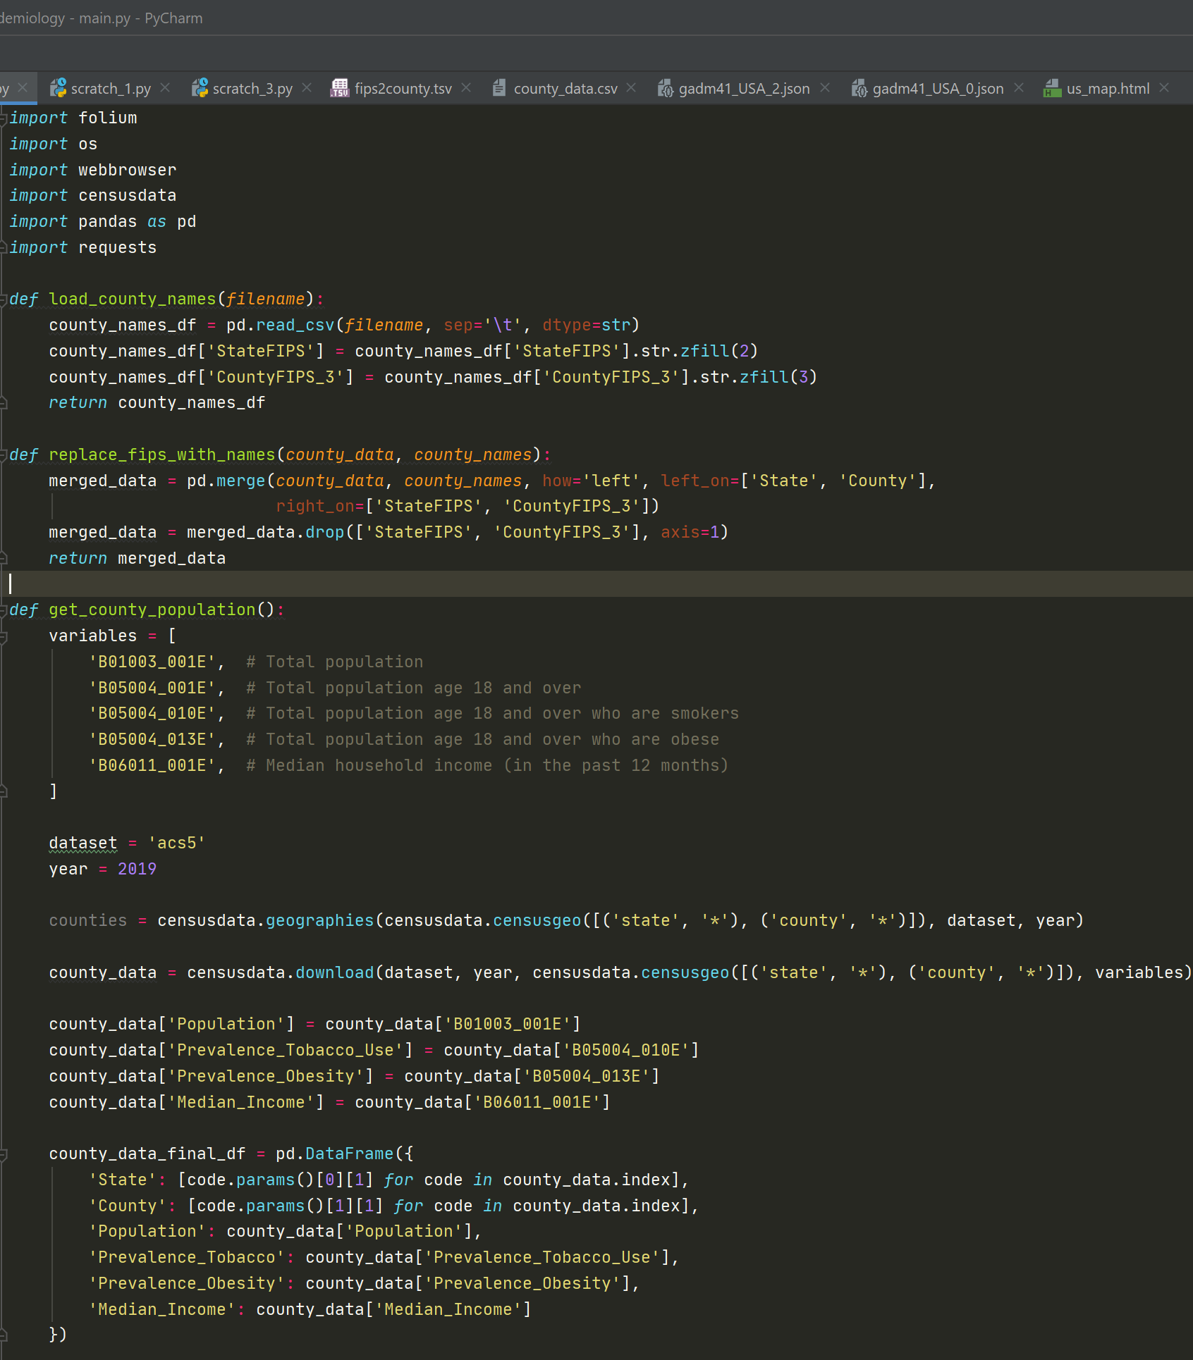
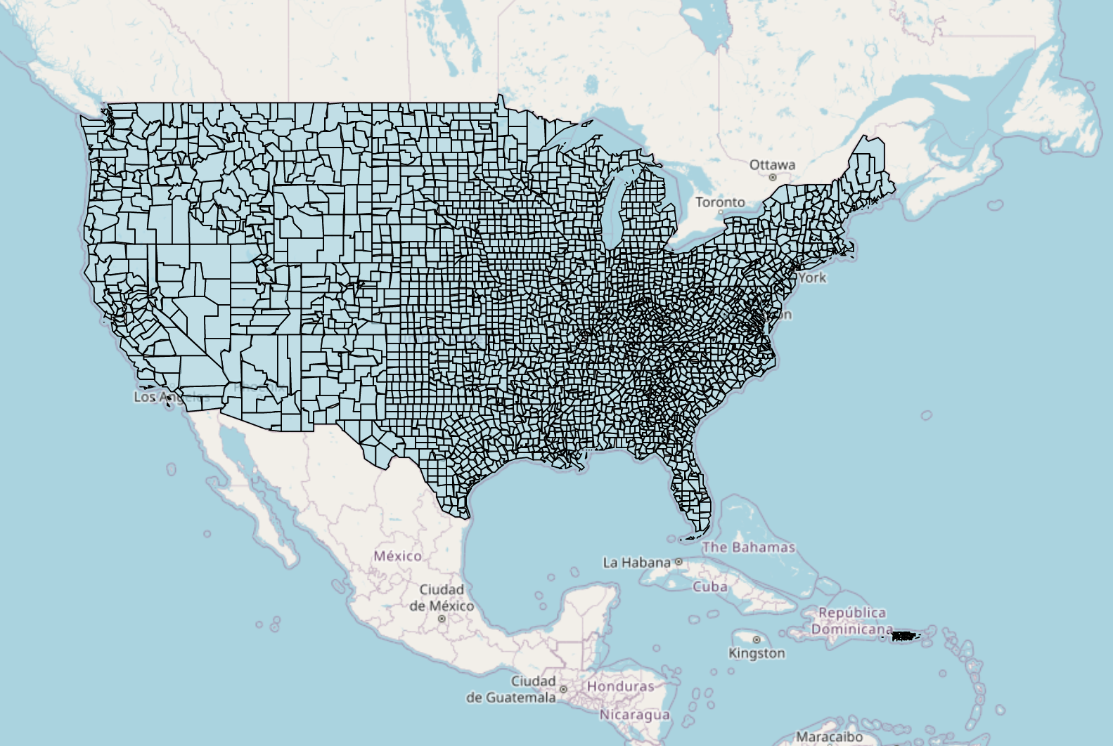
Code Review

Slide 5
What I Learned
Next Steps
FIPS Codes
GeoJSON and Geospatial Data
Working with US Census Data
Map Visualization with Folium
Function Documentation
Optimizing Data Manipulation
Configuration File for Constants
Colors!

Slide 6
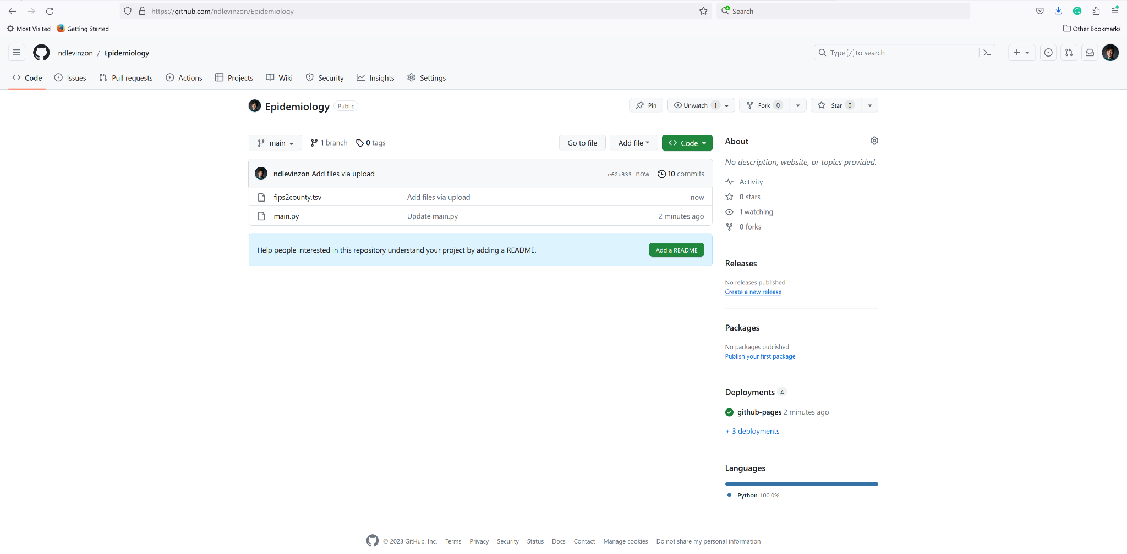
Open-Source: Feel Free to Use!
https://github.com/ndlevinzon/Epidemiology.git

Slide 7
Thank You!
Questions?
ndlevinzon@gmail.com
u1116818@umail.utah.edu
Images: Google Images

