Slide 1
BIRT
(Business Intelligence Reporting Tools)

Slide 2
Introduction
BIRT is an Eclipse-based, free open source reporting system for web applications.
BIRT has two main components
  Report designer based on Eclipse
  Runtime component.
  BIRT also offers a charting engine that lets you add charts to your own application.

Slide 3
Integrate with web application
Create a Web project
Copy all libs from WebViewerExamples/WEB-INF/lib (in folder birt-runtime-<version>) to your project at <Project_Folder>/WebContent /WEB-INF/lib
  You can selective pick the data definitions lib based on the database you are dealing with
Copy the WebViewerExample\WEB-INF\tlds\birt.tld to <Project_Folder>\WebContent\WEB-INF\tlds
Copy the folder webcontent in WebViewerExample in BIRT directory to <Project_Folder>\WebContent
Copy files server-config.wsdd and viewer.properties in folder WebViewerExample\WEB-INF to folder <Project_Folder>\WebContent\birt
Put the report design files into <Project_Folder>\WebContent\birt\reports

Slide 4
Put the following entries in web.xml
  <context-param>
  <filter>
  <listener>
  <servlet>
  <servlet-mapping>
  <jsp-config>
Accessing the report using tags inside a jsp
  <%@ taglib uri="/birt.tld" prefix="birt" %>
  <birt:viewer id="birtViewer" reportDesign="my_report.rptdesign" pattern="frameset" height="500" width=" 900" format="html"></birt:viewer>

Slide 5
Context Params
BIRT_VIEWER_LOG_LEVEL
  Report engine log level
BIRT_RESOURCE_PATH
  Resource location directory: Image, .properties files...
BIRT_VIEWER_WORKING_FOLDER
  Report resources (.rptdesign files) directory
BIRT_VIEWER_CONFIG_FILE
  Defines the BIRT viewer configuration file (viewer.properties)

Slide 6
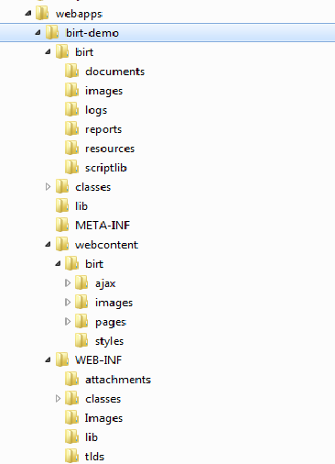
The folder structure should look like this:

Slide 7
References
http://www.eclipse.org/birt/phoenix/tutorial/basic/basic02.php
http://www.vogella.com/articles/EclipseBIRT/article.html
http://download.eclipse.org/birt/downloads/examples/reports/Parameters/Parameters.html (Reports parameters)

