Slide 1

Process Mining Virtual Internship
by
A Nadeem
Roll No. 214G1A3257
Department of Computer Science and Engineering (Data Science)
Srinivasa Ramanujan Institute of Technology
(Affiliated to JNTUA & Approved by AICTE) (Accredited by NAAC with ‘A’ Grade & Accredited by NBA (EEE, ECE & CSE)
Rotarypuram Village, B K Samudram Mandal, Ananthapuramu – 515701.
2023 - 2024

Slide 2

Contents
Course Objective
Introduction
Technology
Applications
Modules
Real Time applications
Learning outcomes
GitHub Link
Queries

Slide 3
Course Objective
Process Mining forms the foundation for the Celonis Execution Management System, enabling organizations to gain a comprehensive understanding of their primary business processes and identify concealed opportunities for value creation. By employing intelligent, automated measures to enhance performance, enterprises can unlock substantial financial gains worth hundreds of millions.
In the Course, you will be introduced to the essential analysis techniques used in process mining. Throughout the course, you will explore different algorithms for process discovery.

Slide 4
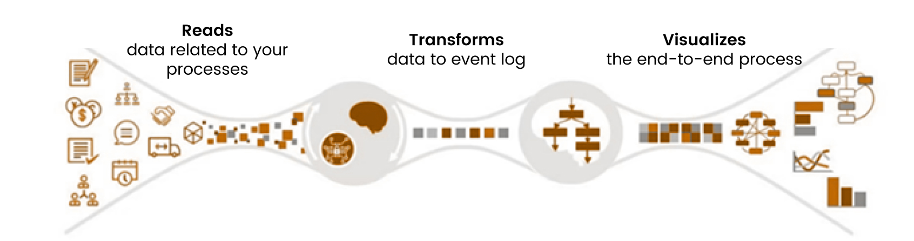
Introduction
What is Process ?
A process can be defined as a sequence of interconnected actions or steps that are undertaken with the aim of attaining a specific objective.
What is Process Mining ?
Process Mining is the merging of two fields: Data Science and Business Process Management. Process mining is a set of techniques that use event logs from information systems to analyze, visualize, and improve business processes. It aims to uncover the actual flow of activities, decisions, and interactions within a process, helping organizations identify inefficiencies, bottlenecks, and opportunities for optimization.

Slide 5
Introduction
In the realm of process management, there exists a method that aids in examining business processes using event logs. This technique leads to enhanced efficiency, effectiveness, and compliance by providing valuable insights. In the realm of process management, there exists a method that aids in examining business processes using event logs. This technique leads to enhanced efficiency, effectiveness, and compliance by providing valuable
insights.
In the realm of process management, there exists a method that aids in examining business processes using event logs. This technique leads to enhanced efficiency, effectiveness, and compliance by providing. v
Current processes can be visually represented in real-time by extracting information from event and transaction logs using efficient and dependable Modern Process Mining technology.
The real-world examples of process mining include procurement, order management, intelligent automation, digital transformation, KPI reporting, accounts, IT development, service management, logistics, and many more.

Slide 6
Technology
Process Mining combines elements of data mining and business process management, utilizing a range of technologies from these domains.
Event Data Handling:
Enterprise: Collecting data from systems.
Storage: Efficiently managing data with databases and big data tools.
Automated Process Understanding:
Mining Algorithms: Deriving process models from event data.
Model Notations: Using standardized notations for representation.
Visual Insights:
Mining Software: Tools for process visualization and analysis.
Custom Dashboards: Creating tailored visuals for specific insights

Slide 7
Applications
In the realm of process management, there exists a method that aids in examining business processes using event logs. This technique leads to enhanced efficiency, effectiveness, and compliance by providing valuable insights. In the realm of process management, there exists a method that aids in examining business processes using event logs. This technique leads to enhanced efficiency, effectiveness, and compliance by providing valuable
insights.
Celonis is a well-known software platform for process mining that focuses on delivering insights, analytics, and automation solutions for processes. It provides a variety of features and functionalities that are customized to meet the specific requirements of different industries and businesses.
Below are some examples of how Celonis can be applied in Process Mining:
Process Conformance Checking: Process Conformance Checking involves the comparison of event data with pre-established process models or anticipated process flows. Through this method, process mining can effectively point out inconsistencies between the intended process and its actual execution. This capability enables organizations to pinpoint non-compliance issues.

Slide 8
Applications
In the realm of process management, there exists a method that aids in examining business processes using event logs. This technique leads to enhanced efficiency, effectiveness, and compliance by providing valuable insights. In the realm of process management, there exists a method that aids in examining business processes using event logs. This technique leads to enhanced efficiency, effectiveness, and compliance by providing valuable
insights.
Process Analysis: Process mining is a valuable tool for analyzing various metrics related to process performance, including cycle times, waiting times, throughput, and resource utilization. By examining these metrics, organizations can pinpoint areas that need improvement and enhance the efficiency of their processes.
Process Discovery and Documentation: Utilizing process mining, organizations can generate visual representations of intricate processes by analyzing event logs. This valuable tool aids in gaining a deeper understanding of the actual workings of these processes, pinpointing any deviations from expected behavior, and enhancing the accuracy of process documentation.

Slide 9
Applications
In the realm of process management, there exists a method that aids in examining business processes using event logs. This technique leads to enhanced efficiency, effectiveness, and compliance by providing valuable insights. In the realm of process management, there exists a method that aids in examining business processes using event logs. This technique leads to enhanced efficiency, effectiveness, and compliance by providing valuable
insights.
Process Enhancement and redesign: Based on the insights gained from process mining, organizations can redesign and enhance their processes to eliminate bottlenecks, streamline workflows, and improve overall efficiency.
Celonis offers process mining capabilities that can be utilized in various industries and processes to discover valuable insights, stimulate enhancements, and elevate operational excellence. The particular use cases will vary based on the distinct requirements and obstacles faced by each organization or industry.

Slide 10
Modules
In the realm of process management, there exists a method that aids in examining business processes using event logs. This technique leads to enhanced efficiency, effectiveness, and compliance by providing valuable insights. In the realm of process management, there exists a method that aids in examining business processes using event logs. This technique leads to enhanced efficiency, effectiveness, and compliance by providing valuable
insights.
Process Mining
Celonis Process Mining Fundamentals
Technical Rising Star
EMS

Slide 11
Celonis Process Mining Fundamentals
In the realm of process management, there exists a method that aids in examining business processes using event logs. This technique leads to enhanced efficiency, effectiveness, and compliance by providing valuable insights. In the realm of process management, there exists a method that aids in examining business processes using event logs. This technique leads to enhanced efficiency, effectiveness, and compliance by providing valuable
insights.
Process Mining is the merging of two fields: Data Science and Business Process Management. In essence, Process Mining applies techniques from Data Science, such as Big Data and AI, to tackle challenges in Process Science like enhancing processes and automating them.
The training course covers the fundamentals of Process Mining, including both theoretical concepts and practical applications.
Process mining takes this data, transforms it into a log of events, and subsequently generates visual representations of the entire process from start to finish, accompanied by valuable analytical insights.

Slide 12
Celonis Process Mining Fundamentals
In the realm of process management, there exists a method that aids in examining business processes using event logs. This technique leads to enhanced efficiency, effectiveness, and compliance by providing valuable insights. In the realm of process management, there exists a method that aids in examining business processes using event logs. This technique leads to enhanced efficiency, effectiveness, and compliance by providing valuable
insights.
Each action taken during the procedure is recorded in an event log, along with the corresponding time and case ID. This log captures all the steps performed, their timestamps, and the specific instances of the process.
Algorithms utilize the event log to generate a process model that accurately reflects the timing and variations of each step within the process.

Slide 13
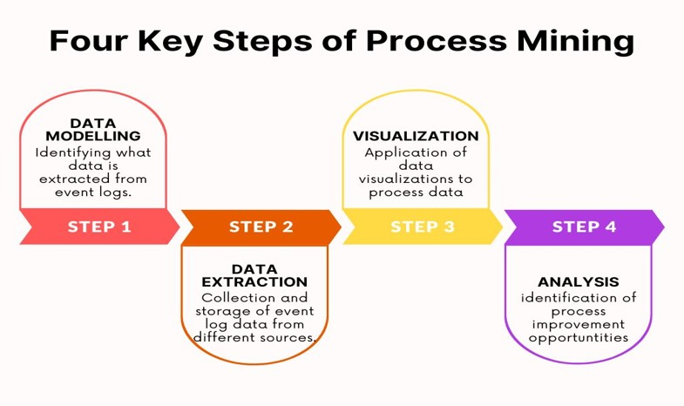
Celonis Process Mining Fundamentals
In the realm of process management, there exists a method that aids in examining business processes using event logs. This technique leads to enhanced efficiency, effectiveness, and compliance by providing valuable insights. In the realm of process management, there exists a method that aids in examining business processes using event logs. This technique leads to enhanced efficiency, effectiveness, and compliance by providing valuable
insights.

Slide 14
Execution Management Consulting for Students
In the realm of process management, there exists a method that aids in examining business processes using event logs. This technique leads to enhanced efficiency, effectiveness, and compliance by providing valuable insights. In the realm of process management, there exists a method that aids in examining business processes using event logs. This technique leads to enhanced efficiency, effectiveness, and compliance by providing valuable
insights.
Introduction to EMS platform service : Traders use an Execution management system, which is an application that shows market data and allows for quick and effortless access to trading destinations. Its main purpose is to facilitate order transactions.
The application includes algorithms from brokers as well as independent ones like TWAP and VWAP. It also provides global market data and technology that can assist in forecasting specific market conditions.
EMS possesses the capability to handle orders across various trading venues, which is a significant aspect of its functionality.
1.Stock exchanges
2.Stock brokerage firms
3.Crossing networks and electronic communication networks.

Slide 15
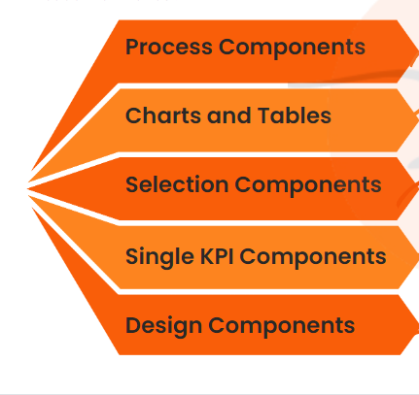
Execution Management Consulting for Students
In the realm of process management, there exists a method that aids in examining business processes using event logs. This technique leads to enhanced efficiency, effectiveness, and compliance by providing valuable insights. In the realm of process management, there exists a method that aids in examining business processes using event logs. This technique leads to enhanced efficiency, effectiveness, and compliance by providing valuable
insights.
Celonis has 5 different categories of components.
Process Components: Visualize your activities
and the way processes flow through them.
Charts and Tables: Organize your data by
plotting it or grouping, segmenting, and
arranging it in various formats such as
OLAP Tables, Pivot Tables, and World Maps.
Selection Components: Helps the user Create Selections.
Single KPI Components: Track your data according to a single KPI.( Key Performance Indicator).
Design Components: Create Design Element for your Analysis.

Slide 16
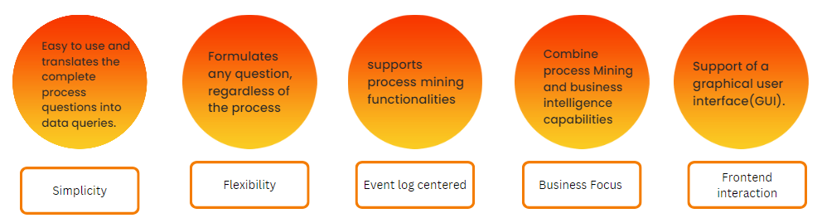
PQL
In the realm of process management, there exists a method that aids in examining business processes using event logs. This technique leads to enhanced efficiency, effectiveness, and compliance by providing valuable insights. In the realm of process management, there exists a method that aids in examining business processes using event logs. This technique leads to enhanced efficiency, effectiveness, and compliance by providing valuable
insights.
Process Query Language
Process mining relies heavily on PQL as a crucial element.
The SQL differs from it in various ways. It has been created to meet specific needs and when presented with a question, it processes the information and provides a meaningful response.
These 5 are Goals of PQL.

Slide 17
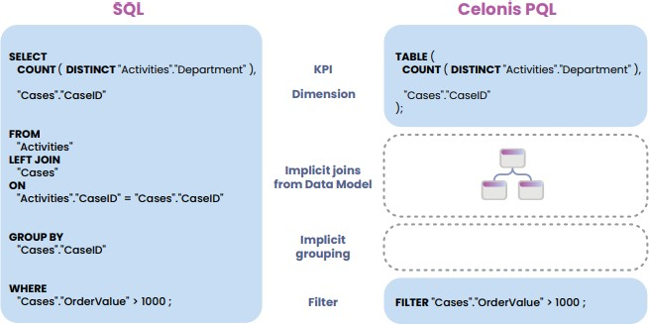
PQL
It's designed to enable users to interact with their process data in a powerful and flexible way, allowing them to uncover insights, identify bottlenecks, discover patterns, and optimize their processes.
Celonis PQL provides a wide range of different operators which can be combined to answer complex business questions. The following list gives an overview of the most important classes of operators.

Slide 18
Real Time Applications
Supply Chain Optimization: Process mining has the ability to offer valuable insights into supply chain processes, allowing for the identification of delays, inefficiencies, and opportunities for optimization across procurement, production, and distribution.
Fraud Detection and Prevention: Detect and prevent fraudulent activities by identifying anomalies and suspicious patterns in real-time transaction data.
Health Process Analysis: This enables them to streamline patient journeys, optimize clinical practices, allocate resources efficiently, ensure accurate billing, enhance medication safety, improve emergency department operations, comply with regulations, and foster continuous improvement in their processes.

Slide 19
Real Time Applications
Audit and Control: Process mining has the ability to offer valuable insights into supply chain processes, allowing for the identification of delays, inefficiencies, and opportunities for optimization across procurement, production, and distribution.
IT Service Management: Utilizing process mining, IT service management processes like incident management and problem resolution can be analyzed. This analysis aims to enhance response times, minimize downtime, and improve the overall quality of IT services.

Slide 20
Learning Outcomes
Upon finishing this Training Track, we will have the capability to:
Analyze process visualizations and utilize analyses.
Store an analysis selection for future use and share it with your team.
Execute fundamental tasks required for constructing Celonis analyses.
Gain familiarity with Analysis Settings and Permissions.
Apply your understanding of the theoretical principles behind Process Mining in practical situations.

Slide 21
Any Queries?

Slide 22
Thank You!!!

