Slide 4

PRESENTATION TITLE
SUBTITLE. SUBTITLE. SUBTITLE.
SUBTITLE. SUBTITLE.

Slide 5
Chapter 1: Smart Home Overview

Slide 6
Chapter 2: General Architecture Of The Smart Home
Function
Monitor the temperature and humidity
Open main door using the password
Open/Close clothesline automatically according to weather
Turn on/off “Movie Mode” entertainment room
Control light, fan, air conditioning, door by remote control system
Alarm system

Slide 7
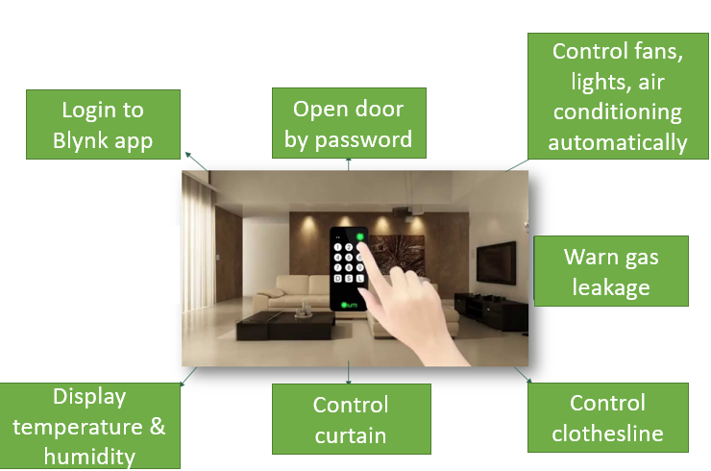
Chapter 2: General Architecture Of The Smart Home

Slide 8
Chapter 2: General Architecture Of The Smart Home
2. Components
Components | Specification | Application
1. DHT11 Sensor | Operating Voltage: 3.3 to 5.5V DC Humidity range: 20% - 90% Temperature range: 0 – 50 degree C | Living room Bedroom
2. Rain Sensor | Operating Voltage: 5V | Clothesline
3. Thermoelectric Peltier Module | Operating Voltage: 3 to 15V DC Cooling power: 50 W, 90 W, 120 W 2-sided temperature difference: up to 67 degree C | Bedroom
4. HC-SR501 Motion Sensor | Operating Voltage: 3.5 to 5.5V DC 2 operating modes: (L) no repeat activation,(H) repeat activation Scan angle < 100 degrees. | Outdoor Kitchen
5. Infrared Sensor | Operating Voltage: 3.3 to 5V DC Comparator IC: LM393 Analog output | Living room
6. Light Sensor | Operating Voltage: 3.3 to 5V DC Comparator IC: LM393 | Outdoor Bedroom

Slide 9
Chapter 2: General Architecture Of The Smart Home
2. Components
Components | Specification | Application
6. MQ2 Gas Sensor | Operating Voltage: 5V Highly sensitive for LPG, Propane and Hydrogen Analog output | Kitchen
7. SG90 Servo Motor |  | Main door
8. 5,6V/2,1A DC stepper motor |  | Clothesline Curtain
9. MG996 RC Servo Motor |  | Garage
10. 17HS8401 Stepper Motor |  | Control motor
11. Arduino Nano |  | Control block for sensors
12. ESP32 |  | Control block for actuators

Slide 10
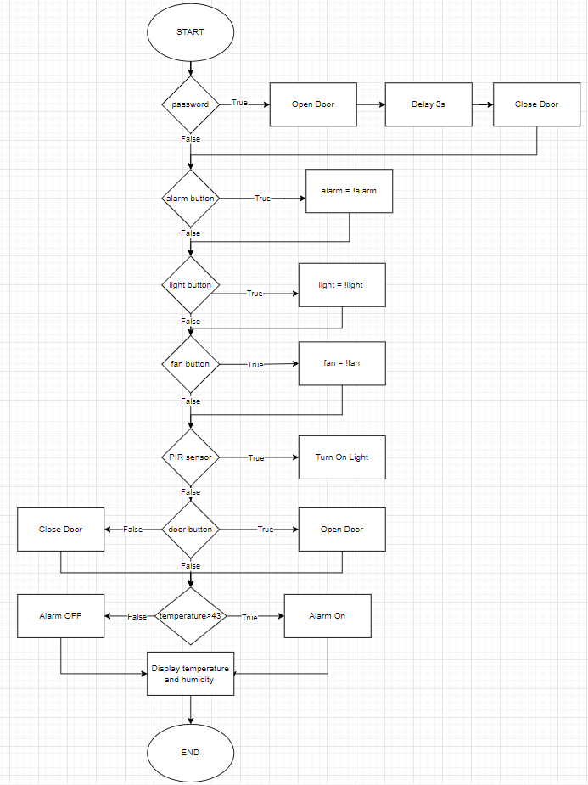
Chapter 3: Detail Working Principle
1. Living Room
Turn on/off the light, fan, door, alarm system by using button.
Monitor the temperature and humidity
Display the temperature and humidity in the LCD.
Turn on the light automatically when someone is in the stair.

Slide 11
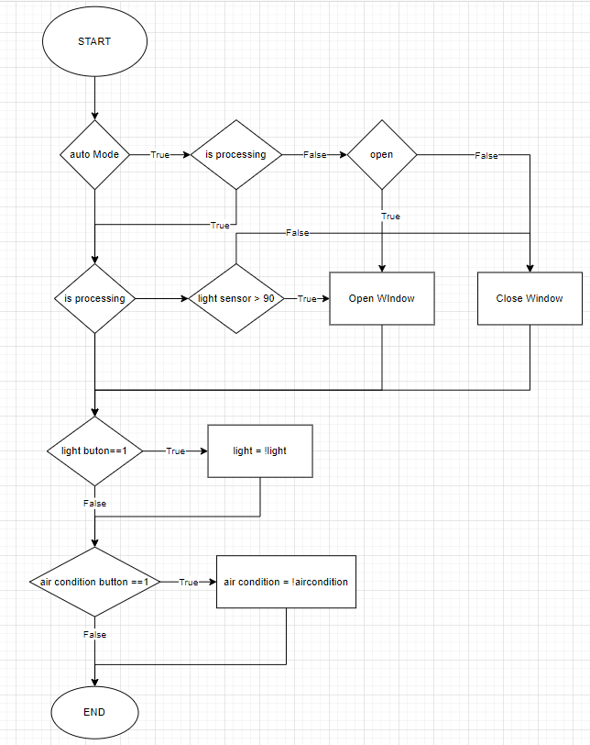
Chapter 3: Detail Working Principle
2. Bedroom
Turn on/off the light and air conditioning system by using button.
Display the temperature and humidity in the LCD.
Turn on/off the light by using Blynk application.
Control the curtain automatically by the light sensor.
Control the curtain system by using Blynk application.

Slide 12
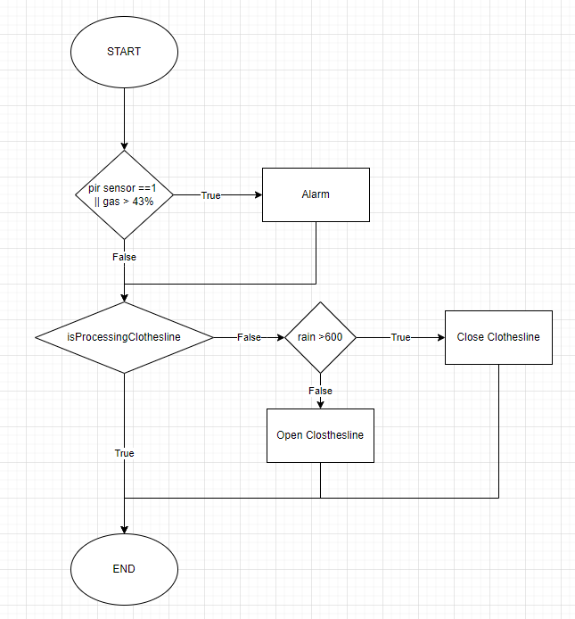
Chapter 3: Detail Working Principle
3. Kitchen
Turn on/off the fan by using button.
Alarm system activates if the gas level over the set value.
Alarm system activates if the motion sensor detects motion.
Clothesline system is control automatically by the weather.
Turn on/off the light and fan by using Blynk application.

Slide 13
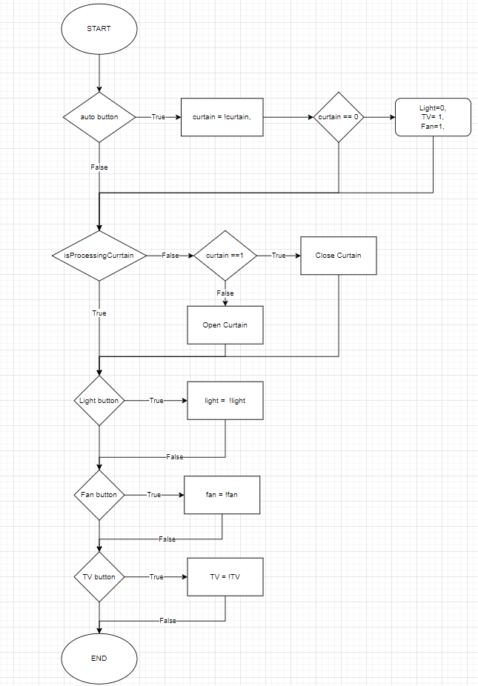
Chapter 3: Detail Working Principle
4. Entertainment room
Turn on/off the “movie mode” by using button.
The curtain closes and the light, fan turns on when the “movie mode” is on
The curtain closes, TV is off when the “movie mode” is off
Turn on/off the light and fan by using Blynk application.

Slide 14
Chapter 3: Detail Working Principle
5. Others
Open the door by password.
The main door’ light turns on when the motion sensor detects the motion
The main door’ light adjusts light level according to the environment
Open/close the garage door by Blynk application.

Slide 15
Chapter 4: Blynk Application
1. Why use Blynk?
Blynk is an app on the phone, allowing users to create interfaces and control the device according to their personal preferences
Easy to use
Beautiful application with full function
Does need to build android and iOS application
Rapid testing, can be monitored anywhere with internet
2. How Blynk works with your system?
Node MCU ESP32 connects to Blynk application
Blynk Server – responsible for all communication between the smartphone and the hardware. You can use Blynk Cloud or run your own Blynk server locally
The Blynk library – for all popular hardware platforms – allows to communicate with the server and process all incoming and outgoing commands

Slide 16
Chapter 5: Result And Conclusion
1. Result
Design a Smart Home model, the model work as expected
Learn the basis and meaning of sensors and collecting data sensors
Learn the basis and meaning of controlling devices via the internet
Understand the working principle of the modules in the system
2. How Blynk works with your system?
Improve the accuracy of the value of sensors
Improve the accuracy of the actuators block
Adjust the power of the cooling system according to the temperature automatically
Improve the anti-theft system by image recognition
Control smart devices through voice
…

Slide 17
THANK YOU !

