Slide 4

PRESENTATION TITLE
SUBTITLE. SUBTITLE. SUBTITLE.
SUBTITLE. SUBTITLE.

Slide 5
Chapter 1: Smart Home Overview

Slide 6
Chapter 2: General Architecture Of The Smart Home
Function
Monitor the temperature and humidity
Open main door using the password
Open/Close clothesline automatically according to weather
Turn on/off “Movie Mode” entertainment room
Control light, fan, air conditioning, door by remote control system
Alarm system

Slide 7
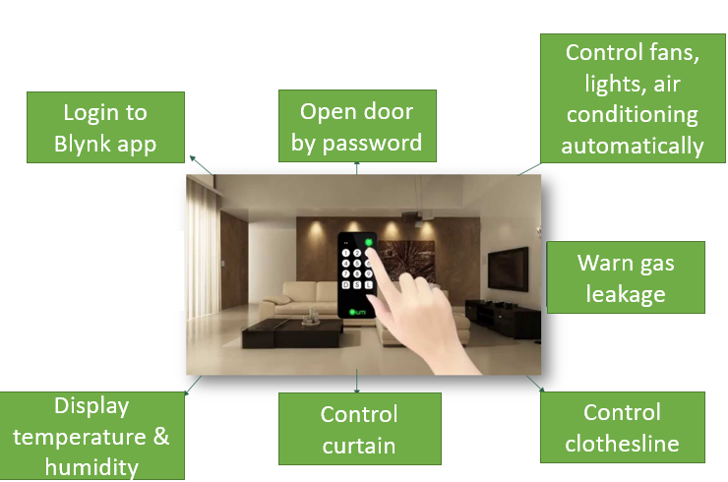
Chapter 2: General Architecture Of The Smart Home

Slide 8
Chapter 2: General Architecture Of The Smart Home
2. Components
Components | Specification | Application
1. DHT11 Sensor | Voltage operation: 3.3 – 5.5V Humidity range: 20% - 90% Temperature range: 0 – 50 degree | Living room Bedroom
2. Rain Sensor |  | Clothesline
3. Thermoelectric Peltier Module |  | Bedroom
4. HC-SR501 Motion Sensor |  | Outdoor Kitchen
5. Infrared Sensor |  | Living room
6. Light Sensor |  | Outdoor Bedroom

Slide 9
Chapter 2: General Architecture Of The Smart Home
2. Components
Components | Specification | Application
6. MQ2 Gas Sensor |  | Kitchen
7. SG90 Servo Motor |  | Main door
8. 5,6V/2,1A DC stepper motor |  | Clothesline Curtain
9. MG996 RC Servo Motor |  | Garage
10. 17HS8401 Stepper Motor |  | Control motor
11. Arduino Nano |  | Control block
12. ESP32 |  | Control block

Slide 10
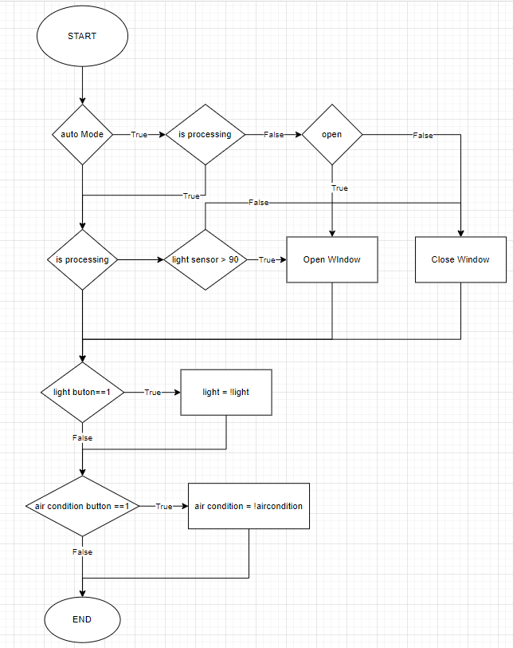
Chapter 3: Detail Working Principle
Living Room
Turn on/off the light, fan, door,
alarm system by using button.
Display the temperature and humidity
in the LCD.
Turn on the light automatically when
someone is in the stair.

Slide 11
Chapter 3: Detail Working Principle
2. Bedroom
Turn on/off the light and air conditioning system by using button.
Display the temperature and humidity in the LCD.
Turn on/off the light by using Blynk application.
Control the curtain automatically by the light sensor.
Control the curtain system by using Blynk application.

Slide 12
Chapter 3: Detail Working Principle
3. Kitchen
Turn on/off the fan by using button.
Alarm system activates if the gas level over the set value.
Alarm system activates if the motion sensor detects motion.
Clothesline system is control automatically by the weather.
- Turn on/off the light and fan by using Blynk application.

Slide 13
Chapter 3: Detail Working Principle
4. Entertainment room
Turn on/off the “movie mode” by using button.
The curtain closes and the light, fan turns on when the “movie mode” is on
The curtain closes when the “movie mode” is off
- Turn on/off the light and fan by using Blynk application.

Slide 14
Chapter 3: Detail Working Principle
5. Others
Open the door by password.
The main door’ light turns on when the motion sensor detects the motion
The main door’ light adjusts light level according to the environment
Open/close the garage door by Blynk application.

Slide 15
Chapter 4: Blynk Application

Slide 16
Chapter 5: Result And Conclusion

Slide 17
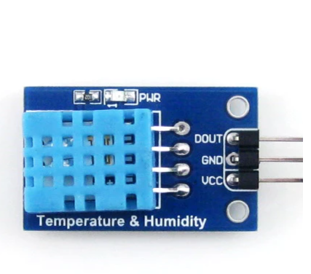
Chapter 5: Design sensors module
I. DHT11 (Digital Humidity Temperature 11)
Specifications
Operating Voltage: 3.5V to 5.5V
Operating current: 0.3mA (measuring) 60uA (standby)
Output: Serial data
Temperature Range: 0°C to 50°C
Humidity Range: 20% to 90%
Resolution: Temperature and Humidity both are 16-bit
Accuracy: ±1°C and ±1%
Application in the system
Living room, Bedroom
DHT11 sensor

Slide 18
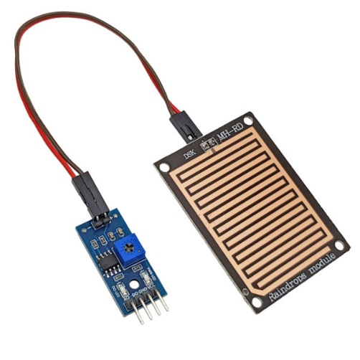
Chapter 5: Design sensors module
II. Rain sensor
Specifications
Operating Voltage: 5V
Power LED (Blue)
Rain warning LED (red)
Operation is based on the principle: Water falling on the board
will create a conductive medium.
There are two types of signals: Analog (AO) and Digital (DO)
Adjust the sensitivity by rheostat
Application in the system
Clothesline automation
Rain sensor

Slide 19

Chapter 5: Design sensors module
III. Thermoelectric Peltier cooling module
Specifications
Size: 4cm x 4cm
I(A): 5 A -10A
Voltage: 3 V~ 15.4 V (DC current)
Cooling power: 50 W, 90 W, 120 W
2-sided temperature difference: ~67°C (so the better the heat is dissipated,
the colder the cold side)
Maximum cooling temperature: – 6 °C (depends on your cooling system)
Application in the system
Bedroom
Thermoelctric Peliter cooling module

Slide 20
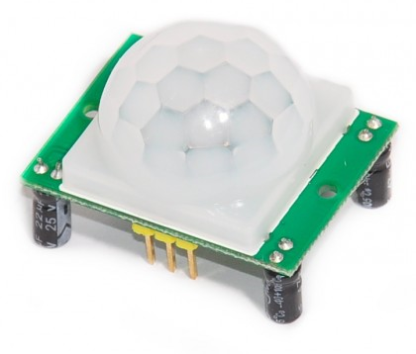
Chapter 5: Design sensors module
IV. Motion sensor HC-SR501
Specifications
Operating Voltage: 3.5V to 5.5V
Pins: Vcc, OUT, GND.
2 operating modes: (L) no repeat activation,(H) repeat activation.
Delay time: adjustable between 0.5-200S.
PCB Size: 32mmx24mm
Scan angle < 100 degrees.
Detection distance: 2 - 4.5m
Application in the system
Living room, kitchen
Motion sensor HC-SR501

Slide 26
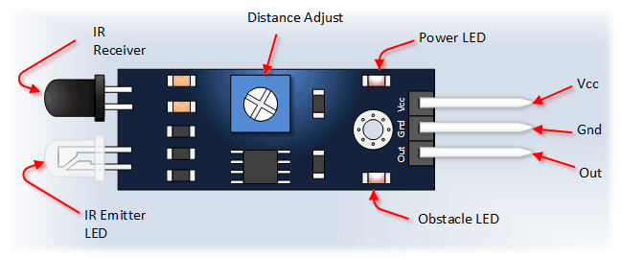
Chapter 5: Design sensors module
V. Infrared sensor
Specifications
Comparator using LM393, stable working
Working voltage: 3.3V – 5V DC
When the power is on, the red power indicator light is on
3mm screw hole, easy to fix, install
Size: 3.2cm * 1.4cm
Application in the system
Living room
Infrared sensor

Slide 27
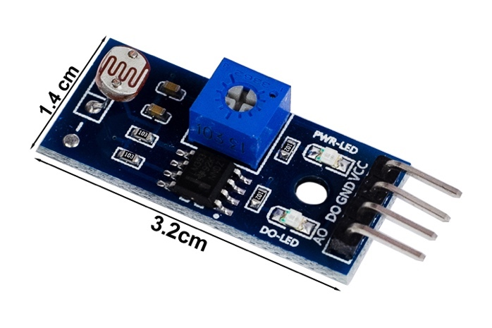
Chapter 5: Design sensors module
VI. Light sensor
Specifications
Operating voltage: 3.3V-5V
PCB Size: 3cm*1.6cm
Green LED indicates power and light
Comparator IC: LM393
DO: Digital signal output (0 and 1)
AO: Analog Output (Analog signal)
Application in the system
Living room, bedroom
Light sensor

Slide 28
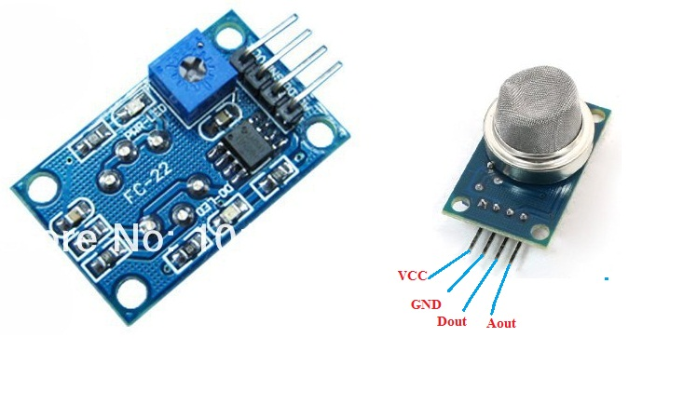
Chapter 5: Design sensors module
VII. Gas sensor MQ2
Specifications
Operating Voltage: 2.5V to 5.5V
Pins: Vcc, Digital Out, Analog Out, GND
Led signal
Size: 40mmx21mm
Application in the system
Kitchen
Alarm block
Dout signal: low signal -> gas detected, high signal -> no gas
Aout: analog signal with 15 % setup => gas detected => 2 leds in module turns on => buzzer system is on
Gas sensor MQ2

Slide 29
Chapter 6: Blynk Application
I. Why use Blynk?
Blynk is actually an app on the phone, allowing users to create interfaces and control the device according to their personal preferences
Easy to use
Beautiful application with full function
Does need to build android and iOS application
Rapid testing, can be monitored anywhere with internet
II. How Blynk works with your system?
Node MCU ESP32 connects to Blynk application via (Blynk_auth_token,your_Wi-fi_name,
your_Wi-fi_password)
Blynk Server – responsible for all communication between the smartphone and the hardware. You can use Blynk Cloud or run your own Blynk server locally
The Blynk library – for all popular hardware platforms – allows to communicate with the server and process all incoming and outgoing commands

Slide 30
Chapter 8: Conclusion
I. Results achieved
Successfully designed a Smart Home model
Know the usage situation and development trends of Smart Home in Vietnam and other countries in the world
Learn the basis and meaning of sensors and collecting data sensors
Learn the basis and meaning of controlling devices via the internet
Understand the working principle of the modules in the system

Slide 31
Chapter 8: Conclusion
II. Future work
Install surveillance camera system for the Smart Home
Improve the accuracy of the value of sensors
Improve the accuracy of the actuators block
Improve the garage system by allowing more than 1 vehicles stored in
Improve the security of our living room by interacting magnetic card system or fingerprint system
Improve door system working like the elevator door mechanism
Improve the cooling system
Improve the anti-theft system by image recognition
Improve the mechanical system
Application of monitoring and control systems in healthcare and education.
Control smart devices through voice
Build a management software on mobile devices, and a management software on the web, which can automatically notify users of adverse conditions.

Slide 32
THANK YOU !

